Slide 1
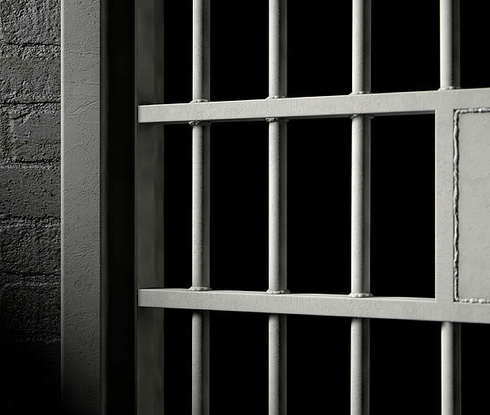
Is criminal behaviour innate or shaped by environment?
Presentation by Leo P., Patrick D., Harvey R., Harrison B.

Slide 2
Is it?
Innate
Psychological
Biological
Classicism
Neoclassicism
Environmental
Subcultural Theory
Differential Association

Slide 3
Innate Behaviour
Innate Behaviour is a basic hardwired inside our brains which makes us react instinctively from birth without having any education or prior experience to the situation. (Khan Academy, 2016)
An example for a Physical Cue that we are reacting to instinctively:
When we feel pain, if somebody is going to come up to you and pinch your hand without you knowing they will do it, more than likely the first thing you will do is to take your hand back.
Reflex Actions
One would be the knee jerk that is being tested by the doctor when doing a medical check-up.
Emotional Expressions
This is another example for innate behaviour where we can see different faces on people that are reacting to how they feel due to what is happenning in that moment. If they are happy you will see them smiling, if they are sad they will keep their head down or they could even be crying.

Slide 4

Psychological Behaviour and Rational Choices
We can all make rational choices of getting up in the morning to get to School, University or to the job so we won't get fired or kicked out.
Rational Choice Theory
It’s a theory directed by Cesare Beccaria which states that every rational decision we make has to have an outcome of a higher benefit than the risk (Wright, J.P. 2009)
Example:
You won't punch a person in front of a police officer, because you know that the repercussion will happen instantly.

Slide 5
Psychological Behaviour and Rational Choices
But can we make the Rational Choice of not committing a Crime?
The way we grew up
The education we got
Our Role Models
And many more.
(Ganti, A. 2022)
Mostly our rational decision will be based on the things that we are aware of, we won't steal from a shop because we know there are CCTV's around that can see us doing the deed and getting caught.
We will not punch people that annoyed us or triggered something within us because we know that the consequences are there. Unless we actually do it because it felt good, but why is that?

Slide 6
Biological
Criminal behaviour can be seen to be innate through the idea of biological positivism.
These theories are brought together by the likes of Cesare Lombroso (1876) and William Sheldon.
It has also been more recently studied that hormones such as testosterone and cortisol is linked to increasing the likelihood of crime (Dolan, 2022).

Slide 7
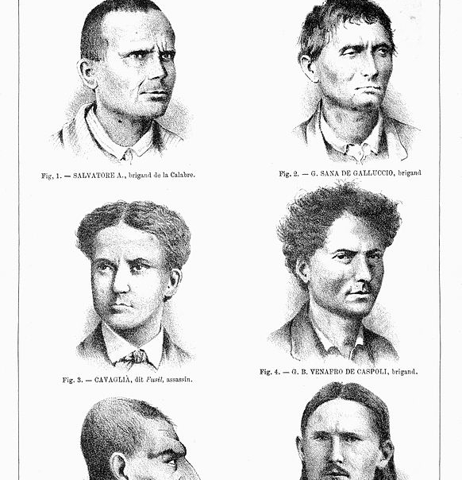
Cesare Lombroso (1876)
Lombroso suggested that most criminals have "jug ears, thick hair, thin beards, pronounced sinuses and broad cheekbones" (Cesare Lombroso, Gibson and Nicole Hahn Rafter, 2006)
Lombroso used specific cases such as "Dumollard" and "Mingrat" both rapists with Thick black hair and Jug ears (Cesare Lombroso, Gibson and Nicole Hahn Rafter, 2006).
This theory was the first theory where scientific data and testing was used (Brookes, 2021).
However, the theory does not consider free will and can be seen as a plausible theory (Brookes, 2021).
Therefore, Lombroso's theory was rejected (Rock, 2007).
(Averdijk, 2019)

Slide 8
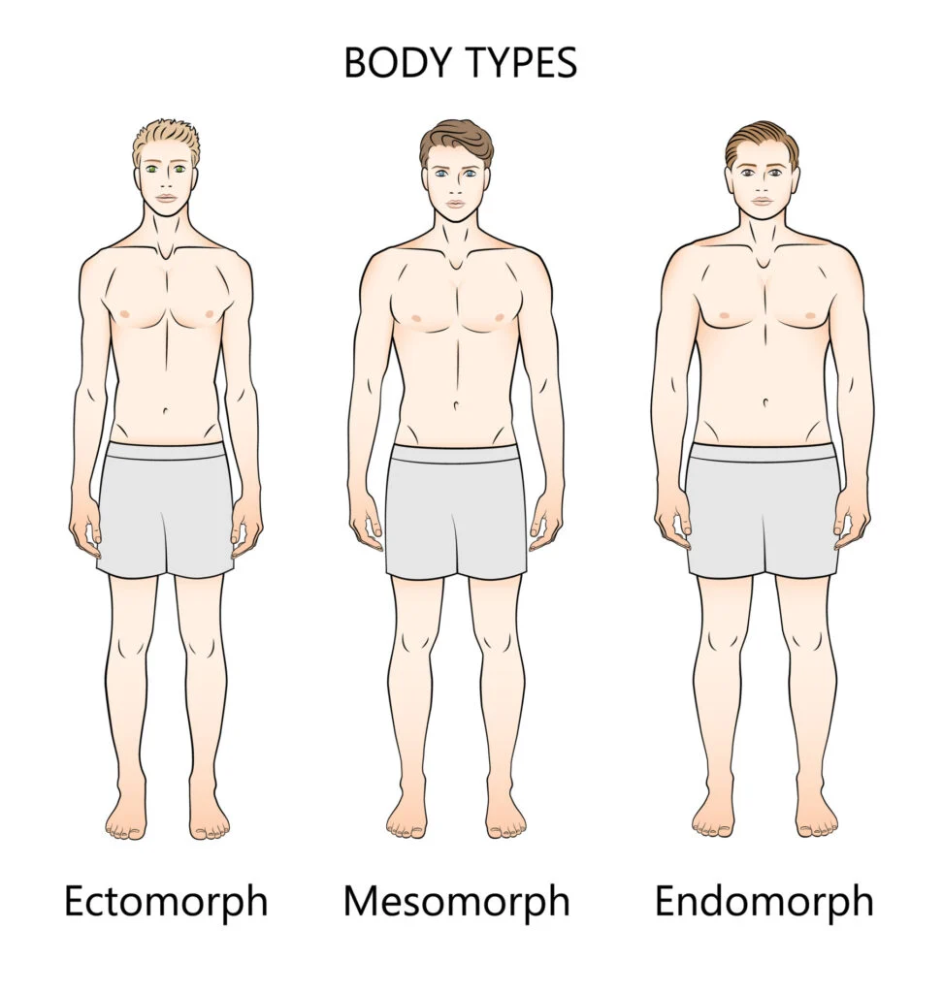
William Sheldon
Sheldon believed that people with mesomorphic physiques were more likely to commit violent and aggressive acts
However, in a study conducted by Patel and Kacker, (2013) it was shown that people with endomorphic features, from the sample, showed the characteristics of an ectomorph according to Sheldon .
(Nickerson, 2022)

Slide 9
The link between testosterone and criminality.
Testosterone is a hormone in humans that is responsible for things such as sex drive, muscle mass and mood levels (Roland, 2014).
It is suggested that high levels of testosterone can make someone more likely to commit violent acts such as assaults and domestic abuse (Armstrong et al., 2022).
In a study by Dabbs et al., (1995) , it was shown that inmates in a prison with higher levels of testosterone were shown to break more rules while in prison.

Slide 10
Environmental
Criminal behaviour can be affected by environmental factors.
Some of these factors are related to Subculture and Differential Association theory can show how environmental factors can affect crime.

Slide 11
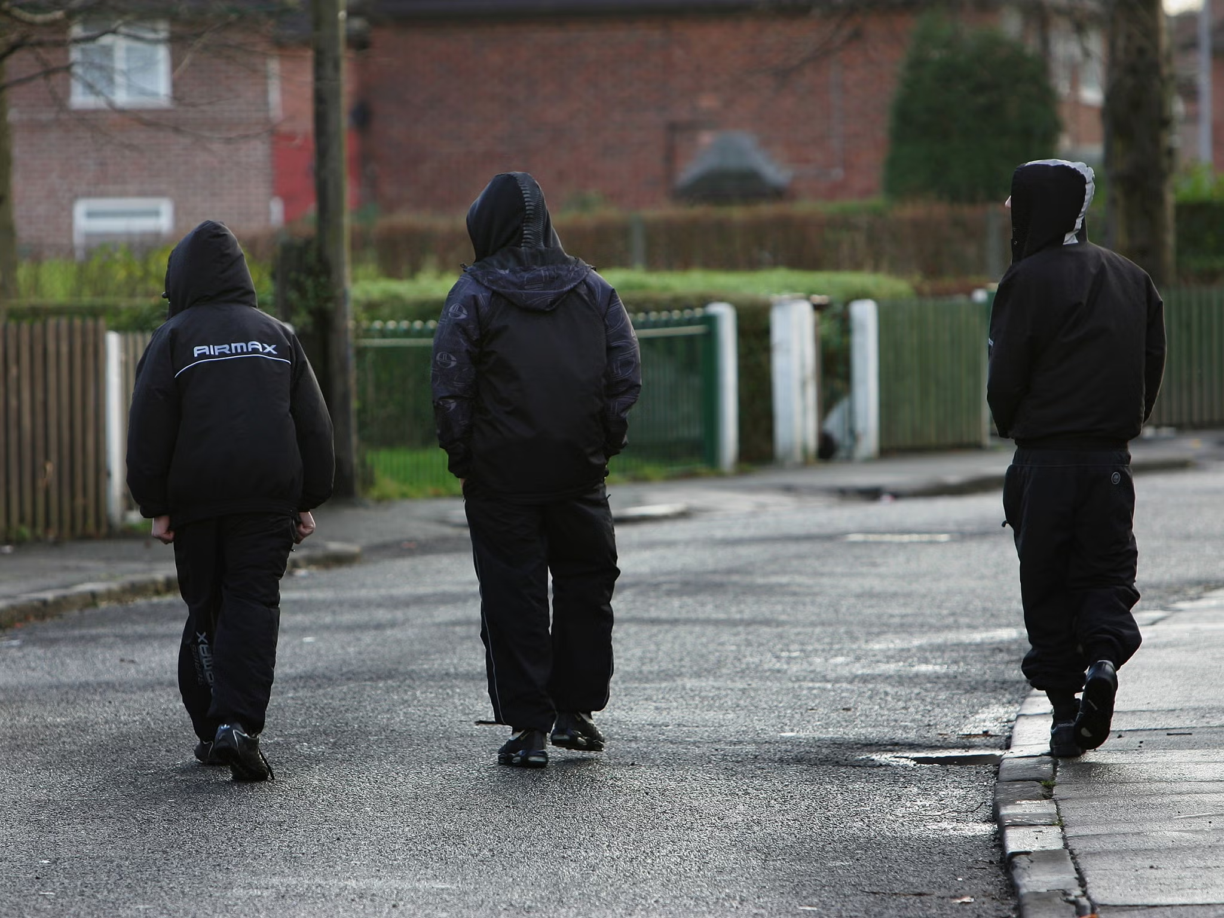
Subcultural Theory
A group of people who feel they don’t fit into societal norms or meet the goals, such as having a well paid job and having a family.
They make their own subculture with those known as delinquents. They create their own goals and norms. These include crime and makes a subculture where crime is deemed as acceptable, and something to achieve and brag about. Cohen (1955)
For example, in gangs it is deemed an achievement to commit crimes.
"Gangs often prey on young and other vulnerable people, coercing them to become involved with crime. Violence may be threatened or used to ensure new recruits stay with the gang and carry out criminal activity to fund its existence and its hierarchy." CPS (2021)
"gangs will exploit any vulnerabilities that a child or their family possess" Children's Commissioner (2019)
This behaviour then becomes the new norm. The child who is in the gang will see this as normal day to day activity. As they grow up, crime becomes a goal in the delinquent subculture of the gang.

Slide 12

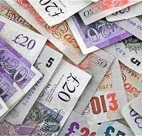
Differential Association
Sutherland (1947) broke his theory into 3 concepts: normative conflict, differential association and differential group organisation
Differential association is where normal criminal activity in society translates into an individual committing crime
"According to differential association, criminal behaviour is learned in a process of intimate groups" (Ross L, 2000)
Examples of differential association definitions include:
"Everyone cheats on their taxes" "This isn't a real crime" "I can drive fine after a few beers"
These definitions are favourable to crime and therefore help dictate and justify criminal behaviour
Definitions favourable to crime can be outweighed by those unfavourable (E.g. "Crime is bad"), so whether criminal behaviour will take place is dependent on the definitions around you.
Therefore if you are in an environment where there are more definitions favourable to crime than unfavorable, then you will be likely to undertake crime. (Ross L 2000)

Slide 13
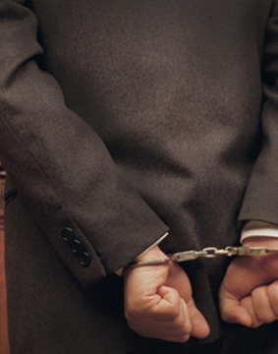
Labelling theory
Labelling theory was made popular in the 1960s due to Howard Becker, however the widely accepted original contributors were Emile Durkheim and Frank Tannenbaum respectively.(Ntara,2021).
Labelling theory is a sociological theory that suggests that behavior and in this example criminal behavior is shaped by the labels and stigmas that are place upon individuals by society. It argues that when an individual is labeled as a criminal or degenerate it can lead to that individual becoming the label that was put upon them.
Labelling theory uses tow forms of deviance which refer to the initial act of rule breaking and the secondary deviance which is the resulting reaction from society (Health knowledge ,no date).
Labelling theory can also lead to defiance amplification where the individual that has been labeled can face an increase in social control leading them to be pushed further into criminal activities due to feeling shunned by society.
An example of this would be that if an individual had been caught committing a crime and branded with the labels of criminal or delinquent they can face an increase in social control via regular searches, curfews and mandatory meetings with a probation officer. This increase in control can lead to them losing friends and becoming distanced from people causing them to view themselves in a bad light or as a criminal causing them to live up to the label placed upon them.
However, labelling theory also has some flaws as it has been criticized for various limitations for example this theory tends to downplay the effect of the motivations of the individual and systemic factors in understanding crime, this theory has also been criticized for struggling to explain why an individual would commit a crime in the primary deviance as this would normally occur prior to them receiving any labels.

Slide 14

Opportunity theory
Opportunity theory was developed by criminologists Richard Cloward and Lloyd Ohlin in the 1960s after they studied the effect of opportunity of opportunity on young people's life choices. (pressbooks.pub, no date).
Opportunity theory is the thought that crime occurs when three factors converge of a motivated offender ,a suitable target and a lack of capable guardianship, opportunity theory helps to explain how environment can shape criminals.
This theory emphasises that every decision is based on a benefit loss ratio and the role that the physical and social environment can have on influencing criminal behavior. An example of this would be in an environment with very little formal or informal surveillance and a lot of suitable targets like an unlocked car creates more opportunities for crime to happen as the benefits far outweigh the risks. This theory is able to recognise that a lot of crime occurs on impulse and that such an easy target with little to no risks could lead non-motivated offenders to commit a crime.
However, despite this opportunity theory does have some shortcomings as this theory neglects various factors that could also lead to an individual committing a crime for example due to the simple concept of the theory it often ignores and downplays the effect of individual and societal factors that could also be affecting an individual leading them to commit a crime for example poverty or unemployment.
This Photo by Unknown author is licensed under CC BY-NC.

Slide 15
To conclude
Theories such as rational choice theory and biological theories such as Cesare Lombroso (1876) and the role of biochemistry and the hormones produced has been shown to affect criminality.
However, environmental theories such as subcultural theory and opportunity theory also shows that criminality can be affected by the environment.
Therefore, our conclusion is that criminality can be seen as both innate and caused by the environment .

Slide 16
References
Armstrong, T.A., Boisvert, D.L., Wells, J., Lewis, R.H., Cooke, E.M., Woeckener, M., Kavish, N., Vietto, N. and Harper, J.M. (2022). Testosterone, cortisol, and criminal behavior in men and women. Hormones and Behavior, [online] 146, p.105260. doi:https://doi.org/10.1016/j.yhbeh.2022.105260.
Averdijk, M. (2019). Cesare Lombroso, Crime, and Atavism - Criminology Web. [online] Criminology Web. Available at: https://criminologyweb.com/cesare-lombroso-theory-of-crime-criminal-man-and-atavism/.
Brookes, E. (2021). Cesare Lombroso: Theory of Crime, Criminal Man, and Atavism - Simply Psychology. [online] www.simplypsychology.org. Available at: https://www.simplypsychology.org/lombroso-theory-of-crime-criminal-man-and-atavism.html.
Cesare Lombroso, Gibson, M. and Nicole Hahn Rafter (2006). Criminal man. Durham, Nc: Duke University Press.
Children's Commissioner (2019). Keeping Kids Safe [online]. Available at: https://dera.ioe.ac.uk/id/eprint/32954/1/CCO-Gangs.pdf
Cohen, Stanley (2011). Folk Devils and Moral Panic, p.8 [PDF] . Available at file:///C:/Users/User/Downloads/9780203828250_previewpdf.pdf
Crown Prosecution Service (2021) Gang Related Offences – Decision making in 'gang 'related offences [online]. Available at: https://www.cps.gov.uk/legal-guidance/gang-related-offences-decision-making
Dabbs, J.M., Carr, T.S., Frady, R.L. and Riad, J.K. (1995). Testosterone, crime, and misbehavior among 692 male prison inmates. Personality and Individual Differences, [online] 18(5), pp.627–633. doi:https://doi.org/10.1016/0191-8869(94)00177-t.
Dolan, E.W. (2022). Testosterone and cortisol levels are linked to criminal behavior, according to new research. [online] PsyPost. Available at: https://www.psypost.org/2022/12/testosterone-and-cortisol-levels-are-linked-to-criminal-behavior-according-to-new-research-64477.

Slide 17
References
Ganti, A. (2022). Rational Choice Theory. [online] Investopedia. Available at: https://www.investopedia.com/terms/r/rational-choice-theory.asp
Health knowledge., (no date) Concepts of health,wellbeing and illness, and the aetiology of illness [online] avaliable at: https://www.healthknowledge.org.uk/public-health-textbook/medical-sociology-policy-economics/4a-concepts-health-illness/section2/activity3/answers#:~:text=Primary%20deviance%20is%20seen%20to,self%2Dregard%20and%20social%20roles
Khan Academy (2016). Innate Behaviours and Fixed Action Patterns (article) | Khan Academy. [online] Khan Academy. Available at: https://www.khanacademy.org/science/ap-biology/ecology-ap/responses-to-the-environment/a/innate-behaviors
L, Ross (2000). Differential Association Theory, Volume 1: Historical, Conceptual and Theoretical Issues, p.126 [online]. Washington University. Available at: https://faculty.washington.edu/matsueda/courses/371/Readings/DA.pdf
Maddan, S., Walker, J.T. and Miller, J.M. (2008). Does size really matter? The Social Science Journal, 45(2), pp.330–344. doi:https://doi.org/10.1016/j.soscij.2008.03.009.
Nickerson, C. (2022). Sheldon’s Constitutional Theory: Somatotyping - Simply Psychology. [online] www.simplypsychology.org. Available at: https://www.simplypsychology.org/sheldon-constitutional-theory-somatotyping.html.
Ntara,C., (2021). Labelling theory overview [online] study.com avaliable at:https://study.com/learn/lesson/labeling-theory.html#:~:text=given%20to%20them.-,Development%20of%20the%20Theory,Tannenbaum%20in%20their%20respective%20works
Patel , N. and Kacker, P. (2013). (PDF) Sheldon’s Personality Theory in Modern ERA. [online] ResearchGate. Available at: https://www.researchgate.net/profile/Priyanka-Kacker/publication/274925211_Sheldon.
Pressbooks.pub, (no date) [online] avaliable at: https://openoregon.pressbooks.pub/criminologyintro/chapter/4-4-opportunity-theories/#:~:text=1%20Differential%20Opportunity%20Theory,to%20create%20differential%20opportunity%20theory
Rock, P. (2007). Caesare Lombroso as a signal criminologist. Criminology & Criminal Justice, 7(2), pp.117–133. doi: https://doi.org/10.1177/1748895807075565
Roland, J. (2014). What Is Testosterone? [online] Healthline. Available at: https://www.healthline.com/health/what-is-testosterone#low-t-levels.
Sutherland, Edwin (1947). Principles of Criminology, fourth edition (pdf) [online] Library Archive. Available at: https://dn790009.ca.archive.org/0/items/in.ernet.dli.2015.34192/2015.34192.Principles-Of-Criminology.pdf
Wright, J.P. (2009). Rational Choice Theories. [online] Oxford Bibliographies. Available at: https://www.oxfordbibliographies.com/display/document/obo-9780195396607/obo-9780195396607-0007.xml

