Slide 1

Llwybr y Gymraeg
Welsh Pathway
Blwyddyn 3
Grŵp C – Darlith/Lecture 13
1.12.2020
Catrin Evans-Thomas

Slide 2
Llwybr y Gymraeg
Welsh Pathway Blwyddyn 3
Minimeicro ☺
Trafod gofynion y portffolio / discuss portfolio requirements
Nod Ac Amcanion
Aims and Objectives
Sesiwn 13

Slide 3
Y Portffolio
Dyddiad cyflwyno / Submission date :
26/03/2021
I’w gyflwyno i’ch Pasbort Dysgu Proffesiynol (PDP)
To be submitted to your Professional Teaching Passport

Slide 4

Welsh Language Competency Framework for Teachers.
Submission date:
26.03.2021

Slide 5
What to include? Part 1
A complete pack focusing on the following and based on one lesson: ​
Film evidence - 10 minutes of a lesson which you present in school​
Tutor notes / observation report measuring the student's skills against the Framework criteria ​
The lesson plan that focuses specifically on developing learners' literacy skills in Welsh - using the University template​
Your written self-reflection (no more than 1000 words written in English or Welsh) showing response to the tutor’s notes

Slide 6
What to include? Part 2
Lesson plans or weekly plans that demonstrate the best example of you developing learners' literacy skills in Welsh and/or improving personal language skills ​
Original resources that show evidence of developing learners' literacy skills and differentiation (up to 3 examples)​
Evidence of correcting a learner's work.

Slide 7
How to submit?
Your Professional Learning Passport (PLP)
A new ‘tab’ will appear in your PLP where you will upload your portfolio. This tab isn’t ‘live’ yet.
Everything must be uploaded as files or documents. e.g. The self-reflection should be in a Word document etc.
A video will be released early 2021 explaining how exactly you can submit your work.
The portfolio will be assessed on your PDP and you will be able to see your levels after it has been assessed.

Slide 8
Submission date:
26th March 2021
You should be collecting evidence already.
Make an additional copy of any suitable resources and lesson plans and save them in a separate folder ‘Welsh Framework Portfolio’.
Being organised now will save a lot of time and stress!

Slide 9
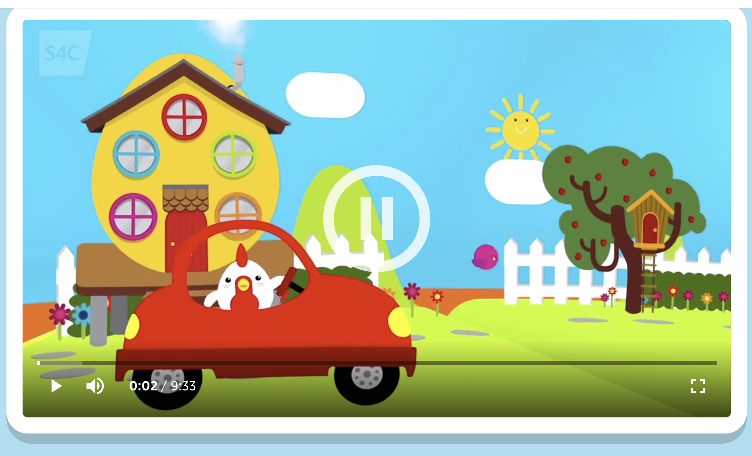
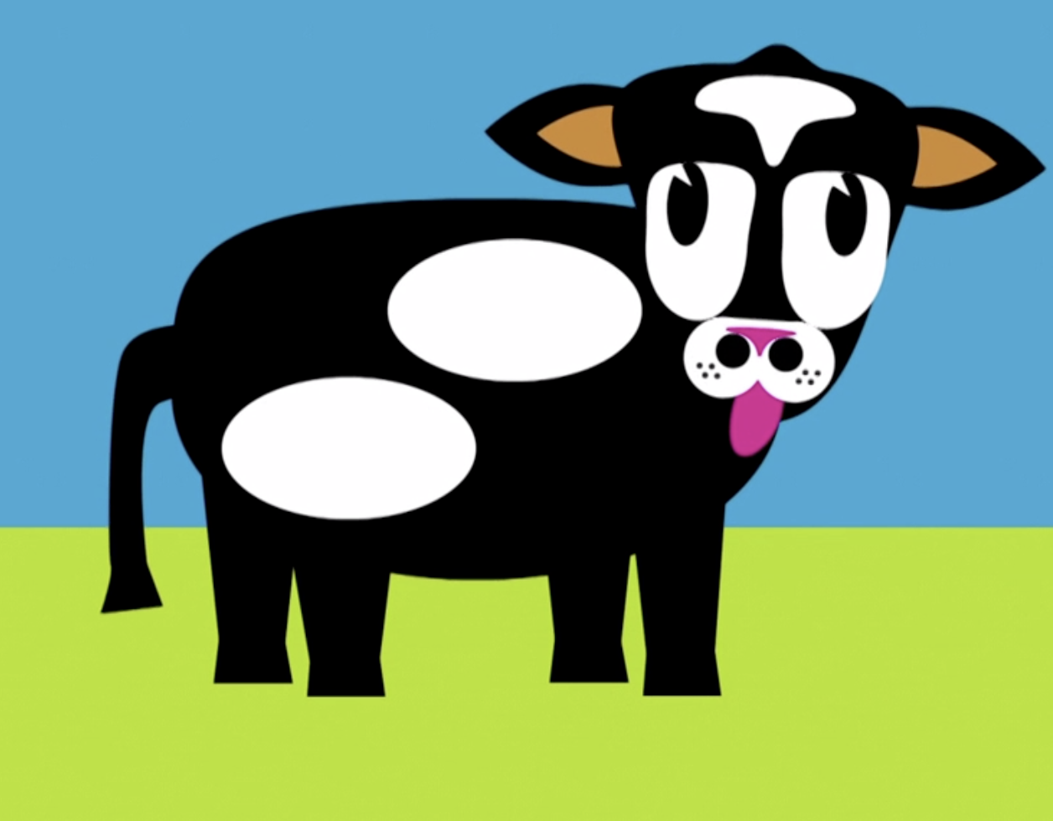
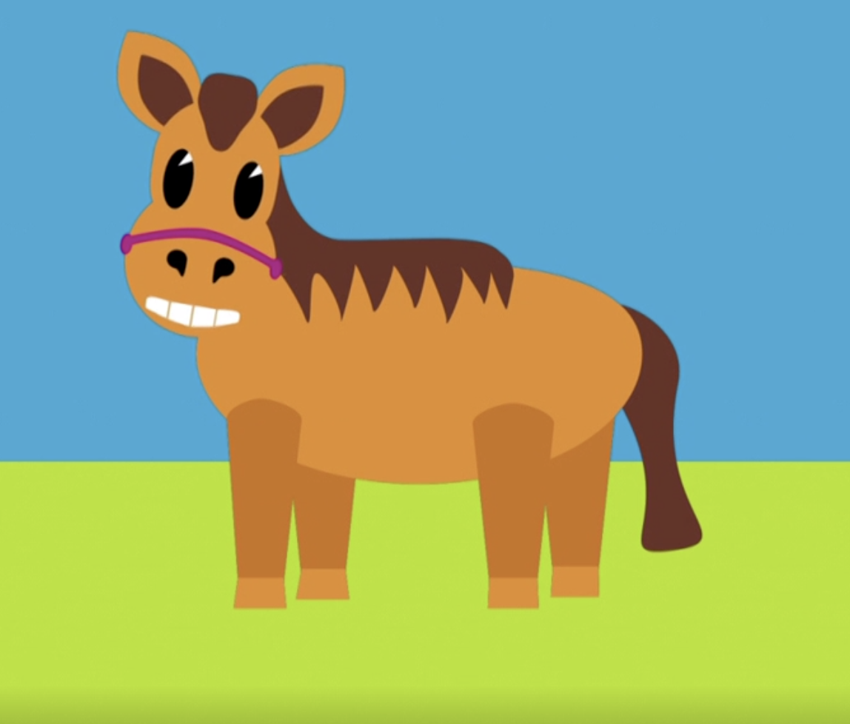
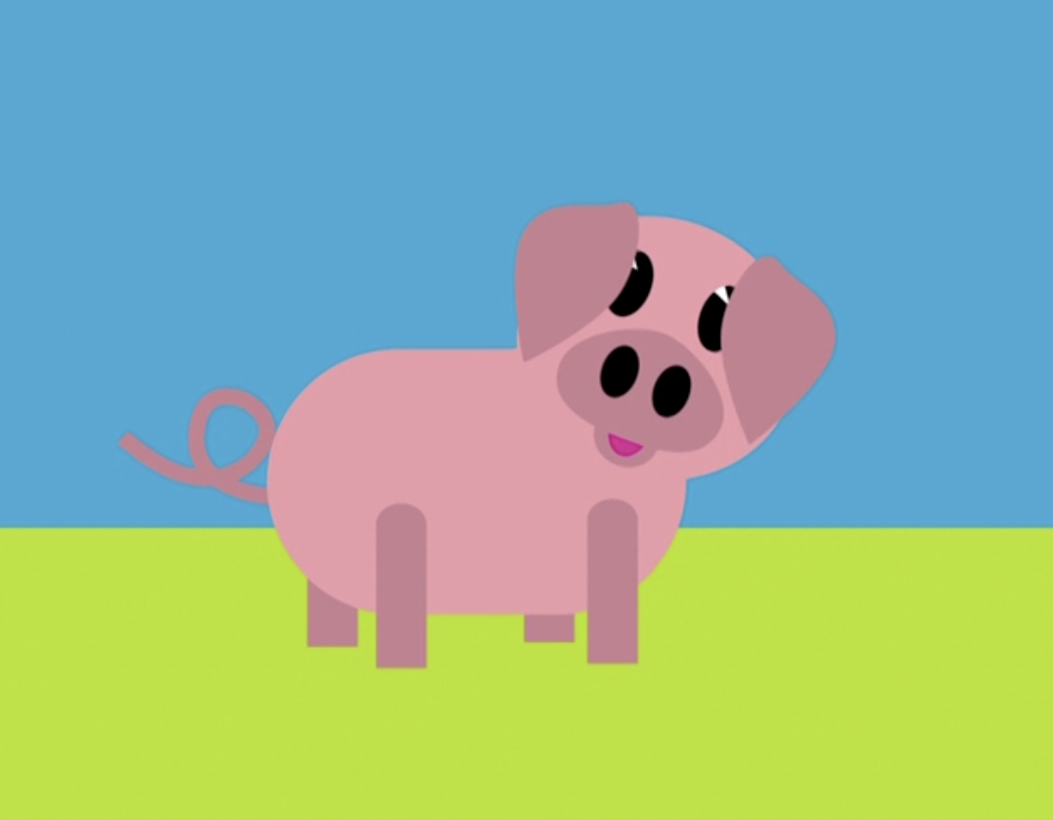
Cyw
Rydyn ni’n mynd i wylio clip o raglen Cyw. Gwyliwch yn ofalus, a bydd y tiwtor yn gofyn cwestiynau i chi i ymarfer y patrymau rydyn ni wedi eu gwneud.
Here’s a clip from one of Cyw’s programmes. Following the clip the tutor will be asking questions, to practice the patterns we have done in these sessions.
Beth mae’r ceffyl yn hoffi (wneud)?
What does the horse like (to do)?
Mae’r ceffyl yn hoffi ... .
The horse likes ... .
Mae e’n/hi’n hoffi ... .
It ikes...
Wyt ti’n hoffi’r _______?
Do you like the ______?
Pam? Why?
Dw i’n hoffi’r ______ achos ...
I like the ______ because ...
Dw i ddim yn hoffi’r ______ achos...
I don’t like the _____ because...
Ble mae Bolgi heddiw?
(Where is Bolgi today?)
Ble mae Bolgi yn eistedd?
(Where is Bolgi sitting?)
Wyt ti’n hoffi’r _______?
Do you like the _______?
Pam? Why?
Dw i’n hoffi’r _______ achos...
I like the _______ because ...
Pa anifail ydy dy hoff un?
Which animal is your favourite?
Pam? Why?
Fy hoff anifail ydy _______ achos...
My favourite animal is _____ because ...
Beth ydy hwn/hon? What’s this?
________ ydy e/hi.
Pa liw ydy e/hi? What colour is it?
Mae e’n/hi’n _______ .
Pa sŵn mae e’n/hi’n wneud?
What sound does it make?
Pa sŵn mae’r _______ yn wneud?
What sound does the ______ make?
Mae e’n/hi’n gwneud sŵn ... .
It makes a sound like....

Slide 10

Adborth
Geiriau wrth roi adborth i waith a sylwadau disgyblion.
How to give feedback on pupils’ work and responses.
Da iawn ti | Well done you
Cywir! | Correct!
Arbennig | Special
Gwych | Excellent
Rhagorol | Outstanding
Ymdrech dda | Good effort
Rydw i’n hoffi dy syniad di | I like your idea
Tria eto | Try again
Anghywir | Incorrect
Ddim yn union | Not quite
Rwyt ti’n agos iawn | You’re very close
Agos! | Close!
Bron yn gywir | Almost correct
Meddylia eto | Think again
Sillafu | Spelling
Atalnodi | Punctuation
Treiglo | Mutation
Tanlinellu | Underlining
Paragraffu | Paragraphing
Ysgrifen glwm | Joined up writing
Tro nesa... | Next time...
Beth am (i ti)...? | How about (you)...?
Dy darged ydy... | Your target is...
Cofia... | Remember (to)...
Mae angen i ti... | You need to...
Gweithia ar... | Work on...

Slide 11

Dysgu cyfeirol
Directed learning
DYSGU MINI MEICRO – 3.12.2020
Ewch i wefan CywTiwb.
Dewiswch un raglen. Dewiswch olygfa i’w thrafod - tua 5 munud o’r rhaglen.
(Choose one programme.Choose a suitable scene from the programme – no more than 5 minutes).
Meddyliwch am gwestiynau i ofyn i’r ‘disgyblion’ am y clip.
(Think of questions to ask the ‘pupil’s about what they see in the clip.)
Byddwch yn gweithio mewn grwpiau i drafod y rhaglen.
(You’ll be working in groups to take it in turns to be the ‘teacher’ and the ‘pupils’.)

