Slide 1




Carbon footprint of Educational Establishments:
The Case of the University of Alicante
Authors:
Maria Reyes Mula-Molina
Mariareyes.mm@gmail.com
Juan Antonio Ferriz-Papi
Juan.ferriz-papi@uwtsd.ac.uk
ICABE 2016 London

Slide 2
ICABE 2016
Carbon footprint of Educational Establishments:
The Case of the University of Alicante
0. Index
1
1. Introduction
2. Aim and Objectives
3. Methodology
4. Results and analysis
5. Conclussions

Slide 3
ICABE 2016
Carbon footprint of Educational Establishments:
The Case of the University of Alicante
1. Introduction
2
Society expectative about environment protection and sustainable development
Universities as centres of knowledge and research excellence
Solutions for our challenging world

Slide 4
ICABE 2016
Carbon footprint of Educational Establishments:
The Case of the University of Alicante
1. Introduction
3
Environment awareness of Spanish Universities
CRUE. Environment Quality and Sustainable Development Workgroup
2007. Creation of ECOCAMPUS office at the University of Alicante
Necessity of environment assessment
Know present situation – scarce or non-existing information
Some actions already carried out. Others to put in practice

Slide 5
ICABE 2016
Carbon footprint of Educational Establishments:
The Case of the University of Alicante
2. Aim and objectives
4
Aim:
Develop a simplified methodology to calculate and compare carbon emissions per user at the University campus.
Objectives:
Study other methodologies applied in different campuses in Spain;
Establish own methodology considering building operations and transport;
Compare and analyse these results.

Slide 6
ICABE 2016
Carbon footprint of Educational Establishments:
The Case of the University of Alicante
3. Methodology
5
INFORMATION COMPILATION
+
REFERENCES
METHODOLOGIES FOR ASSESSMENT
DEFINITION OF OWN METHODOLOGY
Sustainable development
Environment assessment
Indicators
Ecological footprint
Carbon footprint
Corporate ecological footprint
UN publications
ISO,BSI, AENOR
EU Directives
World Resources Institute
etc.
University of Santiago de Compostela
University of Barcelona
Polytechnic University of Cataluña
Miguel Hernández University

Slide 7
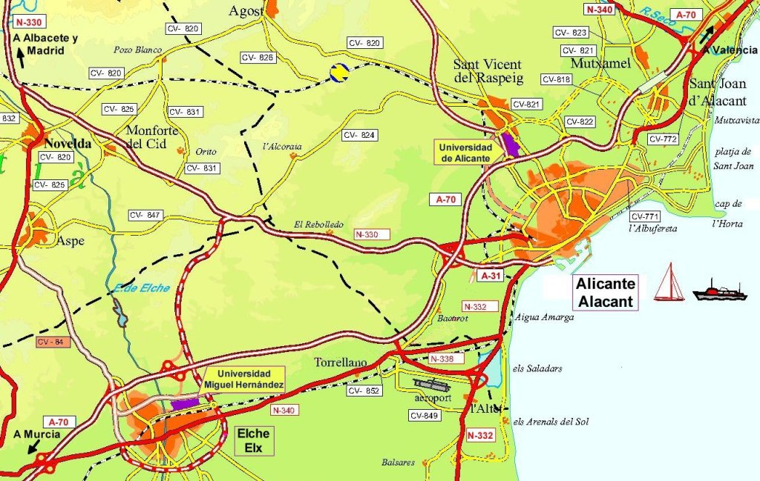
ICABE 2016
Carbon footprint of Educational Establishments:
The Case of the University of Alicante
3. Methodology
6

Slide 8
ICABE 2016
Carbon footprint of Educational Establishments:
The Case of the University of Alicante
3. Methodology
7

Slide 9
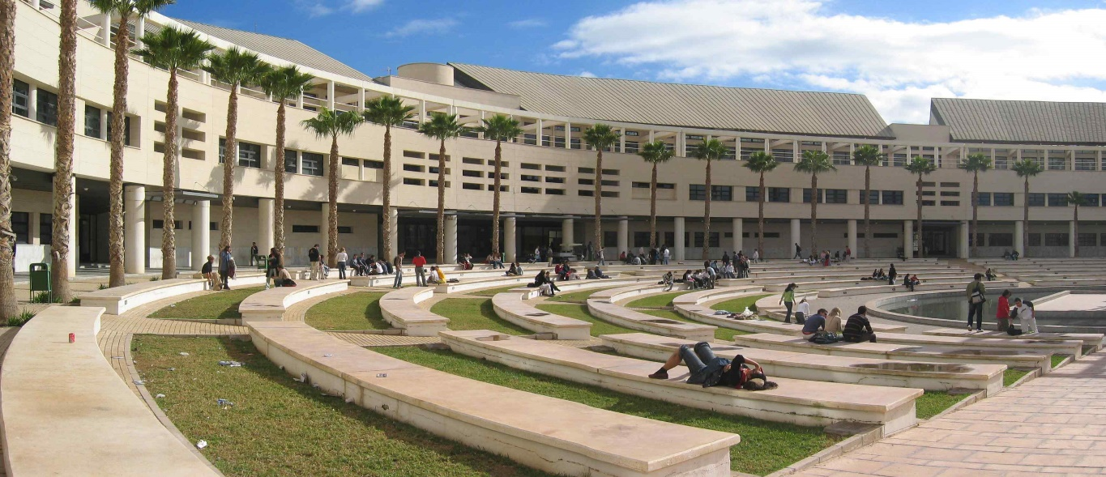
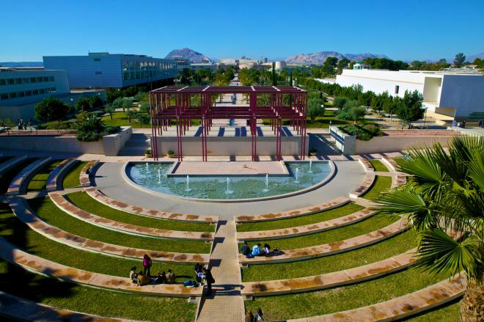
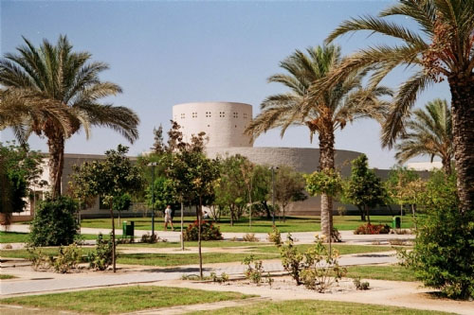
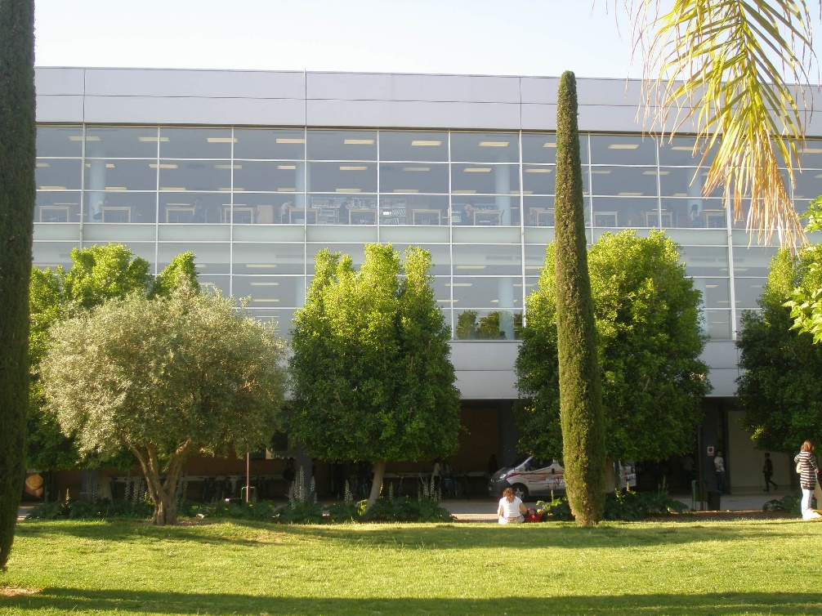
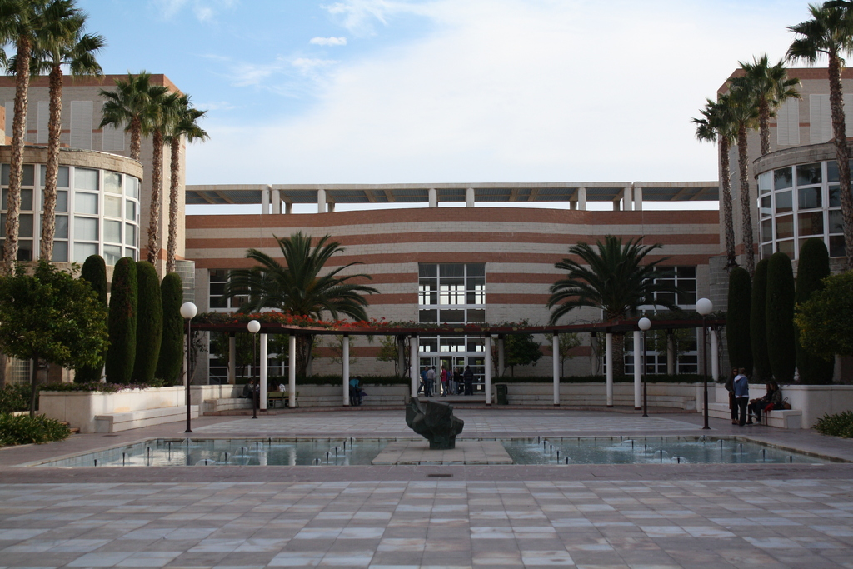
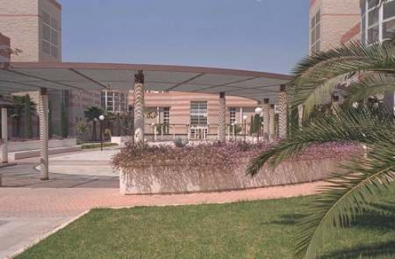
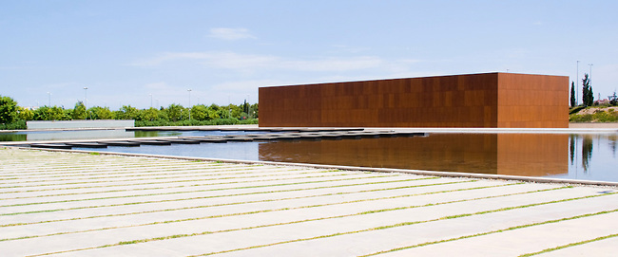
ICABE 2016
Carbon footprint of Educational Establishments:
The Case of the University of Alicante
3. Methodology
8

Slide 10
ICABE 2016
Carbon footprint of Educational Establishments:
The Case of the University of Alicante
3. Methodology
9
ESTIMATION OF CARBON FOOTPRINT
DUE TO BUILDING AND URBAN SERVICES IN THE CAMPUS
OBTAIN ENERGY CONSUMPTION
ESTIMATION OF ELECTRICITY
CARBON EMISSIONS
ESTIMATION OF NATURAL GAS CARBON EMISSIONS
ESTIMATION OF TOTAL CARBON FOOTPRINT
ELECTRICITY
+
NATURAL GAS
EMISSION FACTOR:
ELECTRIC MIX
EMISSION FACTOR:
IDAE
RATE
PER M² BUILT
OVER THE CAMPUS
PER USER

Slide 11
ICABE 2016
Carbon footprint of Educational Establishments:
The Case of the University of Alicante
3. Methodology
10
ESTIMATION OF CARBON FOOTPRINT
DUE TO TRANSPORT
DIFFERENT SITUATIONS
ESTABLISH % OF DAILY ATTENDANCE
ASIGN AVERAGE CONSUMPTION
TRANSPORT SURVEY
UNIVERSITY USERS
SPANISH FLEET
ACADEMIC CALENDAR
TERM TIME
OUTSIDE TERM TIME
FUEL TYPE
VEHICLE TYPE
ESTIMATION OF USERS PER TYPE OF VEHICLE
NUMBER OF TRIPS
ASSIGN AVERAGE DISTANCE
ESTIMATION OF DAILY km
(L) OF DAILY FUEL
CONVERSION FACTORS: IDAE
RATE PER USER

Slide 12
ICABE 2016
Carbon footprint of Educational Establishments:
The Case of the University of Alicante
3. Methodology
11
CARBON FOOTPRINT DUE TO USE
CARBON FOOTPRINT DUE TO TRANSPORT
FINAL CARBON FOOTPRINT

Slide 13
ICABE 2016
Carbon footprint of Educational Establishments:
The Case of the University of Alicante
4. Results and Analysis
12
2011
Kg CO₂ |  | TOTAL
Carbon Footprint due to Use | Carbon Footprint due to Transport
4,716,481 | 28,938,875 | 33,655,356
RATE PER USER
$$Emissions per user=\frac{33,655,356}{43,258}=778.01 kg CO2 per year$$
$$Emissions per user=\frac{778.01}{199}=3.91 kg CO2 per day$$

Slide 14
ICABE 2016
Carbon footprint of Educational Establishments:
The Case of the University of Alicante
4. Results and Analysis
13
Pie chart

Slide 15
ICABE 2016
Carbon footprint of Educational Establishments:
The Case of the University of Alicante
4. Results and Analysis
14

Slide 16
ICABE 2016
Carbon footprint of Educational Establishments:
The Case of the University of Alicante
4. Results and Analysis
15

Slide 17
ICABE 2016
Carbon footprint of Educational Establishments:
The Case of the University of Alicante
4. Results and Analysis
16

Slide 18
ICABE 2016
Carbon footprint of Educational Establishments:
The Case of the University of Alicante
5. Conclussions
17
CONCLUSSIONS
Methodology established for carbon footprint estimation
  Consideration of use and transport footprints
  Aspects not considered: water consumption, paper or other consumables, waste management, etc.
No apparent decrease of carbon footprint
  Energy meters since 2010
  It was reduced in 2013 and 2014. What happened?
  No evolution comparison per user, only per m2
  New buildings have been incorporated, not analysed
No possibility to split per use inside the building
  Global meters, not per zones or use
Different uses in each building, difficult to compare
Transport Report only in 2011
  No later information. Change in bus lanes and new tram lane

Slide 19
ICABE 2016
Carbon footprint of Educational Establishments:
The Case of the University of Alicante
5. Conclussions
18
FURTHER RESEARCH
Evolution of carbon footprint along time
  Per user and per m2
  Consideration of new buildings
  Extension to other campuses of the UA
Consideration of other carbon footprints
  Water consumption
  Paper and other consumables
  LCA of buildings
Action Plan to reduce the carbon footprint in this campus
  Reduction of energy consumption
  Separate energy meters per use
  Use of renewable energies
  New Transport Study
  Analysis of uses in each building
  Energy efficiengy, LED technology, Smart buildings
Comparison to other universities. Network

Slide 20


Carbon footprint of Educational Establishments:
The Case of the University of Alicante
Thank you
for your attention
Maria Reyes Mula-Molina
Mariareyes.mm@gmail.com
Juan Antonio Ferriz-Papi
Juan.ferriz-papi@uwtsd.ac.uk

