Slide 1

Student Name: Rakib Yunusbhai Malek
Student Number: 2327505
Course Name: Human Capital management
Lecturer Name: Nishi Ramsurrun
Session: June 2024 Term

Slide 2
Contents and slide number
Introduction on Toyota Motors 3
Strategic Goal of Toyota Company 4
Job Analysis / Position 5
Job Description 6
Person Specification 7
Required skills 8
Pay and working Conditions 9
Flexible working arrangement with justifications 10
Conclusion 11
References 12

Slide 3

Introduction on Toyota industry
Established on August 28, 1937, out of Sakichi Toyota’s weaving machine company
Launched first car (SA Model) in 1947
Toyota is 3 largest automotive manufacturer
Toyota has annual sales of $120 Billion
Produces~9.3 million vehicles per year
Employs~ 375,235 (as of 2023)
Headquartered in Toyota City, Japan
Producing a diverse range of vehicles, from compact cars and luxury sedans to SUVs, trucks, and hybrid/electric vehicles.

Slide 4
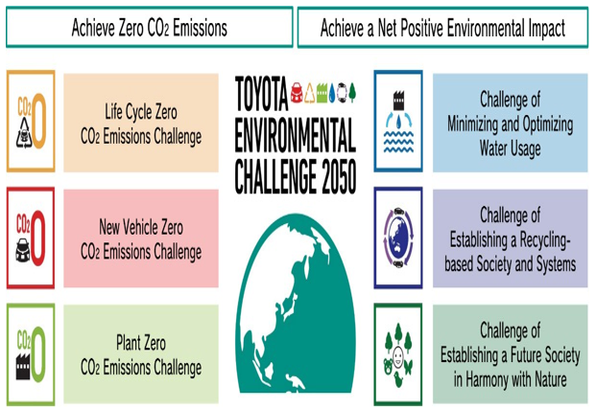
Strategic Goal of Toyota Company
Challenge 2050” has been set by the management of Toyota and this goal has been developed by mitigating negative impacts on the environment (Toyota, 2024b).
6 visionaries have been set by the concerned company, and the primary focus has been shifted by this company to manufacture new vehicles, which are carbon neutral.
The primary focus areas of this company are carbon neutrality, maintaining biodiversity, reducing the waste of water, and responsible use of materials.

Slide 5

Job Analysis / Position
Job Position:
junior Customer Care Assistance
Roles:
A candidate seeking greater career and compensation opportunities at Listers and with prior experience as a Senior Service Advisor, Assistant Service Manager, Parts Manager, or experienced Service Manager would be a good fit for this role.
Unlimited confidence, resilience, drive, energy and talent.
A well-presented individual with a desire, character, and attitude to succeed.
The ability to quickly establish and build rapport with our customers

Slide 6
Job Description
Under your portfolio of regionalized accounts, you are accountable to the Head of Account Management for developing client relationships and services.
Key responsibilities include the management of the strategic relationship between the business and the client and the achievement of targets maximizing all income streams, including building share of wallet, whilst building long term strategic and sustainable relationships with all key stakeholders.
The role demands board level presentation skills and expertise in fleet management that will lead to KINTO becoming a true partner in Fleet strategy with the client.

Slide 7
Person Specification
Qualification & Experience
Complete Bachelor’s Degree in business Management
Customer relationship management(CRM)
2 year work experience in same filed
Basic knowledge of commuter and Microsoft office
Personal Attribution
Strong Analysis skill
Conflict Resolution
Crisis Management
Strong Communication Skill

Slide 8
Required skills
Good Communication Skill And Collaboration Skill
Multitasking
Teamwork
Conflicted Resolution
Problem Solving Skills

Slide 9
Pay and working Conditions
Pay : Competitive a Salary with incentives on the basis of performance
annual salary
Benefits include an OTE of £60,000 - £70,000 and use of a company car.

Slide 10
Flexible working arrangement with justifications
25 days holiday plus bank holidays
The hours of work are Monday - Friday, 08:00 - 18:00
Pension scheme
Health & wellbeing benefits
Group life insurance
Staff discount on car servicing
Listers Benefits - discounts on retailers, restaurants, cinemas & holidays
Long service and loyalty incentives Staff referral scheme

Slide 11

Conclusion
Toyota company has strong brand extinction toward the global car industry and provide good customer care support and customer care assistance play essential role in this company.

Slide 12
References
  Carlier,M .,2024,Toyota Motor Corporation's net revenue from FY 2012 to FY 2024,Available at: https://w w w .statista.com /statistics/262752/total-net-revenues-of-toyota/# :~ :text= The% 20Toyota% 20M otor% 20Corporation's% 20net,to% 20298% 20billion% 20U .S.%20dollars.[Accessed on 13/07/2024]
  Toyota,2024a,Toyota vision and philosophy,Available at:https://w w w .toyota-europe.com /about-us/toyota-vision-and- philosophy# :~ :text= Our% 20M ission% 3A% 20H appiness% 20for% 20All& text= Toyota% 20rem ains% 20com m itted% 20to% 20m aking,h elp% 20everyone% 20enjoy% 20their% 20lives.[Accessed on 13/07/2024]
  Toyota,2024b,Goals & Targets,Available at:https://w w w .toyota.com /usa/environm entalsustainability/goals-and-targets.[Accessed on 13/07/2024]
https://www.workable.com/features/hiring-plan
https://www.toyota.co.uk/discover-toyota/careers

