Slide 1
Final Viva Presentation
Asthma Self Management Website
Naska Sulaiman
Supervisor: Dr Sana Jokhio
Student Number: 2221742
University of Wales Trinity Saint David, Birmingham
Date: 28th November 2025

Slide 2
Introduction
Asthma is widespread and chronic[1][2].
Patients face fragmented resources[3[4].
Need for a unified digital solution[5][6].

Slide 3
Importance of Asthma Self-Management
Prevents flare-ups and emergencies[1][2].
Improves quality of life[3][4].
Empowers patients[5][6]

Slide 4
Problem Statement
Access gap to reliable, practical tools[1][2].
Existing apps: costly, outdated, complex[3][4].
Need for integrated, evidence-based platform[5][6].

Slide 5
Project Objectives
Accessible web interface[7][8].
Symptom tracking[9][10].
Educational resources[11][12].
Personalized action plans[13][14].
Reminders & alerts[15][16].
Progress tracking & visualization[17][18].
Usability testing[19][20].
Low-cost, scalable platform[21][22].

Slide 6
System Architecture Overview
System Architecture overview layers: [1][2].
1. User Interaction Layer
2. Data Processing & Monitoring Layer
3. Notification & Support Layer
Visual: Simple architecture diagram placeholder

Slide 7
Research Contribution
Unified, clinically-informed platform[1][2].
Reduces fragmented asthma resources[3][4].
Reference for healthcare developers[5][6]

Slide 8
Literature Review – Challenges
Non-adherence & poor monitoring[1][2].
Fragmented education & support[3][4].
Guidelines: GINA & WHO[5][6].

Slide 9
Literature Review – Layered Support
Access, Coordination, Healthcare & Support, Application/Service, Data & Analytics layers[1][2].
Integration reduces cost & complexity[3][4].

Slide 10
Literature Review – Core Platform Components
Patient Interface[1][2].
Coordination & Monitoring Layer[3][4].
Healthcare Network[5][6].
Communication & Alerts[7][8]

Slide 11
Integration Challenges
Real-time symptom tracking[1][2]
Secure communication & alerts[3][4]
Solution: cohesive workflow, HIPAA-compliant[5][6]

Slide 12
System Implementation
Open-source web technologies (Wix)[14[2].
Cloud-based services for scalability & security[3][4].
Dashboard, reminders, analytics[5][6].

Slide 13
Home Page
Central hub & dashboard overview[1][2].
Quick access: tracker, education, action plan, communication[3][4].
Visual: Screenshot placeholder

Slide 14
Symptom Tracker Page
Log daily symptoms & triggers[1][2].
Interactive charts for trends[3][4].
Alerts for poor control[5][6].
Visual: Screenshot placeholder

Slide 15
Action Plan Page
Personalized zone-based instructions (Green/Yellow/Red)[1][2].
Checklists & automated reminders[3][4].
Enhances adherence & decision-making[5][6].
Visual: Screenshot placeholder

Slide 16
Triggers & Tips Page
Environmental, behavioral, allergen triggers[1][2].
Tips & checklists for avoidance[3][4].
Personalized recommendations[5][6].
Visual: Screenshot placeholder

Slide 17
Emergency Steps Page
Step-by-step action plan for severe attacks[1][2].
Visual cues & alerts[3][4].
Emergency contacts integration
Visual: Screenshot placeholder

Slide 18
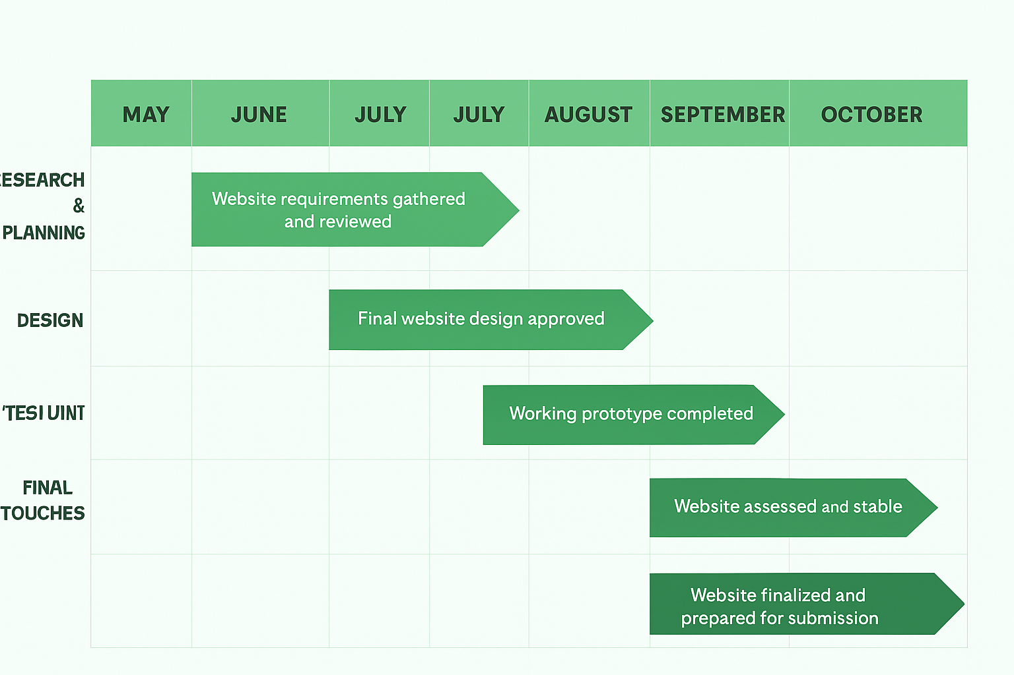
Gantt Chart

Slide 19
Conclusion
Integrated platform improves self-management[1][2].
Usable, secure, scalable, low-cost[3][4].
Supports long-term asthma control[5][6].

Slide 20

Home page

Slide 21

Symptom Tracker

Slide 22
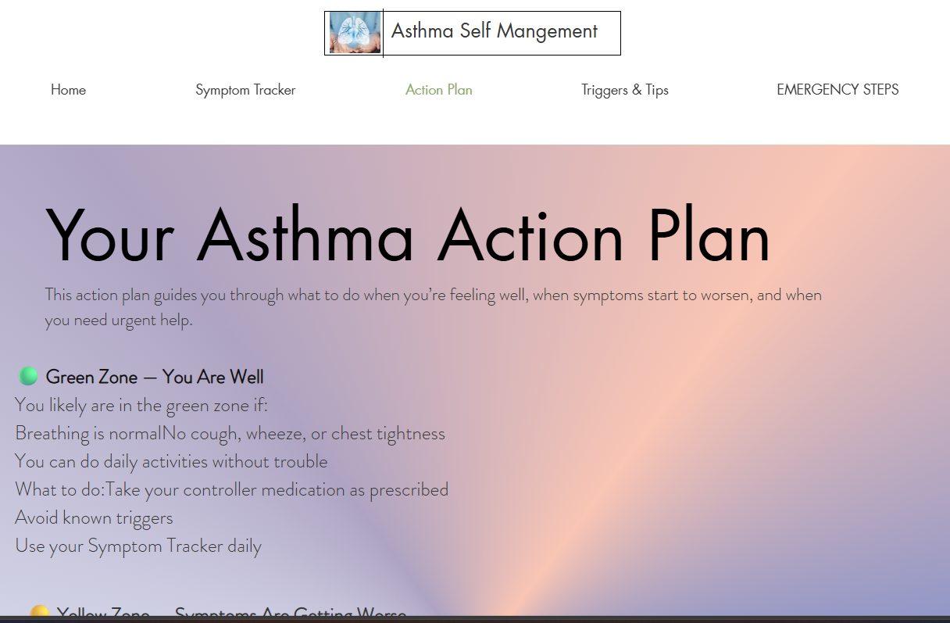
Action Plan

Slide 23
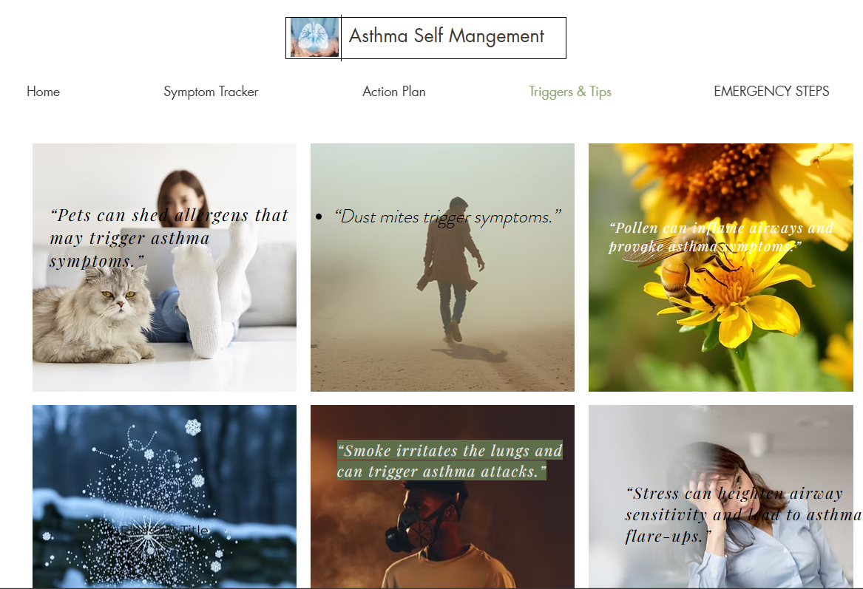
Triggers and Tips

Slide 24
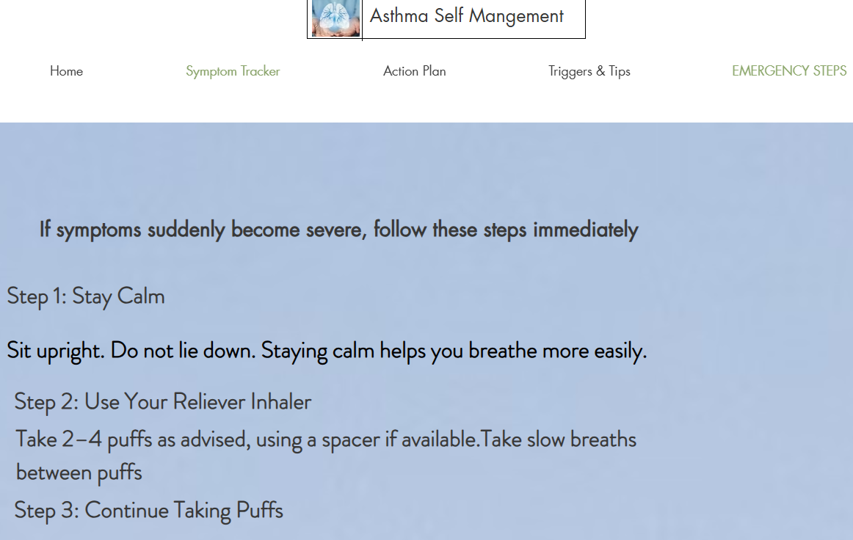
Emergency Steps

Slide 25

References
Highlight key references: GINA 2023, Bender 2005, Faruque 2020
Full reference list available in project report

Slide 26
Reference list
[1] Global Initiative for Asthma (GINA), Global Strategy for Asthma Management and Prevention, 2023. [Online]. Available: https://ginasthma.org
[2] B. G. Bender and S. E. Bender, "Patient-identified barriers to asthma treatment adherence: Responses to interviews, focus groups, and questionnaires," Immunol. Allergy Clin. North Am., vol. 25, no. 1, pp. 107–130, 2005.
[3] A. H. Y. Chan et al., "Electronic monitoring of adherence to inhaled corticosteroids in asthma: A systematic review," J. Allergy Clin. Immunol., vol. 136, no. 4, pp. 1033–1043, 2015.
[4] L. I. Faruque et al., "Digital health interventions for asthma self-management in adults and children: A systematic review," J. Med. Internet Res., vol. 22, no. 7, p. e17372, 2020.
[5] H. K. Reddel et al., "A summary of the new GINA strategy: Asthma management for adults and children," Eur. Respir. J., vol. 53, no. 5, p. 1900238, 2019.
[6] J. M. Foster et al., "Self-management education in asthma: What works?," Curr. Opin. Allergy Clin. Immunol., vol. 14, no. 3, pp. 225–230, 2014.
[7] S. Holley et al., "Digital interventions to support self-management in asthma: Systematic review and meta-analysis," BMJ Open, vol. 7, no. 8, p. e017750, 2017.
[8] R. Morton et al., "Supporting adherence in asthma patients through digital tools: A review of current evidence," J. Asthma, vol. 58, no. 5, pp. 607–618, 2021.
[9] D. Morrison et al., "Digital asthma self-management interventions: Systematic review and meta-analysis," JMIR mHealth uHealth, vol. 2, no. 1, p. e2, 2014.
[10] D. Ryan and A. Murphy, "Mobile health technology for asthma: Current state and future directions," Curr. Opin. Allergy Clin. Immunol., vol. 20, no. 3, pp. 204–212, 2020.
[11] M. M. Cloutier et al., "The National Asthma Education and Prevention Program: Asthma management guidelines," Pediatrics, vol. 125, no. 2, pp. S1–S2, 2010.
[12] M. Schatz and R. S. Zeiger, "Asthma control and self-management: The role of patient-centered care," Allergy Asthma Immunol. Res., vol. 10, no. 5, pp. 455–463, 2018.
[13] H. Pinnock et al., "Digital interventions for self-management of chronic respiratory diseases: Implementation considerations," BMJ, vol. 356, p. j633, 2017.
[14] D. Morrison et al., "The effectiveness of digital interventions in improving asthma control: A systematic review," BMC Pulm. Med., vol. 17, no. 1, p. 133, 2017.
[15] G. Norman et al., "Usability testing for digital health interventions: Methods and guidelines," J. Med. Internet Res., vol. 19, no. 1, p. e21, 2017.
[16] A. C. Williams et al., "Evaluating engagement in digital health platforms for chronic disease management," JMIR Hum. Factors, vol. 6, no. 2, p. e13015, 2019.

