Slide 1
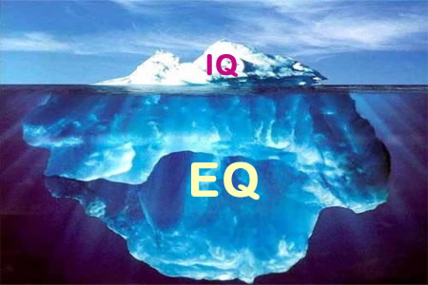
Emotional Intelligence (EI)

Slide 2
Emotional response to Change
When faced with change People can react in a variety if ways:
  Positively e.g. with Excitement relief & Joy.
  Negatively e.g. With fear anger and resistance.
  Peacefully e.g. With Equanimity and Peace.
Understanding how to manage thoughts & Emotions is key to effective Change Management within yourself and others.

Slide 3
Intelligence
Let us start with understanding of awareness and intelligence.

Slide 4
Q: What is Intelligence?
Take a few minutes to quietly reflect and write down a definition of Intelligence?

Slide 5
Intelligence
For years now, "intelligence" has been defined solely as the ability to solve problems logically.
But more and more research indicates that "emotional intelligence" is of much greater importance in learning and change.
Researchers Dryden and Vos in the world's biggest-selling book for 1999, The Learning Revolution, expand on this concept.
Vos, who achieved her doctorate in education after a seven-year research program into the world's best learning methods, describes emotion as "the key to unlock the door to learning".
Ref: http://www.thelearningweb.net/emotional-intelligence.html

Slide 6
IQ
"Intelligence quotient" (IQ) tests were designed early in the 20th Century to measure cognitive ability and intellect, which were widely believed to be the whole story on intelligence.
The school system all over the world was geared to valuing and developing these capacities. Other important capabilities, such as the ability to get on with other people, were largely ignored.
In the early 1980's, some psychologists began to question the claims of IQ to be the only relevant model of intelligence.
In 1983 Howard Gardner challenged the assumptions of the IQ-only model in his book Frames of Mind, setting out his research on "multiple intelligences“.
http://www.coachingleaders.co.uk/what-is-emotional-intelligence/

Slide 7
Emotional vs. Intellectual Intelligence
Not many years ago, the intelligence quotient, or IQ, was seen as a strong indicator of the level of success one could attain in life.
The standard IQ test measured raw intelligence, including abilities such as logic and reasoning skills, reading, writing, and analyzing.
Research, however, soon proved that the IQ could not predict academic and professional performance as once had been thought. There was another element involved: emotional intelligence, also known as the EQ.
Emotional intelligence measures one's understanding of emotions, the ability to empathize and work with others, and manage under stress.
IQ seldom changes while EQ can change through self-discipline or a profound experience.
Nonetheless, they function in tandem and are both important to personal development and success.
http://www.dailyom.com/articles/2005/491.html

Slide 8
Emotional vs. Intellectual Intelligence
Individuals with high EQ's are better equipped to make use of their cognitive abilities.
They are often chosen for advancement in their professions or volunteer experiences because they possess the ability to inspire people to action and to make others feel more confident.
People with high IQ's but low EQ's sometimes sabotage themselves because they are unable to relate to their peers, cannot handle stress constructively, and find emotional connections difficult to maintain.
Developing your EQ can help you access your innate intelligence and amplify your empathy, which can lead to career advancement and better relationships.
Practice embracing your uniqueness and the uniqueness of others, expressing your feelings and interpreting those of your friends and family, and being decisive - all of which can help boost your EQ.
Experts say that a heightened EQ can bring happiness because it lets you focus on feelings as well as logical planning.
A strong EQ also makes you more able and confident to access and use your IQ and takes both achieve success in life.
http://www.coachingleaders.co.uk/what-is-emotional-intelligence/

Slide 9
CIPD Report : 2010
Using the head and heart at work
There is much more to effective performance in the workplace than can be achieved with cognitive intelligence, academic qualifications or hard technical skills alone.
This report explores the value of EQ, and how they complement technical skills and knowledge to drive sustainable organisation performance.
It demonstrates the business case for putting EQ at the heart of the learning and talent development agenda.
http://www.cipd.co.uk/hr-resources/research/soft-skills-business-case.aspx

Slide 10
Intelligence
Intelligence has been defined in many different e.g.
Understanding
Self-awareness
Communication
Reasoning
Learning
Emotional understanding
Planning
Problem solving.

Slide 11
Q: What is Emotional Intelligence?
Take a few minutes to quietly reflect and write down a definition of EI?

Slide 12
Emotional intelligence
Intelligence = understanding.
Intelligence is the ability to understand something.
Emotional intelligence is the ability to understand emotions.

Slide 13
Emotional intelligence
Emotional intelligence (EI) is the ability to be aware, understand and regulate our emotions to support personal growth in ourselves and others.

Slide 14
EI & Education
There is widespread concern about many young people’s lack of Emotional Intelligence
Research reports suggest that schools can play a greater role in people EI education.
Schools are now including taking on a role in building Emotional Literacy.
Teaching Emotional Literacy will improve pupils’ learning working and future parenting skills.
Emotionally healthy children are happier, more cooperative and learn more effectively.
http://www.highlandschools-virtualib.org.uk/ltt/whole_learner/emotional.htm
http://www.investigacion-psicopedagogica.org/revista/articulos/15/english/Art_15_256.pdf

Slide 15
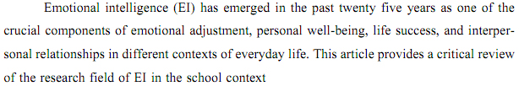
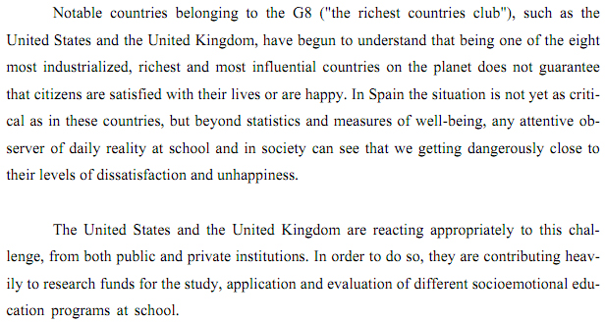
http://www.investigacion-psicopedagogica.org/revista/articulos/15/english/Art_15_256.pdf

Slide 16
EI in Organisations
In his groundbreaking book, Emotional Intelligence, researcher Daniel Goleman reported on compelling breakthroughs from the fields of neuroscience and business.
His research showed that success in life is based more on our ability to be aware of, and able to manage our emotions, than on our intellectual capabilities.
This created a mini-revolution in how organizations think about leadership and how people think about success.
A simple definition of emotional intelligence is the collection of emotional skills we need to manage our relationships and ourselves.
Goleman and other researchers have now demonstrated conclusively that corporate and health care leaders who excel in emotional intelligence skills achieve not only superior business results, but also have higher levels of personal fulfilment and increased well-being.

Slide 17
The 5 key elements and domains of EI (Goleman follows Salovey and Mayer here)
Self-awareness
Understanding our own emotional responses is the most important factor in EI. This gives us the understanding and potential to manage our emotions and support others.
2. Emotional control
We can use strategies to control our emotional state ;
It can be part of the pro-active management of our lives, and in a reactive way in stressful situations.
3. Self-motivation
When we have a goal, the control of emotions will assist greatly in achieving it.
This can lead to a state of “flow” in which intense, productive, creative focus on tasks is possible (see FLOW Mihaly Csikszentmihalyi).
4. Empathy
The ability to recognise signs in others of how they are feeling is important if we are to establish good relationships with them (essential for effective Team-working and Management support).
This can lead to more productive work with colleagues. It can also help us to deal with conflict situations
5. Handling relationships
Good understanding of emotions can help us to manage the emotions of others.
It is possible to teach skills of understanding and managing others’ emotional states
Based on http://www.highlandschools-virtualib.org.uk/ltt/whole_learner/emotional.htm

Slide 18
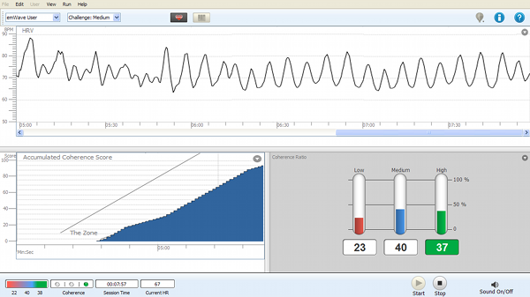
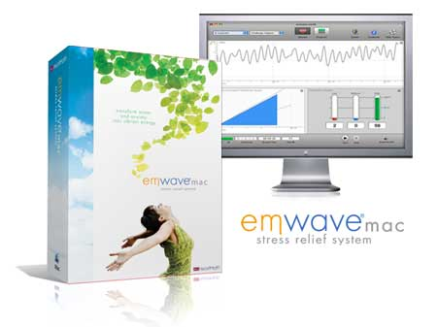
Case-study example :
IHM emWave Technology

Slide 19
The Institute of HeartMath (IHM)
The Institute of HeartMath (IHM) is a research and education organization which through Technology and Training help People and Organisations to improve Performance and Well-being and create optimal environments that improve creativity and productivity.
Studies investigating the impact of HeartMath programs in the workplace have documented a wide range of organizationally relevant outcomes, including increases in productivity, goal clarity, job satisfaction, communication effectiveness, improvement in employee health and reductions in turnover.
Studies also have examined the programs' effect in helping organizations through change and meet challenges such as downsizing and restructuring.
ref: http://www.heartmath.com/about/research-information.html

Slide 20
The IHM & EI
With intention when we activate the power of our hearts we experience Positive Empowering and Sincere feelings such as appreciation, care and love.
Consciously choosing a core heart feeling over a negative one means instead of the drain and damage stress causes to our bodies’ systems, we are renewed mentally, physically and emotionally...
Heartfelt positive feelings fortify our energy systems and nourish the body at the cellular level...
by intentionally thinking positive thoughts and focusing on positive emotions... – a beneficial state of mental, emotional and physical balance and harmony is achieved. (1, p3)
(1) http://www.heartmath.org/templates/ihm/e-newsletter/publication/2011/summer/index.php

Slide 21
IHM Technology
The emWave Desktop Technology is a scientifically validated hardware/software system that teaches techniques to help people create an optimal state in which the heart, mind and emotions are operating in-sync and balanced.
This is achieved through a patented process which displays heart rhythm patterns in real time showing people when they are in this high performance state.
The Technology assist people to learn how to be aware of and maintain a high performance state called “coherence.” Coherence is a mental and emotional state that people experience when they are in the zone - when the heart, brain and nervous system are working in harmony.
There are interactive games designed to help increase Emotional Intelligence and transform stress into creative energy.
The Technology assists people to improve their focus, creativity, intuition and higher-level decision-making. To be more confident, positive, focused and calm.

Slide 22
Demo
4min Intro with emWave Emotion Visualizer: http://www.youtube.com/watch?v=PKYqrviclF0
More BG info:
Good 7min emWave demonstration : Emotional Intelligence and Mastery: http://www.youtube.com/watch?v=l2vUyFdG3wg

Slide 23
IHM & EI cont...
Simply put, the level of the emotional intelligence possessed by the Leader of an Organization largely determines the emotional environment within the organization.
Thus, it is critically important that Leaders develop skills to manage their emotions, especially emotions such as anxiety, anger, frustration, and depression as these drastically impact the energy, vitality, perspective, and overall effectiveness of a workforce.
HeartMath has demonstrated that it is through the coherent development of the intelligence of the heart that emotional intelligence and management skills can be learned and sustained.
ref: The Heart of Success, by Bruce Cryer, CEO/President, HeartMath,

Slide 24
Tutorial/Library/Lab Activity
In Pairs research and simply write one side of A4 that defines Emotional Intelligence and why it is important to:
  Personal Professional and Organisation Development &
  Change Management.
Find relevant information online but also reference a Book/Academic Paper.

Slide 25
More information
CIPD Report : Using the Head and Heart at Work: http://www.cipd.co.uk/NR/rdonlyres/18616949-CF66-47F8-A088-7C8FF2D864E0/0/HeadandheartguideFINAL.pdf
International Academy of Education : Academic and Social Emotional learning http://www.ibe.unesco.org/fileadmin/user_upload/archive/publications/EducationalPracticesSeriesPdf/prac11e.pdf

