Slide 1

MBA managing Marketing change
BMMB7026
Customer Insight, Buying Behaviour and Customer Journey Planning
Gwyneth Jones
June 2025

Slide 2
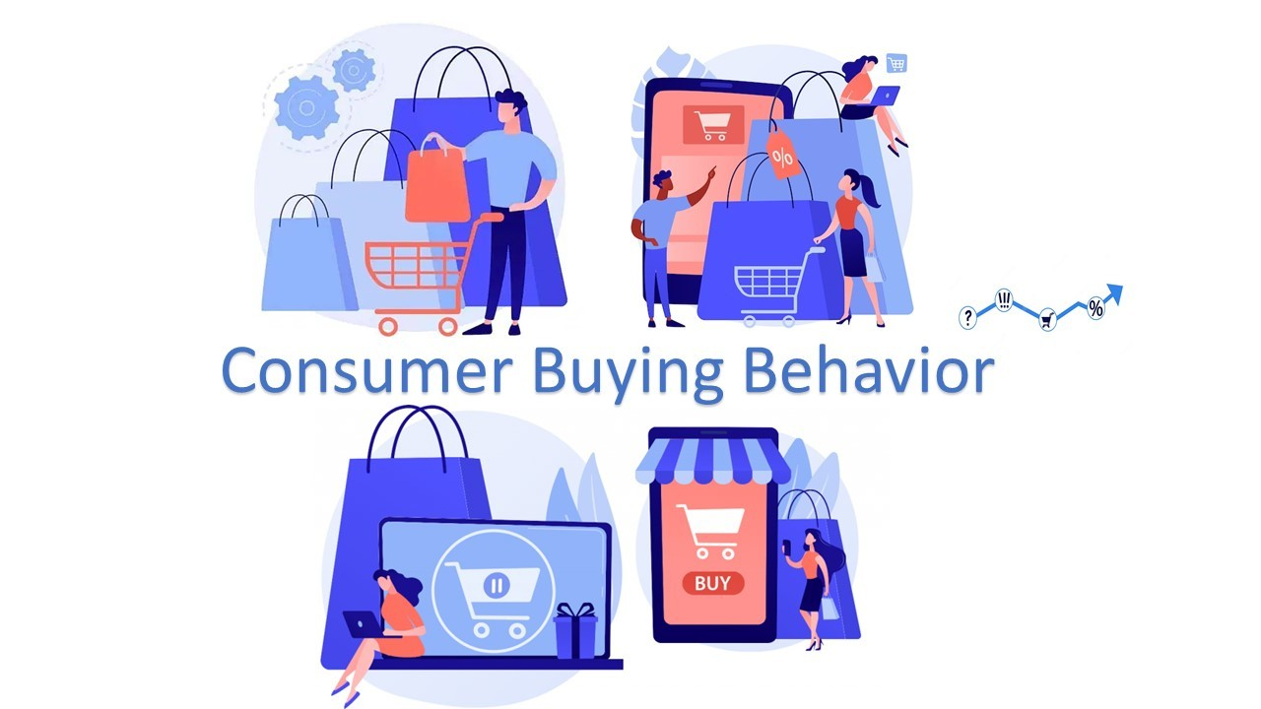
Today’s Lecture
Customer Categories
Consumer Decision Making Process (DMP)
Factors Influencing Buyer Behaviour
Diffusion of Innovation
The Marketing Funnel
Customer Journey Mapping

Slide 3
Customer Insight
From a strategic marketing perspective, customer insight refers to a deep, evidence-based understanding of customer behaviours, motivations, needs, and preferences, which informs long-term strategic decisions and helps create competitive advantage.
“Customer insight is the fresh understanding of customers and the marketplace derived from marketing information that becomes the basis for creating customer value and relationships.” Kotler & Keller (2016)
“In today’s world of data and analytics, organizations have the opportunity for unprecedented insight into their customers, their decisions, and the way they interact with their brand. Companies that can harness the immense amount of information at their fingertips can hone every aspect of their customer strategy–from product design to customer targeting.” McKinsey (2025)

Slide 4
What is ‘Buyer Behaviour’?
Who
is important?
Buyer Behaviour refers to the decisions and acts people (customers) undertake to buy products or services for individual or group use.
How
do they buy?
What are
their choice
criteria?
Customers
Where
do they buy?
When
do they buy?

Slide 5
Strategic Importance of understanding buying behaviour
The importance of consumer behaviour in marketing is far reaching.
Insights gained will help inform the development of your marketing strategy so that you reach your audience most efficiently
It enables optimisation of communications strategies.

Slide 6
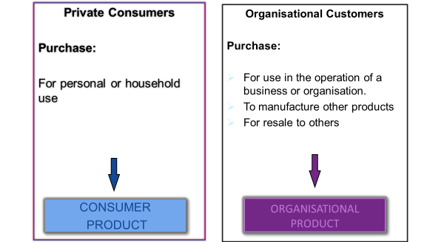
Customer types
There are two broad customer types:
  Private Consumers - B2C (business to consumer)
  Organisational Customers - B2B (business to business)
  Other categories include Customer to Customer C2C and Business to Government B2G

Slide 7
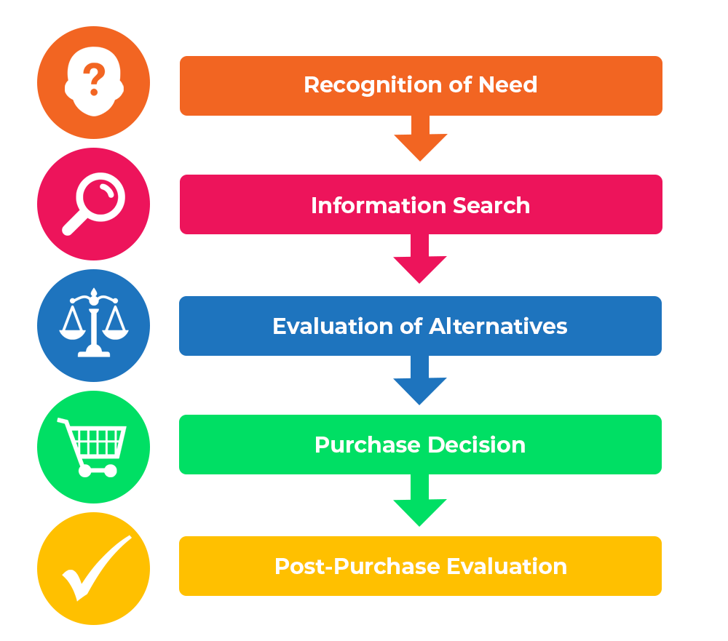
Consumer decision-making process
This model outlines the steps taken throughout purchasing process
It is rooted in cognitive psychology; hence, it deals with problem-solving, decision-making, motivation etc. (Fahy and Jobber 2022)
It assumes that a customer's purchasing decision is rational
It is a relatively rigid and predictable set of five steps…

Slide 8
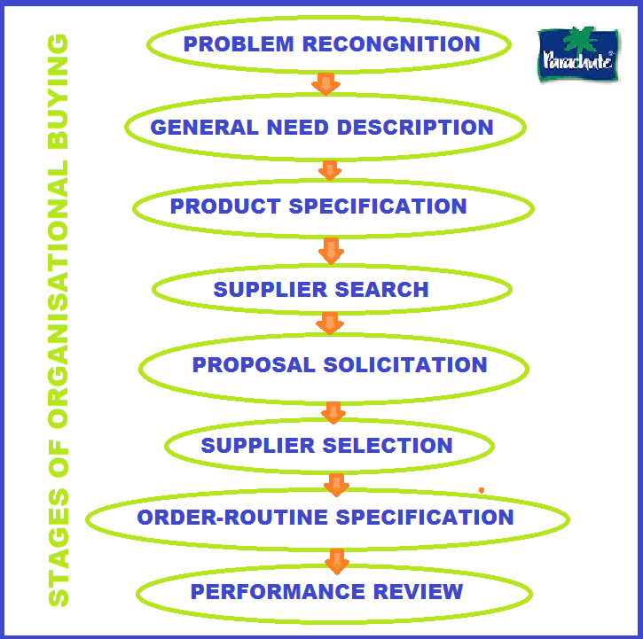
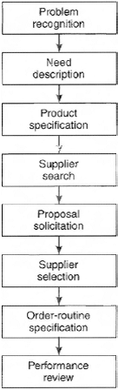
organisational decision-making process (B2B)

Slide 9
Step 1: recognition of need
Also called: ‘problem awareness stage’
Needs can be grouped into three groups:
Functional
Unpredictable
Emotional
Needs are predictable
Examples:
  Buying petrol, food, or heating
Due to situations beyond customer's control
Examples include:
  Dishwasher breaking down
  Car tyre deflating
  Twisting your ankle
Needs can also be referred to as experiential needs
Examples include:
  Urge for ice cream when you’re feeling down
  Buying expensive perfume to increase your status and sense of self

Slide 10

Step 2: information search
Once the customer has identified a need, they will search for information.
Purpose: to build up enough knowledge to feel secure in making a reasoned decision.
First: internal information search whereby the customer attempts to make a decision based on their existing knowledge.
Then: external information search, including talking to friends or experts, reading relevant sales material, or searching the internet for reviews.
Customer set’s his/her expectations, particularly around core needs and non-essential attributes.
Varies considerably for different product categories.

Slide 11
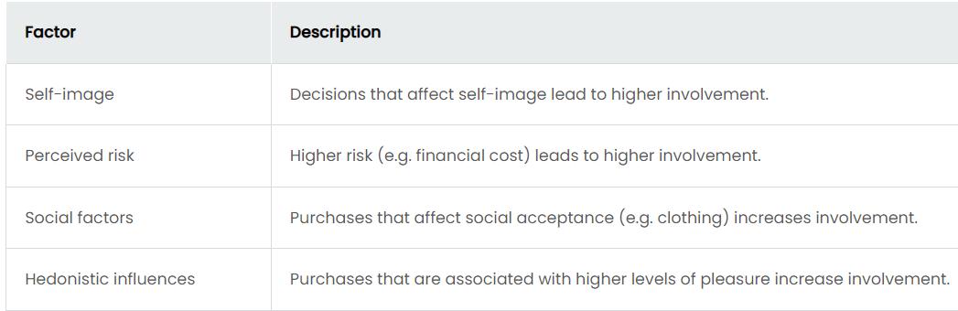
Step 3: evaluation of alternatives
The customer compares alternatives based on criteria derived from their needs and product knowledge.
There are four key factors that cause a ‘higher customer involvement’ (a higher level of activity with regards to evaluating alternatives):

Slide 12

Importance of perceived value and satisfaction
Before purchasing, customers set expectations and make assumptions on how much value and satisfaction they expect to derive from the product.
They will choose the product they conclude will deliver the greatest combination of value and satisfaction.

Slide 13

The nature of customer value
Question: What is Customer Value?
Perceived Sacrifice
Monetary costs
Time costs
Energy costs
Psychological costs (not making the right decision, perception of risk)
Customer Value
Perceived Benefits
Product benefits
Service benefits
Image benefits
Value offered should exceed that of competitors

Slide 14

Step 4: purchase decision
Purchase Stage
  Involves the trade of money for a product or service
  Shoppers in bricks and mortar stores rarely abandon their carts
  Abandonment of virtual shopping carts is quite common and provides marketers with real challenges.

Slide 15

Step 5: post-purchase evaluation
After the Purchase, customers may experience ‘cognitive dissonance’
  Cognitive Dissonance is the perception of contradictory information, and the mental toll of it
  It arises from their feelings of uncertainty as to whether they made the right decision
  It is common for customers to seek reassurance from friends, family, people who have made the same purchase decision
  It is important that customers feel happy with their decision as this leads to word-of-mouth marketing and potential long-term customer relationships.

Slide 16

Overcoming cognitive dissonance
What can businesses do to avoid cognitive dissonance or to help customers to overcome it?
  Ensuring that pre-purchase expectations are realistic (e.g., making reviews from other customers visible)
  Offering post-purchase service (e.g. extended warranties)

Slide 17
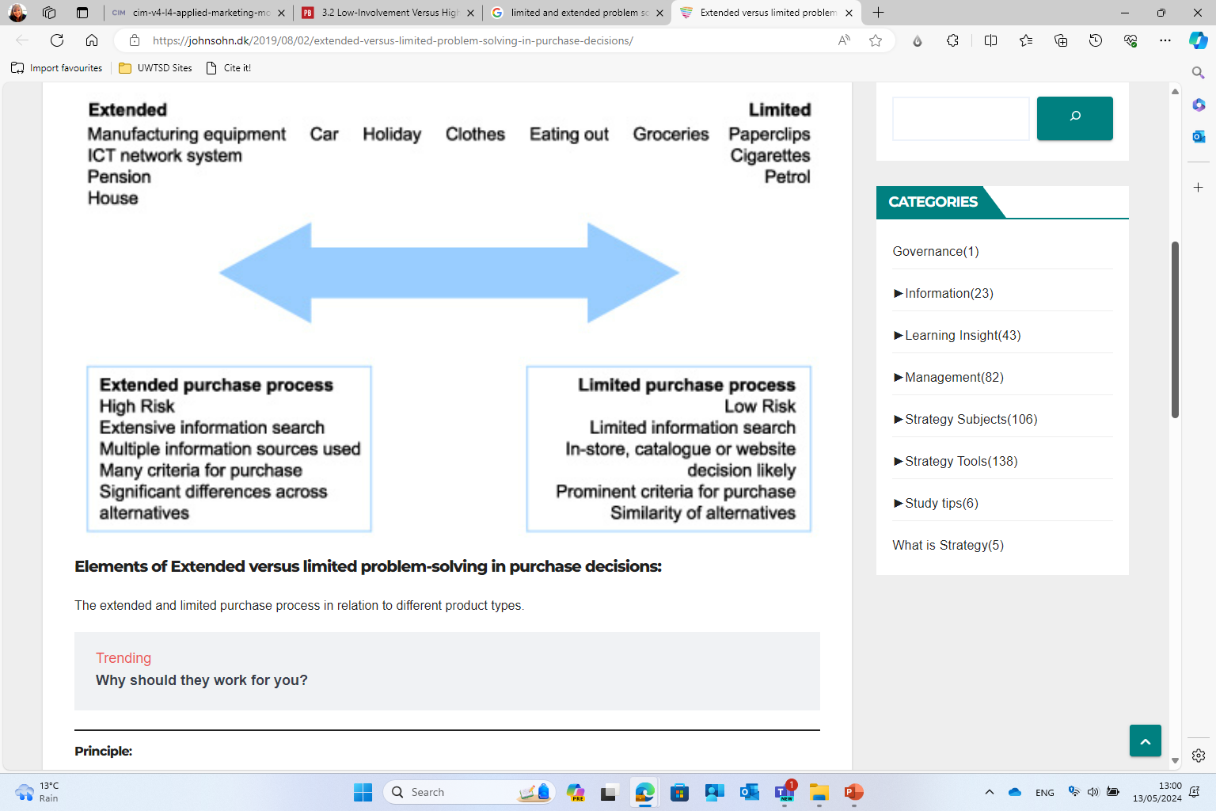
Extended and limited problem solving

Slide 18
Purchase Type Categories
There are several categories used to label the different facets of consumer behaviour:
Routine or Habitual Buying Behaviour. Also known as routine buying behaviour, this consumer behaviour is influenced by repetition and brand familiarity in purchase decisions, and typically covers everyday items that a person buys frequently without much thought.
Impulse buying behaviour. This behaviour occurs when buying decisions are made in the moment – without planning or research – based on an immediate desire. A common example of impulse buying is purchasing chocolate or sweets while in the queue at the supermarket.
Complex buying behaviour. This can include both limited and extended decision-making behaviours. It covers the purchases that people make after giving the matter some thought or conducting research into their options.
Dissonance-reducing buying behaviour. Dissonance-reducing buying occurs when a consumer is engaged in their purchase – typically an important one – but can see little difference between brands or products. This can be unsettling for some consumers, as they worry they’ll regret their decision post-purchase.

Slide 19
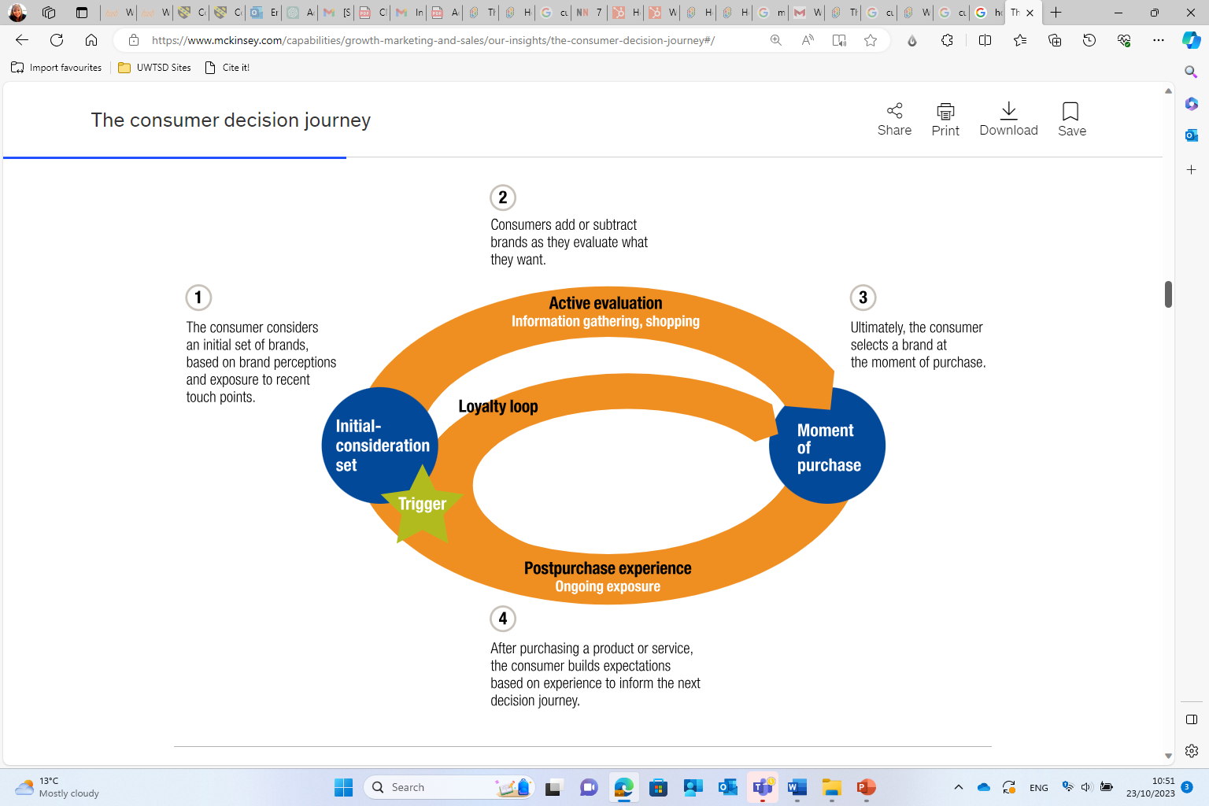
The Consumer Decision Journey – McKinsey loyalty loop

Slide 20
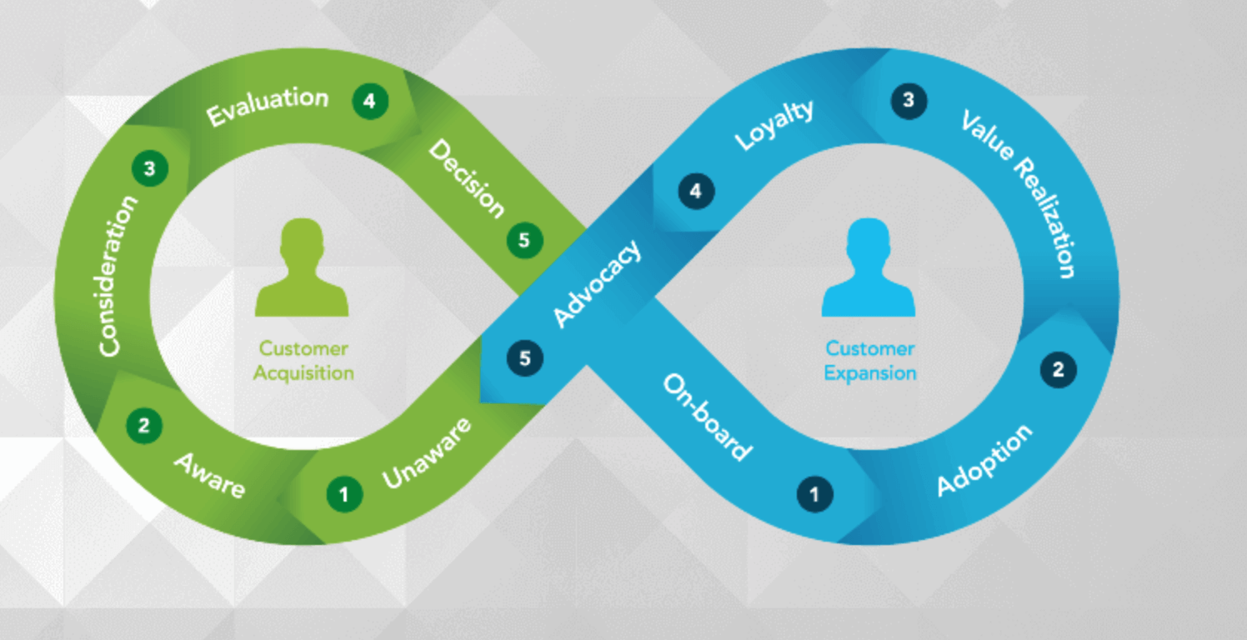
Customer-Centric Loop
Your customers can also be at many stages of their customer journey at once. The process to get, keep, and grow the right customer is an ongoing, infinite process.
Customer-centric organisations focus on lifetime relationships with customers, far beyond the initial acquisition..

Slide 21

Cultural influencing factors
Four categories of purchasing decisions are only a part of consumer behaviour.
Underlying, there are four distinct forces, each of which plays a pivotal role in how buyers decide:
  Cultural
  Social
  Personal
  Psychological

Slide 22

Cultural influencing factors
Refers to the traditions, basic attitudes, and values embedded within the culture in which a consumer lives
Has a significant impact on consumer behaviour:
  What is acceptable in one culture may be completely taboo in another
  What is relevant in one may be of no value to another
  May impact who makes decisions
They are instilled in individuals and reinforced over long periods of time
They can include nationalities, religions, races and geographic regions
May also be driven by social classes

Slide 23
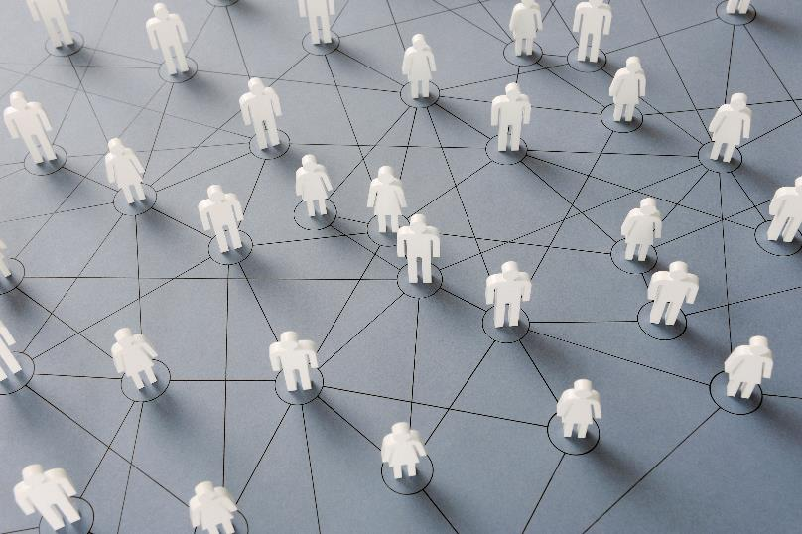
Social influencing factors
Include consumer groups and social networks, family, and roles and status
Social groups refer to groups of two or more individuals who interact to accomplish mutual goals
Individuals within small groups influence one another’s behaviour, typically through word of mouth influence, or direct referrals
Online social networks are extremely influential today. Influencer marketing is a key digital marketing tool.

Slide 24

personal influencing factors
May also influence buyer behaviour
What does it include?
  The individual’s:
    Age and life-cycle
    Occupation
    Lifestyle
    Etc.

Slide 25
psychological influencing factors
Play a key role in consumer behaviour!
Psychological Force | Description
Motivation | The need that sufficiently presses an individual to seek satisfaction of the need.
Perception | The process by which individuals select, organise and interpret information to form their picture of the world.
Economic Situation | The changes in an individual’s behaviour arising from experience.
Beliefs and Attitudes | Beliefs: descriptive thoughts that individuals hold about something Attitudes: reflect a person’s consistent evaluation of particular things or situations

Slide 26

key changes in consumer lifestyle and buying behaviour
Identification of some key changes pre pandemic
https://youtu.be/45P6JVwvan4

Slide 27


McKinsey Report – Key Consumer Trends 2024
“Given consumers’ price sensitivity, value remains the primary reason for consumers to try new brands as well as new places to shop. Aside from value, convenience and availability are most often cited as top drivers of consumers’ decisions about where to shop, while quality and purpose (desire to support local businesses, for example) are the more important considerations when choosing new brands.”
Consumers continue to be open to exploring alternatives, and brand loyalty is fading across demographic groups.
The trends we see emerging as a result of the pandemic include a major shift toward e-commerce, increased shopping at one-stop-shop retailers, and an increased focus on buying local and private label offerings.

Slide 28
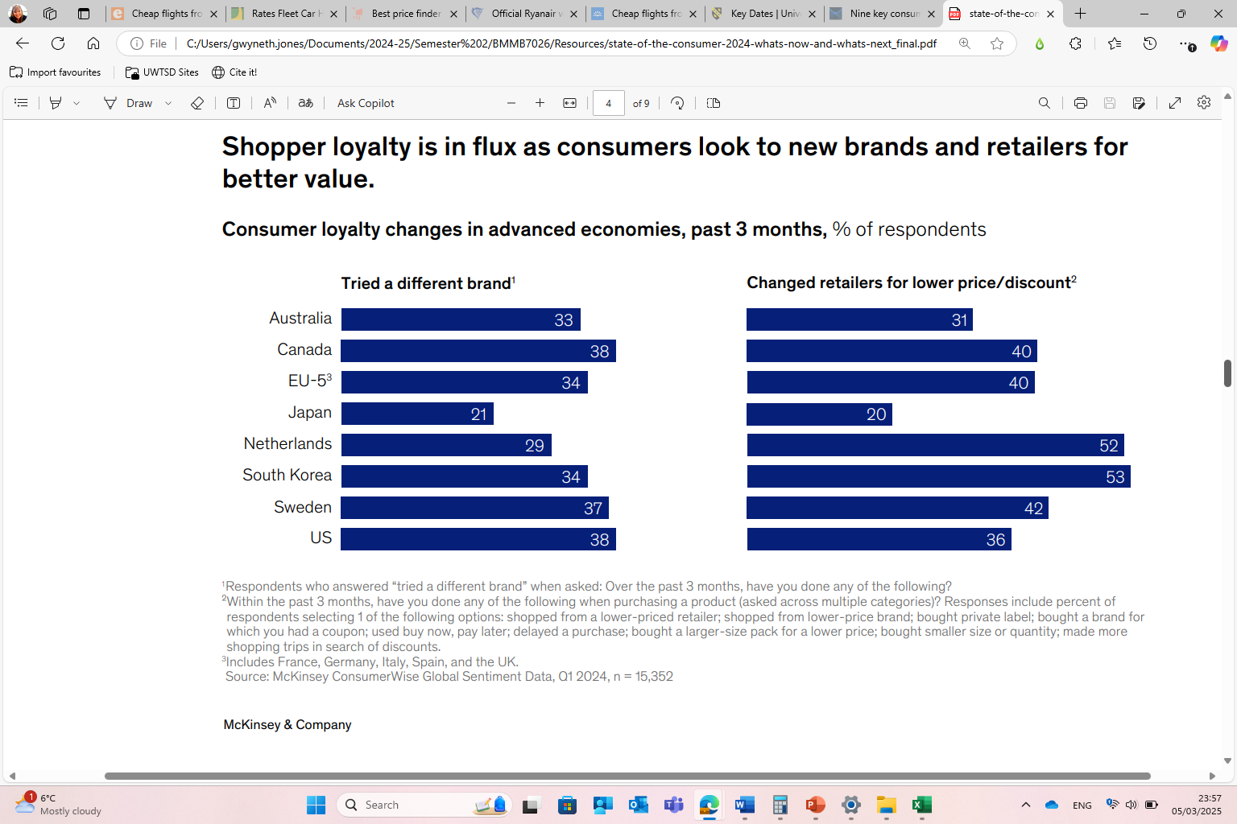

Slide 29
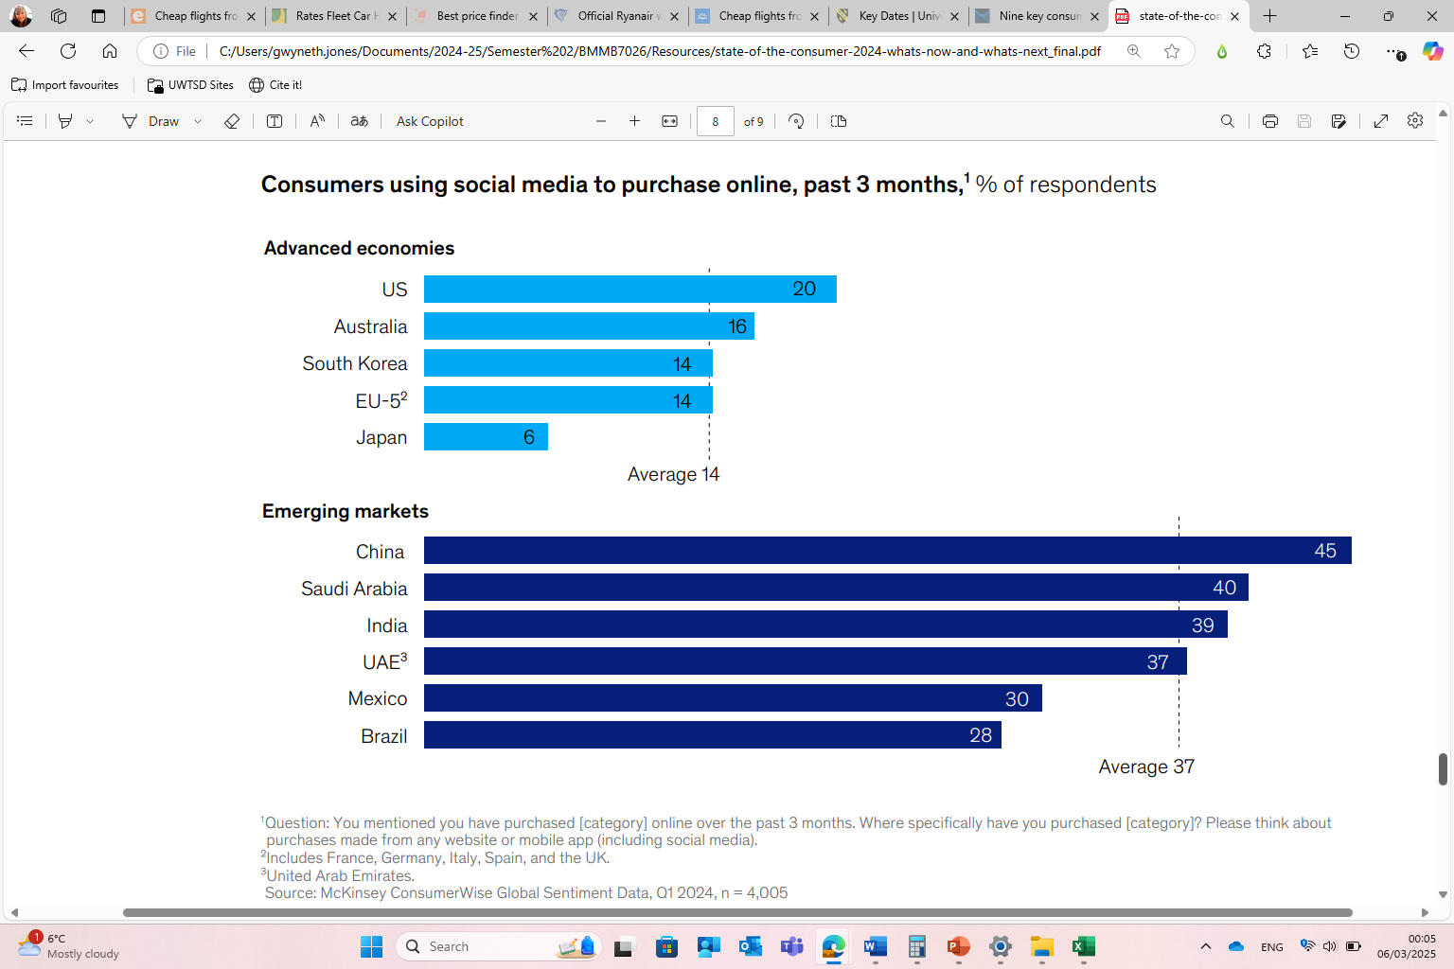

Slide 30
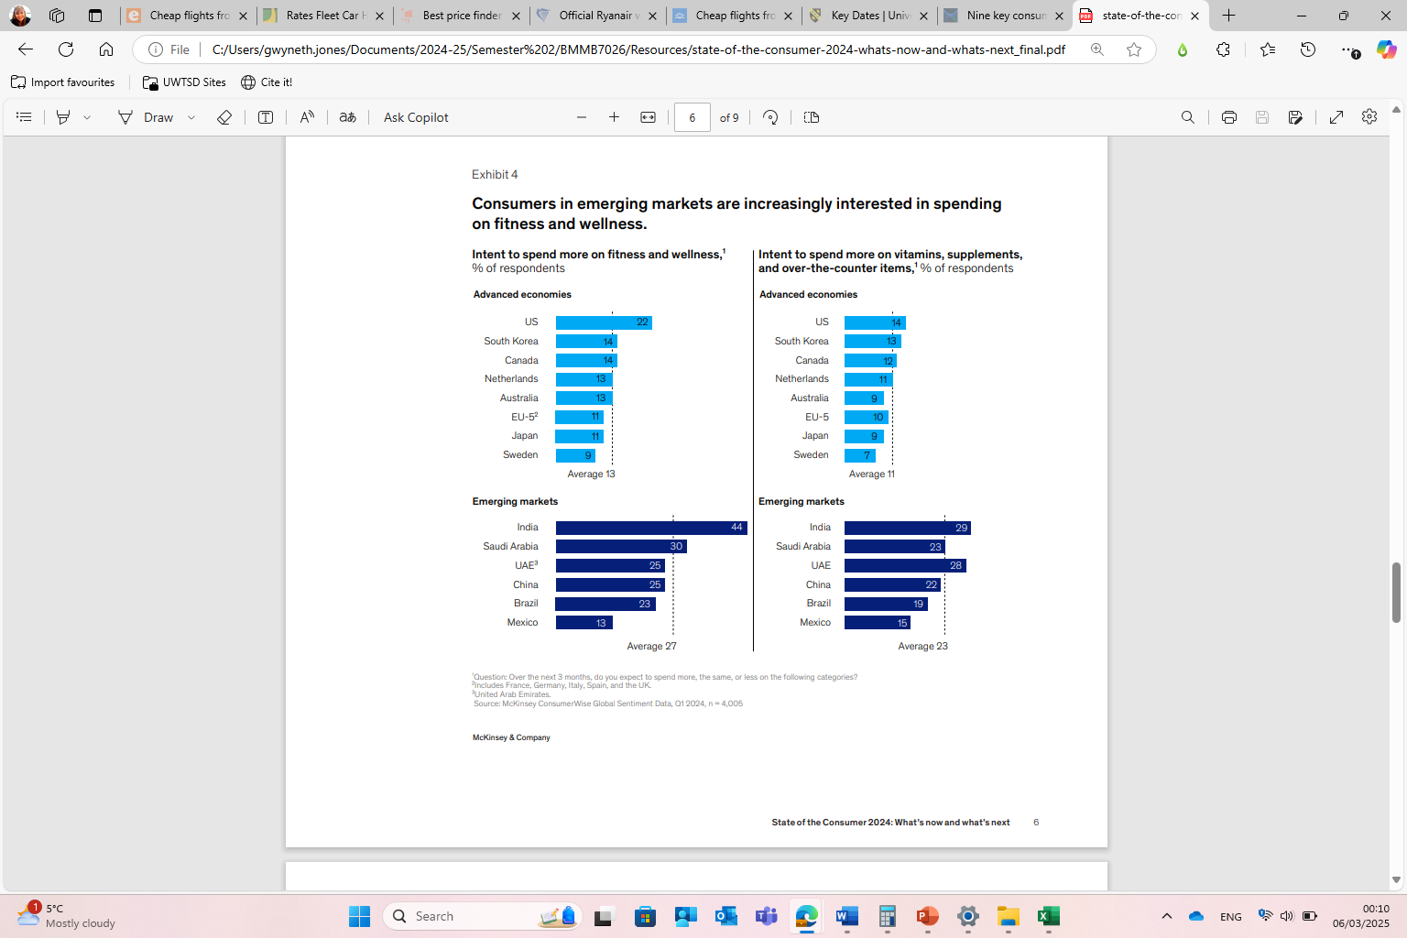

Slide 31
Generic Buyer roles
There are five generic buyer roles – Known as a DMU (Decision Making Unit)
Role | Description
Initiator | Person who begins the process of purchase consideration May collect information to aid decision making
Influencer | Person who attempts to persuade others to make a particular purchase Often gather information to aid their argument
Decider | Person who holds power or financial means necessary to make the final purchasing decision
Buyer | Person who will actually make the purchase
User | The final consumer of the purchased offering
They can be the same person or different people with any purchase

Slide 32
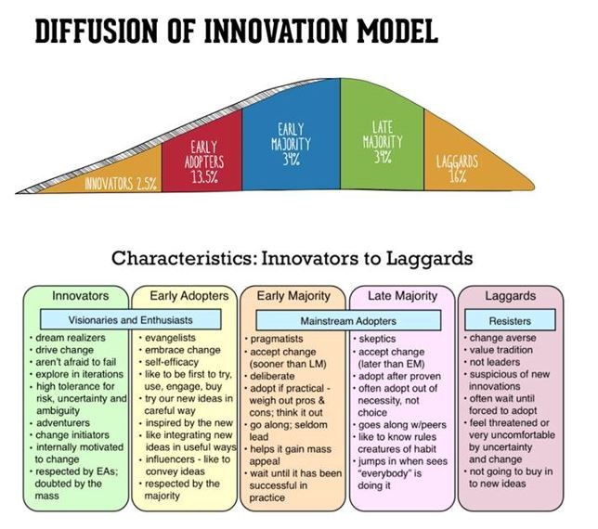
five main factors that influence adoption of an innovation
Relative Advantage - The degree to which an innovation is seen as better than the idea, program, or product it replaces.
Compatibility - How consistent the innovation is with the values, experiences, and needs of the potential adopters.
Complexity - How difficult the innovation is to understand and/or use.
Triability - The extent to which the innovation can be tested or experimented with before a commitment to adopt is made.
Observability - The extent to which the innovation provides tangible results.

Slide 33
The role of marketing
The goal of marketing is to reach consumers at the moments that most influence their purchase decisions.
Marketers seek to identify touch points, when consumers are open to influence during the decision making process (DMP).
Touch points and key buying factors resulting from the explosion of product choices and digital channels, coupled with the emergence of an increasingly discerning, well-informed consumer.
A sophisticated approach is required to help marketers navigate this environment. This is called Customer Journey Planning
Understanding Customer Journey Touchpoints | Qualtrics

Slide 34
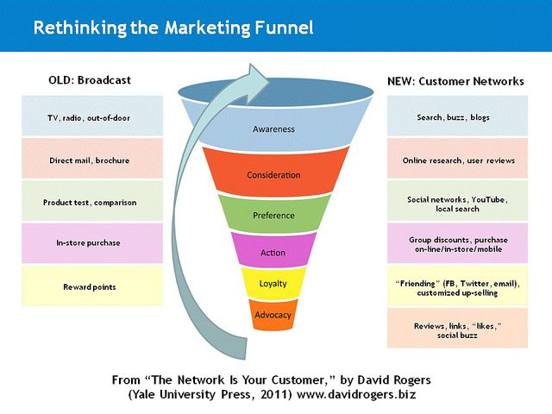
The Sales Funnel

Slide 35
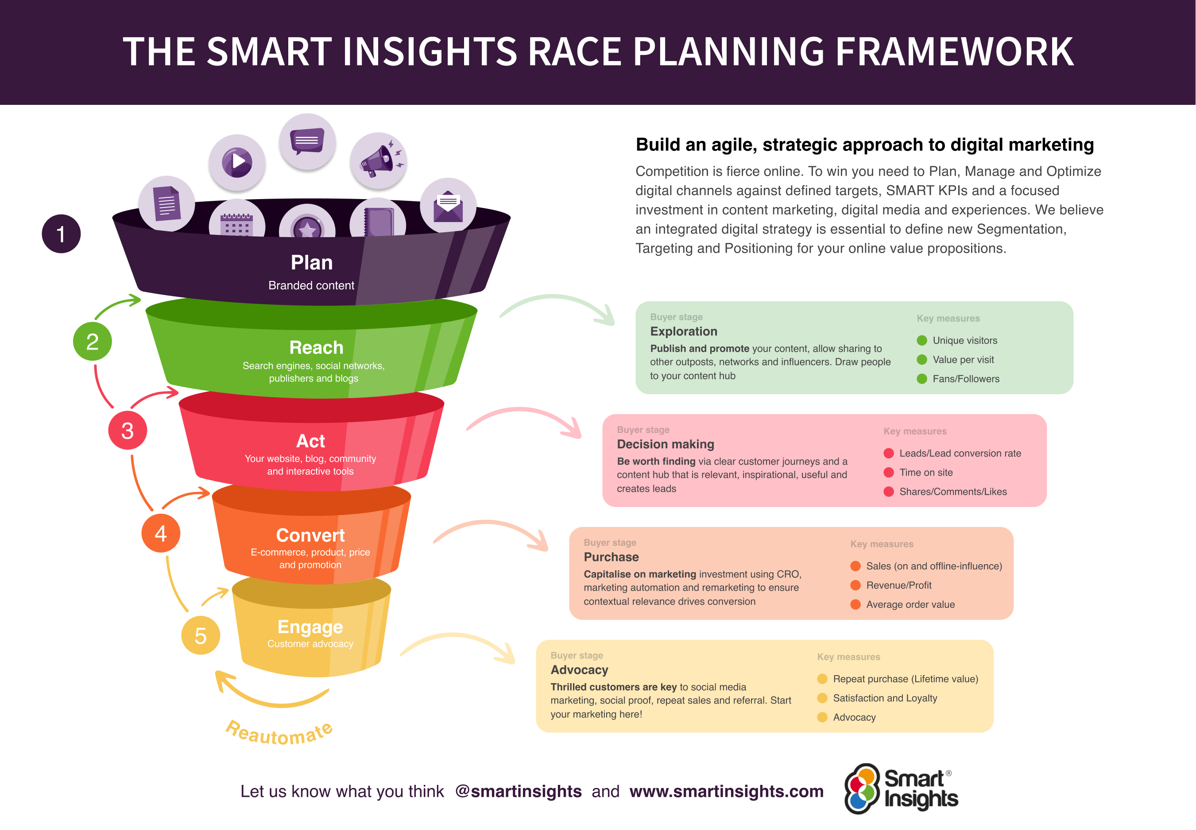

Slide 36

Customer Journey Mapping

Slide 37
What are the benefits of creating a customer journey map?
In today’s digital environment, the process of providing a service or ‘product’ is often complex, with multiple interactions taking place on different platforms to suit the customer’s needs.
Customer journey mapping is a strategic tool to ensure every interaction a customer has with your organisation is as positive as it can be.
It is useful to help identify the customer’s interaction with your organisation, their thought processes and reactions to you, which can reveal opportunities for improvement and innovation in the customer’s experience.
Customer journey mapping can help to identify how the customer is treated during each contact and how the customer feels towards your organisation at the end of the experience. This information can then be used to aid your strategic marketing decisions.
It is a key tool to help understand how customers experience the delivery of products and services, especially in terms of identifying ‘moments of truth’. These are the critical points when activities are most likely to succeed or fail.
As customers navigate touchpoints in different ways, enhancing the omnichannel experience across different platforms is essential for improving marketing. McKinsey.com claim that offering a compelling omnichannel experience is no longer a nice-to-have, but a requirement for survival.

Slide 38
What are the benefits of creating a customer journey map?
Customer journey maps help you understand your buyers’ behaviour. You can use them to quickly identify any possible snags in the journey, and any barriers to sale. They can also show you what areas of your marketing funnel are strong or need developing.
Customer journey mapping helps you get into the mind of your customers and consider their needs at each touchpoint, and as a result better predict future behaviour, wants and needs. You can then use this information to solve their ‘pain points’ with your product/brand by implementing strategic marketing tactics.
Customer journey mapping is all about ironing out these inconsistencies. It enables you to consistently and predictably manage customer behaviour.
Customer journey mapping helps you to:
  Deal with your customers more effectively
  Retain customers
  Increase efficiency
  Minimise negative customer experiences
  Deliver a consistently good service to your customer, in all circumstances

Slide 39
Benefits of customer journey mapping?
You may have excellent promotions and frontline staff, but if websites are slow or unintuitive, staff rude, premises untidy etc, then an organisation’s relationship with its customers can suffer.
Customer journey mapping is all about ironing out these inconsistencies. It enables you to consistently and predictably manage customer behaviour.
Customer journey mapping helps you to:
  Deal with your customers more effectively
  Retain customers
  Increase efficiency
  Minimise negative customer experiences
  Deliver a consistently good service to your customer, in all circumstances

Slide 40
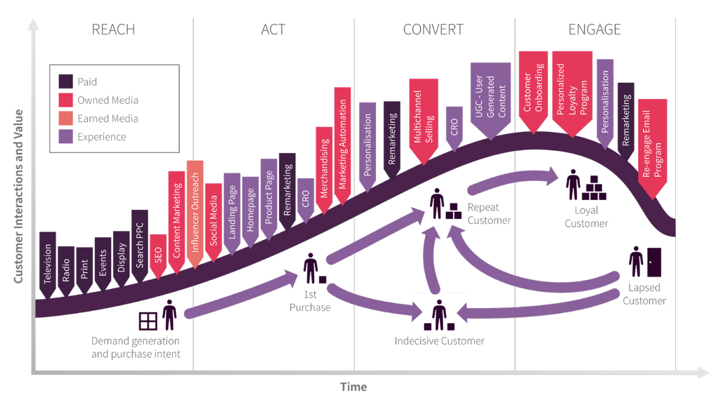
DIGITAL CUSTOMER JOURNEY MAP - SMART iNSIGHTS

Slide 41
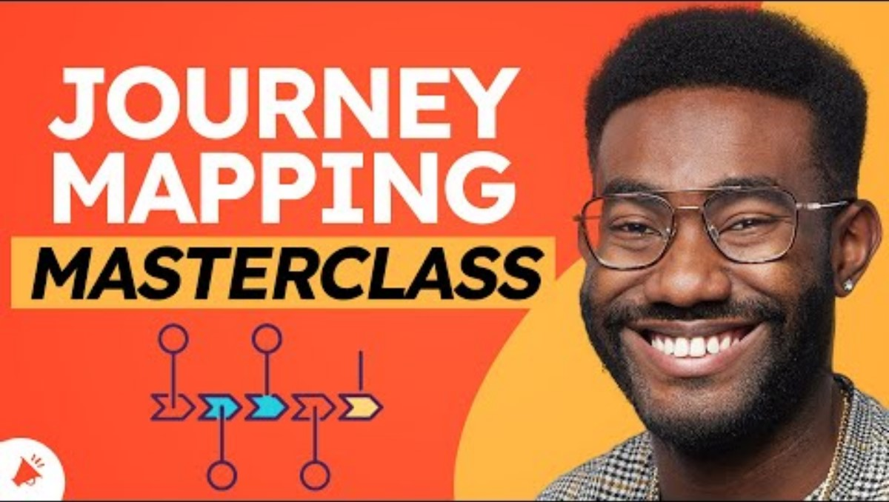

Slide 42
Analysing The Customer journey
Example 1 below from Nielsen Group shows how analysing the customer journey can help optimise the customer experience.
7 Ways to Analyze a Customer-Journey Map (nngroup.com)

Slide 43
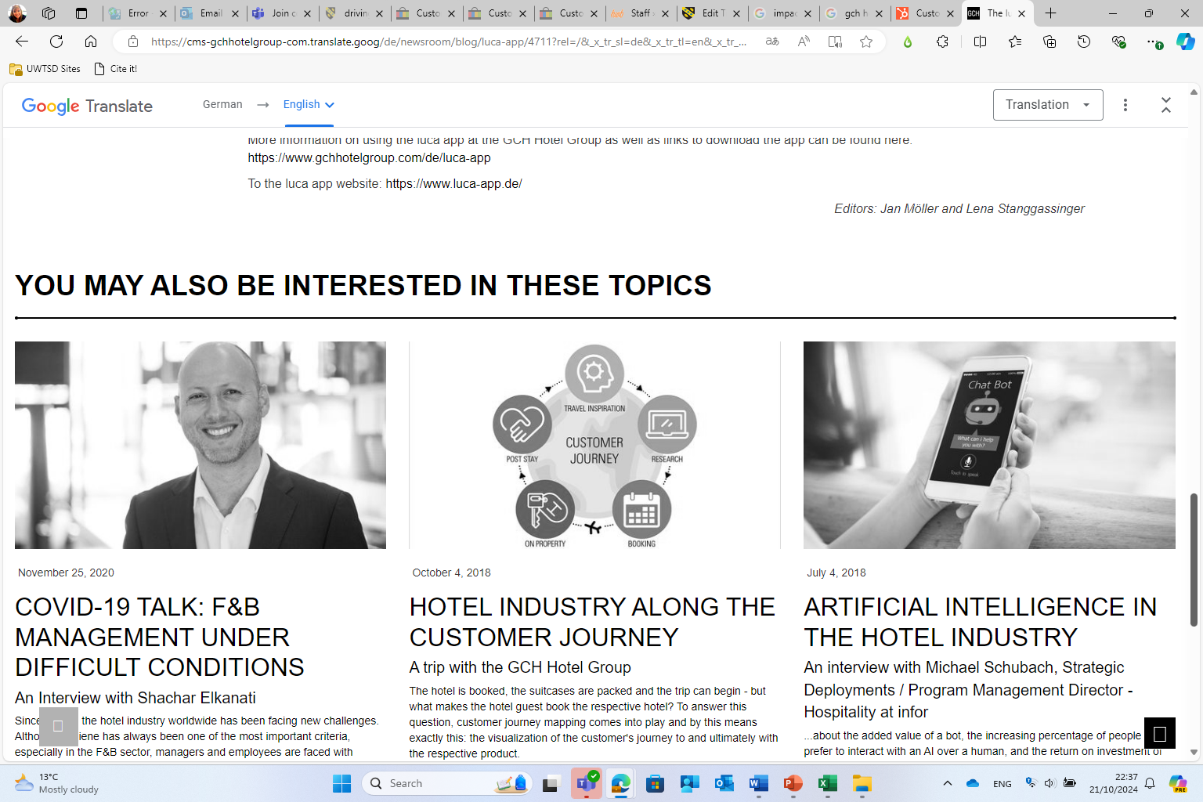
Exercise:
Consider the Customer Journey of a Hotel Guest. What strategies can be used to enhance the customer experience and develop business?

Slide 44
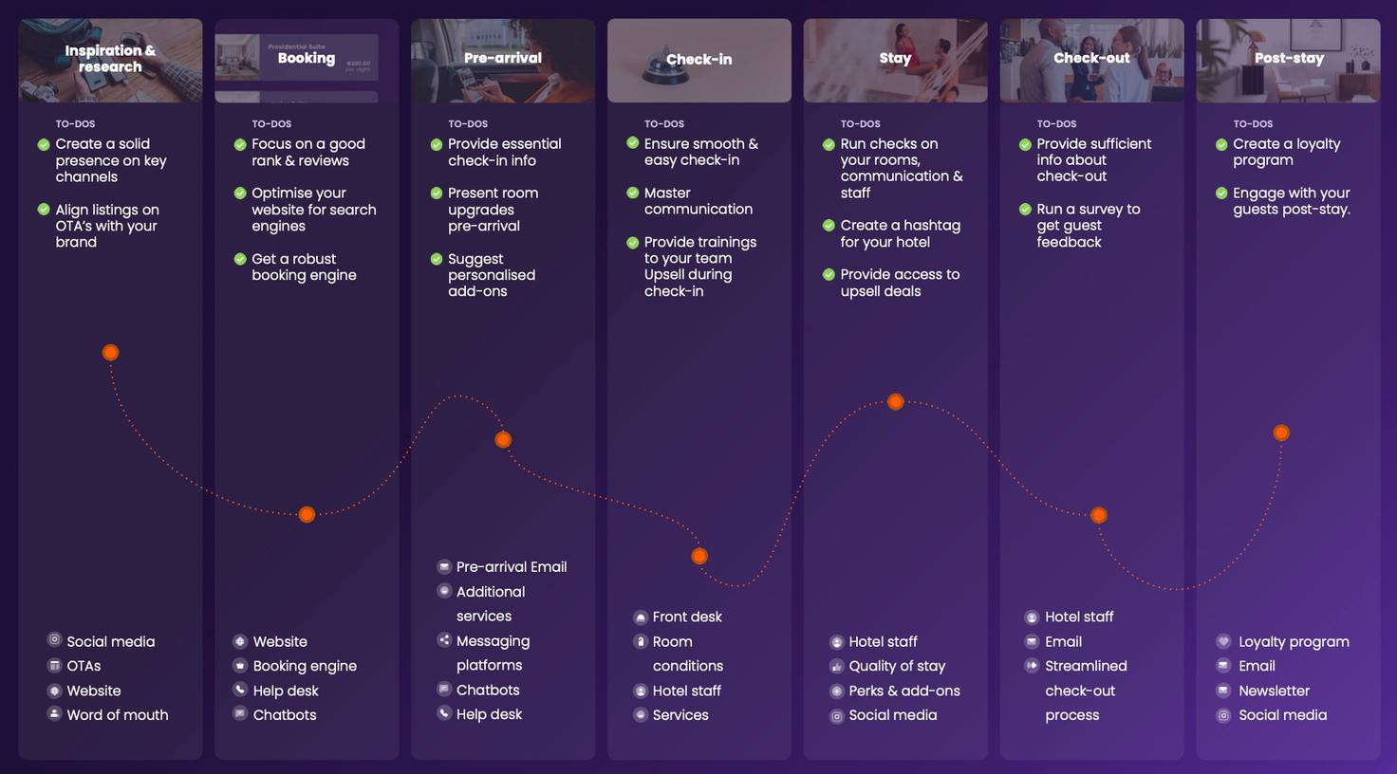

Slide 45

neuromarketing
Neuromarketing:
  Refers to the measurement of biometrics (physical and behavioural characteristics), e.g.:
    Heart rate, levels of sweating, eye tracking data, facial expressions, engagement levels
  Generates insight into customers' motivations, preferences, and decisions
  Can help inform creative advertising, product development, pricing, and other marketing areas”
  Application has ethical implications, depending on the usage and context

Slide 46
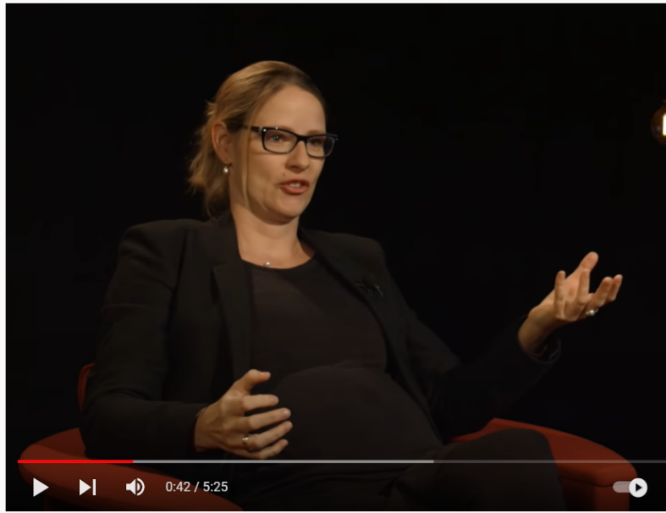
Understanding consumer behaviour – video
Hilke Plassmann
INSEAD Chaired Professor of Decision Neuroscience and Associate Professor of Marketing at INSEAD
https://youtu.be/XowaDm1GEVk

Slide 47

Neuromarketing: knowing why you buy – video
Sam Usher
He studied Engineering Psychology at Tufts University
His interest in Neuromarketing developed after working at Nielsen
https://youtu.be/hMkkVCQdoa4

Slide 48

Useful websites for secondary research
Advertising Research Foundation
http://www.thearf.org/
Datamonitor
www.datamonitor.com
Euromonitor
www.euromonitor.com
European Society for Opinion and Market Research (ESOMAR)
http://www.esomar.org/
Kantar Media – Target Group Index
http://www.kantarmedia-tgigb.com/
The British Market Research Bureau (TNS BMRB)
http://www.tns-bmrb.co.uk/
Market Research Society (MRS)
http://www.marketresearch.org.uk
Mintel International Group
http://www.mintel.com/
ICC Key Note
https://www.keynote.co.uk/about-key-note/who-we-are/

