Slide 1
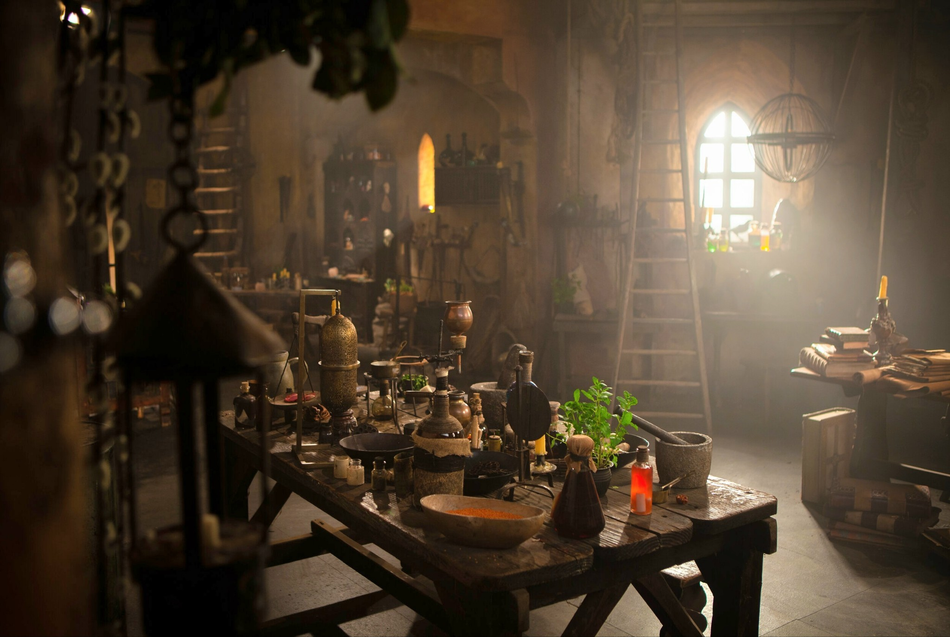
Proposal FOR MY INDEPENDENT PROJECT
By Holly Codd

Slide 2
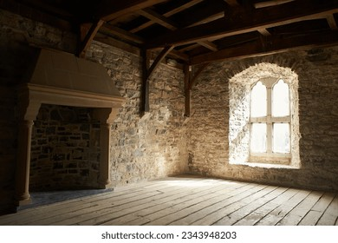
Content page
Slide One- Title page
Slide Two- Content Page
Slide Three- Proposal
Slide Four- Mediaeval Court Physician's Chambers
Slide Five- Styling
Slide Six- Candles
Slide Seven- Sunbeams
Slide Eight- Dust in the Air
Slide Nine- Bibliography

Slide 3
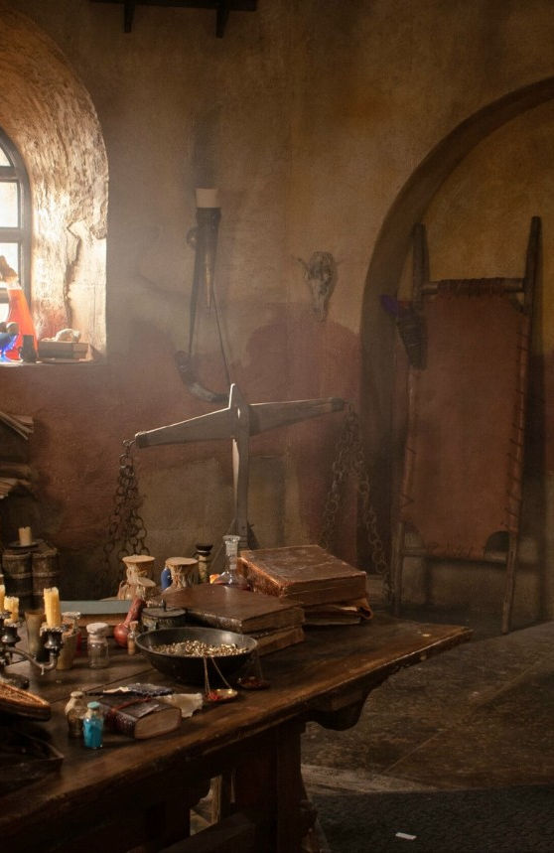
Proposal
For my independent project I want to make a 3D model of a medieval court physicians chambers.
Even though it will be environment I will incorporate some small animations into the scene.
I will use different software like maya and unreal engine to complete this project.
When I finish this project, I want it to have a feeling of calm, still, quiet, as well as can of magic feeling.

Slide 4
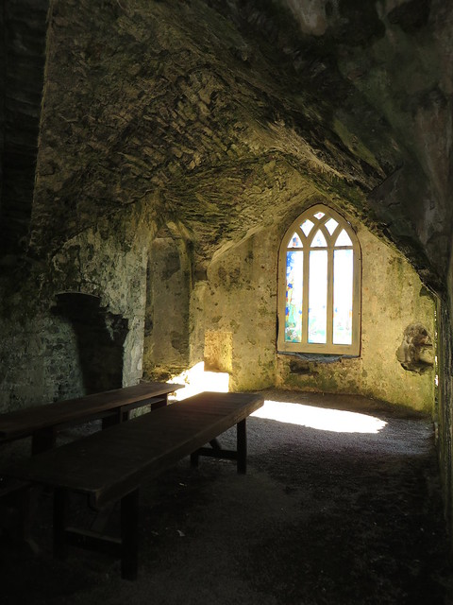
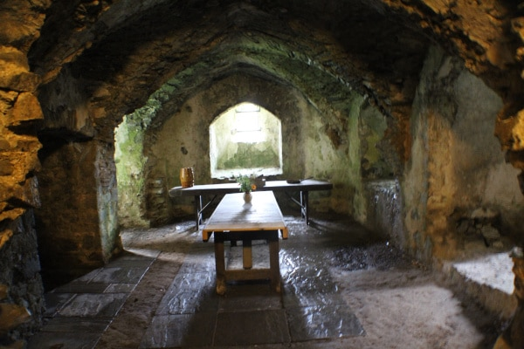
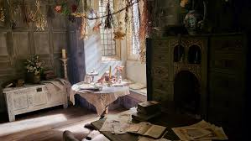
MEDIAEVAL Court Phyician's chambers
I will use ideas from different shows that I have watched as well as my own ideas and different historical sites to model my project off as there is not much images out there to compare things to from those ages of time.
Fig 6
Fig 4
Fig 5

Slide 5
Styling
When it comes to styling, I want to keep it as accurate as possible but if I can't do this I will try and keep it as simple as possible so that it doesn't stand out.
The space is going to be can of small to fit what it would have been like in the mediaeval times.
For the windows there will only be a couple, and they will be small, maybe one bigger one in the middle.
I am going to add things like an upstairs loft part with a bookcase, with a staircase leading up there. For the down-stairs I am going to add things like bookcase, a few tables, books, a cot for the ill, different medical things, candles and some planters to the area.

Slide 6

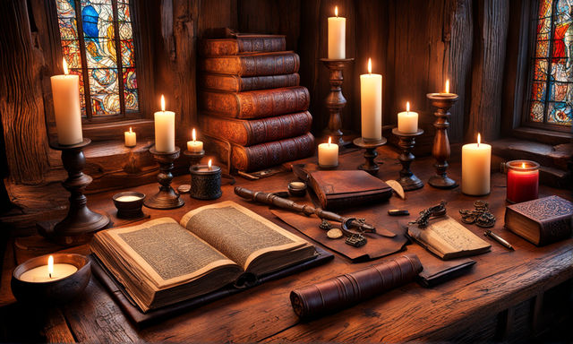
Candles
This is going to be the animation part for this project. I am going to have candles dotted around the room as one of the light sources that will give light to the room or give it some light in darker areas. I will use what I learn in class about lighting to do this.
I am going to try and make some of the candles look like they have been used and are melted. As well as make them different sizes.
Fig 7
Fig 8

Slide 7
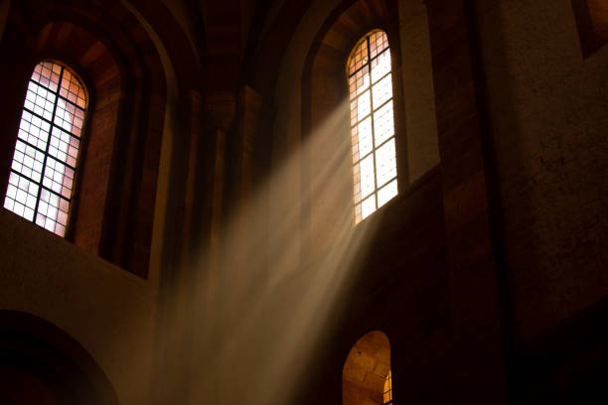
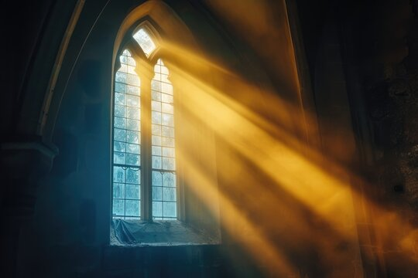
Sunbeams
I want to try and some sun beams coming through the windows. This will be the second light source. I even what to try and animated the light to make it look that it is setting and have sun set colors or dusk colors coming through that will pick up things like dust and stuff in the air.
Fig 9
Fig 10

Slide 8
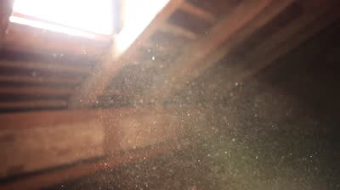
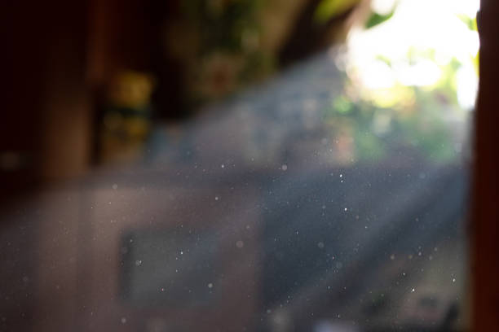
Dust in the air
I want to try and add things like dust in the air that will be picked up by 'sun' light coming through the window. If it is possible I am going to try and animated these so that they are moving around and look realistic.
Fig 11
Fig 12

Slide 9
Bibliography
[1/3] “Aroace of Spades,” Tumblr, 2019. https://chronically-enthusiastic.tumblr.com/post/760433942589472768 (accessed Oct. 21, 2024).
[2] “1,270 Medieval Room Fireplace Images, Stock Photos, and Vectors | Shutterstock,” Shutterstock, 2024. https://www.shutterstock.com/search/medieval-room-fireplace (accessed Oct. 21, 2024).
[4/5]“Carew Castle - the chapel,” Flickr, Oct. 21, 2024. https://www.flickr.com/photos/11763518@N00/10967903646 (accessed Oct. 21, 2024).
[6] “Nathalie Atkinson on Instagram: ‘[stares longingly at the set design of Tudor romantasy MY LADY JANE, sadly cancelled after just one season] 📷Production Designer #WillHughesJones SetDec #MikeWright #GinaCromwell #MyLadyJane,’” Instagram, 2020. https://www.instagram.com/jadedjournalista/p/DBRCsnpxrpI/ (accessed Oct. 21, 2024).
[7/8] “Free and customizeable a medieval table with piles of books and candles templates - Playground,” Playground, 2024. https://playground.com/design?q=a%20medieval%20table%20with%20piles%20of%20books%20and%20candles (accessed Oct. 21, 2024).
[9] Ray, “Church Window With Sunbeams Stock Photos, Pictures & Royalty-Free Images - iStock,” Istockphoto.com, 2024. https://www.istockphoto.com/search/2/image-film?phrase=church+window+with+sunbeams (accessed Oct. 21, 2024).
[10] Warm, “Sun Through Window Images – Browse 56,159 Stock Photos, Vectors, and Video,” Adobe Stock, 2024. https://stock.adobe.com/search?k=sun+through+window (accessed Oct. 21, 2024).
[11/12] Sun, “Dust Particles Sunlight Window Stock Photos, Pictures & Royalty-Free Images - iStock,” Istockphoto.com, 2024. https://www.istockphoto.com/search/2/image-film?phrase=dust+particles+sunlight+window (accessed Oct. 21, 2024).

