Slide 1

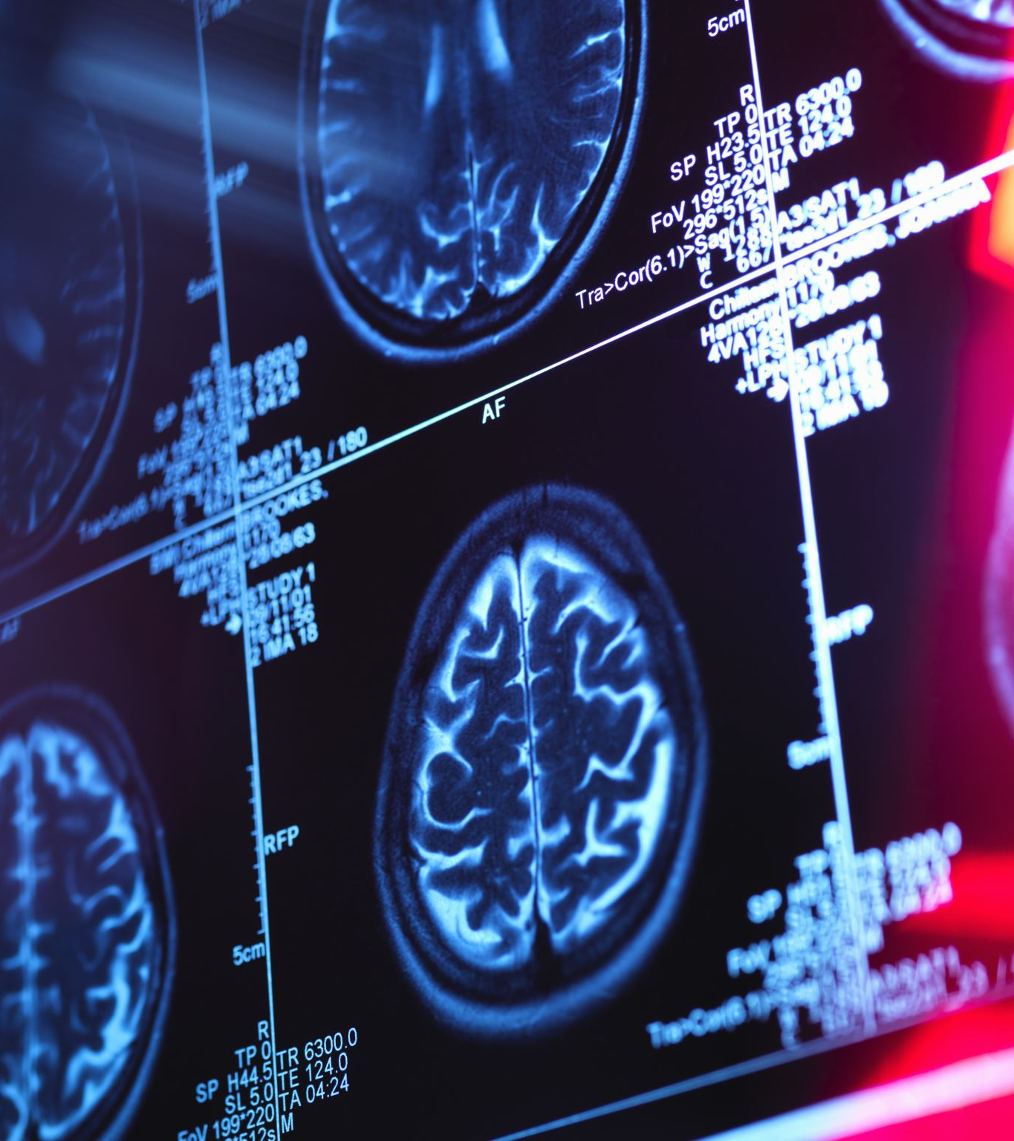

Aims/objectives of this presentation.
Define what is meant by diagnosis.
The purpose of diagnosis. Why?
What models are used in diagnosing-Biomedical and Psychiatry.
Tools used in the diagnostic process-DSM-5.
History of the DSM-5.
Where we are today with the DSM-5.
Bias and how it affects the process of diagnosing.
Labelling and its affects.

Slide 2
What is a diagnosis?
"A psychiatric diagnosis is a medical term used to describe patterns of experiences or behaviours that may be causing distress and/or be seen as difficult to understand" (The British Psychological Society. (2020).

Slide 3

The purpose of a diagnosis?
Effective treatment.
Effective communication.
Greater understanding.
Having a term can be validating.
(DSM-5,2013).

Slide 4
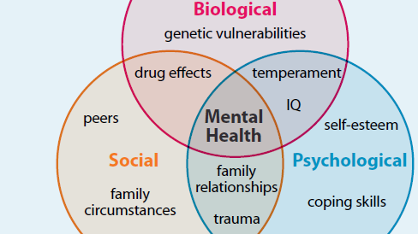
What model is diagnosis based upon?
Biomedical psychology argues that every mental health condition must come from an underlying physical cause.
Treatment can be used in order to change the physical state of the body.
Biomedical does not consider Psychological interventions into account E.g. CBT (Ogden.J 2000).
The biopsychosocial model argues that illness is caused by biological, psychological and social factors (Engel,1997,1980).

Slide 5
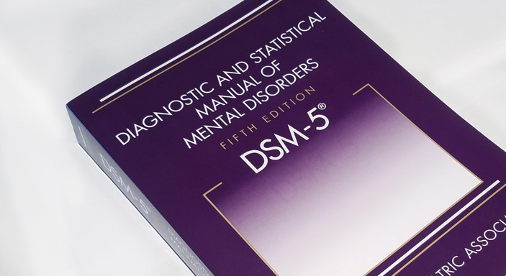
Tools that are used in the diagnostic process?
Psychiatrists/Doctors use the DSM-5 as a framework for diagnosing mental health conditions.
The DSM-5 is based on the biomedical model.
DSM-5 assists in making a clear/reliable diagnoses. Using categorize systems (Davison et al.,2004).
DSM-5 is a valuable framework for professionals to support the development of treatment plans.
Despite the DSM-5 being extremely useful it is not without its drawbacks (Scull, 2016).

Slide 6
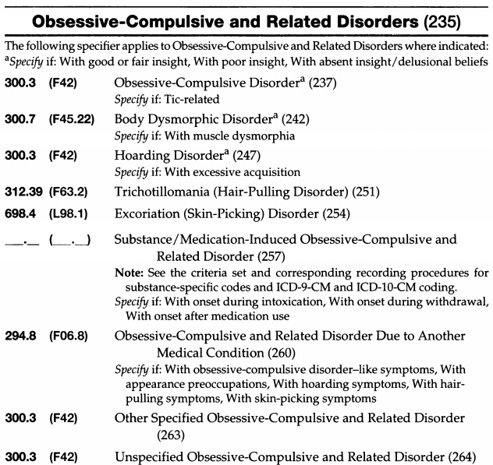
DSM5 is used to diagnose mental health issues.
It diagnoses many different mental health issue.
Helps psychiatrists to see what the conditions could be.
Psychiatrists use as a guideline to see if treatment is needed.
Gives guidance to the treatment that is needed for example antipsychotic medication.
Extract from DSM5
Stanley Jones 1906612

Slide 7
The History of DSM5
Predecessor 1844
More guess work and wrongly diagnosed people.
DSM3 (1980)
Was the best they could produce at the time. It improved consistence in diagnosis.
DSM5 (2013)
As good as we can produce at the moment. More research on the mental illnesses caused a need to update from the DSM3.
ICD 10 is the European medical diagnosis book. It has a wide range of conditions not just mental health conditions.
Stanley Jones 1906612

Slide 8
Rosenhan 1973
Challenging psychiatry
Sent 8 people without a current diagnosis into mental health hospitals.
They stated that they were hearing voices like empty, thud and hollow.
Once in they were admitted they acted normal.
The patients could tell that they weren’t unwell.
The nurses and the doctors didn’t seem to have a lot of interest.
It’s easier to get into a mental health hospital than get out.
Leaving they were diagnosed as in remission not as sane.
Stanley Jones 1906612

Slide 9
Antipsychiatry
Movement
Alternative approaches from psychiatry could include:
Psychology =Looking at cognitive approaches, behaviour, psychodynamic theory and humanistic approaches.
Sociological = The society of the individual being the problem not the individual themselves.
Highlighted by the Rosenhan experiment – The Great Debate.
It’s hard to ensure a diagnosis is correct.
Psychiatrists focus on medication not treating the root cause.
Psychiatrists don’t give the individual life skills to cope just offering medication reduce symptoms.
Stanley Jones 1906612

Slide 10

Where are we today with DSM5?
The DSM5 uses the Bio-medical model for diagnosis
Psychiatrists use the DSM5, using it’s criteria for a diagnosis of a mental health condition.
The Bio-medical model incorporates the biological and the medical. It looks at how the biology of an individual can contribute to a mental health issue and how medicine can alleviate symptoms.
The DSM5 allows a more concise process to diagnosis with information and criteria to establish a more consistent approach. It uses field trials to establish criteria (DSM5).
Daryl Jones 2302973

Slide 11
Bias and how it affects the process of diagnosing
Bias within the criteria - The criteria for diagnosis comes from established research however this could be inherently biased.
Culture bias - Not all cultures are the same the DSM5 addresses this within its text (briefly).
Gender bias – Again addressed in the DSM5 briefly. Not all gender biases are considered.
Bias of method (Audiotape/interview) (Chmielewski et al 2015).
Historic bias (hysteria/ homosexual) (Callard, F. 2014).
Daryl Jones 2302973

Slide 12

Missing the criteria
Not all individuals suffering form a mental health condition will hit all the criteria for a specific condition.
Individuals that are borderline can not be given a diagnosis.
Mental illness could be regarded as a spectrum of disorder.
Misunderstanding information to get a diagnosis.
Schizophrenia indicates the problem with criteria. (Gross, R 2010)
Daryl Jones 2302973

Slide 13
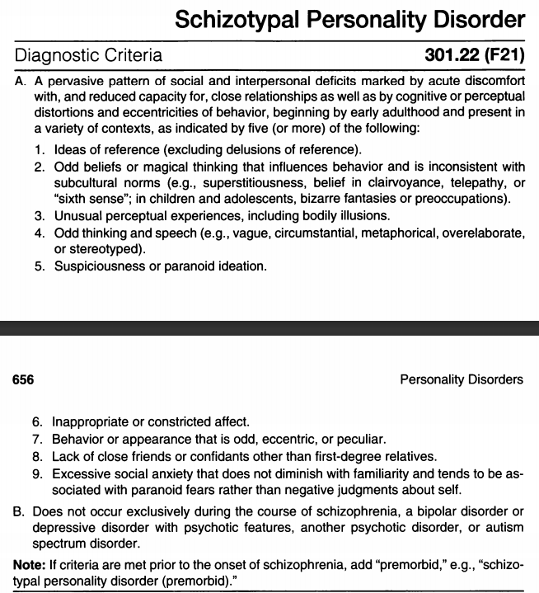
Labelling and its affects.
Stigma can cause distress to many people dealing with a mental health condition.
Individuals with the wrong diagnosis won’t get the right treatment.
Inaccurate diagnosis (Rosenhan 1973).
The benefits of diagnosis.
Treatment for individuals with mental illness can greatly help them manage their lives.
DSM5 can empower individuals to understand their condition and self manage.
Extract from DSM5
Daryl Jones 2302973

Slide 14
A BETTER APPROACH TO BIO-MEDICAL?
Biopsychosocial
Bio-medical Model
Lacks the full understanding of being an unique individual only taking into account the biological and the medical.
Psychology
Biological
Incorporates genetics, hormones etc.
Psychological looks at the cognitive processes
Social looks at the society of the individual
The biopsychosocial model encompasses the uniqueness of the individual and strives to understand what multiple factors can cause a mental health condition. By looking at the full individual, gains in understanding and treatment can be achieved.
Daryl Jones 2302973
Notes:
L

Slide 15

Conclusion
Diagnosis is a term used to define an individual's illness.
The biopsychosocial model is a more understanding model as it considers more factors than the bio-medical model.
The DSM5 is a tool that helps health professionals reach a diagnosis when diagnosing an individual, thus leading to the correct treatment or medication being given.
Rosenhan's experiment showed that without the correct observation's and information regarding one's symptoms and illness then an inaccurate diagnosis can be given.
There is certain criteria that must be met by an individual to help the psychiatrist come to a diagnosis.
Stacey Last 2004423

Slide 16
References
American Psychiatric Association. (2013). Diagnostic and Statistical Manual of Mental Disorders, 5th Edition: DSM-5 (5th ed.). American Psychiatric Publishing.
Callard, F. (2014). Psychiatric diagnosis: the indispensability of ambivalence. Journal of Medical Ethics, 40(8), 526–530. https://doi.org/10.1136/medethics-2013-101763
Chmielewski, M., Clark, L. A., Bagby, R. M., & Watson, D. (2015). Method matters: Understanding diagnostic reliability in DSM-IV and DSM-5. Journal of Abnormal Psychology, 124(3), 764–769. https://doi.org/10.1037/abn0000069
Davison, G.C.,Neale,J.M. & Kring,A.M.(2004) Abnormal Psychology (9th edition). New York: John Wiley & Sons,Inc
Engel.G.L.(1980) The clinical application of the biopsychosocial model.American Journal of Psychiatry,137,535-544.
Engel,G.L.(1997) The need for a new medical model: A challenge for bio-medicine.Science,196,129-135.
Gross, R. (2015). Psychology: The Science of Mind & Behaviour (Illustrated ed.). Hodder Education, 699-721.

Slide 17
.
Hyman, S.E. (2003). DIAGNOSING DISORDERS. SCIENTIFIC AMERICAN,INC, 97-103
Ogden, J. (2000) Health Psychobiology: a textbook (2nd edition). Buckingham: Open University Press.
Rosenhan, D. L. (1974). On being sane in insane places. Clinical Social Work Journal, 2(4), 237–256. https://doi.org/10.1007/bf01785781
Scull, A. (2016). Madness in civilization (1st ed., pp. 14-15). London: Thames and Hudson Ltd.
The British Psychological Society. (2020). Understanding psychiatric diagnosis in adult mental health [Ebook] (1st ed., p. 2). Leicester. Retrieved from https://www.bps.org.uk/sites/www.bps.org.uk/files/Member%20Networks/Divisions/DCP/Understanding%20psychiatric%20diagnosis%20in%20adult%20mental%20health.pdf

