Slide 1

Critical thinking
Week 4
BMSK5001

Slide 2
Learning Outcomes
To understand the concept of socratic questioning
To be able to analyse the differences between beliefs, attitudes and values
To understand the link between personal and organisational values
To understand how bias affects decision making

Slide 3

Six Types of Socratic Questions
Probing underlying concepts
Probing Assumptions
Probing evidence
Probe implications and consequences
Questioning underlying position
Questions about the question
Notes:
Probing underlying concepts
Get them to think more about what exactly they are asking or thinking about. Prove the concepts behind their argument. Basic 'tell me more' questions that get them to go deeper.
Here are some useful examples:
Why are you saying that?
What exactly does this mean?
What do we already know about this?
Can you give me an example?
Are you saying ... or ... ?
Probing assumptions
Probing of assumptions makes them think about the presuppositions and unquestioned beliefs on which they are founding their argument. Dig into that reasoning rather than assuming it is a given. People often use un-thought-through or weakly understood supports for their arguments.
Here are some useful examples:
What else could we assume?
You seem to be assuming ... ?
How did you choose those assumptions?
Please explain why/how ... ?
How can you verify or disprove that assumption?
What would happen if ... ?
Do you agree or disagree with ... ?
Probing the evidence
When they desribe the evidence behind the arguments, prove if those are fact are fiction. Facts are stubborn things. People often use weak, refutable evidence to support for their arguments.
Here are some useful examples:
Why is that happening?
How do you know this?
Show me ... ?
Can you give me an example of that?
What do you think causes ... ?
What is the nature of this?
Are these reasons good enough?
How can I be sure of what you are saying?
Why is ... happening?
What evidence is there to support what you are saying?
On what authority are you basing your argument?
Questioning underling position
If arguments are given from a particular position you can try not attack the arguments directly but attack the underlying foundation -- the position on which they are explicitly or implicitly based. It is important that there might be other, equally valid, viewpoints.
Here are some useful examples:
Does this approach is reasonable, justifiable?
What alternative ways of looking at this are there?
Why it is ... necessary?
Who benefits from this?
Why is it better than ...?
What are the strengths and weaknesses of...?
What are similarities between ... and ... ?
What are differences between ... and ... ?
How could you look another way at this?
Probe implications and consequences
The argument that they give may have logical implications/consequences that can be predicted. Do these make sense? Are they desirable?. Here are some useful examples:
Then what would happen?
What are the consequences of that assumption?
How could ... be used to ... ?
What are the implications of ... ?
How does ... fit with what we learned before?
Why is ... important?
Why this approach is considered to be the best ... ?
Questions about the question
Sometimes it is useful to become reflexive about the whole thing, turning the question in on itself.
Here are some useful examples:
What was the point of asking that question?
Why do you think I asked this question?
What does that mean?

Slide 4

Preparation for Research
Select A theorist
Write a report on a theory (from each theorist), explain its relation to you in your workplace, or state why it doesn’t relate to you. Supply references in your report.
How could this fit in with your assignment?

Slide 5

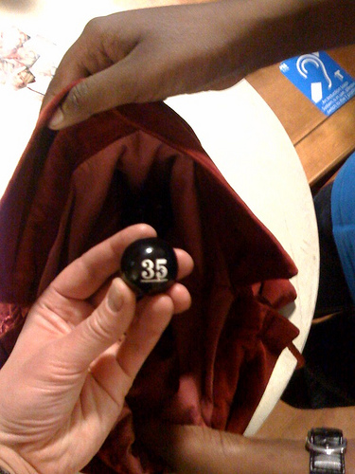
Session on 11th March – The ‘Theorists’ Draw!’
1.John Adair | 8.Frederick Herzberg
2.Charles Handy | 9.Rensis Likert
3.Henry Mintzberg | 10.Edward de Bono
4.Douglas McGregor | 11.Stephen Covey
5.Daniel Goleman | 12.W. Edwards Deming
6.Elton Mayo | 13.Reginald Revans
7.Henri Fayol | 14.Max Weber
Notes:
Tutor to use whatever method they prefer to conduct a ‘draw’ where each student will have one theorist to prepare a report on – approx. 500 words – ready for a group discussion and review at the next session. Make a note of ‘who’ has ‘which theorist. Several students can have the same theorist – it only adds to the debate, and it is critical thinking we are interested in….not necessarily the individual theories.

Slide 6
Theorists – Collate the following…
Name of theorist
Brief background
Most famous theory
Other views, critiques etc
How useful in the workplace
Give a practical example of how its been applied (positive or negative)
Your opinion
Referencing

Slide 7
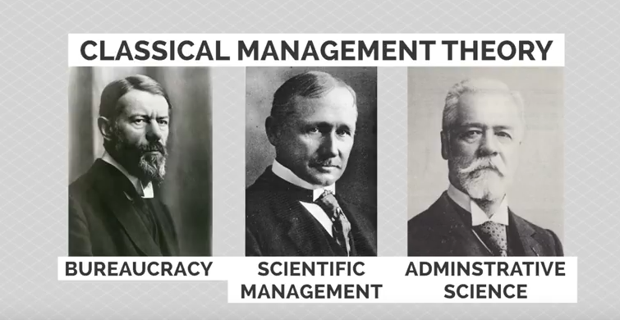
The Major Schools of Management Thought
Webber Taylor Fayol

Slide 8

Values Beliefs & Attitudes

Slide 9

The Relationship
Values
Beliefs
Attitudes
Behaviours
Underpinned by
Form the
basis of
Which are demonstrated through

Slide 10

Values describe and provide a means of talking about what is important to us.
Beliefs are things that we hold to be true which underpin our values. Our experience and view of the world
Attitudes are the ways a person expresses or applies their beliefs and values, and is expressed through words and behaviour

Slide 11
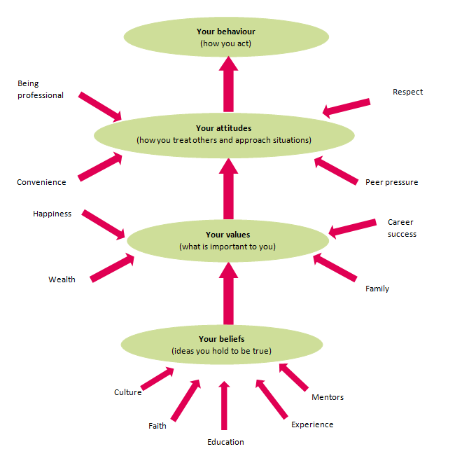
Notes:
What is a belief?
A belief is an idea that is held by a person to be true.
Belief based upon certainties, probabilities or matters of faith.
A belief can come from different sources: experiences, cultural and societal norms, what other people say (e.g. education).
A potential belief sits with the person until they accept it as truth, and adopt.
What are personal values?
Values are stable long-lasting beliefs about what is important to a person. They become standards by which people order their lives and make their choices.
A belief will develop into a value when the person’s commitment to it grows and they see it as being important.
What are attitudes?
Attitudes are the mental dispositions people have towards others and the current circumstances before making decisions that result in behaviour. People primarily form their attitudes from underlying values and beliefs.
However, factors which may not have been internalised as beliefs and values can still influence a person’s attitudes at the point of decision-making. Typical influences include the desire to please, political correctness, convenience, peer pressure.

Slide 12

Where do values come from?
Our values come from a variety of sources. Some of these include:
Family
Peers (social influences)
The workplace
Educational institutions such as schools
Significant life events (death, divorce, losing jobs, major accident and trauma, major health issues, significant losses)
Major historical events (world wars, economic depressions, etc).
Religion
Music
Media
Technology
Culture

Slide 13

Values & their benefits
Helps us understand why we believe what we do and if we wish to change it.
Shared Values are the basis of relationship
They can motivate us –if we value something we will go after it.
Knowing our own values makes us more tolerant of others
They help to give lives meaningful significance

Slide 14
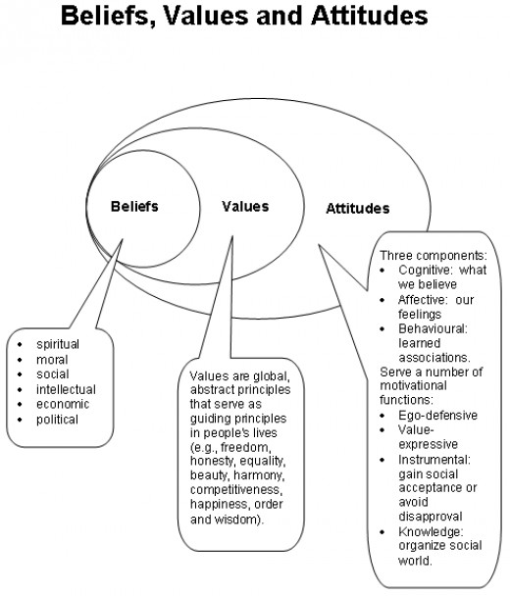

Slide 15

Values
Foundation Values - (these are needed in order to have a solid foundation to our lives)
Focus Values – (These are those value priorities in our lives that inform attitude to relationships and decision making)
Future Values – (They represent what is important to us about the future

Slide 17

Rank your values

Slide 18
The Barrett Model
Values stand at the very core of human
decision‐making. When we work in an organisationwhose culture aligns with our personal values, we
feel liberated. We are able to bring our full selves to work. We not only bring our energy, our creativity, and
our enthusiasm, we also bring our
commitment to the well‐being of our
associates and the success of the
organisation. Unleashing this energy is
tantamount to liberating the corporate soul.
(Barrett, 2010)

Slide 19

What is a personal value?
Values are stable long-lasting beliefs about what is important to a person. They become standards by which people order their lives and make their choices.
A belief will develop into a value when the person’s commitment to it grows and they see it as being important.

Slide 20
Organisational values
Identifying individuals and companies values can help to create “win – win” outcome as individuals find meaning to their work and organisations get a committed work force that functions well.
Value led organisations outperform others; growth in revenue, rate of job creation is higher, growth in stocks is higher, profit performance is higher and turn over is lower
Kotter and Heskett ( reported in Dearlove and Coomber,1999)
Being an values led organisation also leads to attracting people who have the same values and keep people who feel fully committed

Slide 21

Organisational values
Organisational values are defined as essential tenets and guiding principles not specific cultural or operating practices. Some of the most common values found in organisations are: integrity; respect; customer focus; quality; creative/ innovative; accountability and fairness.

Slide 22

Aligning individual and organisational values
Individual’s values drive their behaviours as its emotionally connected to them not just ‘What's In It For Me’ (WIIFM)- giving the feel- good factor.
Applying the same principal to organisations as values guide the actions of value led organisations – there is less need for detailed procedures and management control and individuals are allowed to make decisions within the framework of the organisation.
As shared values provide a reference point.

Slide 23
Examples
A social worker who chooses this line of work because they want to care for people
A social worker who chooses a particular local authority to work for because they value training and development
A banker who leaves their job because of unethical practice within the firm
An administrator who applies for a job in a social enterprise because they dislike profit maximisation

Slide 24
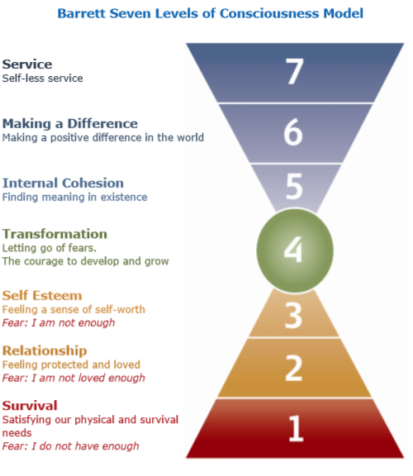
Barrett Model
Notes:
Our values reflect what is important to us. They are a shorthand way of describing our individual motivations. Together with our beliefs, they are the causal factors that drive our decision-making.
Values can be positive or fear-based (limiting). For example, honesty, trust and accountability are positive values, whereas blame, revenge and manipulation are potentially limiting, or fear-based, values.
Personal mastery involves overcoming or eliminating our fear-based beliefs. When our beliefs or behaviours are out of alignment with what is really important to us - our values, we lack authenticity.
Every human being on the planet grows and develops within seven well defined areas. These areas are defined in the Barrett Seven Levels of Consciousness Model Each area focuses on a particular need that is common to all people. The level of growth and development of an individual depends on their ability to satisfy these needs.
At different times you may find that you focus more on some levels and less on others, in response to changing life conditions. It is important to understand that in terms of the seven areas higher is not better; for example it will be difficult for you to focus on helping others if you are having health and money problems.

Slide 25
Assessing your own Values
https://www.valuescentre.com/our-products/products-individuals/personal-values-assessment-pva
Identify 10 values that best describe you
Complete the assessment at home
Complete the on-line course

Slide 26
Activity
Compare your values with those for the chosen organisation
Is there a conflict between your values and that of the organisation?
Would you choose to work here? Why/why not?

Slide 27
Ikea’s Values
IKEA culture
IKEA culture reflects Swedish roots coming from Småland in southern Sweden. People living here are hard-working, down-to-earth, help each other and live in a close contact with nature around. These aspects are translated into IKEA values which form the basics of IKEA culture.
IKEA Key values
We believe that every individual has something valuable to offer and we strive to have the same values in the way we work.

Slide 28

The problem with attitudes
To work effectively it is critical to understand your own values and beliefs.
In order to remain professional it is necessary to leave our personal values out of the professional relationship.
One of the problems with our attitudes is we often ignore any information which is not consistent with them—we become selective in the way we perceive and respond to events and issues—and lose our ‘objectivity’ about the world.
We need to develop an insights about our attitudes in order to reduce the risk of making decisions at work based on our unconscious, pre-existing perceptions, allowing us work more professional.

Slide 29
Cognitive Biases
We are each entitled to our own personal world view.
Unfortunately, when it comes to interpreting information and making objective sense of reality, human brains are hard-wired to make all kinds of mental mistakes that can impact our ability to make rational judgments.
In total, there are 180+ cognitive biases that mess with how we process data, think critically, and perceive reality.
(WEF, 2018)

Slide 30
Activity (30 minutes)
Listen to the extract and tick true or false to the following statements.
Notes:
Witches of Glum exercise.

Slide 31
Michael Shermer – Why People believe weird things
https://www.youtube.com/watch?v=8T_jwq9ph8k

Slide 32
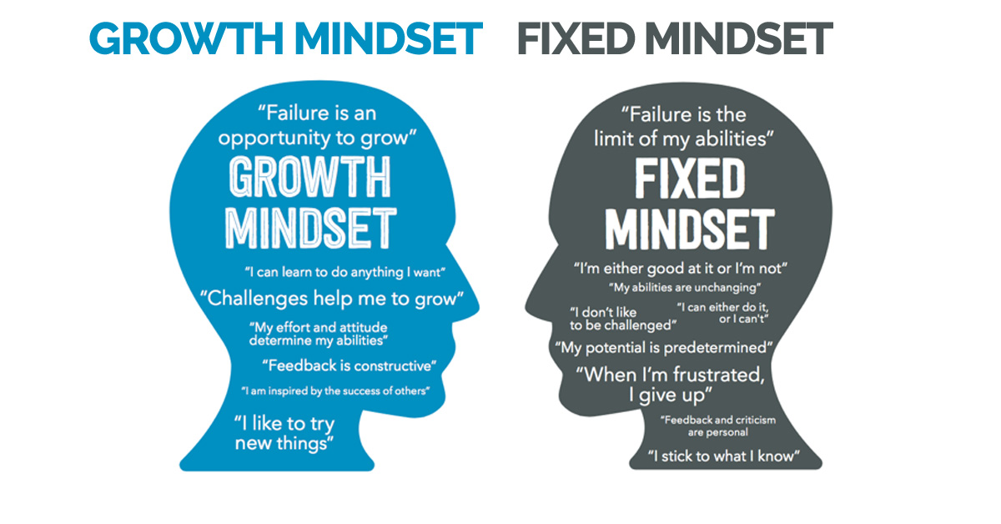
Notes:
WEF (2017)
When it comes to success, it’s easy to think that people blessed with brains are inevitably going to leave the rest of us in the dust. But new research from Stanford University will change your mind (and your attitude).
Psychologist Carol Dweck has spent her entire career studying attitude and performance, and her latest study shows that your attitude is a better predictor of your success than your IQ.
Dweck found that people’s core attitudes fall into one of two categories: a fixed mindset or a growth mindset.
With a fixed mindset, you believe you are who you are and you cannot change. This creates problems when you’re challenged because anything that appears to be more than you can
People with a growth mindset believe that they can improve with effort. They outperform those with a fixed mindset, even when they have a lower IQ, because they embrace challenges, treating them as opportunities to learn something new.

Slide 33

The difference between personal and professional ethics
Personal ethics refers to the ethics that a person identifies with in respect to people and situations that they deal with in everyday life.
Professional ethics refers to the ethics that a person must adhere to in respect of their interactions and business dealings in their professional life.
Notes:
In some cases, personal and professional ethics may clash and cause a moral conflict. For example:
A police officer may personally believe that a law that he is required to enforce is wrong. However, under the Code of Conduct for the Police, he is required to obey all lawful and reasonable instructions to enforce that law.
More often than not people at work resolve moral conflicts by drawing a line between their professional and individual roles.

Slide 34

Personal ethics
As with beliefs and values, personal ethics can differ widely from person to person.
In other words, personal ethics are standards by which a person judges behaviour as being ‘right’ or ‘wrong
Ethical expectations often take the form of principles such as:
• concern for the well-being of others
• respect for others
• trustworthiness and honesty
• compliance with the law
• preventing harm to others.

Slide 35

Professional ethics and codes of conduct
Professional ethics are principles that govern the behaviour of a person or group in a business environment. Like values, professional ethics provide rules on how a person should act towards other people and institutions in such an environment.
Ethical principles
• honesty
• trustworthiness
• loyalty
• respect for others
• adherence to the law
• doing good and avoiding harm to others
• accountability.
Notes:
Ethical principles underpin all professional codes of conduct. & may differ depending on the profession; for example, medical practitioners will differ from those that relate to lawyers or real estate agents.
However, there are some universal ethical principles that apply across all professions, including:
• honesty
• trustworthiness
• loyalty
• respect for others
• adherence to the law
• doing good and avoiding harm to others
• accountability.

Slide 36

Codes of conduct
Professional codes of conduct draw on these professional ethical principles as the basis for required standards of behaviour for members of a profession. They also seek to set out the expectations that the profession and society have of its members.
The intention of codes of conduct is to provide guidelines for the minimum standard of appropriate behaviour in a professional context. Codes of conduct sit alongside the general law of the land and the personal values of members of the profession.
Notes:
Professional codes of conduct provide benefits to:
• build public confidence in the profession’s trustworthiness
• clients can get transparency and certainty about how their affairs will be handled
• members of the profession have a supporting framework for resisting pressure to act inappropriately.
• the profession as a whole, as they provide a common understanding of acceptable practice which builds collegiality and allows for fairer disciplinary procedures

