Slide 1
Mark Huntly
m.huntly@uwtsd.ac.uk
Cloud Technologies –
Docker Compose

Slide 2
Docker Compose
Why docker compose?
  Managing containers
docker-compose.yml file
  File layout
Building services
  Staging
  Multi-stage builds
Docker compose up
Docker compose down

Slide 3
Managing Containers
We now know how to build an image and create a container from it.
  We can add storage to the container, and network it to other containers.
However, often we will want to deploy a group of containers simultaneously.
  Think a web hosting infrastructure – we'll need a database provider (e.g. MySQL, Postgresql), a web server (e.g. Apache, nginx), a database cache (e.g. Redis, Memcached).
  So far we can deploy each container individually.
  It is convenient to be able to manage, deploy, start and stop these as a group.

Slide 4
Why Docker Compose
Orchestrate running multiple containers when you need multiple services for you application to execute
For example;
  To run different environments
    e.g. Development, Testing and Production
  To run multiple containerised services at once
    e.g. database, backend server, frontend UI
Notes:
Dockerfile defines how to build, while the Compose file controls what to build with.

Slide 5
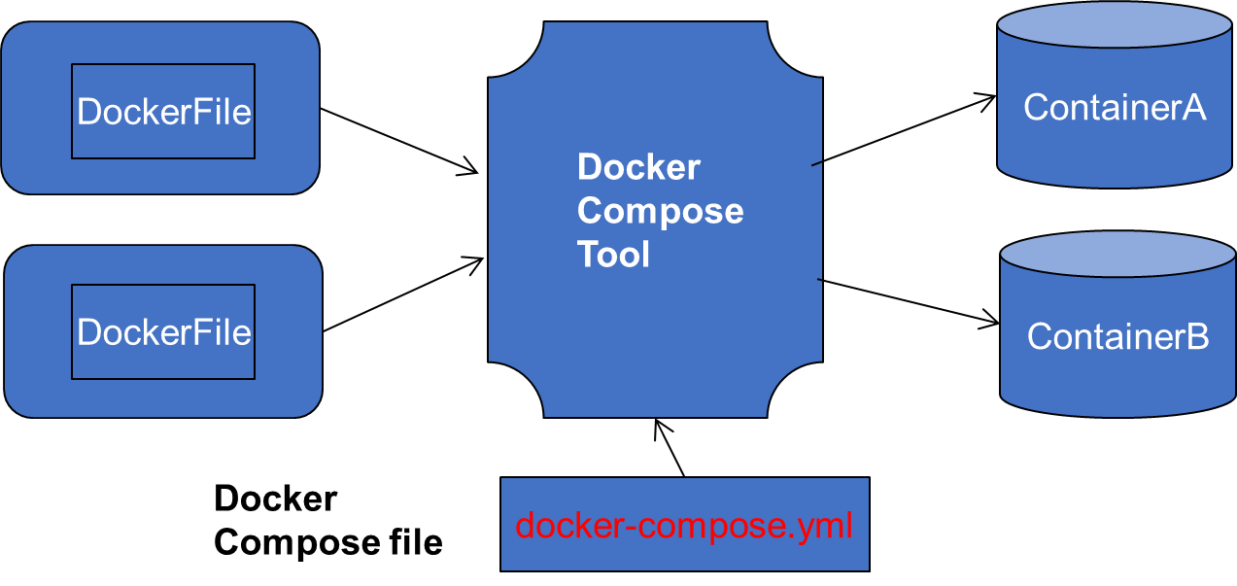
Docker Compose
Determines which services to run.
YAML file format.
Can be named anything you like.**
Docker Compose can only be executed on a single machine.
** However, Docker engine recognises docker compose / docker-compose as the default

Slide 6
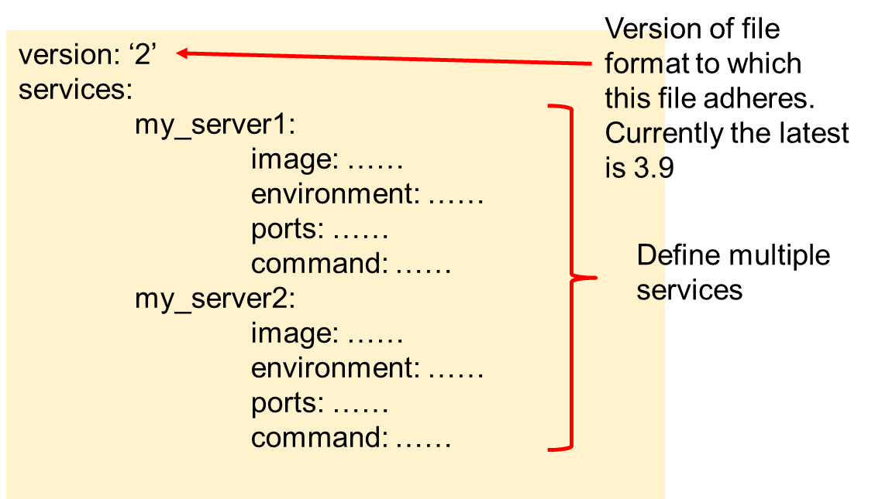
Docker Compose file
docker-compose.yml is the default.
$ docker compose up
  Otherwise the file name must be specified when executing the
  docker-compose command e.g.
    $ docker-compose up --file my_compose.yml

Slide 7
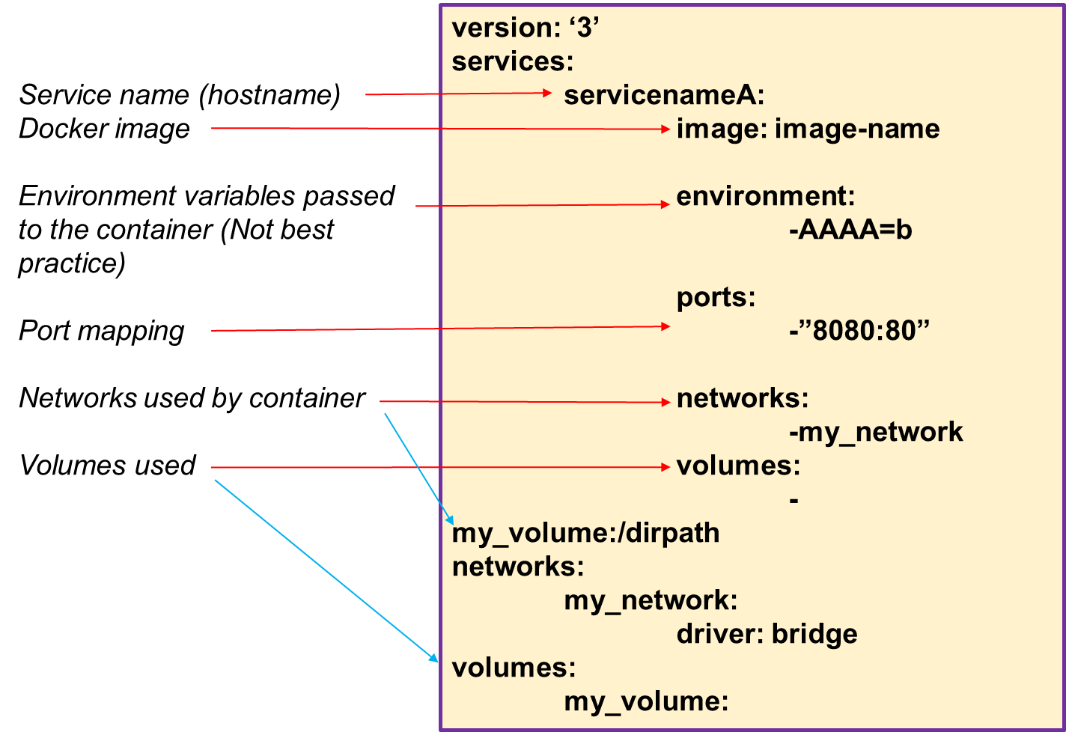
Docker Compose Layout

Slide 8
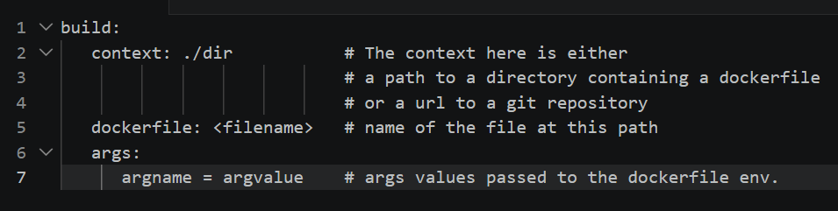
Docker-compose.yml File
Build
  Build the image for the container
  Either a string containing a path to the build context
  build: ./dir
  OR as an object with the path specified in “context” and optionally the “dockerfile” name and the ”args”
  Give your built image a name and tag using the keyword “image”
  build: ./dir
  image: my-image:my-tag
https://docs.docker.com/compose/compose-file/

Slide 9
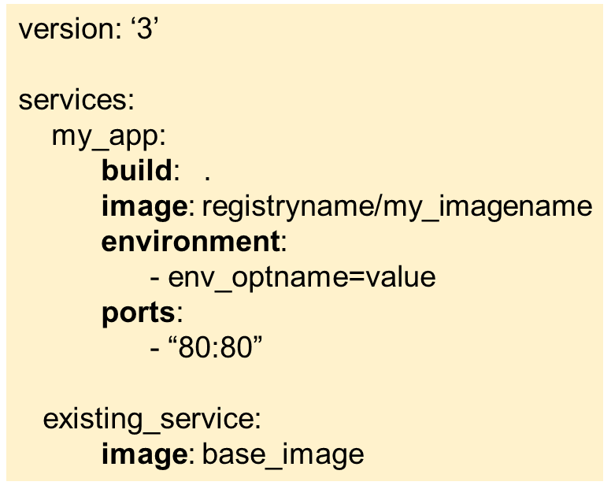
Example
Two services in this example
build: Build a custom image described in the DockerFile
. = look for DockerFile in the current directory
image: used in conjunction with build, it names the image we built e.g. the docker userID/registry name and image name we require
environment: specify an environment value for our application e.g.
BUILD_TYPE = development
ports: mapping the host port to the port number used by our application running in the container (HostPort : ContainerPort)
An existing already built baseline OS image, pulled from DockerHub

Slide 10
Example
Two services in this example
An existing already built baseline OS image, pulled from DockerHub

Slide 11
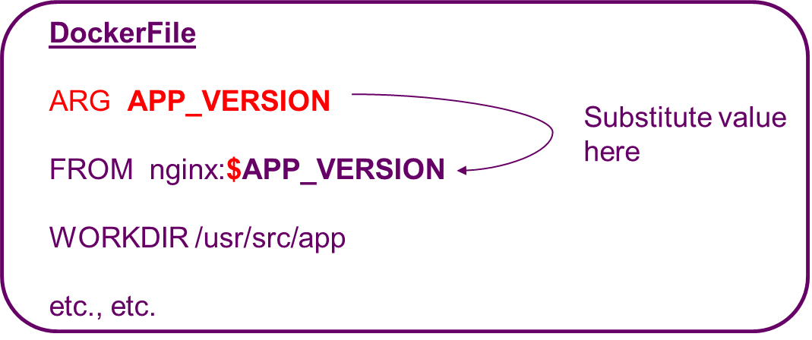
docker-compose.yml file
docker-compose.yml
build:
context: ./dir
dockerfile: filename
args:
APP_VERSION = 2.4.0-someapp4.6
Notes:
A Dockerfile on its own is essentially static — it defines a fixed set of instructions. But in reality, you often want to vary something at build time without maintaining multiple nearly-identical Dockerfiles. Build arguments solve this elegantly.
This pattern is a great example of the separation of concerns principle — the Dockerfile defines how to build, while the Compose file controls what values to build with.

Slide 12
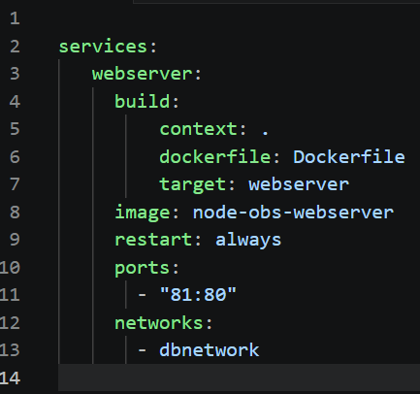

Build Specific Docker Stage
docker-compose.yml
build:
context: ./dir
dockerfile: filename
target: targetname
Example: docker-compose.yml
Directory containing the dockerfile
FROM nodeenv as webserver
EXPOSE 80
WORKDIR /var/www/node
etc., etc….
The Docker build stage name (target) is “webserver”

Slide 13
Multi-Stage Build
Dockerfiles can have multiple stages defined using multiple FROM instructions.
Each FROM build can be given an alias using the AS keyword.
We can have a multi-stage build with each stage serving a different purpose.
  Build Stage – to compile the application
  Test Stage – to run the test suite
  Production Stage – to contain the final runtime artifact
The target key lets Docker know which stage to stop at when building.

Slide 14
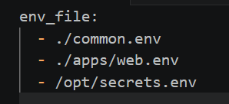
env_file
Environment variables can be placed in a separate text files
Use instead of “environment” option
somefile.env
optname=value
optname2=value2
services:
my_app:
build: .
image: my_imagename
environment:
- env_optname=value
services:
my_app:
build: .
image: my_imagename
env_file:
- ./somefile.env
Notes:
This is a simple but professionally significant pattern — separating configuration from infrastructure definition is a core principle of both twelve-factor app methodology and general cloud-native best practice

Slide 15
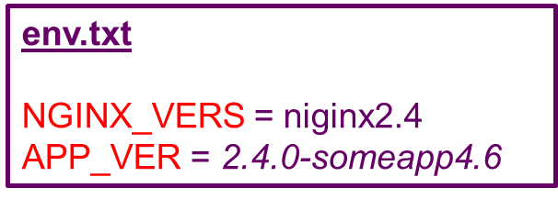
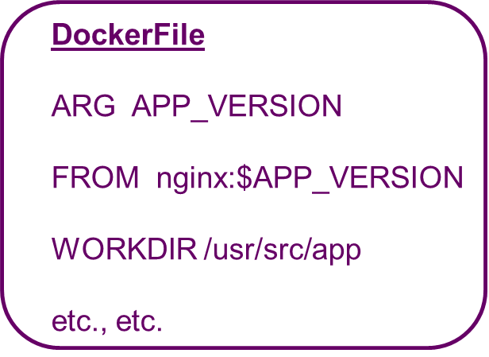
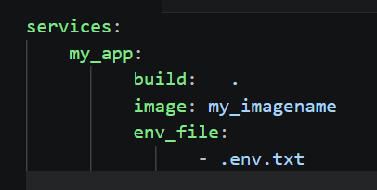
Centralising Build Decisions
docker-compose.yml
image:myrepo/${NGINX_VERS}
build:
context: ./dir
dockerfile: filename
args:
APP_VERSION = ${APP_VER}
Store all version numbers etc in one env_file
Reference them from everywhere:
  docker-compose
  dockerfile
When values need changed it can be done in one place
It is possible to have multiple env files to manage environments.
Notes:
This slide brings together several concepts we've covered — env_file, args, and Dockerfile ARG instructions — into a single pattern for centralising all build decisions in one place.
This is a hallmark of professional, maintainable Docker configuration.
One file controls everything. One change propagates everywhere.

Slide 16
Centralising Build Decisions
docker-compose.yml
image:myrepo/${NGINX_VERS}
build:
context: ./dir
dockerfile: filename
args:
APP_VERSION = ${APP_VER}
This is common practice for cloud engineers and DevOps teams.
It embodies cloud principles:
  DRY coding
  Infrastructure as Code
  Twelve-Factor App
    Seperation of config from code.
  GitOps config changes
Notes:
This slide brings together several concepts we've covered — env_file, args, and Dockerfile ARG instructions — into a single pattern for centralising all build decisions in one place.
This is a hallmark of professional, maintainable Docker configuration.
One file controls everything. One change propagates everywhere.

Slide 17
Container Naming
By default containers are named after the service name provided in the Docker Compose file (which is often the same as the image name if you are pulling a public image)
These names must be unique and are named in the following convention by Docker
projectname_servicename_instancenumber
Docker uses container names as unique identifiers for targeting containers with commands like docker exec, docker logs, and docker stop
If Compose detects a name conflict it will raise an error rather than silently overwrite an existing container.

Slide 18
Container Naming
name using the option in the Docker Compose file
container_name : my_containername
Container names become DNS hostnames on user-defined networks.
  A predictable, meaningful container name means predictable, meaningful DNS entries — database, webserver, cache rather than myproject_db_1.
version: "3"
services:
my_servicename:
container_name: ‘my_containername'
build:
context: ./bin/webserver
etc., etc.
Notes:
Scripting and automation — shell scripts and CI/CD pipelines that interact with specific containers rely on predictable names. Auto-generated names break these scripts every time containers are recreated.
Monitoring and observability — log aggregation tools like the ELK stack, and monitoring platforms like Prometheus, use container names as labels. Meaningful names produce meaningful dashboards and alerts.

Slide 19
Naming Strategy
Best practice would dictate a sensible naming convention.
  Use service names that reflect the role — webserver, database, cache, queue
  Use container_name explicitly when you need absolute predictability
  Be consistent across environments — the same service should have the same name in development, staging, and production to keep scripts and tooling portable

Slide 20
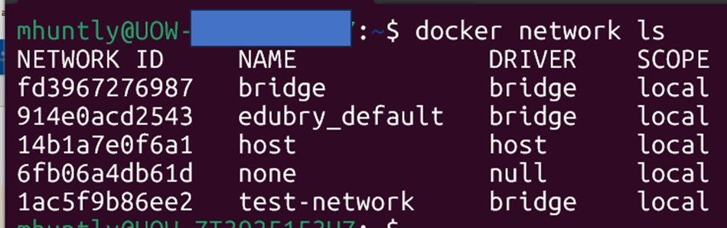
Default Network in docker-compose
If we do not specify a network, a default network is created
Containers connected to the default bridge network can communicate with each other by IP address.
Docker does not support automatic service discovery on the default bridge network.
User-defined networks should be used in stead
C:/> docker network inspect host
The containers are connected to the “default” network
User-defined networks use a built in DNS server so the name can be used in your code running the container if it needs to connect to another container
Notes:
Containers on the default network can reach each other only by IP address — not by name. And as we've established, IP addresses assigned to containers are dynamic and can change every time a container is recreated.
Docker's internal DNS server resolves containers in user-defined networks to whatever IP that container currently has — transparently, automatically, every time.
Your connection string never needs to change regardless of how many times containers are recreated or redeployed.

Slide 21
User-Defined Networks
Containers connected to a user-defined network can refer to each other by their names
  This name may be “service name” specified in the Docker Compose file i.e. to talk to each other the containers can just refer to these names
  Write your code using the “service name” when code in one container needs to connect to the other
Specify networks in Docker compose file
https://docs.docker.com/v17.09/engine/userguide/networking/#bridge-networks
Notes:
This distinction is not just a Docker configuration concern — it directly affects how you write your application code.
Any service-to-service connection string, API endpoint, or database URL in your application should use service names as hostnames, not IP addresses.
This only works reliably on user-defined networks.

Slide 22
User-Defined Networks
version: '2'
services:
web:
build: ./web
networks:
- new
worker:
build: ./worker
networks:
- legacy
db:
image: mysql
networks:
new:
aliases:
- database
legacy:
aliases:
- mysql
networks:
new:
legacy:
Create networks to connect services
You can specify IPV4 and IPV6 addresses if you wish
Containers on each network are identified by their service names. However, you can optionally use aliases (alternative hostnames) for a service per network the service is on
You can optionally specify the driver as bridge for a network on a single host or as overlay for a named network across multiple hosts
Notes:
This distinction is not just a Docker configuration concern — it directly affects how you write your application code.
Any service-to-service connection string, API endpoint, or database URL in your application should use service names as hostnames, not IP addresses.
This only works reliably on user-defined networks.

Slide 23
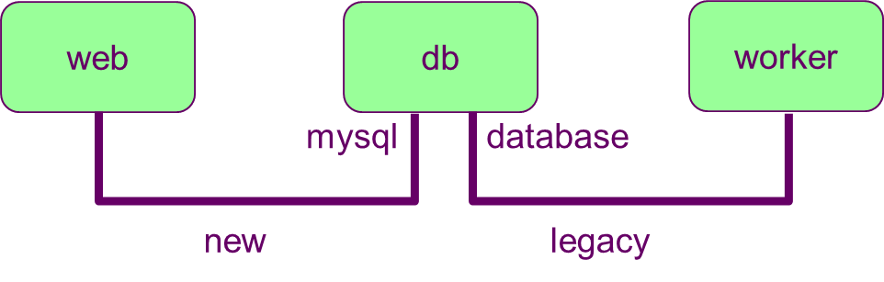
User-Defined Networks
version: '2'
services:
web:
build: ./web
networks:
- new
worker:
build: ./worker
networks:
- legacy
db:
image: mysql
networks:
new:
aliases:
- database
legacy:
aliases:
- mysql
networks:
new:
legacy:
database
mysql
Three services “web”, “worker”, “db” connected by two networks “new” and “legacy”.
The db service is reachable at the hostname db or database on the new network, and at db or mysql on the legacy network.
Notes:
This demonstrates network segmentation — a security best practice.
Services only have network access to what they need. web and worker cannot talk directly to each other, but both can reach the database.
This limits the blast radius if any single service is compromised.
Three services, two isolated network segments, one shared database reachable under different names on each network.
This is a clean, secure, production-ready architecture expressed in a remarkably small amount of YAML.

Slide 24
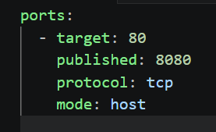
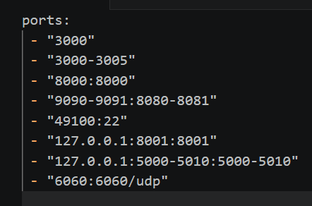
Ports
LONG FORMAT
ContainerPort e.g. “3000” (like EXPOSE but random mapping)
“HostPort:ContainerPort” e.g.
“8080:80” web server port 80 is exposed to host as 8080 i.e. use 8080 in your browser (Default protocol is TCP)
Note: In a docker compose file, when using the short format always explicitly specify your port mappings as strings.
YAML parsing of numbers produces erroneous results for port numbers less than 60 ☹
EQUIVALENT SHORT FORMAT
Notes:
target — the port inside the container that the application is listening on
published — the port on the host that external traffic hits
protocol — either tcp (default) or udp
mode — host publishes the port directly on the host; ingress is used for Docker Swarm load-balanced ports

Slide 25
Problems with Volumes
Some windows users have experienced problems with volumes.
A possible solution is to use code such as this:
Do not use flash drives
volumes:
- type: bind
source: ./source_local_directory
target: c:\target_directory
bind:
propagation: cached

Slide 26
Building the Services
Build the Docker containers, volumes and networks
docker compose build
  By default it looks for the file docker-compose.yml
Built images are cached so they do not rebuild if they have not been changed
  To turn off the caching use
  docker compose build --no-cache
Build and Run
docker-compose up will build the images if they do not already exist.
  However, if you make changes to a Dockerfile an image is based on, then this command will not rebuild that image.
  Therefore, it might be safer to explicitly force a rebuild by specifying the --build option e.g.
  docker compose up --build
https://www.youtube.com/watch?v=4EqysCR3mjo

Slide 27
Docker Compose Commands
Similar to Docker container commands
docker compose help
docker compose ps: look at running services (i.e. containers)
docker compose top
docker compose logs --follow
docker compose logs my_service --follow
docker compose start
docker compose stop
docker compose restart
docker compose build
docker compose up [--build [--no-cache]]
docker compose down
docker compose kill
docker compose rm
https://www.youtube.com/watch?v=4EqysCR3mjo

Slide 28
Docker Compose Up
Builds, (re)creates, starts, and attaches to containers for a service….only builds services that need rebuilding
  Unless they are already running, this command also starts any linked services
  Applies port mapping specified in compose file
Aggregates the output of each container (essentially running docker-compose logs -f).
When the command exits, all containers are stopped OR -d or --detach starts the containers in the background and leaves them running
docker compose up –d --build

Slide 29
Docker Compose Down
Stops containers and removes containers, networks, volumes, and images (as defined in the Compose file) created by a call to the “up” command
docker compose down
Remove the images when we finish:
docker compose down --rmi

Slide 30
Execute Command
Execute commands on already running container
docker compose exec my_service <somecommand>
Example 1: running a single command line on a container
docker compose exec unix_service ls /usr/dev
Example 2: enter a bash shell on a container
docker compose exec unix_service /bin/bash

Slide 31
Docker Compose Run
Starts container and runs one command against the service
Example1: Run the command “bash” against the service named “web”
docker compose run web bash
Example2: Run the “python” command on file “app.py” against the service named “web”
docker compose run web python app.py
  Note: in “running” a container port mapping is not applied from the compose file, if required you have to specify ports on the command line
  docker-compose run -p 8080:80 -p 2022:22 -p 127.0.0.1:2021:21 web python manage.py shell
Run and remove containers when command completes by adding –rm option
docker compose run –rm web bash

Slide 32
Docker Compose
Use cases for each command:
  Day-to-day development — docker-compose up is fine when you haven't changed Dockerfiles
  After Dockerfile changes — always use docker-compose up --build
  CI/CD pipelines — consider --no-cache to ensure reproducible, deterministic builds
  Debugging mysterious issues — docker-compose build --no-cache followed by docker-compose up eliminates caching as a variable entirely

