Slide 1
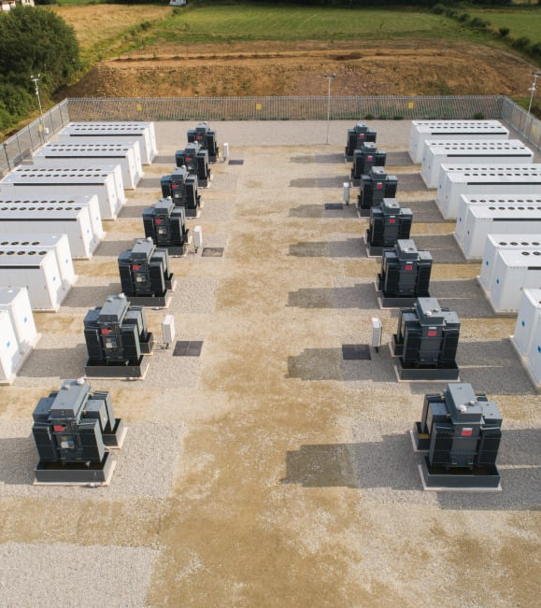
Battery storage for the energy grid
Eva Timms
Today I am going to be discussing the concept of battery storage for the energy grid in the uk. The topics are, the different types of storage, the UK’s current storage uptake and an example of battery storage in the USA.
(Harmony Energy , 2023)

Slide 2
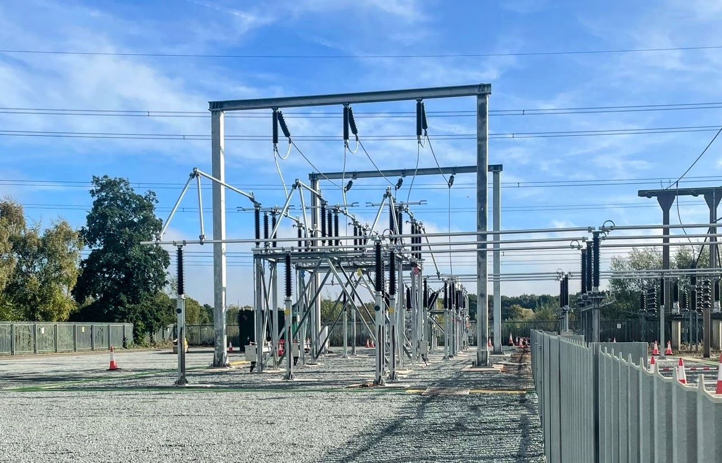
Storage technologies currently available that help carbon emission reduction
(National Grid, 2024)
I am going to be naming a few storage technologies that are currently available.

Slide 3
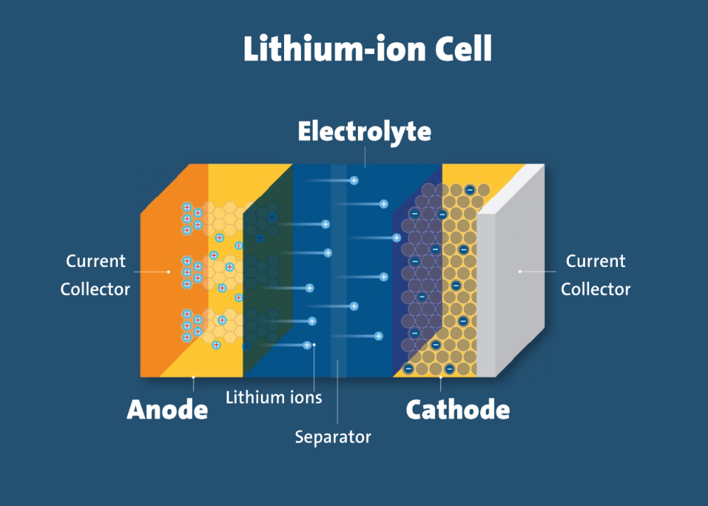
Electrochemical storage
Definition
It converts chemical energy into electrical energy it is mostly found in batteries (Ricardo, 2022).
Examples:
Lithium-ion batteries
Fuel cells
(Research Institutes, 2021)

Slide 4
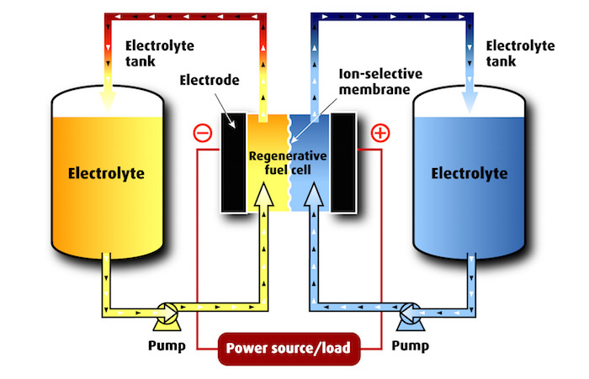
Chemical energy storage
Definition- This is converting energy from sources into a chemical form which creates a high energy fuel (Pacific Northwest National Laboratory , n.d.).
Examples:
Redox flow battery (RFB)
Hydrogen
(Electrosynthesis, n.d.)

Slide 5
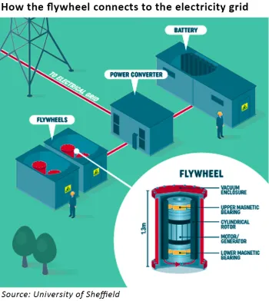
Mechanical energy storage
Definition- It converts electrical energy into kinetic or potential energy, this can be converted back to electrical energy later in the process (JRC, 2025).
Examples:
Flywheels
Pumped hydro
Pumped thermal energy storage
(Watt-Logic, 2017)

Slide 6
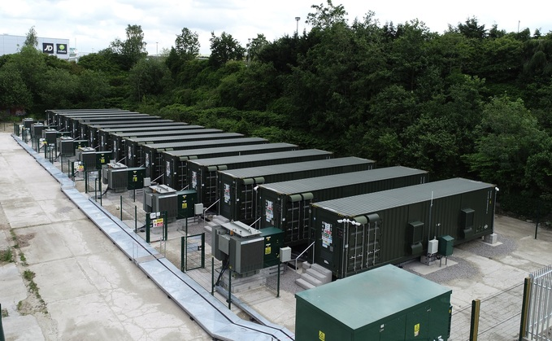
Current uptake in the UK
Currently in the UK there are projects currently undergoing for more renewable energy storage.
Examples are:
Hydrogen storage
Thermal energy storage
Battery storage
(Anesco, 2022)

Slide 7
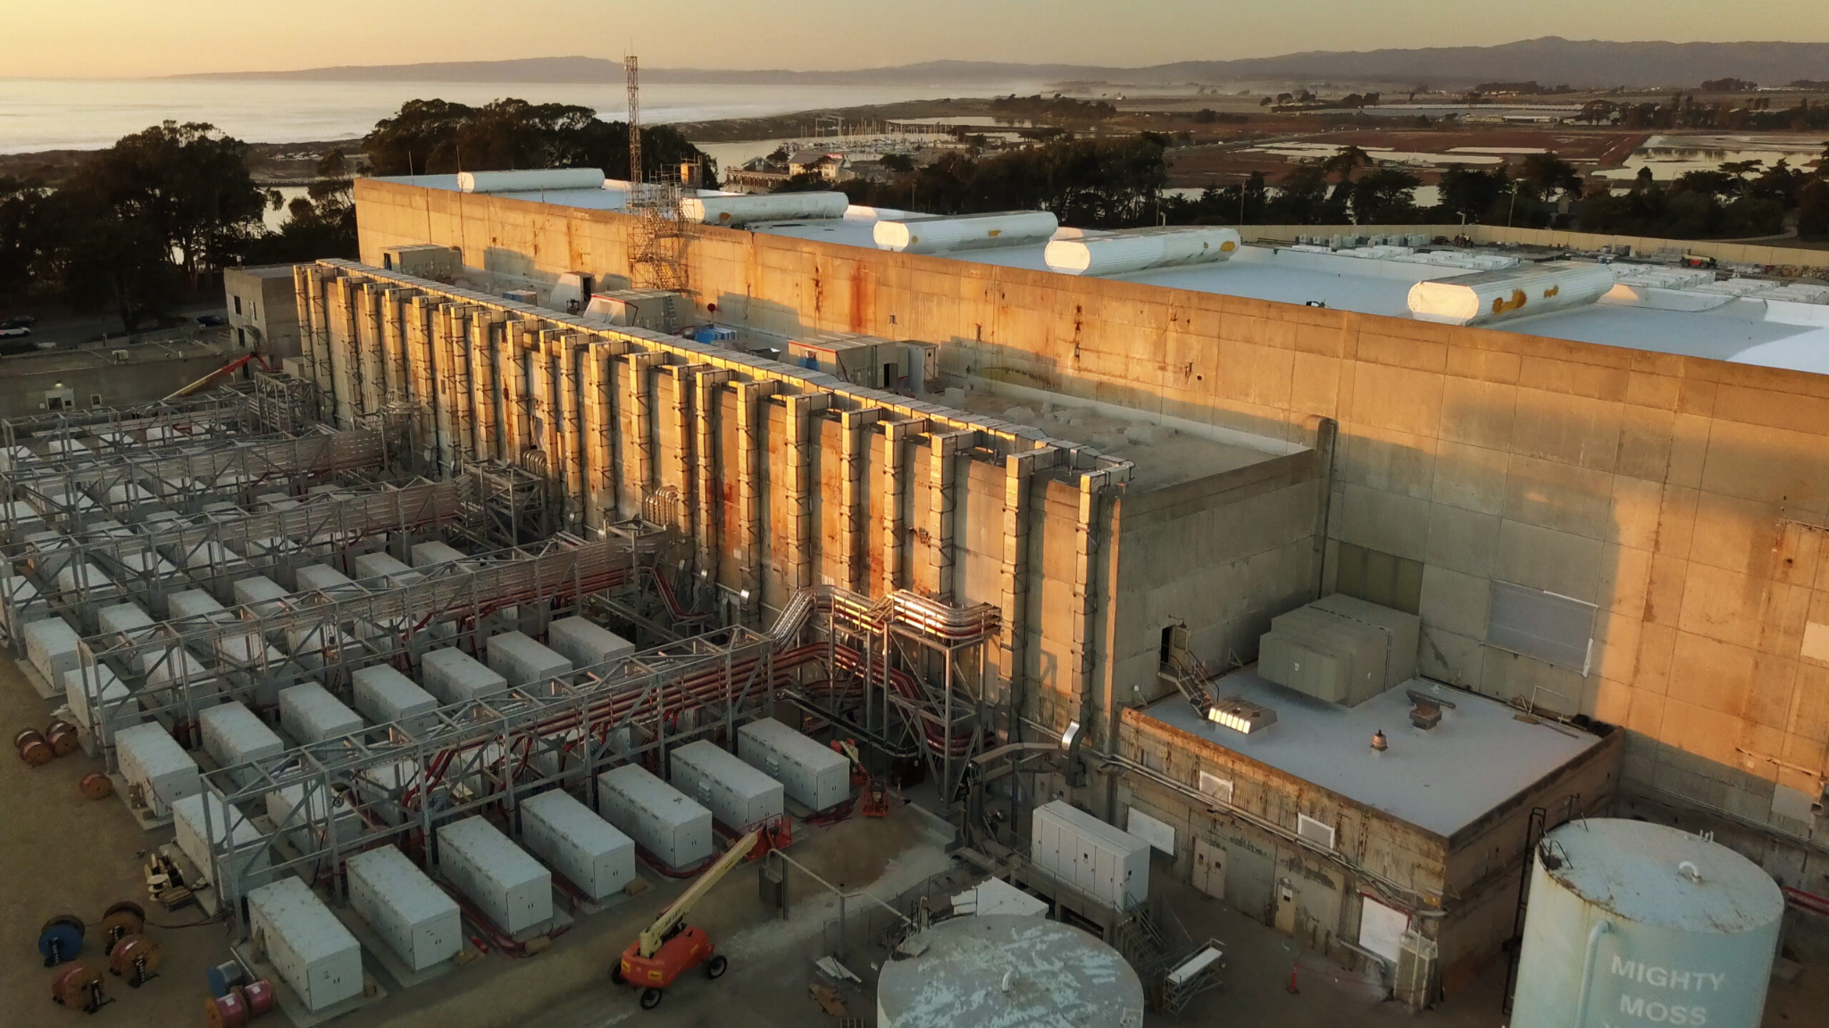
Moss landing energy storage facility- USA California
The site:
It is a lithium battery energy storage system. Due to this system an additional 350MW output and 1,400 MWh energy capacity has been added to the energy plant. The total is now 750MW/3,000 MWh (Colthorpe, 2023).
It is one of the largest lithium-ion energy storage systems in the world and can help generate around 275,000 homes (California ISO, 2022).
(Vistra Corp, 2022)

Slide 8
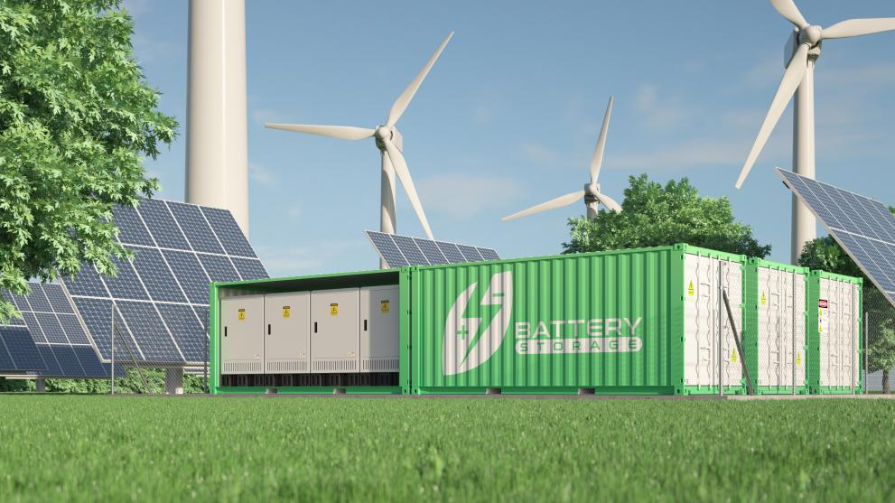
Conclusion
In conclusion there are a wide range of different energy storage technologies, in the UK we have a few different storage technologies as well.
An example of a battery energy storage facility is in California USA, where the biggest battery storage facility in the world is located.
(Adobe Stock, n.d.)

Slide 9
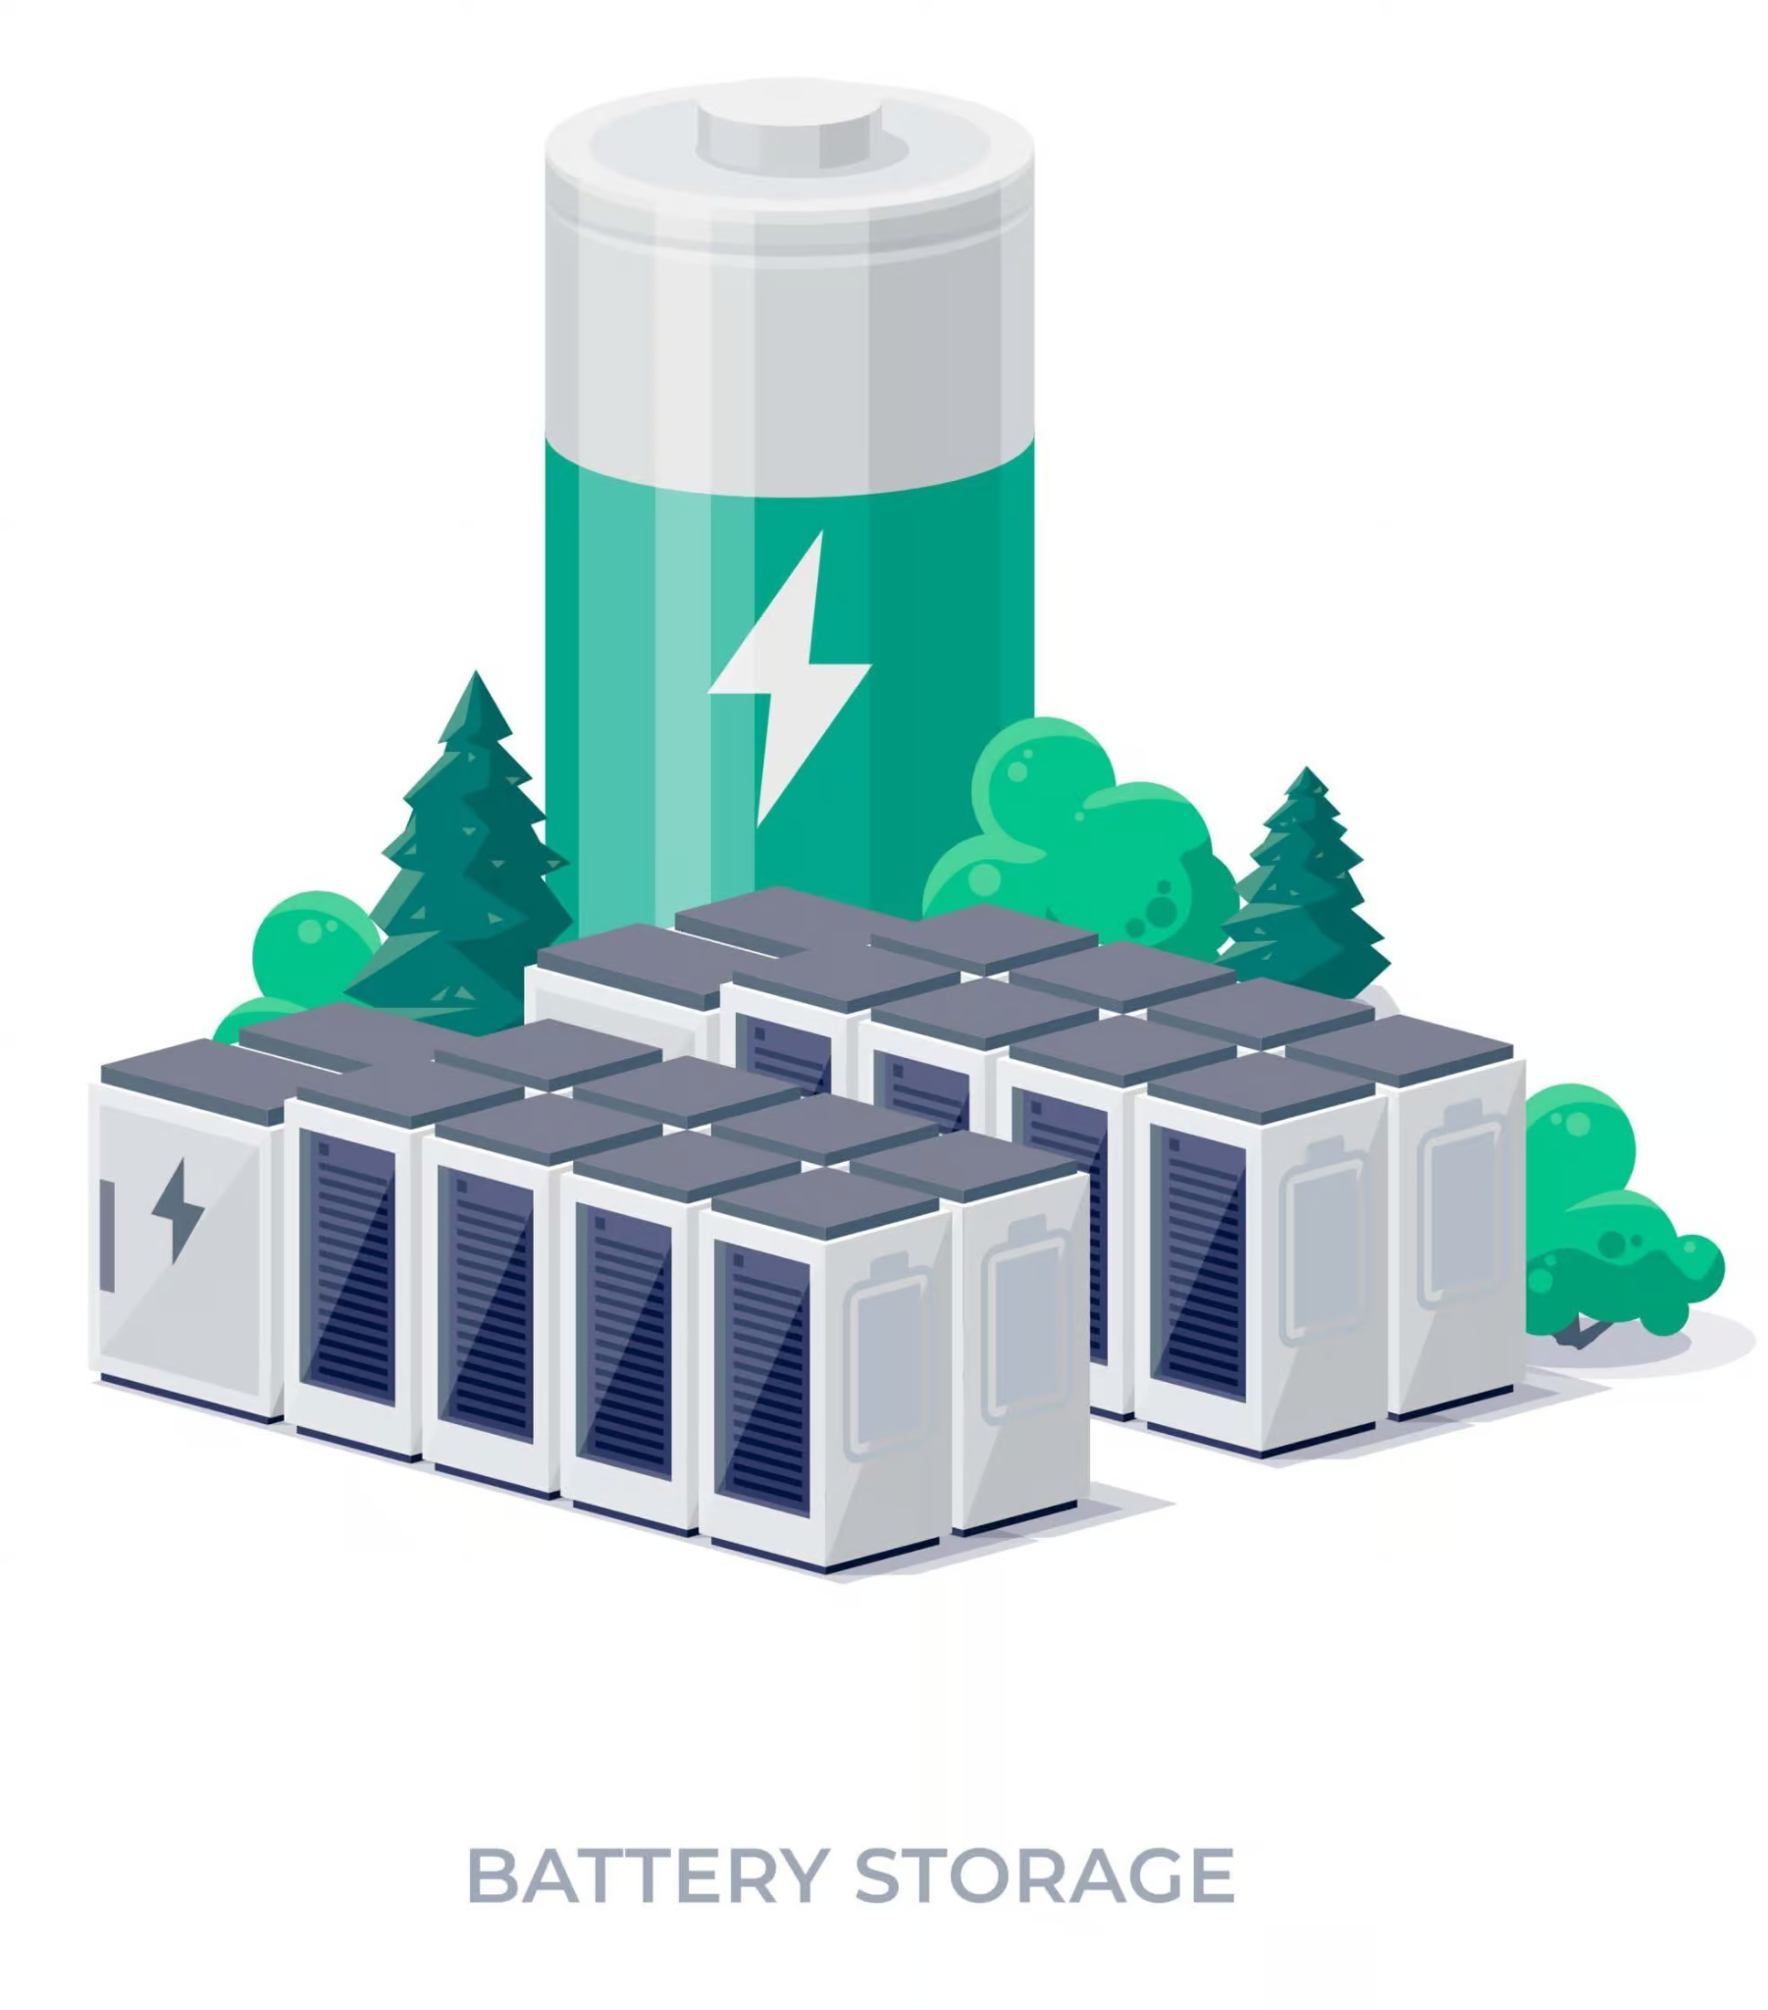
Any questions?
Thank you for listening, are there any questions?
(Thorne & Derrick International, 2023)

Slide 10
References:
Adobe Stock (n.d.). Energy Storage. [Online Image] European Commission . Available at: https://energy.ec.europa.eu/topics/research-and-technology/energy-storage_en [Accessed 19 Jan. 2026].
Anesco (2022). Anesco Is One of the Firms That Has Delivered Battery Storage to the Industry in Recent Years. [Online Image] Business Green. Available at: https://www.businessgreen.com/news/4049620/uk-battery-storage-sector-requires-gbp20bn-boost-2030-analysts [Accessed 21 Jan. 2026].
California ISO (2022). ‘A golden age of energy storage’ . [online] Caiso.com. Available at: https://www.caiso.com/about/news/energy-matters-blog/a-golden-age-of-energy-storage-2 [Accessed 20 Jan. 2026].
Colthorpe, A. (2023). Moss Landing: World’s biggest battery storage project is now 3GWh capacity. [online] Energy-Storage.News. Available at: https://www.energy-storage.news/moss-landing-worlds-biggest-battery-storage-project-is-now-3gwh-capacity/ [Accessed 20 Jan. 2026].
Department For Energy Security & Net Zero (2024). Energy Consumption in the UK (ECUK). [online] GOV.UK, pp.1–18. Available at: https://www.gov.uk/government/statistics/energy-consumption-in-the-uk-2024 [Accessed 20 Jan. 2026].
Department For Energy Security & Net Zero (2025). RAF062/2324: Exploring the take-up and usage of thermal energy storage in heat networks. [online] GOV.UK, pp.9–14. Available at: https://assets.publishing.service.gov.uk/media/689b163bebe5217ba73d0bfb/thermal-energy-storage-heat-networks-raf062-2324.pdf [Accessed 20 Jan. 2026].

Slide 11
References 2:
Electrosynthesis (n.d.). Redox Flow Battery. [Online Image] Electrosynthesis. Available at: https://electrosynthesis.com/energy-storage/ [Accessed 19 Jan. 2026].
eszoneo. (2025). The Future of Sustainable Energy: Understanding the Moss Landing Battery Energy Storage System. [online] Available at: https://eszoneo.com/info-detail/the-future-of-sustainable-energy-understanding-the-moss-landing-battery-energy-storage-system-5 [Accessed 21 Jan. 2026].
Harmony Energy (2023). Contego BESS Site between FRV and Harmony Energy. [Online Image] Solar Power Portal . Available at: https://www.solarpowerportal.co.uk/battery-storage/battery-storage-could-lower-the-cost-of-grid-infrastructure-says-developers [Accessed 19 Jan. 2026].
Hsu, J. (2025). Fire at world’s largest battery facility is a clean energy setback. [online] New Scientist. Available at: https://www.newscientist.com/article/2464625-fire-at-worlds-largest-battery-facility-is-a-clean-energy-setback/ [Accessed 20 Jan. 2026].
JRC (2025). NetZeroCities. [online] netzerocities.app. Available at: https://netzerocities.app/resource-3647 [Accessed 19 Jan. 2026].
Lewis, M. (2023). The world’s largest battery storage system just got even larger. [online] Electrek. Available at: https://electrek.co/2023/08/03/worlds-largest-battery-storage-system-just-got-even-larger/ [Accessed 20 Jan. 2026].

Slide 12
References 3:
McDowall, J., Biensan, P. and Broussely, M. (2007). Industrial Lithium Ion Battery Safety - What Are the tradeoffs? INTELEC 07 - 29th International Telecommunications Energy Conference, [online] pp.701–707. doi:https://doi.org/10.1109/intlec.2007.4448871.
McTigue, J. and Ma, Z. (2025). Analysis of Pumped Thermal Energy Storage Using Particle Media Integrated with Concentrating Solar Power. Solar Energy, [online] 292, p.113436. doi:https://doi.org/10.1016/j.solener.2025.113436.
National Grid (2024). Lakeside facility connects to grid and becomes UK’s largest transmission connected battery. [Online Image] National grid. Available at: https://www.nationalgrid.com/sites/default/files/images/media/2024-11/Drax%20substation%20works%20for%20TagEnergy%20battery3.jpg [Accessed 19 Jan. 2026].
Neises, T. (2024). Pumped Thermal Electricity Storage | Concentrating Solar Power | NREL | Concentrating Solar Power | NREL. [online] Nrel.gov. Available at: https://www.nrel.gov/csp/pumped-thermal-electricity-storage [Accessed 20 Jan. 2026].
Office of Energy Efficiency & Renewable Energy (2024). Pumped-Storage Hydropower. [online] Energy.gov. Available at: https://www.energy.gov/eere/water/pumped-storage-hydropower [Accessed 20 Jan. 2026].
Pacific Northwest National Laboratory (n.d.). Chemical Energy Storage | PNNL. [online] www.pnnl.gov. Available at: https://www.pnnl.gov/chemical-energy-storage [Accessed 19 Jan. 2026].

Slide 13
References 4:
Research Institutes (2021). What are the components of a lithium-ion cell? [Online Image] Research Institutes. Available at: https://ul.org/research-updates/what-are-lithium-ion-batteries/ [Accessed 19 Jan. 2026].
Ricardo (2022). An overview of the four main energy storage technologies | Industry insights | News and insights | Ricardo. [online] RicardoGroupPlc. Available at: https://www.ricardo.com/en/news-and-insights/industry-insights/an-overview-of-the-four-main-energy-storage-technologies [Accessed 19 Jan. 2026].
Sutherland, D. (2024). Battery storage capacity in the UK: the state of the pipeline. [online] Renewableuk.com. Available at: https://www.renewableuk.com/energypulse/blog/battery-storage-capacity-in-the-uk-the-state-of-the-pipeline/ [Accessed 20 Jan. 2026].
Sutherland, D. (2025). RenewableUK. [online] Renewableuk.com. Available at: https://www.renewableuk.com/energypulse/blog/stacking-up-the-storage-where-the-uk-battery-market-stands-in-2025/ [Accessed 21 Jan. 2026].
Thorne & Derrick International (2023). Battery Storage. [Online Image] Thorne & Derrick International. Available at: https://www.heatingandprocess.com/battery-power-storage/ [Accessed 19 Jan. 2026].
Tie, S.F. and Tan, C.W. (2013). A review of energy sources and energy management system in electric vehicles. Renewable and Sustainable Energy Reviews, [online] 20, pp.82–102. doi:https://doi.org/10.1016/j.rser.2012.11.077.

Slide 14
References 5:
UKEn (2024). UK Energy Storage The UK’S Largest Underground Salt Cavern Hydrogen Storage Project. [online] UK Energy Storage. Available at: https://ukenergystorage.co.uk/ [Accessed 20 Jan. 2026].
Venkat L (2021). World’s Largest Utility-Scale Battery Energy Storage System Now Online. [online] Power Info Today | Magazine for Power Industry Executives. Available at: https://www.powerinfotoday.com/renewable-energy/worlds-largest-utility-scale-battery-energy-storage-system-now-online/ [Accessed 21 Jan. 2026].
Vistra Corp (2022). The Moss Landing Energy Storage Facility Has 400 Megawatts of Capacity and the Ability to Run at That Level for up to Four Hours. [Online Image] Inside Climate News. Available at: https://insideclimatenews.org/news/21072022/inside-clean-energy-california-battery-storage/ [Accessed 19 Jan. 2026].
Watt-Logic (2017). How the Flywheel Connects to the Energy Grid. [Online Image] Watt-Logic. Available at: https://watt-logic.com/2017/06/07/flywheel-energy-storage/ [Accessed 19 Jan. 2026].
Winter, M. and Brodd, R.J. (2004). What Are Batteries, Fuel Cells, and Supercapacitors? Chemical Reviews, [online] 104(10), pp.4245–4270. doi:https://doi.org/10.1021/cr020730k.
Yekini Suberu, M., Wazir Mustafa, M. and Bashir, N. (2014). Energy Storage Systems for Renewable Energy Power Sector Integration and Mitigation of Intermittency. Renewable and Sustainable Energy Reviews, [online] 35, pp.499–514. doi:https://doi.org/10.1016/j.rser.2014.04.009.

