Slide 1
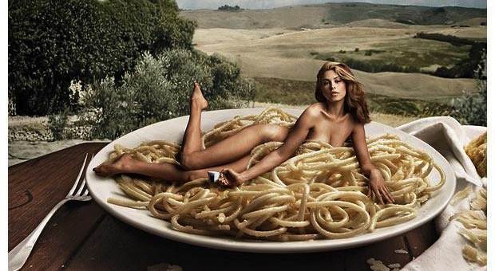
Carol. J. Adams: Women and Meat

Slide 2
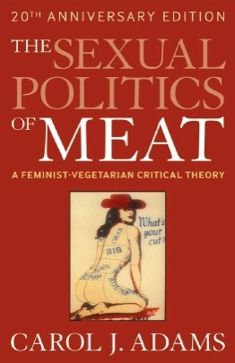
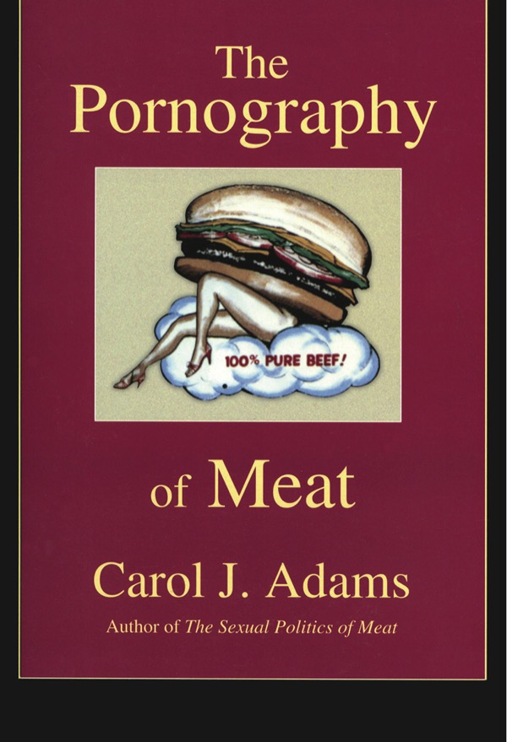
Notes:
In the books show in the slide above, Adams makes links female oppression with the oppression of animals in meat production. She sees correspondences between patriarchal ideas, violence and the domination of animals other than men.
She sees women and meat as objectified – where both could be seen as ‘persons’ – not for sale as objects.
Therefore she sees connections between speciesism and sexism. Women are the other species in this case or put anotehr way, sexism articulates the notion that women are not the same as men (no equality) and therefore can legitimately be dominated or simply used.
Speciesism: coined in 1973 by philospher Ryder, contests the validity and morality of human exceptionalism as speciesist.

Slide 3
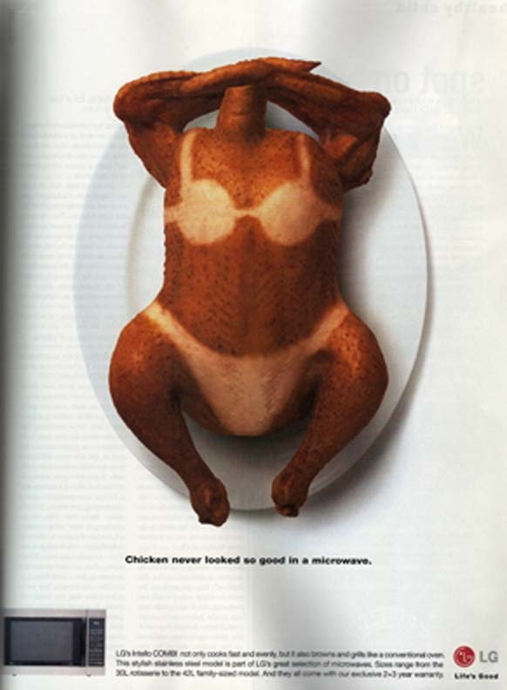
The next 3 slides offer illustrations of advertisements that draw women’s bodies, sexuality and meat eating together explicitly – albeit for different purposes

Slide 4
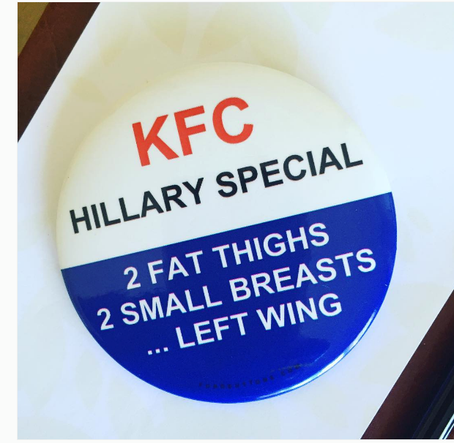

Slide 5
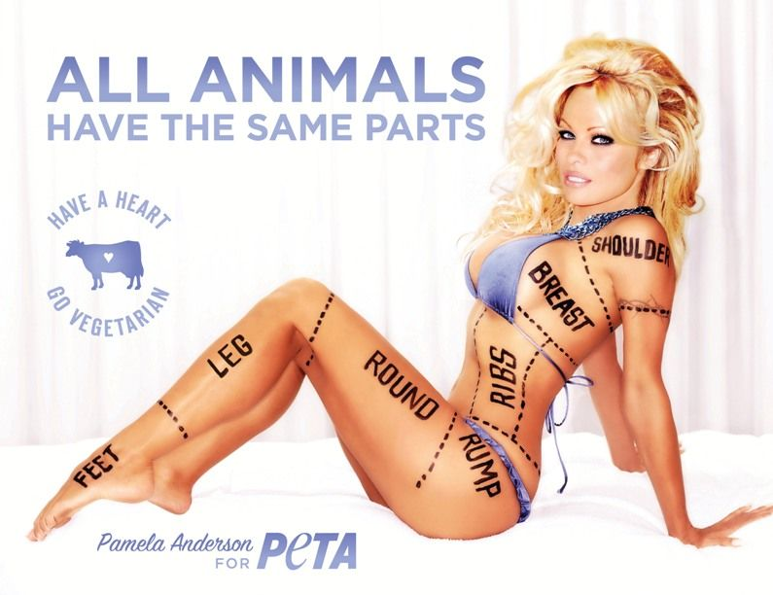
Notes:
Adam’s notes that non-human body parts are sometimes described using the same terms as human bodies parts when it transforms from the living being to a piece of meat. E.g: breast, thighs of a chicken…and so on.

