Slide 1


GROUP G
Student name and ID: Raluca Maria Ionita - 2120292
Radek Zavaleny - 2120115
Rene Tancos - 2120435
• Module: Digital Skills and Research Methods
• Module code: BMSW4003
• Assignment title: Are staff and students confident in using technology to collaborate?
• Lecturer name: Ngozi Ibeji

Slide 2





How do we use technology to collaborate at UWTSD?
Introduction
Student collaboration teaches learners a valuable lesson: how to use the people around them as a resource. What’s more, it gives them a chance to share their voices, developing the opinions that will dictate the people they become as they continue to grow and learn.
With technology, student collaboration and collaborative learning is much easier to facilitate, whether you want students to work together outside the classroom or need to increase student buy-in and engagement.
Raluca Ionita

Slide 3
What will be researched
We will research about using technology to collaborate between staff and students
Technology provides students with easy-to-access information, accelerated learning, and fun opportunities to practice what they learn. It enables students to explore new subjects and deepen their understanding of difficult concepts.
Student collaboration teaches learners a valuable lesson: how to use the people around them as a resource. What’s more, it gives them a chance to share their voices, developing the opinions that will dictate the people they become as they continue to grow and learn.
Raluca Ionita

Slide 4
Abstract
Entrepreneurial education offers valuable opportunities for teachers to foster and enhance creativity and action competence, which are also important for sustainability education. The University of Wales Trinity Saint David (UWTSD) is a leader in the development of entrepreneurial education in teacher education both in Wales and internationally. The objective of this article is to shed light on how an entrepreneurial education approach can help foster social change. The aim of this study is to learn from teacher educators at UWTSD about how they support creativity, innovation, and an enterprising mindset in their learners. A case study approach is applied.
Radek Zavaleny

Slide 5

Why it is relevant to do this research
The effective use of digital learning tools in classrooms can increase student engagement, help teachers improve their lesson plans, and facilitate personalized learning. It also helps students build a lot of new skills.
Virtual classrooms, video, and other technology tools can not only make class more likely, they can also create more inclusive learning environments that foster collaboration and inquisitiveness and enable teachers to collect data on student performance.
The Benefits of Technology to collaborate want to improve student performance, and technology can help them accomplish this aim. To mitigate the challenges, administrators should help teachers gain the competencies needed to enhance learning for students through technology. Additionally, technology in the classroom should make teachers jobs easier without adding extra time to their day.
An interactive approach allows students to take an active role in their education. Active engagement through games, online assignments, discussions, and research help build student confidence through participation. Making learning fun can reduce student frustration and confusion
Raluca Ionita

Slide 6
Ethical consideration
Ethical Considerations can be specified as one of the most important parts of the research. Dissertations may even be doomed to failure if this part is missing.
According to Bryman and Bell (2007)[1] the following ten points represent the most important principles related to ethical considerations in dissertations:
Research participants should not be subjected to harm in any ways whatsoever.
Respect for the dignity of research participants should be prioritised.
Full consent should be obtained from the participants prior to the study.
The protection of the privacy of research participants has to be ensured.
Adequate level of confidentiality of the research data should be ensured.
Anonymity of individuals and organisations participating in the research has to be ensured.
Any deception or exaggeration about the aims and objectives of the research must be avoided.
Affiliations in any forms, sources of funding, as well as any possible conflicts of interests have to be declared.
Any type of communication in relation to the research should be done with honesty and transparency.
Any type of misleading information, as well as representation of primary data findings in a biased way must be avoided.

Slide 7
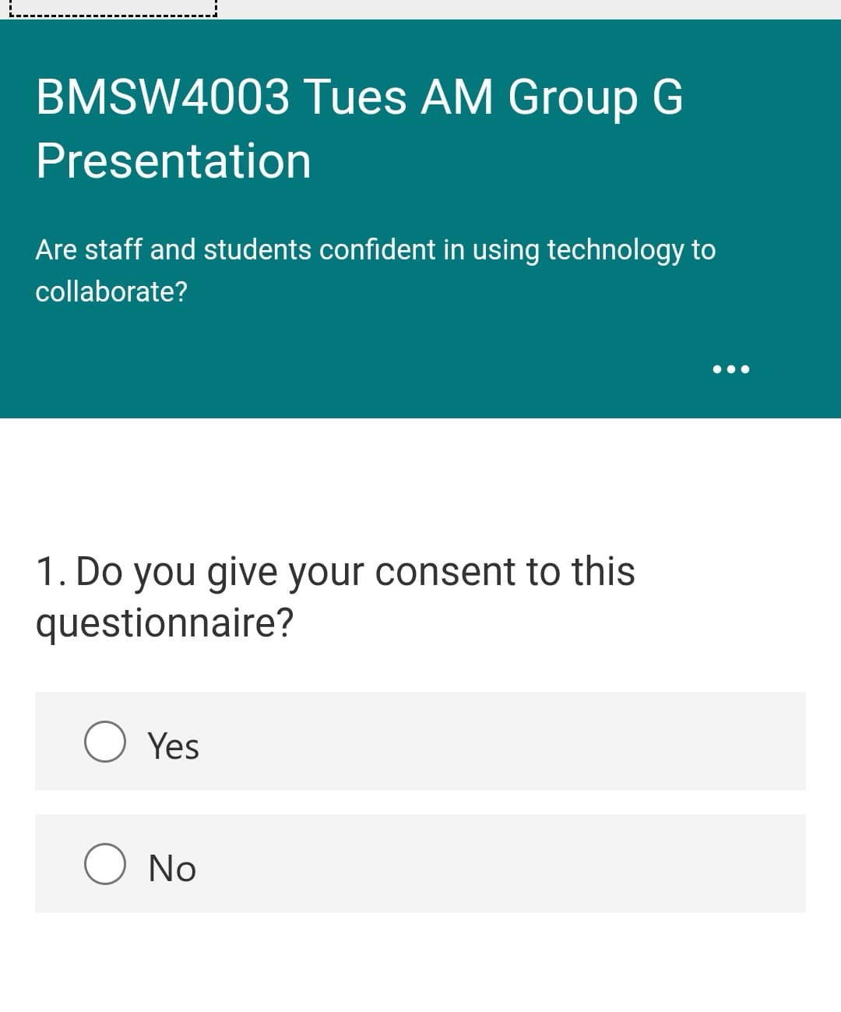
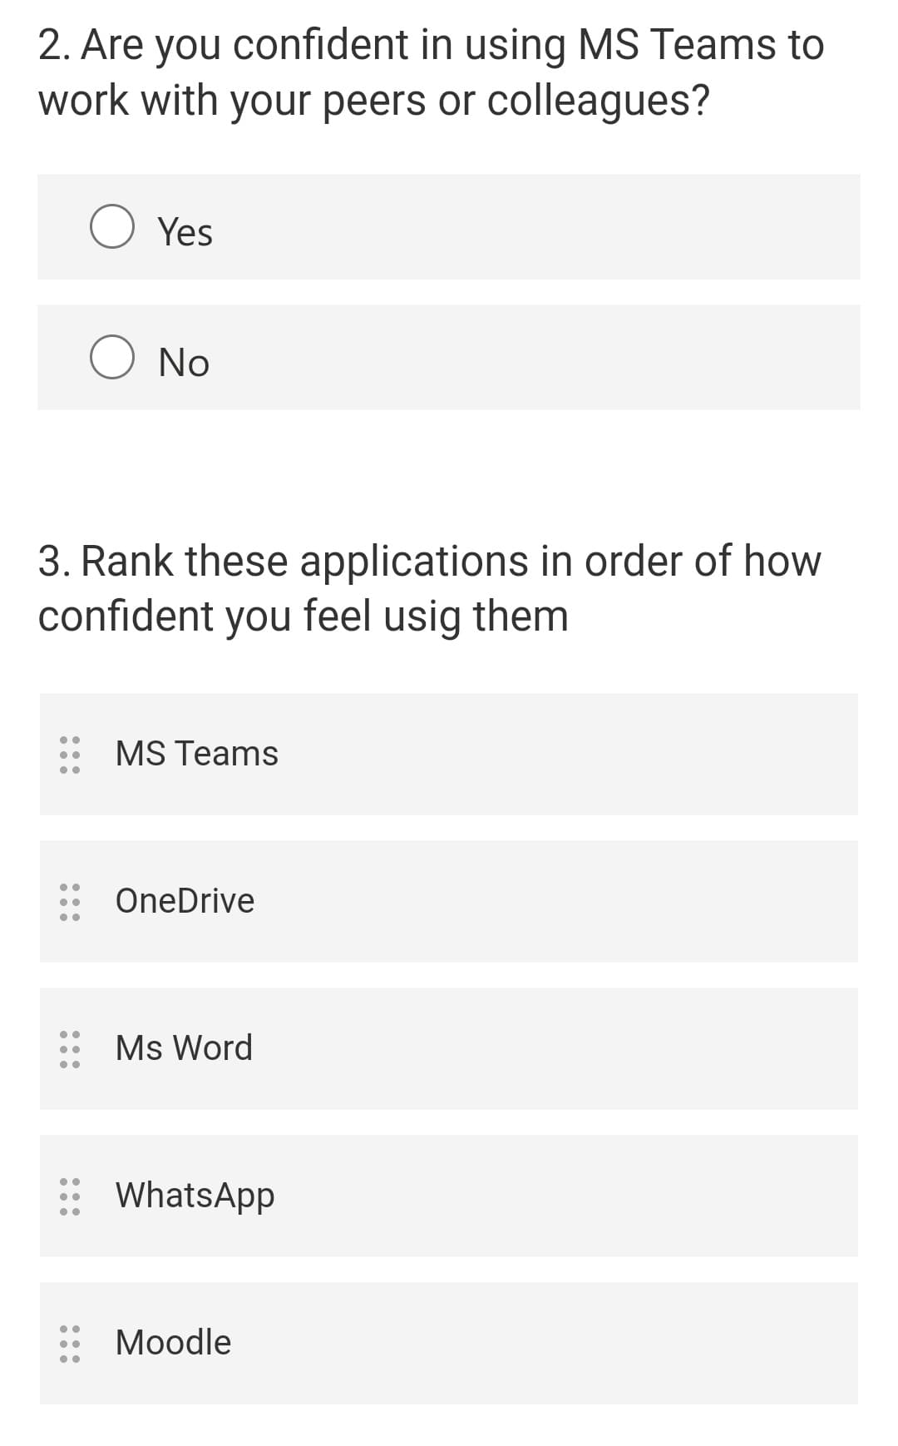
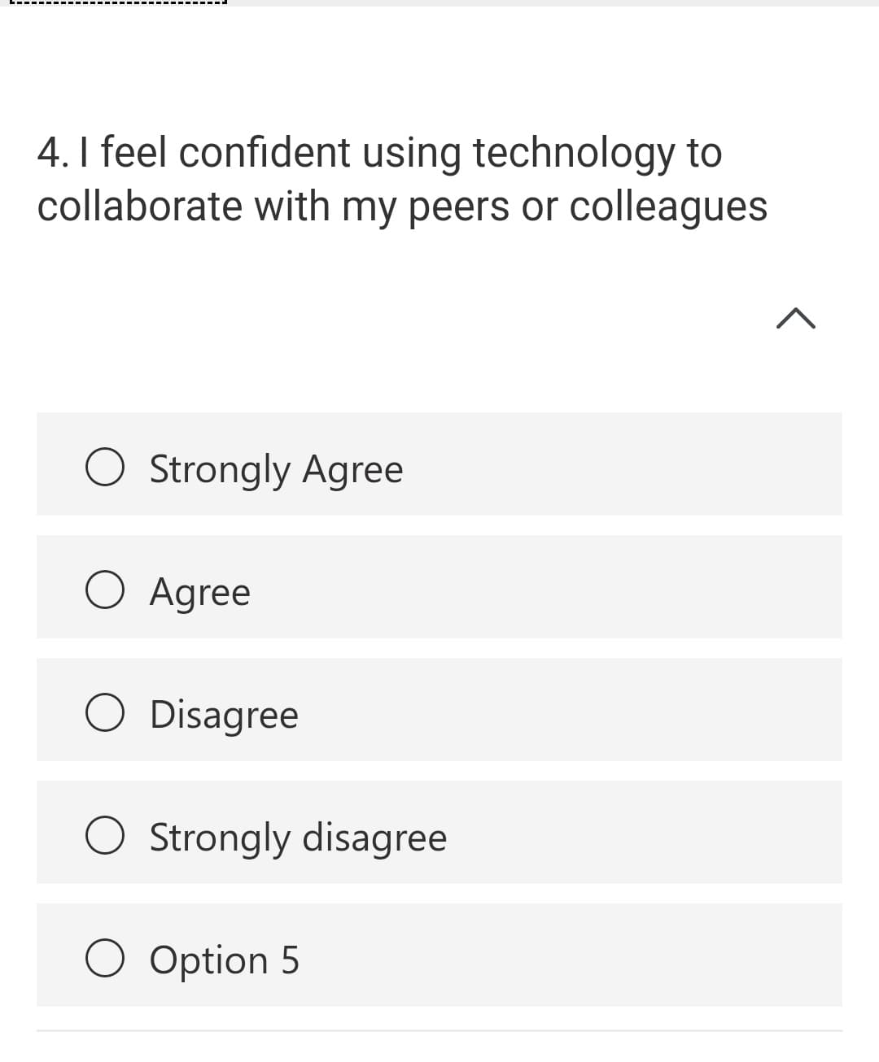
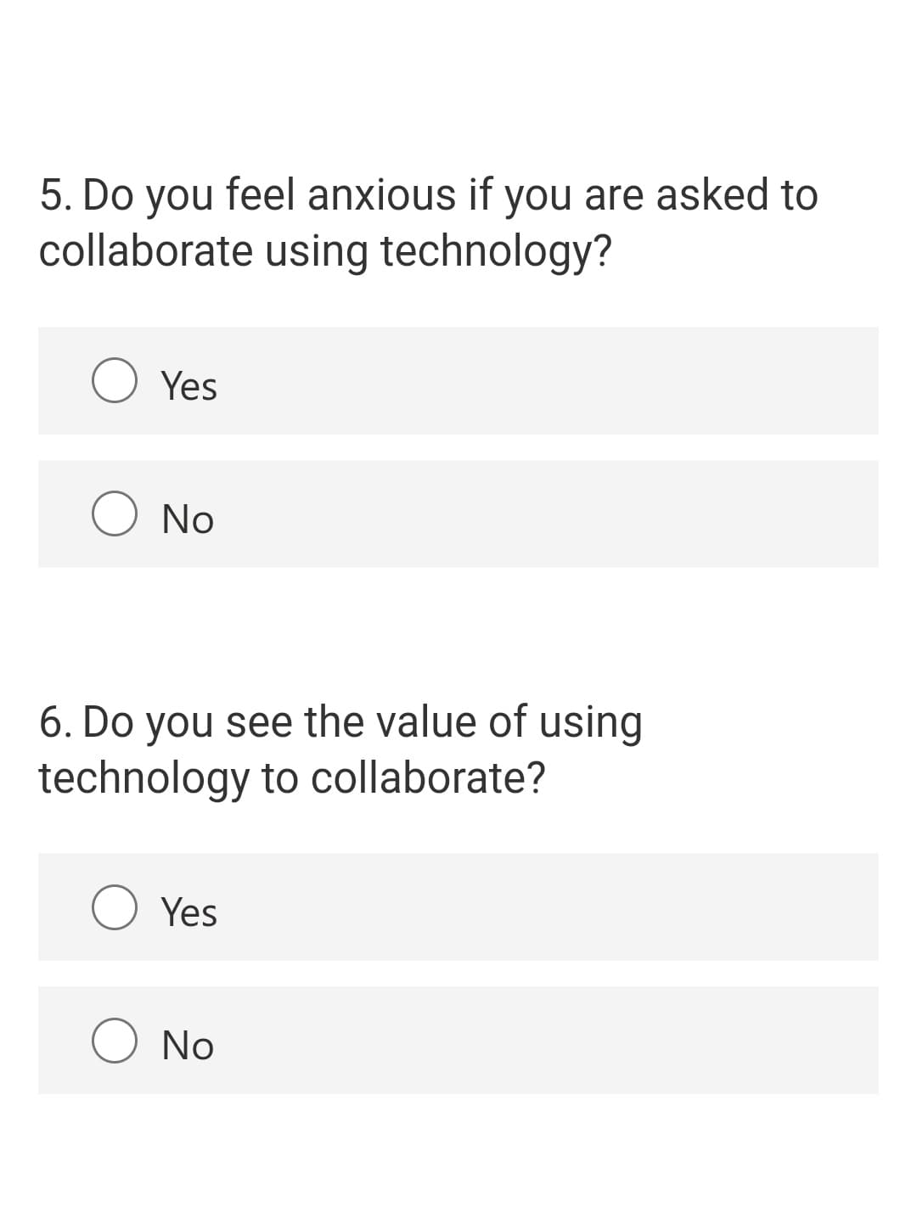
QUESTIONS
We will ask the questions through MS FORMS
Do you give your consent to this questionnaire?
Yes or No
Are you confident in using MS Teams to work with your peers or colleagues?
Yes or No
Likert Scale questions. I feel confident using technology to collaborate with my peers or colleagues.
Strongly Agree
Agree
Disagree
Strongly Disagree
Do you feel anxious if you are asked to collaborate using technology?
Yes or No
Using technology to collaborate with others improves my work.
Strongly Agree
Agree
Disagree
Strongly Disagree

Slide 8
Reference
Sustainability | Free Full-Text | Education for Social Change: The Case of Teacher Education in Wales (mdpi.com)
International Society for Technology in Education, “Preparing Students for Jobs That Don’t Exist”
The Journal, “How Teachers Use Technology to Enrich Learning Experiences”
World Economic Forum, “Learning through Play: How Schools Can Educate Students through Technology”
[1] Bryman, A. & Bell, E. (2007) “Business Research Methods”, 2nd edition. Oxford University Press.
[2] Saunders, M., Lewis, P. & Thornhill, A. (2012) “Research Methods for Business Students” 6th edition, Pearson Education Limited.

Slide 9


