Slide 1
3 day hiking expedition in the Brecon beacons

Slide 2
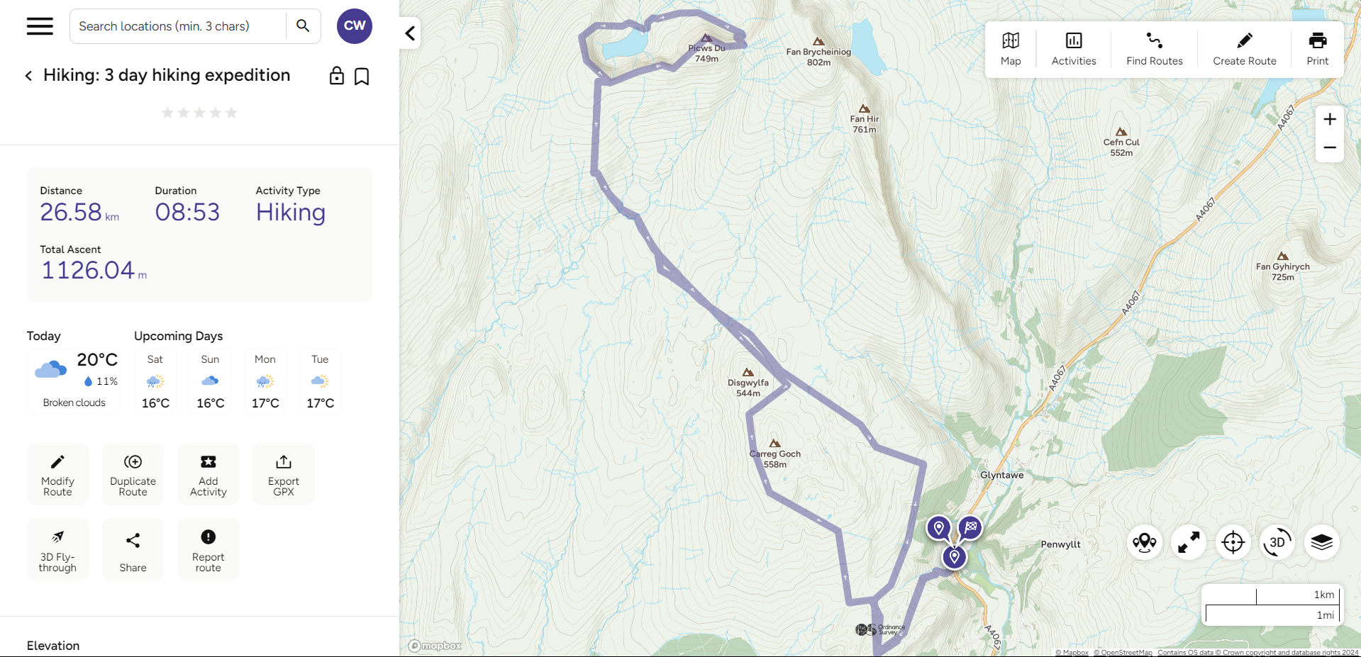


The route

Slide 3
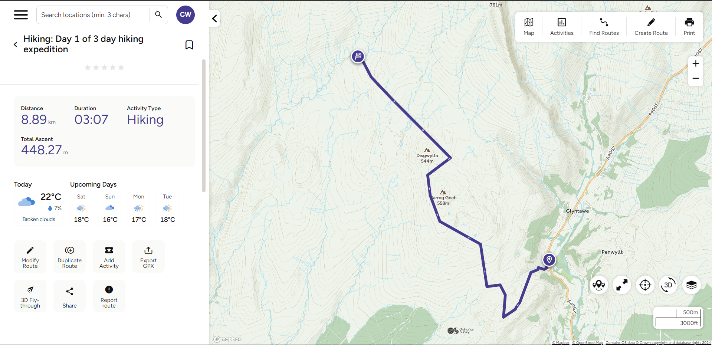

Day 1
08:00 Catch minibus from campus car park.
09:20 Arrive at Craig y Nos Country Park.
09:30 Have Breakfast in the car park while we discuss the plan for the day.
10:00 Begin the hike
12:00/13:00 stop for lunch
16:00-1700 arrive at camp 1, set up camp
17:00-18:00 cook dinner
Camp 1

Slide 4
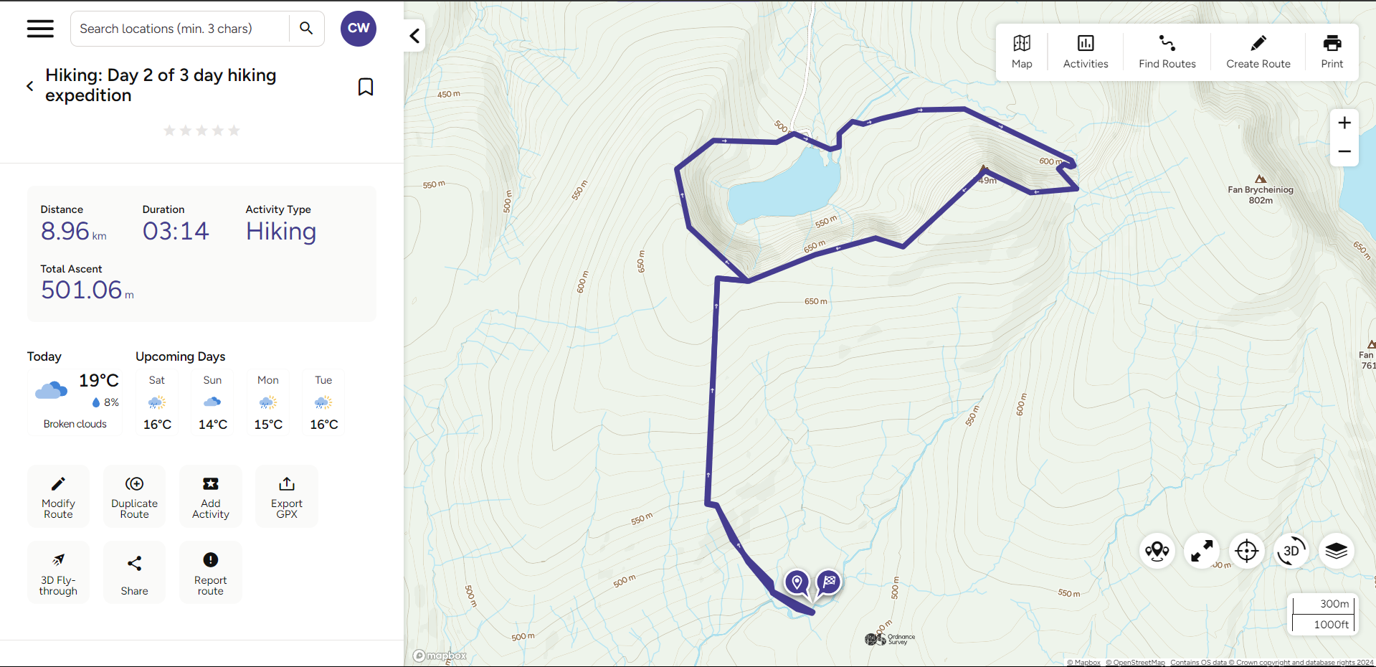


Day 2
09:00 Breakfast and discuss the day
10:00 Pack up camp
10:30 set off
12:00 lunch and swim at Llyn y Fan Fach
15:00/16:00 arrive back at camp, set up camp
16:00/17:00 cook dinner
17:00/18:00 reflect on the day

Slide 5
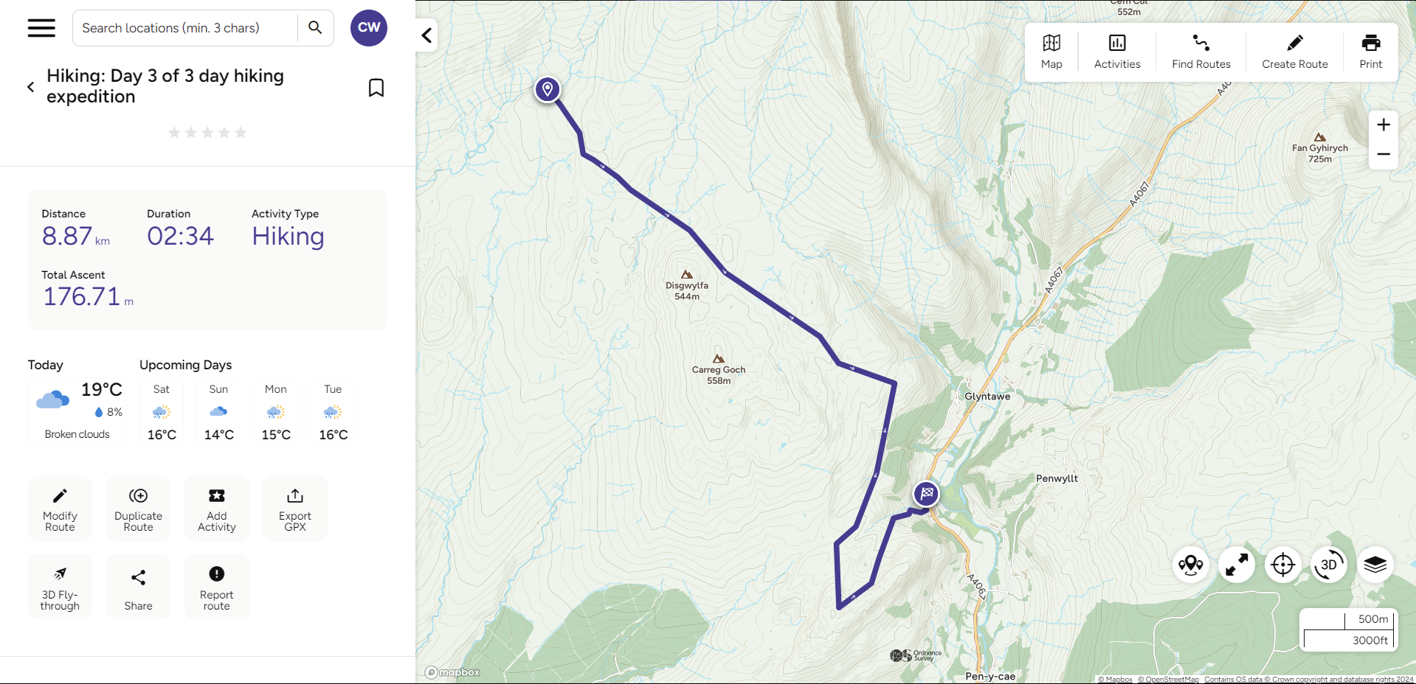




Day 3
09:00 Breakfast and discuss the day
10:00 Pack up camp
10:30 set off
13:00 have lunch
14:00 arrive at Craig Y Nos Country park
15:00 catch minibus back to campus
16:20 arrive back on campus

Slide 6
Why are we doing this?
Getting out has proven to be great for mental health and wellbeing time and time again. It's like a natural reset button and helps put life into perspective. This Is why so many people take part in activities such as hiking, mountain biking and kayaking etc. However not everyone treats the environment with the respect it deserves.
Driving long distances in planes or multiple cars, littering, contaminating water sources and unsustainable hunting and fishing practices are just a few ways we can have a negative impact on the environment.
That is why when planning this trip, I have done everything I can to minimise negative environmental impacts and maximise sustainability.

Slide 7
Sustainability Measures
We will be travelling via minibus in order to minimise fuel wastage and co2 emissions.
We will be travelling locally in order to cut down on fuel consumption and carbon emissions and because we have such beautiful mountain ranges within driving distance.
We will be practising a leave no trace philosophy of camping meaning we will be leaving the campsite exactly how we find and taking any rubbish we generate with us including any waste.
Should we need to go to the toilet we will be keeping a distance of at least 100m from any water source in order to avoid contaminating said water sources.
In totality the only fossil fuels we will be using will be the petrol it takes to get us there and back and the fuel to cook our food.

Slide 8
What you will need
Tent (I recommend sharing a 2 or 3 man with others to save weight)
Rucksack (I recommend at least 45 L)
Water filter e.g. LifeStraw
Trangia/burner for cooking
Spare technical clothing (no cotton)
Enough food for three (personal preference however you are carrying it so lighter the better)
Head torch
Sleeping bag and mat
First aid kit
Good hiking boots
Water bottle
Sun cream
Eating utensils

Slide 9
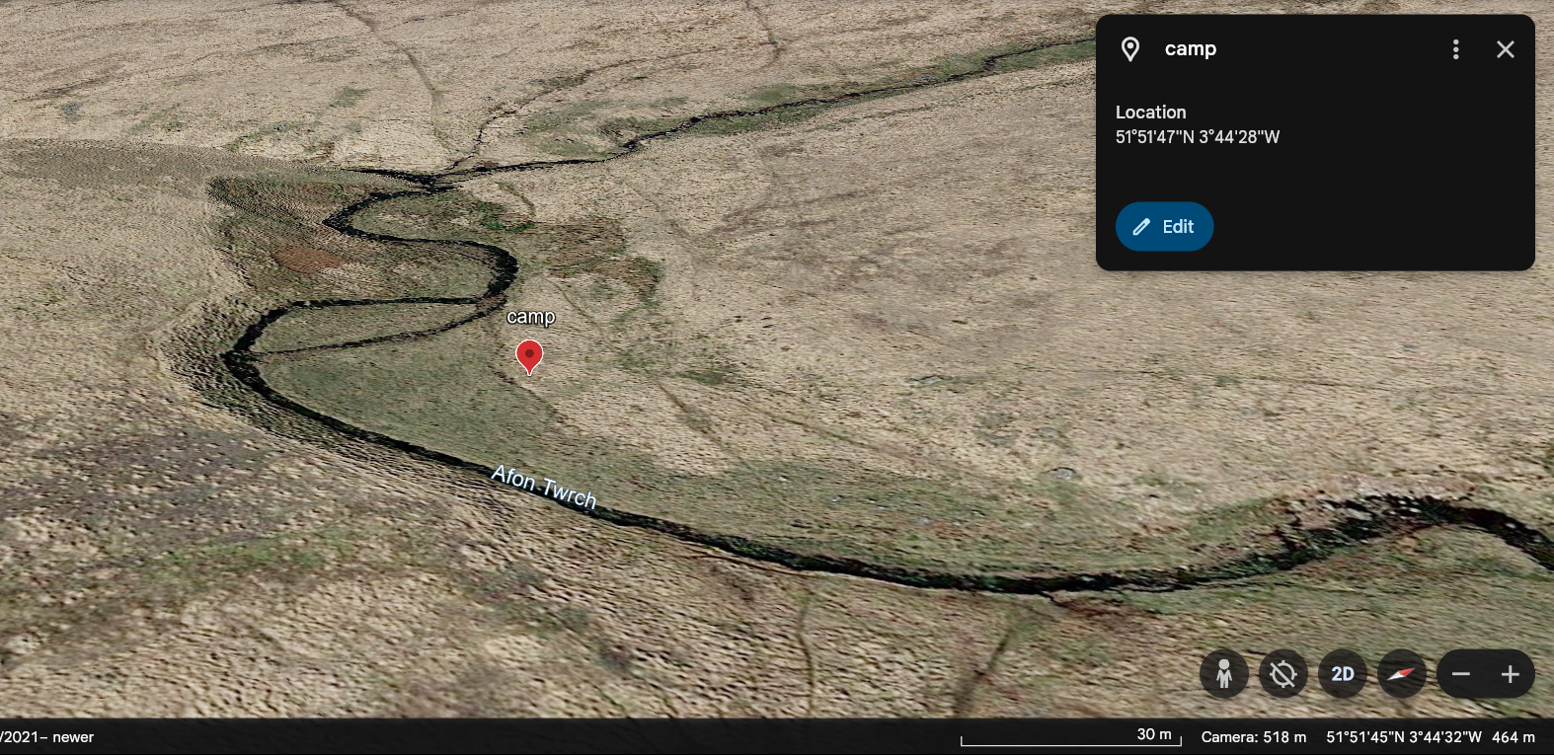
The campsite

Slide 10
References
Works Cited
Horton, Peter, and Benjamin P. Horton. “Re-Defining Sustainability: Living in Harmony with Life on Earth.” One Earth, 20 Sept. 2019, pp. 86–94.midasiak.
“A Beautiful Two Day Walk | OS GetOutside.” OS GetOutside, 15 July 2020, getoutside.ordnancesurvey.co.uk/guides/two-day-hike/. Accessed 19 July 2024
.Ordnance Survey. “Detailed Maps & Routes to Explore across the UK | OS Maps.” Osmaps.com, 2024, explore.osmaps.com/route/22517125/day-3-of-3-day-hiking-expedition?lat=51.840226&lon=-3.717398&zoom=12.3322&style=Standard&type=2d. Accessed 19 July 2024
.Prince, Heather E. “Outdoor Experiences and Sustainability.” Journal of Adventure Education and Outdoor Learning, vol. 17, no. 2, 27 Oct. 2016, pp. 161–171, https://doi.org/10.1080/14729679.2016.1244645. Accessed 19 July 2024.
Saunders, Rob, et al. Personal Transformation through Long-Distance Walking. 2014.Google.com, 2024,
earth.google.com/web/search/llyn+y+fan+fach/@51.86343436,-3.74155866,456.9588432a,207.53973421d,35y,-53.09153008h,72.74489124t,0r/data=CigiJgokCaY38kU4C0pAEWtqfKtn30lAGWxqb-nW9w_AIcgJV8c5mBTAOgMKATA. Accessed 19 July 2024.

