Slide 1
Internet Ethics
Caroline Jawad 2011
Notes:
http://www.scribd.com/doc/20075413/Information-Technology-Ethics-Cultural-Perspectives
The explosion in Internet usage has drawn public attention to the dramatic impact it is having on society.
Electronics technology
and the IT revolution
• Telephone: 1876; radio: 1898
• Vacuum tube: 1906; transistor: 1947
• Semiconductor technology uses the principle that
voltage above a certain threshold will be
conducted (switch that switches a switch)
• Silicon transistor: 1954; integrated circuit: 1957
• 1959 1962: price of semiconductors fell 85%
David Keil Information Technology and Society 1/11 34
1959-• 1962-1971: price of semiconductors fell 98%
• Microprocessor: 1971

Slide 2
Next week
10-11 Room 202 Internet ethics discussion
11-12 Online surveys

Slide 3
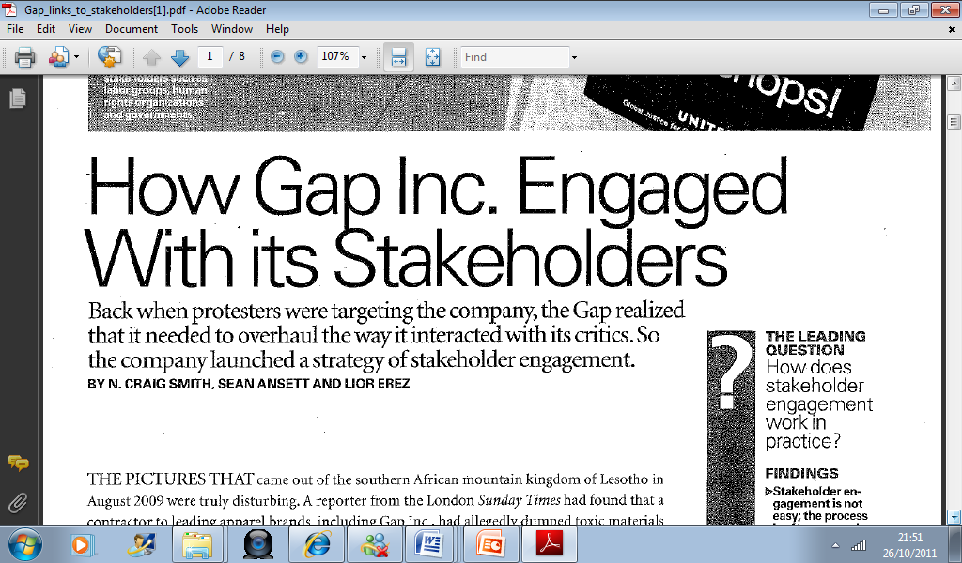

Slide 4
Definition of cyberethics
The field of applied ethics that examines moral, legal and social issues in the development and use of cybertechnology (Spinello and Tavani, 2004)
Richard Spinello and Herman Tavani, Eds.
  Readings in CyberEthics 2nd ed Jones and Bartlett 2004 CyberEthics, 2 ed. Bartlett, 2004.

Slide 5
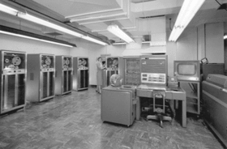

Slide 6
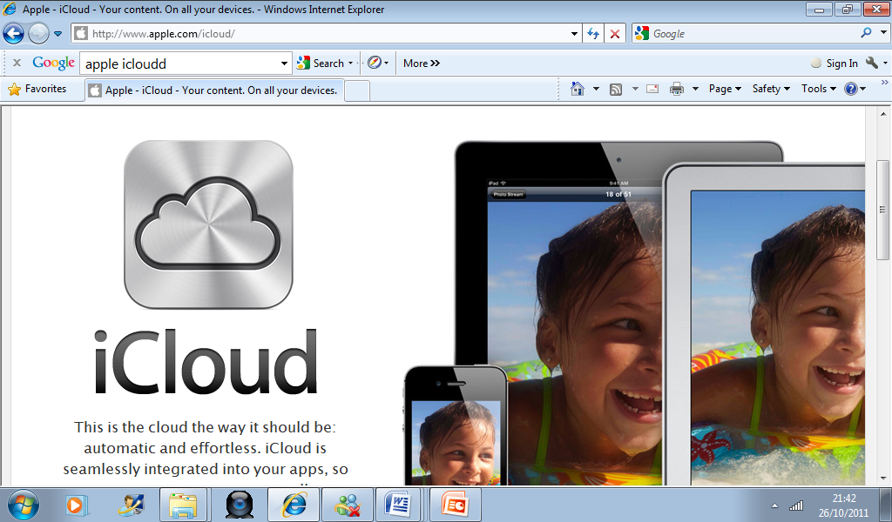

Slide 7
Development
(1950s-1960s) Stand-alone mainframes. Can machines think? Is Big Brother watching you?
(1970s-1980s) Convergence of computers and communications as networks
(1990s-2000s) Internet; convergence of text, video, sound on the Web. Issues: free speech, anonymity, jurisdiction, trust
(2000s) Ubiquity of computing, computers as part of who we are

Slide 8
ACM Code of Ethics
“…breaking into someone’s computer account is in some ways like breaking into someone’s house, but there are interesting differences. It is logical rather than physical entering.
Unauthorised copying of software is a bit like unauthorised copying of a book, and a bit like taking a television set but there are significant differences.” (Weckert, 1997)

Slide 9
Internet – new ethical challenges
Globalisation, enabled by IT, has changed economic relationships
Speed of communication
Worldwide scope of instant communication
Environment is interactive
The Internet enables anonymous communication
New ways exist to reproduce information

Slide 10
Key issues – Voronkov, 2004
ICT may carry cultural and moral values
Working out the ownership (intellectual property) of computer software is complex
Even when behaviour is not against the law, there are issues of “net etiquette”
Individuals who have computer expertise have professional responsibilities - codes of conduct
Since computers and Internet lead to globalization - variety of issues arise regarding how people are affected and what kind of a world will be created
Notes:
Since ICT is powerful, there is a problem with unequal access to these tools;
• ICT may carry cultural and even moral values and yet those who adopt these technologies may not know they are
adopting the values;
• Working out the ownership (intellectual property) of computer software is complex and leads to issues about right
and wrong in copying and using software;
• Even when behaviour is not against the law, there are issues of proper behaviour on the Internet, often referred to as
“net etiquette”;
• Individuals who have computer expertise have professional responsibilities so there should be professional standards
and codes of conduct for computer professionals;
• Since computers and especially the Internet lead to globalization, a variety of issues arise regarding how people are
affected and what kind of a world will be created.
http://iite.unesco.org/pics/publications/en/files/3214629.pdf

Slide 11
Netiquette and censorship
no tone of voice no body language (Scheuermann, Taylor, 1997)
to disguise who you really are (Langford, 2000)
teenage girls use Internet as a tool to exclude other girls from their social circles (Careaga, 2005)
39% of teens admitted to saying things online they would not normally
no one isi n control of internet communication (Scheuermann, Taylor, 1997).
filters on library computers – AOL censorship - thought police (Kandra, 2004, Langford, 2000)
rights to free speech and the issue of privacy (Langford, 2000).
Notes:
Ethics and the Internet
Scott P. Muir
Introduction
The Internet is having a substantive effect on how people in our society behave and interact. For the first time in our history children are more comfortable and knowledgeable with a technology than are their parents, and there are important considerations in this switch (Tapscott, 1998). Telecommunication networks and computer technology are leading the change that is transforming our lives and we lack the resources to understand how to cope with the ethical changes (Stahl, 1999). The internet put us in touch with the entire interconnected world with the ability to hurt, misunderstand, or infuriate through unintended cultural differences (Langford, 2000).
The extensive amount of time some spend online (Sparks, 2005) can lead to depression and other mental health related problems due to the lack of meaningful interactions and close relationships with friends and family. Young people who spend hours online and limit their social interactions with their peers can become socially isolated as they lack opportunities to improve their social skills (Bostick, 2005). Online interaction is just not the same. New students on a campus may find that they do not explore their new environment and make friends through their campus, potentially leaving them isolated and alone. And Dad has now been replaced by the Internet for advice (Internet replaces dad, 2005).
In our day-to-day dealings with other people, there are social mores that govern our interactions with each person. We likely behave differently with our boss than with a co-worker; we treat a professor or dean differently than a classmate. And typically in dealing with people we do not know, we maintain some polite social distance. However on the internet, we lack many of those same ethical touchstones to guide our behaviour.
This paper will not discuss intentional criminal behaviour; things such as identity theft, scamming people for money, breaking into unauthorized computer systems and other such behaviours that go beyond the scope of this research. Instead this paper will focus on netiquette and censorship, plagiarism, copyright, and music downloading.
Netiquette and Censorship
A search of the Internet brings forth a number of articles about rampant rudeness on the web (Merle). The term “Netiquette” has been around for quite some time. It was formed from a combination of the words “network” and “etiquette” (Scheuermann, Taylor, 1997). It is used to describe codes of behaviour that various online communities have developed over time (Ornatowski, 2001). The intent of netiquette is to provide guidelines or rules of behaviour online in an effort to combat rudeness. Americans use the very poorest etiquette when using the email and cell phones, etc. that they rely on the most and distance makes it easier to be confrontational (Careaga, 2005). While not included here there are a number of sources for appropriate etiquette on the internet (Langford, 2000; Merle; Scheuermann, Taylor, 1997). There are a number of challenges here because there is no tone of voice and no body language that gives us clues in our day-to-day in person communications (Scheuermann, Taylor, 1997). It is also easy to disguise who you really are (Langford, 2000). A child can pose as an adult, a young man, or as an old woman.
In many ways behaviours online mirror those in everyday life. A Pew study showed that teenage girls use Instant Message buddy lists as a tool to exclude other girls from their social circles (Careaga, 2005). Researchers have also found that 39% of American teens aged 12 to 17 admitted to saying things over text messaging or instant messaging that they would not normally say to someone in person. A key part of the challenge is that no one is exactly in control of internet communication (Scheuermann, Taylor, 1997).
In some cases, an organization providing the internet service tries to control what happens, although that can be very controversial. For example, witness the implementation of filters on library computers. In other cases, a corporation such as AOL will censor some of what occurs on their site. This, too, is controversial and they are sometimes referred to as thought police (Kandra, 2004, Langford, 2000). This also raises important concerns on the rights to free speech and the issue of privacy (Langford, 2000).
When Internet filters try to control what people can see, it raises a question. Are these filters a valuable tool to eliminate violence and explicit sexual content or are they instead some form of extremist thought control? Each of these filters is subjective and some of them eliminate sites that might provide useful information, such as the classic case of a site that filtered out information on breast cancer in an attempt to avoid pictures of breasts in a pornographic sense. Filters have another downside in that they can limit access based on social decisions, e.g. sites on AIDS or homosexuality (Krantz, 1997). It also raises the question when a site such as AOL filters information, are they acting in good faith or are they starting to take responsibilities more appropriately assigned to parents?
Finally there are questions about the effectiveness of filters. Statistics from one study show that they are only 80% effective and that students can work around them. This same study also shows that 70% of 13 and 14 year olds go into chat rooms where they might be exposed to adult content and discussions (Jones, 2002).
This area is perhaps the grayest of the three areas in this paper because it brings together the issue of free speech and freedom of choice into potential conflict with good behaviour and the welfare of society as a whole. This will continue to be a topic of conversation for some time as we determine how to handle these ethical choices.
Plagiarism
Plagiarizing is easier today in the Internet environment than it ever has been. There are a number of traditional reasons why students plagiarize, but these will not be explored here. Cut-and-paste or easily purchased prewritten papers have shifted the ease with which it can occur (http://www.plagiarism.org). In the past, a plagiarist at least had to go to the library, do some research, copy down notes or photocopy the material where others could watch, possibly hide the source document somewhere in the library to avoid being caught, making this a very public event. Now one can do it all online in the privacy of one's own room (Bugjea, 2004). However, plagiarism is not a technology problem; it is a problem of ethical behaviour, honesty, and correct citation of resources (Hansen, 2003).
Plagiarism is a form of cheating and cheating sets a pattern for life (Phillips & Horton, 2000). It rips at the fabric of our society and is a key part to a student’s moral development. Students who cheat are less likely to learn writing skills needed for their future assignments and careers (Martin, 2005; Phillips & Horton, 2000). We have seen university presidents resign and the New York Times was rocked by scandal when Jason Blair’s plagiarism and made up stories became public (Hansen, 2003).
One change is a generational factor. The issue is not so much that students today are more dishonest or less moral, but the ease of transfer of information has formed new and different attitudes about information, intellectual property, and authorship (Wood, 2004; Kraus, 2002). Many students believe that materials that they find online are free for the taking (Hansen, 2003). The idea is that they are just circulating what already exists similar to a webpage that is often less important for original content than for the links it contains (Kraus, 2002). The sheer volume of resources available through the web can create a sense that there is nothing new to be said about a given topic (Hansen, 2003). In the past students began with a blank sheet of paper in a typewriter, but today it is the already filled screen of the internet (Kraus, 2002).
Collaborative groups also give students mixed messages about intellectual ownership (Wood, 2004). The Wikipedia collective work has created a different perspective on intellectual property (Kraus, 2002). Students do not consider their own work as being original and having value. While they would not steal, this seems different and they do not see plagiarism as stealing (Wood, 2004). Finally, one student opined that because he had paid for a paper purchased online that it was “his” (Hansen, 2003).
Statistics from organizations such as plagiarism.org (http://www.plagiarism.org) and other sites show high rates of plagiarism and other forms of academic dishonesty. Students lean best how to do stuff by doing it themselves (Kraus, 2002). Teachers need to educate students thoroughly on what plagiarism is and they should be taught how to cite correctly. Teachers need to be very clear on penalties for plagiarism. Most importantly teachers can help their students understand and hear their individual voices (Kraus, 2002).
Copyright and Music Downloading
96% of Canadian students agreed that stealing software from a store is a serious offense, but only 40 % felt that way about downloaded software (Weber, 2005). For some reason this is not viewed as the same thing as walking into a record store and swiping a CD. A Pew (2000) study showed that half to three quarters of those who download music do not think of it as stealing, and over half of internet users say that downloading music is not stealing, with almost a third stating it is just a high-tech version of swapping audio cassettes, which has been done without impunity. While there is some question on the legality of cassette swapping, most record studios only pursued the most egregious violators (Adrianson, 2003). Today, digital technology allows high quality, nearly perfect copies that are easily swapped or sold via the internet, and this has changed the dynamic.
The Recording Industry Association of America (RIAA) blames file swapping and music sharing for a 31% drop in CD sales since 2000 (Batstone, 2004). Another study shows that there are declining sales going from sixty million for the Top-Ten albums in 2000 to thirty-four million in 2002 (Adrianson, 2003). As a result the RIAA has filed hundreds of lawsuits against individuals downloading music is an effort to combat declining sales.
The web is a very public forum and this allows of the detection of file swapping (Adrianson, 2003). One can be caught if one downloads only one song (Drexel, 2000), because the RIAA can search a peer-to-peer network and see the transactions. Some claim that the RIAA has engaged in bullying and intimidation tactics. While file swapping is a likely cause of some of the decline, other factors that impact sales might be the high unemployment rate and the poor performance of the economy (Henderson, 2004).
The RIAA is basing its lawsuits on the Digital Millennium Copyright Act (DMCA) which protects copyrighted materials by forbidding circumventing technological measures that are intended to protect some materials (Spinello, 2004). The DMCA has given unprecedented extensions to the copyright of materials (Henderson, 2004). This law is 200 pages in length and unclear to most people. The less understandable and less workable a law, the less likely people are to comply with it and less likely to feel they are violating the law (Litman, 2003; Henderson, 2004).
Today’s copyright law also views your favorite singer in the same legal eyes as it does Microsoft. Copyright law is not protecting the artists anymore; it is protecting the big corporate interests (Henderson, 2004). Given the belief that the RIAA does not represent the individual artists, but the big recording industry itself, many people who download consider themselves ripping off a big corporation and not the artist (Henderson, 2004). There is also considerable anger about the fact that the music industry once said CDs would last forever. People feel they are paying twice now that they have to buy DVDs to replace CDs, and they wonder how long DVDs will last (Carlo, 2005).
There are some interesting parallels to the 1984 case in which the Motion Picture Association of America (MOA) sued to stop the sale of the now defunct SONY Betamax VCR. As it turned out the home entertainment industry was the salvation of the movie industry with the advent of VCRs, DVDs, and digital cable (Drexel, 2000; Batstone, 2004). So perhaps the solution is to look at this in a different light. The Electronic Frontier Foundation suggests a payment system similar to radio broadcasting. Since record companies already monitor what is sold and traded via the peer to peer networks internet, they can use that as a basis for calculating fees owed to artists, based on a pay per play model (Adrianson, 2003).
Like many areas, court rulings sometimes have unintended affects. A Norwegian man created descrambling software so he could view movies on a different machine than one on which the movie was intended to be viewed. In doing so, he intentionally circumvented the Decode Content Scrambling System. He also posted his code to a website so that others could use it. U.S. courts ruled that not only could a website in the U.S. not have that descrambling code which was deemed a violation of the law, but they also ruled that a website could not point (link) to another site which held the code. The court’s decision raises some significant concerns about linkages since this ruling also can suppress links to copyrighted material. Linking permits immediate access from one site to another. That was part of the intended design of the web and without such linkages, the power of the web is greatly diminished. This court ruling raises serious concerns about the future of linking and free speech (Spinello, 2004). An additional concern is that new government regulations might have a negative impact on new developing technologies (Adrianson, 2003).
Conclusion
Moral philosophers base theories of ethical behaviours on the human face; but, in Internet communication there is likely not that human face. This has left a conundrum in which we are shifting from what can be done on the Internet to what should be done and there is no overall philosophical approach. The Internet has flourished because of the freedom it allows without the controls from governments or powerful self-interest groups. Along with this democratic approach one can find all kinds of information considered morally wrong by many, e.g. racist hate speech, child pornography, promotion of terrorism and the incitement to commit violence. The Internet also involves an international perspective, for behaviour illegal in one part of the world may be perfectly legal in another. This has left us with a sense of uncontrollability – who makes the rules and who enforces them. A big challenge is the problem of jurisdiction and the application of protections (Langford 2000).
This paper has shown that the Internet has dramatically changed our communications, social, and education interactions. We will continue to explore ethical issues surrounding intellectual property, downloading, copyright, and personal interactions on the web, because no clear methodology for fully addressing this has emerged. At the 2005 Special Libraries Association conference, Bill Buxton, a noted interface designer, keynoted the second day stating that the effects of technology are not neutral, and we must ensure that they are not detrimental. He also expressed that we must have a human-centered perspective on technology (Carolyne, 2005).
Perhaps most important is a proposal that we need to look at this with a whole new perspective, something along the lines that we are putting new wine into old bottles (Jennings, 2004) and how we use and manage technology needs to be considered carefully, perhaps with new models in mind. As Sydney J. Harris once said, "The real danger is not that computers will begin to think like men, but that men will begin to think like computers."
References
Adrianson, A. (2003, October). Stopping music piracy without breaking the Internet. Consumers Research Magazine, 86 (10) , 10-15.
Batstone, D. (2004). Soujourners Magazine. Retrieved on August 1, 2005 from http://www.sojo.net/index.cfm?action=magazine.article&issue=soj0401&article=040166.
Bostick, K. (2005, August 5) Disconnect? with so many teens online, one group wants them to shut down for week. RedNova. Retrieved on August 5, 2005 from http://www.rednova.com/news/technology/198008/
disconnect_with_so_many_teens_online_one_group_wants_them/.
Bugeja, M. (2004, October). Don’t let students “overlook” Internet plagiarism. Education Digest, 70 (2), 37-44.
Careaga, A. (2005, July 29). Wired for rudeness? Downloaded on August 13, 2005 from http://www.e-vangelism.com/2005/07/wired-for-rudeness.html
Carlo. ( 2005, August 11). Tech Dirt Blog. Retrieved on August 11 from http://www.techdirt.com/articles/20050811/1426247_F.shtml.
Carolyne. (2005 June 07). The information auditor. Downloaded on August 3, 2005 from http://www.theinformationauditor.com/blog/archives/2005/06/sla_2005_bill_b.html
Downes, S. (2004, September 28) Stephen’s Web. Retrieved on August 6, 2005 from http://www.downes.ca/cgi-bin/website/find.cgi?string=site~Business%20Software%20Alliance.
Drexel University. Office of Judicial Affairs. (2000, November 1). Illegal downloading. Retrieved on August 11, 2005 from http://www.drexel.edu/judicial/illegaldownloads.htm.
Hansen, B. (2003, September 19). Combating plagiarism. The CQ Researcher Online, 13, 773-796. Retrieved August 8 2005, from http://library.cqpress.com/cqresearcher/cqresrre2003091900. Document ID: cqresrre2003091900.
Henderson, K. (2004, Fall). Deconstructing the RIAA’s litigious solution to online music piracy. Journal of Information Ethics, 13 (2), 24-37.
Internet Replaces Dad. (2005, August 11). SkyNews. Retrieved on August 11, 2005 from http://www.sky.com/skynews/article/0,,30400-13407864,00.html.
Jennings, M. (2004) A contrarians view: new wine in old bottles, new economy and old ethics-can it work? Social, ethical and policy implications. Macon, Georgia: Mercer University, 2004.
Jones, C. (2002, October, 22) Do internet filters work? CBC News. Retrieved on August 5, 2005 from http://www.cbc.ca/consumers/market/files/health/kids_online/.
Kandra, A. (2004, July). When ISPs think they know best. Consumer Watch. Retrieved on August 9, 2005, from http://www.pcworld.com/howto/article/0,aid,116012,00.asp.
Krantz. M. (1997, August 11). Censor’s sensibility, Time, 150, 488-9.
Kraus, J. (2002, Fall/Winter) Rethinking plagiarism: what our students are telling is when they cheat. Issues in Writing, 13 (1), 80-95.
Langford, D. (2000). Internet ethics. New York, NY: St. Martin’s Press.
Litman, J. (2003). Ethical disobedience. Ethics and Information Technology, 5 (4), 217-223.
Martin, D. (2005, January/February) Plagiarism and technology: a tool for coping with plagiarism. Journal of Education for Business , 80 (3), 149-52.
Merle. (no date). Rampant rudeness on the internet: what would 'Miss Manners' say?
Retrieved on August 3, 2005 from http://www.ideamarketers.com/library/article.cfm?articleid=14230&from=PROFILE.
Ornatowski, C. (2001, July 19). Ethics and the internet. Lore: Rhetoric, Writing, and Culture. Downloaded on August 7, 2005 from http://www-rohan.sdsu.edu/dept/drwswebb/lore/2_2/ornat_internet.html
Pew Internet and American Life Project. (2000, September 20). Press Release. Retrieved on August 10, 2005 from http://www.pewinternet.org/PPF/r/7/press_release.asp.
Phillips, M & Horton, V. (2000). Cybercheating: has morality evaporated in business education? The International Journal of Education Management, 14 (4), 150-155.
Scheuermann, L & Taylor, G. (1997). Netiquette. Internet research: electronic Networking applications and Policy, 7 (4), 269-273.
Sparks. G. (2005, July 26). Professor: students should put away technology to make friends. Ascribe. Retrieved on August 4, 2005 from http://news.uns.purdue.edu/html4ever/2005/050725.T.Sparks.college.html.
Spinello, R. (2004, Fall). The DMCA, copyright law and the right to link. Journal of Information Ethics, 13 (2), 8-23.
Stahl, W. (1999). God and the Chip. Waterloo, CN: Wilfrid Aurier University Press.
Tapscott, D. (1998) Growing Up Digital. New York: McGraw-Hill.
Weber, T. (2005, August 8). Reading, writing and file swapping. Downloaded on August 8, 2005 from http://www.theglobeandmail.com/servlet/story/RTGAM.20050808.wsoft0908/BNStory/Technology/
Wood, G. (2004). Academic original sin: plagiarism, the internet and librarians. The Journal of Academic Librarianship, 30 (3), 237-242.
you are: contents > Article 4 (top)
The content and opinions expressed in this electronic journal are those of the participants and not necessarily representative of the Michigan Library Association.

Slide 12
Continued
filters - tool to eliminate violence and explicit sexual content or thought control?
filters – subjective - social decisions –
80% effective
70% of 13 and 14 year olds go into chat rooms where they might be exposed to adult content and discussions (Jones, 2002)
issue of free speech and freedom of choice into potential conflict with good behaviour and the welfare of society as a whole
Notes:
When Internet filters try to control what people can see, it raises a question. Are these filters a valuable tool to eliminate violence and explicit sexual content or are they instead some form of extremist thought control? Each of these filters is subjective and some of them eliminate sites that might provide useful information, such as the classic case of a site that filtered out information on breast cancer in an attempt to avoid pictures of breasts in a pornographic sense. Filters have another downside in that they can limit access based on social decisions, e.g. sites on AIDS or homosexuality (Krantz, 1997). It also raises the question when a site such as AOL filters information, are they acting in good faith or are they starting to take responsibilities more appropriately assigned to parents?
Finally there are questions about the effectiveness of filters. Statistics from one study show that they are only 80% effective and that students can work around them. This same study also shows that 70% of 13 and 14 year olds go into chat rooms where they might be exposed to adult content and discussions (Jones, 2002).
This area is perhaps the grayest of the three areas in this paper because it brings together the issue of free speech and freedom of choice into potential conflict with good behaviour and the welfare of society as a whole. This will continue to be a topic of conversation for some time as we determine how to handle these ethical choices.

Slide 13
Plagiarism
not a technology problem; it is a problem of ethical behaviour, honesty, and correct citation of resources (Hansen, 2003)
generational factor, ease of transfer of information has formed new and different attitudes about information, intellectual property, and authorship (Wood, 2004; Kraus, 2002)
group work can give students mixed messages about intellectual ownership (Wood, 2004)
Wikipedia created a different perspective on intellectual property (Kraus, 2002)
plagiarism not stealing (Wood, 2004)
Notes:
Plagiarizing is easier today in the Internet environment than it ever has been. There are a number of traditional reasons why students plagiarize, but these will not be explored here. Cut-and-paste or easily purchased prewritten papers have shifted the ease with which it can occur (http://www.plagiarism.org). In the past, a plagiarist at least had to go to the library, do some research, copy down notes or photocopy the material where others could watch, possibly hide the source document somewhere in the library to avoid being caught, making this a very public event. Now one can do it all online in the privacy of one's own room (Bugjea, 2004). However, plagiarism is not a technology problem; it is a problem of ethical behaviour, honesty, and correct citation of resources (Hansen, 2003).
Plagiarism is a form of cheating and cheating sets a pattern for life (Phillips & Horton, 2000). It rips at the fabric of our society and is a key part to a student’s moral development. Students who cheat are less likely to learn writing skills needed for their future assignments and careers (Martin, 2005; Phillips & Horton, 2000). We have seen university presidents resign and the New York Times was rocked by scandal when Jason Blair’s plagiarism and made up stories became public (Hansen, 2003).
One change is a generational factor. The issue is not so much that students today are more dishonest or less moral, but the ease of transfer of information has formed new and different attitudes about information, intellectual property, and authorship (Wood, 2004; Kraus, 2002). Many students believe that materials that they find online are free for the taking (Hansen, 2003). The idea is that they are just circulating what already exists similar to a webpage that is often less important for original content than for the links it contains (Kraus, 2002). The sheer volume of resources available through the web can create a sense that there is nothing new to be said about a given topic (Hansen, 2003). In the past students began with a blank sheet of paper in a typewriter, but today it is the already filled screen of the internet (Kraus, 2002).
Collaborative groups also give students mixed messages about intellectual ownership (Wood, 2004). The Wikipedia collective work has created a different perspective on intellectual property (Kraus, 2002). Students do not consider their own work as being original and having value. While they would not steal, this seems different and they do not see plagiarism as stealing (Wood, 2004). Finally, one student opined that because he had paid for a paper purchased online that it was “his” (Hansen, 2003).
Statistics from organizations such as plagiarism.org (http://www.plagiarism.org) and other sites show high rates of plagiarism and other forms of academic dishonesty. Students lean best how to do stuff by doing it themselves (Kraus, 2002). Teachers need to educate students thoroughly on what plagiarism is and they should be taught how to cite correctly. Teachers need to be very clear on penalties for plagiarism. Most importantly teachers can help their students understand and hear their individual voices (Kraus, 2002).

Slide 14
Copyright and music downloading
96% students agreed that stealing software from a store is a serious offense, but only 40 % felt that way about downloaded software (Weber, 2005)
Pew (2000) study - a third stating it is just a high-tech version of swapping audio cassettes
digital technology allows high quality, nearly perfect copies that are easily swapped or sold via the internet, and this has changed the dynamic
declining sales
lawsuits against individuals downloading music
web - public forum - detection of file swapping (Adrianson, 2003)
Unemployment - economy (Henderson, 2004).
Notes:
96% of Canadian students agreed that stealing software from a store is a serious offense, but only 40 % felt that way about downloaded software (Weber, 2005). For some reason this is not viewed as the same thing as walking into a record store and swiping a CD. A Pew (2000) study showed that half to three quarters of those who download music do not think of it as stealing, and over half of internet users say that downloading music is not stealing, with almost a third stating it is just a high-tech version of swapping audio cassettes, which has been done without impunity. While there is some question on the legality of cassette swapping, most record studios only pursued the most egregious violators (Adrianson, 2003). Today, digital technology allows high quality, nearly perfect copies that are easily swapped or sold via the internet, and this has changed the dynamic.
The Recording Industry Association of America (RIAA) blames file swapping and music sharing for a 31% drop in CD sales since 2000 (Batstone, 2004). Another study shows that there are declining sales going from sixty million for the Top-Ten albums in 2000 to thirty-four million in 2002 (Adrianson, 2003). As a result the RIAA has filed hundreds of lawsuits against individuals downloading music is an effort to combat declining sales.
The web is a very public forum and this allows of the detection of file swapping (Adrianson, 2003). One can be caught if one downloads only one song (Drexel, 2000), because the RIAA can search a peer-to-peer network and see the transactions. Some claim that the RIAA has engaged in bullying and intimidation tactics. While file swapping is a likely cause of some of the decline, other factors that impact sales might be the high unemployment rate and the poor performance of the economy (Henderson, 2004).
The RIAA is basing its lawsuits on the Digital Millennium Copyright Act (DMCA) which protects copyrighted materials by forbidding circumventing technological measures that are intended to protect some materials (Spinello, 2004). The DMCA has given unprecedented extensions to the copyright of materials (Henderson, 2004). This law is 200 pages in length and unclear to most people. The less understandable and less workable a law, the less likely people are to comply with it and less likely to feel they are violating the law (Litman, 2003; Henderson, 2004).
Today’s copyright law also views your favorite singer in the same legal eyes as it does Microsoft. Copyright law is not protecting the artists anymore; it is protecting the big corporate interests (Henderson, 2004). Given the belief that the RIAA does not represent the individual artists, but the big recording industry itself, many people who download consider themselves ripping off a big corporation and not the artist (Henderson, 2004). There is also considerable anger about the fact that the music industry once said CDs would last forever. People feel they are paying twice now that they have to buy DVDs to replace CDs, and they wonder how long DVDs will last (Carlo, 2005).
There are some interesting parallels to the 1984 case in which the Motion Picture Association of America (MOA) sued to stop the sale of the now defunct SONY Betamax VCR. As it turned out the home entertainment industry was the salvation of the movie industry with the advent of VCRs, DVDs, and digital cable (Drexel, 2000; Batstone, 2004). So perhaps the solution is to look at this in a different light. The Electronic Frontier Foundation suggests a payment system similar to radio broadcasting. Since record companies already monitor what is sold and traded via the peer to peer networks internet, they can use that as a basis for calculating fees owed to artists, based on a pay per play model (Adrianson, 2003).
Like many areas, court rulings sometimes have unintended affects. A Norwegian man created descrambling software so he could view movies on a different machine than one on which the movie was intended to be viewed. In doing so, he intentionally circumvented the Decode Content Scrambling System. He also posted his code to a website so that others could use it. U.S. courts ruled that not only could a website in the U.S. not have that descrambling code which was deemed a violation of the law, but they also ruled that a website could not point (link) to another site which held the code. The court’s decision raises some significant concerns about linkages since this ruling also can suppress links to copyrighted material. Linking permits immediate access from one site to another. That was part of the intended design of the web and without such linkages, the power of the web is greatly diminished. This court ruling raises serious concerns about the future of linking and free speech (Spinello, 2004). An additional concern is that new government regulations might have a negative impact on new developing technologies (Adrianson, 2003).

Slide 15
Continued
extensions to the copyright of materials (Henderson, 2004)
of individual artists, but the big recording industry
CDs would last forever
concerns about the future of linking and free speech (Spinello, 2004)
additional concern - government regulations might have a negative impact on new developing technologies (Adrianson, 2003)
Notes:
The RIAA is basing its lawsuits on the Digital Millennium Copyright Act (DMCA) which protects copyrighted materials by forbidding circumventing technological measures that are intended to protect some materials (Spinello, 2004). The DMCA has given unprecedented extensions to the copyright of materials (Henderson, 2004). This law is 200 pages in length and unclear to most people. The less understandable and less workable a law, the less likely people are to comply with it and less likely to feel they are violating the law (Litman, 2003; Henderson, 2004).
Today’s copyright law also views your favorite singer in the same legal eyes as it does Microsoft. Copyright law is not protecting the artists anymore; it is protecting the big corporate interests (Henderson, 2004). Given the belief that the RIAA does not represent the individual artists, but the big recording industry itself, many people who download consider themselves ripping off a big corporation and not the artist (Henderson, 2004). There is also considerable anger about the fact that the music industry once said CDs would last forever. People feel they are paying twice now that they have to buy DVDs to replace CDs, and they wonder how long DVDs will last (Carlo, 2005).
There are some interesting parallels to the 1984 case in which the Motion Picture Association of America (MOA) sued to stop the sale of the now defunct SONY Betamax VCR. As it turned out the home entertainment industry was the salvation of the movie industry with the advent of VCRs, DVDs, and digital cable (Drexel, 2000; Batstone, 2004). So perhaps the solution is to look at this in a different light. The Electronic Frontier Foundation suggests a payment system similar to radio broadcasting. Since record companies already monitor what is sold and traded via the peer to peer networks internet, they can use that as a basis for calculating fees owed to artists, based on a pay per play model (Adrianson, 2003).
Like many areas, court rulings sometimes have unintended affects. A Norwegian man created descrambling software so he could view movies on a different machine than one on which the movie was intended to be viewed. In doing so, he intentionally circumvented the Decode Content Scrambling System. He also posted his code to a website so that others could use it. U.S. courts ruled that not only could a website in the U.S. not have that descrambling code which was deemed a violation of the law, but they also ruled that a website could not point (link) to another site which held the code. The court’s decision raises some significant concerns about linkages since this ruling also can suppress links to copyrighted material. Linking permits immediate access from one site to another. That was part of the intended design of the web and without such linkages, the power of the web is greatly diminished. This court ruling raises serious concerns about the future of linking and free speech (Spinello, 2004). An additional concern is that new government regulations might have a negative impact on new developing technologies (Adrianson, 2003).

Slide 16
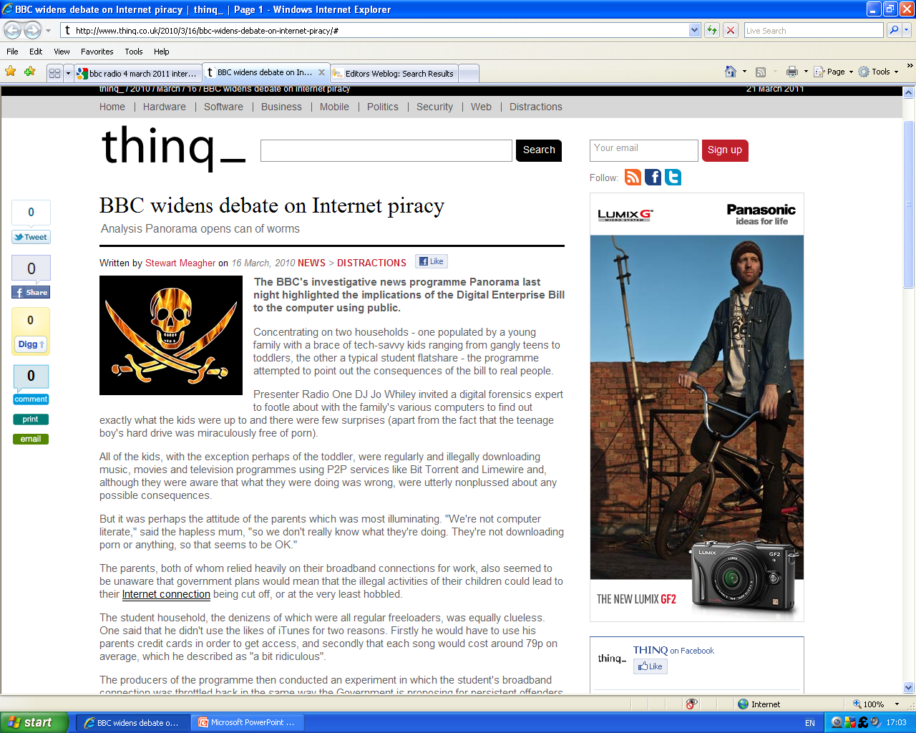

Slide 17
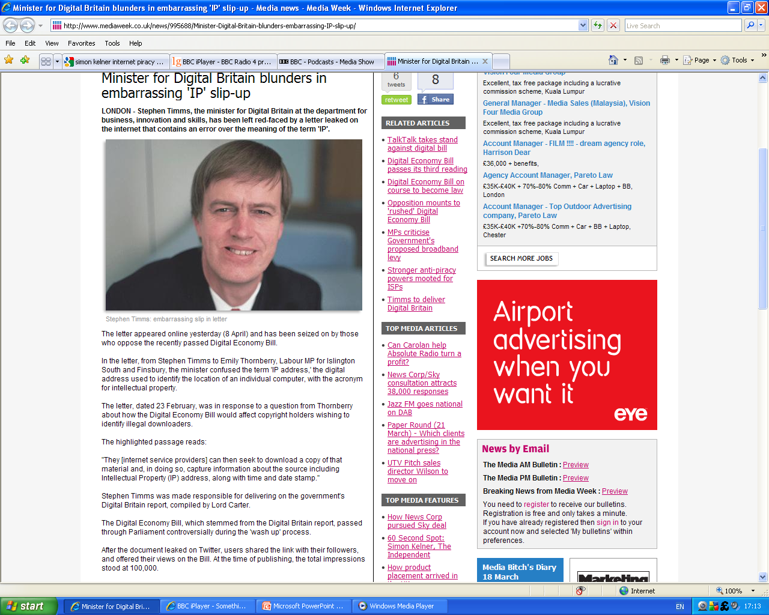

Slide 18
Technology and information
Computer technology has enabled malleability of information; the ability of all to shape it
This creates new possibilities for human activity
Information revolution is not only technological but social and ethical
Thesis: “Many new activities made possible by the new technology are so different from the previous ways of doing things that we need a new set of rules of the game’.” (Baase, p. 26)
  Sara Baase. A Gift of Fire, 3rd ed. Pearson Prentice Hall, 2008.

Slide 19
Individual behaviour
Interpersonal communication
  unreal friends - Matthews & Cocking (1999)
  ethical questions - between person and machine Weckert & Scott (1999)
  cybersex - Turkle (1984, 1995) Negroponte (1995)
Dysfunctional behaviour
  flaming
  rumour-mongering
  Harassment - electronic stalking
Role-playing – Dibbell (1993)
Notes:
Individual Behaviour
There are many very positive ways in which people have applied Internet services, both inter-personal communication capabilities, and information provision and access functions. The question of 'unreal friends' was directly addressed at this conference, in Matthews & Cocking (1999), and ethical questions at the interface between person and machine are addressed in Weckert & Scott (1999). See Adeney (1999) for a consideration of the pleasures of 'cybersex'. See also Turkle (1984, 1995) and Negroponte (1995).
Cyberspace also provides plenty of evidence of dysfunctional behaviour. These are catalogued in (Clarke 1995a). Some are fairly trivial, such as 'flaming' and rumour-mongering. Others are more serious transgressions, such as harassment, and its extension, electronic stalking.
The common Internet activity of role-playing presents much richer challenges to the ethics-analyst. Adopted personae and pretended personality characteristics are intrinsic to many activities in cyberspace, and they have many constructive applications. But they can also be used less pleasantly, as when a male acts like a female psychotherapist, and successfully engages in a one-on-one discussion about intimate women's business; or a male virtually enacts (in image-rich text) a rape of another actor (Dibbell 1993).

Slide 20
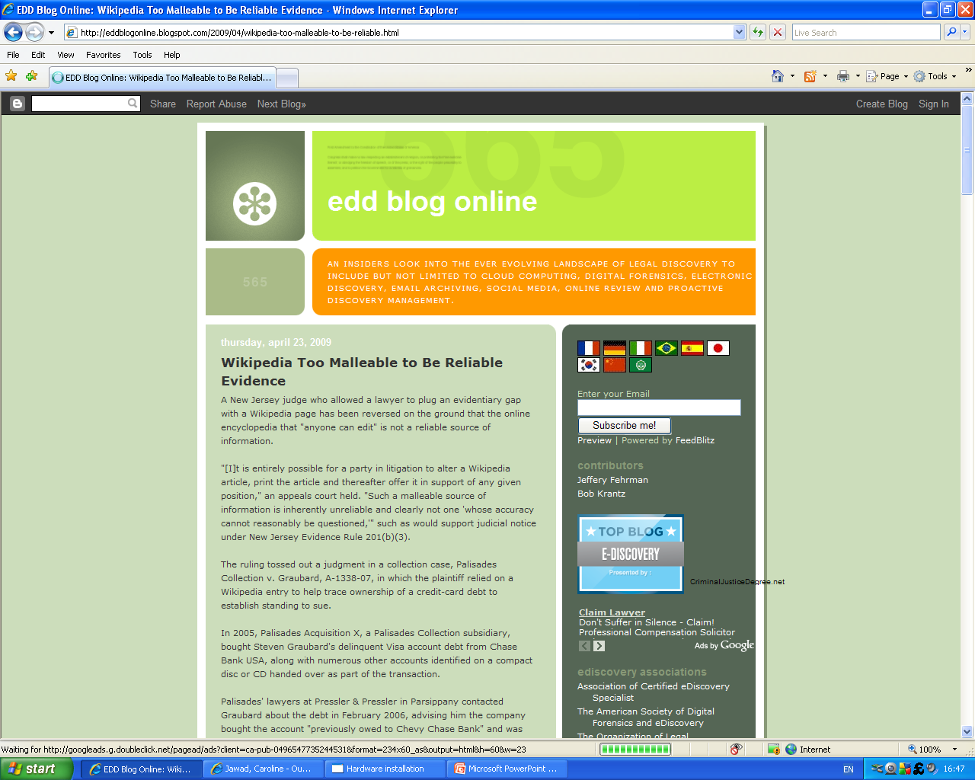

Slide 21
Behaviour in Virtual Communities
Introduction
Virtual communities are groupings of people whose existence is enabled by the use of electronic tools
  Physical / cyberspace
Virtual community arises through some form of common interest
  Party-lines during the first few decades of the telephone.
  Bulletin board systems (BBS)
The Internet - interactions within communities of computer science researchers
Notes:
Introduction
Virtual communities are groupings of people whose existence is enabled by the use of electronic tools. There may be a physical dimension to such a community, through meetings 'in the flesh', or, as netizens tend to put it, in 'meatspace'; but the primary locus is cyberspace.
Like any other form of community, a virtual community arises through some form of common interest. It may be based on physical proximity; but most virtual communities are more limited by lingual boundaries and value-sets than by the inability to meet in physical space, and hence the membership tends to be scattered.
In retrospect, early instances of virtual communities might have arisen through the use of party-lines during the first few decades of the telephone. The phenomenon's emergence is usually traced, however, to bulletin board systems (BBS) in the late 1970s and early 1980s, which involved people with personal computers and modems dialling into a central point to fetch messages posted by others in the community, and to post their own.
The Internet was specifically designed to facilitate interactions within communities of computer science researchers. It subsequently migrated into other disciplines (Clarke (1994a).

Slide 22
Shared Experience, Shared Ethos
Share experiences
Build something greater than the sum of themselves
Shared ethos
  'newbies' killed that ethos?
  more mainstream
  submissive consumer culture
  awakening among consumers
  absorption of virtual community culture into 'real life'
Notes:
The essence of virtual communities is that they provide an opportunity for individuals to share experiences, and to build something greater than the sum of themselves. They have been, to date, primarily social in their orientations, rather than economic. Various aspects of community behaviour are investigated in Clarke (1996a), Clarke (1996e), Clarke (1996f), Clarke (1997d), and Clarke (1997e).
In successful, long-lived virtual communities, shared experiences result in the emergence of a shared ethos. Particularly during the period before the widespread popularisation of the Internet commencing in about 1995, this ethos was remarkably common across a great many virtual communities. It is a matter of ongoing speculation as to whether the surge of 'newbies' onto the net since then is resulting in the death of that ethos; adaptation of the ethos into something closer to mainstream, submissive consumer culture; or perhaps even an awakening among consumers, and absorption of virtual community culture into 'real life'.

Slide 23
Continued
There's no 'there' there (originally said about Oakland, but co-opted)
On the net, nobody knows you're a dog (the caption to a New York Times cartoon)
National borders are just roadbumps on the information superhighway (from the signature block of cyberanarchist Tim May)
National borders are not even roadbumps on the information superhighway (Tim May's revised version)
The street finds its own uses for things (William Gibson)
Information wants to be free (Stewart Brand)
Denies the propertisation of information, and holds appropriation to be a good thing
  information reticulates in cyberspace
Notes:
Authoritative descriptions of netizen ethos are not easy to come by. (Indeed, the very idea of an 'authoritative description' would be argued by many to be unsympathetic and even antithetical to the object of study). It is easiest to grasp the sense of community values through consideration of a set of central aphorisms (Clarke 1997c):
There's no 'there' there (originally said about Oakland, but co-opted)
On the net, nobody knows you're a dog (the caption to a New York Times cartoon)
National borders are just roadbumps on the information superhighway (from the signature block of cyberanarchist Tim May)
National borders are not even roadbumps on the information superhighway (Tim May's revised version)
The street finds its own uses for things (William Gibson)
Information wants to be free (Stewart Brand)
In relation to information, the Internet ethos adopts a very distinctive approach. It denies the propertisation of information, and holds appropriation to be a good thing. In Clarke (1999i), I draw attention to a series of alternative metaphors that are more appropriate than a 'marketplace' as a means to depict the way in which information reticulates in cyberspace. These include 'barn-raising' (as distinct from 'horse-trading' - Rheingold 1992, 1994), a 'cooking pot' into which people place the day's catch, and sup on the resulting stew (Ghosh 1998), and 'bees around a honey pot' (Clarke 1999a).
Detailed consideration of the new economics is to be found in Lamberton (1971, 1996), Clarke (1994a), Barlow (1994), Dyson (1995), Romer (with a populist description in Kelly 1996), Clarke (1999a), Clarke (1999e) and Shapiro & Varian (1999).

Slide 24
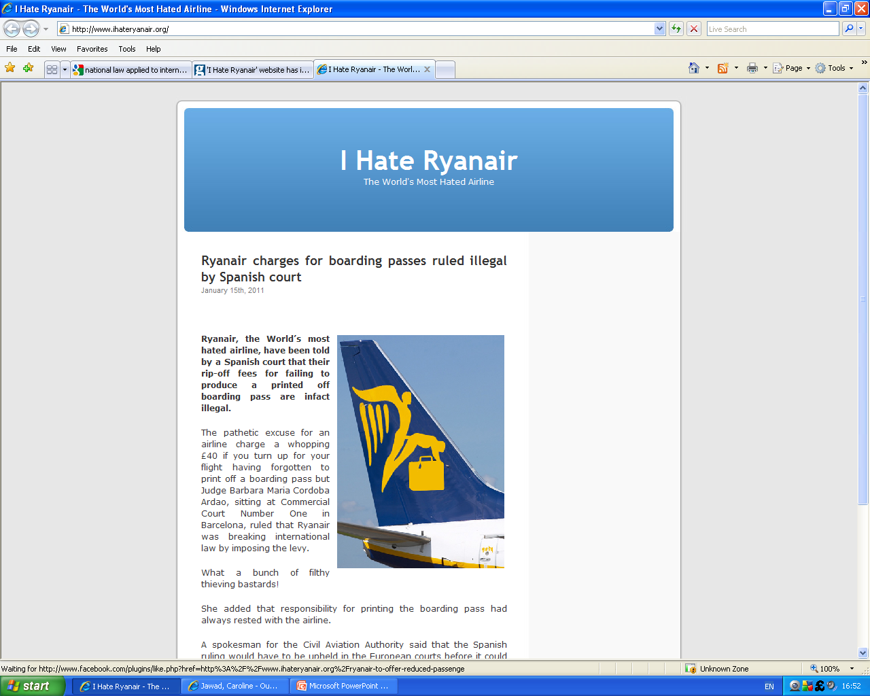

Slide 25
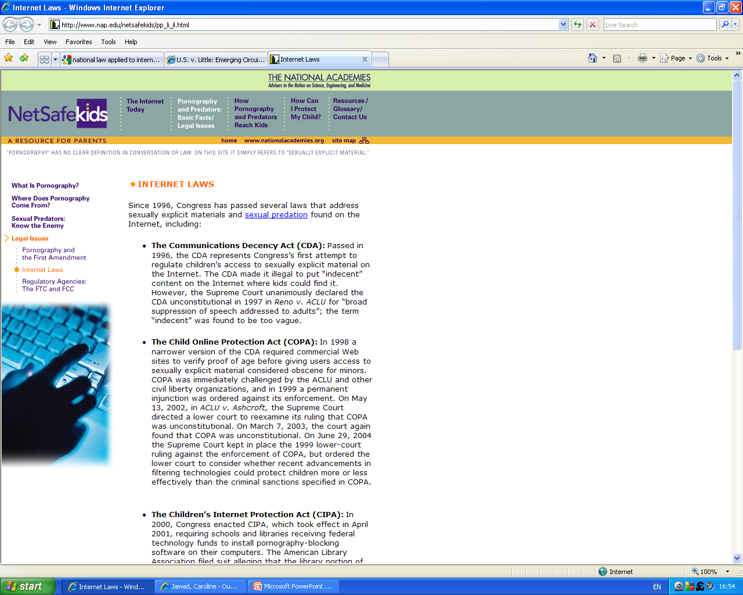

Slide 26
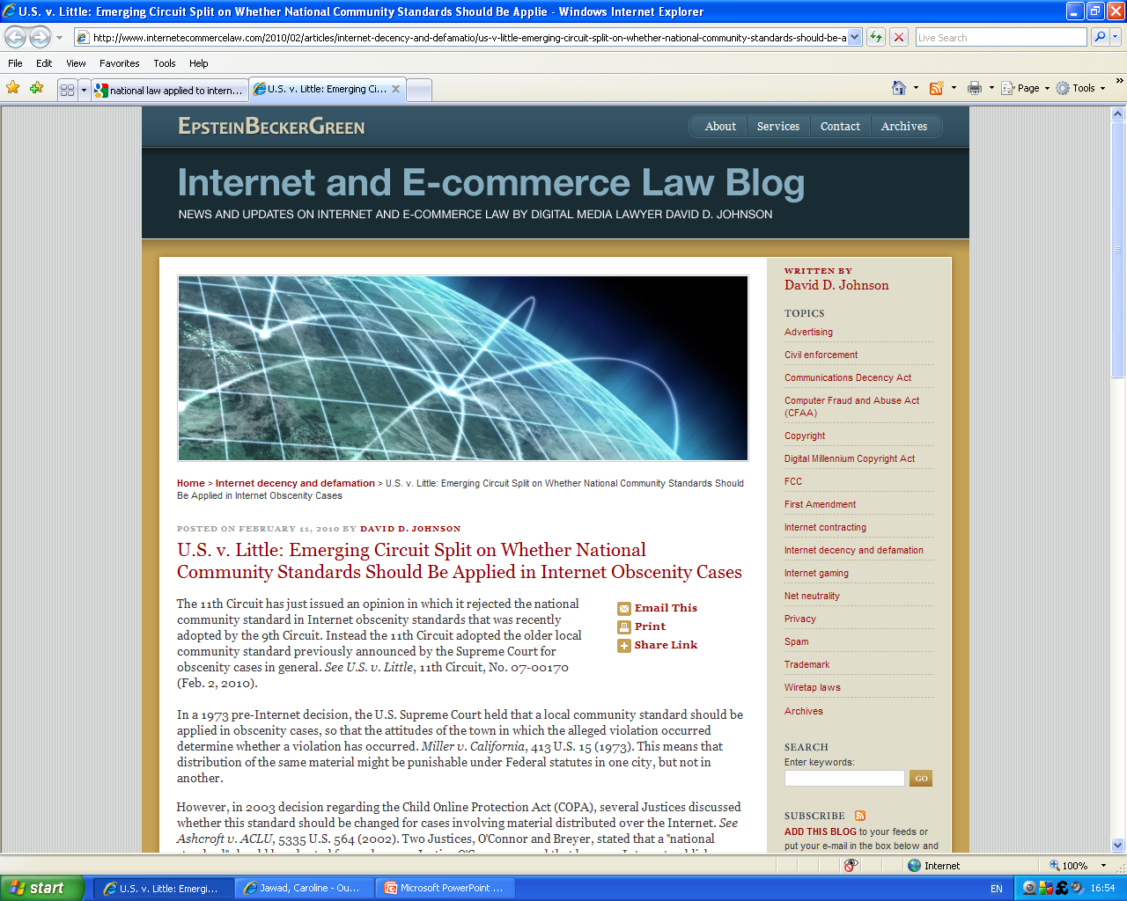

Slide 27
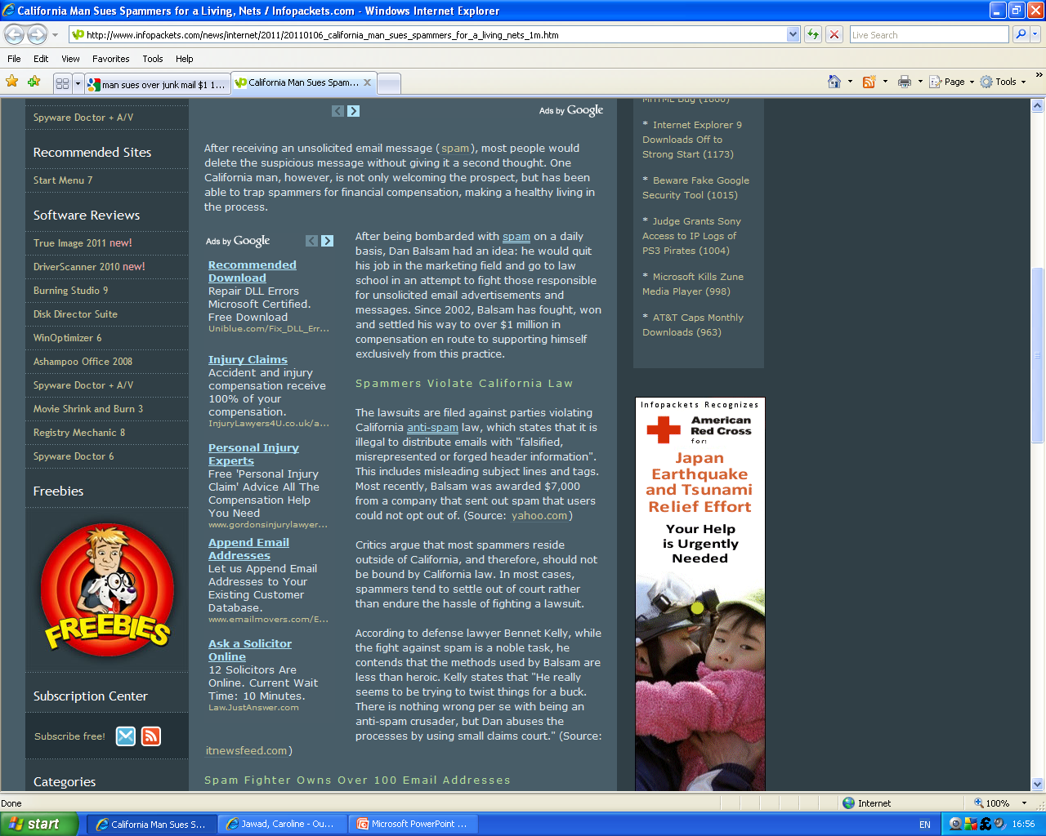

Slide 28
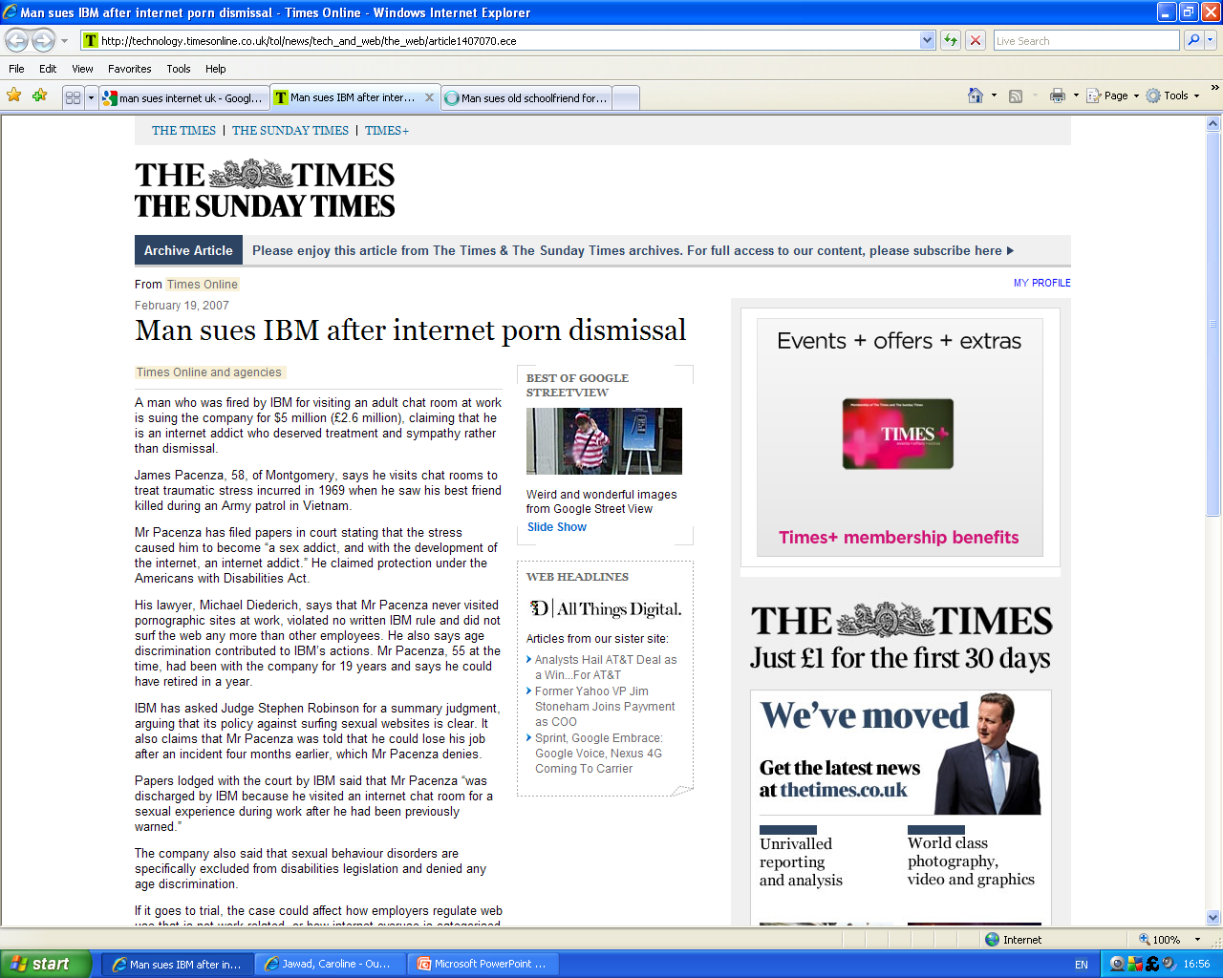

Slide 29
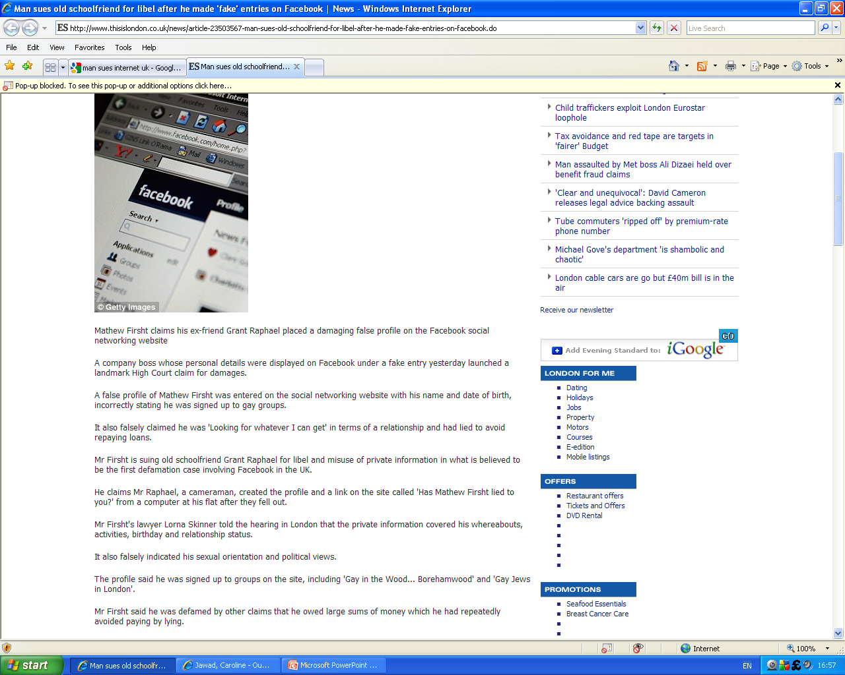

Slide 30
Freedom Theme
Expectations of greater freedoms, reflected in the term 'electronic frontier'
Enhanced freedom of access to information,
Unprecedented volume of information being made available
Wikileaks
Freedom to act anonymously
  threat of retribution
  uncontrollable anti-social acts
  law enforcement agencies, in an attempt to defeat, or at least compromise, electronic anonymity.
  Investment to ensure that anonymous electronic behaviour is sustained
Notes:
The Freedom Theme
One of the recurring elements in electronic communities is expectations of greater freedoms, reflected in the term 'electronic frontier' (Kapor & Barlow 1990). The kinds of freedoms that netizens expect are documented in Clarke (1997i).
One aspect that is particularly worthy of closer examination is the expectation of greatly enhanced freedom of access to information, summed up by the call-to-arms 'information wants to be free' Clarke (1999h). During the period 1995-99, the efforts of millions of people have resulted in an unprecedented volume of information being made available, readily discovered and easily and quickly downloaded to individuals' own machines, for display, analysis and printing.
There are signs, however, that this period of enlightenment may be about to be reversed, and that a new 'dark ages' may come about Clarke (1999i). The use and misuse of the public's right to know was directly addressed at this conference, in Spence (1999).
Another aspect that should be of significant interest to ethicists is the expectation of freedom to act anonymously (Clarke 1996j, 1999g). Although the threat of retribution is only one of the forms of accountability, the freedom to act anonymously brings with it a risk of uncontrollable anti-social acts, in physical as well as in virtual space. A great deal of energy is being expended by law enforcement agencies, in an attempt to defeat, or at least compromise, electronic anonymity. And an even greater (although less well organised) effort is being invested by technologists (in respectable companies as well as in home-garages) in order to ensure that anonymous electronic behaviour is sustained.

Slide 31
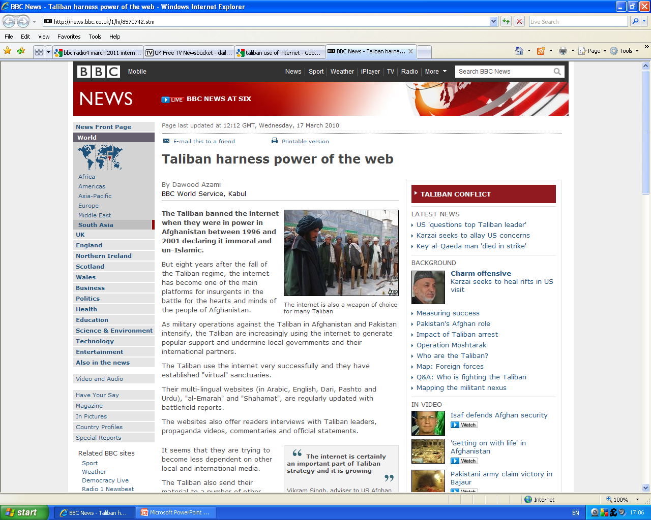

Slide 32
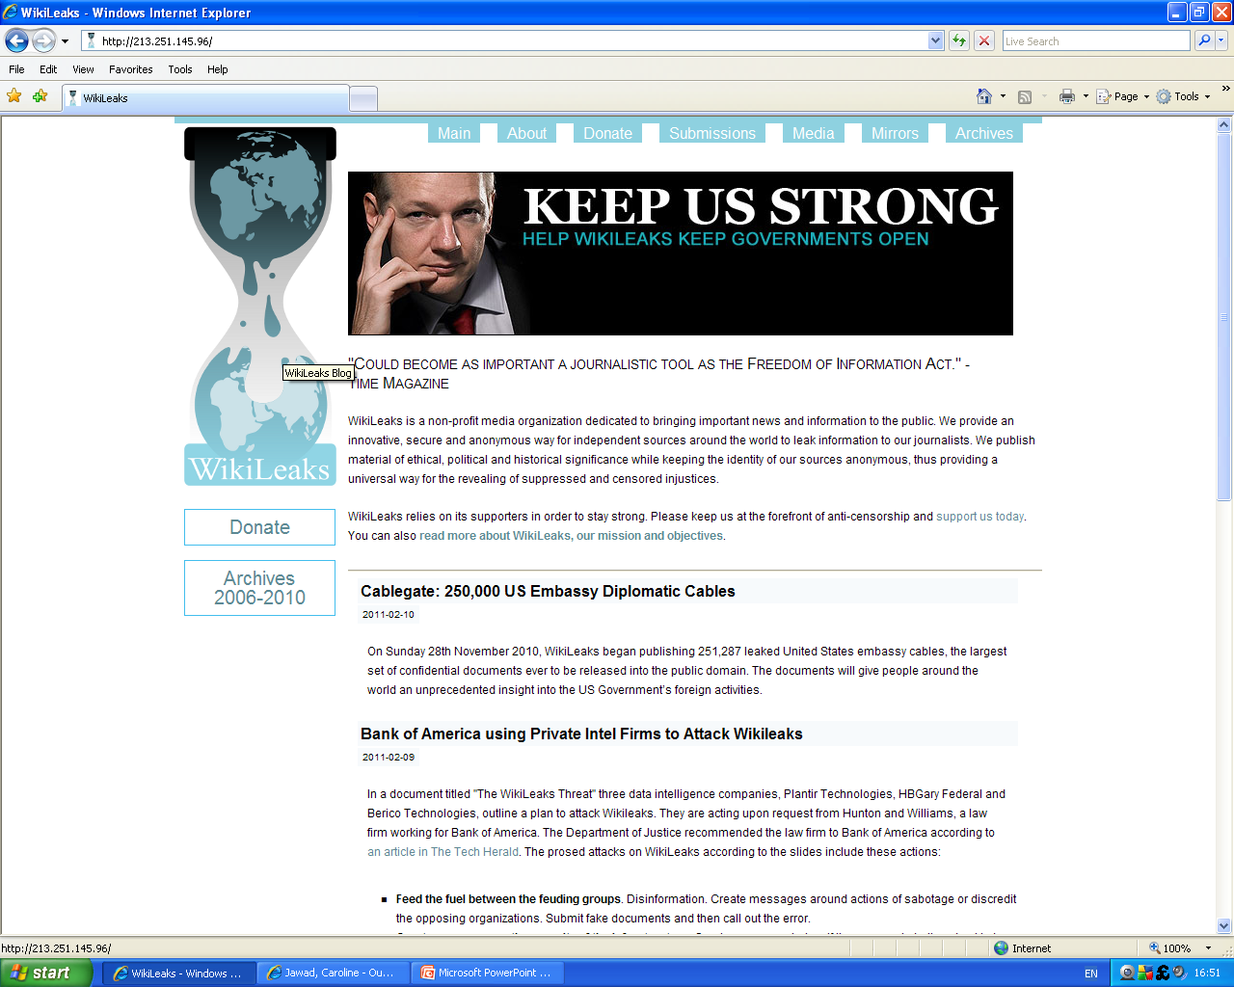

Slide 33
Corporate behaviour
1994, - concept of 'vision'
different net-consumer
ethic that 'information wants to be free‘ - 'I don't like paying for information'
leading market segments, pornography and gambling
consumer protection issues
  spam (unsolicited emails)
  cookies
  lack of public confidence
  trust
  (un)willingness of net-consumers to pay
  invading personal space
  the privacy implications of direct marketing practice
Notes:
Corporations discovered the potential of the Internet only in 1994, but since then there has been an absolute feeding-frenzy. Among marketers, the concept of 'vision' has less to do with perceiving the future, and more to do with the quality of the graphic design. As a result, there has been a substantial failure to appreciate that mass-marketing techniques that were effective in the era of broadcast technologies (particularly radio and television), and the mass media that they supported, are inappropriate and ineffectual ways of influencing the very different net-consumer via the very different technologies of the Internet.
Moreover, the ethic that 'informations wants to be free' has tended to be corrupted into the expectation that 'information wants to be gratis' and hence the assertion that 'I don't like paying for information' (Clarke 1999h). This has created barriers for electronic publishers, who need to find new business models to support their empires and the authors on whose creative output they depend. The implications for the publishing industry are discussed in Clarke (1999c).
Leaving aside the special case of information-for-profit, consumer Internet commerce in physical goods has not enjoyed the meteoric growth-rates of other Internet metrics (although the anticipation that, sometime, somehow, it will break through, has resulted in ridiculously speculative valuations of Internet companies). With the exception of the leading market segments, pornography and gambling, there is good reason to expect that growth in trading volumes will remain constrained unless and until marketers change their ways.
Consumer protection issues are considered in Clarke (1996i), and the specific challenges of spam (unsolicited emails) in Clarke (1997a), and cookies in Clarke (1997b). Broader treatment of the lack of public confidence and trust is in Clarke (1999a). The (un)willingness of net-consumers to pay is examined in Clarke (1999e). Clarke (1998f) addresses the general topic of cyberspace invading personal space, the privacy implications of direct marketing practices are assessed in Clarke (1998b), and Clarke (1998i) considers specific needs in relation to marketing codes of practice. The ethical implications of current Internet market models were also directly addressed at this conference, in Kronenberg (1999).

Slide 34
Government behaviour
Additional service delivery channel,
Additional source of data for social control - increased intensity of data trails about citizens.
Applications of technology in the areas of identification, particularly smart cards, digital signatures and public key infrastructure
Widespread availability of strong cryptography
Notes:
The Internet has been recognised by government agencies as an additional service delivery channel, and an opportunity to reeduce costs, while sustaining the image, and even perhaps the reality, of service (Clarke 1999f).
It has also been recognised as an additional source of data for social control, and as a means of achieving increased intensity of data trails about citizens. Major initiatives are in train among law enforcement agencies and national security communities to harness Internet technologies to the location of people (Clarke 1999k). This would enable them to stretch their surveillance budgets, monitor more people more intensively, and automate the collection of both intelligence and evidence.
There are some potentially very aggressive applications of technology in the areas of identification, particularly smart cards, digital signatures and public key infrastructure (Greenleaf & Clarke 1997, Clarke 1998d). In an area closely related to public key infrastructure, the (primarily U.S.) national security community spent five years trying unsuccessfully to preclude the widespread availability of strong cryptography (Clarke 1996c), which is the technical means whereby the contents of messages can be protected from prying eyes. Finally, in September 1999, they accepted the inevitable, and changed their strategy.

Slide 35
Regulation of Internet behaviour
In some respects, the law has coped -
  pornography, malicious harm, stalking, and fraud have been uncovered and prosecuted
  creation of statutory 'computer crimes' has rendered criminal, particular acts that previously were not prosecutable.
Ill-fitting laws In the civil law arena
In the criminal jurisdiction, possession offences, particularly in the extreme case of child pornography, have shown the law to be a serious affront
Enforcement of the law is seriously challenged by technical aspects of the Internet
Notes:
In some respects, the law has coped quite well with challenges created by the Internet. For example, some instances of pornography, malicious harm, stalking, and fraud have been uncovered and prosecuted. Moreover, the creation of statutory 'computer crimes' has rendered criminal, particular acts that previously were not prosecutable.
There are, however, many instances of ill-fitting laws. In the civil law arena, for example, there are continuing doubts about the efficacy of existing laws relating to signatures and documents in the electronic context (Clarke 1999d). And in the criminal jurisdiction, possession offences, particularly in the extreme case of child pornography, have shown the law to be a serious affront to logic as well as to personal dignity, e.g. Clarke (1998e).
Enforcement of the law is seriously challenged by technical aspects of the Internet (Clarke 1996h, Clarke et al. 1998a, Clarke et al. 1998b).
In addition, the limitation of law enforcement agencies to specific geographic jurisdictions creates serious challenges for them when they investigate activities that can be readily contrived to be extra-jurisdictional (i.e. occur somewhere else), trans-jurisdictional (i.e. occur across two or more areas), or are supra-jurisdictional (i.e. occur somewhere that no agency has jurisdiction over). One effect of the Internet has been to lower the cost of 'tax-havens' and regulatory arbitrage, such that they are no longer restricted to corporations and wealthy individuals. See Clarke (1997c).
Two primary areas in which regulation has been attempted are pornography Clarke (1996b) and gambling (Clarke et al. 1998b). Additional areas include fraud, unfair marketing practices, and 'cyber-squatting' (a vogue term for the acquisition of domain-names that seem likely to command a premium at some future time). In some other areas, notably privacy, and aspects of consumer protection, there has been a marked reluctance by governments, especially in the U.S.A. and Australia, to take action. See van den Hoven (1999).
Regulation by geographically limited governments still has a role to play, but needs to be complemented by other means. International collaboration and harmonisation might help. Another important consideration is community self-regulation. A further approach is enhancements and adaptations to the architecture of the Internet. Attempts are being made through such mechanisms as PICS (Clarke 1996d), P3P (Clarke 1998c) and a new standard for cookies Clarke (1997b). For discussions of more fundamental change, see Greenleaf (1998, 1999).
For discussions of a range of specific issues arising in relation to the regulation of Internet behaviour, see Clarke (1999b) and de Zwart (1999). In relation to the specific matter of privacy, see Clarke (1994b), Clarke (1996g), Clarke (1997g), Clarke (1997h) Clarke (1998b) Clarke (1999j).

Slide 36
Continued
Geographic jurisdictions creates serious challenges
Tax-havens and regulatory arbitrage,
Two primary areas in which regulation has been attempted are pornography and gambling
Additional areas include fraud, unfair marketing practices, and 'cyber-squatting‘
Some areas, notably privacy, and aspects of consumer protection, there has been a marked reluctance by governments, especially in the U.S.A. and Australia, to take action. See van den Hoven (1999).

Slide 37
Continued
Regulation by geographically limited governments still has a role to play, but needs to be complemented by other means
International collaboration
Self-regulation.
Architecture of the Internet
Notes:
http://www.rogerclarke.com/II/IEthics99.html

Slide 38
Conclusion
moral philosophers base theories of ethical behaviours on the human face; but, in Internet communication there is likely not that human face
Internet has flourished because of the freedom it allows without the controls from governments or powerful self-interest groups
all kinds of information considered morally wrong by many, e.g. racist hate speech, child pornography, promotion of terrorism and the incitement to commit violence
international perspective, for behaviour illegal in one part of the world may be perfectly legal in another
uncontrollability – who makes the rules and who enforces them
problem of jurisdiction and the application of protections (Langford 2000).

