Slide 1
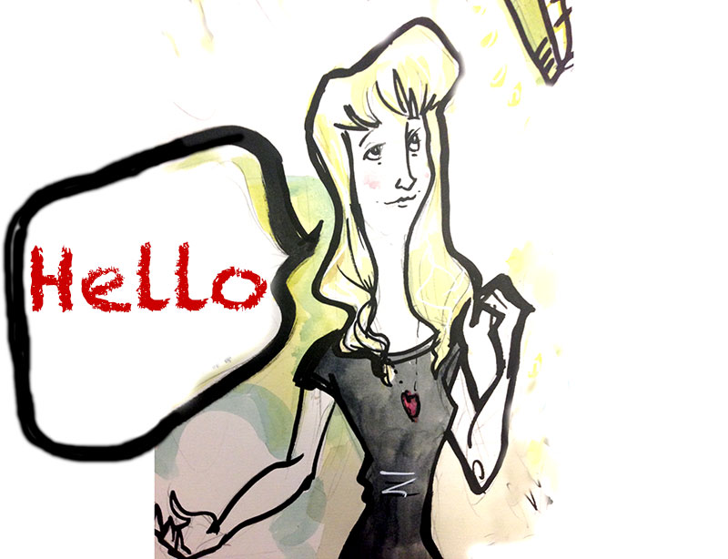

Kath Penaluna
© Karl Mountford 2010

Slide 2
Question 1
Paper and pen is given to an artist...
Who does a drawing and gives it to a friend...
The friend discards the drawing (hates it)...
Which is discovered by somebody who appreciates its value...
An offer from a print company is accepted..
Are they legally entitled to print it?

Slide 3
Question 2
A local journalist discovers the story and takes a photo of the drawing with its owner...
And runs a story in the local paper about it
The photo includes the drawing
Was this legal?

Slide 4
Innovation Protection?
To fully exploit the potential of IPR you need to understand the range and type of intellectual property rights that are available to you... however
“Because IP assets cannot be seen or touched it is sometimes hard to appreciate their value” (UKIPO, 2007)
In the US, what % of company assets are not the factories and other physical and human resources?
“65% of US assets are intellectual property”
(Christobal, 2006)

Slide 5
A brief summary of IPR assets:
Patents
…protects invention
Copyright
…protects the author
Trademarks
...a distinguishing mark
Registered Designs
...protect appearance

Slide 6



Innovation Protection?
Who is this?

Slide 7

Innovation Protection?
How did you know??

Slide 8

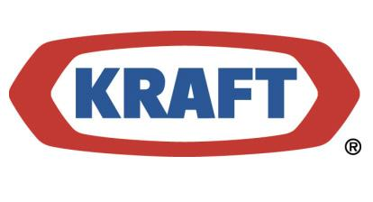
Innovation Protection?
What is that knowledge worth to the company?
In the UK alone…
£60 million to the owners

Slide 9
Trademarks - recognition
Registered Trademark = ®
Must be distinctive for your goods or service
And not resemble one already in your line of business
This will be subject to checking
In the ‘Trade Marks Journal’

Slide 10
Trademarks - recognition
Unregistered Trademark = ™
Common law allows you to simply use this
And to defend it against infringers
However, it is far more difficult to enforce
And it could be your most valuable asset!!

Slide 11
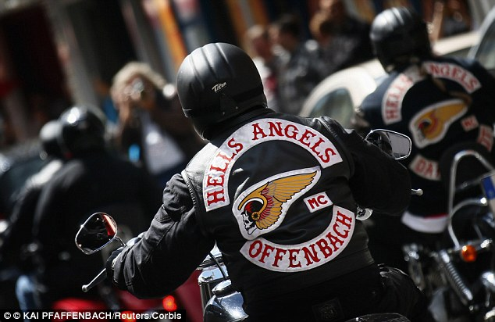
November 2013 – Hells Angels accuse rapper Young Jeezy's clothing line and Dillard's store of trademark infringement over winged head design

Slide 12

This jacket shows the Death Head symbol that's the basis of a federal lawsuit by Hells Angels against 8732 Apparel and Dillard's.

Slide 13
UWTSD will have permissions to reproduce the images in all forms and media for the purpose of teaching and promotion. UWTSD will ensure that your moral rights to be identified as the creator of the images are respected.
You warrant that you are entitled to grant us the rights and that the exercise of such rights will not (a) infringe the copyright or any other personal or property rights of any person of (b) entitle any person to claim any payment from us or from any of our licensees.

Slide 14
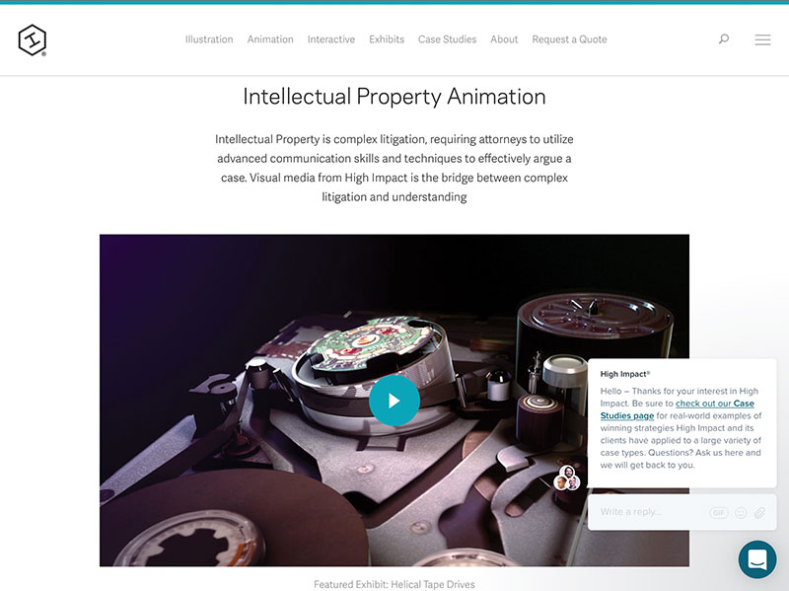
Help??
https://highimpact.com/services/intellectual-property-animation

Slide 15
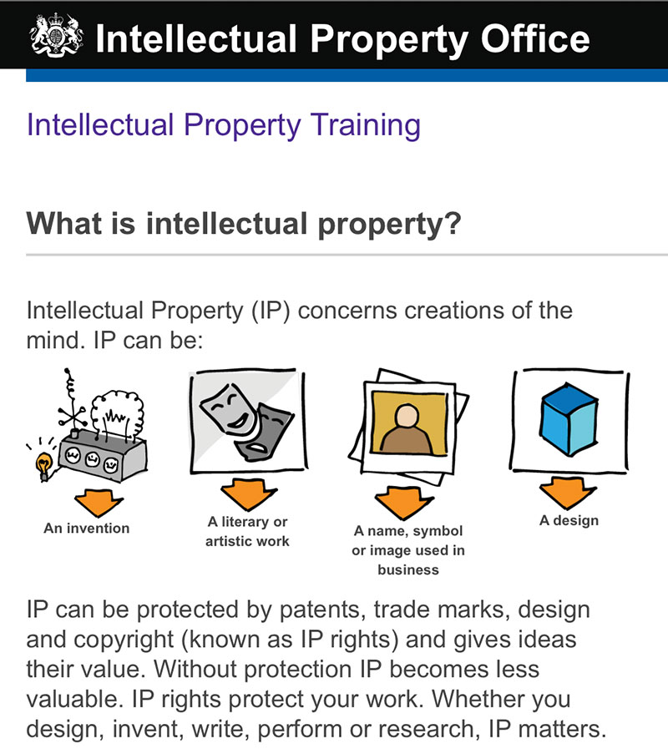
Help??
http://www.ipo.gov.uk/blogs/iptutor/

Slide 16
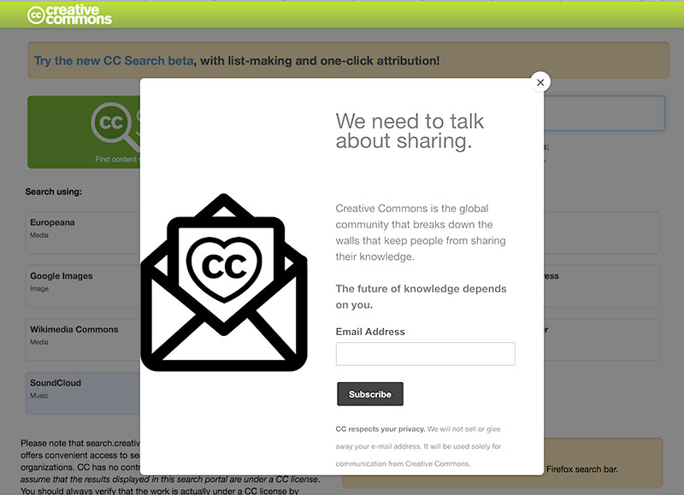
Help??
https://search.creativecommons.org/

Slide 17

Kathryn Penaluna
The Creativity and Business Intersection lectures: Protecting your rights and avoid being sued
04 March 2017
© Andy & Kathryn Penaluna

