Slide 1
ACUA 6001
Data Centre Virtualization
Week 4
Network Programming
- Koushik Modak

Slide 2
Lesson Aims
  To understand why network programmability is necessary for evolving networks.
  To understand software-defined networking.
  To understand the controllers used in network programming.
Notes:
2
Cisco Networking Academy Program
Connecting Networks v6.0
Chapter 7: Network Evolution

Slide 3
Network Programming
Notes:
7 – Network Evolution
7.2 – Cloud and Virtualization

Slide 4
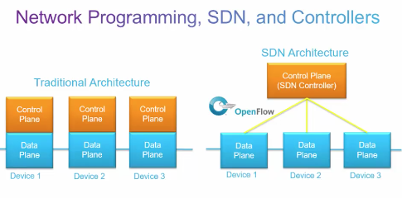
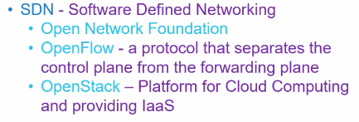
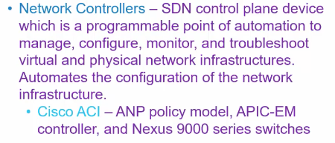
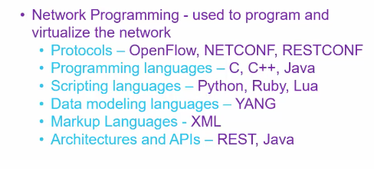
Software-Defined Networking
Video – Network Programming, SDN, and Controllers
Notes:
7.3 – Network Programming
7.3.1 – Software-Defined Networking
7.3.1.1 – Video – Network Programming, SDN, and Controllers

Slide 5
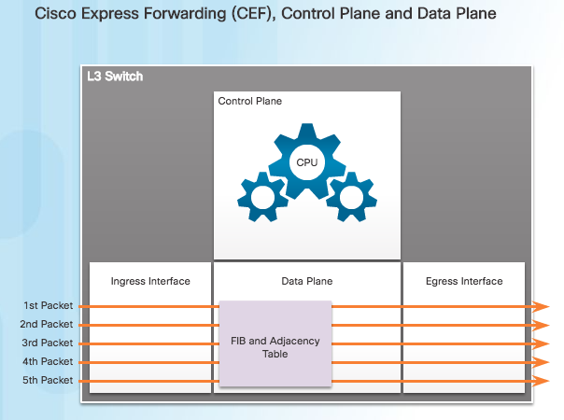
Software-Defined Networking
Control Plane and Data Plane
A network device contains the following planes:
  Control plane - Regarded as the brains of a device. Used to make forwarding decisions. Information sent to the control plane is processed by the CPU.
  Data plane - Also called the forwarding plane, this plane is the switch fabric connecting the various network ports on a device. The data plane of each device is used to forward traffic flows.
CEF is an advanced, Layer 3 IP switching technology that enables forwarding of packets to occur at the data plane without consulting the control plane. Packets are forwarded directly by the data plane based on the information contained in the Forwarding Information Base (FIB) and adjacency table, without needing to consult the information in the control plane.
Notes:
7.3 – Network Programming
7.3.1 – Software-Defined Networking
7.3.1.2 – Control Plane and Data Plane

Slide 6
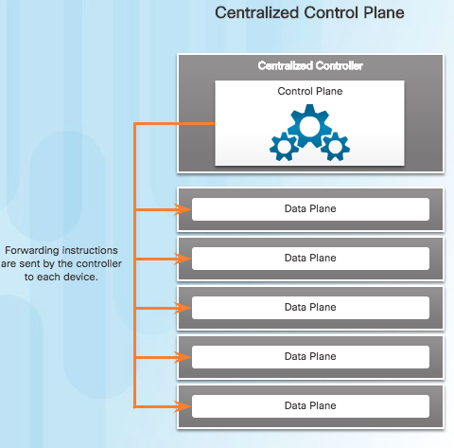
Software-Defined Networking
Control Plane and Data Plane (Cont.)
To virtualize the network, the control plane function is removed from each device and is performed by a centralized controller.
The centralized controller communicates control plane functions to each device.
Each device can now focus on forwarding data while the centralized controller manages data flow, increases security, and provides other services.
Notes:
7.3 – Network Programming
7.3.1 – Software-Defined Networking
7.3.1.2 – Control Plane and Data Plane (Cont.)

Slide 7


Software-Defined Networking
Virtualizing the Network
Two major network architectures have been developed to support network virtualization:
  Software Defined Networking (SDN) - A network architecture that virtualizes the network.
  Cisco Application Centric Infrastructure (ACI) - A hardware solution for integrating cloud computing and data center management.
These are some other network virtualization technologies, some of which are included as components in SDN and ACI:
  OpenFlow - The OpenFlow protocol is a basic element in building SDN solutions.
  OpenStack - This approach is a virtualization and orchestration platform available to build scalable cloud environments and provide an infrastructure as a service (IaaS) solution.
Notes:
7.3 – Network Programming
7.3.1 – Software-Defined Networking
7.3.1.3 – Virtualizing the Network

Slide 8
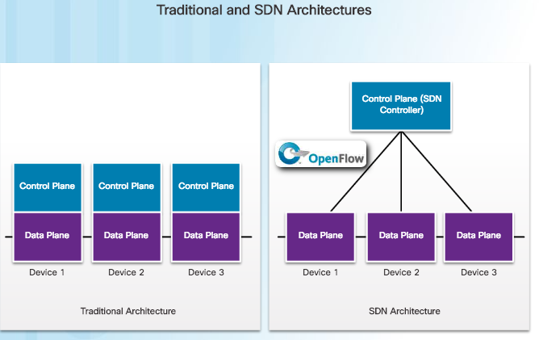
Software-Defined Networking
SDN Architecture
In a traditional router or switch architecture, the control plane and data plane functions occur in the same device. Routing decisions and packet forwarding are the responsibility of the device operating system.
Software defined networking (SDN) is a network architecture that has been developed to virtualize the network. SDN can virtualize the control plane. SDN moves the control plane from each network device to a central network intelligence and policy-making entity called the SDN controller.
Notes:
7.3 – Network Programming
7.3.1 – Software-Defined Networking
7.3.1.4 – SDN Architecture

Slide 9
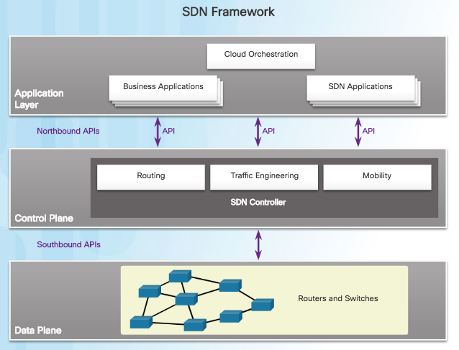
Software-Defined Networking
SDN Architecture (Cont.)
The SDN controller enables network administrators to manage and dictate how the data plane of virtual switches and routers should handle network traffic.
The SDN controller uses northbound APIs to communicate with the upstream applications. These APIs help network administrators shape traffic and deploy services.
The SDN controller also uses southbound APIs to define the behavior of the downstream virtual switches and routers.
An API is a set of standardized requests that define the proper way for an application to request services from another application.
OpenFlow is the original and widely implemented southbound API.
Notes:
7.3 – Network Programming
7.3.1 – Software-Defined Networking
7.3.1.4 – SDN Architecture (Cont.)

Slide 10
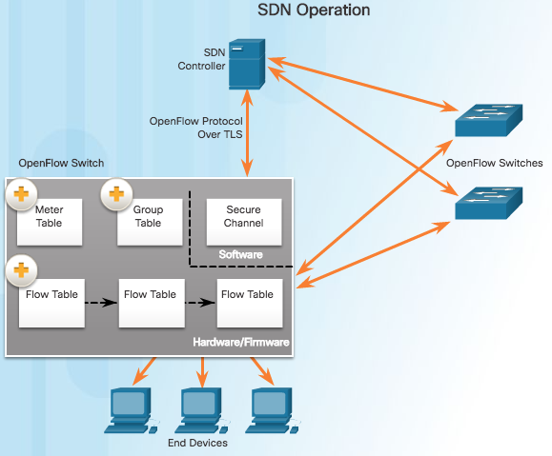
Controllers
SDN Controller and Operations
SDN controller defines the data flows that occur in the SDN Data Plane. A flow could consist of all packets with the same source and destination IP addresses, or all packets with the same VLAN identifier.
Each flow traveling through the network must first get permission from the SDN controller. If the controller allows a flow, it computes a route for the flow to take and adds an entry for that flow in each of the switches along the path.
The controller populates and the switches manage the flow tables. Each OpenFlow switch connects to other OpenFlow switches. They can also connect to end-user devices that are part of a packet flow.
To the switch, a flow is a sequence of packets that matches a specific entry in a flow table.
Notes:
7.3 – Network Programming
7.3.2 – Controllers
7.3.2.1 – SDN Controller and Operations

Slide 11



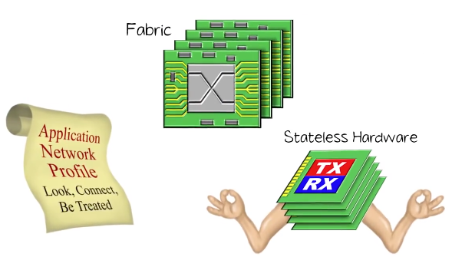
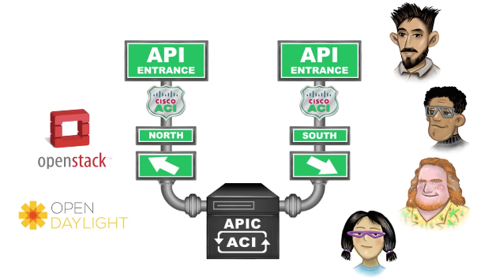
Controllers
Video - Cisco Application Centric Infrastructure
Notes:
7.3 – Network Programming
7.3.2 – Controllers
7.3.2.2 – Video - Cisco Application Centric Infrastructure

Slide 12
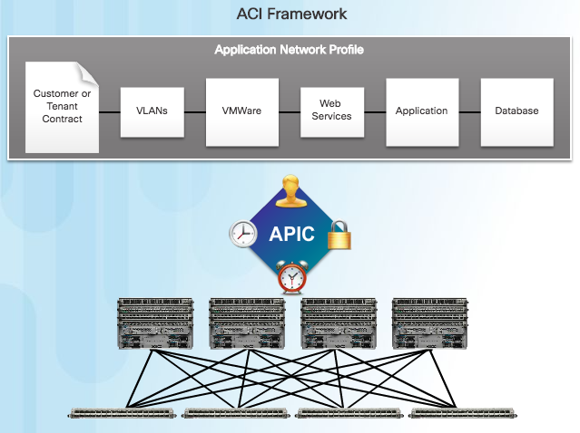
Controllers
Core Components of ACI
Three core components of the ACI architecture:
  Application Network Profile (ANP) - Collection of end-point groups (EPG), their connections, and the policies that define those connections.
  Application Policy Infrastructure Controller (APIC) – The brains of the ACI architecture. A centralized software controller that is designed for programmability and centralized management. Translates application policies into network programming.
  Cisco Nexus 9000 Series switches – Provide an application-aware switching fabric and work with an APIC to manage the virtual and physical network infrastructure.
APIC is positioned between the ANP and the ACI-enabled network infrastructure. The APIC translates the application requirements into a network configuration to meet those needs.
Notes:
7.3 – Network Programming
7.3.2 – Controllers
7.3.2.3 – Core Components of ACI

Slide 13
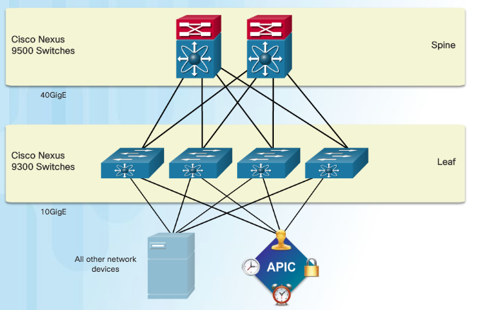
Controllers
Spine-Leaf Topology
Cisco ACI fabric is composed of the APIC and the Cisco Nexus 9000 series switches using two-tier spine-leaf topology, as shown in the figure.
Leaf switches always attach to the spines, but they never attach to each other.
Spine switches only attach to the leaf and core switches (not shown).
Cisco APICs and all other devices in the network physically attach to leaf switches.
When compared to SDN, the APIC controller does not manipulate the data path directly.
The APIC centralizes the policy definition and programs the leaf switches to forward traffic based on the defined policies.
Notes:
7.3 – Network Programming
7.3.2 – Controllers
7.3.2.4 – Spine-Leaf Topology

Slide 14
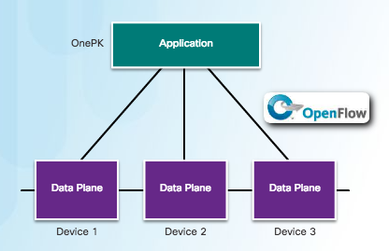
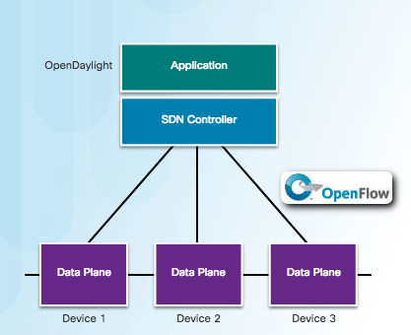
Controllers
SDN Types
To better understand APIC-EM, it is helpful to take a broader look at the three types of SDN:
  Device-based SDN - The devices are programmable by applications running on the device itself or on a server in the network. Cisco OnePK is an example of a device-based SDN. It enables programmers to build applications to integrate and interact with Cisco devices.
  Controller-based SDN - Uses a centralized controller that has knowledge of all devices in the network. The applications can interface with the controller responsible for managing devices and manipulating traffic flows throughout the network. The Cisco Open SDN Controller is a commercial distribution of OpenDaylight.
Notes:
7.3 – Network Programming
7.3.2 – Controllers
7.3.2.5 – SDN Types

Slide 15
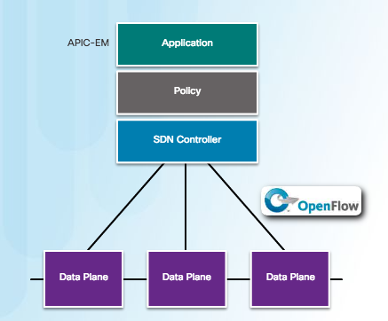
Controllers
SDN Types (Cont.)
  Policy-based SDN - Similar to controller-based SDN where a centralized controller has a view of all devices in the network. Includes an additional Policy layer. Uses built-in applications that automate advanced configuration tasks via a guided workflow and user-friendly GUI. No programming skills are required. Cisco APIC-EM is an example of this type of SDN.
Policy-based SDN is the most robust, providing for a simple mechanism to control and manage policies across the entire network.
Notes:
7.3 – Network Programming
7.3.2 – Controllers
7.3.2.5 – SDN Types (Cont.)

Slide 16
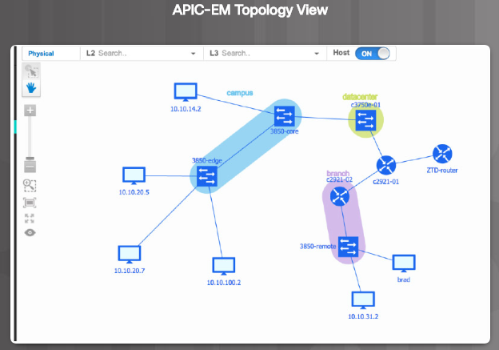
Controllers
APIC-EM Features
Cisco APIC-EM provides the following features:
  Discovery - Supports a discovery functionality that is used to populate the controller's device and host inventory database.
  Device Inventory - Collects detailed information from devices within the network including device name, device status, MAC address, IPv4/IPv6 addresses, IOS/Firmware, platform, up time, and configuration.
  Host Inventory - Collects detailed information from hosts with the network including host name, user ID, MAC address, IPv4/IPv6 addresses, and network attachment point.
  Policy - Ability to view and control policies across the entire network including QoS.
  Topology - Supports a graphical view of the network (topology view).
  Policy Analysis - Inspection and analysis of network access control policies. Ability to trace application specific paths between end devices to quickly identify ACLs in use and problem areas.
Notes:
7.3 – Network Programming
7.3.2 – Controllers
7.3.2.6 – APIC-EM Features

Slide 17
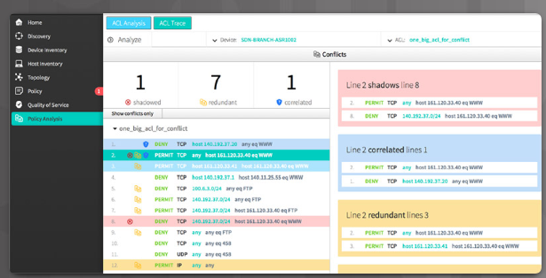
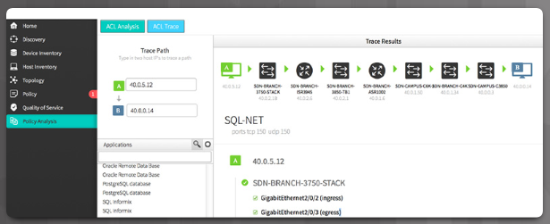
Controllers
APIC-EM ACL Analysis
ACL Analysis
One of the most important features of the APIC-EM controller is the ability to manage policies across the entire network.
APIC-EM ACL Analysis and Path Trace provide tools to allow the administrator to analyze and understand ACL policies and configurations.
  ACL Analysis Tool - Enables ACL inspection and interrogation across the entire network, exposing any problems and conflicts.
  ACL Path Trace - This tool examines specific ACLs on the path between two end nodes, displaying any potential issues.
ACL Path Trace
Notes:
7.3 – Network Programming
7.3.2 – Controllers
7.3.2.7 – APIC-EM ACL Analysis

Slide 18
Student Activity
Explain why network programmability is necessary for evolving networks.
Notes:
7.4 – Summary
7.4.1 – Conclusion
7.4.1.1 - Chapter 7: Network Evolution

Slide 19
References
Nunes, Bruno AA, et al. "A survey of software-defined networking: Past, present, and future of programmable networks”, Communications Surveys & Tutorials, IEEE 16.3 (2014): 1617-1634.
C. J. Sher Decusatis, A. Carranza, C. M. Decusatis, "Communication within clouds: open standards and proprietary protocols for data centre networking," Communications Magazine, IEEE , vol.50, no.9, September 2012.
Santana, G.A.A. (2013) Data Centre Virtualization Fundamentals: Understanding Techniques and Designs for Highly Efficient Data Centres with Cisco Nexus, UCS, MDS, and Beyond, Pearson Education.

