Slide 1
MODULE NAME: Problem Solving and Decision Making
MODULE CODE: LCLM4004_LON
STUDENT NAME: Mariana Repeta
STUDENT ID: 2439669
LECTURER: Mustakkima Afrin
Assignment 1: Presentation

Slide 2
OVERVIEW
Introduction
Company background
Problem: nature and scope
PESTLE ANALYSIS: Green Haven Florists
Cause and effect analysis: Fishbone diagram
Conclusion
References

Slide 3
Introduction
Green Haven Florists is a small flower shop in Norwich, UK.
It was started in 2016 by Liam and Priya Patel.
The shop became popular because:
It makes beautiful custom flower arrangements
It uses eco-friendly packaging
It has a good relationship with the local community
But in the last year, the business has had problems.
Their in-store sales have gone down by 30%.
This presentation will explain the problems and analyse them using business tools.
A drop in sales refers to a decrease in the amount sold or the revenue generated between two time periods (Calculator Ultra, 2025).
Notes:
Green Haven Florists is a small independent flower shop located in Norwich in the United Kingdom.
The business was founded in 2016 by Liam and Priya Patel.
The shop became popular because it created custom floral arrangements, used eco-friendly packaging, and developed strong relationships with the local community.
However, in the last 12 months the business has faced serious challenges.
In-store sales have dropped by 30 percent, which means fewer customers are visiting the shop and revenue has decreased.
A drop in sales refers to a decrease in the amount sold or the revenue generated between two time periods (Calculator Ultra, 2025).
In this presentation I will analyse the causes of this problem using business tools including:
The 5W2H model
PESTEL analysis
A Fishbone diagram
These tools help identify both internal and external factors affecting the business.

Slide 4
Company background
Green Haven Florists
Founded: 2016
Location: Norwich, UK
Owners: Liam Patel and Priya Patel
Business: Independent flower shop
Products: Bouquets, custom flower arrangements, wedding and corporate flowers
Known for eco-friendly packaging and strong community ties
Serves walk-in customers, events, and businesses
Recently facing a 30% drop in in-store sales due to competition and rising costs.
Problem identification is an important first step in understanding business challenges (BA Guide, 2023).
Notes:
Over the last year, Green Haven Florists has experienced a 30 percent decline in in-store sales.
There are several reasons for this problem.
First, the location has become less busy. Some nearby businesses have closed, which means fewer people are visiting the high street.
Second, there is strong competition from online flower delivery companies. Many customers now prefer ordering flowers online because it is more convenient and often cheaper.
Third, operational costs have increased due to inflation and supply chain disruptions. Imported flowers such as orchids and tulips have become more expensive.
Finally, the business has limited digital marketing and an outdated website, which makes it harder to compete with online businesses.
Understanding these issues is important because problem identification is the first step in improving business performance (BA Guide, 2023).

Slide 5
Problem: nature and scope
Who: Liam and Priya Patel
What: 30% decline in in-store sales
Where: Green Haven Florists shop in Norwich, UK
When: During the last 12 months
Why: Online competition, rising costs, and fewer customers visiting the high street
How: Customers prefer online flowers delivery and the shop has weak digital marketing
How Much: In-store sales decreased by 30%
The 5W2H method helps organisations clearly analyse and understand problems by asking key questions (Campos, 2013).
Notes:
To clearly define the problem, we can use the 5W2H model.
The 5W2H method is a management tool used to analyse problems by asking key questions such as Who, What, Where, When, Why, How and How Much (Campos, 2013).
Applying it to Green Haven Florists:
Who – The business owners, Liam and Priya Patel.
What – The problem is a 30 percent decline in in-store sales.
Where – The problem is occurring at the Green Haven shop in Norwich, UK.
When – The decline has happened over the last 12 months.
Why – Because of online competition, rising costs, and fewer high-street customers.
How – Customers prefer online ordering, while the shop has limited digital marketing and an outdated website.
How Much – In-store sales have dropped by 30 percent.
This model helps clearly define the problem before identifying solutions.

Slide 6
PESTLE ANALYSIS: Green Haven Florists
PESTEL analysis helps businesses understand external factors that can affect their performance (CIPD, 2025).
POLITICAL
Government rules for importing flowers from other countries
Business taxes and policies affecting small businesses
ECONOMIC
Inflation increasing flower prices and packaging costs
Customers spending less money due to rising living costs
Economic factors such as inflation and customer spending can affect business performance (Investopedia, 2025).
SOCIAL
People prefer buying flowers online instead of visiting shops
Growing interest in eco-friendly and sustainable products
Notes:
A PESTEL analysis helps businesses analyse external factors that can affect performance (CIPD, 2025).
Political
Government policies and regulations can influence small businesses.
For example, import regulations can affect the availability and cost of flowers from other countries.
Economic
Economic factors such as inflation and rising living costs increase operational expenses.
Customers may also spend less money on non-essential products like flowers.
Economic factors such as inflation and customer spending can affect business performance (Investopedia, 2025).
Social
Consumer behaviour has changed significantly.
Many customers now prefer the convenience of ordering flowers online rather than visiting a shop.
However, there is also growing demand for sustainable and eco-friendly products, which is a strength of Green Haven Florists.

Slide 7
PESTLE ANALYSIS: Green Haven Florists
TECHNOLOGICAL
Competitors using modern websites and online ordering systems
Strong social media marketing by other florists
ENVIRONMENTAL
Demand for eco-friendly packaging
Weather and climate affecting flower supply
LEGAL
Employment laws for workers in the shop
Business regulations for selling products and operating a store
Notes:
Technological
Technology plays an important role in modern retail.
Competitors use modern websites, online ordering systems, and strong social media marketing, while Green Haven’s website is outdated and difficult to navigate.
Environmental
Environmental factors include climate conditions that affect flower production.
There is also increasing demand for sustainable packaging and locally sourced flowers, which increases costs but also creates opportunities for eco-focused branding.
Legal
Legal factors include employment laws, business regulations, and consumer protection laws that the shop must follow when operating.
Overall, the PESTEL analysis shows that external environmental factors are strongly influencing the business.

Slide 8
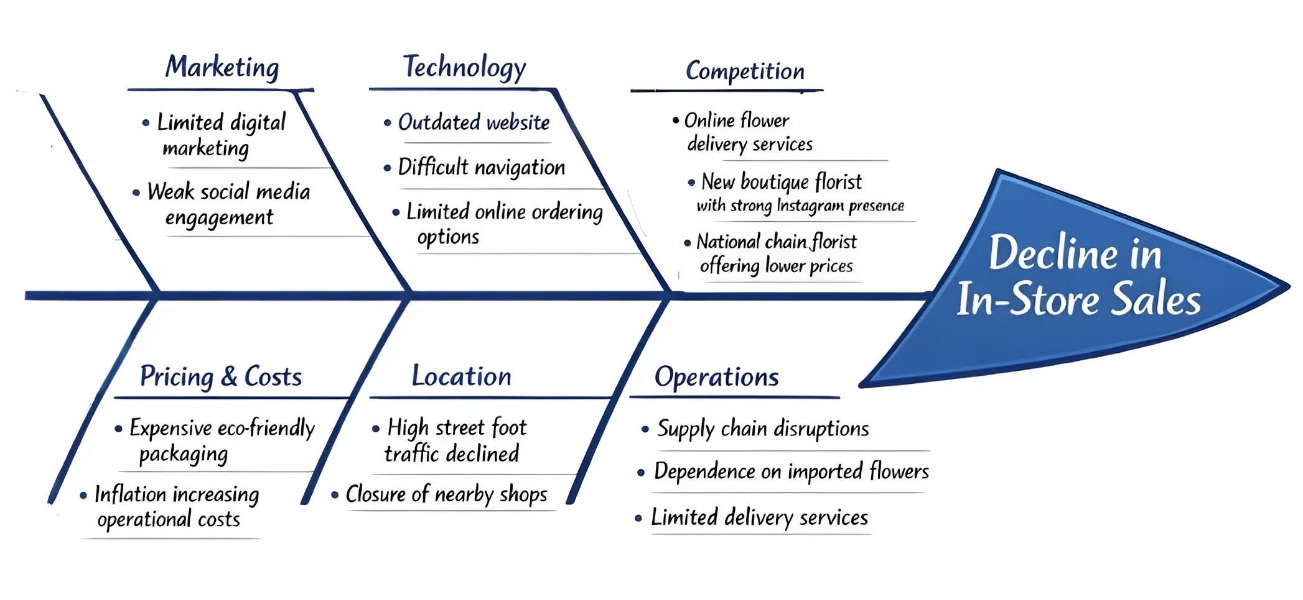
Cause and effect analysis: Fishbone diagram
Fishbone analysis can be used to identify and solve problems, and assist staff to make changes to benefit both customers and staff (Nursing Times, 2013)
Notes:
A Fishbone diagram, also called an Ishikawa diagram, we used to identify the roots problem and solve them (Nursing Times, 2013).
In this case, the main problem is the decline in in-store sales.
How we can see on the screen they have a several categories.
Marketing
Limited digital marketing
Weak social media engagement
Technology
Outdated website
Difficult navigation
Limited online ordering options
Competition
Online flower delivery companies
A boutique florist with strong Instagram marketing
A national chain offering lower prices
Pricing and Costs
Expensive eco-friendly packaging
Inflation increasing operational costs
Location
Declining high-street foot traffic
Closure of nearby shops
Operations
Supply chain disruptions
Dependence on imported flowers
Limited delivery services
The fishbone diagram helps visually identify all possible causes contributing to the decline in sales.

Slide 9
Conclusion
Key Points
Green Haven Florists has seen a 30% drop in store sales
The main reasons are online competition, rising costs, and fewer customers
The 5W2H model helped explain the problem clearly
The PESTEL analysis showed outside factors affecting the business
The Fishbone diagram helped identify the root causes
Conclusion
To improve sales, the shop may need to:
Improve its website
Use social media marketing
Offer better delivery services
Oakland (2014) emphasizes that operational excellence is achieved through continuous improvement in all areas of management.
Notes:
In conclusion, Green Haven Florists is facing a significant decline in in-store sales.
The main causes include:
Increased online competition
Rising costs of flowers and sustainable packaging
Reduced high street foot traffic
Weak digital presence
The analysis tools used in this presentation helped identify both internal and external factors affecting the business as:
The 5W2H model helped explain the problem clearly
The PESTEL analysis showed outside factors affecting the business
The Fishbone diagram helped identify the root causes
To improve sales, the business may need to:
Upgrade its website and online ordering system
Increase social media marketing
Introduce delivery and subscription services
These strategies could help the business adapt to the changing retail environment.
Oakland (2014) emphasizes that operational excellence is achieved through continuous improvement in all areas of management.

Slide 10
References
BA Guide (2023) Why Problem Identification is the Critical First Step in Every Project Available at: https://thebaguide.com/blog/why-problem-identification-is-the-critical-first-step-in-every-project/ (Accessed: 12 March 2024).
Calculator Ultra (2025) Find More Calculator. Available at: Drop in Sales Calculator & Formula Online Calculator Ultra (Accessed: 6 October 2025).
Campos, L. (2013) Using the 5W2H method in management practices. Journal of Business Administration, 45(3), pp. 77–84.
CIPD (2025) PESTLE ANALYSIS Available at: https://www.cipd.org/en/knowledge/factsheets/pestle-analysis-factsheet/ (Accessed: 12 February 2025)
Investopedia (2025) What Is a Market Economy, and How Does It Work? Available at: https://www.investopedia.com/terms/m/marketeconomy.asp (Accessed: 24 June 2025).
Nursing Times (2013) Using fishbone analysis to investigate problems. Available at: Using-fishbone-analysis-to-investigate-problems-160413.pdf Vol. 109, N15, pp. 18-20 (Accessed: 16 April 2013)
Oakland, J. (2014) Total Quality Management and Operational Excellence. London: Routledge.
Notes:
Problem identification is an important first step in understanding business challenges (BA Guide, 2023).
A drop in sales refers to a decrease in the amount sold or the revenue generated between two time periods (Calculator Ultra, 2025).
The 5W2H method is used to clearly define problems in management (Campos, 2013).
PESTEL analysis helps businesses understand external environmental factors (CIPD, 2025).
Economic factors such as inflation and customer spending can affect business performance (Investopedia, 2025).
Fishbone diagrams help identify the root causes of a problem (Nursing Times, 2013).
Oakland (2014) emphasizes that operational excellence is achieved through continuous improvement in all areas of management.

Slide 11

Questions
Notes:
Q1: Why is digital marketing important for Green Haven Florists?
Digital marketing helps businesses reach customers online through platforms such as social media and websites. Since many customers now search and shop online, improving digital marketing can attract new customers and increase online sales.
Q2: What is the main cause of the decline in in-store sales?
The main causes are increased online competition, fewer customers visiting the high street, and rising operational costs.
Q3: How does the PESTEL analysis help the business?
PESTEL analysis helps identify external factors such as economic conditions, technology changes, and government policies that may affect the business.
Q4: What is the purpose of the Fishbone diagram?
The Fishbone diagram helps identify and organise the root causes of a problem, making it easier to understand what factors are contributing to the issue.
Q5: What strategy could improve the company’s sales?
Improving the website, increasing social media marketing, and offering better delivery services could help the business attract more customers.

