Slide 1
Principles of Health and Social Care Practice
(BMHP5016)
Week 5: Legislation in Health and Social Care

Slide 2
Aim of Lecture
(Week 5)
To develop an understanding of the current legislation in relation to effective health and social care practice.

Slide 3
Learning objectives
(Week 5)
Discuss and analyse how aspects of different legislation are reflected in health and social care.

Slide 4
Group task - 20 minutes
Discuss in groups the difference between legislation, policy, regulations and standards.
Find one example of any legislation or policy in health and social care.
Explain why it is important in health and social care.
Notes:
Legislations are made by legislator who makes laws
Policy : policy is a documents which has been developed to see that the law has been taken under consideration
Regulations: make sure that the policy has been implemented
Standards: Promote cooperation between the public sector, private sector, and civil society and made sure that the laws has been implemented in all the health care organization
CQC ask the same five questions of all the services we inspect:
Are they safe? Safe: you are protected from abuse and avoidable harm.
Are they effective? ...
Are they caring? ...
Are they responsive to people's needs? ...
Are they well-led?

Slide 5
The relationship between legislation, policy, regulations, and standards
Legislation is the law passed by a legislature, the law-making body of the government.
The policy ensures that legislation is being followed. The implementation steps and course of action are written in the policy statement.
Notes:
https://carelearning.org.uk/qualifications/level-3-diploma-eyp/unit-21-intro/1-3-describe-the-relationship-between-legislation-policies-and-procedures/

Slide 6
The relationship between legislation, policy, regulations, and standards
Regulations are rules imposed by regulatory bodies, or the decision-making body of the government, on its subjects, in order to implement, obey with and enforce the law.
Example of UK regulatory bodies: Care Quality Commission (CQC).
Notes:
Regulatory bodies are public or government agencies that are set up to regulate or supervise some area of human activity)

Slide 7
What are standards?
Development agencies* create and approve official standards, based on legislation and regulation to provide guidelines in order to plan and deliver services to provide the best possible care (e.g. NICE).
* Development agencies promote cooperation between the public sector, private sector and civil society.
Source: https://www.nice.org.uk/standards-and-indicators
Notes:
National Institute for Health and Care Excellence
We evaluate new health technologies for NHS use, considering clinical effectiveness and value for money.

Slide 8

Activity
Search online to find what the Care Quality Commission (CQC) does.
Share your findings with the class.

Slide 9
The Care Quality Commission (CQC)
The care provided by a hospital, a care home, an agency in own home, the dentist, a GP practice and elsewhere must meet standards required by law.
The Care Quality Commission (CQC) monitors and inspects all organisations providing care to ensure standards are being met.
All NHS and social care providers have to be registered with CQC and they have to conform to a set of standards.
For more information on CQC see this link: https://www.cqc.org.uk/

Slide 10

The Office for Standards in Education, Children's Services and Skills (Ofsted)
Ofsted is responsible for inspecting a range of educational institutions, including state schools and independent schools.
It also inspects childcare, adoption and fostering agencies and initial teacher training and regulates a range of early years and children’s social care services.
For more information on Ofsted see this link: https://www.gov.uk/government/organisations/ofsted

Slide 11
Recognising people’s rights in law
Legislation in health and social care:
Human Rights Act (1998)
Equality Act (2010)
Data Protection Act (2018)
Care Act (2014)
Health and Safety at Work Act (1974)
Safeguarding Vulnerable Groups Act (2006)
Mental Capacity Act (2005)
Mental Health Act (1983)
Notes:
Act and legislation are same
act typically refers to a written law passed by a legislative body

Slide 12
Group Work – 25 minutes
Each group will be given one of the following Acts.
You need to discuss what this Act is about and think of one example of a situation that this Act is applicable. The example should be related to Health and Social Care.
Present your group findings in the class.
The Human Rights Act (1998)
The Equality Act (2010)
Data Protection Act (2018)
The Care Act (2014)
Safeguarding Vulnerable Groups Act (2006)
Mental Capacity Act (2005).

Slide 13

Human rights make sure people are:
Treated with dignity
Treated with respect
Treated fairly
Listened to and have a say over their lives

Slide 14

Video: What are human rights?
Source: https://youtu.be/jN_M0N3wIlE

Slide 15

Background
In 1948 the United Nations established a Convention on Human Rights.
The European Convention on Human Rights 1950 provided direct redress for European citizens. (Implemented in UK in 1951).
The Human Rights Act 1998 was implemented in 2000.
Image source: http://primaryfacts.com/6888/battle-of-berlin-facts-about-the-world-war-ii-conflict/

Slide 16
Human Rights
Under Article 8 of the European Convention on Human Rights, individuals have a right to respect for their private life.
Interference must be justified and for a particular purpose.
This is not an absolute right and can be overridden if necessary and in accordance with the law.
A decision to share information and reasoning should be recorded.
Justification could be protection of health, prevention of crime, protection of the rights and freedoms of others.

Slide 17

The Human Rights Act (1998)
The Human Rights Act 1998 is the main legislation that sets out the rights of people in the UK.
You have the right to speak your mind and be kept safe from harm, as well as the right to respect, dignity and equality.
You should make sure an individual’s rights are respected, not only by yourself but by other people involved in their care.
Source: https://www.scie.org.uk/key-social-care-legislation/human-rights-act

Slide 18
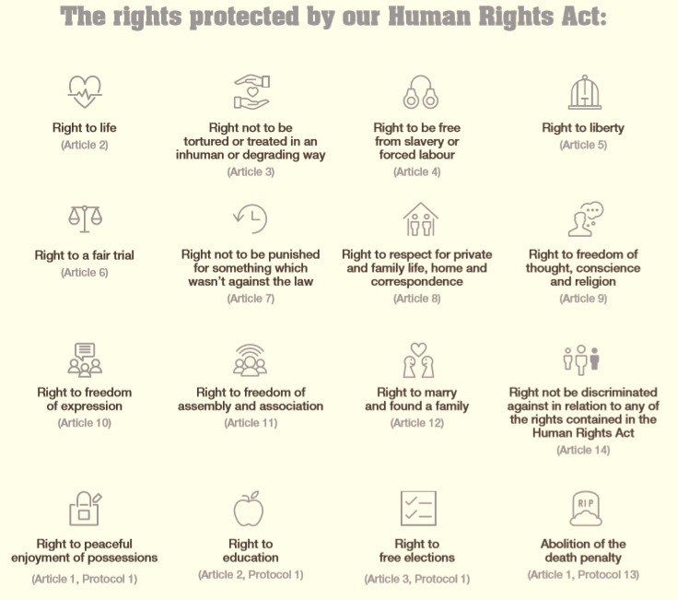

Slide 19
Scope of The Human Rights Act 1998
Note: The Human Rights Act 1998 only applies to public authorities:
  Courts and tribunals
  Core public authorities (e.g. local authorities and police)
  Functional public authorities
Notes:
In the UK, human rights are protected by the Human Rights Act 1998. Public authorities, like a local authority or the NHS, must follow the Act. If a public authority has breached your human rights, you may be able to take action under the Act.
From 2000, when the Act was implemented, the Govt has drafted laws to be compatible and courts interpret laws to be compatible. If the Courts find an Act isn’t compatible with the HRA, they issues a ‘declaration of non-compatibility’, for the Govt to then address.
You can still go to ECHR but they will allow margin of appreciation, i.e. leeway.
Case law will be changing as the Act is re-interpreted and now includes ECHR in Strasbourg case law. This makes it a living instrument.
The Act defines three categories of public authority:
The courts and tribunals.
Core public authorities who are wholly within the public spheres, such as local authorities and the police.
Functional public authorities, which have a mix of public and private functions such as Network Rail. In this third category only the public functions fall within the Act.

Slide 20
Scope of the HRA 1998
Absolute and limited rights
and their derogation.
Example:
Absolute right: Article 3: Freedom from torture and inhumane or degrading treatment
Limited right: Article 5: The Right to liberty and security.
Qualified rights and
their derogation.
Example
Qualified right: Article 8: The right to respect for private and family life.
Notes:
Some rights have been classified by the Act as absolute, meaning that there can be no derogation, i.e. exemption from them. The right to protection from torture is an example of an absolute right.
Limited rights allow for specific exceptions expressed within the Act, for example the right to liberty is limited to allow for the incarceration of criminals.
Qualified rights can be interfered with only if the following two guiding principles have been applied:
The ‘rule of law’ guiding principle:
the interference has a basis in law.
the interference is to achieve a permissible aim, for example, the protection of public health.
it is necessary to achieve a pressing social need, pursue a legitimate aim and
the proportionality guiding principle - the intervention is proportionate to the social need.
Derogation (not abiding by) rights is possible under article 15 in times of war or public emergency.
(Article 15 is a derogation clause. It affords to Contracting States, in exceptional circumstances, the possibility of derogating, in a limited and supervised manner, from their obligations to secure certain rights and freedoms under the Convention)
An example of a qualified right would be the right to respect for private and family life. Within this right a person has a right to confidentiality, but an exception to that right would be if that person was physically abusing their partner.
A partial derogation exists from article 5, the right to liberty and in May 2007, the Home Secretary, John Reid, suggested that it might become necessary to derogate from other aspects of the HRA 1998 due to the emergency threat posed by terrorism (Times 2007).

Slide 21

The Equality Act (2010)
The Equality Act says that people who fall into the following categories (people who have a ‘protected characteristic’) must not be discriminated against.
The protected characteristics are:
Age, disability, gender reassignment, marriage and civil partnership, pregnancy and maternity, race, religion and belief, sex, sexual orientation.
Source: https://www.scie.org.uk/key-social-care-legislation/equality-act

Slide 22

Video: What is disability discrimination?
Source: https://youtu.be/-2XZmjzP0HM

Slide 23
Data Protection Act (2018)
When storing information, it is important to understand what you can and cannot do with service users/patients’ data.
The Data Protection Act places a duty of care on those who handle sensitive personal data in the UK (e.g. healthcare professionals and social workers).
You must keep this data secure and safe from any unauthorised access or use, as well as keep records of how and with whom the data is shared.
Source: https://www.scie.org.uk/key-social-care-legislation/data-protection#dpa

Slide 24
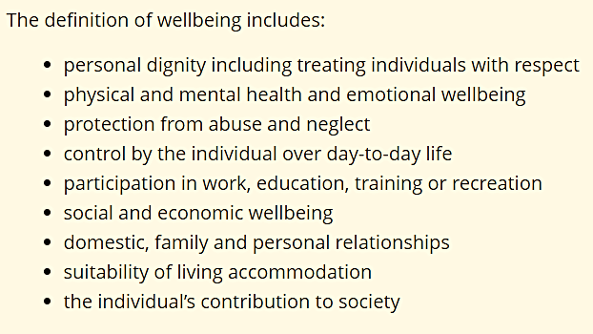
The Care Act (2014)
This Act places a general duty on local authorities to promote the wellbeing of individuals when carrying out care and support functions.

Slide 25

Key Legislation protecting vulnerable people from harm and abuse
Everyone has the right to live in safety, free from abuse and neglect.
Abuse and neglect can occur anywhere: in own home or a public place, in hospital or a day centre, or in a college or care home.

Slide 26

What is Safeguarding?
Research the meaning of this term and discuss in class.

Slide 27

Safeguarding
Safeguarding is a concept that was introduced several decades ago in the United Kingdom and refers to the collection of measures that ensure groups, such as children, young people, and vulnerable adults are protected from abuse, harm and neglect in society.

Slide 28
Why is Safeguarding Important?
Safeguarding is particularly important because the groups in question - children, young people and vulnerable adults - are those most at risk from abuse, neglect and harm.
This is primarily because they have a lessened ability to keep themselves safe, which means that it is the responsibility of others to ensure that happens.
As a result, anyone who works with or is otherwise responsible for these groups, is likely to need to understand what safeguarding is, and how they can play a part in it.

Slide 29

Video: Safeguarding Children in Social Care Settings – share your thoughts on the video
Source: https://youtu.be/mR-5JQBo8r8

Slide 30
Key Legislation & Statutory Guidance in Safeguarding Children
Legislation
Guidance
The Children Act 1989
The Children Act 2004
The Safeguarding Vulnerable Groups Act 2006
The Children and Social Work Act 2017
Working Together to Safeguard Children 2023
Keeping Children Safe in Education 2022

Slide 31
Local Government responsibilities to safeguarding adults?
A local authority must act when it has ‘reasonable cause’ to suspect that an adult in its area (whether or not ordinarily resident there):
has needs for care and support (whether or not the authority is meeting any of those needs),
is experiencing, or is at risk of, abuse or neglect, and
as a result of those needs is unable to protect himself or herself against the abuse or neglect or the risk of it.’ (Care Act 2014, section 42)
https://www.scie.org.uk/safeguarding/adults/introduction/what-is

Slide 32
What is Adult Safeguarding?
Protecting an adult’s right to live in safety, free from abuse and neglect.
It is about people and organisations working together to prevent and stop both the risks and experience of abuse or neglect, while at the same time making sure that the adult’s wellbeing is promoted including, where appropriate, having regard to their views, wishes, feelings and beliefs in deciding on any action.
This must recognise that adults sometimes have complex interpersonal relationships and may be ambivalent, unclear or unrealistic about their personal circumstances
Care Act statutory guidance

Slide 33
What is safeguarding in action?
Activities aimed at upholding a person’s fundamental right to be safe.
It means protecting people from all forms of harm, abuse, neglect, including poor practice.
Safeguarding should be part of everyday practice for those working with adults potentially at risk.
It is everyone’s responsibility to recognise, prevent and manage abuse.
Organisations should support safeguarding by working together.
Recognition that adults have choice and the need to take into account individual wishes and best interests – if they are unable to make decisions for themselves.

Slide 34
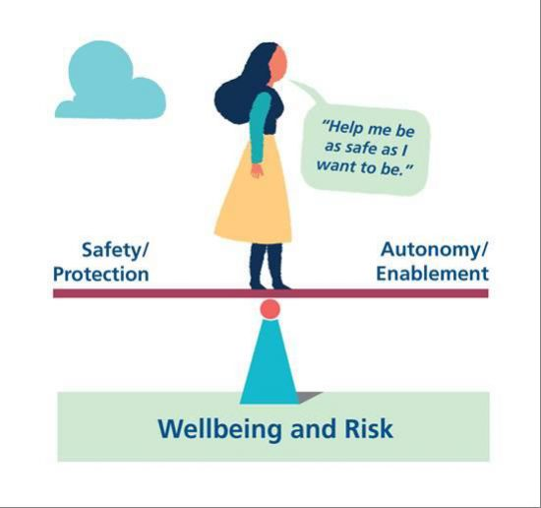
Safeguarding – A Balancing Act
If we wish to protect a boat it would be best to keep it in harbour, but that is not what boats were designed for. Similarly, people do better if they are able to live their lives, including some risk.
(Reckless Kettle and Rose 2016 Theatre company Risking Happiness)
Notes:
There is a tension in what we are trying to do - wanting people to be safe and wanting them to be able to live their lives as they wish.
We will discuss risk more in week 3.
Mental capacity is crucial in this balancing act and we will look at the Mental Capacity Act 2005 in a later session.

Slide 35
Six Guiding Principles of Safeguarding Adults (Care Act 2014)
‘EPPPPA’
Empowerment
Accountability
Prevention
Proportionality
Partnership
Protect
What do each of these principles mean?

Slide 36
Six Principles of Adult Safeguarding
Principles | Description
Empowerment | People being supported and encouraged to make their own decisions and informed consent.
Prevention | It is better to take action before harm occurs.
Proportionality | The least intrusive response appropriate to the risk presented.
Protection | Support and representation for those in greatest need.
Partnership | Local solutions through services working with their communities. Communities have a part to play in preventing, detecting and reporting neglect and abuse.
Accountability | Accountability and transparency in safeguarding practice.
Notes:
Adult safeguarding means protecting a persons right to live in safety, free from abuse and neglect. Key are prevention, choice and control.
The six principles were first introduction by the Department of Health in 2011 and were subsequently embedded in the Care Act 2014. They apply to all health and care settings.

Slide 37
What about us?
Think about how you would like to be safeguarded as an adult?
What would worry you?
What principles would be important to you?
What support do you think you would need?

Slide 38
Six Principles of Adult Safeguarding (1/2)
The Care Act 2014 sets out the following principles that should underpin the safeguarding of adults.
Empowerment
People are supported and encouraged to make their own decisions and informed consent.
“I am asked what I want as the outcomes from the safeguarding process and this directly informs what happens.”
Prevention
It is better to take action before harm occurs.
“I receive clear and simple information about what abuse is. I know how to recognise the signs, and I know what I can do to seek help.”
Proportionality
The least intrusive response appropriate to the risk presented.
“I am sure that the professionals will work in my interest, and they will only get involved as much as is necessary.”

Slide 39
Six Principles of Adult Safeguarding (2/2)
Protection
Support and representation for those in greatest need.
“I get help and support to report abuse and neglect. I get help so that I am able to take part in the safeguarding process to the extent to which I want.”
Partnership
Services offer local solutions through working closely with their communities. Communities have a part to play in preventing, detecting and reporting neglect and abuse.
“I know that staff treat any personal and sensitive information in confidence, only sharing what is helpful and necessary. I am confident that professionals will work together and with me to get the best result for me.”
Accountability
Accountability and transparency in delivering safeguarding.
“I understand the role of everyone involved in my life and so do they.”

Slide 40
Discussion
What types of abuse can adults be at risk of?

Slide 41
Type of Abuse | Examples
Physical | Anything that causes physical harm e.g. hitting, pushing, shaking, pinching or over-medicating.
Domestic Violence | Violence within the family or household including psychological, physical, sexual, financial, emotional and so called ‘honour’ based violence.
Sexual | Any sexual activity that a person does not understand or want.
Discriminatory | Includes racist or sexist abuse or abuse based on a person’s age, disability, gender, sexual orientation or religion.
Financial or material | Includes theft, fraud, on-line scamming, illegal or improper use of a person’s money, benefits, property, pension, bank account or other belongings.
Modern Slavery | Includes domestic servitude, human trafficking, forced labour that forces a person into a life of restricted and inhumane treatment.
Neglect or acts of omission | Not providing the help, support or treatment that is needed including food, drink or medical care.
Self-neglect | Covers a range of behaviour including neglecting to care for one’s personal hygiene, health or surroundings.
Organisational | Includes neglect and poor care within an institution or care setting e.g. hospital, care home or care provided in someone’s home.
Radicalisation
Notes:
Abuse is a violation of an individual human and civil rights by any other person or persons. It can be a one-off single act or repeated or ongoing acts. Examples: serial abusing e.g. grooming someone for sex or routinely stealing money; long-term abuse e.g. domestic violence between partners; opportunistic abuse – theft of money or jewellery as is available.
Abuse may be perpetrated deliberately – i.e. with intent, or as a result of negligence or ignorance. It is still abuse.

Slide 42
Safeguarding Vulnerable Groups Act (2006)
This Act deals with the vetting process for those that will be working with vulnerable people and children.
Safe recruitment is one of the important safeguarding principles.
The Disclosure and Barring Service (DBS) helps employers make safer recruitment decisions.
Source: https://www.scie.org.uk/key-social-care-legislation/safeguarding-adults

Slide 43
Health and Safety at Work Act (1974)
The Act covers a wide range of issues relating to workplace health, safety and welfare across different sectors.
Employees have a general obligation under the Act to take care of others and cooperate with employers’ health and safety requirements.
Source: https://www.scie.org.uk/key-social-care-legislation/health-and-safety

Slide 44
What is Mental Capacity?
Under the law, ‘having capacity’ means when a decision needs to be made (e.g. about what treatment you should have) you are able to: understand - remember - weigh up the pros and cons and - let people know what you have decided.
Sometimes having a learning disability, dementia or brain damage, drinking alcohol or taking drugs might mean you are not able to do those things. Under the law this is called ‘lacking capacity’.

Slide 45
Mental Capacity Act (2005)
It has five key principles:
Assume a person has capacity unless proved otherwise.
Do not treat people as incapable of making a decision unless all practicable steps have been tried to help them.
A person should not be treated as incapable of making a decision because their decision may seem unwise.
Always take decisions for people without capacity in their best interests.
A best interest decision made on someone’s behalf must be one that is least restrictive of their rights and freedom.

Slide 46

Video: The Role Of The IMCA - Independent Mental Capacity Advocate
Source: https://youtu.be/NKWQRCTb9s8

Slide 47
The Mental Health Act (1983)
The Mental Health Act (1983) is the main piece of legislation that covers the assessment, treatment and rights of people with a mental health disorder.
People inside under the Mental Health Act need urgent treatment for a mental health disorder and are at risk of harm to themselves or others.
Source: https://www.nhs.uk/mental-health/social-care-and-your-rights/mental-health-and-the-law/mental-health-act/

Slide 48

Protecting patients at risk of suicide
Melanie Rabone was 24 years old and voluntarily admitted herself to a mental health hospital after she had attempted to take her own life.
She was assessed as being at high risk of suicide, and while on leave from the hospital took her own life.
Her family took a human rights case to court, and the court ruled that the hospital had failed in their duty to protect Melanie’s right to life.
The hospital had a duty to take reasonable steps to protect Melanie’s life, including by delaying her under the Mental Health Act to try and prevent her suicide.
(Rabone v Pennine Case NSA Foundation Trust, 2012)

Slide 49



QUESTION TIME

Slide 50

What did I learn?
What I have learnt today will help me in my practice because....

Slide 51
References
NHS (2022) Mental Health Act. Available at: https://www.nhs.uk/mental-health/social-care-and-your-rights/mental-health-and-the-law/mental-health-act/ (Accessed: 7 July 2022).
SCIE - Social Care Institute for Excellence (2022) Key adult social care legislation. Available at: https://www.scie.org.uk/key-social-care-legislation/health-and-safety (Accessed: 7 July 2022).

