Slide 1
Assessment Task 2
Enterprise and Entrepreneurship
Presentation Template

Slide 2
Business Plan
Slide 1 - cover page
Student id: 2507978
Student name: Leon Hughes
Lecturer: Thomas Adeyemi
Enterprise and Entrepreneurship (LCLM4006_LON)

Slide 3
Introduction
Introduce yourself.
This presentation introduces the core purpose of my marketing business: helping organisations that struggle to find the time, expertise, or consistency to promote themselves effectively. Whether it’s small businesses caught up in daily operations or larger companies with gaps between departments, marketing often gets overlooked. My role is to step in as a dedicated partner, delivering strategic, reliable, and results‑driven support that keeps brands visible and growing.
I’ll walk you through how my services—social media management, content creation, digital advertising, branding, and targeted outreach—help businesses attract customers, strengthen their reputation, and stay competitive. By combining creativity with data‑driven strategy, I provide marketing that’s professional, consistent, and tailored to each client’s goals and audience.
You’ll also see my mission: giving businesses more time to focus on what they do best while I handle the marketing that moves them forward. With flexible packages, clear communication, and measurable results, I position my company as the go‑to partner for entrepreneurs and established brands needing dependable support without the cost of an in‑house team.
Finally, I’ll share my vision—to become a trusted marketing provider across the UK, known for reliability, innovation, and helping businesses unlock their full potential through powerful, consistent, strategic marketing.
Notes:
When introducing yourself remember to Keep the introduction section concise but impactful. The goal is to establish trust and confidence in your ability to lead the business successfully. Remember to focus on relevant information that aligns with your business idea and creates a positive impression of you. You may include the following information.
Name and Role: Start by stating your name and your position or role in the company. If you are the founder or one of the key team members, mention your title (e.g., CEO, Co-founder).
Background and Experience: Briefly share your relevant background and experience. Highlight any expertise, qualifications, or achievements that demonstrate your capability to lead and execute the business idea effectively.
Passion and Motivation: Explain why you are passionate about the business and the problem you are solving. Share your vision for the company and what drives you to pursue this venture.
Connection to the Industry: If you have a personal or professional connection to the industry in which your business operates, share that information. It could be an experience, personal story, or a passion for the industry that led you to start this venture.
Keep the introduction section concise but impactful. The goal is to establish trust and confidence in your ability to lead the business successfully. Remember to focus on relevant information that aligns with your business idea and creates a positive impression of you and your team.

Slide 4
Section 1 - Overview of the Business Idea
My business provides done‑for‑you marketing support for companies that don’t have the time, expertise, or consistency to promote themselves effectively. I offer a full suite of services—including social media management, content creation, digital advertising, branding, and targeted outreach—designed to help businesses attract customers, build their reputation, and grow.
In simple terms: I handle the marketing, so businesses can focus on what they do best.
Businesses today struggle with consistent, high‑quality marketing because they lack time, expertise, or dedicated staff. My service fills that gap by providing professional, reliable, done‑for‑you marketing support that keeps brands visible, competitive, and growing. I give businesses the consistency and strategy they can’t maintain on their own—at a fraction of the cost of hiring in‑house.

Slide 5
Section 2 - Legal Format and Management Structure
My startup will operate as a Limited Company (Ltd). This structure gives me professional credibility, protects my personal assets, and supports long‑term growth. It also aligns with my goal of scaling into a trusted UK‑wide marketing provider, making it easier to work with larger clients, hire staff, and expand services as the business grows.
My business operates with a simple, clear structure. As the Founder and Marketing Lead, I oversee strategy, client relationships, service delivery, and overall business growth. Supporting roles—such as content creation, social media management, and advertising support—are organised beneath this lead position to ensure smooth workflow and consistent results.
Notes:
Refer to week 3 slides: Legal format of Enterprises & Building a Founding team

Slide 6
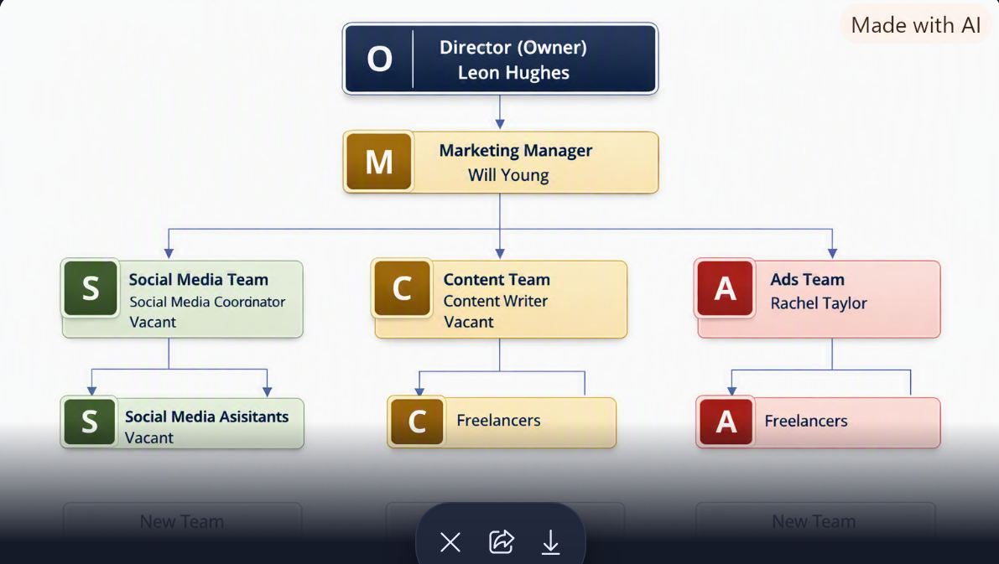
Notes:
You can use either MS Visio or MS Word to create this.

Slide 7
Political Brexit and changing government policies influence marketing regulations and business confidence.
Economic Interest rates, inflation, and consumer spending affect how much businesses invest in marketing.
Social Shifting demographics, cultural trends, and consumer expectations shape how brands communicate.
Technological AI, automation, and digital tools are rapidly transforming marketing, analytics, and content creation.
Environmental Growing demand for sustainability pushes brands to adopt eco‑friendly practices and messaging.
Legal GDPR, advertising standards, and IP laws require strict compliance in all marketing activities.
Political Brexit‑related changes mean staying adaptable and compliant. I’ll keep my services flexible and update clients on any marketing‑related regulatory shifts.
Economic With fluctuating budgets, I’ll offer scalable packages so businesses can maintain marketing consistency even during economic dips.
Social As consumer behaviour evolves, I’ll tailor content and campaigns to match new trends, cultural shifts, and audience expectations.
Technological Rapid tech growth is an opportunity. I’ll leverage AI, automation, and advanced analytics to deliver faster, smarter, and more effective marketing.
Environmental Growing sustainability demands mean promoting eco‑friendly messaging and helping clients communicate their environmental commitments clearly.
Legal Strict laws like GDPR require strong compliance. I’ll maintain transparent data practices and ensure all marketing activity meets UK legal standards.
Notes:
Apply PESTEL analysis taught in week 4:
Analyse the following factors:
Political – Government policies, regulations, tax laws, trade restrictions.
Economic – Inflation, interest rates, economic growth, consumer spending.
Social – Demographics, cultural trends, lifestyle changes, education.
Technological – Innovation, digital transformation, automation.
Environmental – Sustainability, climate change regulations, waste management.
Legal – Employment laws, intellectual property rights, industry-specific regulations.
2. Align PESTEL with Business Strategy
After identifying key external factors, explain how they impact your business and what strategies you will adopt to mitigate risks or leverage opportunities.

Slide 8
1. Small Businesses (SMEs) They lack time, expertise, and resources for consistent marketing, so they need affordable, done‑for‑you support. Key traits: limited marketing knowledge, tight budgets, high demand for social media/content, prefer clear communication, fast‑paced environments.
2. Growing Companies They’re scaling and need structured, strategic marketing to support expansion and fill skill gaps. Key traits: need advanced services, value data‑driven strategy, require seamless integration, focused on visibility and growth.
3. Established Brands They face departmental gaps or inconsistent output and rely on dependable partners to maintain brand presence. Key traits: expect high‑quality delivery, need reliability and alignment, outsource specific tasks, value long‑term partnerships.
.
Primary Customer Segments
Small Businesses (SMEs) – Need affordable, consistent, done‑for‑you marketing support.
Growing Companies – Require strategic, scalable marketing to support expansion.
Established Brands – Seek reliable external partners to maintain consistent marketing output.
Unique Selling Points
Done‑for‑you marketing that saves businesses time and removes the stress of managing it themselves.
Flexible, affordable packages tailored to different business sizes and needs.
Consistent, high‑quality output that keeps brands visible and competitive.
Data‑driven strategy + creative execution for smarter, more effective marketing.
Clear communication and measurable results that build trust and long‑term partnerships.
Social Media Marketing – Use consistent content, reels, and ads to reach SMEs, growing companies, and established brands.
Targeted Digital Advertising – Run precise campaigns to attract businesses actively searching for marketing support.
Content Marketing – Share valuable tips, case studies, and results to build trust and authority.
Networking & Partnerships – Connect with local businesses, agencies, and communities to generate referrals.
Email Marketing – Nurture leads with updates, offers, and insights that keep your brand top‑of‑mind.
Strong Branding & Online Presence – Present a professional, reliable image that appeals to all customer segments.
.
Notes:
Refer to week 5: Market Segmentation, Targeting, Positioning and marketing mix
Here are some key aspects of Unique Selling Points:
Differentiation: USPs highlight what makes a product or service unique and differentiates it from similar offerings in the market. It can be a feature, quality, or capability that competitors do not offer or cannot replicate easily.
Customer-Centric: USPs are designed to address the needs, wants, or pain points of the target market. They showcase how the product or service fulfills a specific customer demand or solves a particular problem effectively.
Value and Benefits: USPs emphasize the value customers will gain by choosing the product or service. They demonstrate the benefits and advantages the customers will experience by using the offering.
Memorability: A compelling USP is memorable and easy to communicate. It should be concise, clear, and leave a lasting impression on the audience.
Emotional Appeal: USPs can tap into emotions and aspirations of customers. They can create an emotional connection, making the product or service more appealing and desirable.
Competitive Advantage: USPs help companies gain a competitive edge in the market. They provide a reason for customers to choose their offerings over alternatives from competitors.
Examples of Unique Selling Points:
A smartphone with an exceptionally long-lasting battery life.
A cleaning product that is eco-friendly and non-toxic, appealing to environmentally conscious consumers.
An online platform that offers 24/7 customer support and assistance.
A restaurant that serves unique fusion cuisine not available anywhere else in the area.
An e-commerce website with free and fast shipping, setting it apart from competitors with longer delivery times and shipping fees.
Identifying and effectively promoting USPs is crucial for successful marketing and business growth. It allows businesses to position themselves as the best solution for their target customers and build a loyal customer base.
Regenerate

Slide 9
Funding Requirement
I am seeking £10,000 in initial funding to launch and sustain the business during the first six months.
Allocation of Funds
Startup Costs (one‑off)
Equipment & software: £2,000
Branding & website development: £1,500
Initial marketing & advertising: £1,000 Total: £4,500
Fixed Costs (monthly)
Software subscriptions: £150
Phone & utilities: £50
Workspace/office costs: £300 Total: £500 per month
Variable Costs (monthly)
Paid ads, content tools, outsourcing: £300
Travel & client meetings: £100 Total: £400 per month
6‑Month Financial Forecast
Breakeven Analysis
With monthly costs at £900, the business reaches breakeven once monthly income exceeds this amount. Based on projections, breakeven occurs in Month 2, with consistent profit growth from Month 3 onward.
Month | Projected Income | Fixed Costs | Variable Costs | Total Costs | Profit/Loss
Month 1 | £1,000 | £500 | £400 | £900 | £100
Month 2 | £1,500 | £500 | £400 | £900 | £600
Month 3 | £2,000 | £500 | £400 | £900 | £1,100
Month 4 | £2,500 | £500 | £400 | £900 | £1,600
Month 5 | £3,000 | £500 | £400 | £900 | £2,100
Month 6 | £3,500 | £500 | £400 | £900 | £2,600

Slide 10
Startup Cost
Furniture | £2,000
Accessories | £4,000
Toileteries | £2,000
Electricity | £2,000
Total | £10,000

Slide 11
Variable Costs | Jan | Feb | Mar | Apr | May | June
Electricity | £300 | 400 | 500 | 700 | 700 | 750
Raw materials | £400 | 600 | 650 | 800 | 800 | 1000
hourly paid Emp | £0 | 500 | 500 | 600 | 600 | 700
Total Var cost | £700 | £1,500 | £1,650 | £2,100 | £2,100 | £2,450

Slide 12
Investment capital needed = £25000 ('£18000 + £3250 + £2550 + £1200)
Investment needed = Total Startup Cost + (Operational Cost– Revenue up to the break-even point)
Category | Month 1 | Month 2 | Month 3 | Month 4 | Month 5 | Month 6
Fixed Costs | £900 | £900 | £900 | £900 | £900 | £900
Variable Costs | £400 | £500 | £600 | £700 | £700 | £800
Total Costs | £1,300 | £1,400 | £1,500 | £1,600 | £1,600 | £1,700
Revenue | £2,500 | £2,500 | £3,000 | £4,500 | £4,500 | £5,000
Profit/Loss | £1,200 | £1,100 | £1,500 | £2,900 | £2,900 | £3,300
Notes:
Investment needed = Total Startup Cost + (Operational Cost– Revenue ) - up to the break-even point

Slide 13

Questions?

