Slide 1
CertHE Skills for the Workplace
Module: BMSK4005
Professional Career Development
Online Session 1

Slide 2
Overview of Workshop
Introduction to the module
A look at professional career development
Concepts of self awareness
Go Mad!
Learning how to learn

Slide 3
Professional Career Development
By the end of this module, you should be able to: -
  Understand the skills and knowledge needed for working effectively
  Demonstrate readiness for employability and personal advancement through an understanding of personal strengths and areas for further development
  Establish employment goals and develop a personal action plan

Slide 4

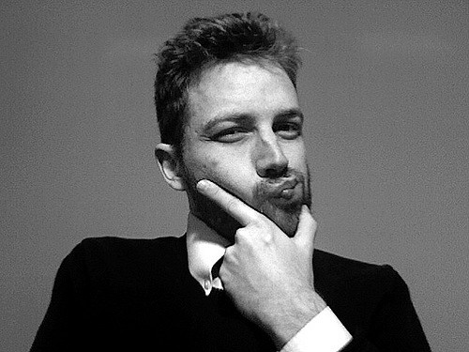

Notes:
Facilitator to allow everyone a minute or two to get their thoughts together – the clearer your picture of where you want to be, the more likely you will be able to map a path there! What about 10 years from now? One of Stephen Covey’s 7 Habits of Highly Effective People is ‘To begin with the end in mind’ – what do you think this means?

Slide 5
Reality Check!
It’s a competitive world
Change is constant
You are responsible for your own development
Great employers hire the best people
You need to be one of the best people
You need to constantly improve – your skills, knowledge, attitude and behaviours!

Slide 6
Concepts of Self Awareness
Developing your self awareness is the first step toward learning.
Do you really know yourself, your preferences, need and desires?
Do you have a clear perception of your personality, attitudes and behaviours, including strengths, weaknesses, thoughts, beliefs, motivation and emotions?
Self awareness allows you to better understand yourself, other people & how they perceive you.

Slide 7
Self Assessment
Think of something you are good at.
You probably learned it by self-assessment, by asking yourself:
  What am I trying to do exactly?
  What went well and why?
  What went less well and why?
  How could I do better next time?
So, it’s likely you have already made use of self assessment without realising it.

Slide 8
Self Awareness Exercises
Let’s try and develop our self-awareness. Here are some more self-assessment exercises.
  Take 5 minutes to write down what being a success means to you
Notes:
Share and compare the wide range of descriptions to see if there are any common themes (Tutor led facilitated discussion).

Slide 9
Self Awareness Exercises
  Think about your strengths and weaknesses.
Notes:
Share and compare the wide range of descriptions to see if there are any common themes.

Slide 10
SWOT Analysis
STRENGTHS
What advantages do you have that others don't have ?
What do you do better than anyone else?
What personal resources can you access?
What do other people (and your boss, in particular) see as your strengths?
Which of your achievements are you most proud of?
What values do you believe in that others fail to exhibit?
Are you part of a network that no one else is involved in?
Do you have connections with influential people?
Notes:
STRENGTHS
What advantages do you have that others don't have (for example, skills, certifications, education, or connections)?
What do you do better than anyone else?
What personal resources can you access?
What do other people (and your boss, in particular) see as your strengths?
Which of your achievements are you most proud of?
What values do you believe in that others fail to exhibit?
Are you part of a network that no one else is involved in? If so, what connections do you have with influential people?
Consider this from your own perspective, and from the point of view of the people around you. And don't be modest or shy – be as objective as you can.
And if you have any difficulty with this, write down a list of your personal characteristics. Some of these will hopefully be strengths!
Tip:
Think about your strengths in relation to the people around you. For example, if you're a great mathematician and the people around you are also great at math, then this is not likely to be a strength in your current role – it may be a necessity

Slide 11
SWOT Analysis
WEAKNESS
What tasks do you usually avoid?
What do you and the people around you see as your weaknesses?
Are you completely confident in your education and skills training? If not, where are you weakest?
What are your negative work habits?
Do you have personality traits that hold you back in your field?
Are you restricted in how far you can travel to work?
Notes:
WEAKNESSES
Again, consider this from a personal/internal perspective and an external perspective. Do other people see weaknesses that you don't see? Do co-workers consistently outperform you in key areas? Be realistic – it's best to face any unpleasant truths as soon as possible.

Slide 12
Self Awareness Exercises
  Now think about your Opportunities and Threats
    Share and compare the wide range of descriptions to see if there are any common themes.

Slide 13
SWOT Analysis
OPPORTUNITIES
Is your industry/sector growing?
Do you have a network of strategic contacts to help you, or offer good advice?
What trends do you see and how can you take advantage of them?
What new technology can help you?
Are any of your competitors failing to do something important?
Is there a need in your company, industry or sector that no one is filling?
Do your customers, internal or external, complain about something in your company? If so, could you create an opportunity by offering a solution?
Notes:
OPPORTUNITIES
Also, importantly, look at your strengths, and ask yourself whether these open up any opportunities – and look at your weaknesses, and ask yourself whether you could open up opportunities by eliminating those weaknesses.
THREATS
Performing this analysis will often provide key information – it can point out what needs to be done and put problems into perspective

Slide 14
SWOT Analysis
THREATS
What obstacles do you currently face at work?
Are any of your colleagues competing with you for projects or roles?
Is your job (or the demand for the things you do) changing?
Does changing technology threaten your position?
Could any of your weaknesses lead to threats?

Slide 15
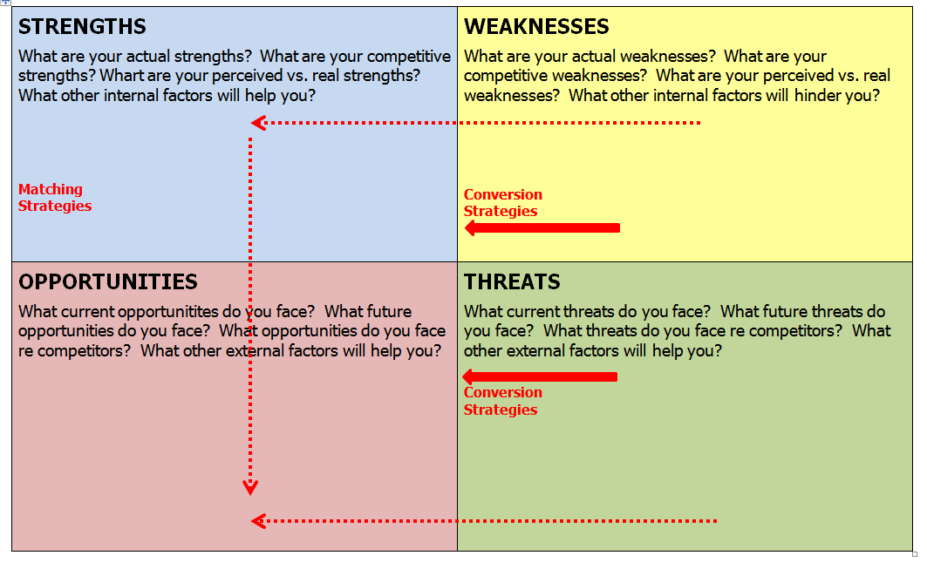
Next Steps
Notes:
Turn your weaknesses into strengths, build upon your strengths. Negate or reduce your threats, turning them into opportunities. Match your strengths to the opportunities.

Slide 16
Learning How to Learn
Learning how to learn: it’s a process which we all engage in throughout our lives, although often we do not realise that we are, in fact, learning how to learn.
Most of the time we concentrate on what we are learning rather than how we are learning it.
Most learning has to be an active process - and this is particularly true of learning how to learn.

Slide 17
Learning How to Learn
You will find that this module, in fact most of the course, will contain a range of activities for you to complete.
Sometimes you will take notes, sometimes just learn through your participation (or active learning). The main thing is you are learning.

Slide 18
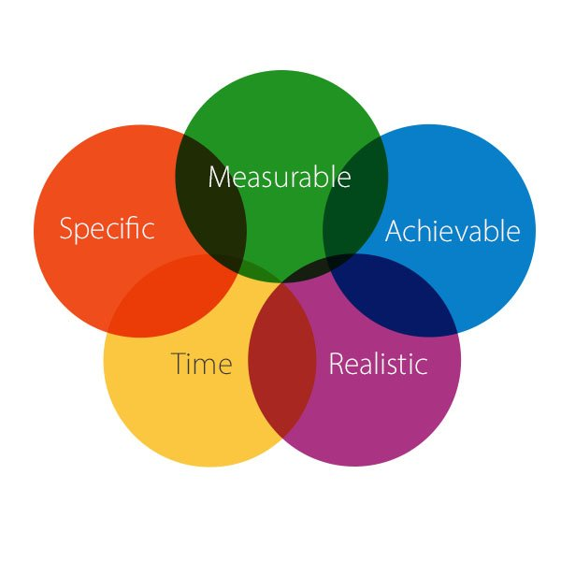
Setting Personal/Business Objectives
SMART OBJECTIVES
S = Specific
M = Measurable
A = Achievable (Agreed)
R = Realistic (Relevant)
T = Time bound

Slide 19
What is an Objective?
An objective is a clear statement
about what is to be achieved and what the end result will look like.
It contains:
  an active verb (e.g. to plan, to ensure, to prepare, to maintain)
  an outcome (e.g. an increase in sales, a new product, a safe environment)
  success indicators that are SMART (i.e. specific, measurable, achievable, realistic, time-bound)

Slide 20
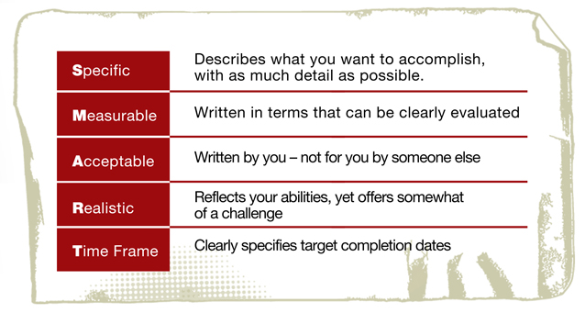
Write a SMART objective……for something meaningful to you
5 mins, then discuss with a colleague and evaluate the effectiveness of your objectives…

Slide 21

Why Learning is Important
Improve Knowledge
Develop Skills
Enhance Job Prospects
Help Adjust To Change
Keeping Up To Date
It Can Be Fun
Improve Understanding
Analyze & Improve Performance
This hoto by Unknown Author is licensed under CC BY-NC-ND

Slide 22
The Learning Cycle
Having an experience
Planning the next steps
Reviewing the experience
Concluding from the experience
Kolb. D. A. and Fry, R. (1975) ‘Toward an applied theory of experiential learning’, in C. Cooper (ed.), Theories of Group Process, London: John Wiley

Slide 23
Stage 1- Having the Experience
You have chosen to attend this course, therefore you have consciously decided to have this experience (Proactive)
One way of having an experience is letting that experience come to you (Reactive)
Notes:
One way of having an experience, is letting that experience come to you (reactive). The second way is to consciously seek the experience out (proactive). You have chosen to attend this course therefore you have consciously decided to have this experience. However if you have for example, to regularly attend a weekly meeting at work which tends to be deadly dull. You could instead try a proactive approach and decide to view it as a learning opportunity and start to experiment with different ways of improving the meeting

Slide 24

Stage 2 - Reviewing the Experience
Reflect on what happened
Review what went well – what didn’t
Notes:
If you are to learn from that experience it is essential that you review what happened during it. If the weekly meeting is deadly dull, then you might change the agenda items or rearrange them. Try a different chairperson if that is possible, noting the way the best and the worst chairperson conducted the meeting.

Slide 25
Stage 3 – Concluding from the experience
There was no formal agenda
People wandered off the point
Time keeping was poor
There was little summary of agreed points, etc.
Notes:
Review the raw material from stage two and draw conclusions. What did you learn? How can the experience be improved or developed? As an example you may have concluded that:
There was no formal agenda and people wandered of the point
Time keeping was poor
There was little summary of agreed points, etc-
Review the raw material from stage two and draw conclusions. What did you learn? How can the experience be improved or developed? As an example you may have concluded that:
There was no formal agenda and people wandered of the point
Time keeping was poor
There was little summary of agreed points, etc-

Slide 26
Stage 4 - Planning the next steps
Translate the conclusions into a form where they can be actioned (use SMART objectives)
Use the ACTIONS to inform your Action Plan.
Always use “SMART objectives” to implement your actions
Notes:
Planning is the process of translating the conclusions into a form where they can be actioned. In this example you may plan to ensure that there is always a written agenda with time allocated for each topic ensuring that the chairperson sums up the points made by each contributor etc.
Learning is a continuous process. No stage makes sense in isolation from the others if learning is to be effective, and they are mutually supportive. However, each stage plays an equally important part in the process, even though the time spent on each stage may vary considerably. You can start anywhere on the cycle because each stage feeds into the next.

Slide 27
Learning Logs
The log helps you record your learning experience - it is the Learning Cycle put into practice!
Write a running summary of what you have learned in the session
Reflect and draw conclusions on what you have learned - list learning points
Plan how to implement the point you have learned and when you expect to do it (Remember to set a SMART objective)

Slide 28
Learning Logs
My description of what happened
My conclusions / lessons learned
My plan to do something better / different
(set a SMART objective)

Slide 29
Self Assessment and Learning
The ability to self-assess your work is a critical skill for you to develop, if you want to improve your performance and quality of learning.
If you can assess your own work accurately and identify the gap between what is required and what you are producing, you are more likely to be able to close the gap, in other words improve.
Making an accurate and honest self-assessment is not an easy skill to develop, even though it is crucial in learning how to learn.

Slide 30
Self Assessment and Learning
What works best for you may not be the case for others, even those studying the same course.
We are all unique as learners, although there are some patterns that emerge in any group of students.
In trying to find what works best for you, by all means share ideas with other students and try some that seem to work well for your colleagues, but if they don’t work for you, either modify them or try a different approach, that you feel comfortable with.

Slide 31
Summary
Take 5 minutes to reflect on the day and summarise your learning from today.

Slide 32
Further Research
Fully complete your SWOT Analysis.

