Slide 1

How does the concept of ‘ESDGC’ contribute to reducing global inequalities?
By Katie John

Slide 2
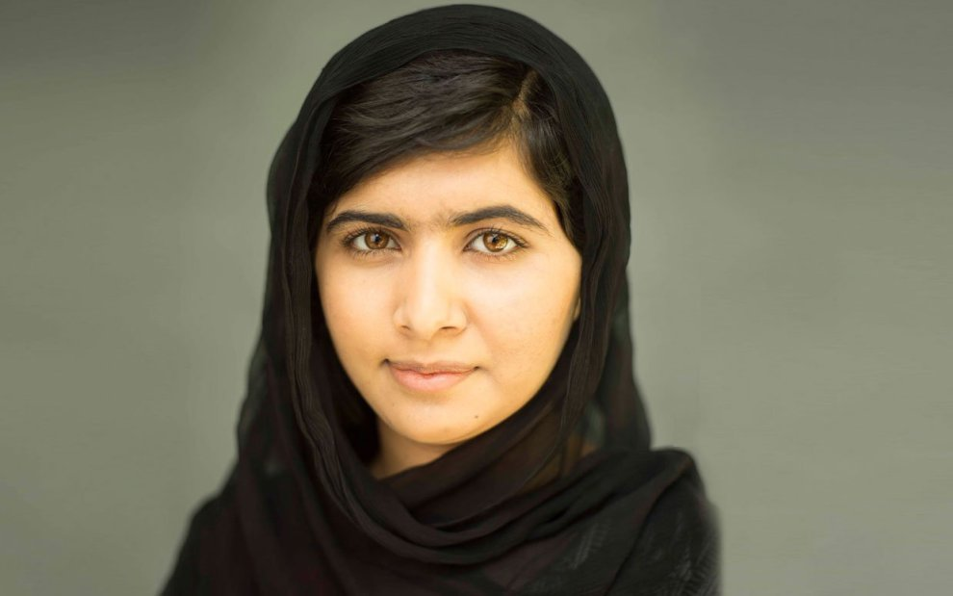
(Merriweather, n.d.)

Slide 3
What is
Education for Sustainable Development and Global Citizenship about?
The links between society, economy and environment and between our own lives and those of people throughout the world.
• The needs and rights of both present and future generations.
• The relationship between power, resources and human rights.
• The local and global implications of everything we do and the actions that individuals and organisations can take in response to local and global issues.
(ESDGC Why? What? How? ACCAC 2002)

Slide 4
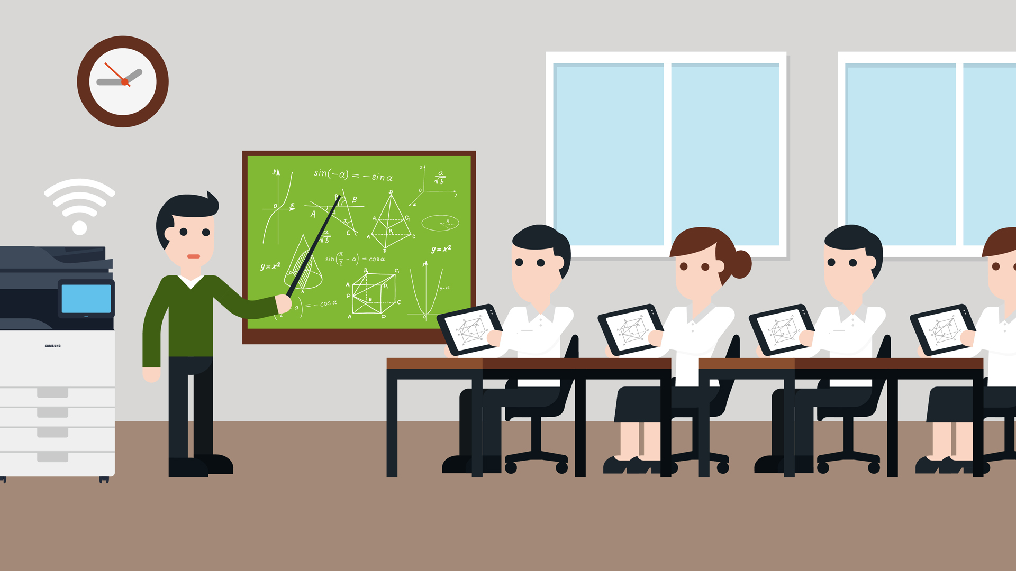
Nelson Mandela :
‘Education is the most powerful weapon which you can use to change the world’

Slide 5
How is education the ‘most powerful weapon?’
Eliminates Gender Inequality
1
Reduces Poverty
2
Creates a Sustainable Environment
3
Prevents needless Deaths and Illnesses
4
Spreads Peace
5

Slide 6
How can schools promote global equality through education?
Learning more diverse languages and cultures promoting communication amongst the world around us
Linking up with other schools: Germany and Wales – exchange languages so both schools benefit and learn
Cooking classes – using local produce, encouragement for multi-cultural foods, assessing expense and produce of different cuisines
Learning in history of how countries lived and the impact it has on today’s society
Celebrating religious festivals to gain a better understanding of the world we live in and others beliefs
Education through construction promoting energy efficient homes, eco friendly housing, less CO2

Slide 7
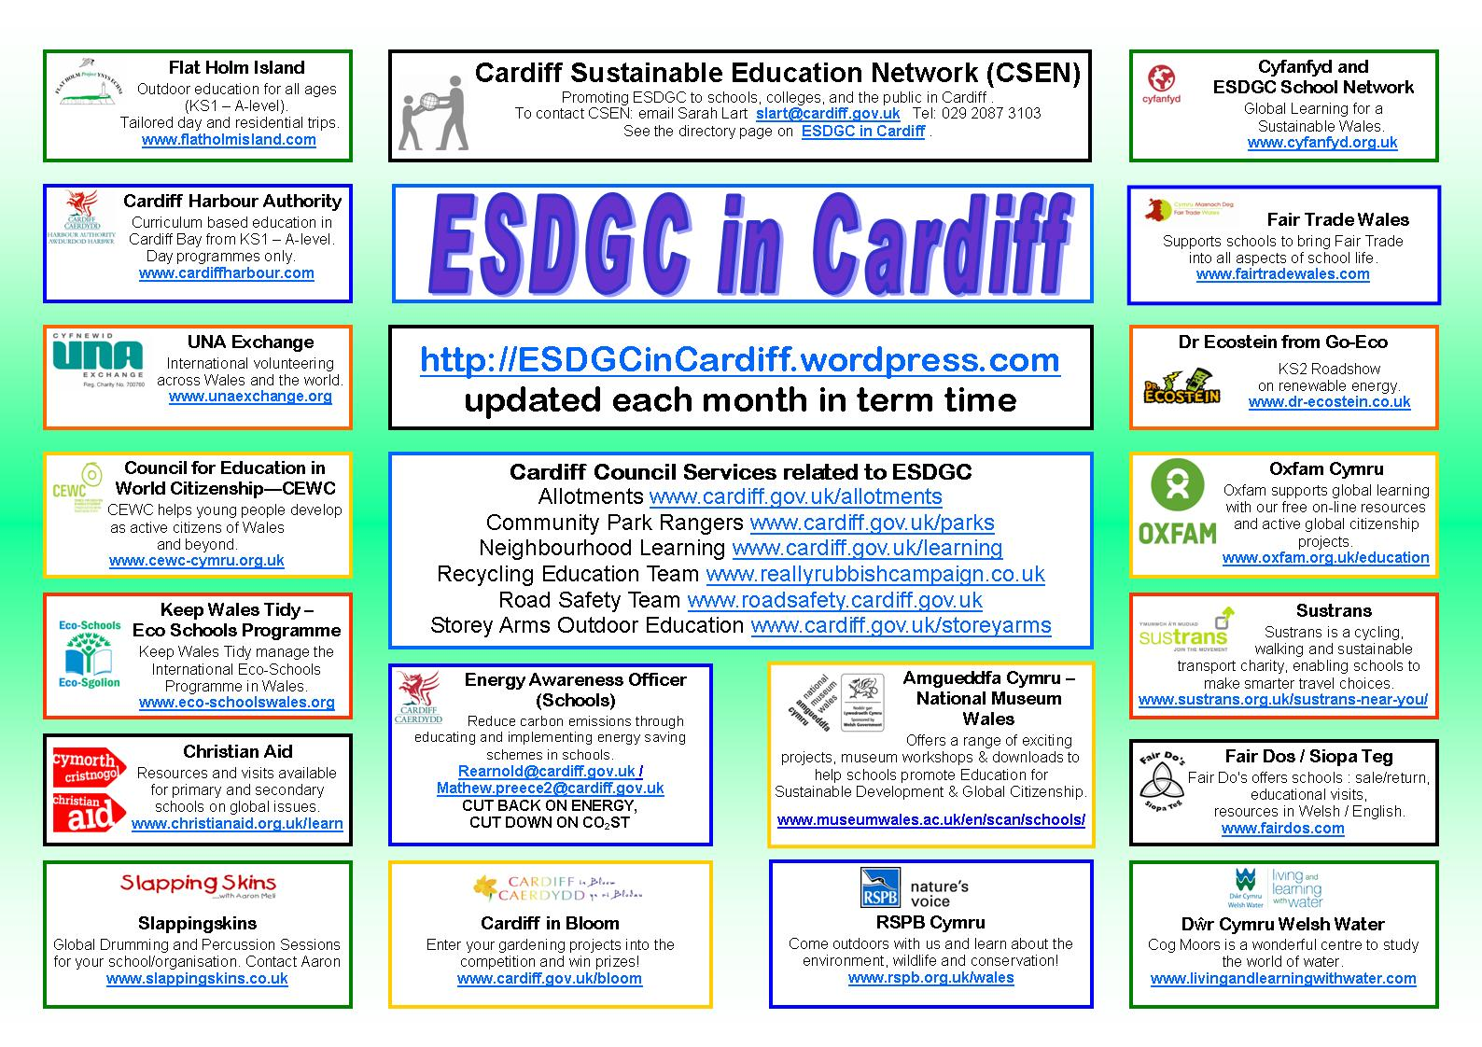
Application of ESDGC to a local level
(Esdgcincardiff.files.wordpress.com, 2012)

Slide 8
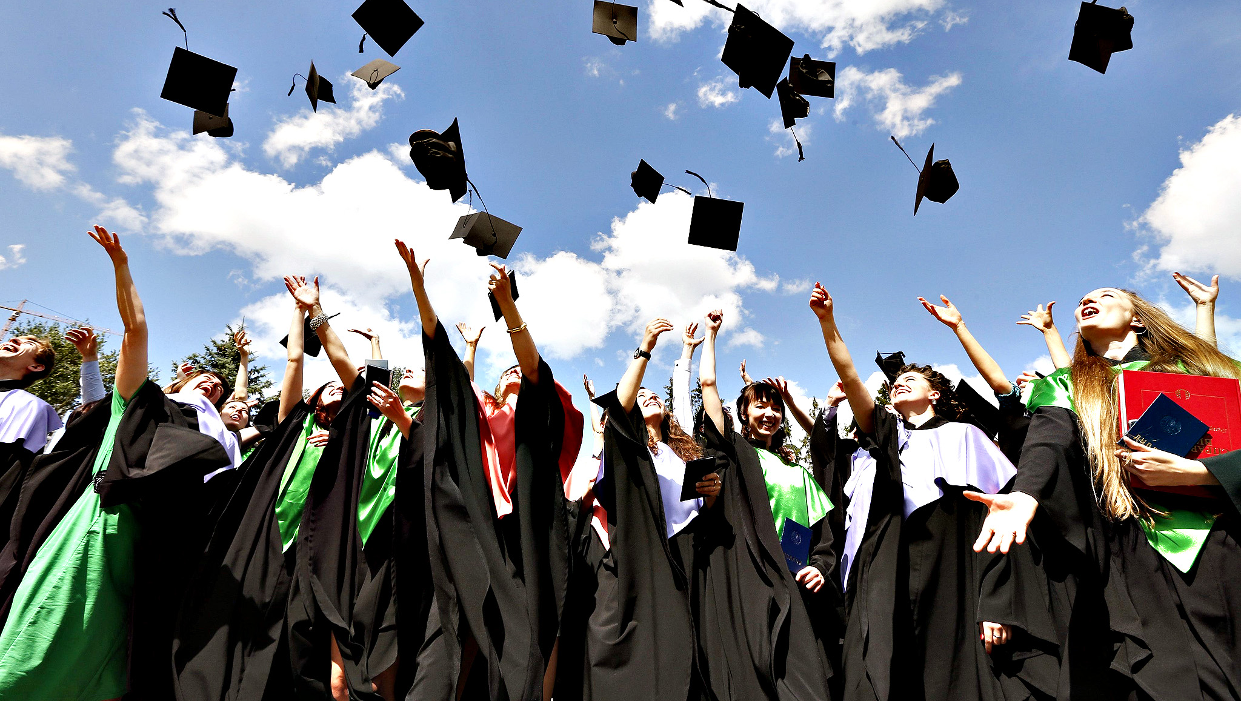
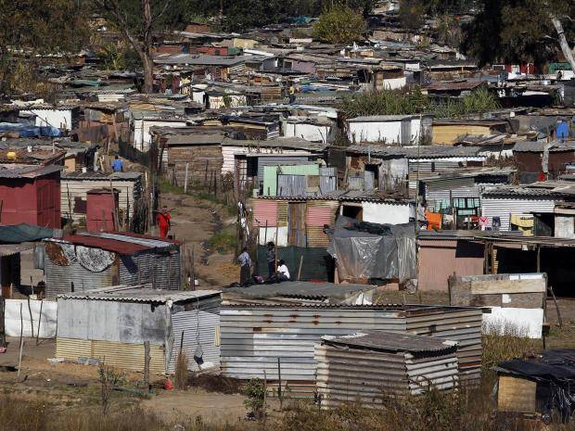
The inequality of education amongst countries
Both countries have ‘the right to education’ (HRA)
England and Wales
South Africa
Education is compulsory
Must be at least sixteen before you leave education.
You will be prosecuted if your child doesn’t attend school.
Education is easily accessible.
Help to low income families can be gained through school uniform, transport and school meals
Over 1/5th between 6-11 are out of school
Highest rate of school exclusion in the world
Girls are more likely to stay out of school compared to boys
If every girl in sub-Saharan Africa completed even just a primary education, the maternal mortality rate would likely decrease by 70%.
(Rotsky, 2017)

Slide 9
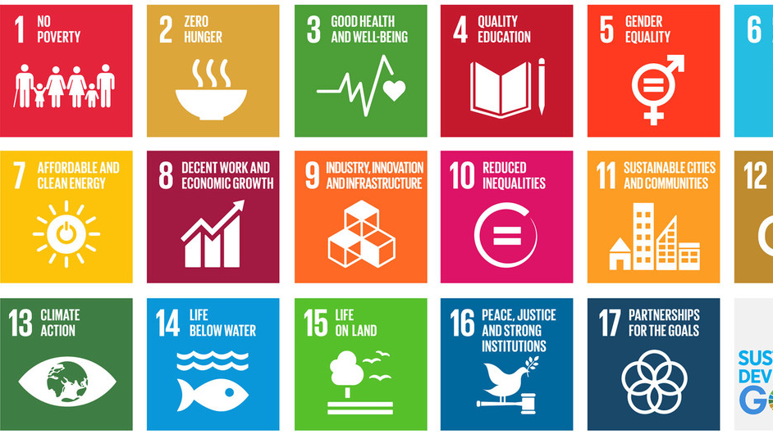
17 Sustainable Development goals
Aim to reach by 2030
All these goals play a part in creating a better environment, improving the planet and people.
Apply to every nation and every sector.
(Government, 2017)

Slide 10
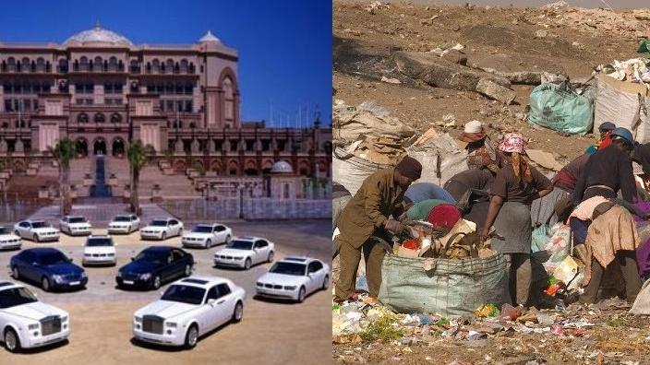
Themes: Wealth and Poverty
Goal 4: Quality Education
1
Goal 3: Good Health and Well-being
2
Goal 8: Decent Work & Economic Growth
3

Slide 11

Themes: Decent Work and Economic Growth
Goal 9: Industry, Innovation and Infrastructure
Goal 3: Good Health and Well-being
Goal 11: Sustainable Cities and Communities
Goal 5: Gender Equality

Slide 12
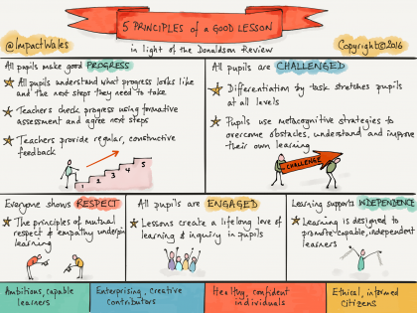
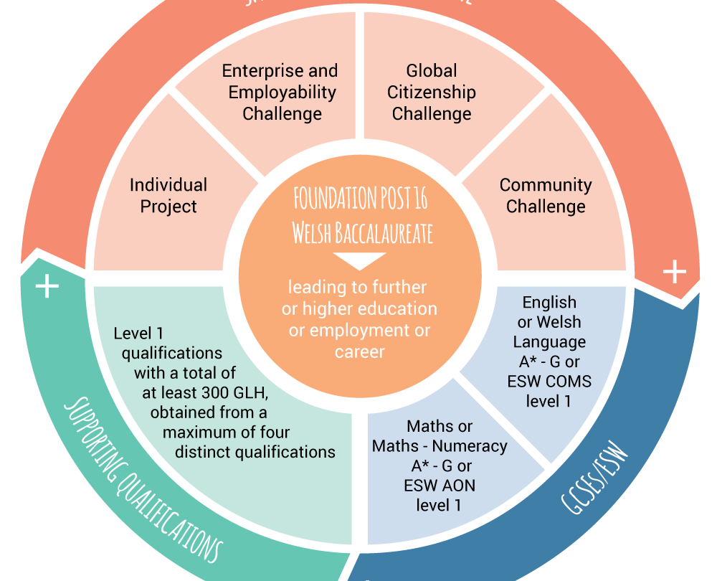
The Donaldson Report: Successful Futures
Aims to include all Learning Experiences and Assessments
Change of Learning in Education with the aim to get children engaged and interacting
Prepare children not for just future Employment but Life Skills and Activities where they seek Achievement and Enjoyment
To become Informed Citizens of Wales and the World
Strengthen the Welsh Language and Culture
Example: Welsh Bachelorette
(Donaldson, 2015)

Slide 13
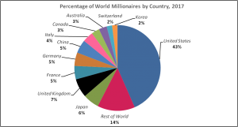
‘World’s richest 1% get 82% of the wealth’
(Oxfam, 2018)
More than 70 percent of the world’s adults own under $10,000 in wealth. This 70.1 percent of the world holds only 3 percent of global wealth. The world’s wealthiest individuals, those owning over $100,000 in assets, total only 8.6 percent of the global population but own 85.6 percent of global wealth (Inequality, 2017.)
(Credit Suisse Global Wealth Report, 2017)

Slide 14
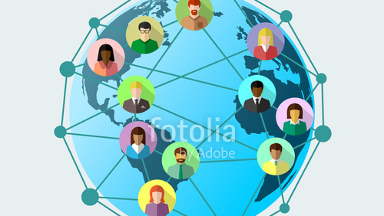
To Conclude:
We are becoming more connected as a society through sustainable development. Example -Windrush
People are coming to live and work here and we are becoming aware of issues in the world
Due to technology and social media we are more connected now that we have been
However
Education vs Neo-liberalism
Is the EDGSC big enough to make radical change to the educational system?
EFA goals not reached in 2015
Simultaneously
If all countries were to promote these goals and themes then a difference would be made to these global inequalities

Slide 15
References
Donaldson, G. (2015). Successful Futures. [ebook] Wales. Available at: http://file:///C:/Users/User/Downloads/Donaldson%20Report%20-%20Successful%20Futures%20-%20Independent%20Review%20of%20Curriculum%20and%20Assessment%20Arrangements%20in%20Wales%20(3).pdf [Accessed 8 May 2018].
Esdgcincardiff.files.wordpress.com. (2012). [online] Available at: https://esdgcincardiff.files.wordpress.com/2012/09/esdgcin-cardiff1.jpg [Accessed 2 May 2018].
Hutt, J. (2008). Education for Sustainable Development and Global Citizenship. [ebook] 5-15. Available at: http://learning.gov.wales/docs/learningwales/publications/081204commonunderstschoolsen.pdf [Accessed 2 May 2018].
Inequality.org. (2017). Global Inequality - Inequality.org. [online] Available at: https://inequality.org/facts/global-inequality/ [Accessed 2 May 2018].
Merriweather, M. (n.d.). Malala Yousafzai. [image] Available at: https://richtopia.com/women-leaders/malala-yousafzai-bravery-young-girl-provides-opportunity-education-women-worldwide [Accessed 8 May 2018].
Oxfam.org. (2018). Richest 1 percent bagged 82 percent of wealth created last year - poorest half of humanity got nothing | Oxfam International. [online] Available at: https://www.oxfam.org/en/pressroom/pressreleases/2018-01-22/richest-1-percent-bagged-82-percent-wealth-created-last-year [Accessed 2 May 2018].
Rotsky, N. (2017). 10 Important Facts About Education in Africa - The Borgen Project. [online] The Borgen Project. Available at: https://borgenproject.org/10-facts-about-education-in-africa/ [Accessed 2 May 2018].
Uis.unesco.org. (2018). Education in Africa | UNESCO UIS. [online] Available at: http://uis.unesco.org/en/topic/education-africa [Accessed 2 May 2018].

