Slide 1
Digital Transformation in the Health and Care Professions (BMHP6026)
Component 2 Assessment
Student name: Stephanie Owusu
Student ID: 2316785
Lecturer’s name : Shepherd Ziko

Slide 2
Use of AI Acknowledgement
I confirm that I have not used any AI tools in the research and creation of this assignment. I confirm that I have not presented any AI generated materials as my own work. I confirm I have copies of my drafts, notes, and other resources I used, which I may be asked to provide in evidence

Slide 3
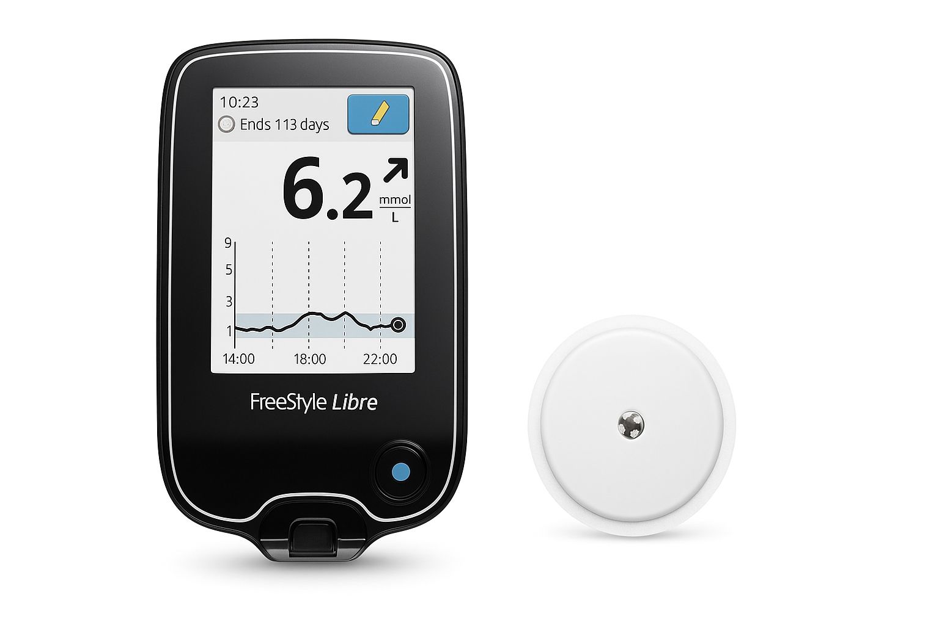
Introduction
A flash glucose monitoring device called Freestyle Libre (FSL) is transforming diabetes care in the National Health Service (NHS) (Abott, 2017).
Expanded access for Type 1 and Type 2 diabetes after being approved for NHS funding in 2017 (NHS England, 2020).
Uses a skin‑worn sensor to provide continuous glucose readings per minute (Abbott, 2017).
Reduces finger-prick tests by sending real-time data to cellphones and readers (Abott, 2017).
Represents one of the major digital advancements in current diabetes care (Abott,2017).

Slide 4
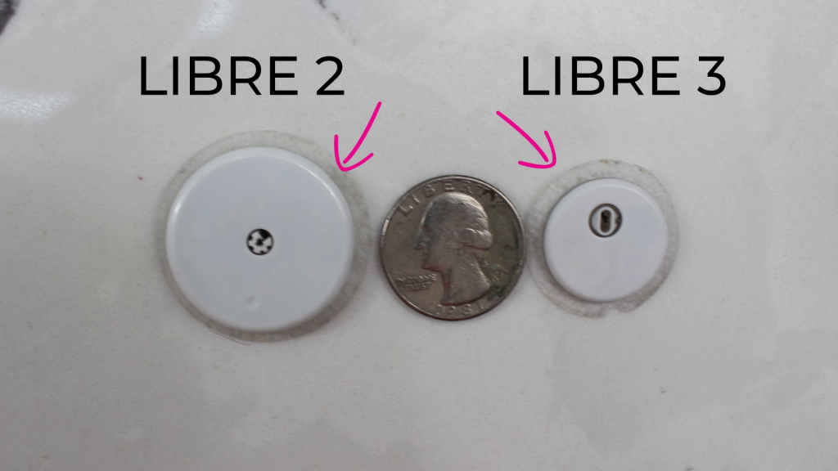
Freestyle Libre 2 vs Freestyle Libre 3 Key Differences
Freestyle Libre 2
Requires scanning to view glucose levels
Good accuracy (MARD – 9.2%)
Optional glucose alarms
Freestyle Libre 3
Real time glucose readings
Improved accuracy (MARD- 7.6%)
More reliable alarms.
(Hughes, 2025)

Slide 5
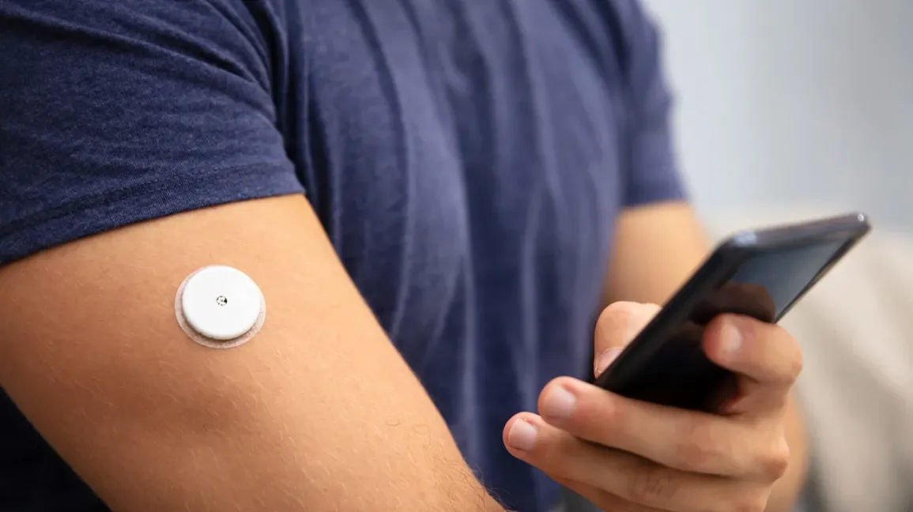
Impact on Workforce
Implementation requires structured clinician training on device use and data interpretation.
Expands nursing roles: data review, digital coaching, and sensor initiation.
Workflows changed with virtual diabetes reviews through LibreView .
Community nurses collaborate more closely with diabetes teams .
Challenges include digital competency gaps and workload pressures.
(Health Education England, 2021; Gregory and Curtis, 2022)

Slide 6
Impact on service delivery
Shift from episodic appointments to continuous, remote monitoring.
Virtual reviews reduce need for in‑person clinic visits.
New digital pathways for sensor initiation and data upload .
Enables trend‑based decision‑making and earlier intervention.
Associated with reduced emergency admissions for glucose‑related.
(NHS England, 2020; Kelly,2019; Diabetes. UK, 2022)

Slide 7
Impact on patients
Real‑time glucose visibility improves confidence and quality of life.
Reduces burden of finger‑prick testing.
Improves HbA1c, time‑in‑range, and hypoglycaemia detection.
Supports patient empowerment but requires digital literacy skills.
Some inequalities remain in device access.
(NICE, 2022 ; Cucinotta et al.,2024; Diabetes UK, 2021)

Slide 8

Impact on community
Enables decentralised diabetes care across home, community clinics, and remote services.
Family members can support monitoring via connected apps.
Encourages co‑production through shared glucose data review.
Reduces pressure on emergency and hospital services.
Improves access in rural and deprived communities.
(NICE, 2022 ; NHS England, 2020)

Slide 9
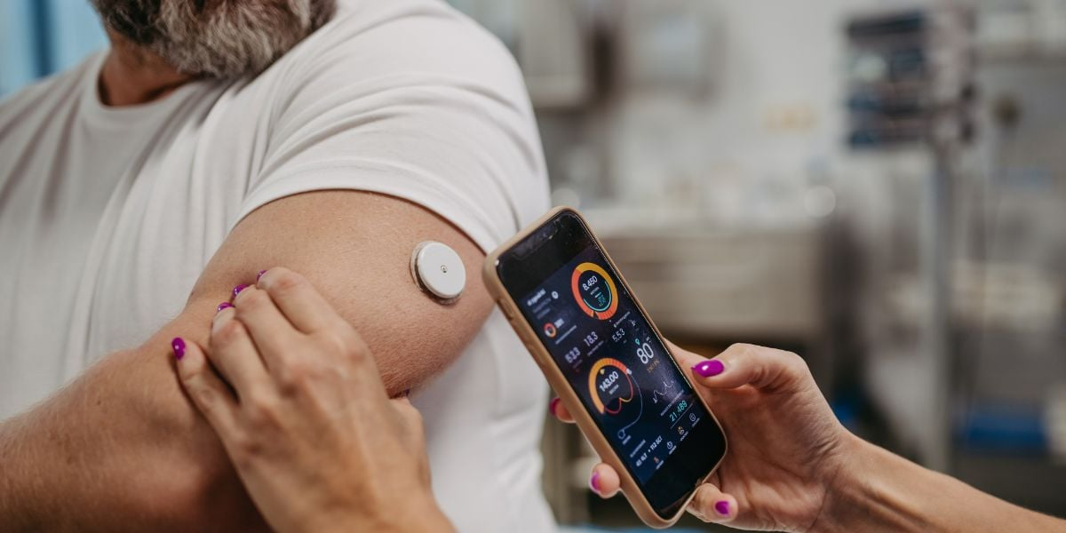
Challenges of the innovation
Digital literacy barriers, especially for older adults.
Technical issues such as sensor inaccuracies and connectivity problems.
Inequitable access across NHS regions.
Training demands on clinicians to interpret digital data.
Increased workload from continuous data monitoring.
Cost and long-term sustainability concerns.
Privacy and data security risks with cloud-based systems.
(National Library of medicine ,2018; Beasant et al.,2023)

Slide 10
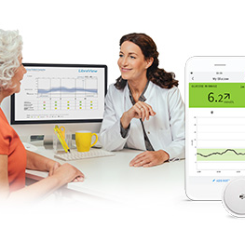
Conclusion
FSL has transformed diabetes care by increasing accuracy, autonomy, and efficiency.
Workforce roles expanded and require digital skill development.
Benefits extend to families, communities, and public health outcomes.
Represents a successful digital transformation across UK health and social care.

Slide 11
References
Abott (2017) FreeStyle Libre Flash Glucose Monitoring Technology Gains Reimbursement Approval From The United Kingdom’s National Health Service. Available at: https://abbott.mediaroom.com/2017-09-13-FreeStyle-R-Libre-Flash-Glucose-Monitoring-Technology-Gains-Reimbursement-Approval-from-the-United-Kingdoms-National-Health-Service (Accessed :4th November 2025)
Beasant, L., Cullen, F., Thomas, E., Kandiyali, R., Shield, J.P.H., Mcgregor, D., West, N. and Ingram, J. (2023). Flash glucose monitoring in young people with type 1 diabetes—a qualitative study of young people, parents and health professionals: ‘It makes life much easier’. BMJ Open, [online] 13(4), p.e070477. https://pmc.ncbi.nlm.nih.gov/articles/PMC10124239/
Cucinotta, G., Tariq, Z., Sankar, A., Martin, F.L. and Nyangoma, S. (2024). The use of FreeStyle libre improves glycaemic control along with reducing diabetes burden and hospital admissions in a socially deprived Northwest English population. Journal of diabetes and metabolic disordershttps://doi.org/10.1007/s40200-024-01424-4.
Diabetes UK (2021) Flash Glucose Monitoring. Available at : https://www.diabetes.org.uk/sites/default/files/2021-10/Position%20statement%20on%20Flash%20glucose%20monitoring%20211021.pdf (Accessed : 26th November 2025)
Diabetes UK (2022) New NICE guidelines recommend wider access to flash and cgm. Available at : https://www.diabetes.org.uk/about-us/news-and-views/nice-guidelines-recommend-wider-use-for-flash-and-cgm (Accessed :28th November 2025)
Gregory, S. and Curtis, K. (2022). Embedding flash glucose monitoring technology within neighbourhood nursing teams Article points. Journal of Diabetes Nursing, [online] 26. Available at: https://diabetesonthenet.com/wp-content/uploads/235.- Gregory.pdf (Accessed: 7th November 2025).
Health Education England (2021) Data driven healthcare in 2030: Transformation requirements of the NHS digital technology and health informatics workforce (Interim Report). Available at : https://www.hee.nhs.uk/sites/default/files/Data%20Driven%20Healthcare%20in%202030%20-%20Full%20report%20-%20Mar%2021.pdf (Accessed : 7th November 2025)
Hughes .E, (2025) FreeStyle Libre vs FreeStyle Libre 2 vs FreeStyle Libre 1: What’s the Difference? Available at: https://livewellnationwide.co.uk/guides/freestyle-libre-vs-freestyle-libre-2-vs-freestyle-libre-3/#:~:text=Frequently%20Asked%20Questions,3%20is%20the%20best%20option. (Accessed : 1st December 2025)
Kelly, B. (2019). FreeStyle Libre use in a real-world population: The Southampton City experience Article points. Journal of Diabetes Nursing, [online] 23, p.2019. Available at: https://diabetesonthenet.com/wp-content/uploads/pdf/dotn8df2bb1fcf47f62bbfa494d169dcd8de.pdf (Accessed : 10th November 2025)

Slide 12
REFERENCES
National Library of medicine (2018) Flash forward: a review of flash glucose monitoring. Available at : https://pubmed.ncbi.nlm.nih.gov/29356072/ (Accessed : 30th November 2025)
NHS England (2020) Diabetes Programme Delivery- letter to regions . Available at : https://www.england.nhs.uk/coronavirus/documents/diabetes-programme-delivery-letter-to-regions/ (Accessed : 26th November 2025)
NICE (2022) Diabetes in children and young people. Available at : https://www.nice.org.uk/guidance/qs125/chapter/quality-statement-4-continuous-glucose-monitoring-in-type-1-diabetes (Accessed : 26th November 2025)

