Slide 1
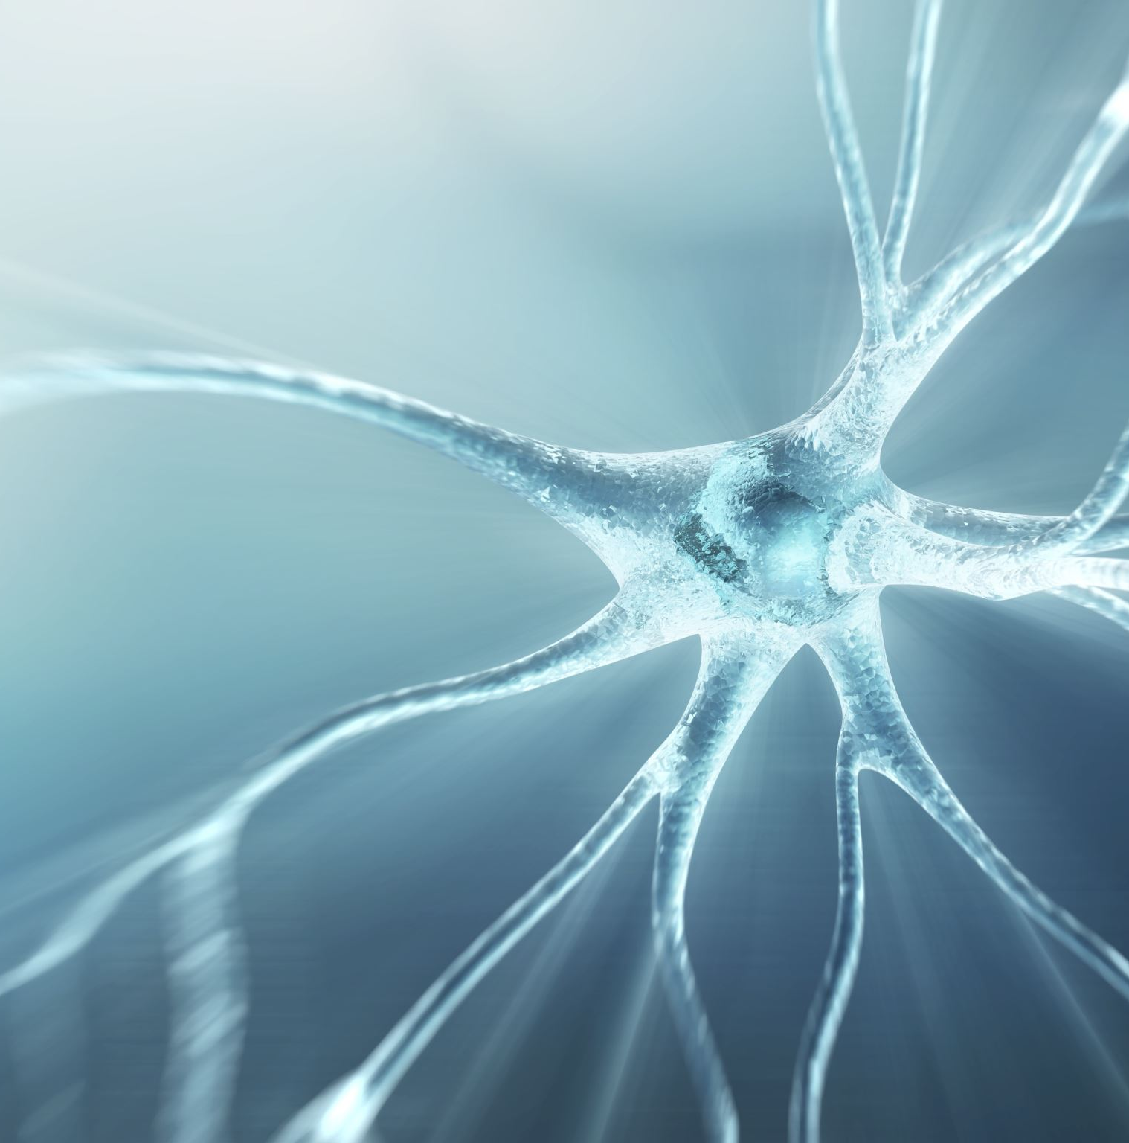
Understanding Mental Illness
Understanding Psychosis and Mood Disorders

Slide 2
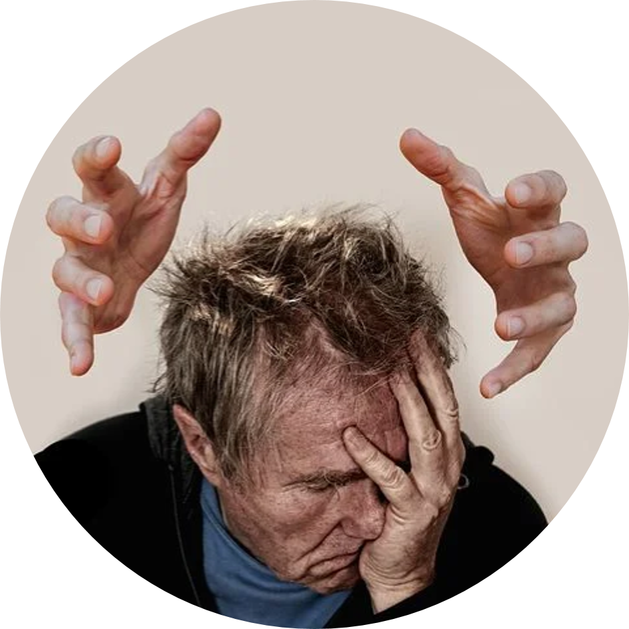
Understanding psychosis

Slide 3
Brief Historical Overview
Descriptions of schizophrenic symptoms can be traced far back in history, but not considered to be symptoms of a single disorder until later in the nineteenth century.
Kraepelin (1921) - "Dementia Praecox" - Chronic psychotic illness with a slow declining course - senility of the young
Bleuler (1911) - the disorder did not always end in profound deterioration or always begin in later adolescence
Bleuler suggested a new name for the disorder – schizophrenia: The splitting of mental associations
Notes:
Kraepelin wrote about every major type of psychiatric disorder recognised in this time. However he was particularly interested in the more severe forms of madness in which the individual appears to lose touch with reality.
Kraepelin suggested that mental illness fell into a small number of discoverable types and these could be independently identified by studying symptoms. Kraepelin's analysis, an understanding of the language of symptoms would allow the researcher to decode both the biological underpinning sof madness and their origins.
Bleuler did not agree wholly with the idea of Dementia Praecox. Bleuler suggested that at the core of the illness, there was a separation between the different psychic functions of personality, thinking, memory and perception.
Four A's: Associations (word salad),
Ambivalence – the holding of conflicting emotions and attitudes towards others,
Autism – preference for linving in an inner world of fantasy
, affect- display of emotions that are incongruent with patient's circumstances.

Slide 4

Lack of agreement as to the exact nature of schizophrenia.
Classification of schizophrenia has proven difficult: current debate around whether it actually exists as a specific diagnosis.
DSM-III criteria differed from DSM-IV, which differs from DSM-V Classification;
  Indicates difficulties in accurate classification

Slide 5
Classifying Schizophrenia
Generally considered to be a psychosis comprising several related disorders (spectrum) around distorted thinking and perceptual processes:
Characterised by:
  Delusions
  Hallucinations
  Disorganised thought/behaviour

Slide 6
Synopsis of Symptoms
Schizophrenia is a psychosis which is characterised by distortions in thinking, perceptions, emotions, language, sense of self and behaviour.
Notes:
Hallucinations; Hearing, seeing or feeling things that are not there
Delusion: Fixed false beliefs or suspicions not hared by others in the person's culture and that are firmly held even when there is evidence to the contrary
Abnormal behaviour: disorganised behaviour such as wandering aimlessly, mumbling or laughing to self, strange appearance, unkempt
Disorganised speech incoherent or irrelevant speech
Or disturbances of emotions: marked apathy or disconnect between reported emotion and what is observed such as facial expression or body language

Slide 7
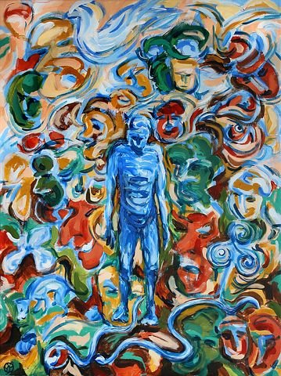
Hallucinations
Hearing voices are the most common form of hallucination
Voices may be experienced as describing the individual's activities, warning of impending dangers, ordering them to behave in certain ways

Slide 8
Delusions
Persecutory
Grandiose
Delusions of control
Delusions of reference
Nihilistic delusions
Erotomanic delusions

Slide 9
Disorganised thinking
Derailment
Tangentiality
Clanging
Neologisms
Word Salads

Slide 10
Clanging
TH: "What colour is your dress?"
CL: "Red...like a bed"
TH: "Why is it like a bed?"
CL: "Because it's dead"
TH: "Why is a bed like being dead?"
CL:" "I dunno..maybe it's a med."
TH: "What's a med?"
CL:"A bled."

Slide 11
Neologism
Many individuals suffering psychotic symptoms often make up words
These neologisisms are frequently constructed by condensing or combining several words
  Sniggeration – a giggle or sniggering
  Relaudation – praising over and over
  Circlingology - study of a rolling circle

Slide 12
Word salad
‘Everything is going around in slow motion. The boxes are clanging and chattering to be let out. Behind my forehead the past is surfacing mixing a bottle of acid solution. A stake jams a door that leads to a mirage of broken appearances. Inside a box, pounding fists try to pull down my imagination. The ground work is split into hundreds of pieces; each fragment is separate as if it had some kind of individual purpose. The truth is locked up in a unit.’

Slide 13
Abnormal motor behaviour
Disorganized behaviour may include:
  Childlike and silly behaviour
  Behaviour inappropriate to the context (e.g. masturbating in public)
  Unpredictable and agitated (e.g. shouting and swearing in the street)
  Catatonic behaviours are characterized by decreased reactivity to the environment, rigidity and immobility

Slide 14
The prevalence of schizophrenia spectrum problems
Lifetime prevalence is around 0.3-0.7%
24 million diagnosed worldwide
Largely between 15-35 years old
Mortality is 50% higher than normal
Significant lifelong impairment
Cultural differences in course of disease progression and prevalence
  Immigration
  Ethnicity

Slide 15
The "schizophreniA" controversy
The experience and symptoms of schizophrenia vary markedly – Two people with schizophrenia may present in very different ways and report very different experiences
Degree to which symptoms effect daily functioning also vary
People diagnosed with schizophrenia respond to different medications (some fail to respond to any)
Suggests individual symptoms may have different causes and require different treatment
Suggests that there is not one underlying cause of Schizophrenia – but different disorders?

Slide 16
Contd..
Bentall (1993): the diagnosis of schizophrenia is not valid & should be abandoned
Bennett (2003):
  better to look at the various symptoms of schizophrenia and each be treated as a disorder in its own right .
  need to better understand causes of Schizophrenia
  Van Os (2009): should be re-named “salience disorder” to avoid stigma
  Paris (2013) – “we will have to wait for a better understanding of the illness before we are in a position to give it a better name” (p95)

Slide 17

Treatment

Slide 18
Hospital treatment
Some patients are chronically disturbed and require long-term institutional treatment.
Social learning programmes, sometimes called token economies, can be useful for these patients.
Specific behavioural contingencies are put into place for all of the patients on a hospital ward.
Carefully structured inpatient programmes can have important positive effects for chronic schizophrenic patients.

Slide 19
Biological treatments
Antipsychotic drugs
Electro-convulsive therapy – Was first treatment in past but limited use in present –
Tharyan (2002): 50% showed some improvement compared to placebo in short-term but not longer term
– Less effective than antipsychotic medicine --
ECT in Modern Psychiatry
(ECT for schizophrenia)

Slide 20
pharmacotherapy
Reduce the severity of, and sometimes eliminate, psychotic symptoms.
All antipsychotic medications act by blocking dopamine receptors in the cortical and limbic areas of the brain.
They also affect a number of other neurotransmitters, including serotonin, norepinephrine, and acetylcholine
Control the positive symptoms of schizophrenia
Sedative effect of most antipsychotic drugs
Dramatically reduce average hospital stay
Sarti &Cournos (1990): delay rather prevent relapse
Side-effects
Low-adherance

Slide 21
Community treatment
A psychosocial intervention that is delivered by an interdisciplinary team of clinicians.
They provide a combination of psychological treatments—including education, support, skills training, and rehabilitation—as well as medication.

Slide 22
Psychological treatments
Focus on teaching communication and living skills and reducing isolation in people with schizophrenia
Behavioural: operant conditioning, modeling,
Cognitive: Recognition of demoralizing attitudes they may have toward their illness,
Family interventions: family therapy, token economies
Social Interventions: self-help groups, assertive community treatment programs.

Slide 23
Summary
Schizophrenia is one of the most server disabling mental health disorders
Concerns over nature and classification of schizophrenia
Course and treatment effectiveness for schizophrenia varies widely across individuals
No one causal factor: a number of potential biological, social and psychological risk factors have been identified
Different courses and effectiveness of treatment further reflect these
Complexities!

Slide 24
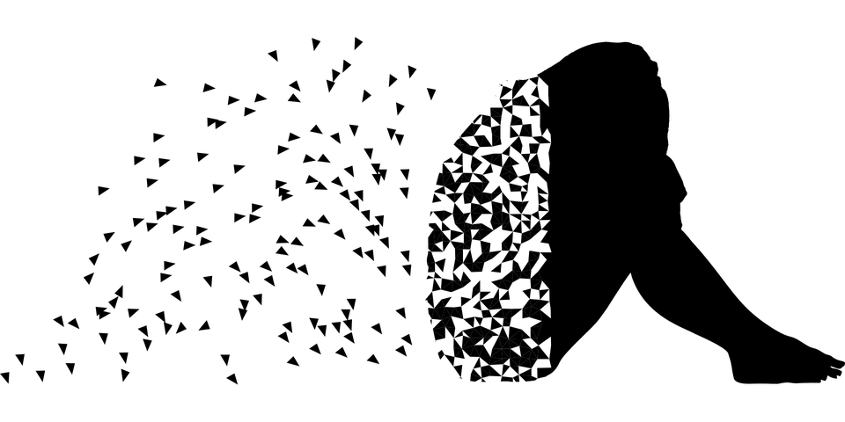
Depression and mood disorders

Slide 25
Major depression - diagnosis
DSM-5 changes to categorisation and diagnosis of major depression •
New criteria for major depressive episode
➢5 or more symptoms in 2-week period
Two main types of depressive disorder defined:
➢Major depressive disorder, single episode
➢Major depressive disorder, recurrent
Diagnosis is a controversial issue

Slide 26
Major depression - diagnosis
Problematic diagnosis:
➢Degrees of distress and meeting criteria
➢Overdiagnosis
➢Risk of medicalisation
Comorbidity:
➢Mixed anxiety/depressive disorder

Slide 27
Major depression - prevalence
Most widely prevalent of psychopathologies (second cause of illness in 2020)
Contributes 12% to nonfatal global disease burden
Mixed anxiety & depression is the most common mental disorder in Britain, with 7.8% of people meeting criteria for diagnosis
4-10% of people in England will experience depression in their lifetime.

Slide 28
Major depression - prevalence
Common mental health problems such as depression and anxiety are distributed according to a gradient of economic disadvantage across society.
Mixed anxiety and depression has been estimated to cause one fifth of days lost from work in Britain.
Steady increase in incidence since 1915
Age of onset has decreased to around 27 years • Gender differences

Slide 29
Major Depression – biological theories
Genetic factors
➢Strong evidence of inherited component
➢Specific pathways still unknown •
Neurochemical factors:
➢Reliable association with neurotransmitter abnormality (serotonin, norepinephrine and dopamine)
➢Drugs developed have significantly alleviated symptoms: tricyclics; monoamine oxidase inhibitors; selective serotonin reuptake inhibitors

Slide 30
Major depression – biological theories
Brain abnormalities
➢Growth of cognitive neuroscience
➢Prefrontal cortex - goal representation
➢Anterior cingulate cortex - emotional regulation
➢Hippocampus - contextualisation
➢Amygdala - prioritisation of affective stimuli
Neuroendocrine factors
➢Lack of inhibitory control over cortisol secretion

Slide 31
Major depression – psychological theories
Psychodynamic explanations
➢Freud (1917)
➢Depression as response to loss (of loved one or parent)
➢Introjection (regression to oral stage)
➢Concept refined to symbolic loss
➢Contribution of parenting style (affectionless control)
➢Some empirical support
➢Many controversies of application and conceptualisation

Slide 32
Major depression – psychological theories
Behavioural theories
➢Diminished behavioural repertoire
➢‘Behavioural vacuum’
➢Lack of reward and reciprocal interaction
➢Interpersonal theories of depression
➢Excessive reassurance seeking
Negative cognitions and self-schema
➢Beck’s Cognitive Theory (1967, 1987)
➢Negative schema
➢Negative triad
➢Pessimistic thinking

Slide 33
Bipolar disorder- diagnosis and prevalence
DSM-V Defines two main types:
  Bipolar I Disorder: Full manic and depressive episodes in alternating sequences
  Biplar II Disorder: Major depressive episodes alternate with periods of hypomania
  Cyclothymic Disorder: Milder form of bipolar disorder
  Bipolar disorder is less common than major depression
  Lifetime prevalence rate of around 1%

Slide 34
Bipolar disorder - triggers
Depressive episode triggers similar to those for general depression •
Manic episode triggers similarly varied
➢Increased responsiveness to reward
➢Disrupted sleep
➢Seasonality
➢Stress

Slide 35
Biological treatments
Drug therapy for depression
➢Tricyclic drugs
➢MAO inhibitors
➢SSRIs
Beneficial but not without side effects
Delayed reaction
Some controversy around risk of suicide

Slide 36
Biological treatments
Drug therapy for bipolar disorder
➢Lithium carbonate is the traditional treatment
➢Alleviates both depression and mania
➢Difficulty of getting dosage right - toxic
➢Risk of relapse if discontinued

Slide 37
Biological treatments
Electroconvulsive therapy (ECT)
➢Primarily for treatment-resistant severe depression
➢Short term relief
➢Side effects
➢Lasting memory loss
➢Frightening
➢Unclear mechanisms of effect
➢Benefits may be short term
Treating Depression: Electroconvulsive therapy

Slide 38
Psychoanalysis
Depression as internalised anger as a result of loss
Psychodynamic therapy aims to aid insight into repressed inner conflict Techniques include:
➢Free association
➢Dream interpretation
Scarce evidence of efficacy

Slide 39
Cognitive Therapy
Beck’s Cognitive Theory of Depression (1967) •
Depression maintained by set of negative beliefs that create a negative schema
➢Led to one of the most successful therapeutic approaches
➢Cognitive therapy/cognitive retraining/cognitive restructuring
Process is based on:
➢ Identify - challenge - replace negative beliefs
➢ Clients monitor negative automatic thoughts

Slide 40
Cognitive therapy
Philosophical focus is one of correction of negative thinking bias
Can be supplemented by reattribution training
➢Positive reinterpretation of difficulties
Cognitive therapy at least as effective as drug therapy
Appears to have better long-term effects
Combination of cognitive and drug therapies superior
Some debate about how it achieves its beneficial effects – cognition or biological influence?

Slide 41
Mindfulness-based cognitive therapy
Crucial to be able to predict and prevent relapse in depression
Successive low moods reactivate negative thinking which leads to relapse.
MBCT is based on CBT and mindfulness-based stress reduction: Mediation and monitoring of attention
Skills taught to encourage disengagement from dysfunctional cognitive routines.
Significantly reduces possibility of future relapse

Slide 42
Discussion point
We've discussed psychosis and mood disorders today.
Working in small groups, think about your own understanding of these two different mental illnesses.
  What is your understanding of these client groups?
  Do you have any concerns or fears if working with these client groups?

Slide 43
Other Mental Illnesses
Understanding personality disorders
1
Understanding substance misuse disorders
2

