Slide 1

How to Use This Resource
This resource has been created to help schools understand the Eco-Schools process, and how to achieve the Eco-Schools Green Flag award. It’s also packed with examples of how other schools have interpreted the Eco-Schools seven step process. This should help you implement the process in your school to the best effect.
The key criteria for the Green Flag Award are presented on the explanation slide for each of the seven steps. These are the foundations of the Eco-Schools process, and should be implemented before visiting the eight topic areas (litter, waste minimisation, energy, water, transport, school grounds, healthy living and global citizenship).
The Green Flag Award is based on the implementation of these criteria. Examples and suggestions can be seen for each of the criteria. It’s important to note that each school will interpret the criteria slightly differently, as we acknowledge that each school setting is unique. The key is to adapt the process to work for your school.
Feel free to dip in and out of the various areas of this resource, as and when you want guidance, or a little inspiration!
Let’s Get Started!

Slide 2
The Eco-Schools Process
How Eco-Schools Works
Eco-Schools is an environmental education programme, designed to encourage pupils to engage with environmental issues through seven inter-connecting steps.
The seven steps of the Eco-Schools Programme include the establishment of an Eco-Committee – the driving force. This is made up of pupils, staff, governors and parents who then ensure that the other six elements are implemented and encourage the involvement of all members of the school community. The school then undertakes an environmental review, which feeds into an action plan. Progress is then monitored and evaluated, and any necessary changes implemented. They must also involve and inform the wider community. The production of an ‘Eco-Code’, a statement of their environmental stewardship and commitment to the programme, helps to spread the message. The whole process should be integrated within the curriculum, to ensure the process becomes embedded throughout the school.
Click on the step to view a full explanation
Linking to the Curriculum
Eco-Committee
Environmental
Review
Monitoring and Evaluation
Action Plan
Informing and Involving
Eco-Code
Tell me about the Awards

Slide 3


The Eco-Schools Awards
Click on the award to view the criteria and to make an application
Registration
Bronze
Silver
Platinum Status (4th Flag)
Back to Title Slide
Green Flag
Re Award (every 2 yrs)

Slide 4
Eco-Committee
At the heart of the process
Why have an Eco-Committee? This group will represent the views of the whole school, and act as the focus to push forward actions and discuss progress. The Eco-Committee also work to keep the profile of the Eco-Schools programme high.
Key Criteria:
(Click on the criteria to view examples and ideas)
The Eco-Committee need to meet regularly
Adults and non pupils should be involved, either by attending meetings or helping with specific tasks
A record of meetings must be kept
The Eco-Committee make sure the rest of the school is told what they have been doing/talking about
Back to Title Slide

Slide 5

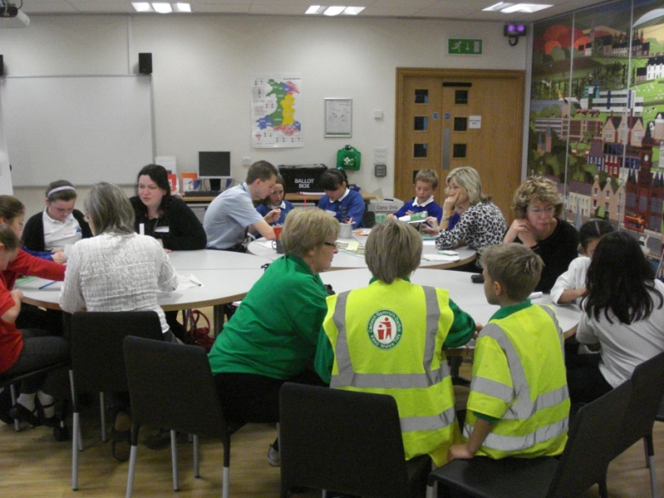
The Eco-Committee need to meet regularly
Ysgol Brynteg, Wrexham have an Eco-Committee Meeting on a Tuesday for the elected members. They meet for half an hour at lunchtimes to discuss how things are going, and to plan the next steps. Alongside this, they have another meeting at lunchtime on Thursday open to anyone. Here practical tasks are undertaken, and it is an opportunity for anyone to raise any issues.
Afan Taff High School successfully operate Eco-Schools through their School Council, making sure that every meeting has an Eco-Schools agenda point.
Pupils at Baglan Primary School, Port Talbot put a lot of thought to their application to be a member. This way they ensure the school will have a strong Eco-Committee. Click here to view an example.
Sandfields Primary School hold Eco-Committee meetings once every half term to decide on targets and evaluate progress. The Eco-Club then meets weekly to carry out practical tasks.
Springwood Primary School hold a campaign week followed by elections for the Eco-Committee as well as the School Council. The pupils have to fill in ballot papers in election cubicles to submit an official vote.
The Eco-Committee could be renamed as something else, in order to sound more appealing to potential members, especially in a high school setting.
Rhostyllen Primary needed to raise the profile of the Eco-Committee. Elections were held so now they have the same status as the School Council. Eco-Committee members have more pride in their role and are more effective.
Back to Title Slide
Wat’s Dyke Primary’s Eco-Committee meet weekly after school. They dedicate most of the hour to ‘hands on’ activities, but make sure there’s time to discuss the Action Plan and any developments.

Slide 6
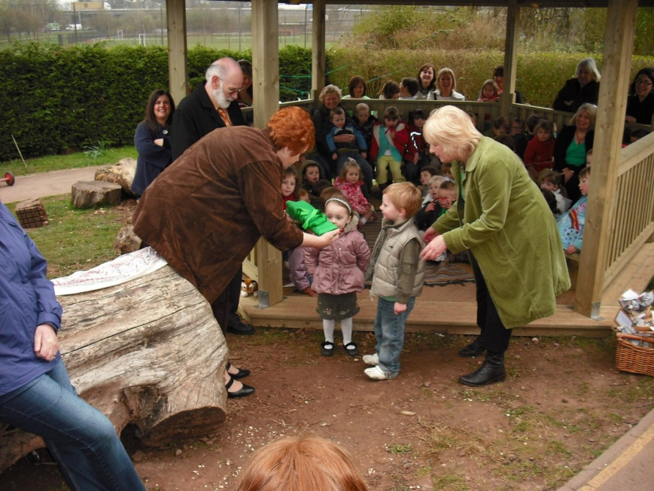
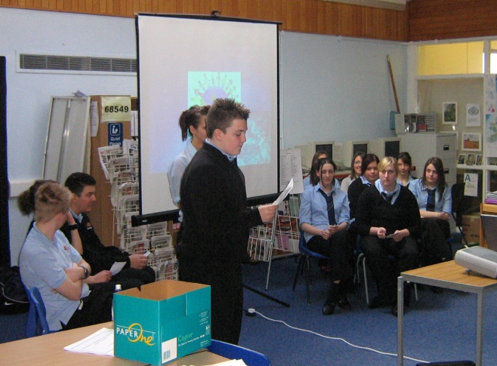
Adults and non pupils should be involved, either by attending meetings or helping with specific tasks
Gwaunmeisgyn School sent a request out to parents to ask if they could spare some time to help with their green day.
The Eco-Committee from Cyfartha High school have a slot at the Governors meeting each year. This is a great opportunity to feedback what they have been doing, and also to request any help they may need.
At Llanedeyrn Primary school, the caretaker has been essential in helping the action plan targets to be achieved. The children found them to be a goldmine of information. Assisting the Eco-Committee is even in the caretaker’s job description at Nottage Primary.
Back to Title Slide

Slide 7
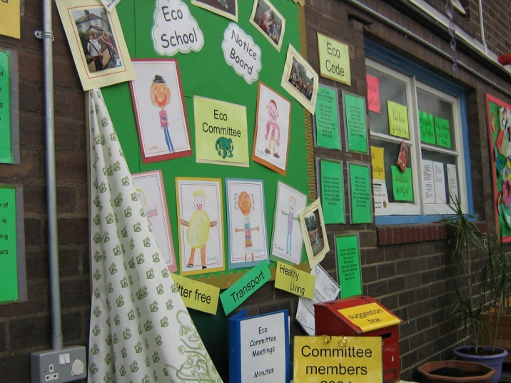
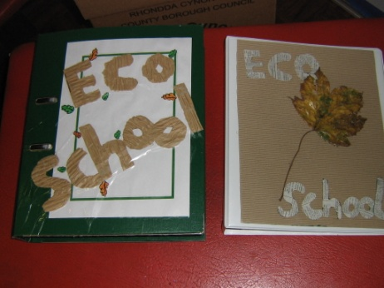
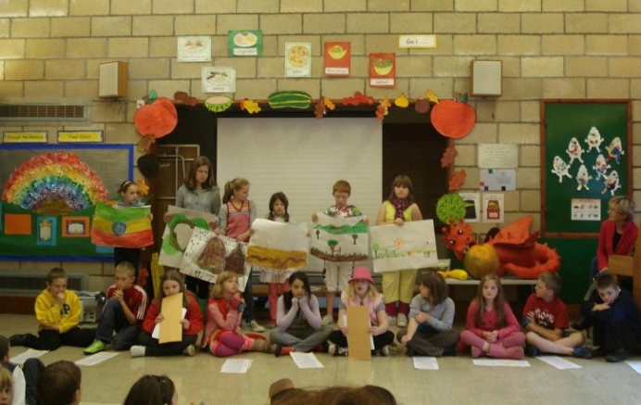
A record of meetings must be kept
Keeping minutes is an important task in order to remember what was discussed during previous meetings. Wat’s Dyke Primary keep a log book with brief notes of what happened at each meeting.
The Hollies Special School found it easier to record some of their meetings with a video recorder so that those unable to attend can gain an update on the actions taken. The videos provide evidence of the children’s contribution and demonstrate the development of their understanding of environmental views.
The Eco-Committee make sure the rest of the school is told what they have been doing/talking about
Irfon Valley Primary School’s Eco-Committee hold regular assemblies. They use this opportunity to feedback any developments, or to launch a new action.
Pil Primary School elect extra Y6 members to their committee to represent reception and Y1 pupils. Part of their role is to feed back ideas and gather suggestions.
Back to Title Slide

Slide 8

Environmental Review
A look at what’s going on in school
Why carry out an Environmental Review? The purpose of the review is to help the Eco-Committee come up with ideas as to how the school can reduce its impact on the environment. Conducting a comprehensive review will ensure that no significant areas of impact are overlooked. These ideas then feed into the Action Plan.
Key Criteria:
(Click on the criteria to view examples and ideas)
All eight topic areas should be reviewed annually
The pupils must be involved in undertaking the review
The results are then discussed
Back to Title Slide

Slide 9

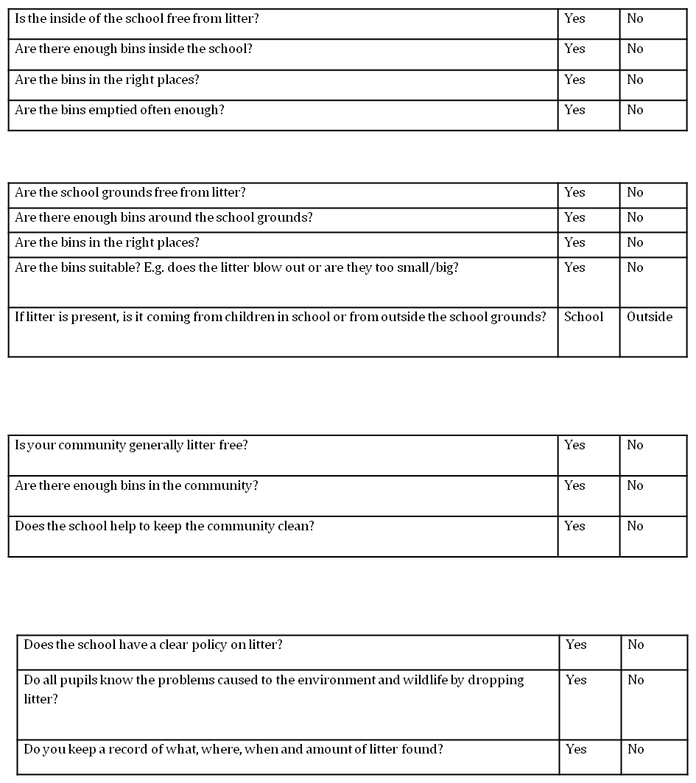
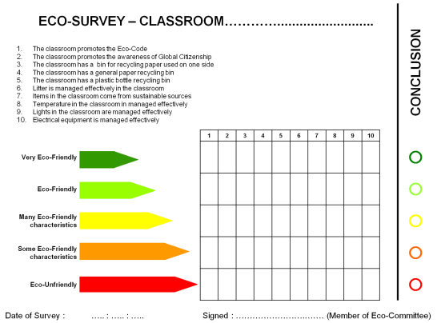
All eight topic areas should be reviewed annually
The Eco-Schools eight topic areas are: Litter, Waste, Energy, Water, Transport, School Grounds, Healthy Living, Global Citizenship. Reviewing them at the start of the academic year is an ideal time to feed into your action plan.
Ysgol Gyfun Llanhari created their own review to investigate areas where improvements could be made in the school. This resulted in each room in the school being given their very own ‘Display Energy Certificate’ style rating. Click on the photo to view the full document.
Plasnewydd Primary gave each class responsibility for investigating one area of the review. This way the pupils were able to look in detail at the topic areas and discuss ideas to put forward to the Eco-Committee.
Fancy something different? There are over 50 countries involved in Eco-Schools around the world ,so why not investigate how they do it?
Click on the photo to take you to the Eco-Schools Environmental Review Template.
There is also an infant friendly version of the Environmental Review. Click here to view it.

Slide 10
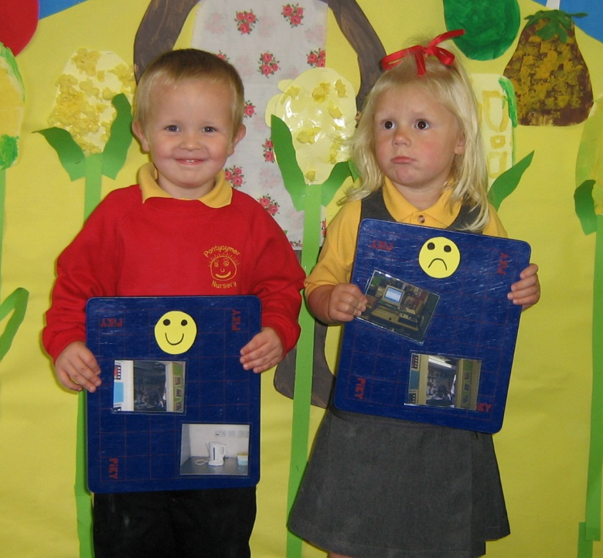
The pupils must be involved in undertaking the review
It is important that the pupils understand that the Environmental Review is a document to help them identify areas for improvement, not a test. The aim is not to be able to answer ‘yes’ to everything, but to highlight where action can be taken. Make sure that you use the action points box to explore challenges further.
Eco-Spies: Pupils usually enjoy being given ‘access all area passes’ in order to complete the review. It is important that all areas of the school’s environmental impact are taken into consideration during the review process.
Some areas of the review require some investigation, so the Eco-Committee may want to interview some people in the know, such as the caretaker, kitchen and office staff.
The review could be completed by the Eco-Committee, working in pairs on each topic area. Ogmore Comprehensive decided to set up sub-groups linking to each topic area and then fed back to the whole Eco-Committee.
Back to Title Slide

Slide 11
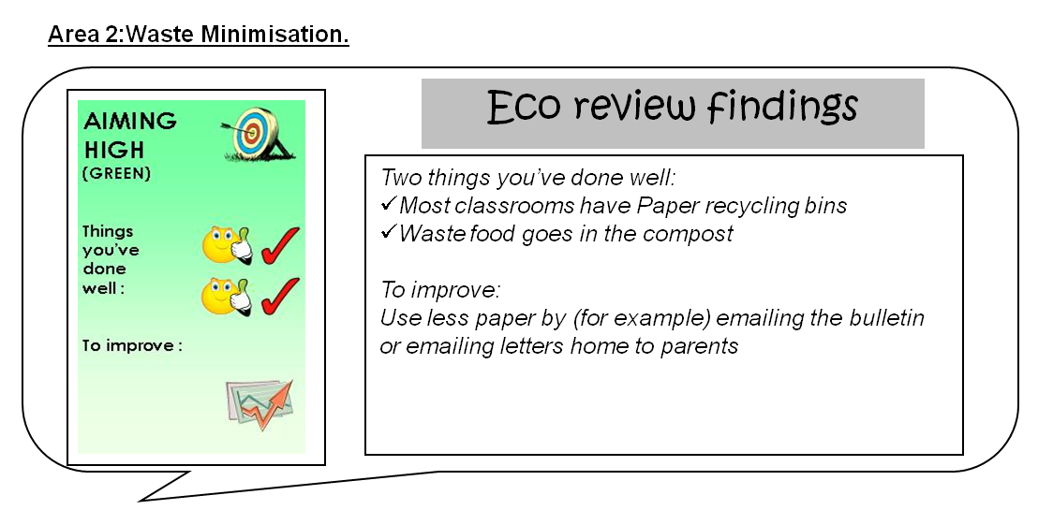
The results are then discussed
Prestatyn High’s Eco review 2011 was carried out in September. This will become the annual month for reviews. In a discussion prior to the review it was decided to use the schools ‘Two ticks and a wish’ style of feedback to inform the rest of the school.
It’s a really good idea to discuss the results with the Senior Managment Team. They may have their own aims which you could collaborate on, and there may be more opportunities for obtaining resources.
Eco-Committee members could diamond rank suggestions from the results of the Environmental Review in order to prioritise their targets for the action plan and display this on their notice board.
Our Lady of the Angel Primary School used a map of the school to highlight areas where action could be taken for each topic area. Subsequent reviews were compared to previous years to show progression.
Ideas highlighted from the environmental review could be written on a large sheet of paper, and displayed on the Eco-Committee’s notice board. Each pupil is then given one small sticker to put near the idea they would most like to see as a target on the action plan. This way the whole school has the chance to contribute.
Back to Title Slide

Slide 12
Action Plan
Making change happen
Why have an Action Plan? It’s very important to organise your ideas into an action plan. Through the process of creating the plan you will be able to make sure that you include a realistic number of activities, and also work out how you will monitor and measure the progress of your actions. Having a SMART action plan will really help everyone to focus.
Key Criteria:
(Click on the criteria to view examples and ideas)
The Action Plan needs to clearly show proposed actions and how they will be undertaken.
It needs to be appropriate for the age and ability of the pupils (or there needs to be another version that is)
It needs to be in a format that is understood by any other member of staff.
Back to Title Slide
The Action Plan must be supported by the Head Teacher.

Slide 13

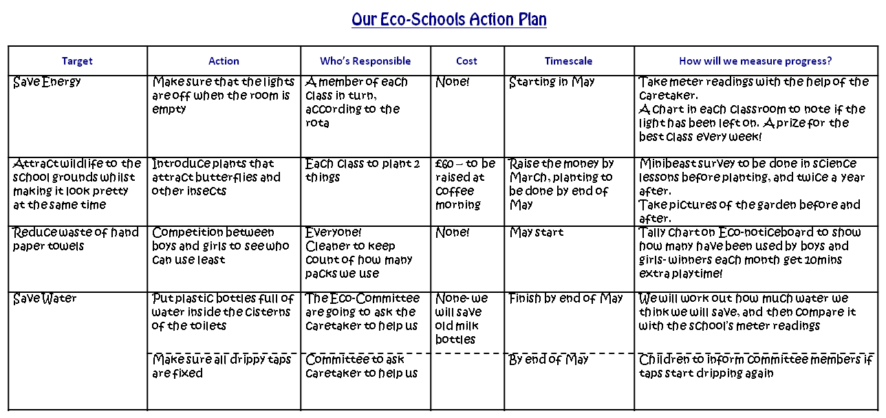
The Action Plan needs to clearly show proposed actions and how they will be undertaken.
Click on the photo for an action plan template
Llysfaen Primary’s Action Plan covers a term, and targets are added / removed at the beginning of each term.
Creating a SMART Action Plan will help ensure you have the greatest chance of succeeding with your targets. Ensure your targets are:
S: Specific
M: Measurable
A: Appropriate
R: Resourced
T: Timescaled
The action plan doesn’t have to include all eight topic areas. It’s the Eco-Committee’s job to prioritise which areas to act upon first. Over the years more topic areas can be targeted and tackled.
The action plan could be written at the beginning of each academic year, with timescales for the actions spread over the year.
Back to Title Slide

Slide 14
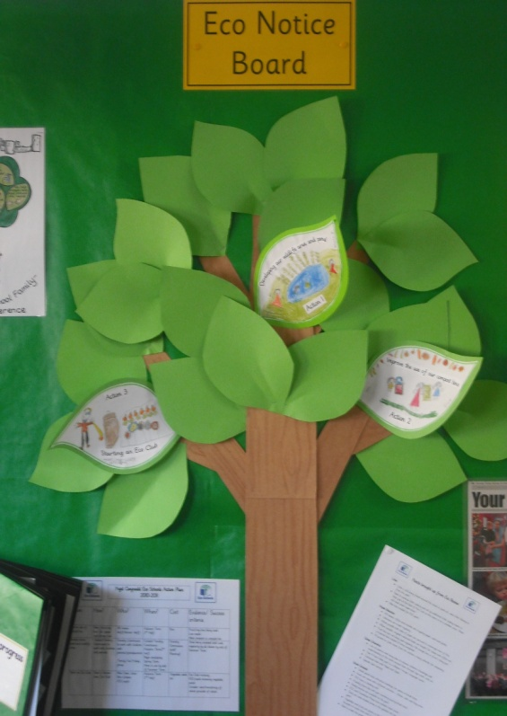
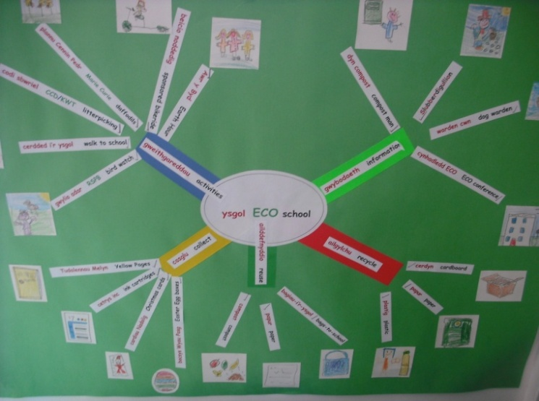
It needs to be appropriate for the age and ability of the pupils (or there needs to be another version that is)
The Eco-Committee at Ysgol Gwynedd, Flintshire have a ‘Target Tree’ alongside their Action Plan. The Action Plan holds all the details, but the Target Tree makes it more interesting and accessible to the whole school.
In addition to the staff’s detailed action plan, Llanfairfechan Infants’ School created a mind map with their young Eco-Committee members to plan their actions.
Back to Title Slide

Slide 15
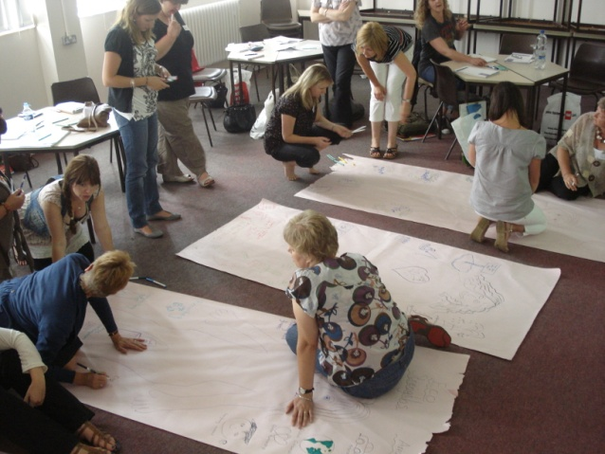
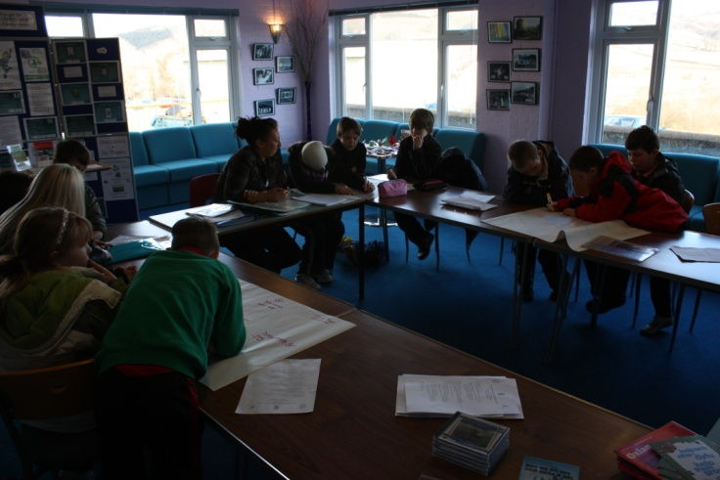
It needs to be in a format that is understood by any other member of staff.
Presenting the Action Plan at a staff meeting will help to ensure that everyone is aware of your targets. If another member of staff needs to take over for any reason, they won’t have problems getting to grips with the process.
Staff should be asked to help deliver some of the targets with their classes. This will help to integrate with the curriculum and deliver ESDGC.
The Action Plan must be supported by the Head Teacher.
Glan Yr Afan Primary School feed back ideas and progress to their head after each meeting.
Including the Eco-Schools action plan within the school development plan will raise the status and help communicate targets to other staff and governors.
Back to Title Slide

Slide 16
Monitoring and Evaluation
What impact have we made?
Why Monitor and Evaluate? To find out whether you are successfully achieving the targets set out in your action plan, you must monitor and measure your progress. This will allow you to evaluate the success of your activities and plan any necessary changes to ensure you’re still on track to achieving your targets.
Key Criteria:
(Click on the criteria to view examples and ideas)
Monitoring should be meaningful and appropriate to the pupils involved
Some of the monitoring work should be undertaken as part of class work
The progress of the Action Plan must be discussed by the Eco-Committee, but ideally as a whole school
Back to Title Slide

Slide 17

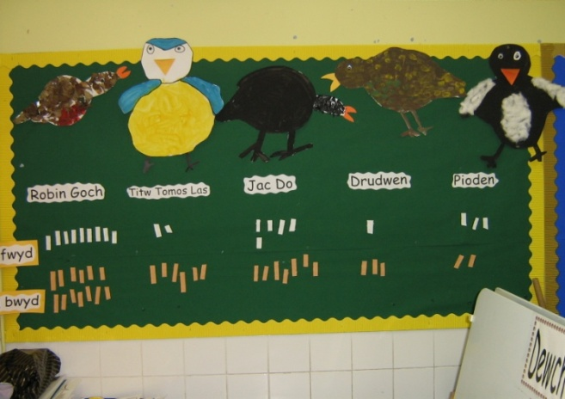
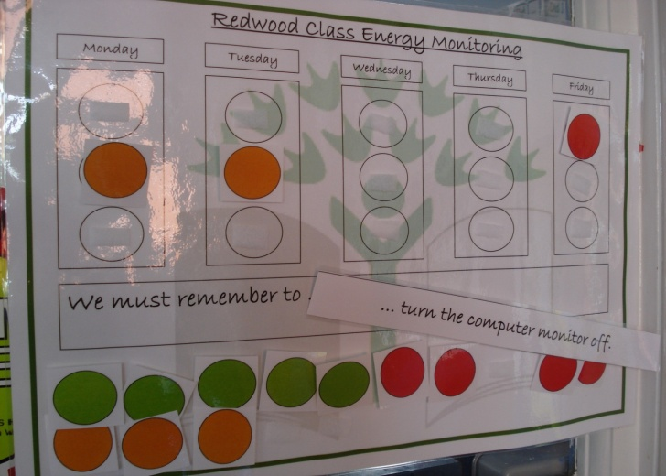
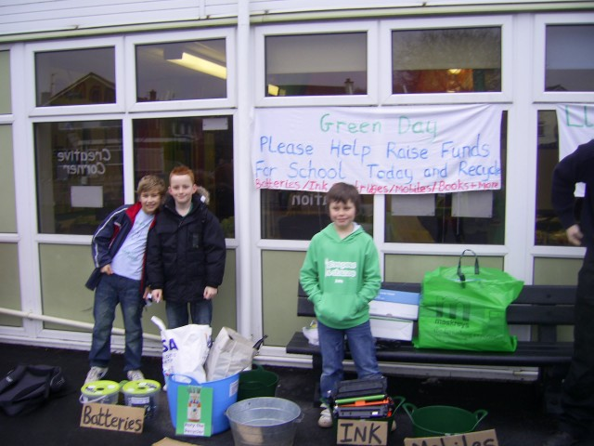
Monitoring should be meaningful and appropriate to the pupils involved.
Schools may be able to monitor their Action Plan targets for themselves as well as other organisations. Schools who conduct the RSPB Big Garden Birdwatch annually can see if their grounds have attracted more birds, as well as contributing to a national survey.
The Eco-Spies in Herbert Thompson Primary School carry out a daily check to see how well the classes are doing at reducing energy use. Green light for everything off, amber if one thing is left on and red if more than one thing is left on. The totals are then added up to reward the best class.
Llysfaen Primary held a Green Week in which they collected phones, ink cartridges batteries and other materials. A total of 265kg of materials was diverted from landfill during this simple exercise.
Back to Title Slide

Slide 18
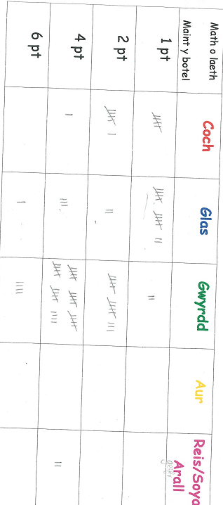
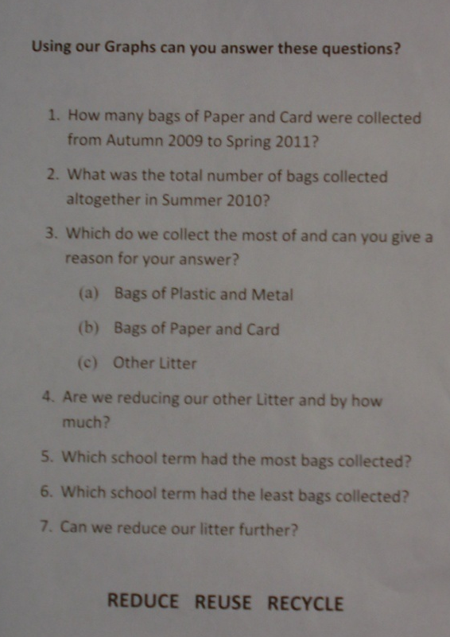
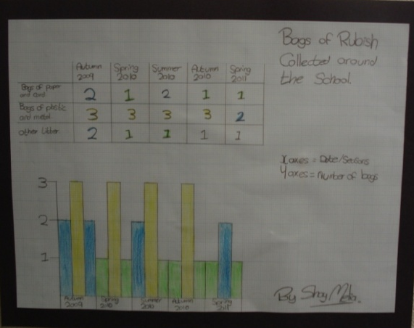
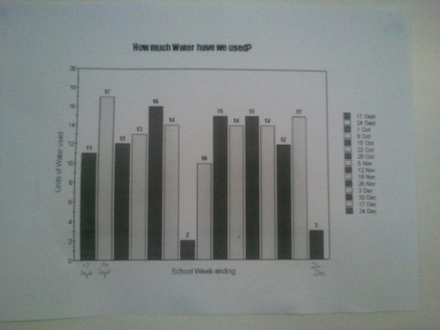
Some of the monitoring work should be undertaken as part of class work
Year 4 pupils at Ysgol Y Bannau undertook a class study to find out what type of milk they all drank and the quantities it was bought in. They then analysed the results and suggested to parents that if they bought their milk in larger containers it would not only reduce the plastic used but also be cheaper per pint.
Classwork at Crickhowell High utilised data collected by the Eco-Committee over 2 years worth of litter picks to analyse the impact. Fantastic reduction so far!
Hengoed Primary studied their water consumption in a maths lesson. They analysed the graph to evaluate whether their water saving measures had made an impact.

Slide 19
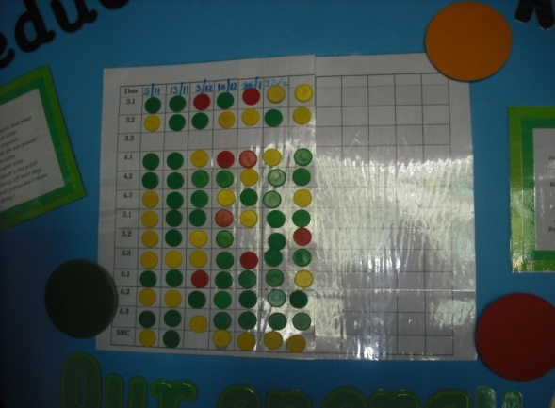
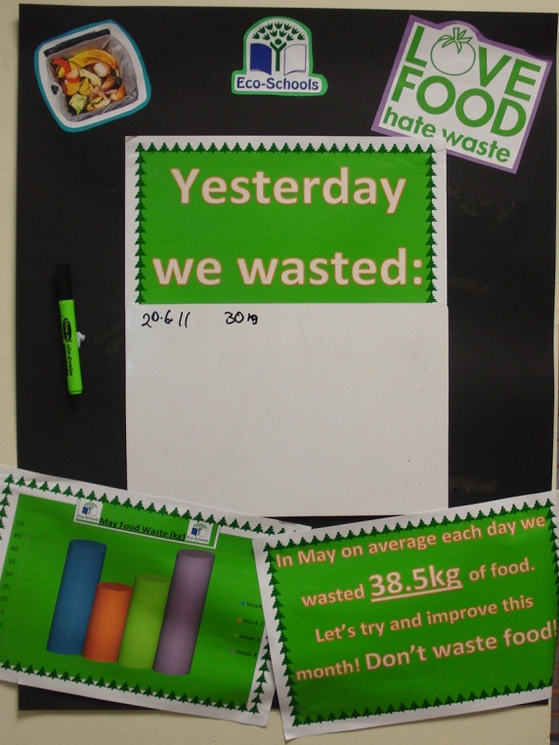
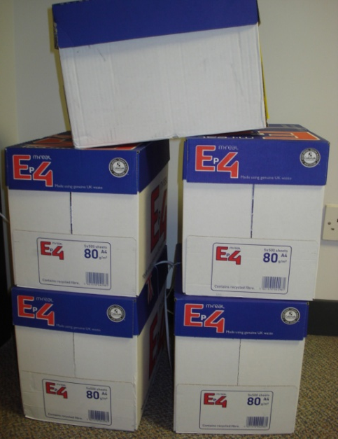
The progress of the Action Plan must be discussed by the Eco-Committee, but ideally as a whole school
The Eco-Committee at Ysgol Sant Elfod keep a record of each class’ ‘eco-rating’, they can then see at a glance which classes are doing well, and which need a little more help to recycle and switch off lights etc.
Nottage Primary involved their caretaker to help with the monitoring. Each week the caretaker reported to the Eco-Committee how many black bin bags were being sent away. This helped to find out if the recycling campaign was working.
Celebration of achievments is very important. Ysgol Gwaelod Y Garth calculated that by moving to email and texts, they were reducing paper use by 24 boxes a year. The committee illustrated the impact by stacking the 24 boxes in the hall during a whole school assembly.
Back to Title Slide
Cathedral School were monitoring their food waste as a whole school, with the amount of food thrown away recorded and displayed in the canteen every day.

Slide 20

Eco-Code
A representation of our aims
Why have an Eco-Code? The Eco-Code is a fun way of capturing the main objectives of the Eco-Schools Committee. It should be presented in a format that’s meaningful to pupils and the school community. It can be used to raise the profile of the Eco-Committee and the action plan targets, and should be reviewed regularly to ensure it remains relevant and recognised.
Key Criteria:
(Click on the criteria to view examples and ideas)
The Eco-Code should be developed by the pupils
It should be revised, or at the very least reviewed each year
The whole school must be made aware of the Eco-Code, and what it stands for
Back to Title Slide

Slide 21


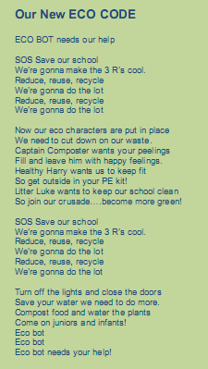
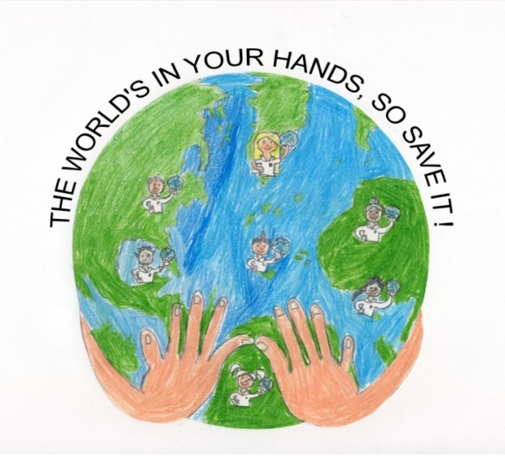
The Eco-Code should be developed by the pupils
Llysfaen Primary ran a competition within school so that all pupils had the chance to contribute to the code:
ECO NEWS (from Website)
We have a NEW ECO CODE! The ECO Committee are holding a competition. They would like you to design a poster for our eco code. The winning poster will be copied and displayed all around the school.
Back to Title Slide
Custom House Lane Primary decided to create a striking logo and a snappy slogan.

Slide 22

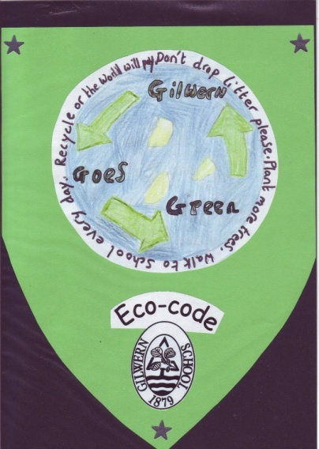
It should be revised, or at the very least reviewed each year
If you want to keep your code the same, why not redesign the background/artwork to raise the profile. You can then re-launch it through a whole school assembly.
The whole school must be made aware of the Eco-Code, and what it stands for
Shotton Infant School, Flintshire, wanted to make sure that their Eco-Code was adopted by all pupils. Since they are very young, the Eco-Committee came up with words they wanted to include in the Eco-Code, and their teacher helped them turn it into a song. The children sing this often to remind them of their responsibilities.
Ysgol Dinas Bran High School include their Eco-Code in the students’ planner.
Back to Title Slide

Slide 23
Informing and Involving
Getting everyone on board
Why Inform and Involve? It is important to ensure as many people as possible know about and are involved in your activities. Having more people involved in your Eco-actions will enable you to increase your impact and maximise the fun!
Key Criteria:
(Click on the criteria to view examples and ideas)
The whole school need to be aware of the role that the Eco-Committee play
All pupils should be given the opportunity to input ideas and suggestions if they wish to
The whole school must be made aware of what’s included in the Eco-Schools Action Plan and its progress
Back to Title Slide
The wider community should be informed about the aims of the school, and any progress made

Slide 24

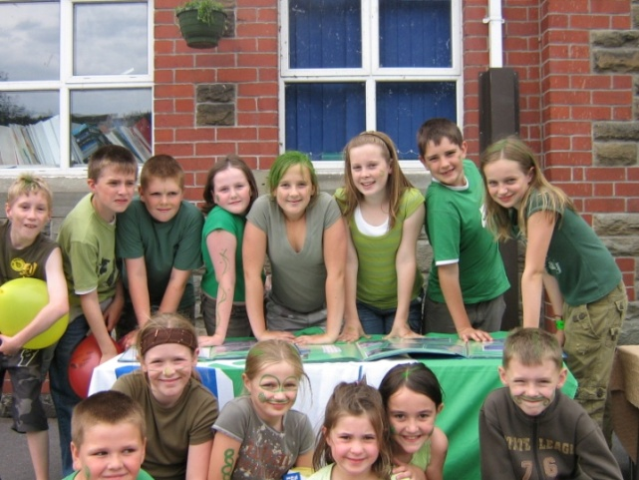
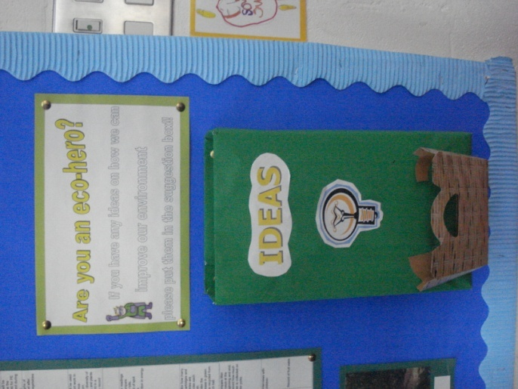
The whole school need to be aware of the role that the Eco-Committee play
A simple way to grab everyone’s attention is to arrange a day where all pupils and staff should wear something green to school. The day could involve activities that relate to your action plan.
All pupils should be given the opportunity to input ideas and suggestions if they wish to
It’s tough to keep coming up with ideas by yourself, so Willowbrook Primary have an ‘Eco-suggestion box’ which lives near their Eco-Schools notice board. To encourage engagement from the whole school, the Eco-Committee offer an award for the best eco-idea. They discuss and respond to all ideas placed in their box, and give reasons if an idea can’t be put on the action plan (e.g. too costly, or no real benefit to the environment).
Back to Title Slide

Slide 25
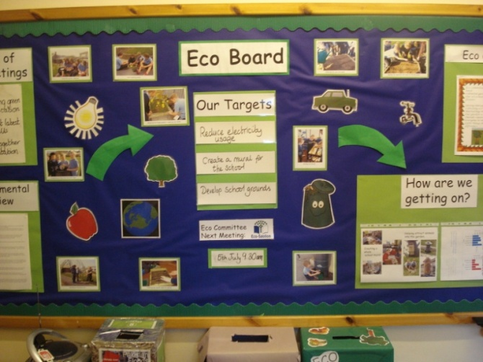
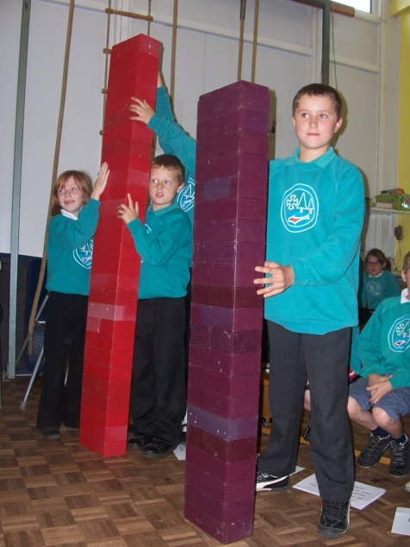
The whole school must be made aware of what’s included in the Eco-Schools Action Plan and its progress
Crynallt Juniors bring their Eco-Actions to life with their prominent, colourful and informative Eco-Board
Archdeacon Griffiths CIW Primary held an assembly where the Eco-Committee illustrated to the rest of the school how much water they had saved
The wider community should be informed about the aims of the school, and any progress made
Rhydypennau Primary worked with the city’s Hilton hotel to help them reduce their energy consumption. By taking on board the advice the Eco-Committee gave them, they saved a third on their electricity bills over a year.
Maerdy Primary text Eco-Top-Tips every week to parents. Other schools spread the message through newsletters, websites, community events and notice boards.
Neath Abbey Infants have a Groundforce Week each year where parents and grandparents are invited in to help develop the school grounds.
Back to Title Slide
St John the Baptist Eco-Committee members carried out an Environmental Review of their adjacent church. Recommendations arising from this were given to help reduce the environmental impact of the church.

Slide 26
Linking to the Curriculum
Teach it!
Why link to the curriculum? By ensuring that the Eco-Schools process links into the school’s curriculum, rather than being a separate activity for the small group on the Eco-Committee, ESDGC is delivered. It also ensures that other members of staff are involved in supporting the work. Pupils from throughout the school gain an understanding of how real life environmental issues are dealt with in a real life setting.
Key Criteria:
(Click on the criteria to view examples and ideas)
Aspects of Eco-Schools should be undertaken as part of curriculum work
More than one class should be involved
Back to Title Slide

Slide 27

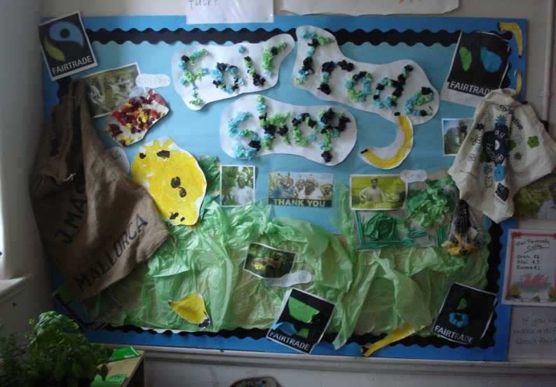
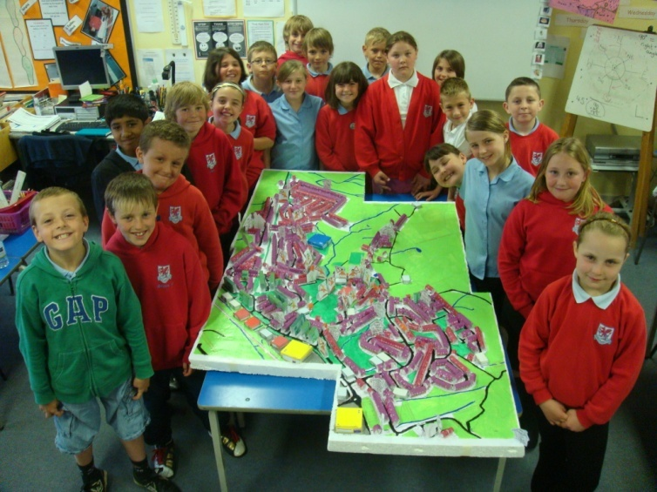
Aspects of Eco-Schools should be undertaken as part of curriculum work
Pupils in the Foundation Phase at Herbert Thompson are excited to play in their role-play area that is not just any shop, but a Fair Trade shop, selling all sorts of yummy treats and Fair Trade goods. Pupils as young as nursery are able to recognise and understand the Fair Trade symbol.
Pupils at Rogerstone Primary learnt about biodiversity while developing their IT and literacy skills to produce a video.
One of Bodnant Juniors’ Action Plan targets was to promote pupils to walk or cycle to school. The Yr 5 class took charge of organising everything, from researching best routes to take, to designing the posters, to recording how many pupils walked or cycled to school.
Back to Title Slide

Slide 28
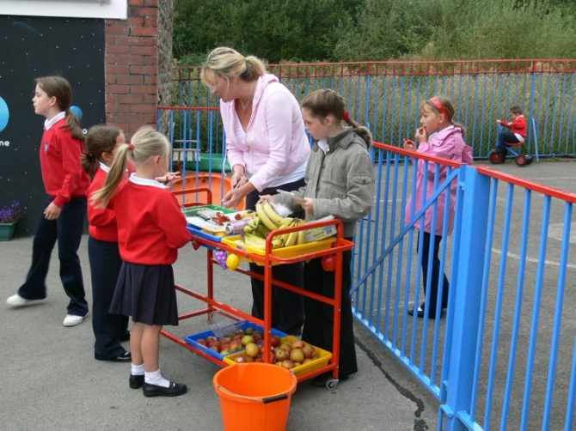
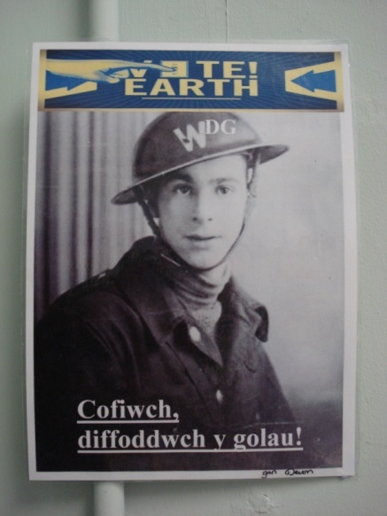
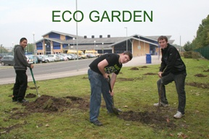
More than one class should be involved
Heol Y Cyw pupils developed their entrepreneurial skills by setting up a healthy food tuck shop. They were involved in ordering, selling and marketing the produce to the whole school.
History provides lots of opportunities to link with Eco issues, as illustrated by Ysgol Gynradd Ynysgedwyn who used the blackouts to promote their ‘turn off the lights’ message.
Before construction began at St Josephs High, the 6th form Welsh Baccalaureate students tested the soil quality. While the Eco Committee at the school are keeping a close eye on developments, they have invited suggestions from other departments to ensure that this is no White Elephant. English and Drama departments have ear marked the proposed decking area for outdoor performances, while Geography and Science departments will be studying the bio-diversity and testing what crops of plants will grow best.
Back to Title Slide

