Slide 1

Contemporary issues in leadership
09/02/24

Slide 2


Happy Chinese New Year

Slide 3

Please share
How do you celebrate Chinese New Year?

Slide 4

Agenda
Future of Work
Equality, Inclusion and Diversity
Multi-generation workforce
Assignment

Slide 5

What is the future of work?
When you think of the future of work, what do you imagine?
Pace of change accelerating even before COVID-19
The pandemic accelerated three trends:
Remote Work
E-commerce
Adoption of digital technologies, including AI and automation

Slide 6
Trends that impact upon work
How we use technology
Workforce diversity
Globalisation
Industrial change
Individualisation
Social responsibility
Education

Slide 7
External drivers for change
Political change
Brexit (UK's decision to leave European Union)
War in Ukraine
Elections in 2024 (UK and US)

Slide 8
Economic change
Economic factors impact decision-making
Exchange rates
Trade agreements
Recession
Cost of living

Slide 9
Remote working – the future
McKinsey (2023) 20-25% of the workforce in advanced economies can work from home 3-5 days per week
Half the workforce has little or no opportunity for remote work.
Of these, many are low wage and at risk from automation

Slide 10

How is AI changing work?

Slide 11
Assisted intelligence: eg GPS navigation in cars
Augmented intelligence
Autonomous intelligence: for example, self –driving cars
Different types of AI

Slide 12
Thoughts?
AI can create a world where human abilities are amplified as machines help humans process, analyse and evaluate the abundance of data that creates today's world, allowing humans to spend more time engaged in high-level thinking, creativity, and decision-making (PWC report)
"Automation, machines are replacing so many jobs. Many people think that only the poor and uneducated are being displaced. I'm afraid that in a few years everyone will be replaceable"

Slide 13
Develop future-fit skills
We all need to be agile
Training of leaders must keep up to date with rapid changes
Leaders need skills associated with change and project management
We need skills such as:
learning mindset
Change orientation
Autonomy
Relationship management
Collaboration

Slide 14
Digital and technical transformation
1 in 10 jobs will cease to exist in 15-20 years (OECD 2019)
32% of jobs will change significantly
Job losses and job creation

Slide 15
The employee experience – digital transformation
New jobs emerging - highly skilled
Automation will drive a reduction in the workforce
Growing interest in job quality
Leaders must focus on::
reskilling
Redeployment
Job reinvention

Slide 16
Wellbeing
Is technology influencing wellbeing at work?
29% say tech blurs boundaries between work and home
Leaders must focus on:
work/life balance
Managing burnout/stress
Zoom fatigue
Support healthy and flexible working

Slide 17
Group work
Thinking about the changing skills required by organisations to respond to technological change, research the ways in which organisations can respond.
How can companies identify what skills are needed?
How can they establish what skills their employees already have?
Recommend HOW this can be done and by who – this is what we will discuss in class a

Slide 18
The role of HR – learning needs analysis
Assess future needs – how?
Assess current skills, attitudes and knowledge
Gather information from stakeholders
Design workforce development plan
Must be relevant, aligned with goals, able to be measured

Slide 19
Is there a role for government?
UK workforce 32.6 million people
Government has a role in supporting workforce skills
The market needs help in supplying skills the country needs to provide goods and services and ensure productivity (National Audit Office, 2022)
https://www.nao.org.uk/reports/developing-workforce-skills-for-a-strong-economy/

Slide 20
Diversity at Work
Promoting EDI essential part of leadership
Creating working environments and cultures where individuals feel a sense of belonging
What do we mean by EDI?
Why is it important?

Slide 21
What is equality?
Equality of access, treatment, outcomes and impact in employment and services
In UK: Equality Act 2010 "every individual must have an equal opportunity to make the most of their lives and talents"
No one should have poorer life changes because of their background, personal identity or experience

Slide 22
Diversity
Differences in colour, ethnicity, abilities, age, gender, belief, interests, class, marital status, sexual orientation, education....and more!
Recognises that everyone is different in a variety of visible and non-visible ways

Slide 23
Inclusion
"Including people in a way that is fair for all, values everyone's differences, and empowers and enables each person to be themselves and achieve their full potential at work"

Slide 24
Moral case
Building fair and inclusive labour markets and workplaces – the right thing to do
This is what we call the moral case

Slide 25
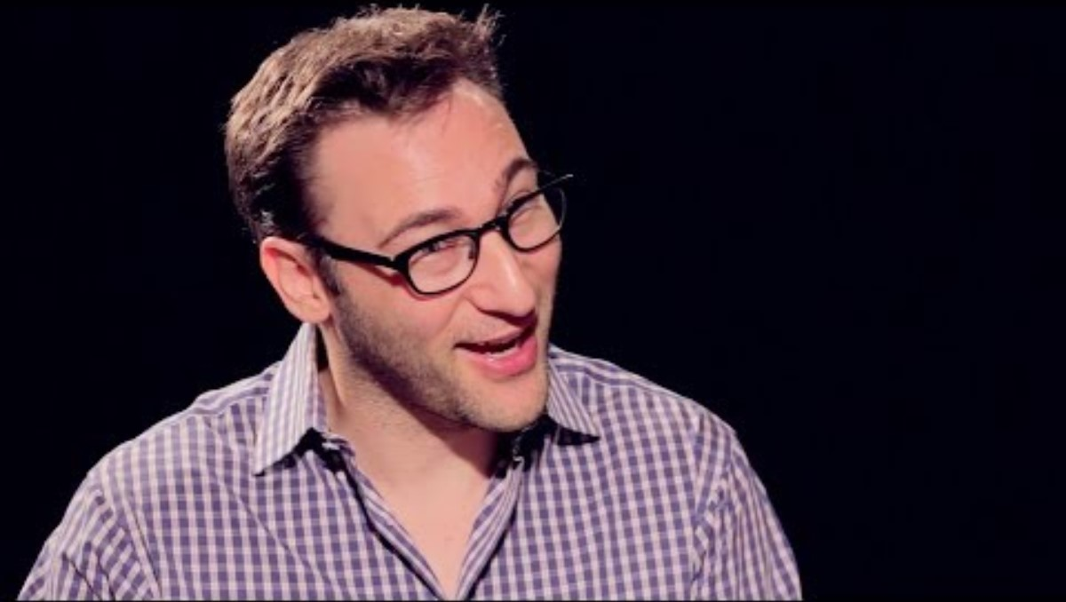
The business case

Slide 26
Why is diversity important?
Depth and breadth of experience & perspective
Inclusive decision making
Attract and retain top talent
Better employee and customer relationships
Sets tone for organisation
Spotting opportunities and risks

Slide 27
Facts
Companies in top quartile for gender diversity at executive level are 21% more likely to generate higher profits (McKinsey)
Companies in the top quartile for ethnic/cultural diversity on executive teams are 1/3 more likely to have higher profitability
If leadership is homegenous, there's a negative impact on the bottom line

Slide 28
The legal perspective
Equality Act 2010
People have the right not to be discriminated against on the grounds of protected characteristics:
  Age
  Disability
  Gender reassignment
  Marriage or civil partnership
  Pregnancy and maternity
  Religion or belief
  Sex
  Sexual orientation

Slide 29
How can businesses increase diversity?
In your groups, consider how organisations can increase diversity. What steps can they take?
Imagine you are a new graduate. Your first project is to make recommendations on how your employer can attract and retain a diverse workforce. Come up with a plan based on your research to present back to the class.

Slide 30

Multi generation workforce

Slide 31
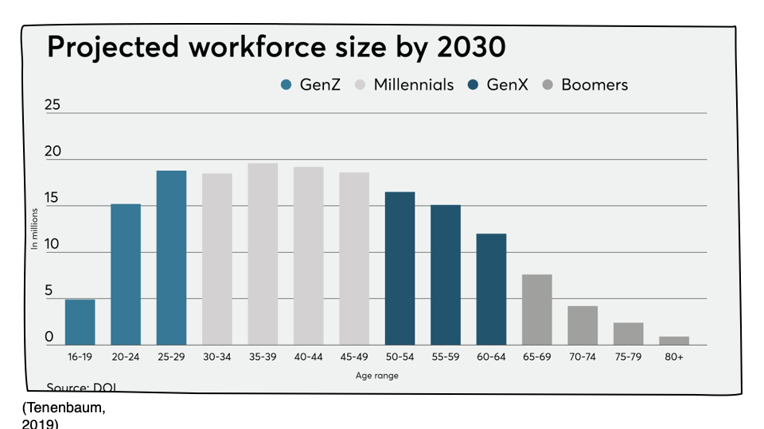

Slide 32
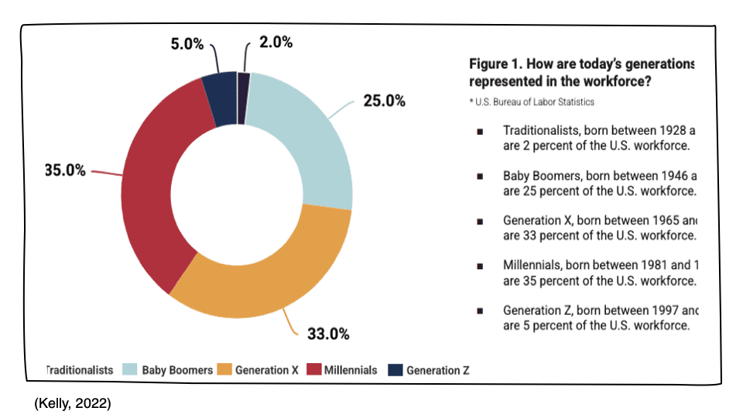

Slide 33


Slide 34
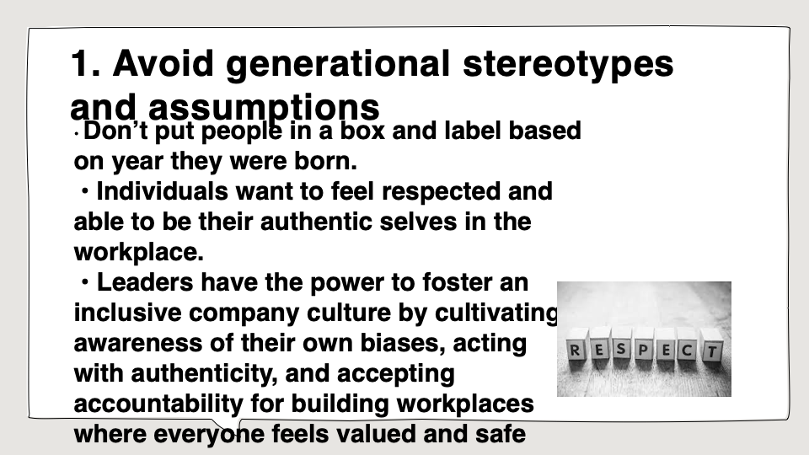

Slide 35
Challenge for leaders
All employees should be seen as individuals with unique skills sets
Avoid stereotypes and assumptions based on age
Create a plan to promote knowledge sharing

