Slide 1
HPAN5022/6022
Post-Colonial States and Civil Society
Introduction and Overview
Themes:
Euro-Centrism
Colonialism
Post-Colonialism
The State
Civil Society

Slide 2
Module Structure
(as set out on the Moodle Page)
Part 1: Colonialism and its legacies; Independence Struggles and Decolonisation
Part 2: New States, Rogue States and Failed States: Governance and Globalisation
Part 3: Case Studies: Latin America, Africa and Asia
Part 4: Problems of the 21st Century World Order

Slide 3
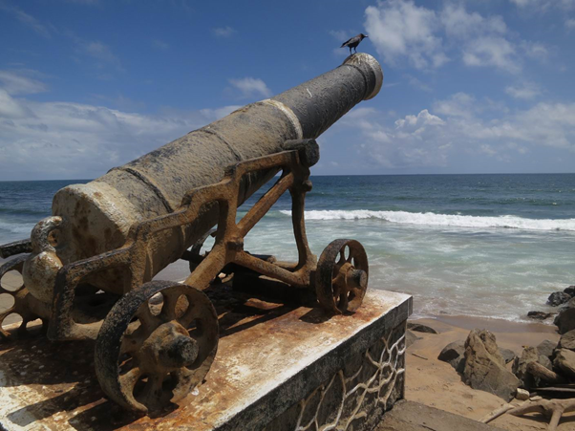
Part 1: Colonialism and its legacies; Independence Struggles and Decolonisation
Legacy of colonialism: Rusty Portuguese cannon on a Sri Lankan beach
In Part 1, we will examine Europe's rise to world dominance from the 16th to the 19th centuries, looking at the part played by maritime and armaments technologies, trade, transfers of resources and massive demographic changes, not least those brought about by the slave trade.
We will also trace the countervailing narrative of colonial revolt and resistance - culminating in the liberation of Latin America in the 19th century and of Africa and Asia in the 20th.

Slide 4
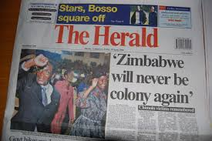
Part 2: New States, Rogue States and Failed States: Governance and Globalisation
Building on Part 1, we will examine the changeover from colonial administration to political independence, looking particularly at processes of state-building and the problems which faced newly independent countries in finding a viable place in the world economy.
We'll explore the question "What is the State?" and will review cases and relevant literature dealing with what have been described as weak states, rogue states and failed states. We'll examine issues of democracy, coups and military rule - and the relevance of human rights and civil society as a component in sustainable, democratic rule.

Slide 5
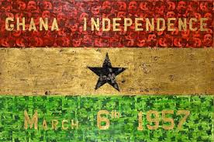
Part 3: Case Studies: Latin America, Africa and Asia
We will examine a range of national case studies, looking at pathways to independence, challenges and achievements in economic and social development, and current dilemmas.
This will be integrated with in-class essay workshops tackling the individual student assignments for this module.
Specifically, we will examine case studies including the states which emerged from the British withdrawal from India in 1947 and at states in Africa and the Caribbean.
We will also examine the important case of China, its pathway to independence in 1949 and its development since then to become a major world power.

Slide 6
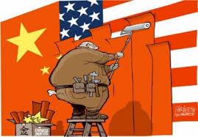
Part 4: Problems of the 21st Century World Order
In Part 4, we will build on the cases studied in Part 3, focusing on worldwide developments, as they affect the Third World, since the year 2000. In particular, we'll look at the increasing influential role of China in the developing world.
There will be further in-class essay workshops to help each student to complete their assignments, with individual supervision and support.

Slide 7
Assessments
With reference to the new, immersive system of teaching, class time will be allocated to two interconnected assignments for this module. In-class essay workshops will be timetabled where each student can benefit from 1:1 supervision and advice in planning and formulating their essays.
Essay 1: In consultation with your class tutor, choose one country which has achieved political independence since 1945. Select and assess key developments in its pathway to independence and in its history since then. Describe and evaluate its position on the world stage today and comment critically on its prospects for the near future.
Essay 2: In consultation with your class tutor, choose a different country from the one chosen for Essay 1 and, with reference to the same criteria of analysis, compare the two countries, critically.
Deadlines:
The deadline for Essay 1 is 23:59 on Sunday, 4 December 2022
The deadline for Essay 2 is 23:59 on Sunday, 18 December 2022

Slide 8
Break
Followed by Overview

Slide 9
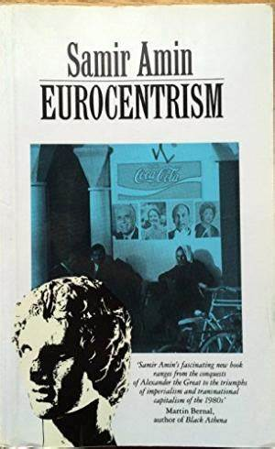
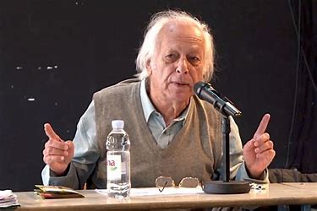
UWTSD 2020/21 International Development and Global Politics (IDGP)
A world view: a warning about Eurocentrism;
Global inequality
Samir Amin, 1931-2018 French-Egyptian Marxian economist: Coined the term “Eurocentrism” in 1988

Slide 10
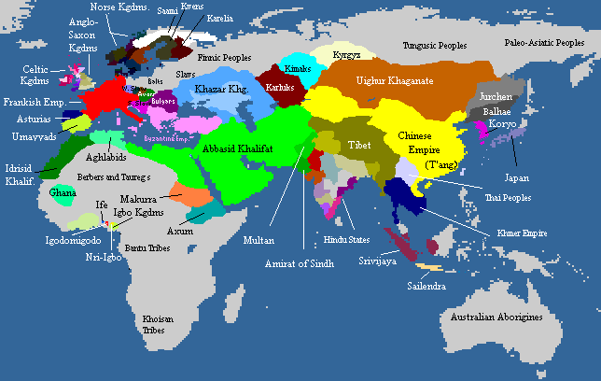
Creating the modern world and “Modernity”
Frontrunners in 820 CE?

Slide 11
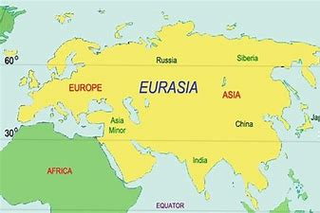
Europe, Asia and Eurasia

Slide 12
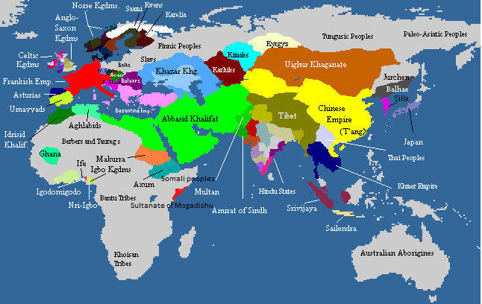
Eurasia in Early Modern Times: East and West
The rise of Islam and Europeans’ search for sea-routes to “the Indies”
China’s cultural, and scientific dominance 1200-1800
(See: Morris, I. 2010. Why the West Rules for Now. London: Profile Books and
Diamond, J. 2005. Guns, Germs and Steel. London: Vintage)

Slide 13
The Early Medieval World
A number of powerful blocs:
Christendom (rival kingdoms and fiefs)
Islam
China
The Mongol Khanate
Meso-American/South American civilisations (unknown to the “Old World”)
Ghana, Igbo kingdoms
No obvious “front-runner” (?)

Slide 14
Eurasia: long-distance trade links exist
Christendom-Islam-China
Overland trade: Sahara-Mediterranean (salt and gold), Europe-China (Marco Polo, the Silk Road), Mediterranean-the North (via the Alpine passes) etc.
Maritime trade routes: mostly coastal around Europe; China-India-Africa (Mombasa, Malindi etc.)

Slide 15
Mechanisms for Trade (focussing on Europe)
Fairs (the foremost, in Champagne)
Banking (Fuggers and Medici etc.)
Towns and Ports
Depôts and fondachi
Guilds and Corporations
See: The Town as an Agent of Civilisation 1200-1500, Jacques Bernard

Slide 16
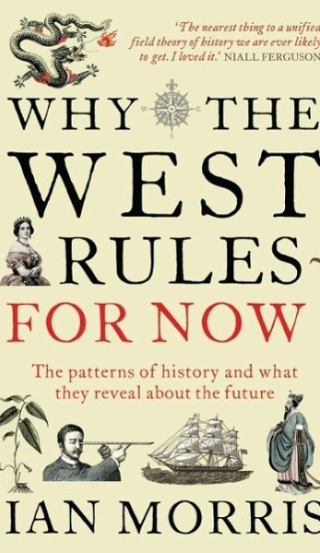
China’s place in the world
Changes in relative power and world hegemony. China and “the West”: 600-1800; 1850-2000; 2050 and after?

Slide 17
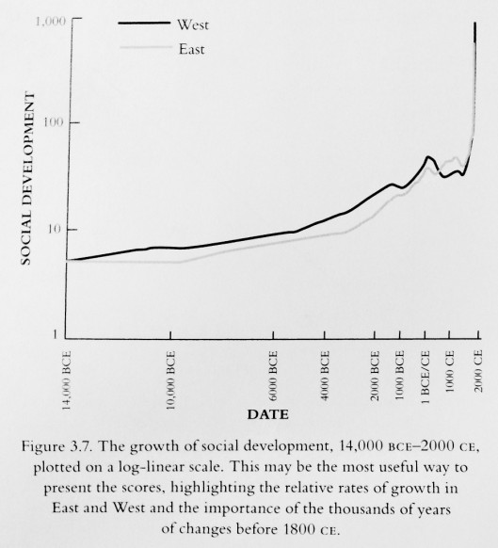
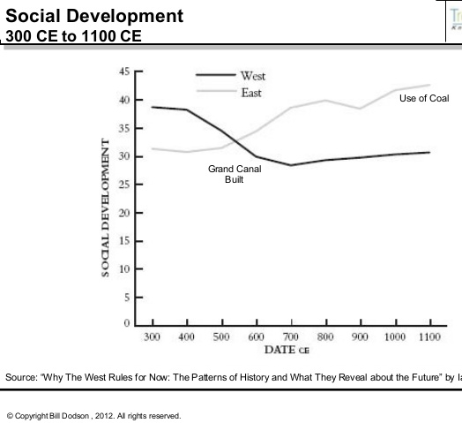
East and West compared (from Why the West Rules for Now by Ian Morris)

Slide 18
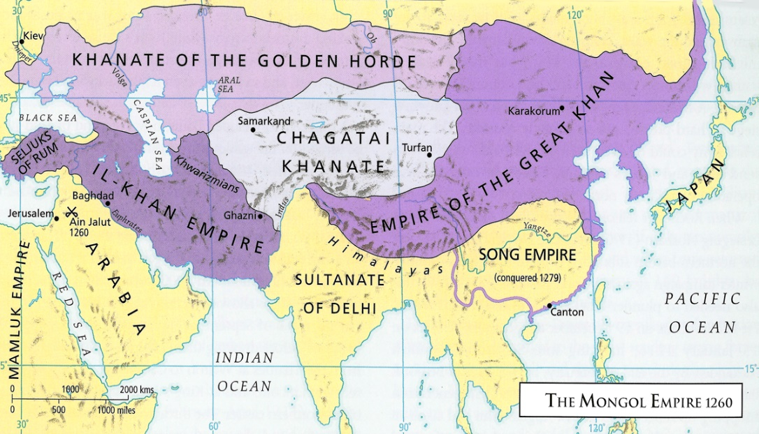
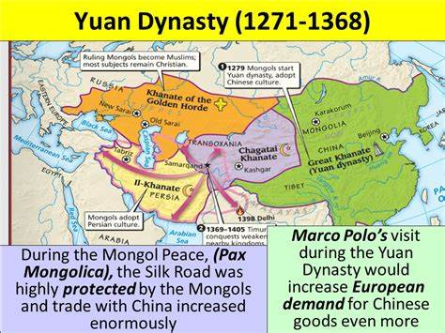
Pax Mongolica and the Silk Road
Disruption or
Connection?

Slide 19
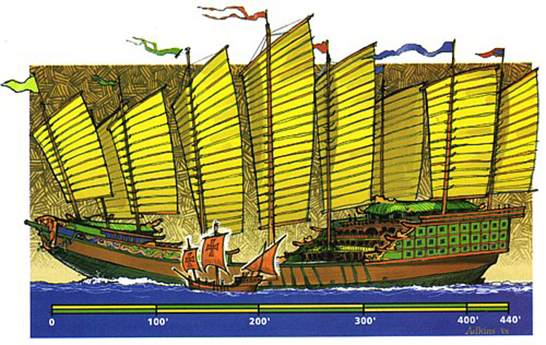
Maritime supremacy in the
15th century: Zheng He’s fleet

Slide 20
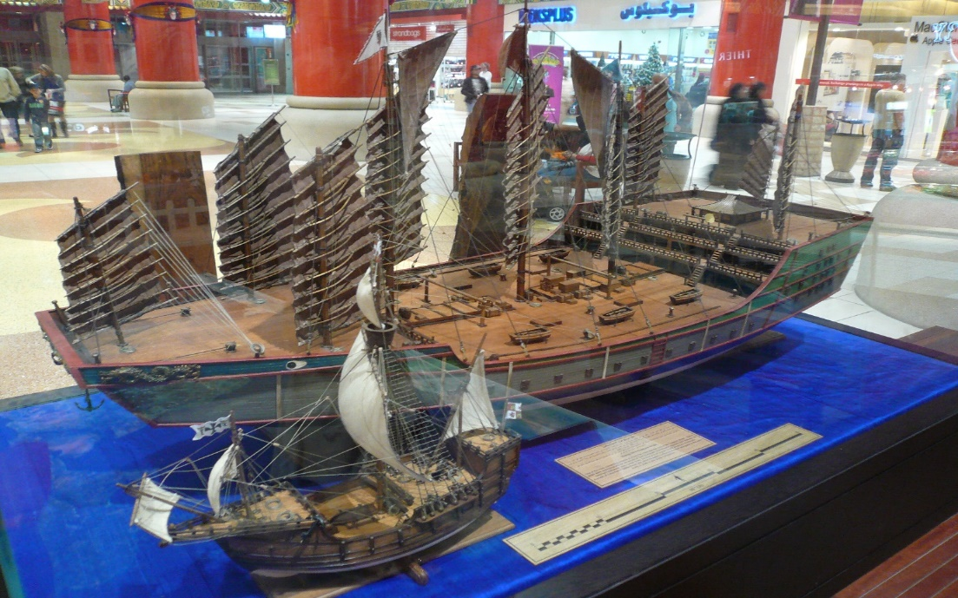
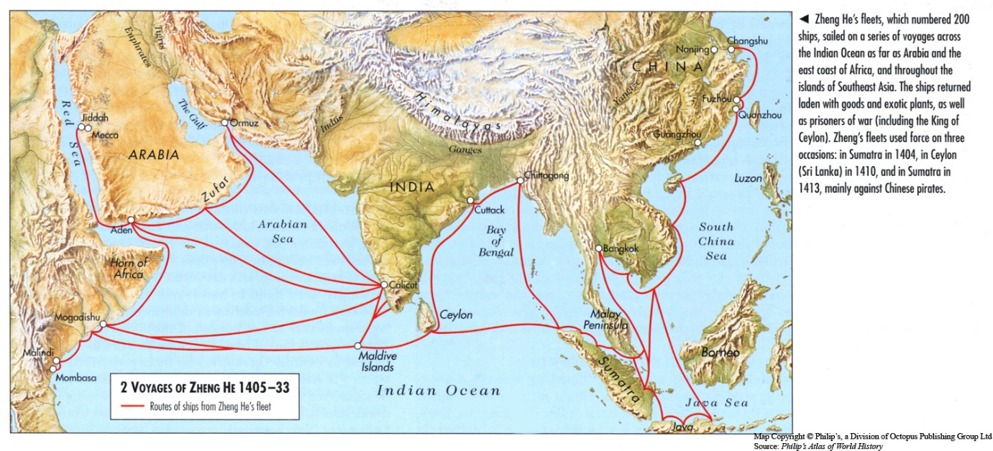
Voyages of
Zheng He
1405-1433
The Ming Empire withdraws from transoceanic trade and “exploration”

Slide 21
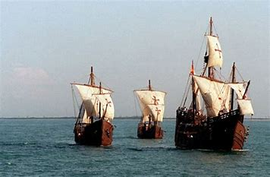
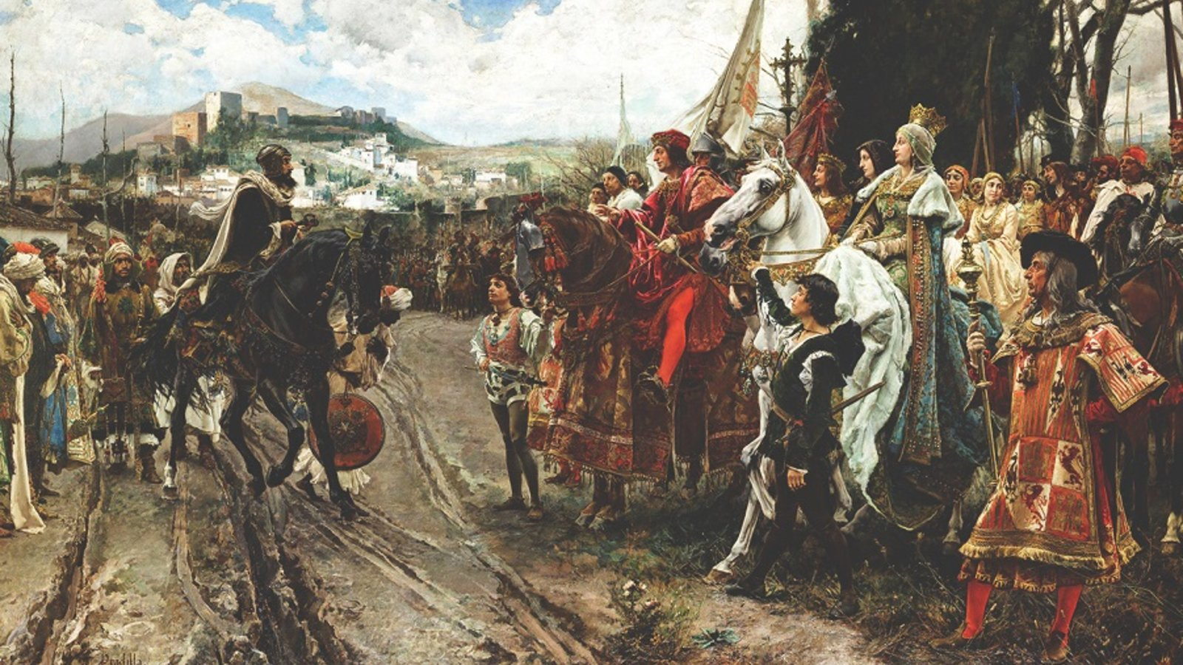
Meanwhile, in Iberia…
1492 – a pivotal year
Reconquista, the fall of Granada – and a turn to the Atlantic and “The Indies”

Slide 22
Break
Followed by Part 1:
Colonialism and its Legacies
Independence Struggles and Decolonisation

Slide 23
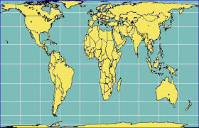
Part 1: Colonialism and its legacies; Independence Struggles and Decolonisation

Slide 24
The world of today: 190+ nations

Slide 25
The world of today: a key text
Capitalist colonialism has rendered our understanding of the world Eurocentric, and we are unable to think outside the categories and concepts that emerged in post-Columbian Europe…It is only through the relentless focus on the world historical experience of capitalist colonialism…that we can begin to understand and reverse its effects and embark on human development.
Such human development must...also be an act of profound decolonization that tries to reverse the political, social, economic, and cultural domination of the rest by the West.
[Continued over…]

Slide 26
The underdevelopment approach emphasizes the role of the third world in the making of Europe. The latter would not be what it is without the material, social, intellectual, and cultural interactions with the colonial world over the past few centuries. Thus the West and the third world are seen as mutually constitutive entities that have emerged with their distinct characteristics due to their interaction. The idea that one of them (the West) is the source of modernity and that the other (the third world) has to learn how to modernize itself through imitation is fundamentally flawed for this reason.
Krishna, S. 2009. Globalization and Postcolonialism. Lanham MD: Rowman and Littlefield (Ch. 1, p.29-30) (My emphasis)
In that sense, we all live in a postcolonial world

Slide 27
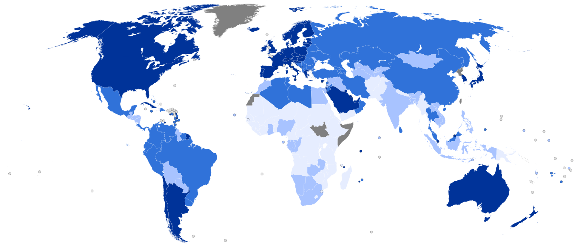
Rich and Poor Countries
Introducing the UNDP’s Human Development Index (HDI)
UNDP Map published 2014

Slide 28
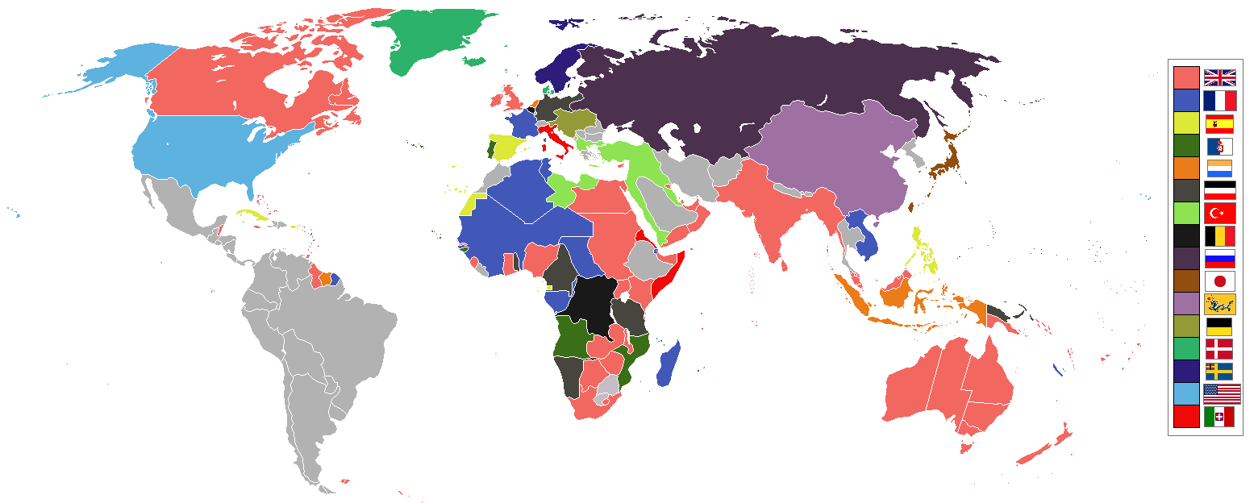
Rich and Poor Countries
Colonial possessions of the main powers in 1898

Slide 29
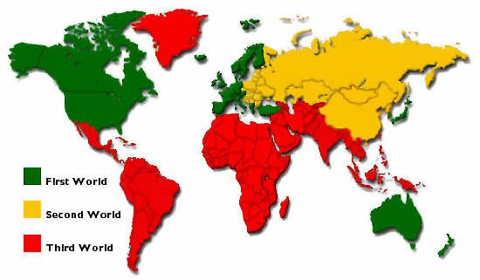
Rich and Poor Countries
What is the “Third World”? A reflection of Cold War political rivalries?

Slide 30

The UN’s Human Development Index
www.hdr.undp.org/en/composite/HDI
List of countries, ranked by HDI, from Norway (No.1) to Niger (no. 189)

Slide 31
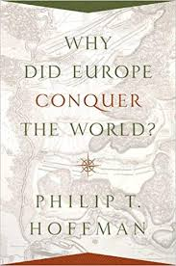
So…

Slide 32
Possible answers to Hoffman’s question:
Higher/more secure agricultural output per head?
Superior culture/level of civilisation?
Religious mission?
None of the above
Hoffman’s verdict: “Gunpowder technology”
(and, I would add, transoceanic seafaring skills and technologies)

Slide 33
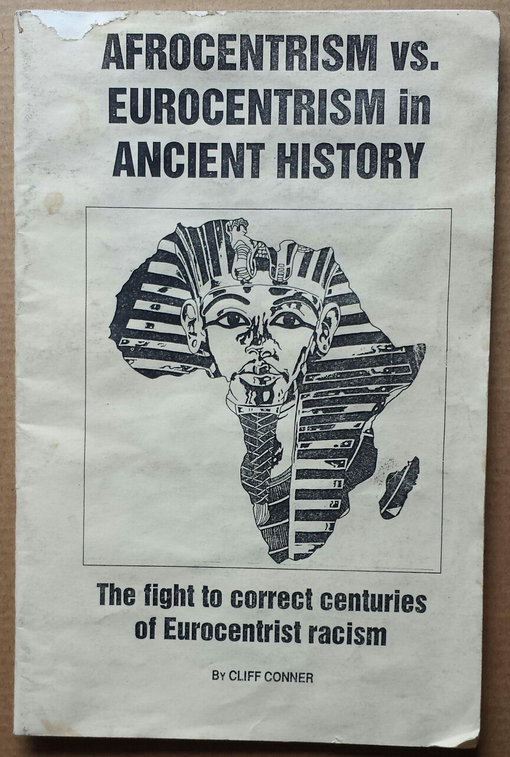
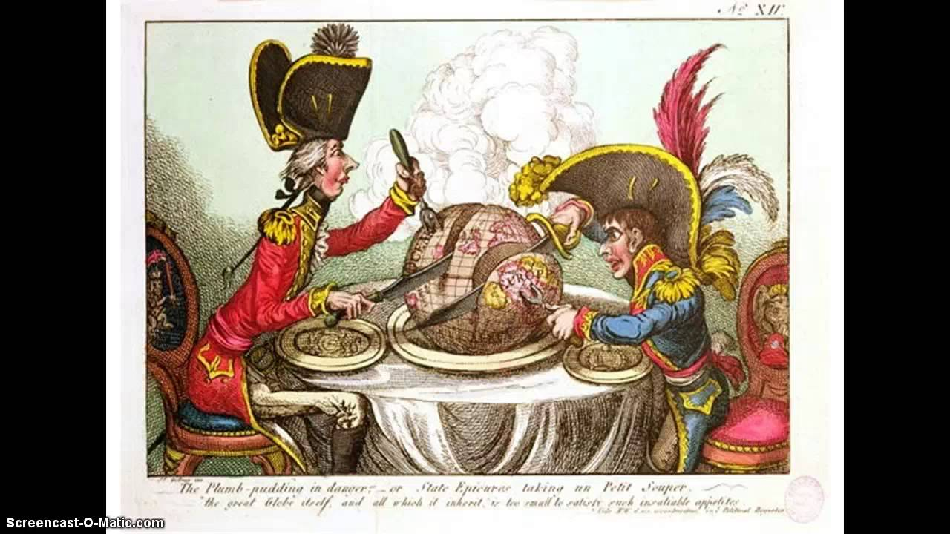
Europe: maritime and gunpowder technologies
Dominance – disruption and distortion; cultures and economy

Slide 34
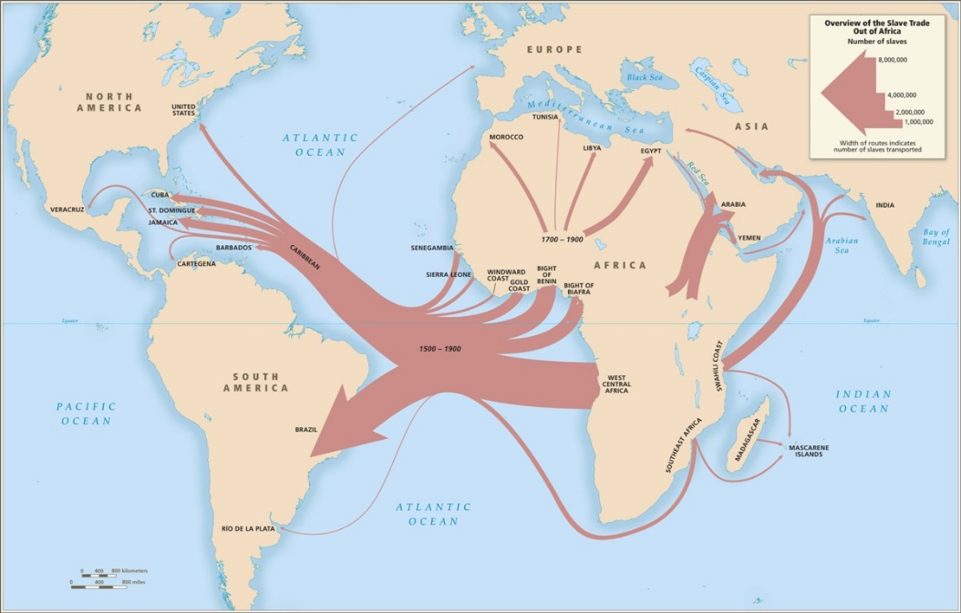
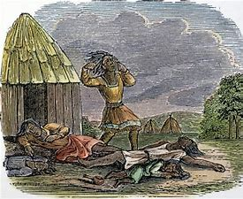
Distortions?
Massive demographic change
[We will need to return to these issues in much more detail.]
The Great Dying in the Americas
Genocide of indigenous peoples (e.g. Australia)
12m Africans enslaved and transported to the Americas
The re-peopling of continents

