Slide 1
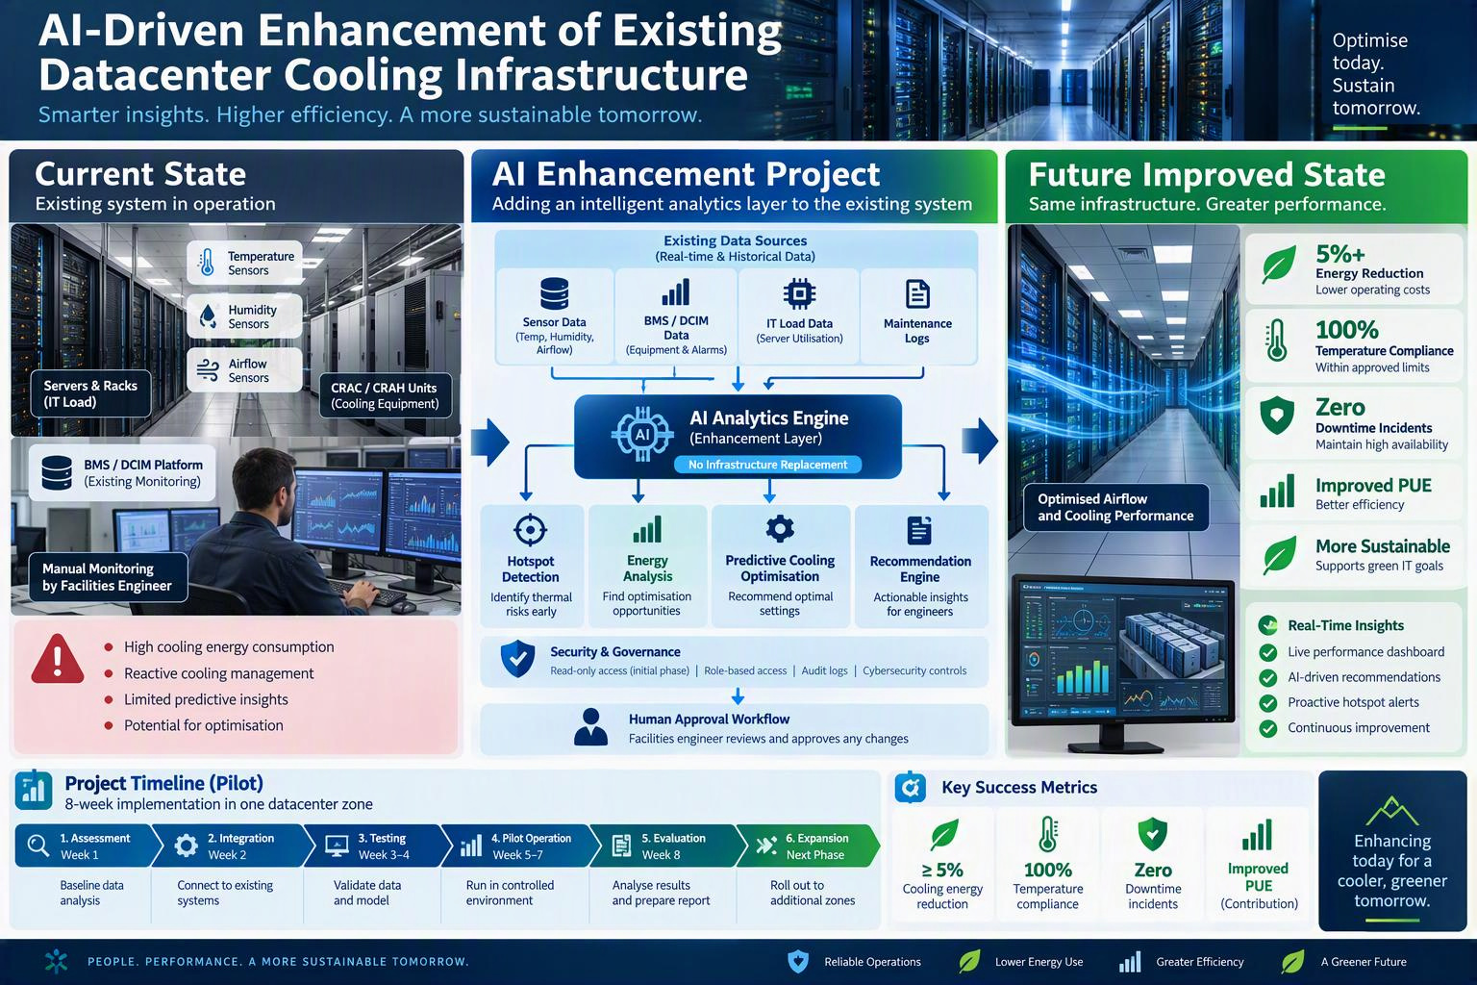

Slide 2
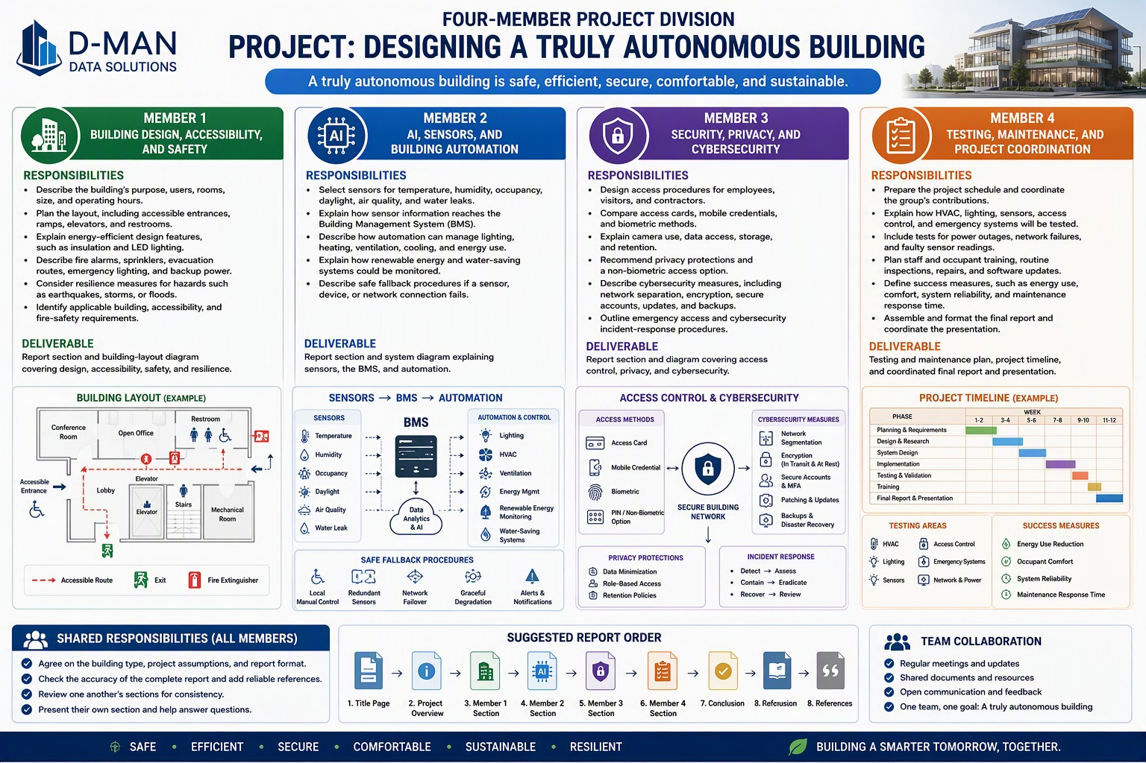

Slide 3
D-MAN Data Solutions
AI-driven autonomous
building upgrade
3,000 m²
Existing three-storey building
9 weeks
Integrated project report and four-member delivery plan
Planned delivery period
October 2026
D-MAN Data Solutions
01
Notes:
Source: D-MAN data solutions project outline.docx, October 2026. This presentation summarises the supplied project proposal. Outcomes are planned, not measured results.
## Executive Summary
This project upgrades D-MAN Data Solutions’ existing three-storey office and training centre with connected sensors, a modern Building Management System (BMS), and AI-assisted analysis. The solution will improve efficiency, comfort, fault detection, maintenance visibility, access management, and resilience. Facilities staff will retain oversight and manual control, while required life-safety systems will remain independent of AI operation.
<table>
<tr>
<th>
Priority
</th>
<th>
Planned outcome
</th>
</tr>
<tr>
<td>
Building performance
</td>
<td>
Demand-led lighting, HVAC, ventilation, energy, and water management
</td>
</tr>
<tr>
<td>
Safety and resilience
</td>
<td>
Independent life-safety systems, manual operation, and safe fallbacks
</td>
</tr>
<tr>
<td>
Security and privacy
</td>
<td>
Controlled access, data minimisation, and network separation
</td>
</tr>
<tr>
<td>
Delivery assurance
</td>
<td>
Defined ownership, testing, training, maintenance, and measurement
</td>
</tr>
</table>

Slide 4
Project scope and planned outcomes
Current building
Proposed upgrade
Office and training centre with separate systems or fixed operating schedules.
Connected operations
Connect sensors and meters through a modern Building Management System (BMS).
Weekdays: 7:00 a.m. to 7:00 p.m.
Limited after-hours access
Building improvements
Review accessibility, LED lighting, insulation, shading and HVAC zoning.
Planned benefits: greater efficiency and comfort, earlier fault detection and clearer maintenance records.
D-MAN Data Solutions
02
Notes:
Source: D-MAN data solutions project outline.docx, October 2026.
## 1. Project Overview
### 1.1 Existing Building
D-MAN Data Solutions operates a three-storey office and training centre of approximately 3,000 m² (32,300 ft²). It serves employees, visitors, and contractors from 7:00 a.m. to 7:00 p.m. on weekdays, with limited after-hours access.
### 1.2 Project Need
Many current systems operate separately or on fixed schedules. The project will connect compatible equipment, add sensors and meters where information is missing, and use AI-assisted analysis to improve operational decisions within approved limits.
### 1.3 Design Principles
- Improve accessibility, efficiency, comfort, safety, security, and resilience together.
- Retain human oversight, local controls, and documented manual procedures.
- Keep fire alarms, sprinklers, emergency lighting, and other life-safety systems independent.
- Protect privacy through data minimisation and controlled access.
- Measure results against a documented pre-upgrade baseline.

Slide 5
Sensors and BMS integration
Data source | Operational use
Temperature and humidity | Heating, cooling and comfort control
Occupancy and daylight | Demand-led lighting and ventilation
Air quality | Ventilation monitoring and adjustment
Leak sensors, energy and water meters | Early warning, baseline comparison and anomalies
Existing HVAC controls | Equipment status, schedules and operating data
AI supports operational decisions within approved limits.
D-MAN Data Solutions
03
Notes:
Source: D-MAN data solutions project outline.docx, October 2026. HVAC means heating, ventilation and air conditioning. BMS means Building Management System.
## 2. Technical Project Design
### 2.1 Building Improvements
- Inspect entrances, routes, lift controls, restrooms, signs, and evacuation provisions.
- Replace suitable older lighting with LED fixtures and add occupancy and daylight control.
- Improve insulation, air sealing, shading, HVAC schedules, and zoning where practical.
- Install energy and water meters to identify abnormal consumption.
### 2.2 Sensors and Automation
<table>
<tr>
<th>
Data source
</th>
<th>
Operational use
</th>
</tr>
<tr>
<td>
Temperature and humidity
</td>
<td>
Heating, cooling, and comfort control
</td>
</tr>
<tr>
<td>
Occupancy and daylight
</td>
<td>
Demand-led lighting and ventilation
</td>
</tr>
<tr>
<td>
Air quality
</td>
<td>
Ventilation monitoring and adjustment
</td>
</tr>
<tr>
<td>
Leak, energy, and water meters
</td>
<td>
Early warning, baseline comparison, and anomaly detection
</td>
</tr>
<tr>
<td>
Existing HVAC controls
</td>
<td>
Equipment status, schedules, and operating data
</td>
</tr>
</table>
### 2.3 Security and Safe Operation
- Use individual employee credentials and time-limited visitor and contractor access.
- Separate building-control, office, guest, public, and security networks.
- Use role-based permissions, strong authentication, tested updates, and secure backups.
- Revert to safe schedules and local controls when sensors, networks, or AI services fail.

Slide 6
Safety, security and human oversight
Independent safety systems
Keep fire alarms, sprinklers and emergency lighting independent of AI.
Manual control and fallbacks
Keep local controls available. Use safe schedules if sensors, networks or AI services fail.
Controlled access and privacy
Use individual credentials and access expiry dates. Collect only necessary personal data.
Network protection
Separate control, office, guest, public and security networks. Test updates and backups.
D-MAN Data Solutions
04
Notes:
Source: D-MAN data solutions project outline.docx, October 2026. Facilities staff retain oversight. Apply role-based permissions and strong authentication.
## 2. Technical Project Design
### 2.1 Building Improvements
- Inspect entrances, routes, lift controls, restrooms, signs, and evacuation provisions.
- Replace suitable older lighting with LED fixtures and add occupancy and daylight control.
- Improve insulation, air sealing, shading, HVAC schedules, and zoning where practical.
- Install energy and water meters to identify abnormal consumption.
### 2.2 Sensors and Automation
<table>
<tr>
<th>
Data source
</th>
<th>
Operational use
</th>
</tr>
<tr>
<td>
Temperature and humidity
</td>
<td>
Heating, cooling, and comfort control
</td>
</tr>
<tr>
<td>
Occupancy and daylight
</td>
<td>
Demand-led lighting and ventilation
</td>
</tr>
<tr>
<td>
Air quality
</td>
<td>
Ventilation monitoring and adjustment
</td>
</tr>
<tr>
<td>
Leak, energy, and water meters
</td>
<td>
Early warning, baseline comparison, and anomaly detection
</td>
</tr>
<tr>
<td>
Existing HVAC controls
</td>
<td>
Equipment status, schedules, and operating data
</td>
</tr>
</table>
### 2.3 Security and Safe Operation
- Use individual employee credentials and time-limited visitor and contractor access.
- Separate building-control, office, guest, public, and security networks.
- Use role-based permissions, strong authentication, tested updates, and secure backups.
- Revert to safe schedules and local controls when sensors, networks, or AI services fail.

Slide 7
Building and automation responsibilities
Member
01
Building, accessibility
and resilience
Member
02
AI, sensors
and BMS integration
Survey every floor and user needs. Review access routes, lifts, restrooms, fire protection and emergency provisions.
Audit controls. Select devices and locations. Map data flows and design the BMS architecture.
Confirm upgrade requirements and inspect completed work. Validate safety and manual operation.
Set rules, alerts, limits and safe defaults. Calibrate devices and commission automation. Optimise settings.
Outputs
Survey, action list, improvement schedule, safety and resilience reviews.
Outputs
Sensor plan, architecture, rules, fallback plan and commissioning records.
D-MAN Data Solutions
05
Notes:
Source: D-MAN data solutions project outline.docx, October 2026. Member 1 and Member 2 lead the workstreams shown. The full activity register and weekly matrix follow in these notes.
## 3. Four-Member Roles and Complete Activity Register
Each member leads a specialist workstream, contributes to joint decisions, supports integrated testing, and presents the results for their area.
<table>
<tr>
<th>
Member
</th>
<th>
Lead area
</th>
<th>
All assigned activities
</th>
<th>
Deliverables
</th>
</tr>
<tr>
<td>
Member 1
</td>
<td>
Building design, accessibility, safety, and resilience
</td>
<td>
Document the building and users; review all floors; inspect entrances, routes, lifts, restrooms, signs, fire protection, emergency lighting, evacuation routes, backup power, drainage, and equipment anchoring; identify accessibility barriers and efficiency upgrades; confirm relevant requirements; inspect completed work; validate safety, resilience, and manual operation.
</td>
<td>
Building survey, layout summary, accessibility action list, improvement schedule, safety checklist, and resilience review
</td>
</tr>
<tr>
<td>
Member 2
</td>
<td>
AI, sensors, BMS integration, and automation
</td>
<td>
Audit existing controls; select sensors and meters; define device locations; map data flow; design BMS architecture; configure HVAC, lighting, ventilation, utility, and maintenance rules; set limits, alerts, overrides, and safe defaults; support installation and calibration; commission automation; review performance and optimise settings.
</td>
<td>
Sensor schedule, device plan, architecture, automation rules, alert schedule, fallback plan, and commissioning records
</td>
</tr>
<tr>
<td>
Member 3
</td>
<td>
Access control, privacy, and cybersecurity
</td>
<td>
Review access processes; define employee, visitor, contractor, emergency, and restricted-area access; compare credential options; establish approval and removal procedures; assess camera purpose and retention; minimise personal data; design network separation; define authentication, encryption, updates, backups, remote access, logging, and incident response; test permissions and recovery.
</td>
<td>
Access matrix, credential procedure, privacy assessment, camera policy, network plan, cyber control schedule, and incident-response plan
</td>
</tr>
<tr>
<td>
Member 4
</td>
<td>
Testing, maintenance, training, measurement, and coordination
</td>
<td>
Maintain the programme; coordinate meetings, dependencies, decisions, and documents; establish the baseline; prepare tests for HVAC, lighting, sensors, access, alerts, power loss, network loss, AI loss, and incorrect data; record defects and corrective actions; prepare training; define maintenance and backup routines; track performance; compile the report and coordinate the presentation.
</td>
<td>
Programme, decision log, baseline, test plan, defect register, training pack, maintenance plan, dashboard, report, and presentation
</td>
</tr>
</table>
### 3.1 Shared Activities
- Agree the scope, assumptions, priorities, success criteria, and report structure.
- Coordinate decisions where building, automation, security, and assurance overlap.
- Attend design, installation, commissioning, and acceptance reviews.
- Maintain evidence for decisions, tests, defects, corrective actions, and approvals.
- Peer-review every section and contribute to the final recommendations.
- Present each specialist workstream and support questions as a team.
### 3.2 Nine-Week Activity Matrix
<table>
<tr>
<th>
Weeks
</th>
<th>
Member 1
</th>
<th>
Member 2
</th>
<th>
Member 3
</th>
<th>
Member 4
</th>
</tr>
<tr>
<td>
1–2
</td>
<td>
Survey layout, accessibility, fabric, safety, and resilience
</td>
<td>
Audit controls, equipment, sensors, data, and meters
</td>
<td>
Review access, cameras, privacy, networks, and accounts
</td>
<td>
Set scope, baseline, programme, risks, records, and meetings
</td>
</tr>
<tr>
<td>
3–4
</td>
<td>
Design accessibility, lighting, fabric, and resilience improvements
</td>
<td>
Design sensor layout, BMS architecture, rules, alerts, and fallbacks
</td>
<td>
Design credentials, permissions, segmentation, and privacy controls
</td>
<td>
Develop testing, training, maintenance, and measurement plans
</td>
</tr>
<tr>
<td>
5
</td>
<td>
Confirm safety requirements and integrated design
</td>
<td>
Confirm data flow, limits, and manual overrides
</td>
<td>
Lead security, privacy, remote-access, and retention review
</td>
<td>
Coordinate approval, actions, evidence, and readiness
</td>
</tr>
<tr>
<td>
6–7
</td>
<td>
Inspect building works and accessibility changes
</td>
<td>
Lead installation, integration, calibration, and configuration
</td>
<td>
Verify credentials, segmentation, backups, and logging
</td>
<td>
Track installation, defects, dependencies, and documentation
</td>
</tr>
<tr>
<td>
8
</td>
<td>
Validate safety, resilience, accessibility, and manual operation
</td>
<td>
Commission automation, sensors, alerts, and fallbacks
</td>
<td>
Test access, privacy controls, cyber response, and recovery
</td>
<td>
Lead integrated testing, defect closure, and training
</td>
</tr>
<tr>
<td>
9
</td>
<td>
Confirm building outcomes and recommendations
</td>
<td>
Report automation performance and optimisation actions
</td>
<td>
Confirm security, privacy, and incident readiness
</td>
<td>
Compile results, complete the report, and coordinate presentation
</td>
</tr>
</table>

Slide 8
Security and assurance responsibilities
Member
03
Access control, privacy
and cybersecurity
Member
04
Testing, maintenance
and coordination
Define permissions, credentials and access approval or removal. Assess camera purpose and data retention.
Track the programme, decisions and dependencies. Establish the baseline and plan integrated tests.
Plan network separation, authentication, encryption, remote access and logging. Test recovery and permissions.
Track defects and performance. Prepare training and maintenance routines. Compile the report and presentation.
Outputs
Access matrix, privacy assessment, cyber controls and incident-response plan.
Outputs
Test plan, defect register, training pack, maintenance plan and dashboard.
D-MAN Data Solutions
06
Notes:
Source: D-MAN data solutions project outline.docx, October 2026. Member 3 and Member 4 lead the workstreams shown. Full activities and deliverables appear in these notes.
## 3. Four-Member Roles and Complete Activity Register
Each member leads a specialist workstream, contributes to joint decisions, supports integrated testing, and presents the results for their area.
<table>
<tr>
<th>
Member
</th>
<th>
Lead area
</th>
<th>
All assigned activities
</th>
<th>
Deliverables
</th>
</tr>
<tr>
<td>
Member 1
</td>
<td>
Building design, accessibility, safety, and resilience
</td>
<td>
Document the building and users; review all floors; inspect entrances, routes, lifts, restrooms, signs, fire protection, emergency lighting, evacuation routes, backup power, drainage, and equipment anchoring; identify accessibility barriers and efficiency upgrades; confirm relevant requirements; inspect completed work; validate safety, resilience, and manual operation.
</td>
<td>
Building survey, layout summary, accessibility action list, improvement schedule, safety checklist, and resilience review
</td>
</tr>
<tr>
<td>
Member 2
</td>
<td>
AI, sensors, BMS integration, and automation
</td>
<td>
Audit existing controls; select sensors and meters; define device locations; map data flow; design BMS architecture; configure HVAC, lighting, ventilation, utility, and maintenance rules; set limits, alerts, overrides, and safe defaults; support installation and calibration; commission automation; review performance and optimise settings.
</td>
<td>
Sensor schedule, device plan, architecture, automation rules, alert schedule, fallback plan, and commissioning records
</td>
</tr>
<tr>
<td>
Member 3
</td>
<td>
Access control, privacy, and cybersecurity
</td>
<td>
Review access processes; define employee, visitor, contractor, emergency, and restricted-area access; compare credential options; establish approval and removal procedures; assess camera purpose and retention; minimise personal data; design network separation; define authentication, encryption, updates, backups, remote access, logging, and incident response; test permissions and recovery.
</td>
<td>
Access matrix, credential procedure, privacy assessment, camera policy, network plan, cyber control schedule, and incident-response plan
</td>
</tr>
<tr>
<td>
Member 4
</td>
<td>
Testing, maintenance, training, measurement, and coordination
</td>
<td>
Maintain the programme; coordinate meetings, dependencies, decisions, and documents; establish the baseline; prepare tests for HVAC, lighting, sensors, access, alerts, power loss, network loss, AI loss, and incorrect data; record defects and corrective actions; prepare training; define maintenance and backup routines; track performance; compile the report and coordinate the presentation.
</td>
<td>
Programme, decision log, baseline, test plan, defect register, training pack, maintenance plan, dashboard, report, and presentation
</td>
</tr>
</table>
### 3.1 Shared Activities
- Agree the scope, assumptions, priorities, success criteria, and report structure.
- Coordinate decisions where building, automation, security, and assurance overlap.
- Attend design, installation, commissioning, and acceptance reviews.
- Maintain evidence for decisions, tests, defects, corrective actions, and approvals.
- Peer-review every section and contribute to the final recommendations.
- Present each specialist workstream and support questions as a team.
### 3.2 Nine-Week Activity Matrix
<table>
<tr>
<th>
Weeks
</th>
<th>
Member 1
</th>
<th>
Member 2
</th>
<th>
Member 3
</th>
<th>
Member 4
</th>
</tr>
<tr>
<td>
1–2
</td>
<td>
Survey layout, accessibility, fabric, safety, and resilience
</td>
<td>
Audit controls, equipment, sensors, data, and meters
</td>
<td>
Review access, cameras, privacy, networks, and accounts
</td>
<td>
Set scope, baseline, programme, risks, records, and meetings
</td>
</tr>
<tr>
<td>
3–4
</td>
<td>
Design accessibility, lighting, fabric, and resilience improvements
</td>
<td>
Design sensor layout, BMS architecture, rules, alerts, and fallbacks
</td>
<td>
Design credentials, permissions, segmentation, and privacy controls
</td>
<td>
Develop testing, training, maintenance, and measurement plans
</td>
</tr>
<tr>
<td>
5
</td>
<td>
Confirm safety requirements and integrated design
</td>
<td>
Confirm data flow, limits, and manual overrides
</td>
<td>
Lead security, privacy, remote-access, and retention review
</td>
<td>
Coordinate approval, actions, evidence, and readiness
</td>
</tr>
<tr>
<td>
6–7
</td>
<td>
Inspect building works and accessibility changes
</td>
<td>
Lead installation, integration, calibration, and configuration
</td>
<td>
Verify credentials, segmentation, backups, and logging
</td>
<td>
Track installation, defects, dependencies, and documentation
</td>
</tr>
<tr>
<td>
8
</td>
<td>
Validate safety, resilience, accessibility, and manual operation
</td>
<td>
Commission automation, sensors, alerts, and fallbacks
</td>
<td>
Test access, privacy controls, cyber response, and recovery
</td>
<td>
Lead integrated testing, defect closure, and training
</td>
</tr>
<tr>
<td>
9
</td>
<td>
Confirm building outcomes and recommendations
</td>
<td>
Report automation performance and optimisation actions
</td>
<td>
Confirm security, privacy, and incident readiness
</td>
<td>
Compile results, complete the report, and coordinate presentation
</td>
</tr>
</table>

Slide 9
Nine-week delivery programme
Weeks | Phase | Key result
1–2 | Assessment | Baseline, constraints, risks and priorities
3–4 | Integrated design | Building, automation and assurance design
5 | Assurance review | Safety, privacy and implementation controls
6–7 | Installation and integration | Configured devices and documented connections
8 | Testing and training | Accepted functions and closed critical defects
9 | Evaluation and handover | Final evidence, report and presentation
All four members support design reviews, integrated testing and final recommendations.
D-MAN Data Solutions
07
Notes:
Source: D-MAN data solutions project outline.docx, October 2026. The six phases summarise the delivery plan in section 4.1. This note retains the complete member-by-member nine-week activity matrix.
## 3. Four-Member Roles and Complete Activity Register
Each member leads a specialist workstream, contributes to joint decisions, supports integrated testing, and presents the results for their area.
<table>
<tr>
<th>
Member
</th>
<th>
Lead area
</th>
<th>
All assigned activities
</th>
<th>
Deliverables
</th>
</tr>
<tr>
<td>
Member 1
</td>
<td>
Building design, accessibility, safety, and resilience
</td>
<td>
Document the building and users; review all floors; inspect entrances, routes, lifts, restrooms, signs, fire protection, emergency lighting, evacuation routes, backup power, drainage, and equipment anchoring; identify accessibility barriers and efficiency upgrades; confirm relevant requirements; inspect completed work; validate safety, resilience, and manual operation.
</td>
<td>
Building survey, layout summary, accessibility action list, improvement schedule, safety checklist, and resilience review
</td>
</tr>
<tr>
<td>
Member 2
</td>
<td>
AI, sensors, BMS integration, and automation
</td>
<td>
Audit existing controls; select sensors and meters; define device locations; map data flow; design BMS architecture; configure HVAC, lighting, ventilation, utility, and maintenance rules; set limits, alerts, overrides, and safe defaults; support installation and calibration; commission automation; review performance and optimise settings.
</td>
<td>
Sensor schedule, device plan, architecture, automation rules, alert schedule, fallback plan, and commissioning records
</td>
</tr>
<tr>
<td>
Member 3
</td>
<td>
Access control, privacy, and cybersecurity
</td>
<td>
Review access processes; define employee, visitor, contractor, emergency, and restricted-area access; compare credential options; establish approval and removal procedures; assess camera purpose and retention; minimise personal data; design network separation; define authentication, encryption, updates, backups, remote access, logging, and incident response; test permissions and recovery.
</td>
<td>
Access matrix, credential procedure, privacy assessment, camera policy, network plan, cyber control schedule, and incident-response plan
</td>
</tr>
<tr>
<td>
Member 4
</td>
<td>
Testing, maintenance, training, measurement, and coordination
</td>
<td>
Maintain the programme; coordinate meetings, dependencies, decisions, and documents; establish the baseline; prepare tests for HVAC, lighting, sensors, access, alerts, power loss, network loss, AI loss, and incorrect data; record defects and corrective actions; prepare training; define maintenance and backup routines; track performance; compile the report and coordinate the presentation.
</td>
<td>
Programme, decision log, baseline, test plan, defect register, training pack, maintenance plan, dashboard, report, and presentation
</td>
</tr>
</table>
### 3.1 Shared Activities
- Agree the scope, assumptions, priorities, success criteria, and report structure.
- Coordinate decisions where building, automation, security, and assurance overlap.
- Attend design, installation, commissioning, and acceptance reviews.
- Maintain evidence for decisions, tests, defects, corrective actions, and approvals.
- Peer-review every section and contribute to the final recommendations.
- Present each specialist workstream and support questions as a team.
### 3.2 Nine-Week Activity Matrix
<table>
<tr>
<th>
Weeks
</th>
<th>
Member 1
</th>
<th>
Member 2
</th>
<th>
Member 3
</th>
<th>
Member 4
</th>
</tr>
<tr>
<td>
1–2
</td>
<td>
Survey layout, accessibility, fabric, safety, and resilience
</td>
<td>
Audit controls, equipment, sensors, data, and meters
</td>
<td>
Review access, cameras, privacy, networks, and accounts
</td>
<td>
Set scope, baseline, programme, risks, records, and meetings
</td>
</tr>
<tr>
<td>
3–4
</td>
<td>
Design accessibility, lighting, fabric, and resilience improvements
</td>
<td>
Design sensor layout, BMS architecture, rules, alerts, and fallbacks
</td>
<td>
Design credentials, permissions, segmentation, and privacy controls
</td>
<td>
Develop testing, training, maintenance, and measurement plans
</td>
</tr>
<tr>
<td>
5
</td>
<td>
Confirm safety requirements and integrated design
</td>
<td>
Confirm data flow, limits, and manual overrides
</td>
<td>
Lead security, privacy, remote-access, and retention review
</td>
<td>
Coordinate approval, actions, evidence, and readiness
</td>
</tr>
<tr>
<td>
6–7
</td>
<td>
Inspect building works and accessibility changes
</td>
<td>
Lead installation, integration, calibration, and configuration
</td>
<td>
Verify credentials, segmentation, backups, and logging
</td>
<td>
Track installation, defects, dependencies, and documentation
</td>
</tr>
<tr>
<td>
8
</td>
<td>
Validate safety, resilience, accessibility, and manual operation
</td>
<td>
Commission automation, sensors, alerts, and fallbacks
</td>
<td>
Test access, privacy controls, cyber response, and recovery
</td>
<td>
Lead integrated testing, defect closure, and training
</td>
</tr>
<tr>
<td>
9
</td>
<td>
Confirm building outcomes and recommendations
</td>
<td>
Report automation performance and optimisation actions
</td>
<td>
Confirm security, privacy, and incident readiness
</td>
<td>
Compile results, complete the report, and coordinate presentation
</td>
</tr>
</table>

Slide 10
Testing, training and maintenance
Normal operation
and failure testing
Before activation
Record test evidence and assign defect owners. Confirm corrective actions and close critical defects before acceptance.
HVAC, lighting and sensors
Access permissions and alerts
Manual overrides
Power, network and AI-service loss
Incorrect data and recovery
After handover
Train facilities staff. Maintain equipment, sensors, software, permissions, logs and backups.
D-MAN Data Solutions
08
Notes:
Source: D-MAN data solutions project outline.docx, October 2026.
## 4. Implementation and Assurance
### 4.1 Delivery Phases
<table>
<tr>
<th>
Phase
</th>
<th>
Weeks
</th>
<th>
Key result
</th>
</tr>
<tr>
<td>
Assessment
</td>
<td>
1–2
</td>
<td>
Verified baseline, constraints, risks, and priorities
</td>
</tr>
<tr>
<td>
Integrated design
</td>
<td>
3–4
</td>
<td>
Approved building, automation, security, and assurance design
</td>
</tr>
<tr>
<td>
Assurance review
</td>
<td>
5
</td>
<td>
Confirmed safety, privacy, cybersecurity, and implementation controls
</td>
</tr>
<tr>
<td>
Installation and integration
</td>
<td>
6–7
</td>
<td>
Installed, configured, and documented devices and connections
</td>
</tr>
<tr>
<td>
Testing and training
</td>
<td>
8
</td>
<td>
Accepted functions, closed critical defects, and trained staff
</td>
</tr>
<tr>
<td>
Evaluation and handover
</td>
<td>
9
</td>
<td>
Final evidence, recommendations, report, and presentation
</td>
</tr>
</table>
### 4.2 Testing and Maintenance
- Verify HVAC schedules, lighting controls, sensors, alerts, and manual overrides.
- Test access permissions, power loss, network loss, AI-service loss, and incorrect data.
- Record results, assign defects, and confirm corrective actions before activation.
- Train facilities staff and maintain sensors, equipment, software, permissions, logs, and backups.

Slide 11
Performance measures and evidence
Measure | Evidence | Lead
Energy | Metered use compared with baseline | Members 2 and 4
Comfort | Feedback and temperature consistency | Members 1, 2 and 4
Reliability | Availability, faults and successful fallbacks | Members 2 and 4
Accessibility and safety | Issues identified, resolved and verified | Member 1
Security and privacy | Access, update, log-review and incident records | Member 3
Quantified savings and performance targets are not yet specified.
D-MAN Data Solutions
09
Notes:
Source: D-MAN data solutions project outline.docx, October 2026. No quantified improvement target, budget or achieved performance result is stated in the supplied document.
## 5. Performance Measures
<table>
<tr>
<th>
Measure
</th>
<th>
Evidence
</th>
<th>
Lead
</th>
</tr>
<tr>
<td>
Energy
</td>
<td>
Metered use compared with baseline
</td>
<td>
Members 2 and 4
</td>
</tr>
<tr>
<td>
Comfort
</td>
<td>
Feedback and temperature consistency
</td>
<td>
Members 1, 2, and 4
</td>
</tr>
<tr>
<td>
Reliability
</td>
<td>
Availability, faults, and successful fallbacks
</td>
<td>
Members 2 and 4
</td>
</tr>
<tr>
<td>
Accessibility and safety
</td>
<td>
Issues identified, resolved, and verified
</td>
<td>
Member 1
</td>
</tr>
<tr>
<td>
Security and privacy
</td>
<td>
Access, update, log-review, and incident records
</td>
<td>
Member 3
</td>
</tr>
</table>

Slide 12
Handover and shared accountability
Handover package
Shared accountability
Project report and executive summary
Building, accessibility and safety assessment
Sensor schedule and automation design
Access, privacy and cybersecurity plan
Programme, tests and defect records
Training and maintenance plan
Baseline and performance dashboard
All four members agree scope and criteria.
Peer-review every workstream.
Keep decision and test records.
Present results jointly.
D-MAN Data Solutions
10
Notes:
Source: D-MAN data solutions project outline.docx, October 2026. Shared activities: agree scope, assumptions, priorities, success criteria and report structure; coordinate overlapping decisions; attend reviews; maintain evidence; peer-review every section; jointly present results and support questions. The final presentation includes all four members.
## 6. Final Deliverables
- Professional project report and executive summary.
- Building, accessibility, safety, and resilience assessment.
- Sensor schedule, BMS architecture, and automation design.
- Access, privacy, cybersecurity, and incident-response plan.
- Programme, test evidence, defect register, training, and maintenance plan.
- Baseline and performance dashboard.
- Final team presentation led jointly by all four members.

