Slide 1
MPhil to PhD Transfer Viva
Ethan Court

Slide 2
Intro:
A Novel Method to Measure Quality of Experience (QoE) of Video Traffic over the Internet in Real-Time
What I will cover today:
  Go over aims and objectives – what I’ve done
  Establish findings over the past year
  Outline next stages*
    Talk about Research Methodology – experiment/testing*
    Define how the project will be deemed a success*
    State the contributions to research area*

Slide 3
Aims and Objectives
Design, implement and evaluate a methodology to accurately measure video QoE in real-time
Establish an advanced understanding of video QoE assessment
Research previous works carried out in the area of video QoS/QoE assessment
Carry out extensive research into the area of No-Reference QoE in video
Develop an understanding of possible future methods and directions for QoE in video (X)
Create a list of fundamental recommendations for a real-time QoE model (X)
Implement previously established recommendations in the creation of a new method
  Includes preliminary testing and design – “what can we do with what we have”
Critically evaluate the newly created method against previously established methods
Made good process – still work to do.

Slide 4
Literature Findings:
QoS vs QoE
What is QoE – “The overall acceptability of an application or service as perceived subjectively by the end-user” [1]
Compared to QoS – “Totality of characteristics of a telecommunications service that bear on its ability to satisfy stated and implied needs of the user of the service” [2]
End user characteristics, hardware specs/requirements

Slide 5
Literature Findings:
The benefits of QoE
Identifying, isolating and fixing service delivery problems.
Design and planning
  User expectations and agreed terms?
  The ability for service providers to give a guarantee of end-user experience, not just service delivery.
Understanding your customers/end-users
  Are our users satisfied with our service?
  Allows decision makers to have a better picture of service delivery
Understanding the impacts of changes
  New products/services

Slide 6
Literature Findings
The QoE Measurement cycle
  Research seems to go in circles
  Subjective vs Objective
Limitation of previous methods
  Time, cost, man-power
  Real-time services require real-time assessment

Slide 7
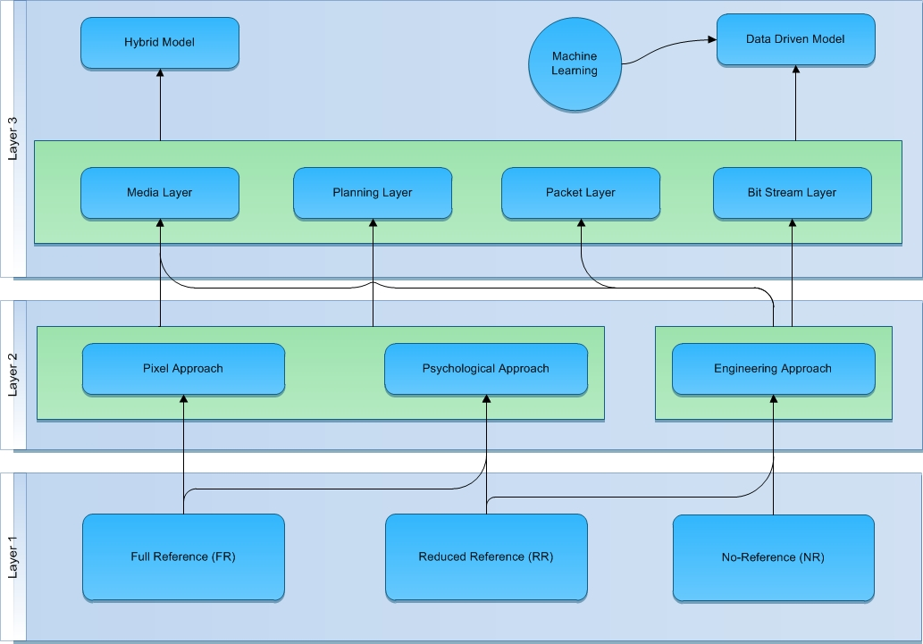
What I’ve done:
  Created a model categorisation
    To assist understanding of research area
    Add new context
  I will focus on the data driven and machine learning model.

Slide 8
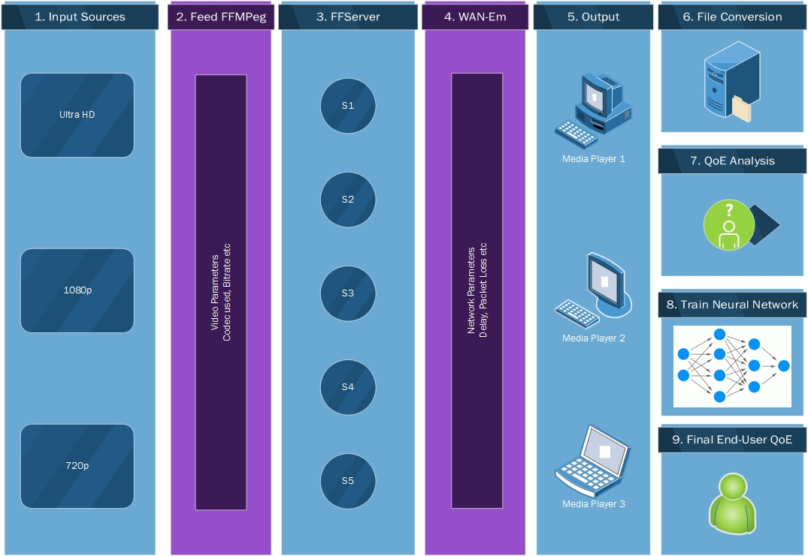
Cont.
  Set out preliminary testing plan
    Running some baseline tests for 1080p
  Set out parameters for video testing
  This will result in trained model for the creation of a NR Real Time solution for HD + video

Slide 9
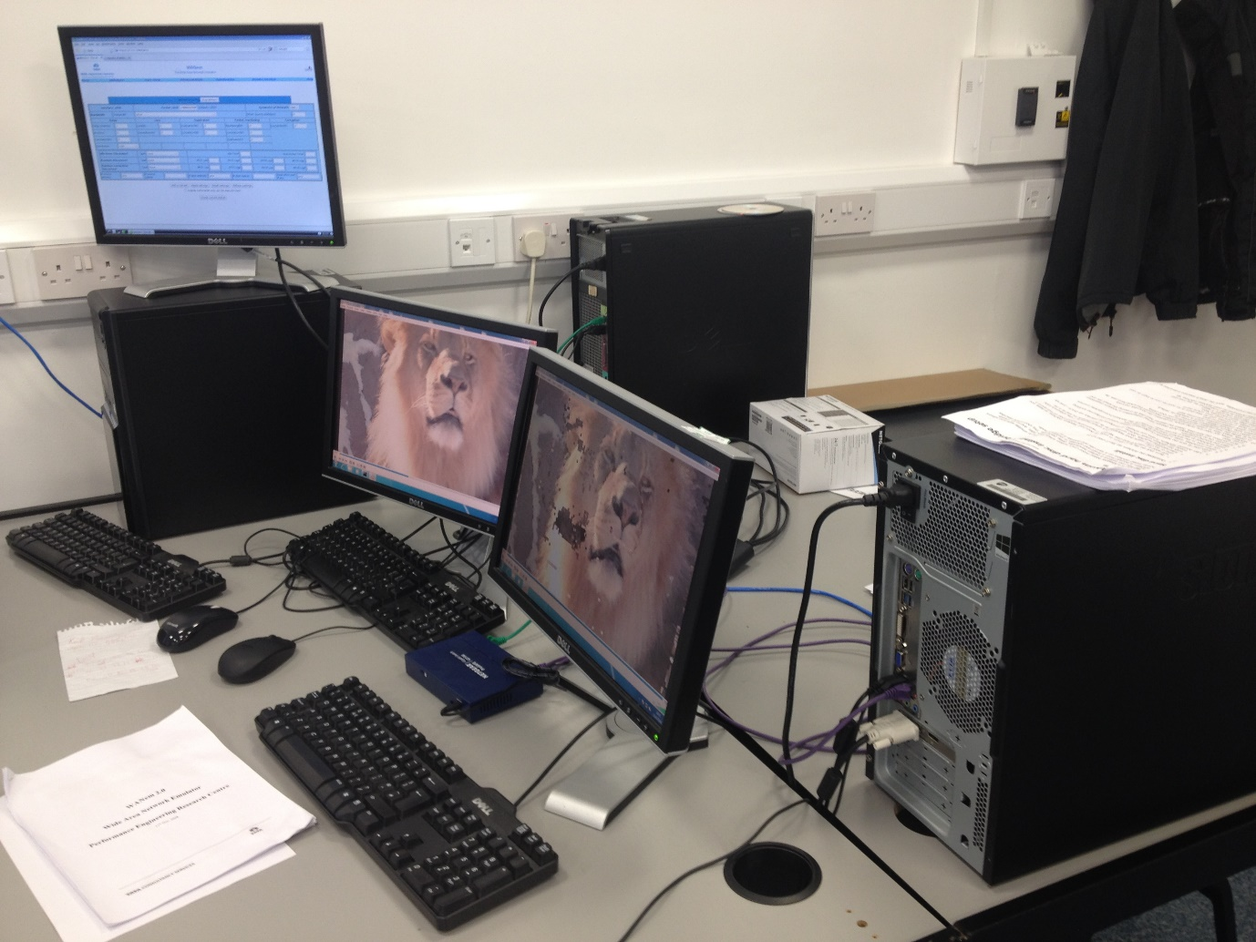
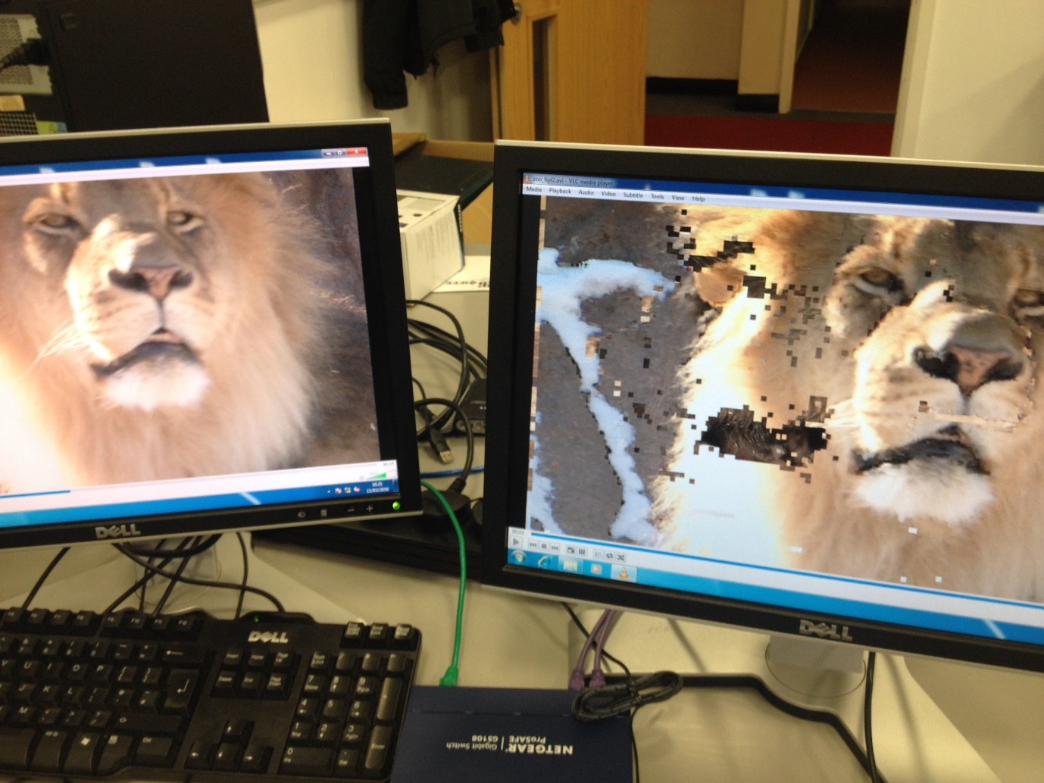
Cont.

Slide 10
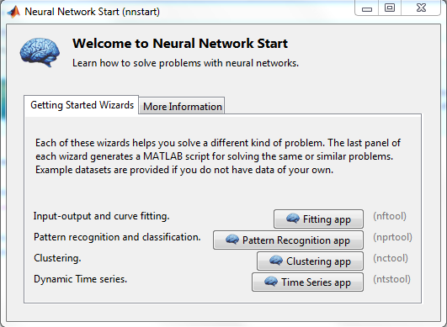
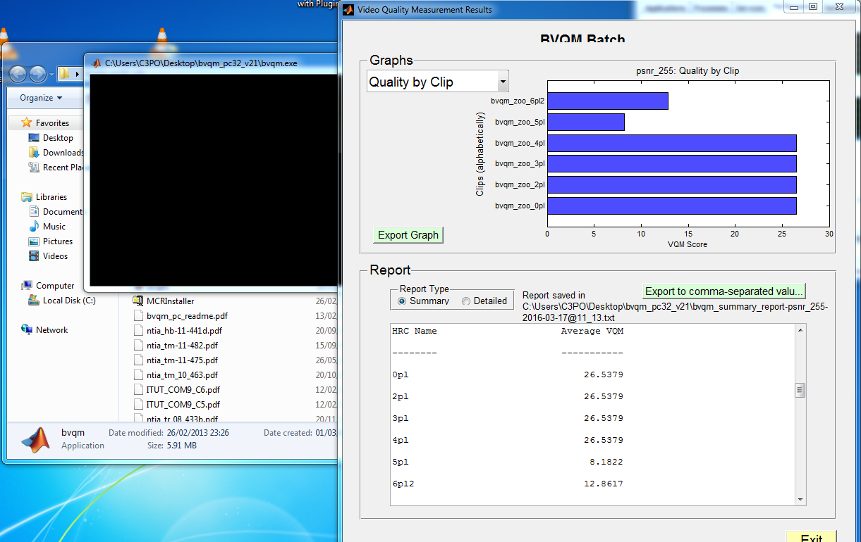
Next Stages – Methodology/Experiment
  Complete experiment and creation of video data sets
  Test video data sets using objective QoE methods
  Train and map outputs using RNN
  Other:
    Continuous Lit review
    Knowledge expansion
    Expertise increase
    Collab with others in field

Slide 11
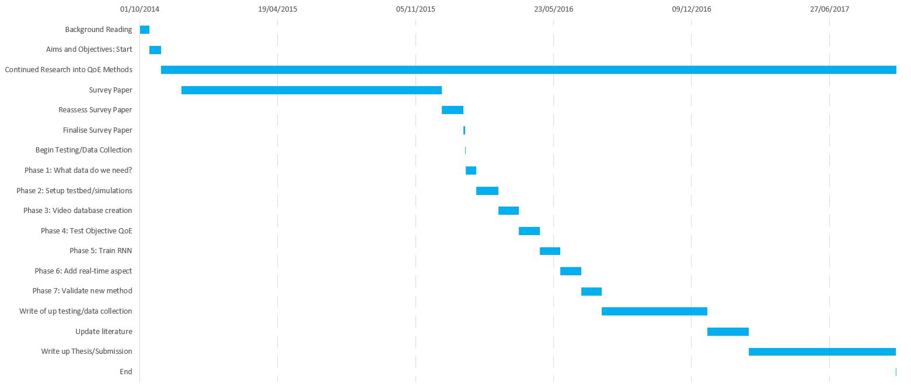
Next Stages

Slide 12
Success?
Accuracy of methodology compared to subjective/objective metrics
  Particularly in HD +
Implementation in real-time
Extension to U-HD

Slide 13
Contribution
Accurate objective QoE model for HD video
  Most method use smaller resolutions (CIG, QCIF)
Implementation of model in real-time
  As discussed previously
Challenges:
  Data size – computers only understand raw uncompressed video
    2gb per HD(1080p) uncompressed 10second video clip – 4tb per video data set
  Knowledge gaps – programming
  Time
    Objective metrics used for testing are slow…
    (Links with the real-time aspect – as accurate as some are, video is a real-time service)

Slide 14
Questions?

Slide 15
References:
[1] - ITU-T. ”Recommendation P.10/G.100: Vocabulary for Performance and Quality of Service”, July 2007.
[2] - ITU-T. ”Recommendation E.800: Definitions of terms related to Quality of Service” April 2009.

