Slide 1
Communication and Communities in a connected World
SJSS5001
Dr C Lohmann-Hancock
Joanne Davies

Slide 2
Aim
To enable the students to gain an understanding of the changing social, cultural and political landscape
From a global perspective

Slide 3
Learning Outcomes
Develop a critical understanding of the role of power in social change and sustainability in relation to equality and globalisiaton.
Relate this knowledge to a critical understanding of how society is becoming more connected.
Explore in-depth external influences which may impact upon an organisation which supports individuals who are at risk of exclusion.

Slide 4
Content
Exploration of how social power is embodied within a range of policies, laws and strategies that support social inclusion within society. A consideration of the barriers and challenges to initiating and sustaining change.
Critically examining the relationship between structure and agency in relation to the globalising world.
Looking at case studies showing the uneven impact of social, cultural and political influences on communities around the world, and critically examining the globalisation of policies, practices and the role of virtual environments and the worldwide web.
A critical examination of case studies of social inclusive practices within Wales, UK and beyond to sustain healthy and prosperous communities.

Slide 5
Assignment Questions
ASSIGNMENT 1
Examine, in depth, the implication of globalisations on a group/context of your choice.
3,500 Word Essay
27th March 2020
ASSIGNMENT 2
Focus on a specific community or group and consider the social, cultural and political influences and how these support ‘A Healthy and Prosperous World’.
10 Minute Poster Presentation
20th April 2020

Slide 6
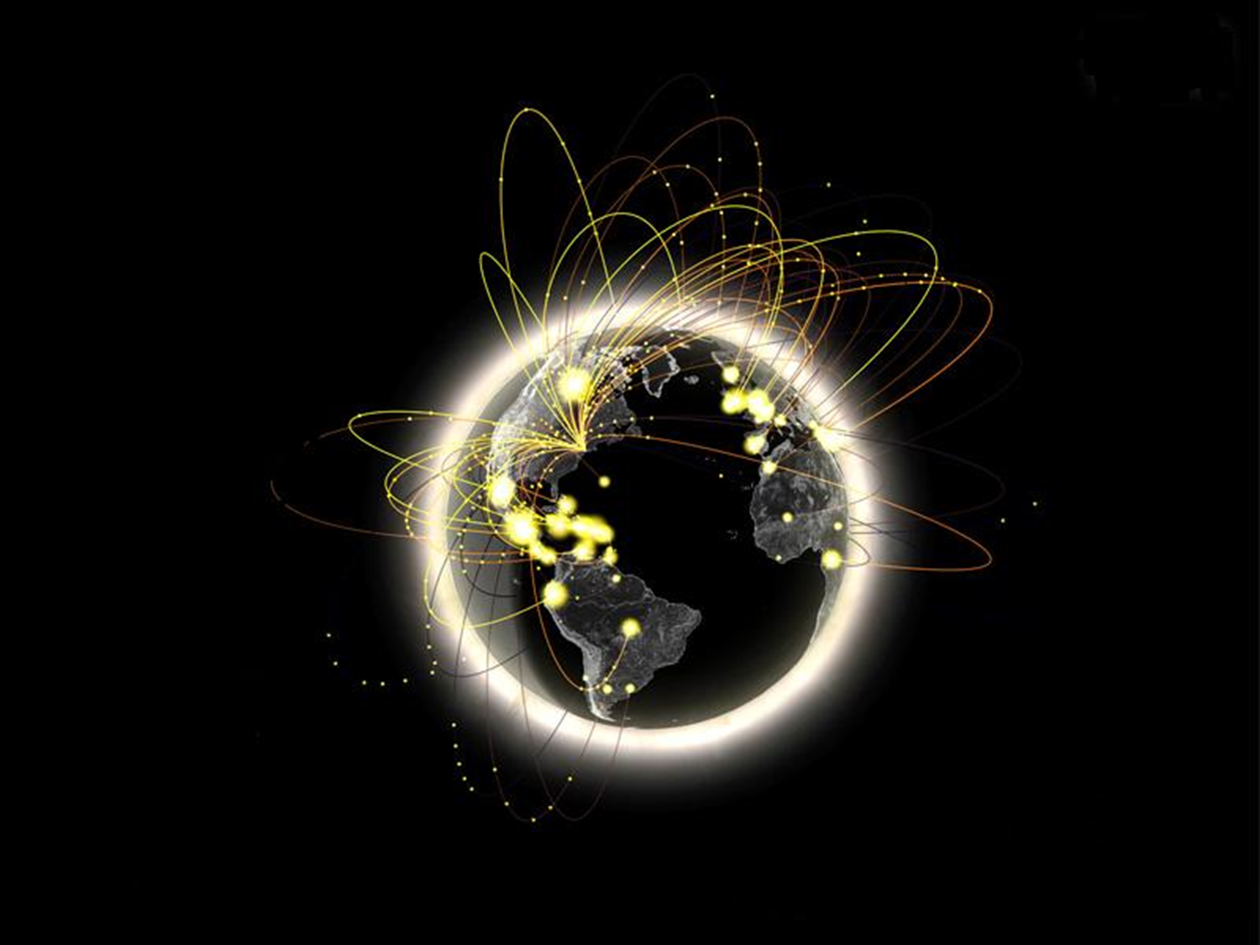
A connected world

Slide 7
What is a connected world?
How do we make a definition?
Make one up
Talk to your neighbour
‘Google’ it!
Go to the library

Slide 8
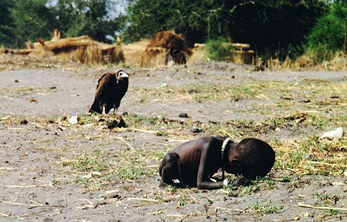
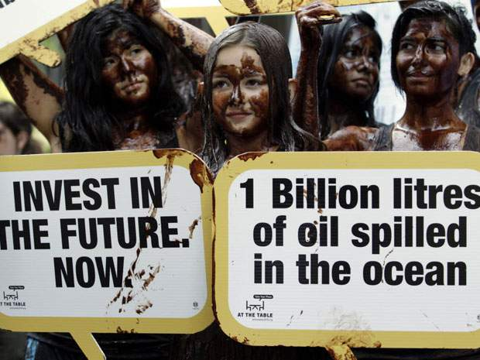
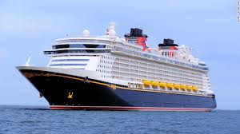

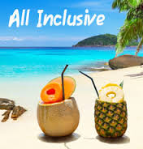
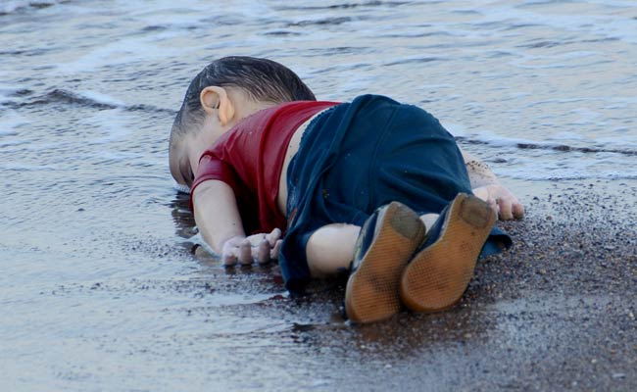
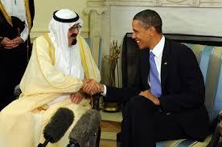
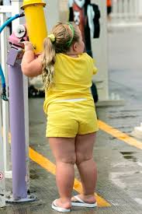

Let’s think……

Slide 9
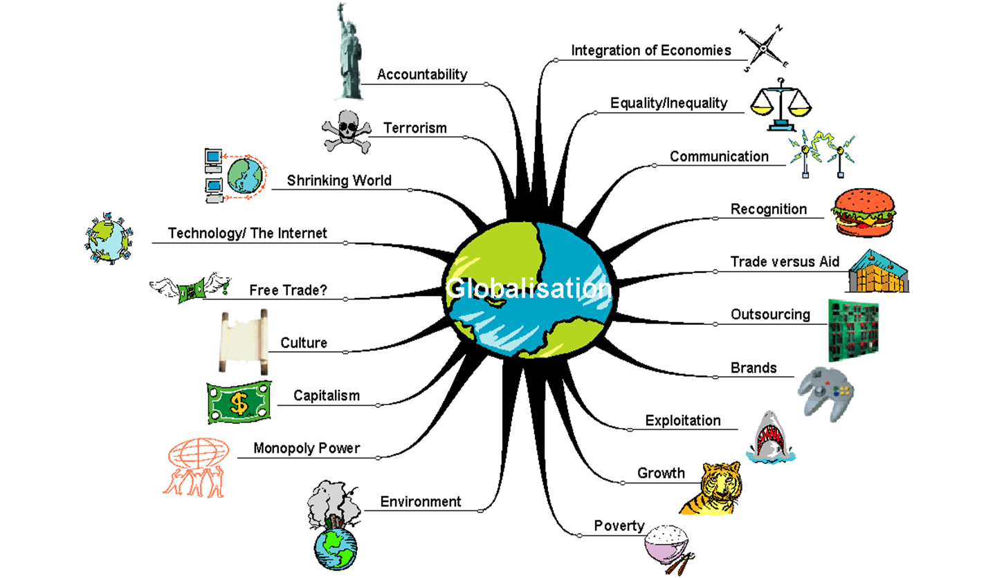

Slide 10
What is Globalisation?
An increasing internationalisation of markets for goods and services, the means of production, financial systems, competition, corporations, technology and industries. (OECD, 2013)
Economic, social, cultural and political interdependence and interconnectedness with other parts of the world (JRF, 2011)

Slide 11
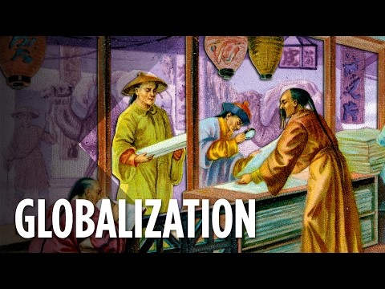

Slide 12
Is Globalization Good or Bad?
What do you think?
Watch the following videos and take notes for class discussion

Slide 13
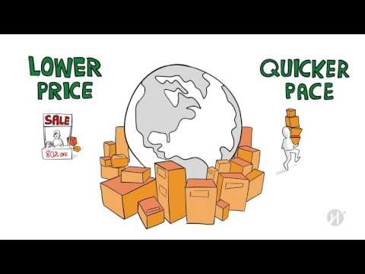
Disadvantages of Globalization

Slide 14
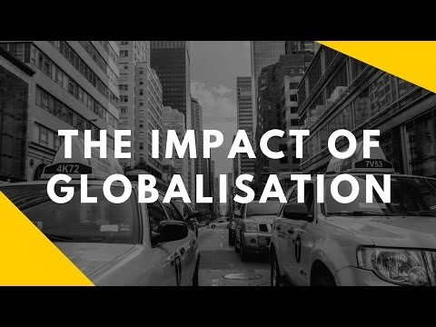

Slide 15
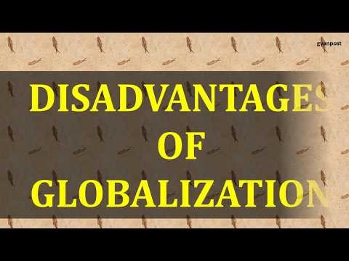

Slide 16
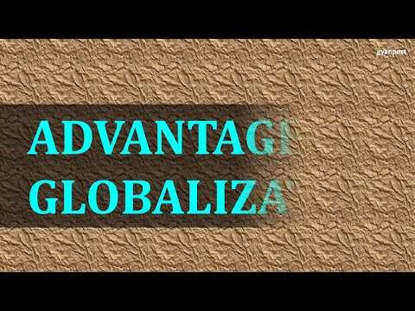

Slide 17
What do you think?
Activity
In groups, discuss and list advantages and disadvantages
Feedback to class

Slide 18
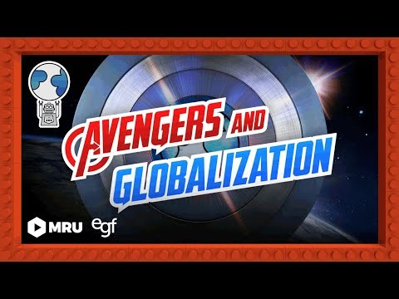

Slide 19
Challenges of Living in a Global Society

Slide 20
The global village
Marshall McLuhan (1964) predicted the global village, one world interconnected by an electronic nervous system, making it part of our popular culture before it actually happened.
McLuhan chose the insightful phrase "global village" to highlight his observation that an electronic nervous system (the media) was rapidly integrating the planet -- events in one part of the world could be experienced from other parts in real-time, which is what human experience was like when we lived in small villages.
https://livinginternet.com/i/ii_mcluhan.htm

Slide 21

Early globalisation theorists
Today, after more than a century of electric technology, we have extended our central nervous system itself in a global embrace, abolishing both space and time as far as our planet is concerned.
- Marshall McLuhan, Understanding Media, 1964.

Slide 22
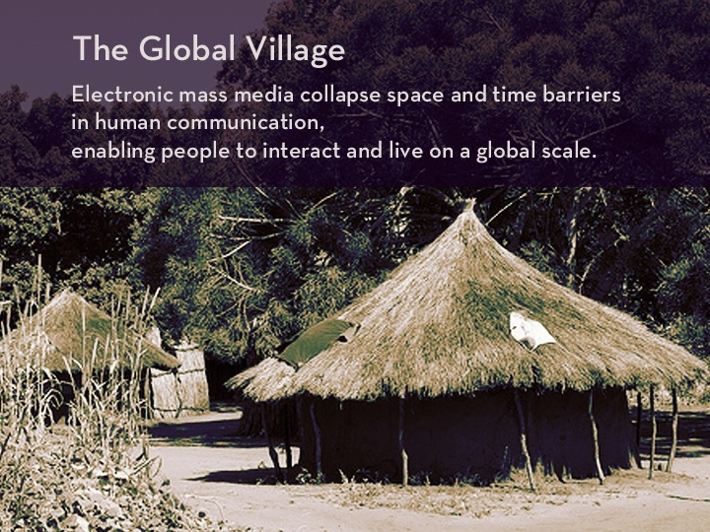

Slide 23
Early globalisation/communication theorists
While McLuhan popularized this concept, he was not the first to think about the unifying effects of communication technology.
One of the earliest thinkers along this line was Nicolas Tesla, who in an interview with Colliers magazine in 1926 stated:
‘When wireless is perfectly applied the whole earth will be converted into a huge brain, which in fact it is, all things being particles of a real and rhythmic whole. We shall be able to communicate with one another instantly, irrespective of distance. Not only this, but through television and telephony we shall see and hear one another as perfectly as though we were face to face, despite intervening distances of thousands of miles; and the instruments through which we shall be able to do his will be amazingly simple compared with our present telephone. A man will be able to carry one in his vest pocket.’

Slide 24
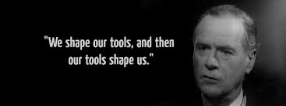
McLuhan's second best known insight is summarized in the expression "the medium is the message", which means that the qualities of a medium have as much effect as the information it transmits. For example, reading a description of a scene in a newspaper has a very different effect on someone than hearing about it, or seeing a picture of it, or watching a video
McLuhan was particularly fascinated by the medium of television, calling it a "cool" medium, noting its soporific effect on viewers.
One wonders what McLuhan would make of the Internet, the most powerful medium we have yet invented, driving integration of the global village he foresaw?

Slide 25
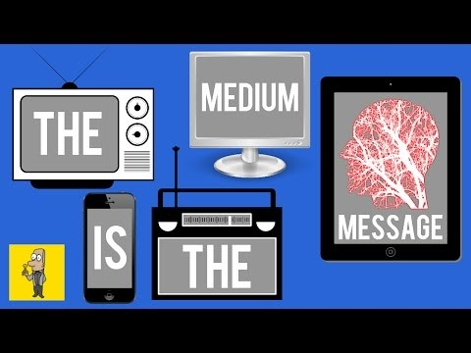
Shall we change the medium???
The Media is the massage
The Media is the message
https://www.youtube.com/watch?v=gCr2binb4Fs

Slide 26
Contributors to cultural diversity (1)
Advanced technology and transportation systems:
Train, car, aeroplane.
Internet, fax machine, satellites, telephone, social media, podcasting, blogging.
Increased intercultural encounters create opportunities of
understanding and possibilities of misunderstanding.
Understanding other cultures is a challenge we face today.

Slide 27
Contributors to cultural diversity (2)
Global economy and business transactions:
Global transformation.
International expansion.
Diverse workforce.
Understanding cultural tensions created by economic
transformations is a challenge we face in the business context
of intercultural communication.

Slide 28
Contributors to cultural diversity (3)
Mass migration and international exchange:
Immigration flow, mainly from developing to developed countries.
Migrants who move to the host country for work or study.
Promoting inter-ethnic co-existence is a challenge we face in
our multicultural society.

Slide 29
Questions for classroom discussion
What do you see as some of the advantages and disadvantages of culturally diverse nation?
Why do you think migrants tend to move to developed countries?
What do you see as some of the advantages and disadvantages of this movement for the host countries? Could you give an example to illustrate your view?

Slide 30
Multiculturalism and Interculturalism
Multiculturalism can be used to describe the composition of a society made up of diverse cultures. It can also refer to a society’s tolerance and acceptance of cultural diversity.
Interculturalism
Something greater than coexistence
Allegedly more geared toward interaction and dialogue than multiculturalism
Conceived as something less ‘groupist’ or more yielding of synthesis than
multiculturalism
More committed to a stronger sense of the whole, in terms of such things as societal cohesion and national citizenship
More likely to lead to criticism of illiberal cultural practices (as part of the process of intercultural dialogue)

Slide 31
Intercultural communication
Intercultural communication refers to communication between individuals of diverse cultural backgrounds and between diverse groups.
How can knowledge and skills of intercultural communication benefit us?

Slide 32
Necessity and benefits of intercultural communication (1)
Building intercultural understanding:
Understanding is the first step towards acceptance
People around the world have accumulated a rich stock of cultural traditions and customs, but we are often not aware of the cultural rules governing our own behaviour
To understand another culture, we need to communicate with its people

Slide 33
Ethnocentrism
What does it mean to be Ethnocentric?
Ethnocentrism means seeing our own culture as the centre of the universe and seeing other cultures as insignificant or even inferior.
Ethnocentrism may lead to prejudice, stereotypes or discrimination.

Slide 34
Contact theory
The intergroup contact hypothesis was first proposed by Allport (1954), who suggested that positive effects of intergroup contact occur in contact situations characterized by four key conditions:
equal status,
intergroup cooperation,
common goals,
and support by social and institutional authorities
According to Allport, it is essential that the contact situation exhibits these factors to some degree.
Indeed, these factors do appear to be important in reducing prejudice, as exemplified by the unique importance of cross-group friendships in reducing prejudice (Pettigrew, 1998).

Slide 35
Cultural Relativism
Cultural relativism is the degree to which an individual judges another culture by its context.
Cultural relativism evaluates the behaviours of a culture by its assumptions about the reality.

Slide 36
Necessity and benefits of Intercultural Communication (2)
Promoting international business exchange:
Three competencies essential in the global workplace are: intercultural communication skills, problem solving ability and global leadership.
Communicating with unfamiliar cultures does not simply mean finding a translator to facilitate the process.
You need to know what to expect when someone engages in an interaction (e.g. Guanxi in business negotiation with Chinese).

Slide 37
Necessity and benefits of Intercultural Communication (3)
Facilitating cross-cultural adaptation:
Cross-cultural adaptation is a two way process.
The tension between immigrants and host nationals often centres on the issue of ethnic cultural maintenance.
True multicultural society is characterized by mutual acceptance and equal societal participation.

Slide 38
Important!!! Reading!!!
For this module, it is extremely important that you ‘get the bigger picture’.
So, please start digging!
Think of suggested topics for next weeks one hour session

Slide 39
Reference list
Author Unknown. An Overview of Key Terms and Definitions of Globalization © 2016 by EBSCO
Publishinghttp://connection.ebscohost.com/businessfinances/globalization/overview-key-terms-and-definitions-globalization
Everett,J. Onu, D.(2013) ‘Intergroup Contact Theory: Past, Present, and Future’ The Inquisitive Mind. 2(17). Available at:
http://tedcantle.co.uk/wp-content/uploads/2013/03/092-Intergroup-contact-theory-explained-Everett-J-2013.pdf
International Monetary Fund. (2006). Glossary of Selected Financial Terms and Definitions. Available at:
http://www.imf.org/external/np/exr/glossary/showTerm.asp#91
Meer, N. & Modood, T. (2011) ‘How does Interculturalism Contrast with Multiculturalism?’ Journal of Intercultural Studies. First article, pp. 1-22. Available at:http://www.bristol.ac.uk/media-library/sites/ethnicity/migrated/documents/interculturalism.pdf
NPR, (2011). Ike's Warning Of Military Expansion, 50 Years Later. Available at:
http://www.npr.org/2011/01/17/132942244/ikes-warning-of-military-expansion-50-years-later
OECD, (2013) Globalisation. Available at: https://stats.oecd.org/glossary/detail.asp?ID=1121 (Accessed: 6 January 2020).
Steger, M. (2013). Globalization: A very short introduction, Oxford: Oxford University Press
Liu, S.; Volcic, Z.; Gallois, C. (2015) Introducing Intercultural Communication - Global Cultures and Contexts. London: Sage.
Companion website https://study.sagepub.com/liu2e

