Slide 1
Interim Viva
Luke Penhalagan

Slide 2
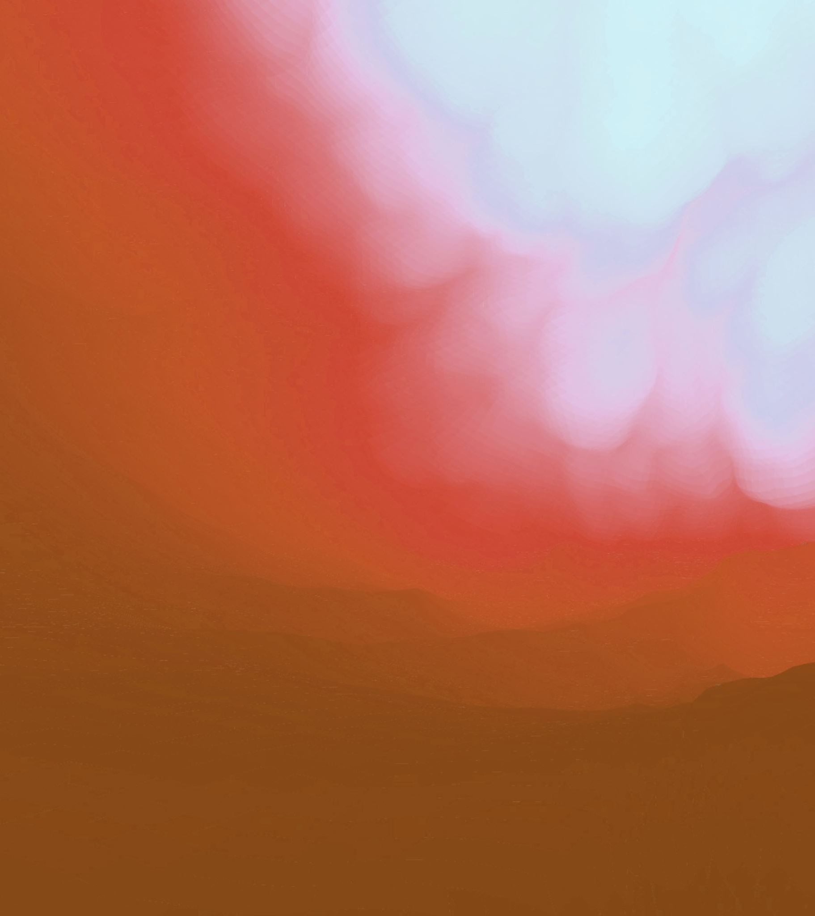
Initial Idea
My initial Idea for the project was a short action/exploration sequence following an adventurer into a mysterious tomb/temple.
It would an Indiana Jones-esque discovery following our protagonist as he explores this environment and attempts to steal an artifact
I was also interested in utilizing "reverse animations" at some point during the sequence where time would reverse at some point during the animation

Slide 3
Initial Idea
I elected to use Unreal Engine for the majority of my project as it’s the program I am most experienced in and hope to specialise in, in the future.
I wasn't sure whether I wanted the animation to be a fantasy piece or a sci-fi piece, so I decided to design the character first before making any of these decisions.

Slide 4
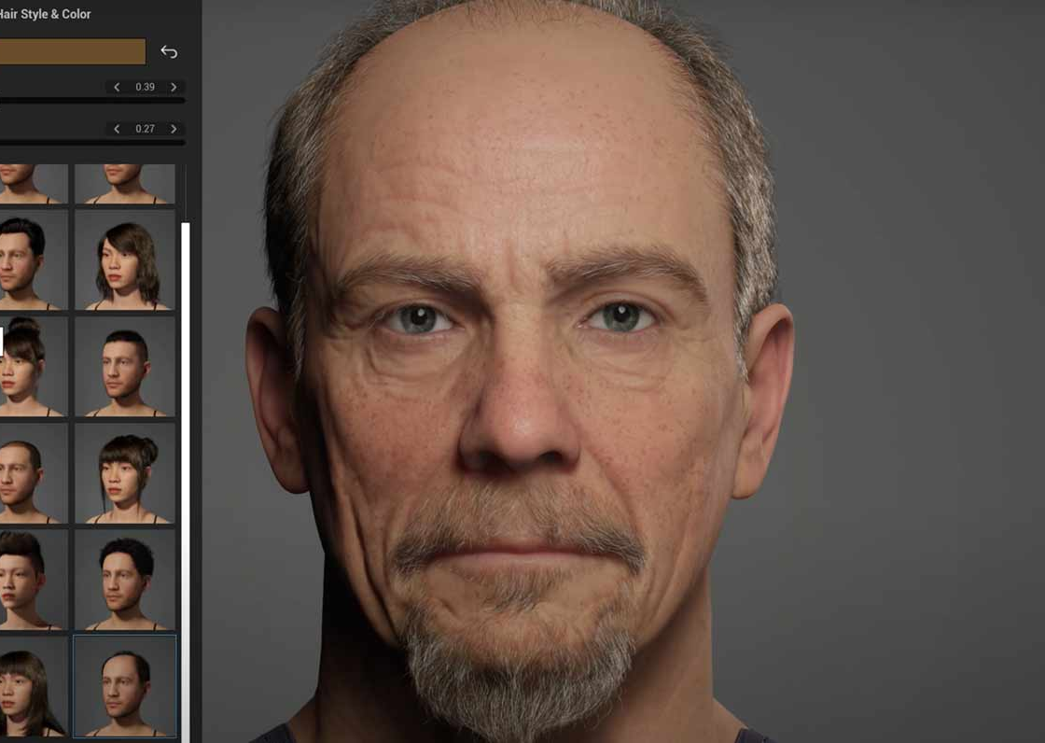
Character Design - Metahuman
To make the character I decided to the best approach to use Unreal Engines inbuilt system – Metahuman.

Slide 5
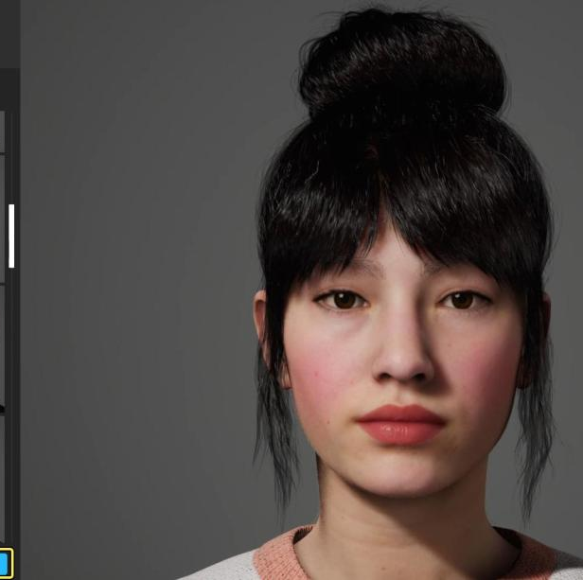
Character Design - Metahuman
The program works by allowing you to completely alter a wide selection of presets. This can be done by in multiple ways, including:
Adjusting Sliders
Dragging parts of the face
Or even choosing "Parent presets" that allow to decided which features they can share with a selection of other presets.

Slide 6
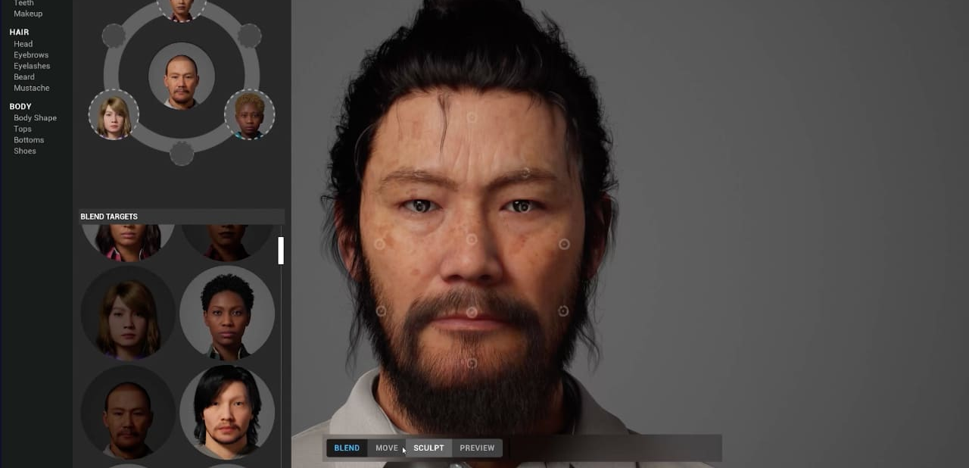
Character Design - Metahuman

Slide 7
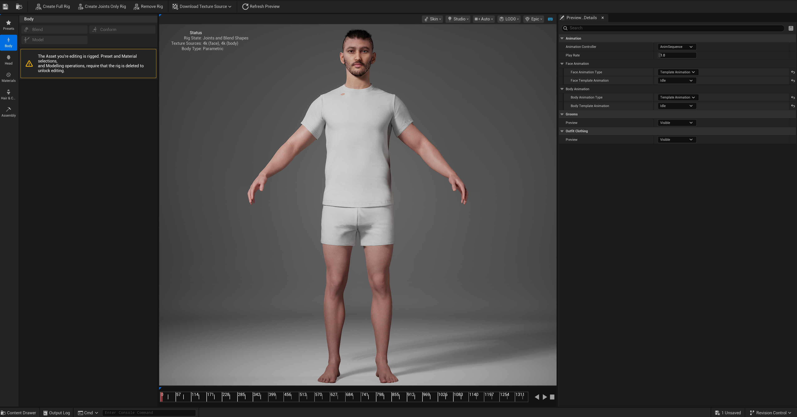
Creating Jayson

Slide 8
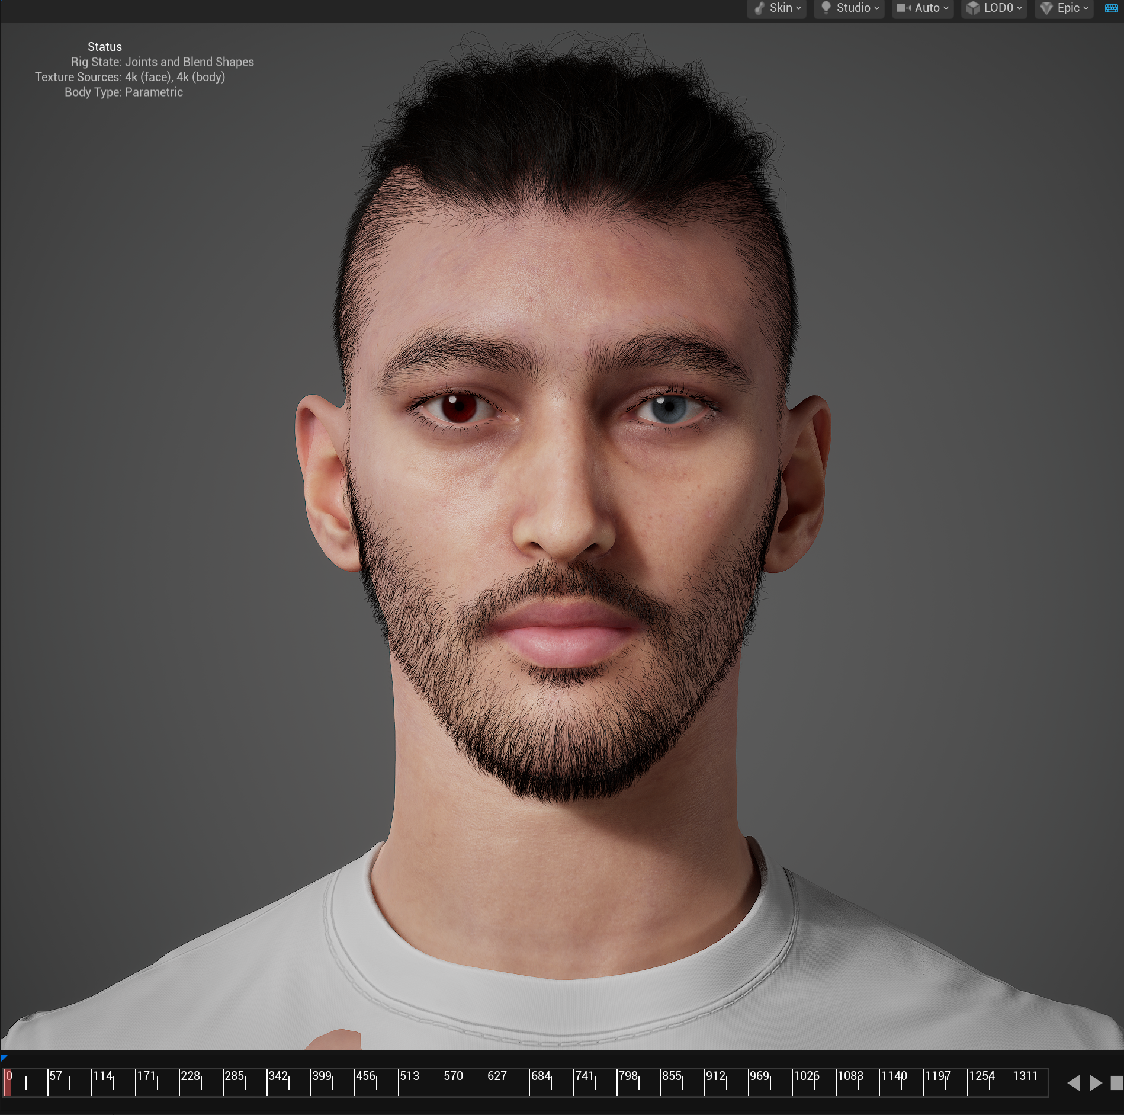
Rigging and exporting Jayson
The advantage of using Metahuman, other than it being quicker, is the ability to quickly rig the model and have it instantly available with your Unreal Project
I simply, I created a full rig for the character and then "Assembled" the model.

Slide 9
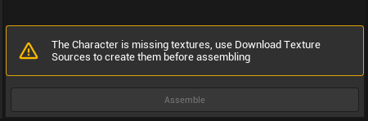
Problem faced
When I first went to "assemble" the model, an error message popped up saying it, "Couldn’t find the textures for the head."
To fix this I simply had to select the "Download textures" button and choose which quality I would like.
It gave options of 2k, 4K, and 8k textures, I chose the 4K ones as there was no real need for a higher quality that could increase render times and hinder performance.
Once I did this the program would allow me to assemble the model

Slide 10

Clothing Jayson
I found that the clothing available with Unreal Engine were very basic and didn't quite fit the tone of the project.
I looked on the FAB marketplace for some but didn't really want to pay for a high-quality clothing textures.
To find better clothing I downloaded a program called Metatailor.

Slide 11
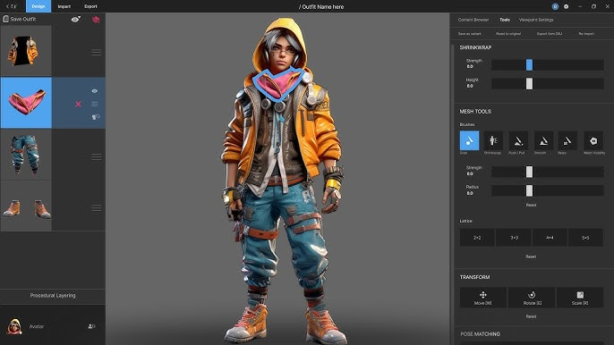
Metatailor
Before dressing the model, I simply had to export the skeletal mesh as an FBX file, and then import it into Metatailor
From here, I could choose from a large selection of clothing options and layer them however I wanted.
Eventually, I decided on a rogue leather look that would suit a Sci-fi genre rather than a fantasy one.

Slide 12
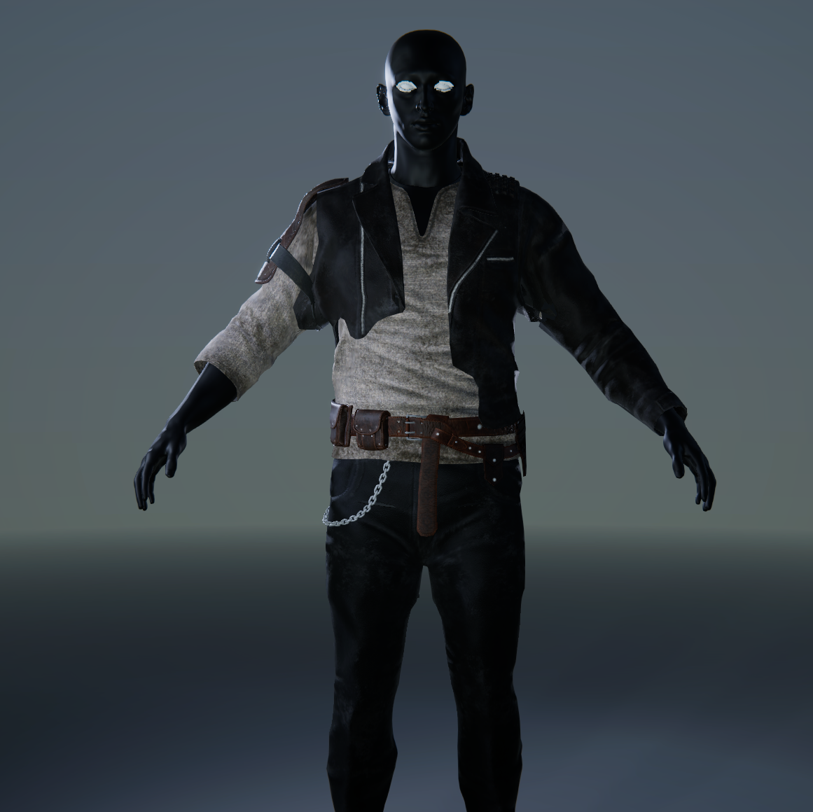
Final Clothing Selection

Slide 13
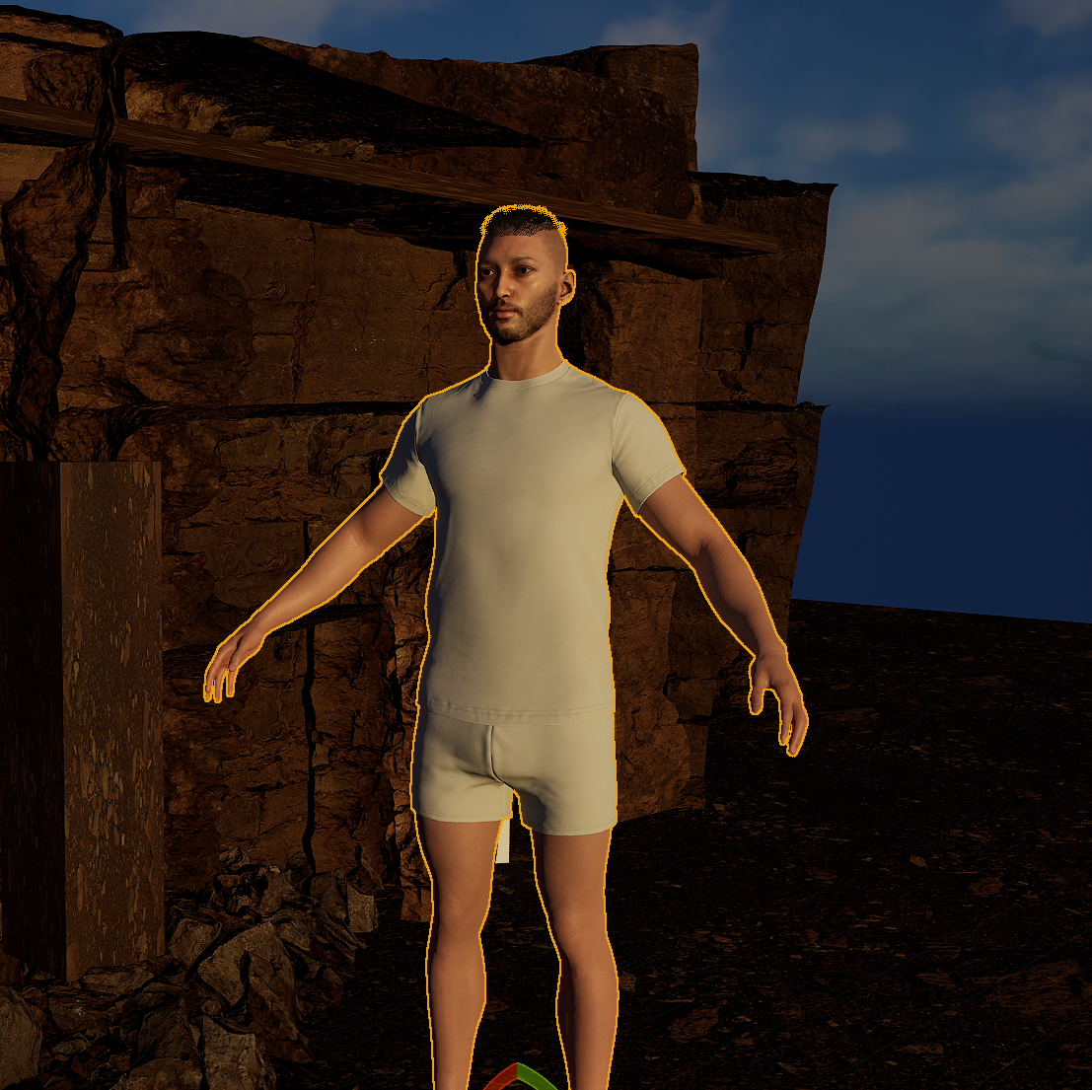
Clothing Jayson
From here, I could simply export the outfit only, or the whole character, and bring it back into Unreal Engine.

Slide 14
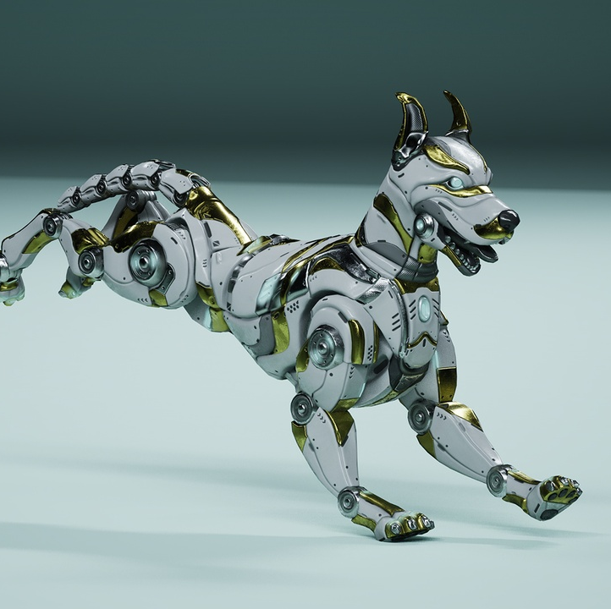
Robot Dog
When making projects within Unreal Engine I often have a look at the FAB market for any offers or deals that can I use for the project.
This time I found, a model of a robotic dog that I instantly knew I wanted to use.
This further reinforced that I was choosing a Sci-fi look and style of the project.

Slide 15
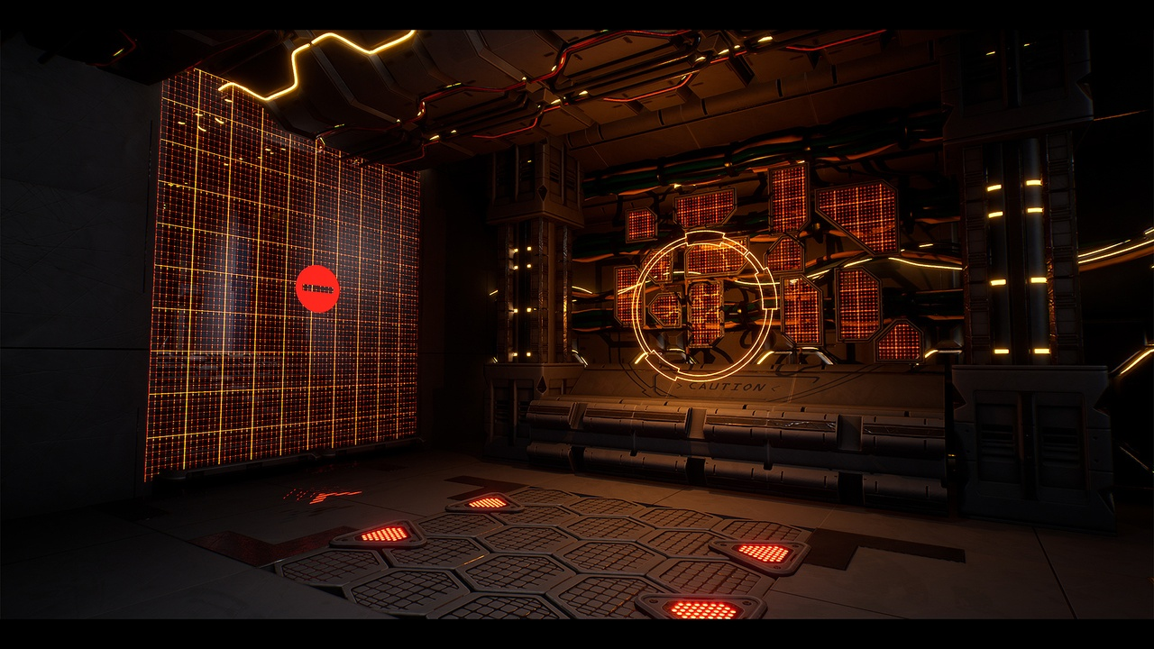
Megascans
At the same time, I also looked for free megascans and modular kits that could help me make the environment.
For the cave, I used a pack called "Quarry Collection"
And for the sci-fi elements I used:
Cyberpunk industries Vol.1
Sicka Free Environment Pack
Polar Facility

Slide 16
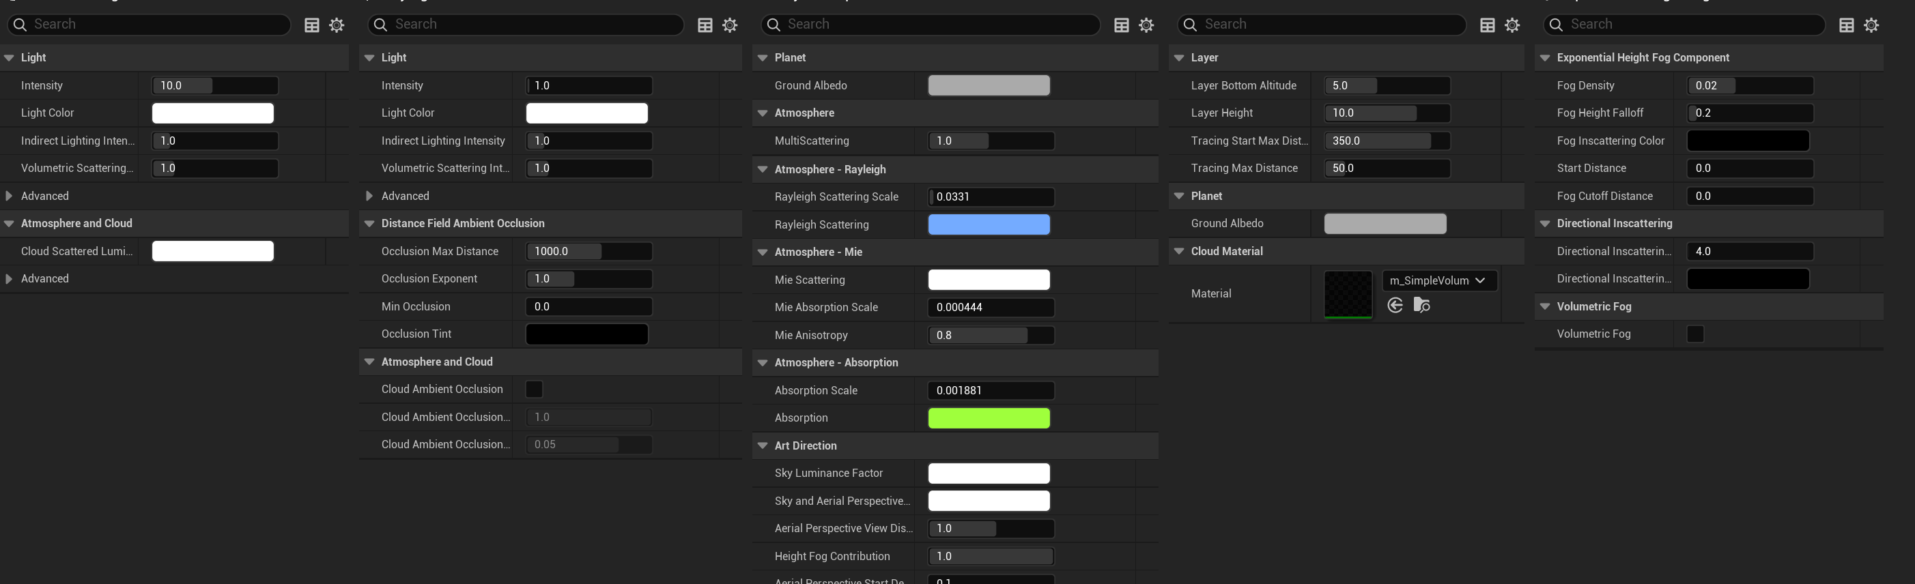
Environment - Setup
The first step I follow when creating a new project in Unreal Engine is to set up the atmosphere and sky light.
To do this I open the "Environment Light Mixer"
Then I add the key components:
Directional light – Simulates Sunlight
Sky Light - Captures ambient light of environment
Sky atmosphere - Realistic sky gradient
Volumetric clouds – unnecessary as the animation will take place on the interior
Exponential Height Fog - Simulates atmospheric height and fog,

Slide 17
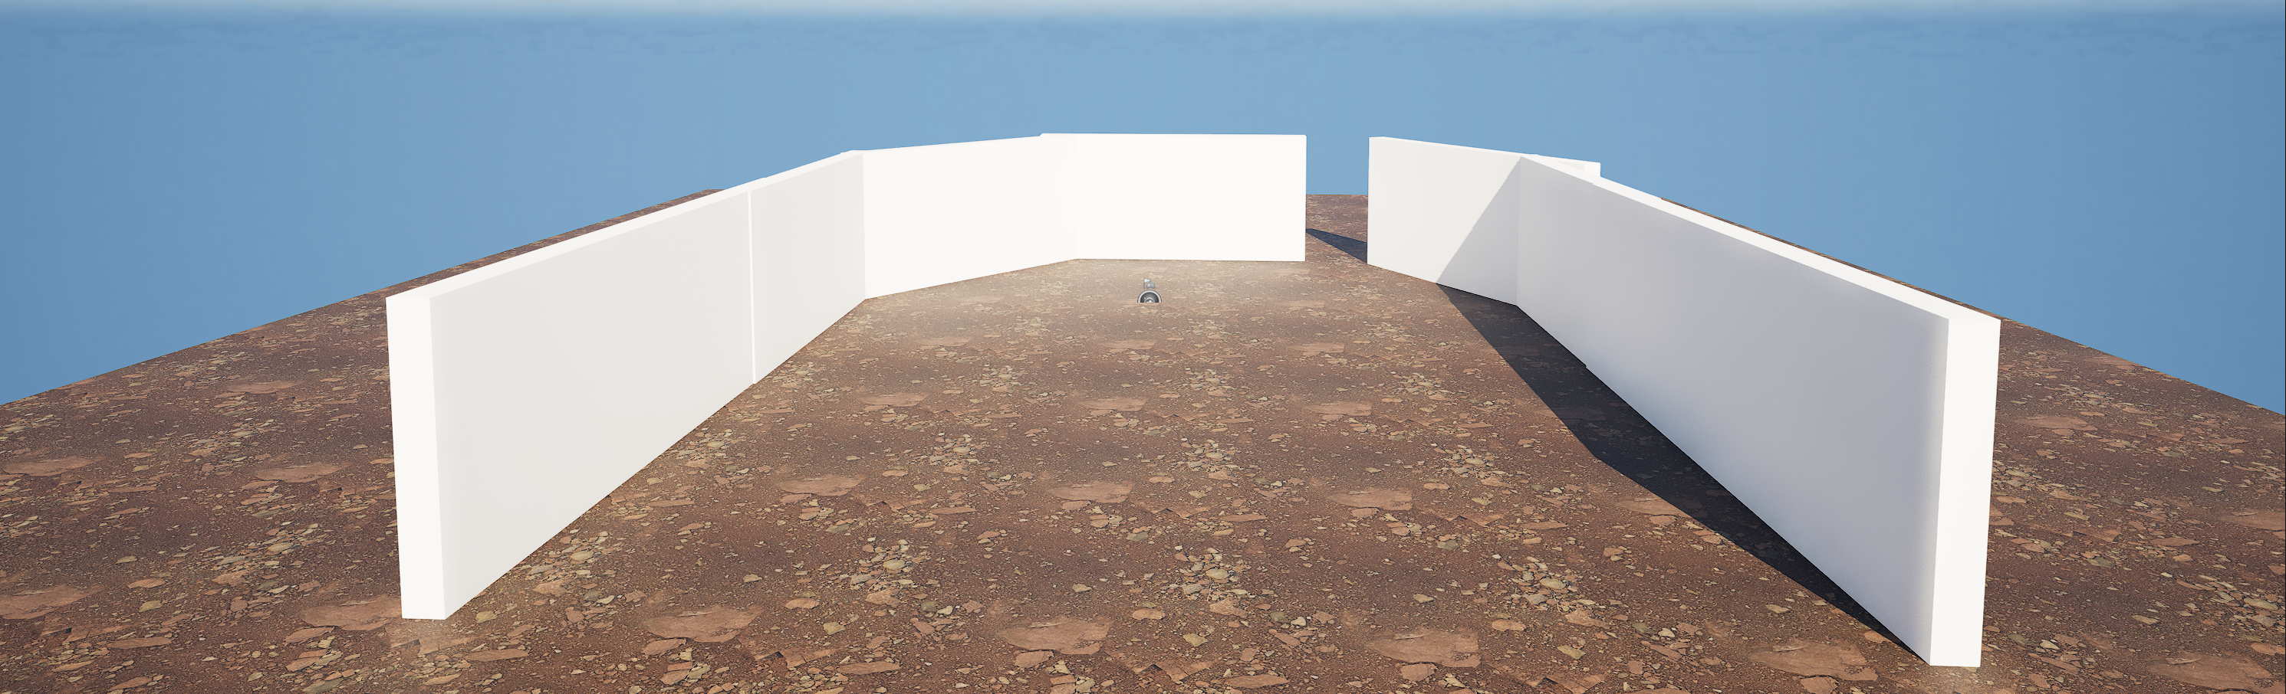
Environment - Blocking
Next, I applied a basic texture to the platform before blocking out the cave.
For this, I used the basic shapes and manipulated them into the shape and set-up I imagined for the scene.

Slide 18
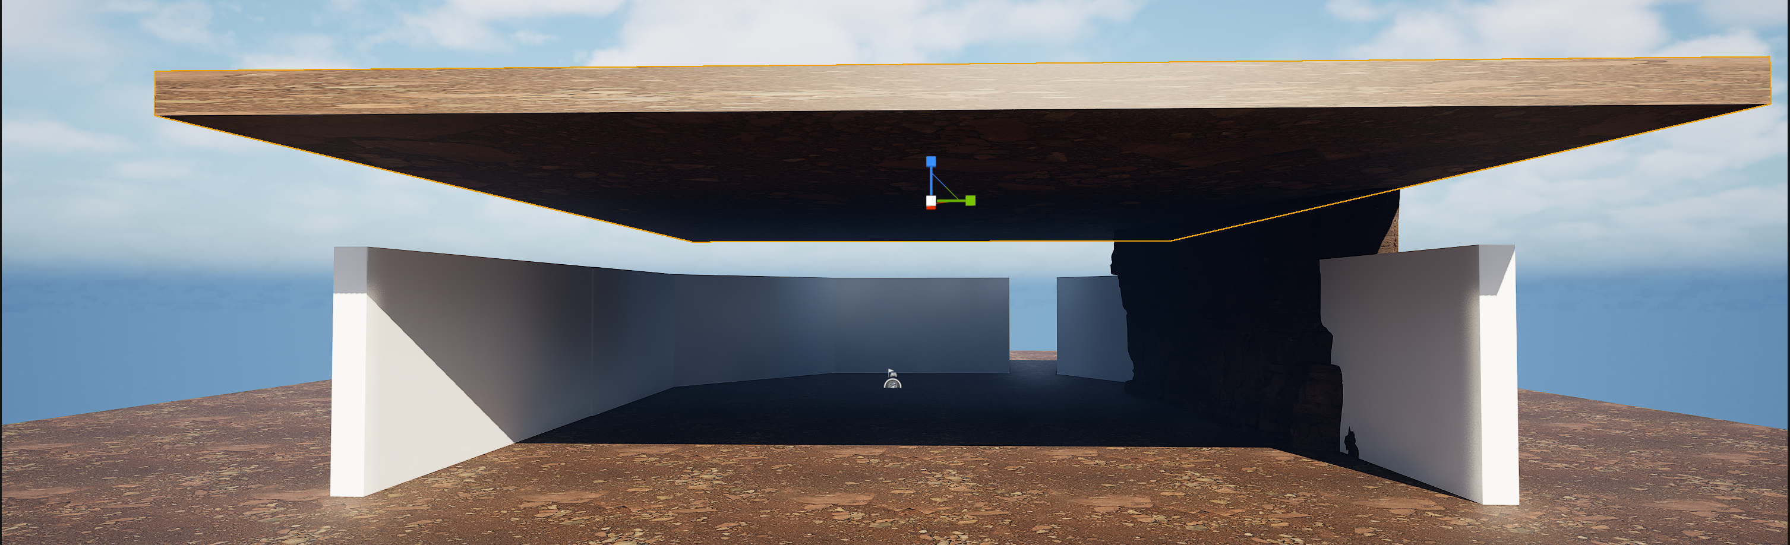
Environment - Cave
I used these megascans and began to place them along the "walls".
Hiding them with cliff faces and rocks, making sure to leave a man-sized hole at one end where my protagonist would enter from.
I then placed a basic rectangle above and put the same texture on it.

Slide 19
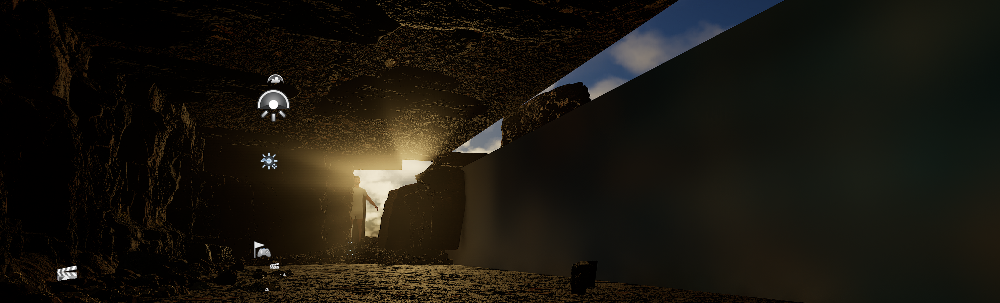
Environment - Cave
Along the floor, I then placed some smaller rocks structures and at the entrance a larger sloping build-up of rocks.
I then changed the direction of the sun so that it shined through the hole.

Slide 20
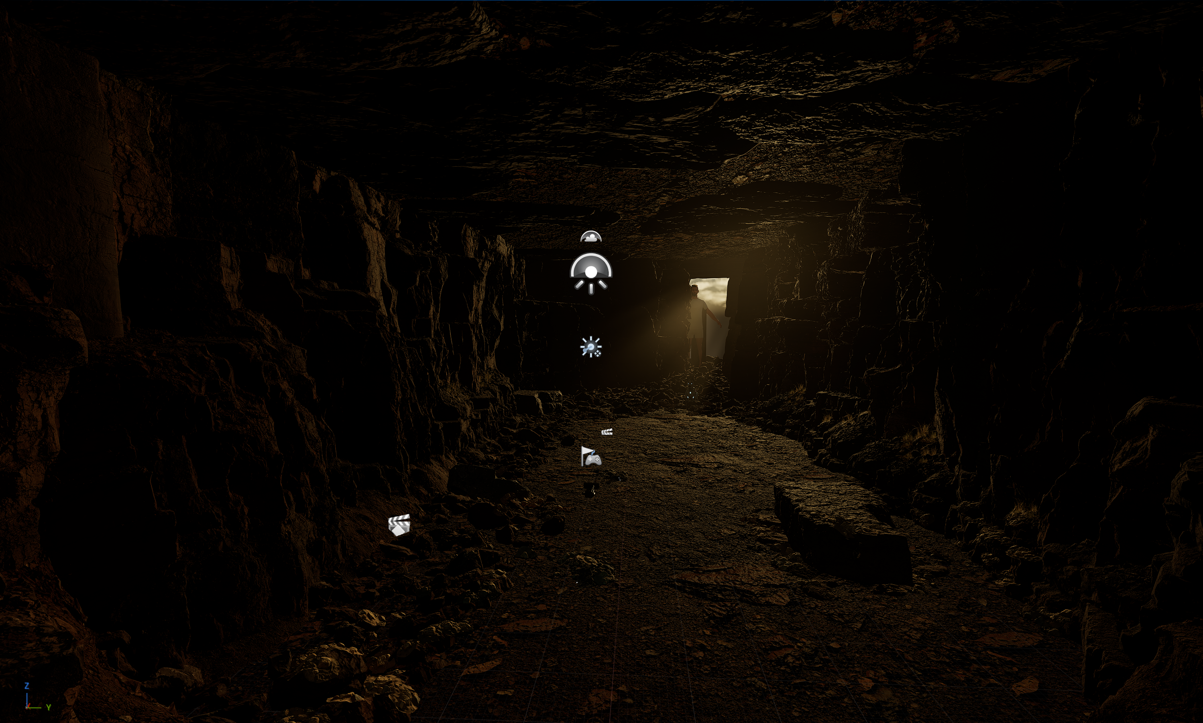

Slide 21
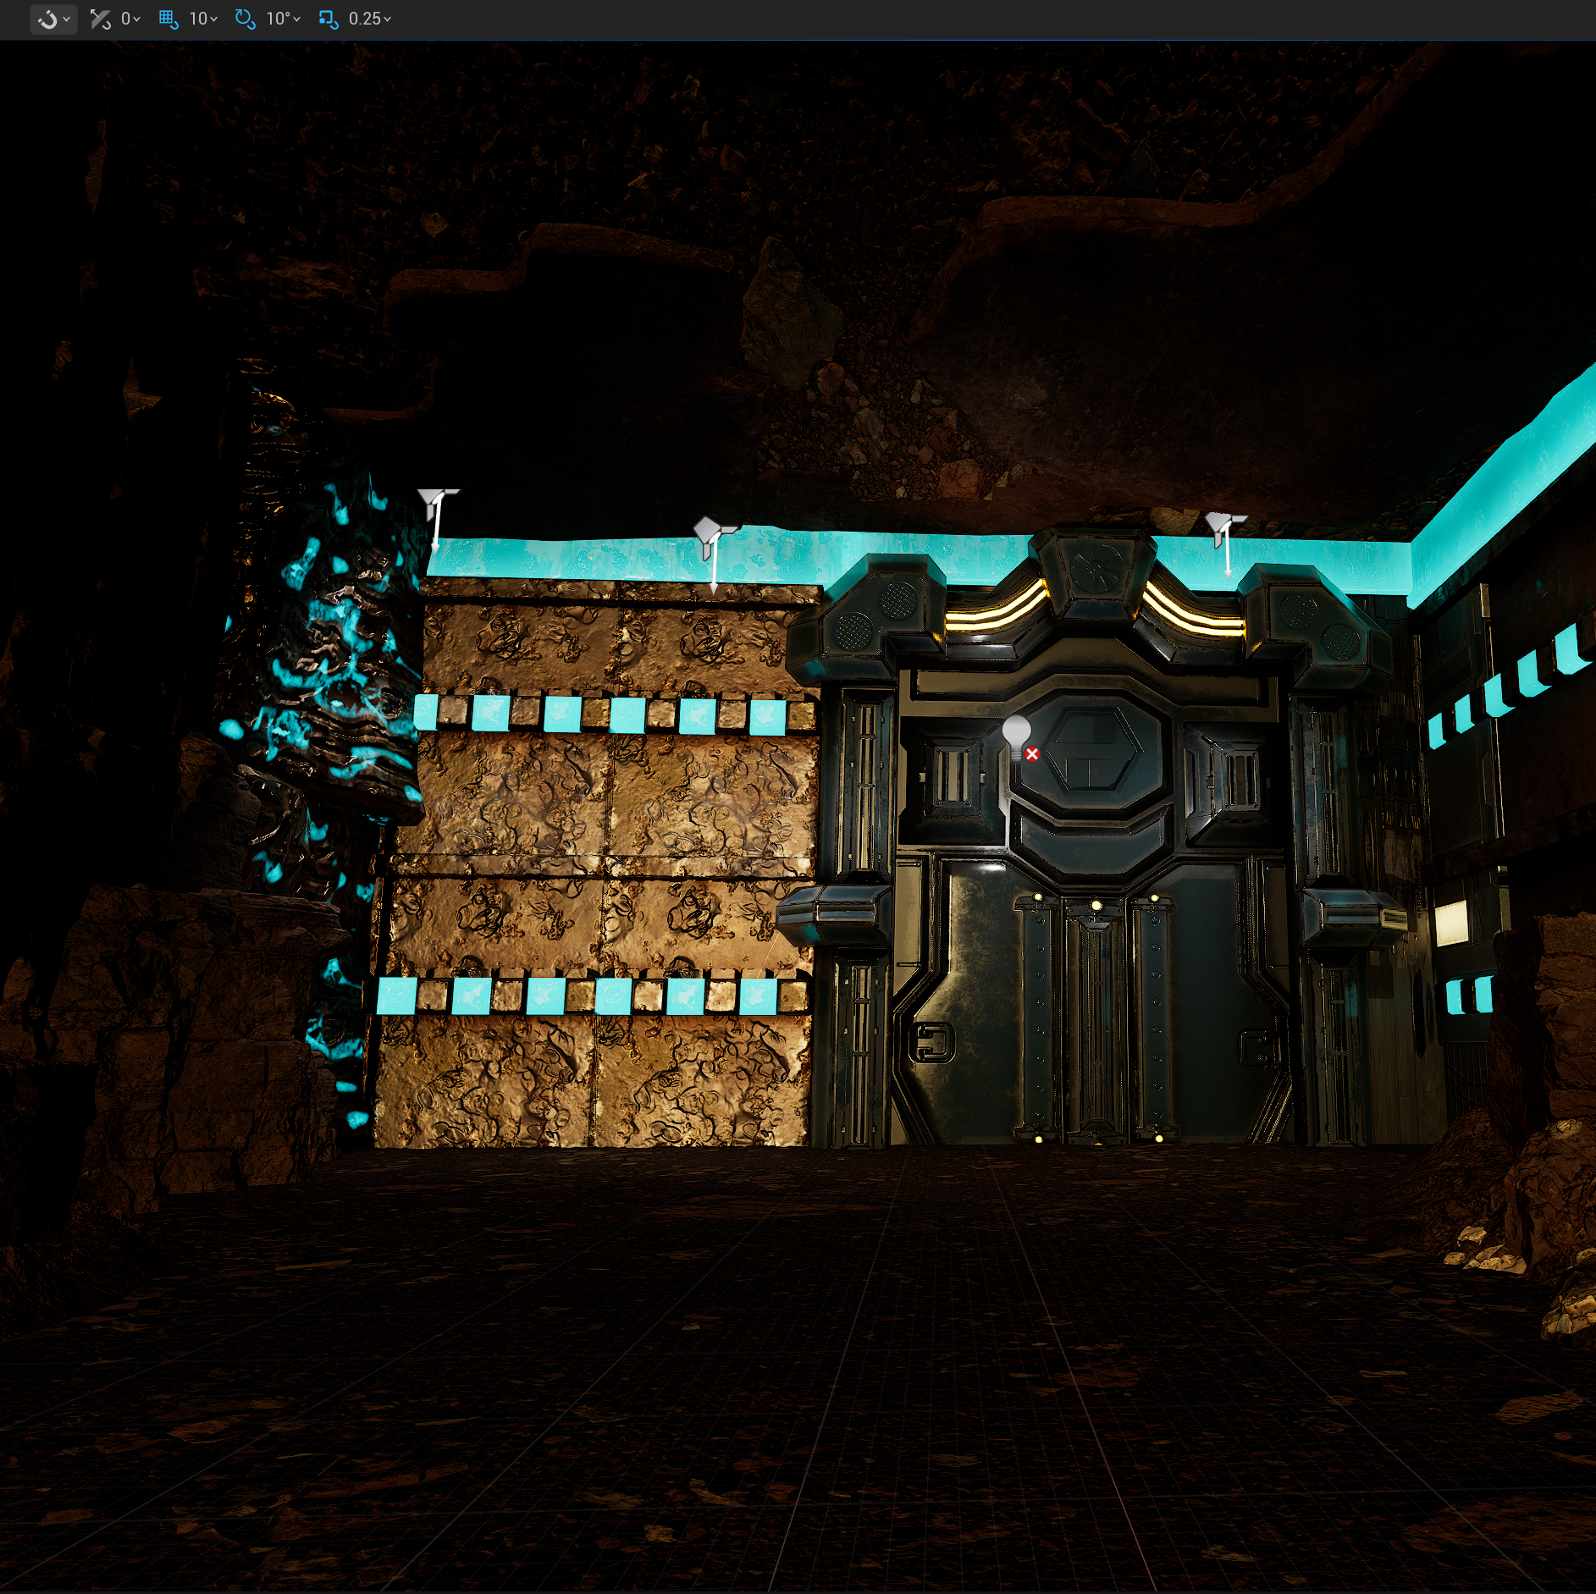
Environment – Secret Base
I wanted the tomb to be a mixture of man-made and natural phenomena so I downloaded multiple packs of science fiction assets that I could mix and match together. The idea being that It would like a secret research facility that was studying some ancient rock.
At the end of the cave, I placed large metal door and some walls.

Slide 22
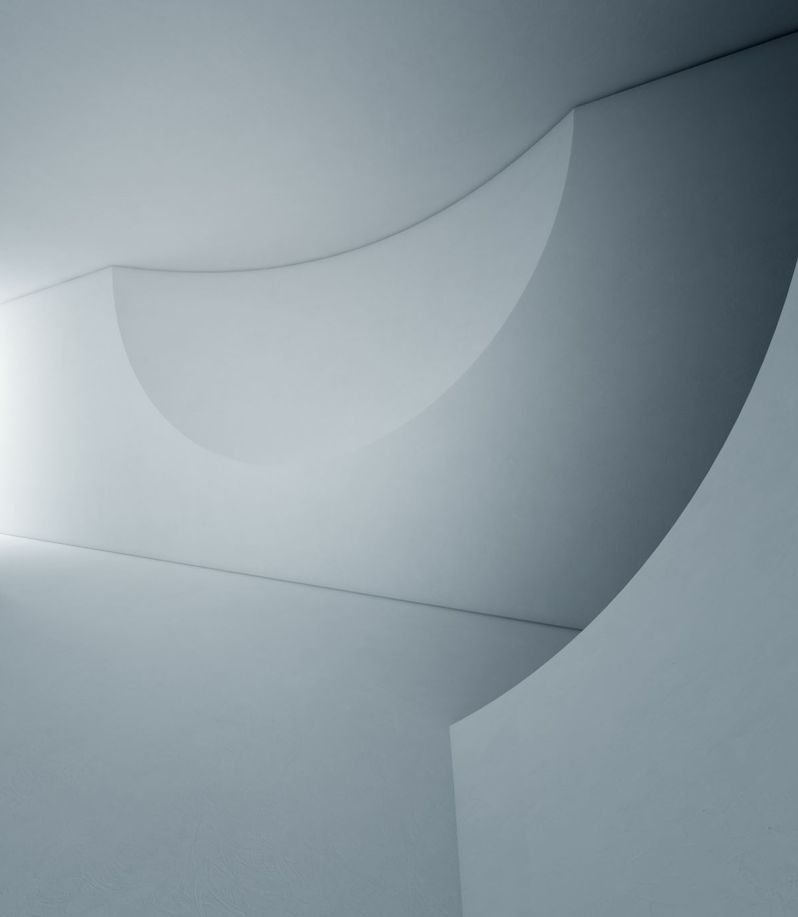
Environment – Secret Base
I was going to create the interior of the base in another level but decided it wouldn't be too difficult to do it directly connected to the cave.
On the other side of the door, I followed the same process and initially blocked out the room with basic white shapes.
I then covered these with Science fiction assets.

Slide 23
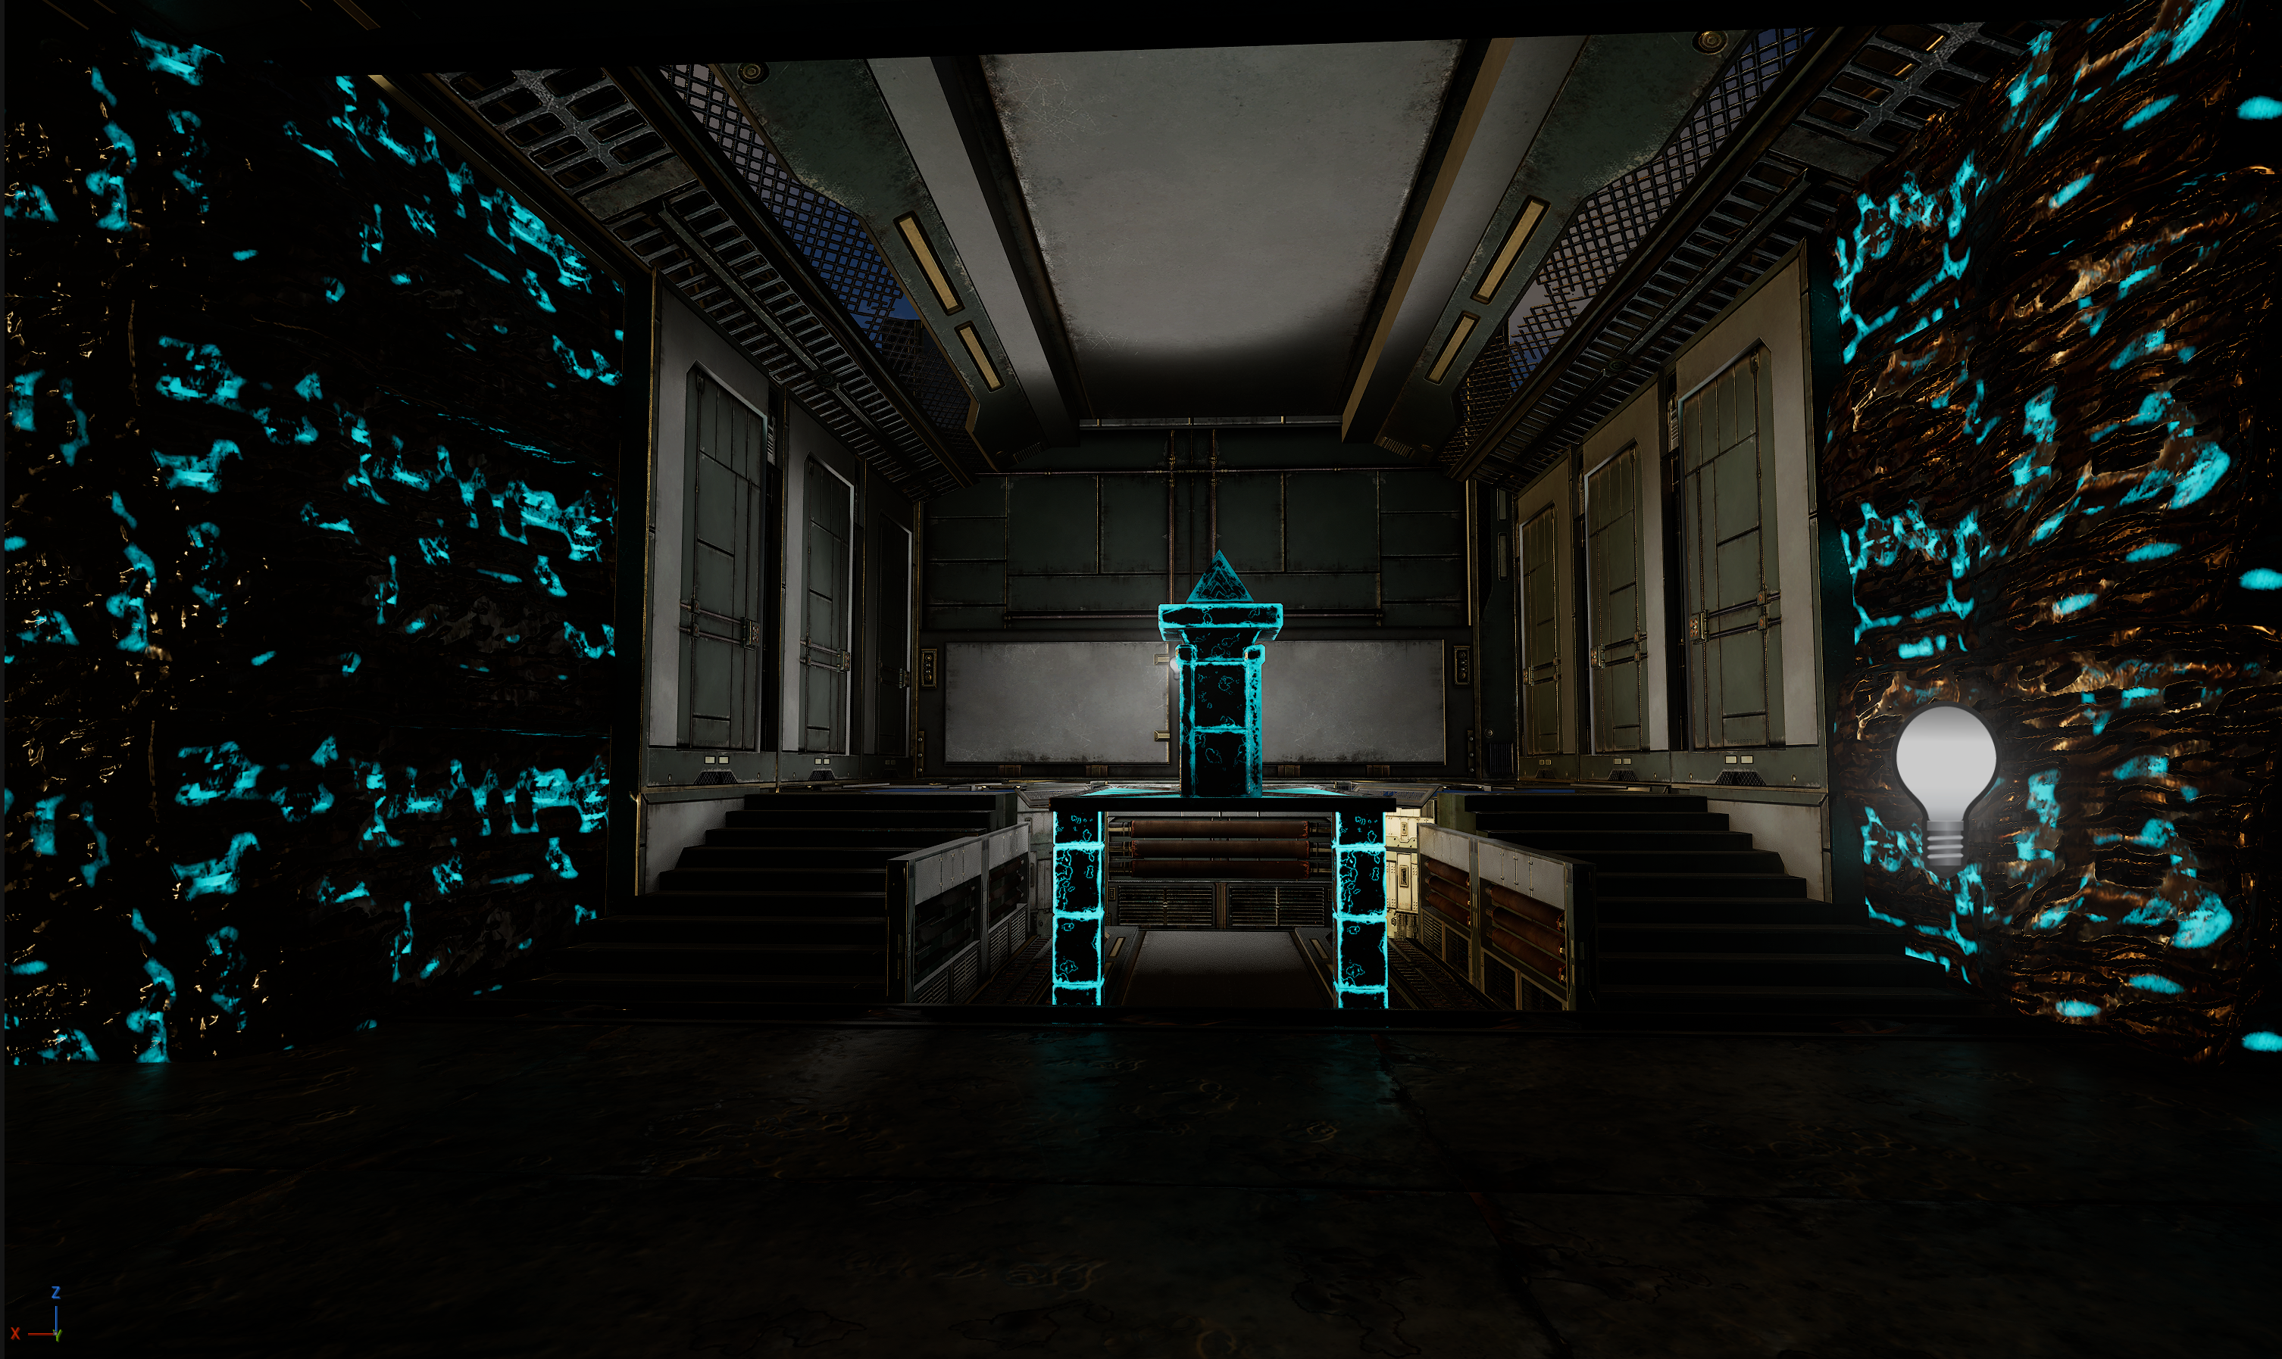

Slide 24
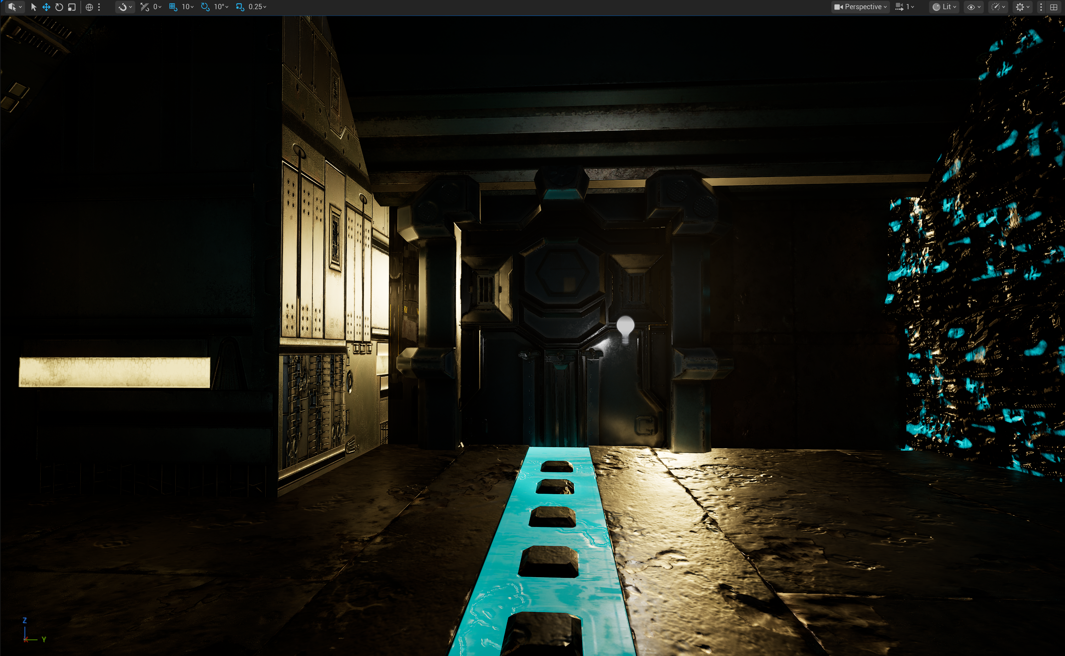

Slide 25
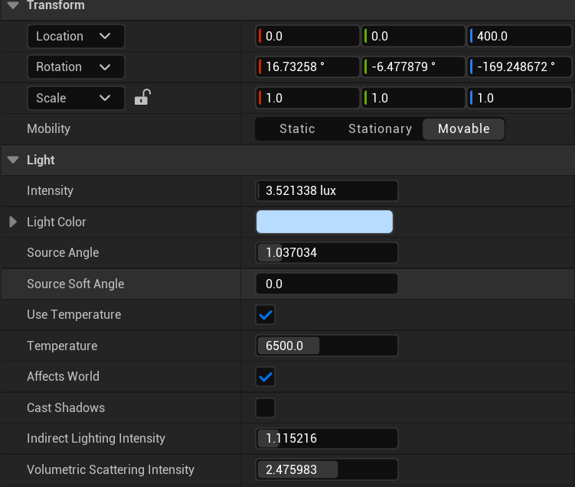
To make life easier
One problem I faced was how dark the interior was because all the sun was being blocked by the assets.
To fix this I turned "Cast shadows" option off on the directional light , meaning the sunlight was shining through the walls and giving me more light to design the interior.
When rendering/sequencing I would turn this option back on and light the scene properly.

Slide 26
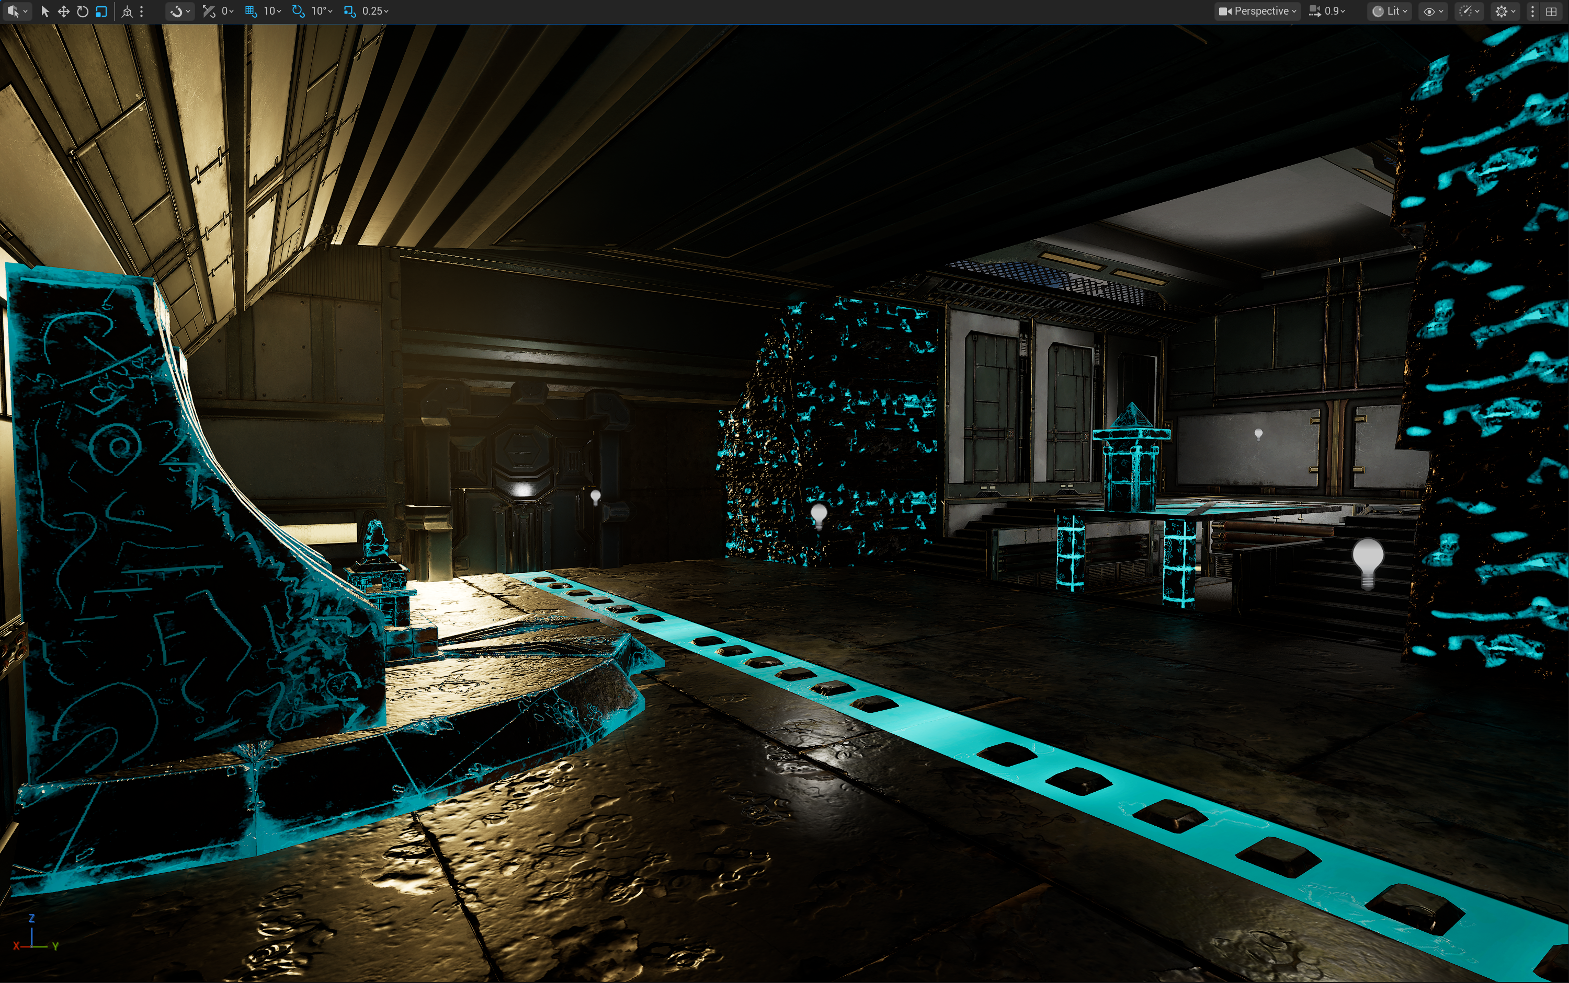
Environment – Ancient artifacts
The final pieces I had to add to finish the environment were artifacts and I also added these "Unnatural" rocks to the corners.

Slide 27
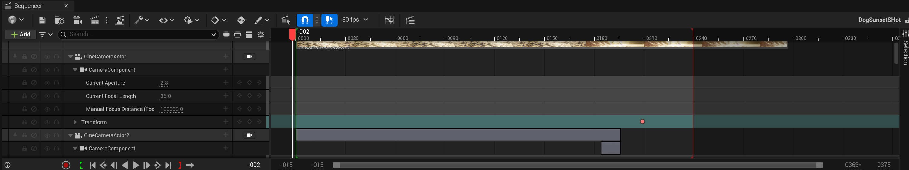
Sequencing
I have now started to begin sequencing the project within a level sequence, focusing on the opening shot.
To begin I simply brought a camera, my character, the dog into the sequencer and using the timeline to time everything out.

Slide 28
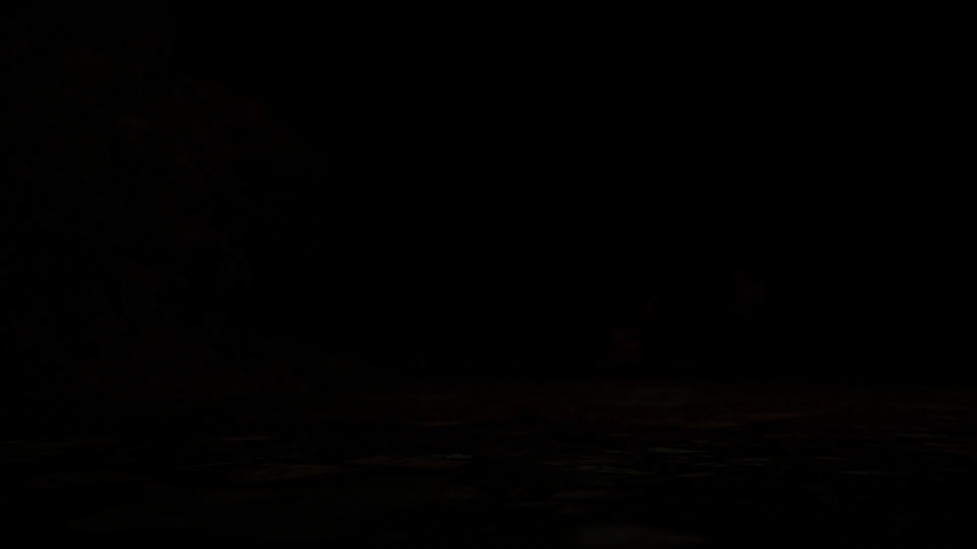
Opening Shot

Slide 29
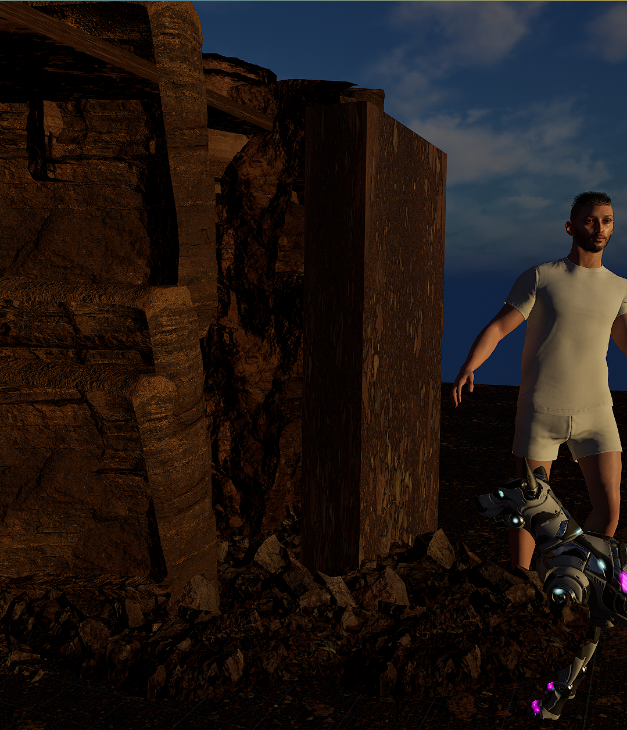
Behind the shot
That is just the rough outline of the opening, and the timing and animations will be touched up.
I wanted it to begin in complete darkness before having a beam of light slowly develop as a rock is moved in the distance.
To create the blur effect, I simply keyed and timed out the focus of the digital camera.

Slide 30

What's next?

Slide 31
Animating Jayson
Complete animation for the rest of the project.
I envision it will go as follows:
Jayson continues into base
Jayson inspects artifact
Artifact begin to glow and shoot out a beam
Time reverses, Jayson and the dog end up back outside the cave

Slide 32
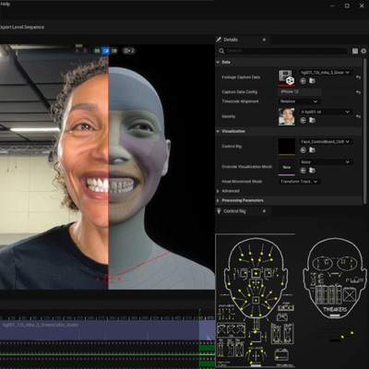
Facial Animation
Use Metahumans Facial Capture system.

Slide 33
VFX and editing

Slide 34
Thank You

