Slide 1

Problem Solving and Decision Making
LCLM4004
Cafaro Renato
2511420
Toyin Adisa
Assignment 1: presentation

Slide 2
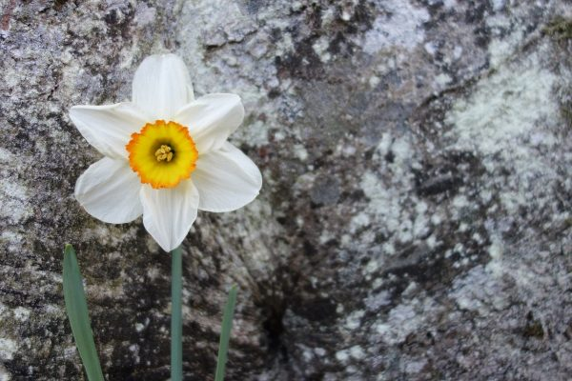
Overview
Introduction: Green Haven Florists
Company background
Problem: nature and scope
PESTLE analysis: macro-environmental factors
Fishbone diagram: cause and effect analysis
Conclusion
References
Background image: Daffodils-The Green Revolution(2026)

Slide 3
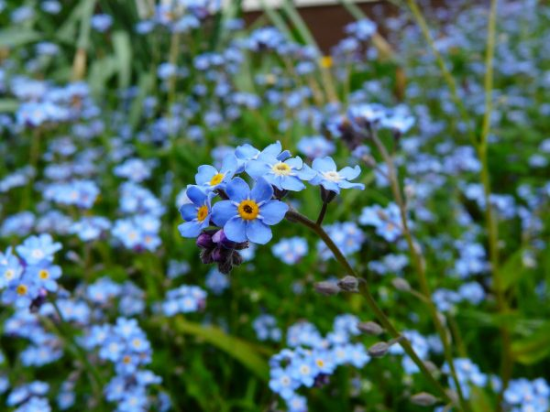
Introduction
This presentation analyses the challenges faced by a business called Green Haven Florist and evaluates the internal and external factors influencing its performance. The slide deck aims to identify the nature and scope of the problem thanks the 5W2H framework; a PESTLE analysis will be used to examine the macro-environmental influences, while a Fishbone diagram framework will help uncover the root causes of the problem providing a structured and analytical evaluation to support strategic decision-making and long-term sustainability.
Background image: Don’t forget me-The Green Revolution(2026)

Slide 4
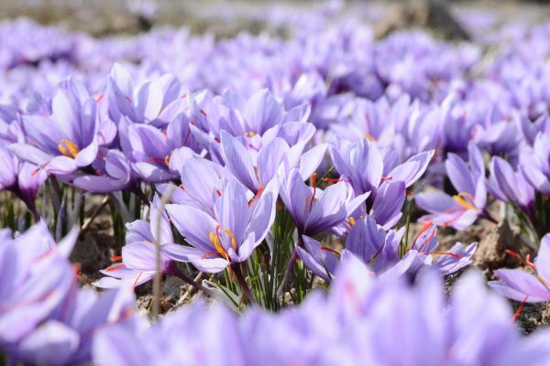
Company background
Small independent florist in competitive local market;
Offers flowers, bouquets, arrangements for all occasions;
Primarily serves local customers, depends on physical store sales, seasonal and event-based orders;
The company’s operations include sourcing flowers, in-store arrangement preparation and direct sales to customers;
Faces high competition, price sensitivity, digital shift.
Background image: Crocus minimus-The Green Revolution(2026)

Slide 5
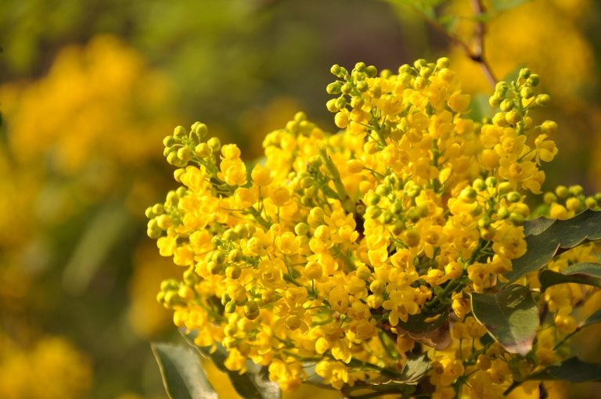
Problem: nature and scope
5w2h framework
What: Declining sales revenue and reduced customer retention.
Why: Competition, online shift, inefficiency and limited presence.
Where: Local market where florist mainly operates.
When: Issue developed progressively over recent months/years.
Who: Owner, staff, suppliers, and customers affected.
How: Low foot traffic, poor marketing, high costs.
How Much: Revenue loss, cash flow risk, sustainability threat.
(Adisa,2026)
Background image: Mimosa-The Green Revolution(2026)

Slide 6
PESTLE
Political
Local business regulations and licensing requirement.
Government taxation policies affecting small enterprises.
Economic
Inflation affecting consumer purchasing power.
Increased supplier costs.
Social
Changing consumer preferences.
Increasing demand for sustainable and eco-friendly products.
(Adisa,2026)
Background image: Daffodils-The Green Revolution(2026)

Slide 7
PESTLE
Technological
Growth of e-commerce platforms.
Online delivery services integration.
Legal
Employment law compliance.
Health & safety regulations.
Environmental
Sustainability concerns.
Ethical sourcing of flowers.
(Adisa,2026)
Background image: Don’t forget me-The Green Revolution(2026)

Slide 8
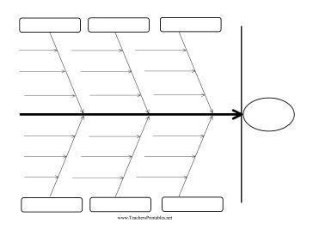
Fishbone diagram
Product
Place
External factor
High price
Weak online
Competition
No innovation
Low visibility
Consumer habits
Limited product differentiation
Few channels distribution
Rising supplier cost
Declining sales
Weak marketing strategies
Limited digital marketing skill
Low use social media
Inventory issue
Poor training
Poor advertising
Costumer service inconsistencies
Online limit
No loyalty
Process
People
Promotion
(Adisa,2026)
Fishbone diagram: Pinterest (n.d.)
Background image: Crocus minimus-The Green Revolution (2026)

Slide 9
Conclusion
The analysis demonstrates that internal weaknesses and external macro-environmental factors are contributing to declining sales.
The PESTLE analysis highlights significant economic and technological pressures, while the Fishbone analysis identifies operational, marketing, and strategic gaps.
To ensure long-term sustainability, Green Haven Florist may need to consider strategic adaptation, including digital transformation, improved marketing strategies, cost management, and enhanced customer engagement.
Background image: Mimosa-The Green Revoltion(2026)

Slide 10
References
Adisa, T. (2026) Week 1: Introduction to Problem Solving and Decision Making. LCLM4004 Problem Solving and Decision Making. Available at: https://moodle.uwtsd.ac.uk/mod/folder/view.php?id=650813 (Accessed: 07 March 2026).
Adisa, T. (2026) Week 2 PPP. LCLM4004 Problem Solving and Decision Making. Available at: https://moodle.uwtsd.ac.uk/mod/folder/view.php?id=668461 (Accessed: 07 March 2026).
Adisa, T. (2026) Week 4: Cause and Effect Diagram (Fishbone). LCLM4004 Problem Solving and Decision Making. Available at: https://moodle.uwtsd.ac.uk/mod/folder/view.php?id=616204 (Accessed: 07 March 2026).
Pinterest (n.d.) Fishbone diagram template. Available at: https://uk.pinterest.com/pin/180495897550603087/ (Accessed: 07 March 2026).
The Green Revolution (2026) 15 splendidi fiori di marzo. Available at: https://www.thegreenrevolution.it/15-splendidi-fiori-di-marzo/ (Accessed: 07 March 2026).
Background image: Daffodils-The Green Revolution(2026)

Slide 11
Thank you
Question & Answer

