Slide 1
Enterprise Troopers
Thomas Braddock
P138630

Slide 2
Aims
Understand Youth Entrepreneurial Strategy (YES plan).
Understand enterprise troopers
ACRO Model
How enterprise troopers links with policy and theory
Critique and recommendations

Slide 3
What Is An Entrepreneur?
Problem solving
Creativity
Innovation
Team Building
Goal Orientation
Decision Making
Someone who sets up a business by taking on financial risks in order to gain a profit (Earl, 2014).
Miner (1996)

Slide 4
Youth Entrepreneurial Strategy
  “To develop and nurture self-sufficient, entrepreneurial young people in all communities across Wales, who will contribute positively to economic and social success” (Welsh Gov, 2004).
Engaging, Empowering, Equipping
Brings together economic development and education policies
People aged 5-25 to realise their potential
From 2004, the action plan was progressed to 2015

Slide 5
What Is Enterprise Troopers?
“Starting and running a business is a great way to develop important skills in a lively and enjoyable way” (Enterprise Troopers, 2018).
Ages 5-25
Competition between schools for the best business
Part of the Welsh Governments YES campaign (Youth Entrepreneurial Strategy)
Enterprise troopers are based on an ACRO model

Slide 6
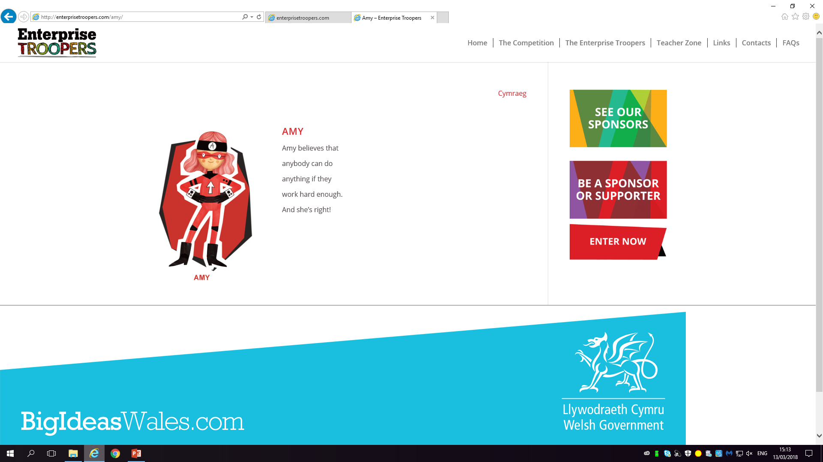
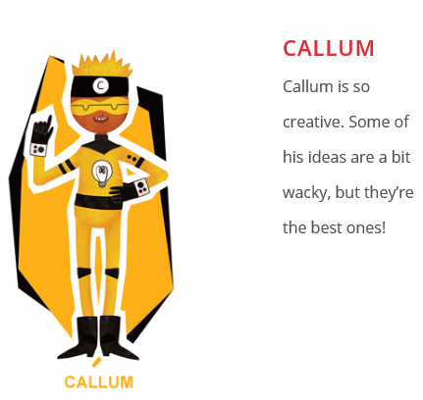
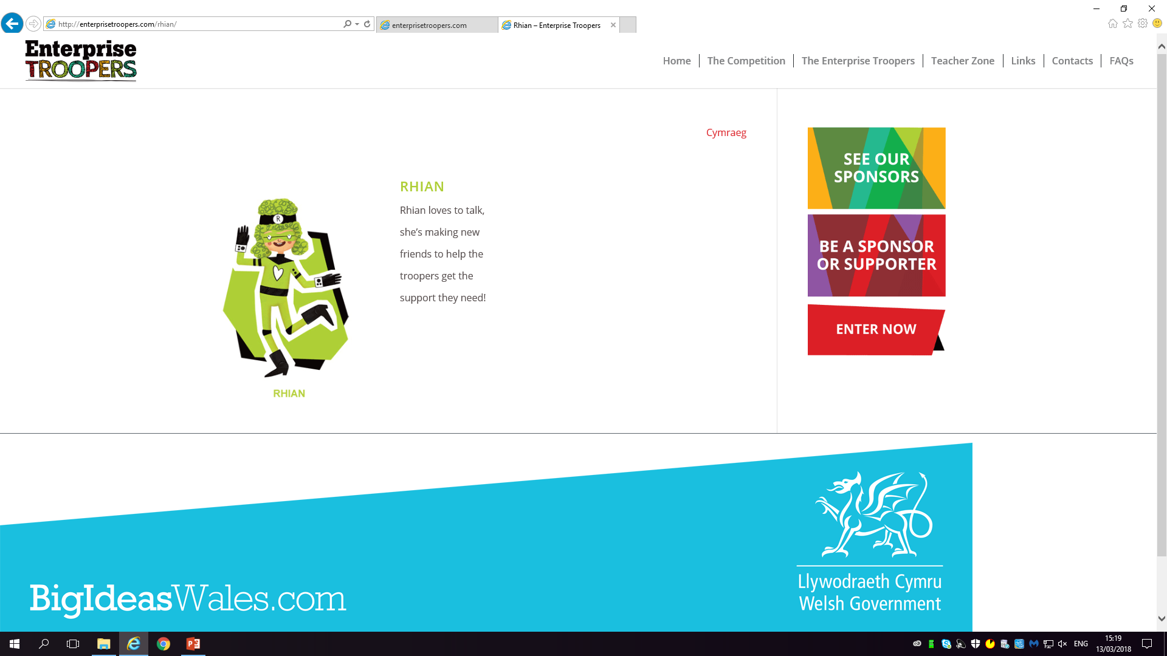
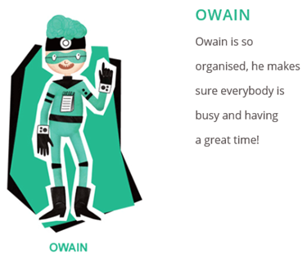
ACRO Model
Attitude | Creativity | Relationships | Organisation
(Enterprise Troopers, 2018)

Slide 7
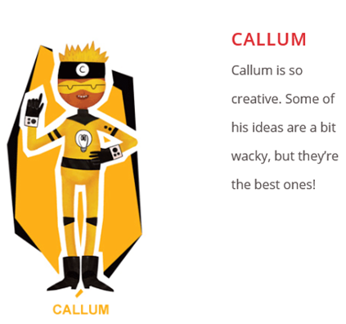
Transferrable Skills From Enterprise Troopers
Confidence
Public Speaking
Transferrable skills are essential to progress in the 21st century. (Cameron, 2016)
Problem Solving
Literacy and numeracy
Self-Motivation
Decision Making
Digital competency
Ambitious, capable learners, ready to play a full part in life and work (WAG, 2015)
Communication
Critical Thinking
Working with others
Reasoning skills

Slide 8
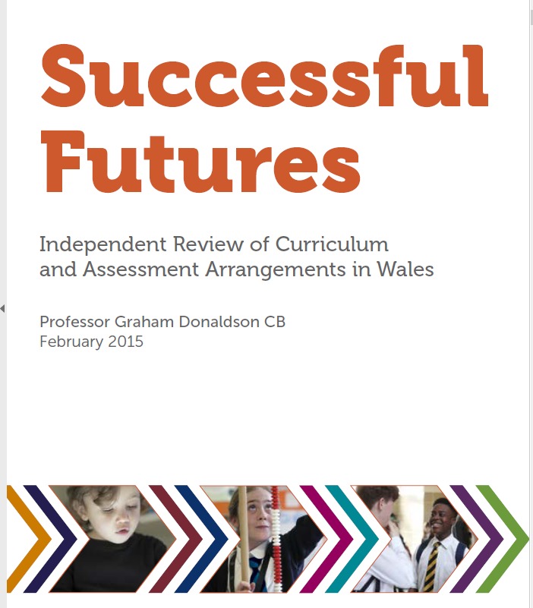

Government Policy and Enterprise Troopers
◦ambitious, capable learners, ready to learn throughout their lives
◦enterprising, creative contributors, ready to play a full part in life and work
◦ethical, informed citizens of Wales and the world
◦healthy, confident individuals, ready to lead fulfilling lives as valued members of society.
◦ambitious
◦empowering
◦engaging
◦inclusive
Digital Comptency
(Welsh Gov, 2015)

Slide 9
Entrepreneurial Theories
Schumpeter (2011): Entrepreneurship aids the process of development within an economy.
McClelland (1987): Entrepreneurship stimulates the three needs that people have, Need for achievement, need for affiliation, and need for power.

Slide 10
Literacy Numeracy Framework
The literacy numeracy framework aims to develop curriculum content so that all learners have the chance to develop skills set out in LNF
Example
Reception – paying for items with change (5p, 10p etc)
Year 7 – using profits and losses to work out selling calculations
Top level – compound interest, tax and VAT.
WAG (2014)

Slide 11
Good or Bad?
Positive
Negative
Transferrable life skills
Develops confidence levels
Easily embedded into curriculum
Not all schools will implement it
Different schools will give different budgets
Some schools will do all of the work because they want to win

Slide 12
Recommendations
All schools should do enterprise troopers as compulsory
Set budgets for each business
Mini competition within each school

Slide 13
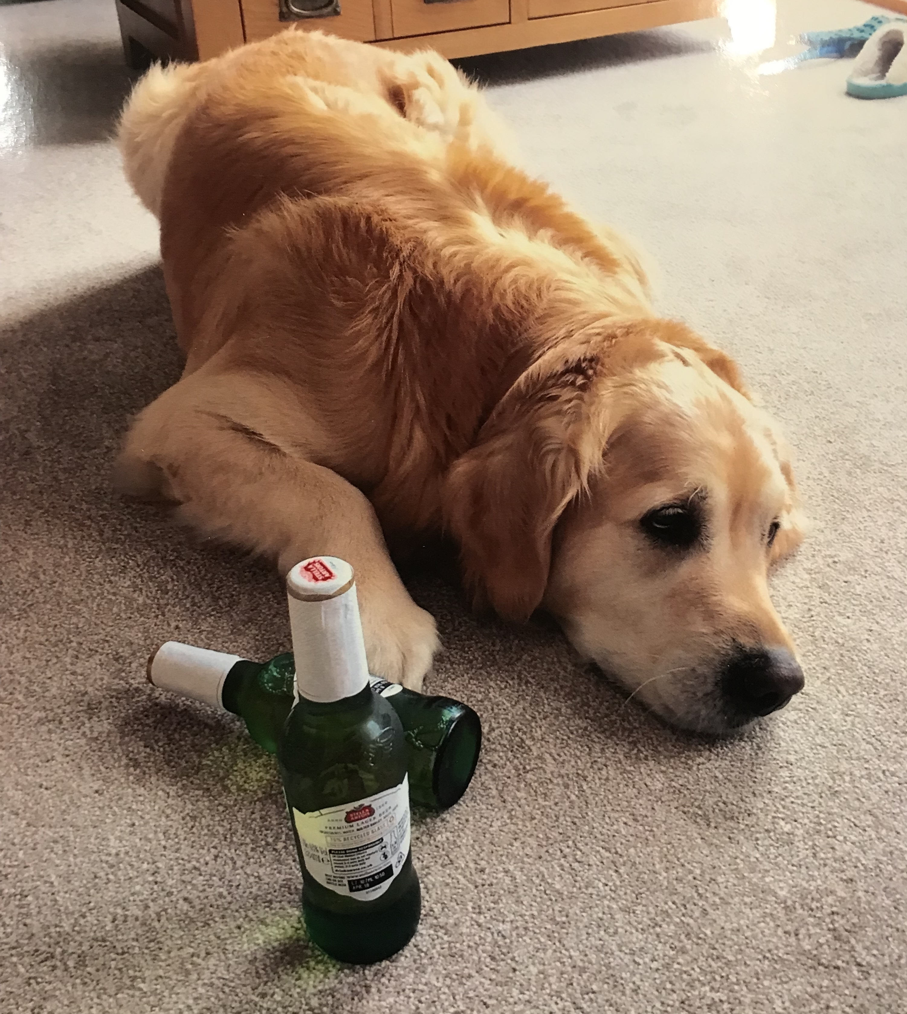
Any Questions?

Slide 14
Reference List
Cameron, S. (2016). Business Student's Handbook. Harlow, England: Pearson Education Limited.
Earl, C. (2014). What does it mean to be an entrepreneur?. Broomall, PA: Mason Crest.
Enterprise Troopers (2018). Enterprise Troopers – Big Ideas Wales. [online] Enterprisetroopers.com. Available at: http://enterprisetroopers.com/ [Accessed 13 Mar. 2018].
McCLELLAND, D. (1987). Characteristics of Successful Entrepreneurs*. The Journal of Creative Behavior, 21(3), pp.219-233.
Miner, J. (1996). The 4 routes to entrepreneurial success. San Francisco: Berrett-Koehler Publishers.
Nagendra, S. (2008). Entreneurship and management. Banglore: Sanguine Technical Publishers.
Schumpeter, J., Becker, M., Knudsen, T., Swedberg, R. and Schumpeter, J. (2011). The entrepreneur. Stanford, California: Stanford University Press.
Welsh Assembly Government (2014). National Literacy and Numeracy Framework. Welsh government.
Welsh Assembly Government (2015). Successful Futures. Welsh Assembly Government.
Welsh Gov (2004). A Youth Enterprise and Entrepreneurship Strategy for Wales. Cardiff: Welsh Assembly Government.

