Slide 1

Counselling Skills and Approaches ECPS5010
Week 2
Cognitive Behavioural Therapy (CBT)

Slide 2


Overview
Cognitive Behavioural Therapy (CBT)
An overview of CBT
Aaron Beck
Albert Ellis
Journal article discussion/case study

Slide 3
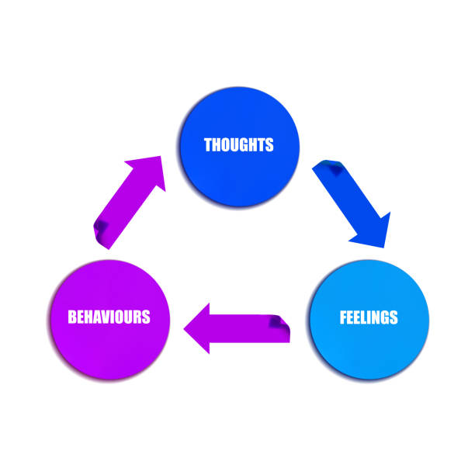
Cognitive Behavioural Therapy (CBT) https://youtu.be/ZRijYOJp5e0

Slide 4
What is CBT?
The behavioural model focuses on the environmental conditions that shape our behaviour (Joseph, 2010)
Cognitive behavioural therapy (CBT) is a type of therapy that looks at your thoughts, feelings and behaviours and helps to change some of these to manage your problems.
A key part of this is identifying the negative thinking patterns that you may feel trapped in, helping you to break free from these and to feel better.
CBT focuses on equipping you with the tools to address current problems in your life and relieve the symptoms you’re facing, before making links to your past and how your beliefs started.
-BACP

Slide 5
What can CBT help with?
CBT works for lots of different people and problems, and is widely recommended by national treatment guidelines across the UK, EU and North America.
The National Institute for Health and Clinical Excellence (NICE) provides independent, evidence-based guidance for the NHS on the most effective, proven treatments. CBT is recommended in NICE guidelines for many different problems, including:
anxiety disorders (including panic attacks)
depression
obsessive compulsive disorder (OCD)
post-traumatic stress disorder (PTSD)
psychosis and schizophrenia
bipolar disorder
eating disorders
tinnitus
Insomnia
Babcp.com

Slide 6
How does CBT work?
The aim of CBT is that through the sessions, homework and practice you will find out what skills and techniques help you to have a better quality of life
CBT can be offered in individual sessions with a therapist or as part of a group. The number of CBT sessions needed depends on the difficulty. Often it is between five and 20 weekly sessions - usually lasting about an hour.
CBT is mainly concerned with how we think and act now, although sometimes our current difficulties are related to things which have happened in our past, and so these might also be part of what we talk about.
Goals for therapy are set together with the therapist after talking things through to properly understand the problem.
Most sessions begin with agenda setting - agreeing together what that session will concentrate on. A therapist will not tell someone coming for therapy what to do or what to talk about.
CBT works best when it involves working on things in between sessions as well as during them. Tasks will be planned together.
As the therapy comes to an end we will think together about to continue using CBT techniques in daily life after treatment.
CBT is available in a wide range of different settings, including schools, GP surgeries, specialist clinics and hospitals. It is sometimes provided online. This may be combined with flexible telephone, video or face-to-face appointments to check progress and help overcome any obstacles. This has made CBT more accessible to busy people and reduced delays in getting help.

Slide 7
What are the techniques used in CBT?
There are a variety of techniques used in CBT – including keeping thought records, relaxation and breathing, progressive muscle relaxation, identifying and challenging your style of thinking and behavioural experiments.
One technique is behavioural activation which looks at how you engage in certain activities, such as hobbies and socialising, and how you can increase your chances of enjoying them and getting a sense of achievement from life.
Another is exposure therapy which helps you learn to face your fears in a methodical and structured way

Slide 8

Cognitive Therapist
It is both highly structured (although always based on a formulation of the relationship between the client’s presenting problems and underlying cognitive and/or behavioural processes) and flexible due to the constant evaluation of the outcome of the interventions.
Cognitive therapists do not usually interpret or seek for unconscious motivations but bring cognitions and beliefs into the current focus of attention (consciousness) and through guided discovery encourage clients to gently re-evaluate their thinking.

Slide 9
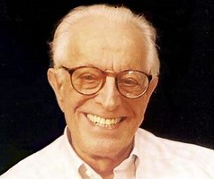
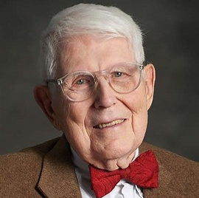

Behaviour therapy and cognitive therapy.
Much of the research in the development of behaviourisms was based on experiments and observations of animal behaviour.
Cognitive behaviour however aimed to look at thinking processes that might influence behaviour.
  Aaron T. Beck
  Albert Ellis
  Donald Meichenbaum CBM

Slide 10
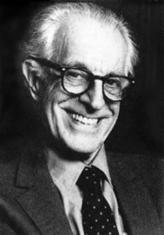
Albert Ellis (1913 – 2007)

Slide 11
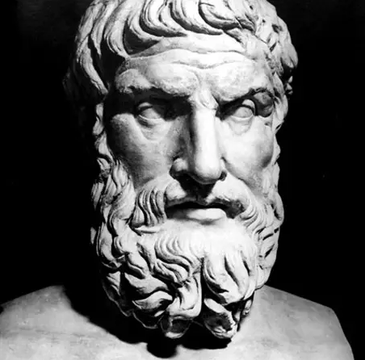
“People are disturbed not by events, but by the views they take of these events”
Epictetus (Greek Philosopher)

Slide 12
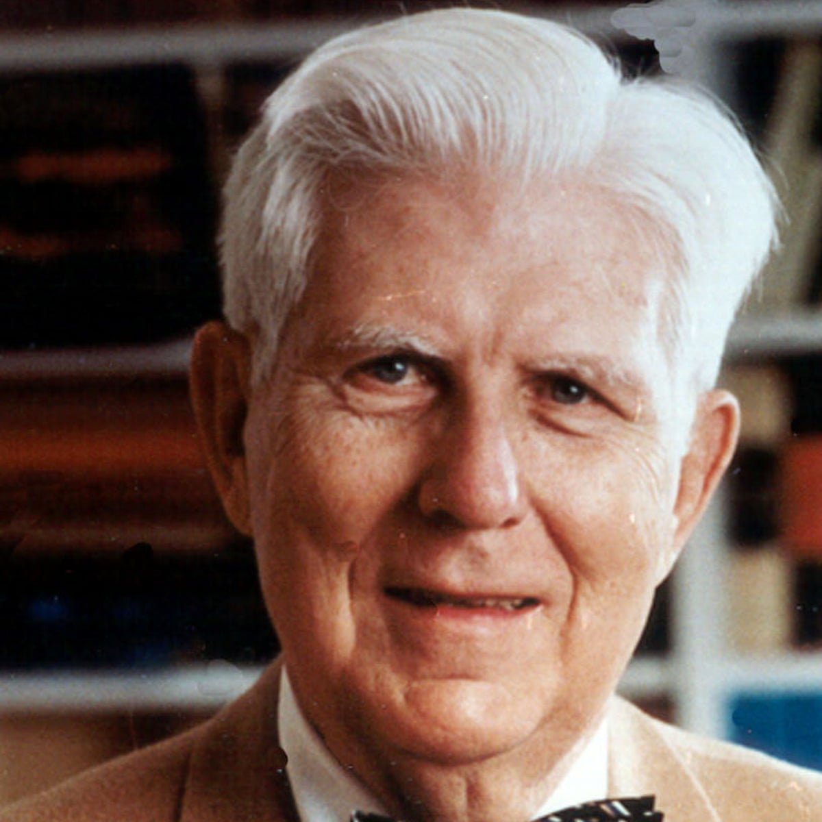
Aaron Beck

Slide 13
Aaron T. Beck
Beck argued that the processes of thinking are influenced by emotional difficulties.
He argued that if we change our thinking patterns it will also reduce the emotional difficulties.
Cognitive therapy can be seen as working with emotion.
Emotions and behaviour are mediated by cognitive processes, this makes it different to psychoanalysis which gives prime importance to the unconscious.

Slide 14
Two Key Publications
Cognitive Therapy and the Emotional Disorders (Beck, 1976)
Cognitive Therapy of Depression (Beck et al., 1979)
Notes:
Therapists support the client to consider how they think about a situation. If the therapist can enable the client to see how they can influence the way they experience a situation, this can help them to bring about emotional change.

Slide 15
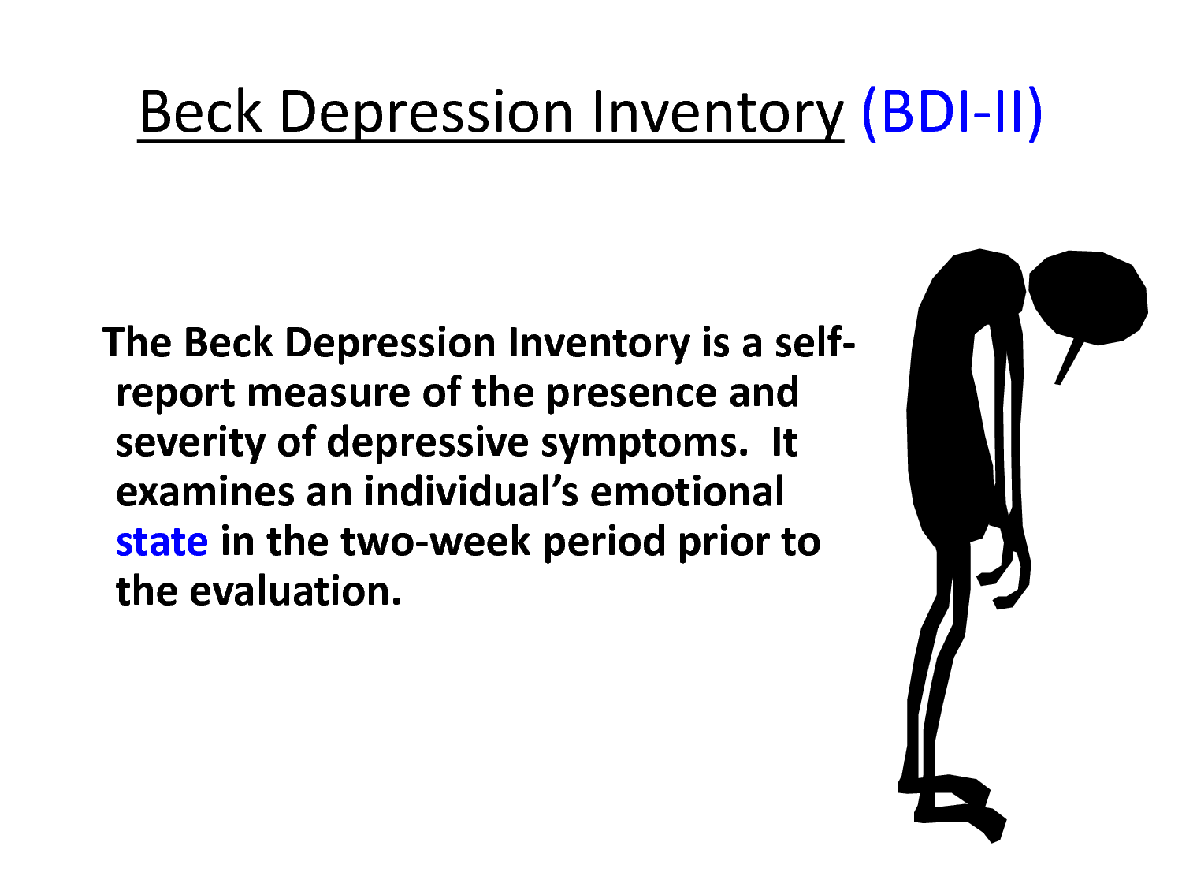

Slide 16
Pioneering Work on Depression
In Depression there is a negative view of the Self, the world and the future.
In Anxiety there is an overestimation of the physical or social threat alongside the underestimation of the individual’s ability to cope with the situation.
In Panic and Health anxiety the focus of the client’s attention is usually on bodily symptoms
In Generalised Anxiety Disorder it is worry which is the cause of distress.
Any negative events can set off worry, worry is then chosen as the coping strategy, but then negative beliefs about worry set in and a vicious cycle is set up.

Slide 17
Cognitive Model
Thoughts
Behaviours
Emotions
We interact with our environment through:
Thinking
Interpreting
Evaluating
These in turn our linked to our:
Feelings
Behaviour

Slide 18
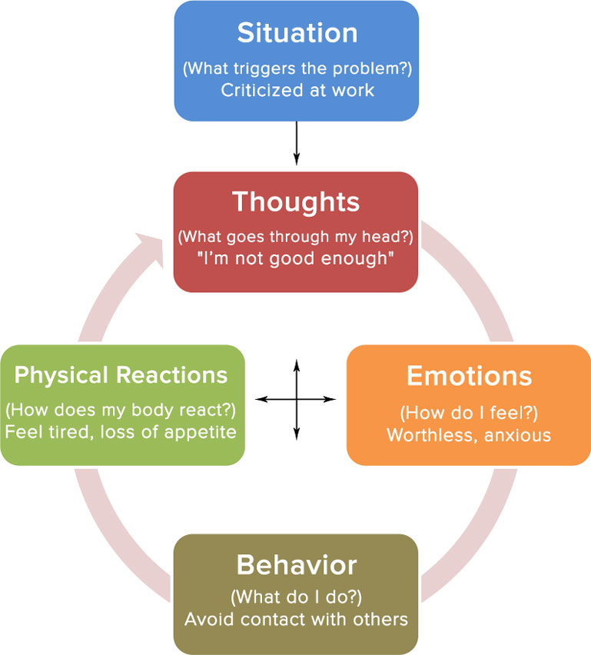

Slide 19

Three Types of Cognition
Information Processing
Individuals constantly receive information from inside themselves (body experiences) and their environment.
Automatic Thoughts
The internal dialogue that occurs in an unplanned way
Schema
Core beliefs and views of the world. Our schema allow us to filter out unwanted information and attend to important aspects of our environment.

Slide 20
Negative Automatic Thoughts
People with psychological disorders often have frequent, disruptive thoughts known as ‘negative automatic thoughts’
Spontaneous thoughts that pop into the head, they seem plausible at the time, but when they are thought through are unrealistic.

Slide 21
Maintaining Behaviours
The depressed client will maintain their thought processes.
The person who believes they will fail won’t try anything and so the result is a confirmation of the negative belief.

Slide 22

Beck’s Illogical ways of thinking
Arbitrary Inference
  Reaching conclusions without any evidence
Catastrophising
  Predicting a negative result, without thinking of other possible outcomes
Overgeneralisation
  Sweeping negative beliefs about a situation
Magnification
  Emphasising problems, situations or issues
Minimising
  Reducing own values or successes
Dichotomous Thinking
  Using extreme terms in thinking e.g. Never
Filtering
  Selecting or highlighting negative aspects at the expense of a fuller picture.

Slide 23
Pause for reflection…
One of the main issues in cognitive therapy is who decides what is an irrational thought? How do we know when a thought is irrational or not? Should we always want to rid ourselves of such thoughts?

Slide 24
Emotional Disturbance and Information Processing
In emotional disturbance information-processing is biased, usually in a negative and distorted way.
Beck reasoned that we need to use Reality-Testing skills to solve personal problems as they happen.
A depressed individual who was not successful at job interview would have illogical ways of thinking about the process.
An adaptive way of thinking would be to consider the reasons why the job interview did not go well and take responsibility and look for ways to prevent it in the future.

Slide 25
Cognitive Schemata
Cognitive schemata are useful for effective functioning in the world.
Healthy schemata are reasonably flexible. Unhealthy schemata will be more rigid, absolute and overgeneralized.
e.g. “I must get high grades for all of my work”.
A healthy response would be
“It would be great to get the high grades, but sometimes it isn’t possible”.
An individual with rigid schemata will criticise themselves heavily if they fall short of their excessively high standard.

Slide 26
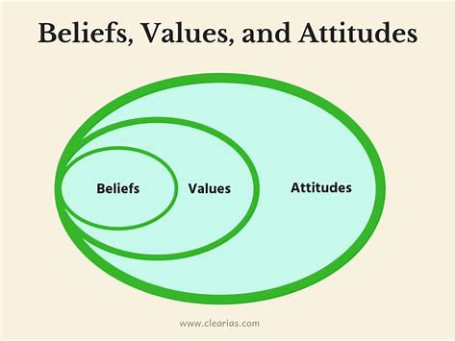
Where do beliefs and attitudes come from?
Early experiences
Traumas
Chronic stresses

Slide 27
Albert Ellis: Rational Emotive Behaviour Therapy (REBT)
Established in 1955
Having trained as psychoanalyst Ellis was disappointed with the results he was seeing with his patients. He became increasingly disenchanted.
He began to highlight the importance that thoughts and philosophies have in creating and maintaining psychological disturbance.
He continued to develop the idea that cognitive factors have a role to play in human disturbance
You are responsible for your own emotions and behaviours.

Slide 28
Pioneering Text:
Reason and Emotion in Psychotherapy (Ellis, 1962)
  Cognitions, Emotions and Behaviours are linked and interact and often overlap.
  By changing our thinking, we can change our emotion.

Slide 29
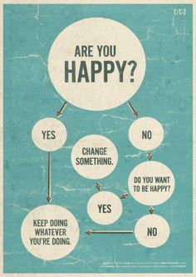
Cognitive Behavioural Therapy- Albert Ellis
Take responsibility for your distress
Only you can upset yourself about events--the events themselves, no matter how undesirable, can never upset you
Identify your "musts." Once you admit that you distort your own emotions and actions, then determine precisely how. The culprit usually lies in one of the three core "musts:"

Slide 30

Image of the Person
The main human goal is to stay alive and to pursue happiness
Human fallibility: Humans naturally make errors as they seek to achieve their basic goals and purposes.
Biological Emphasis:
  Virtually all humans show evidence of major human irrationalities
  Many human irrationalities actually go counter to the teachings of parents, peers and the mass media
  Humans often adopt other irrationalities after giving up on former ones
  Humans often go back to irrational activity even though they have worked hard to over come it. (Ellis, 1976)

Slide 31

Image of a Person
Humans can achieve their goals if they are active in the pursuit of them. If they are half hearted the goals will not be achieved.
The most effective way in which a client can experience lasting change is to alter their philosophies.

Slide 32
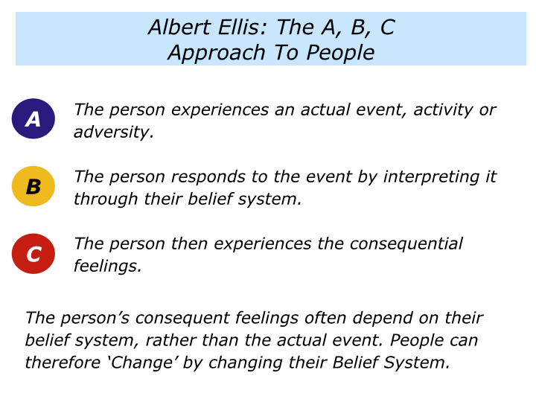

Slide 33
REBT
"Must" #1 (a demand on yourself): "I MUST do well and get approval, or else I'm worthless." This demand causes anxiety, depression, and lack of assertiveness
"Must" #2 (a demand on others): "You MUST treat me reasonably, considerately, and lovingly, or else you're no good." This "must" leads to resentment, hostility, and violence
"Must" #3 (a demand on situations): "Life MUST be fair, easy, and hassle-free, or else it's awful." This thinking is associated with hopelessness, procrastination, and addictions

Slide 34

REBT
Dispute your “musts”. The only way you can ever remain disturbed about adversity is by vigorously and persistently agreeing with one of these three “musts”.
Thus, once you’ve bared them, then relentlessly confront them and question your demands.
Begin by asking yourself: “What’s the evidence for my ‘must’?” “How is it true?” “Where’s it etched in stone?” and then by seeing: “There’s no evidence my ‘must’ is entirely false.”

Slide 35
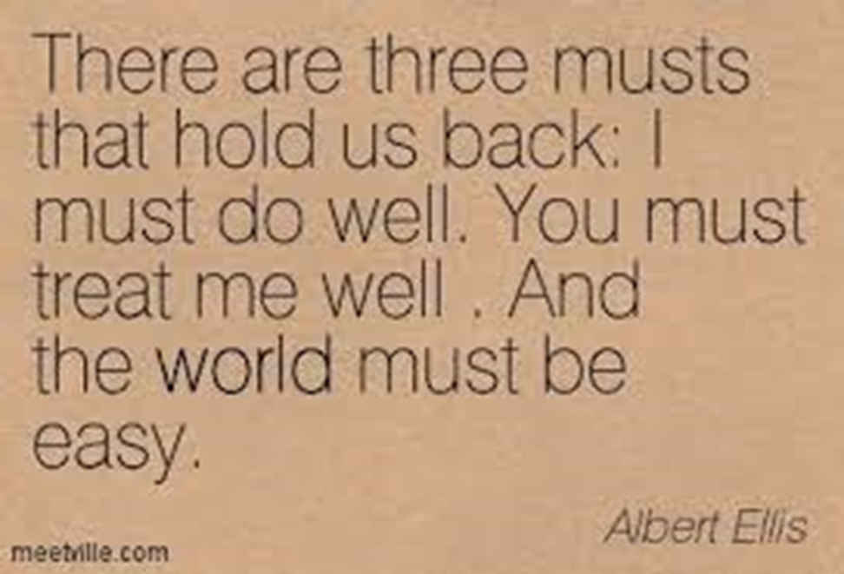
REBT
Reinforce your preferences and conclude, therefore:
Preference #1: "I strongly PREFER to do well and get approval,
but even if I fail, I will accept myself fully,“
Preference #2: "I strongly PREFER that you treat me reasonably, kindly, and lovingly,
but since I do not run the universe, and it's a part of your human nature to, I, then, cannot control you,“
Preference #3: "I strongly PREFER that life be fair, easy, and hassle-free,
and it's very frustrating that it isn't, but I can bear frustration and still considerably enjoy life."

Slide 36
Concepts
Irrational Beliefs
Rigid, extreme and illogical. They are inconsistent with reality
Rational Beliefs
Flexible, logical and consistent

Slide 37

Collaboration
Is a way of being with clients based on an equal partnership, each party bringing something to the relationship.
The therapist should not have pre-conceived ideas about where the therapy is going.
The overall aim is for the individual to attribute improvement in their problems to their own efforts, in collaboration with the psychotherapist
Notes:
The therapist brings skills and knowledge of psychological processes, theories of emotion and techniques that have helped others and could help the current client. The client is an expert in their own experience, and brings their own resources.

Slide 38

Reflective Quote
“Cognitive therapy seeks to alleviate psychological stresses by correcting faulty conceptions and self-signals. By correcting erroneous beliefs we can lower excessive reactions.”
— Aaron T. Beck

Slide 39

Journal Articles
Please see Moodle

Slide 40
Mid Module Evaluation

Slide 41
Further reading…
Albert Ellis Institute http://albertellis.org/
Beck Institute https://beckinstitute.org/
MIND https://www.mind.org.uk/information-support/drugs-and-treatments/cognitive-behavioural-therapy-cbt/about-cbt/
BABCP British Association of Behavioural Cognitive Psychotherapist (Check out their Podcasts https://www.babcp.com/What-is-CBT
Others NHS Guidelines/ Nice Guidelines
www.BACP.com
Binnie, J. and Spada, M. (2018) Let’s put the “T” back into CBT. Mental Health Review Journal VOL. 23 NO. 4 2018, pp. 240-245. DOI 10.1108/MHRJ-02-2018-000

Slide 42
Summary
Mode/Delivery of Therapy
Overview of CBT
Individual Therapy
Group Therapy
Online Approaches
Speciality
Working with Trauma
Children and Young People
Eating Distress
Addictions
Other
Depression, Anxiety, Phobia, OCD others.
It is a form of therapy that addresses problems in a direct and targeted way.
It focuses on a shared model of understanding, using a psycho-educational approach, open sharing of the formulation and teaching of self-evaluation and management skills.
Its potency as a model is shown by its increasing use and accumulating recommendation by a range of evidence-based guidelines (NICE, NHS)

Slide 43

Next Time
New Cognitive Approaches (Third Wave)
Mindfulness Based Stress Reduction (MBSR)
Mindfulness Based Cognitive Therapy (MBCT)
Dialectical Behavioral Therapy (DBT)
Schema Therapy (ST)
Compassion Focus Therapy
Acceptance and Commitment Therapy (ACT)
Trauma Focused Cognitive Behavioral Therapy (TfCBT)
Others

