Slide 1

A presentation on Self-Evaluation, Professional Development Plan and Assigned Topic Summary
Module Name: Learning in the Digital Era
Module Code: ACCA 4025
Student Name: HENRY Ossei-Gerning
Student ID:2538384
Lecturer’s Name: SUNeth Fernando
Group:2

Slide 2
Table of Contents
Table of contents
Introduction
Task 1 Self-Evaluation
Task 1 Traits gained from Self- Evaluation
Task 2 Reflective model
Task 2 Reflective model continued
Traits gained from Self-Reflection​
Task 2: Professional Development Plan with SMART Goals​
Task 3 unit 4 Becoming a Lifelong learner (Unpacking experiences)​
Task 3 unit 4 Becoming a Lifelong learner (Reflexivity)​​
Task 3 unit 4 Becoming a Lifelong learner (Gibbs Cycle)​
Conclusion
References

Slide 3
Introduction
Hello my name is Henry Ossei-Gerning. I’m level 4 undergraduate student studying computing skills at University of Wales Trinity Saint David at London Canary Wharf Campus. In this presentation I will be covering the following topics:
Task 1 |Self-Evaluation
Task 2 Profession Development Plan
Task 3 unit 4 Becoming A Lifelong Learner
Each task has its own distinctive topic which I will break down into segments and explain some of the key factors of growth in the development of Self- Evaluation, and a healthy Professional Development.

Slide 4
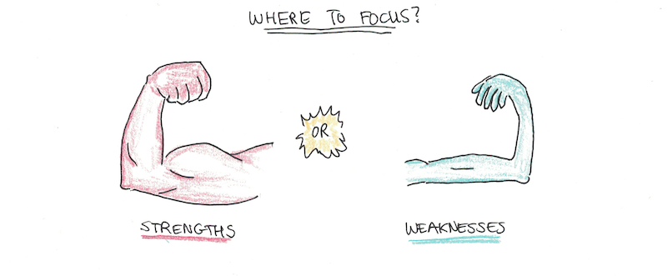
Task 1: Self-Evaluation
Strengths
Weaknesses
I always challenge myself with new tasks, and try to achieve the goals set.
My time management skill needs to be improved.
I am motivated in learning new things, topics, and generally how to become better than I was yesterday
I am a very passionate person, which transform into a strength of mine, anything I do, I strive to be the best, want the best for and take seriously, so I can achieve results.
I also struggle with perfectionism, always wanting to be able do it right first time, so some times, or most time end up not even starting it or working on a certain project longer than I should.
I realised I procrastinate a lot and need to be more pro active with my thoughts.

Slide 5
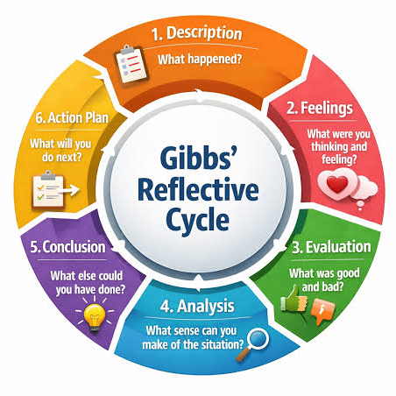
Task 2 Professional development Plan
(Reflective Model)
Description- It all started from a young teenager chasing a dream of becoming a professional player for club and country. I became a semi-professional footballer, back in the summer or early 2005. Which very quickly got cut short due to serious foul play (a tackle) during a football match I was involved in. That game turned out to be my last, and becoming a career defining moment of my competitive career. I obtained a serious injury tearing my ACL, and Medial Meniscus, and a damaged cartilage.
Feelings- It has been noted that injury can have psychological as well as physical consequence (Lisa Pearson, MSc Sports, physiotherapist). At the time of this incident, I endured a certain type of depression for a minimum period of 4 years, I had no interest in football, even to watch the game and enjoy what I once used to love and couldn’t go without. I also felt like I had nothing else to offer as I truly believed this was my path and the only path for me as I ate, breathed, slept and studied the game of football, I became a shadow of myself, and started to do all the things football had no room for, i.e. going out partying and drinking.
Evaluation- Upon reflection, while lying in my hospital bed after undergoing surgery, I remember my mother not being very empathic towards me in terms of, what kind of impact this had on me and where I was going to in life, she was always doubtful of my possible playing career and always told me to have a backup plan. For me, plan B is not an option. It's a safety net just in case plan A fails, (LaQuan Stephens, Quora, Plan) I remember thinking ‘damn she must be thinking see I told you’, but she just looked at me with a face that could have made me want to be swallowed up by the hospital bed. This was one of the most dramatic and awful experiences of my teenage life. realised I had no more room for the way I was feeling and living which I then woke up to realise I had to-do something about the way I felt and find a newform of life, new goals and ambition.

Slide 6
Task 2 PDP Reflective Model (continued)
Analysis—My journey has involved many trials that helped me discover what I wanted to pursue. I explored football coaching, men’s physique bodybuilding, boxing and coaching, and completed numerous courses that have contributed to my personal and professional development. These experiences have led me to where I am today. I now work full-time as a painter and decorator in partnership with my brother. The flexibility of self-employment also allows me to work behind the scenes with footballers, coaches, clubs and agents. Football was once a major passion of mine, and it has now come full circle by giving me another way to remain involved in the sport. More recently, university has shown me the value of higher education and inspired me to succeed in a completely different field while gaining a qualification I can use throughout my life. In the future, I may also find a way to combine my different areas of work.
Conclusion- Taking a new career path, has given me a new type of ambition and mindset in order to be able to finish strong in my going to be 40 years of being on this earth, and return reward me with the ability to generate lots of income and provide me with a future that is respectable and the direction of the world evolution.
Action Plan— I intend to achieve my goals by continuing my university studies, completing additional courses and earning a degree in Software Engineering, with the aim of specialising in AI and cybersecurity. I may also combine these skills with my painting and decorating work by developing digital tools, such as an app that helps painters price jobs or find new work. Creativity has no limits, and by remaining consistent in developing my plan, I can create something original and valuable.

Slide 7

Task 2 Traits gained from Self-Reflection
I have learned that my strengths and weaknesses go hand in hand, the power I possess lies within myself and it can only be activated when I put my mind to it and stay focused on the task at hand, trying to be perfect first time isn’t realistic because we are humans and we all make mistakes and errors. By acknowledging this, I can make haste on producing results through trial and error, which will allow myself to tap into my creative mind in a positive and proactive manner.
2.) I gained a real understanding of critical thinking and reflection, using this method challenged my mindset to really think about what I want to achieve and prosper within myself, taking time to analyse my goals and aspirations comes from the heart as well as the brain, asking myself why what and how really put me in a critical thinking state of mind, which I always knew it was there, but a different dimension/version of myself was discovered
3.) Knowledge is power, and winning is a mentality, knowing that failure isn’t a option for me, I see that effort stretches along way, and wanting to be great and successful academically and all future endeavours require, hard work, a robust work ethic and a strong desire to accomplish phenomenal results

Slide 8
Task 2: Professional Development Plan with SMART Goals
Goal to Achieve | Personal Action Plan | Resources and Support required | Development Opportunity with Professional Qualification | Performance Measurement | Expected Completion Date
To be able to study with intention to understand | Taking time whilst reading and ponder on what I've read. | Books, Articles, Documentaries, Asking for help via tutor's/lecturer's questions. | Personal study time, Continue with studies through university. | Finish Uni and obtain a degree | 1 year
Time Keeping | Prioritise Tasks, Learn time management, Set goals | LinkedIn Learning, Setting Alarms, Daily check ups (via priority list) | Apply for work consistently, Being present when required (Uni, work, events) | Analysing progress, Setting reminders | Daily
Attention To Detail | Note taking, developing observation skills (via courses) | Video analysis, LinkedIn Learning, IPSO courses | Pass courses, Gain certification | Tracking progress, | Finishing the courses

Slide 9
Task 3: Unit 4 Becoming a Lifelong learner
(Unpacking experiences)
Becoming a lifelong learner requires a lot of key points, Reflexivity (a form of critical thinking), Reflection (deep intuitive thought), time and effort, commitment, resilience, an open mind, patience, and many more.
In this unit I’m going to talk about Unpacking experiences and the way it integrates with ‘Becoming a lifelong learner’ Our world is changing around us in such a frantic pace that if we do not continue to grow and develop; we will soon be left behind [ [1] In order to do this being aware of the differences between Reflection and Reflexivity is important, equally are powerful for developing growth, however they are both necessary.
Reflection: - This is the ability to think about past tense moments, history of a situation, or taking time to ponder, think about learnt experiences, analysing mistakes, and looking back at certain actions, realizing what actually was beneficial and what or how could it be done differently if you had a chance to. A systematic process by which we think about or experience what we are doing in practice and why. [2]

Slide 10
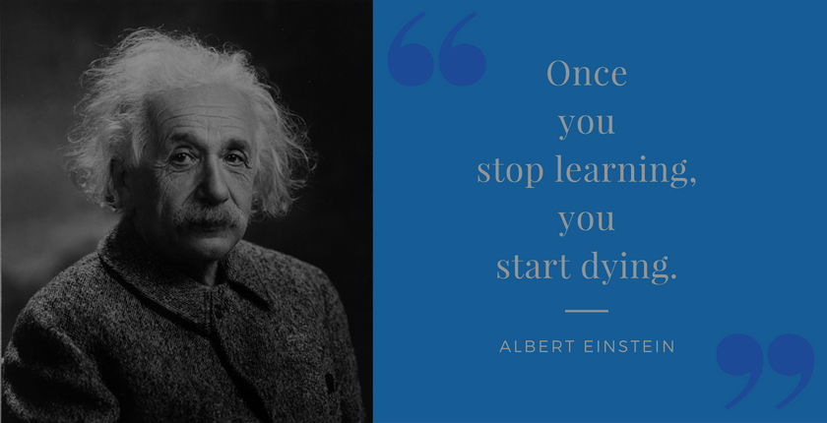
Task 3 Cont-: Unit 4 Becoming a Lifelong learner
(Reflexivity)
Reflexivity: - Reflexivity is largely practiced in qualitative research, where it is used to legitimate and validate research procedures. This study introduces different perspectives of analysis by focusing the discourse on the main philosophical approaches to reflection. [3] While this dives in a little deeper, allowing you the ability to not take everything on face value without asking questions or having any real knowledge on the matter. It intertwines with cultural differences, beliefs, standards, conscious or unconscious bias, values, morals, assumptions, it defines the present way critical thinking, It’s a mindset.
Unpacking Experiences through learning also breaks down the various models of learning. Below are a few reflective models that demonstrate this;
Gibbs Reflective Model
Johns (2006)
Rolfe (2001)
Kolb (1984)
Driscoll (1984)

Slide 11
Task 3: Unit 4 Becoming a Lifelong learner
(Gibbs Reflective Model)
I’d like to quickly elaborate on The Gibbs Reflective Model. This model breaks down a thought process that is durable, robust and effective, it helps pinpoint real life situations which enables you to have a safe space to think clearly and directly to give you a concise outcome. The cycle has six steps—Description, Feelings, Evaluation, Analysis, Conclusion, and Action Plan—that guide students in understanding their work, learning from it, and planning for future improvement. [4] Description, the reason for the brainstorm, Feeling, how you felt about the situation and thought on it allowing you to relive the moment no matter the sensitivity, Evaluation, having the ability to assess the situation and really think about the circumstance(s) in a nutshell, deciphering between facts and fiction either through your eyes or someone else, Analysis, very similar to evaluation but in my eyes the real defining moment of change and growth, it gives you real clarity on yourself without bias and can prompt you to use discernment, Conclusion, give a full breakdown of what was done what has happened and what lesson were learn and taught. Action Plan, going forwards what is the aim, goal, and angle you intend to take to see a clear path towards winning.

Slide 12
Conclusion
Summary
Lesson learnt
Personal Evaluation
This presentation is about myself and my development through the reflective model(Gibbs Cycle).
It talks about strengths and weaknesses and breaks down the reflective cycle in detail. Deciphering the differences between reflection and reflexivity. It also talks about extensive learning reflection models and how it benefits users in todays' studies
I have learnt to research information via articles & citations, reflecting on past life experiences to help navigate my direction when breaking down self-development plans, setting goals to achieve results through brain expansion and strategic preparation
I have recognised the paths I have taken consciously and unconsciously and have found a new way of analysing myself through the Gibbs reflective model, I never knew existed.
I will continue with these practices going forward

Slide 13
References
[1] M. Laal and P. Salamati, "Lifelong learning; why do we need it?" vol. 31, pp.399–403,2012,
[2] R. Arms Almengor, "Reflective practice and mediator learning: A current review," vol.36, no. 1, pp.21–38, 2018,
[3] L. Mortari, "Reflectivity in research practice: An overview of different perspectives,"vol. 14, no. 5, pp.1609406915618045, 2015,
[4] K. S. Praveena, F. Juslin, C. M. Patil and K. Bhargavi, "Using gibb's reflective model approach for enhancing project-based learning among students through reflective assessment," pp.148–155, 2025,

Slide 14
Presentation Video
HOG Portfolio Presentation.mp4

