Slide 1
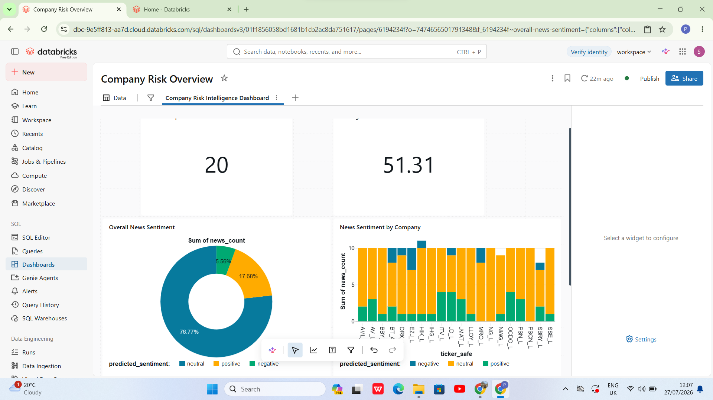
COMPANY RISK INTELLIGENCE PLATFORM
Company Risk
Intelligence Platform
An end-to-end Databricks lakehouse combining company, financial and news data with explainable sentiment results.
Shivam Sanjivkumar Patel | Student ID: 2435900
MSc Data and Artificial Intelligence | ACFA7003
University of Wales Trinity Saint David
Project presentation
Notes:
Good morning. My project is called the Company Risk Intelligence Platform. I built it to bring fragmented UK company information into one reliable Databricks solution and present the results through a dashboard. I will explain the problem, architecture, implementation, AI evaluation, results and limitations.
[Sources]
- 2435900_report.docx — Company Risk Intelligence Platform report, Shivam Sanjivkumar Patel (2026).
[/Sources]

Slide 2
The problem was fragmented company-risk information
Business problem
Project aim
• Official corporate records, market data and news were held in separate sources.
• Company numbers and ticker symbols did not provide one shared identity.
• Raw API responses were not ready for analysis or dashboard use.
• News sentiment needed measurable model evaluation and traceability.
Build a governed, repeatable platform that converts raw company data into business-ready risk information.
Sources
Companies House + Yahoo Finance
Delivery
Delta tables + AI predictions + dashboard
2
Notes:
I started with a practical problem: a reviewer must check several systems to understand one company. Companies House uses company numbers, while Yahoo Finance uses ticker symbols. My aim was to create one controlled platform that collects, cleans, connects and presents these records in a traceable way.
[Sources]
- 2435900_report.docx — Company Risk Intelligence Platform report, Shivam Sanjivkumar Patel (2026).
[/Sources]

Slide 3
Six objectives connected engineering, AI and business delivery
01
Collect
02
Preserve
03
Improve
Ingest Companies House and Yahoo Finance data through Python REST clients.
Keep source-aligned records and audit metadata in Bronze Delta tables.
Clean, validate, standardise and deduplicate data in Silver.
04
Connect
05
Analyse
06
Deliver
Map company numbers to financial tickers through a conformed dimension.
Create Gold risk features and compare two news-sentiment models.
Automate the workflow and publish an interactive AI/BI dashboard.
3
Notes:
The objectives were designed as one connected chain. I first needed reliable collection and raw-data preservation. Then I improved quality and solved company identity. Only after that could I create analytical features, compare sentiment models, automate the tasks and deliver the dashboard. This order prevented the AI and dashboard from being built on untrusted data.
[Sources]
- 2435900_report.docx — Company Risk Intelligence Platform report, Shivam Sanjivkumar Patel (2026).
[/Sources]

Slide 4
Four questions test integration, trust, AI and delivery
RQ1
How can corporate, financial, market and news data be integrated in one traceable lakehouse?
RQ2
How can Bronze, Silver and Gold processing improve data quality and company matching?
RQ3
Which baseline model—Linear SVM or Logistic Regression—classifies financial-news sentiment more effectively?
RQ4
How can orchestration and a dashboard turn the processed data into repeatable decision support?
The project is evaluated as one connected platform—not as separate notebooks or isolated models.
4
Notes:
The report is guided by four research questions. The first asks how different sources can be integrated. The second focuses on data quality and Medallion processing. The third compares the two sentiment models using held-out metrics. The fourth evaluates whether orchestration and the dashboard make the solution repeatable and useful. I answer these questions again when I present the results.
[Sources]
- 2435900_report.docx — Company Risk Intelligence Platform report, Shivam Sanjivkumar Patel (2026).
[/Sources]

Slide 5
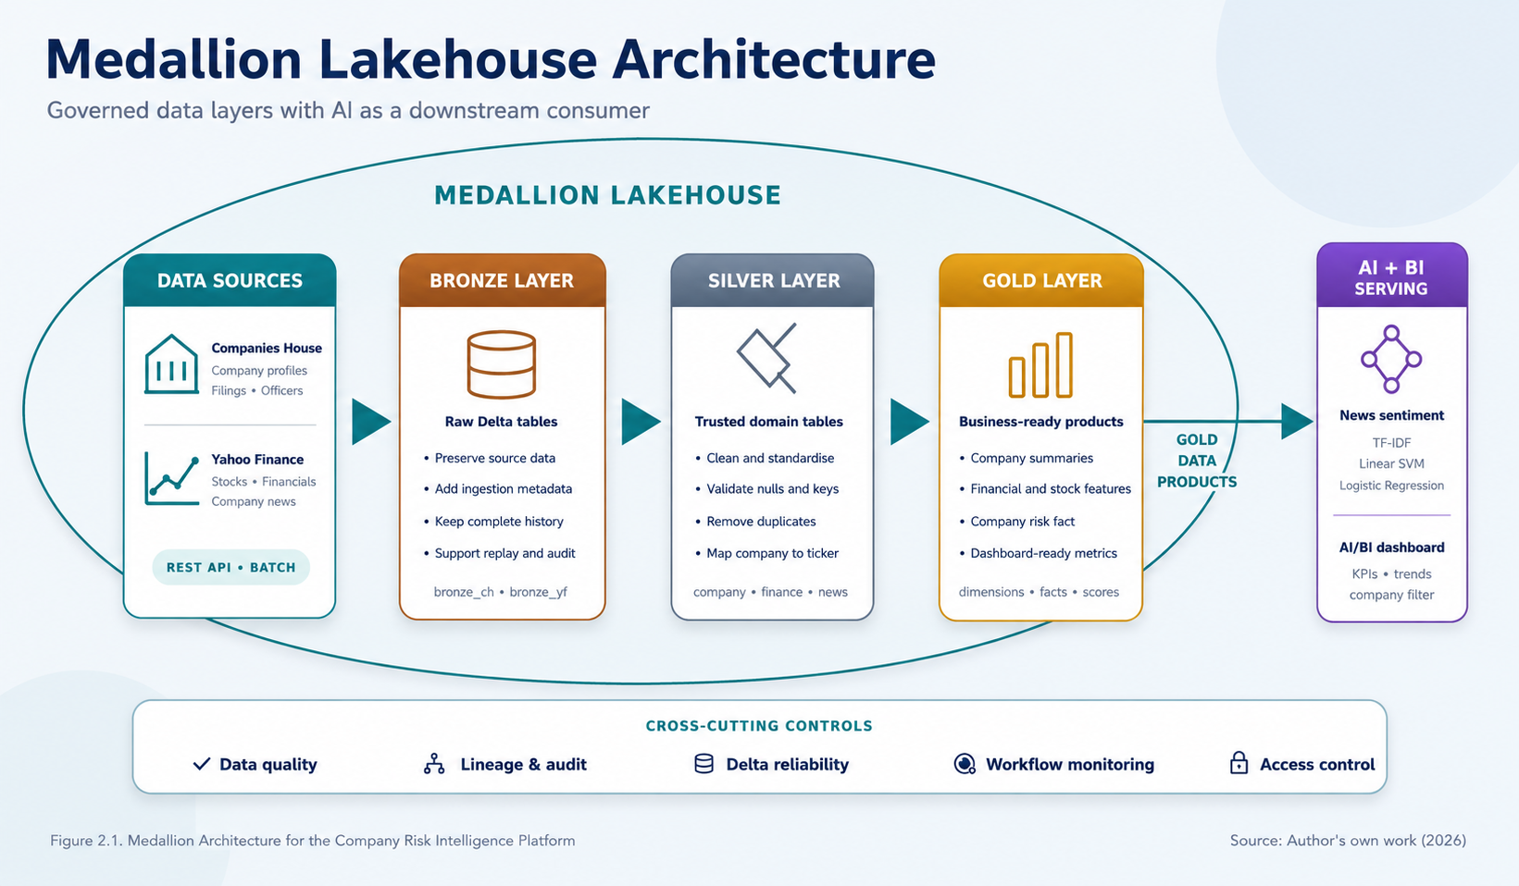
The architecture separates trusted data layers from AI
Architecture logic
• Bronze preserves recoverable source evidence.
• Silver applies trust, standardisation and company mapping.
• Gold creates stable measures for reporting.
• AI consumes prepared data as a downstream service.
• Quality, lineage and monitoring apply across the platform.
AI is not a Medallion layer
5
Notes:
This is the platform architecture. Data sources, Bronze, Silver and Gold form the governed lakehouse flow. Bronze preserves raw evidence. Silver cleans and standardises it. Gold provides business-ready products. The AI component is outside the Medallion boundary and consumes prepared data as a downstream process.
[Sources]
- 2435900_report.docx — Company Risk Intelligence Platform report, Shivam Sanjivkumar Patel (2026).
[/Sources]

Slide 6
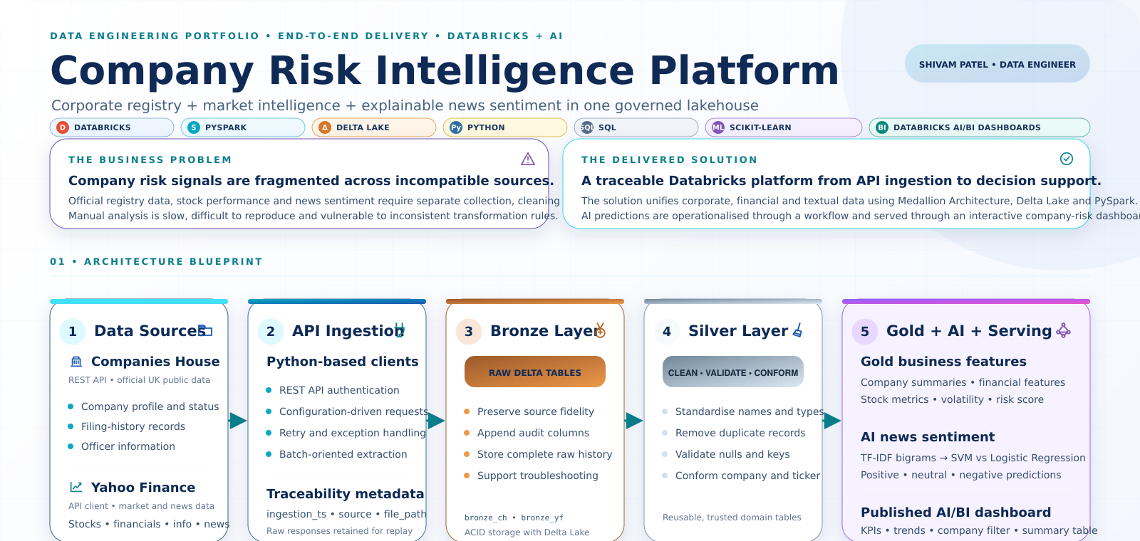
The portfolio blueprint shows how every component connects
What this view adds
• Shows the business problem beside the delivered solution.
• Connects both data sources to Python API ingestion.
• Separates Bronze preservation from Silver trust rules.
• Places Gold, AI and dashboard delivery downstream.
• Summarises the technologies used across the build.
One picture connects the report, code and demonstration
6
Notes:
This portfolio blueprint summarises the project in one visual. It begins with the fragmented business problem and the delivered Databricks solution. The architecture shows Companies House and Yahoo Finance feeding Python API ingestion, followed by Bronze preservation, Silver validation and the downstream Gold, AI and dashboard components. I use this view to connect the report structure to the practical implementation.
[Sources]
- 2435900_report.docx — Company Risk Intelligence Platform report, Shivam Sanjivkumar Patel (2026).
- data bricks(2).png — project portfolio infographic supplied by Shivam Patel.
[/Sources]

Slide 7
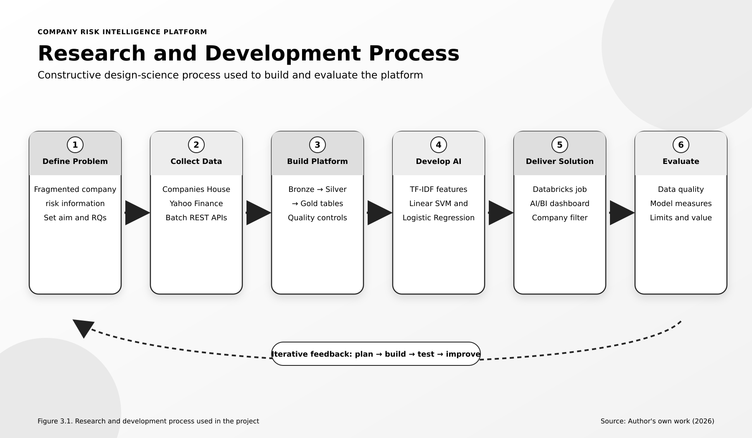
Design Science guided an iterative build–test–improve cycle
Why this method?
• The project produced and evaluated a working technical artefact.
• API structures and dashboard needs were not fully known at the start.
• Each layer was tested before the next stage was built.
• Failures led to code, mapping or aggregation improvements.
Plan → Build → Test → Improve
7
Notes:
I used a pragmatic Design Science approach because the purpose was to build and evaluate a working artefact. I first defined the problem, collected data, built the lakehouse, developed the AI component, delivered the workflow and dashboard, and then evaluated the results. When testing found an issue, I returned to the relevant stage and improved it.
[Sources]
- 2435900_report.docx — Company Risk Intelligence Platform report, Shivam Sanjivkumar Patel (2026).
[/Sources]

Slide 8
A pragmatic approach matched the practical development problem
Pragmatism
Why not only positivism?
Why not interpretivism?
Selected because the project combined measurable results with practical problem-solving. The important question was whether the platform worked reliably and produced useful evidence.
Positivism supports numerical testing, but it would not fully explain the iterative design decisions, coding corrections and dashboard development needed to build the artefact.
Interpretivism is useful for human experiences and meanings, but this study mainly evaluated a technical system through records, metrics, tests and observable outputs.
Design Science provided the build–evaluate structure; pragmatism allowed quantitative and practical evidence to be used together.
8
Notes:
I selected pragmatism because this was a practical development project. I needed numerical evidence such as model scores and row reconciliation, but I also needed to explain design choices and lessons from implementation. A purely positivist study would focus strongly on measurement but less on iterative artefact development. Interpretivism was not the main fit because I was not studying personal experiences. Design Science supplied the structured build and evaluation cycle.
[Sources]
- 2435900_report.docx — Company Risk Intelligence Platform report, Shivam Sanjivkumar Patel (2026).
[/Sources]

Slide 9
The two sources used different company identifiers
Companies House
Yahoo Finance
Official UK corporate evidence
Market, financial and news evidence
• Company profiles
• Filing history
• Company officers
• Primary identifier: company number
• Company and financial information
• Stock-price history
• Financial news and provider metadata
• Primary identifier: ticker symbol
Integration challenge: company number ≠ ticker symbol
9
Notes:
Companies House supplied official corporate profiles, filings and officers using the company number. Yahoo Finance supplied company information, financials, stock history and news using the ticker symbol. The data also had different grains: one company can have many filings, officers, prices and articles. I therefore kept separate entities and solved identity through a controlled mapping table.
[Sources]
- 2435900_report.docx — Company Risk Intelligence Platform report, Shivam Sanjivkumar Patel (2026).
[/Sources]

Slide 10
The requirements connect technical controls to user needs
Functional requirements
Non-functional requirements
• Collect company, filing, officer, financial, stock and news data.
• Preserve raw records and audit metadata.
• Clean, validate, deduplicate and connect company identities.
• Create risk features and sentiment predictions.
• Publish repeatable outputs through Jobs and a dashboard.
• Traceability: retain timestamps, file paths, URLs and model details.
• Reliability: use Delta tables, validation and controlled dependencies.
• Maintainability: separate entities and use reusable layer rules.
• Security: manage access through Databricks and Unity Catalog.
• Usability: provide clear company filters and interpretable measures.
Every requirement was linked to an implemented table, notebook, workflow task or dashboard output.
10
Notes:
The functional requirements describe what the platform must do: collect, preserve, clean, analyse and publish. The non-functional requirements describe how it should behave. Traceability was supported by audit fields. Reliability came from Delta tables and task dependencies. Maintainability came from separating entities and layers. Access was controlled in Databricks, and usability was addressed through the dashboard. This prevented the project from becoming only a collection of code cells.
[Sources]
- 2435900_report.docx — Company Risk Intelligence Platform report, Shivam Sanjivkumar Patel (2026).
[/Sources]

Slide 11
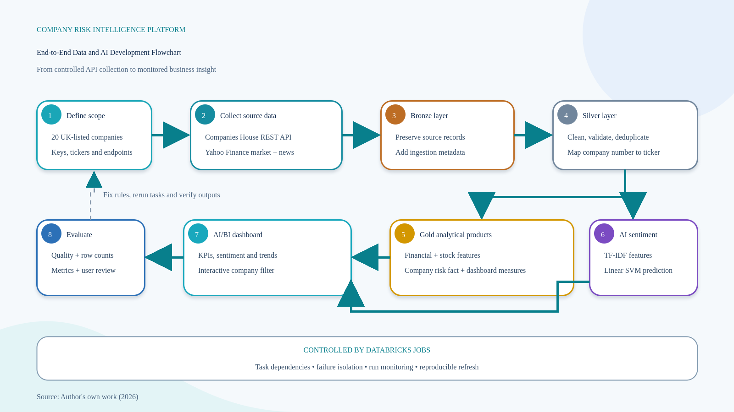
The implemented workflow moves from APIs to monitored insight
Execution sequence
1. Collect and audit
2. Preserve raw data
3. Clean and map
4. Build risk features
5. Classify news
6. Refresh dashboard
Databricks Jobs controls dependencies
11
Notes:
This flowchart follows the real implementation. Python clients collected Companies House and Yahoo Finance data. Bronze kept source records and audit metadata. Silver cleaned, validated and deduplicated the entities and mapped company numbers to tickers. Gold produced financial, stock and risk features. AI classified news, and the dashboard communicated the result. Databricks Jobs controlled task order and failure isolation.
[Sources]
- 2435900_report.docx — Company Risk Intelligence Platform report, Shivam Sanjivkumar Patel (2026).
[/Sources]

Slide 12
Each lakehouse layer has one clear responsibility
BRONZE
SILVER
GOLD
Preserve
Trust
Serve
Raw API-aligned values
Ingestion timestamp
File path and replay evidence
Types and dates
Null and key checks
Deduplication and ticker mapping
Company summaries
Financial and stock features
Company-risk fact and dashboard measures
The current project uses monitored batch processing; future incremental loads can apply watermarks and Delta MERGE.
12
Notes:
Bronze, Silver and Gold are not three copies of the same table. Bronze keeps recoverable source evidence. Silver applies entity-specific rules and creates trusted, reusable domains. Gold changes the focus from technical records to business measures. This prototype uses batch processing. A future production version could use watermarks to detect new or changed records and Delta MERGE to update managed tables incrementally.
[Sources]
- 2435900_report.docx — Company Risk Intelligence Platform report, Shivam Sanjivkumar Patel (2026).
[/Sources]

Slide 13
Bronze keeps source evidence before business rules are applied
What the code does
Why Bronze matters
• Calls each REST endpoint with controlled parameters.
• Keeps source-aligned values instead of forcing one common schema.
• Adds ingestion timestamp, source and file-path metadata.
• Writes entity-specific Delta tables for company and Yahoo data.
• Allows replay when downstream transformation logic changes.
Without Bronze, an API schema change or incorrect Silver rule could destroy the original evidence. Bronze creates a recoverable boundary between external systems and internal processing.
Raw does not mean unmanaged
Preserve first → transform second
13
Notes:
Bronze is the preservation layer. The ingestion code calls the external APIs and stores source-aligned records with audit information. I did not force every endpoint into one generic structure because company profiles, officers, prices and news have different grains. Bronze also means I can replay Silver logic without calling the external API again, which improves traceability and debugging.
[Sources]
- 2435900_report.docx — Company Risk Intelligence Platform report, Shivam Sanjivkumar Patel (2026).
[/Sources]

Slide 14
Data quality and controlled company mapping made integration reliable
01
02
03
04
Completeness
Consistency
Uniqueness
Traceability
Required business keys and important analytical fields were checked.
Dates, types, names and ticker formats were standardised in Silver.
Grain-specific business keys removed repeated filings, prices and news.
File paths, ingestion times, providers and URLs were retained for audit.
20 matched companies • 0 unmatched • 100% Gold row reconciliation
14
Notes:
The key integration problem was identity. Company names were not safe join keys because punctuation, suffixes and abbreviations could differ. I created a controlled company dimension that connected company number, company name, ticker and ticker_safe. The final run matched all 20 selected companies and preserved the Gold table grain.
[Sources]
- 2435900_report.docx — Company Risk Intelligence Platform report, Shivam Sanjivkumar Patel (2026).
[/Sources]

Slide 15
Silver applies trust; SCD and incremental loading solve different problems
Silver transformation
Slowly Changing Dimensions
Incremental loading
• Cast types and standardise dates.
• Check required identifiers.
• Remove duplicates by entity grain.
• Create ticker_safe and company mapping.
• Retain useful lineage fields.
SCD controls how dimension changes are stored. Type 1 overwrites the current value. Type 2 keeps history using effective dates and an is_current flag.
Incremental loading controls which source rows are processed. A production design can store a watermark, read only newer records and use Delta MERGE for inserts and updates.
Prototype: current-state company dimension
Prototype: monitored full batch
SCD manages history; incremental loading manages processing volume. They are related, but they are not the same.
15
Notes:
This slide clarifies two concepts that are sometimes confused. SCD controls the history of dimension attributes. Type 1 replaces an old value, while Type 2 adds a new version and retains the previous record. Incremental loading controls how many source records are processed in each run, normally using a watermark. In my prototype, Silver creates a current-state conformed company dimension and the workflow runs as a monitored batch. A production extension could add watermarks, Delta MERGE and SCD Type 2 for attributes whose history matters.
[Sources]
- 2435900_report.docx — Company Risk Intelligence Platform report, Shivam Sanjivkumar Patel (2026).
[/Sources]

Slide 16
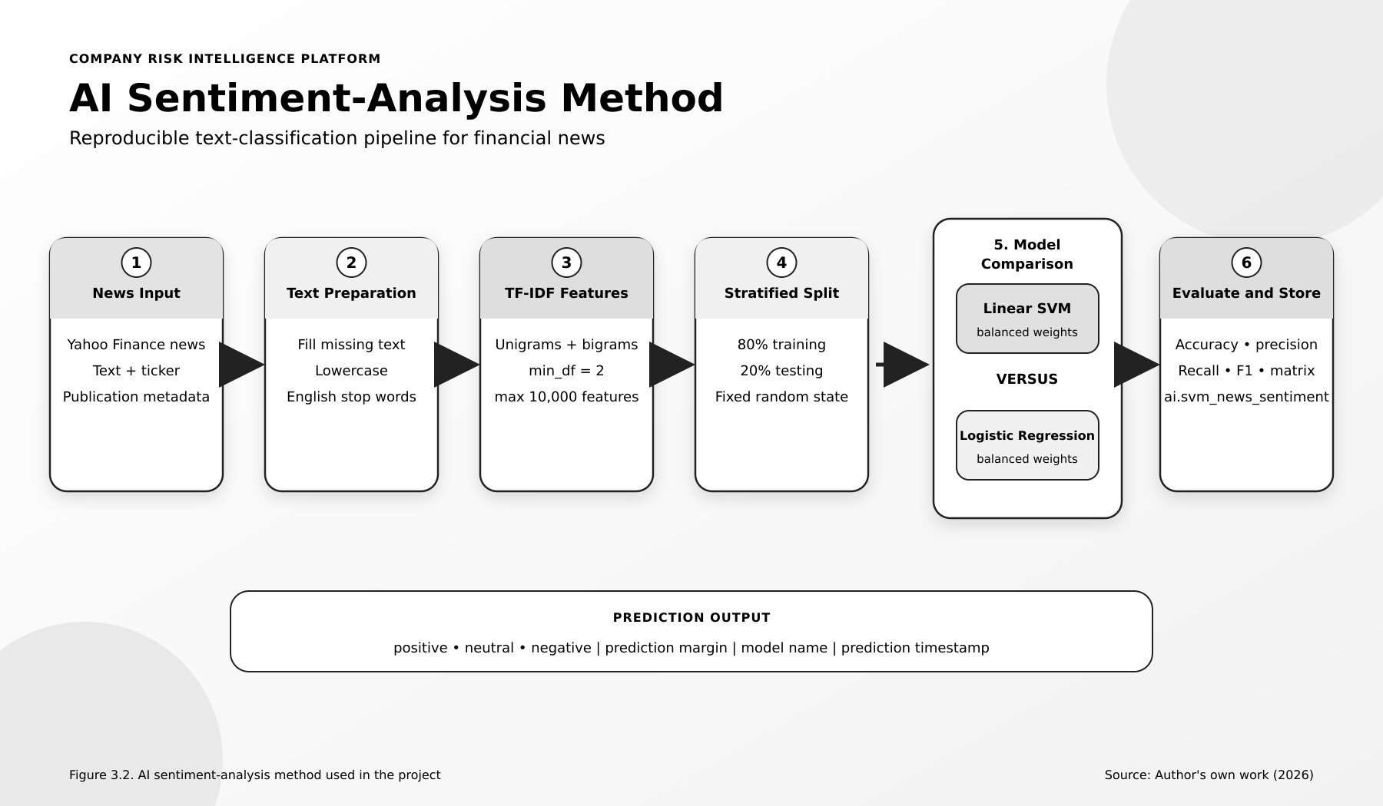
Both models were compared under the same text pipeline
Controlled comparison
• TF-IDF with unigrams and bigrams
• Maximum 10,000 features
• Stratified 80/20 train-test split
• Fixed random state
• Balanced class weights
• Accuracy, precision, recall, F1 and confusion matrix
Same inputs and settings = fair comparison
16
Notes:
For the AI task, I prepared Yahoo Finance news text and transformed it with TF-IDF. I used lowercase text, English stop words, unigrams and bigrams, a minimum document frequency of two and a maximum of ten thousand features. I compared Linear SVM and Logistic Regression using the same stratified 80/20 split, fixed random state and balanced class weights.
[Sources]
- 2435900_report.docx — Company Risk Intelligence Platform report, Shivam Sanjivkumar Patel (2026).
[/Sources]

Slide 17
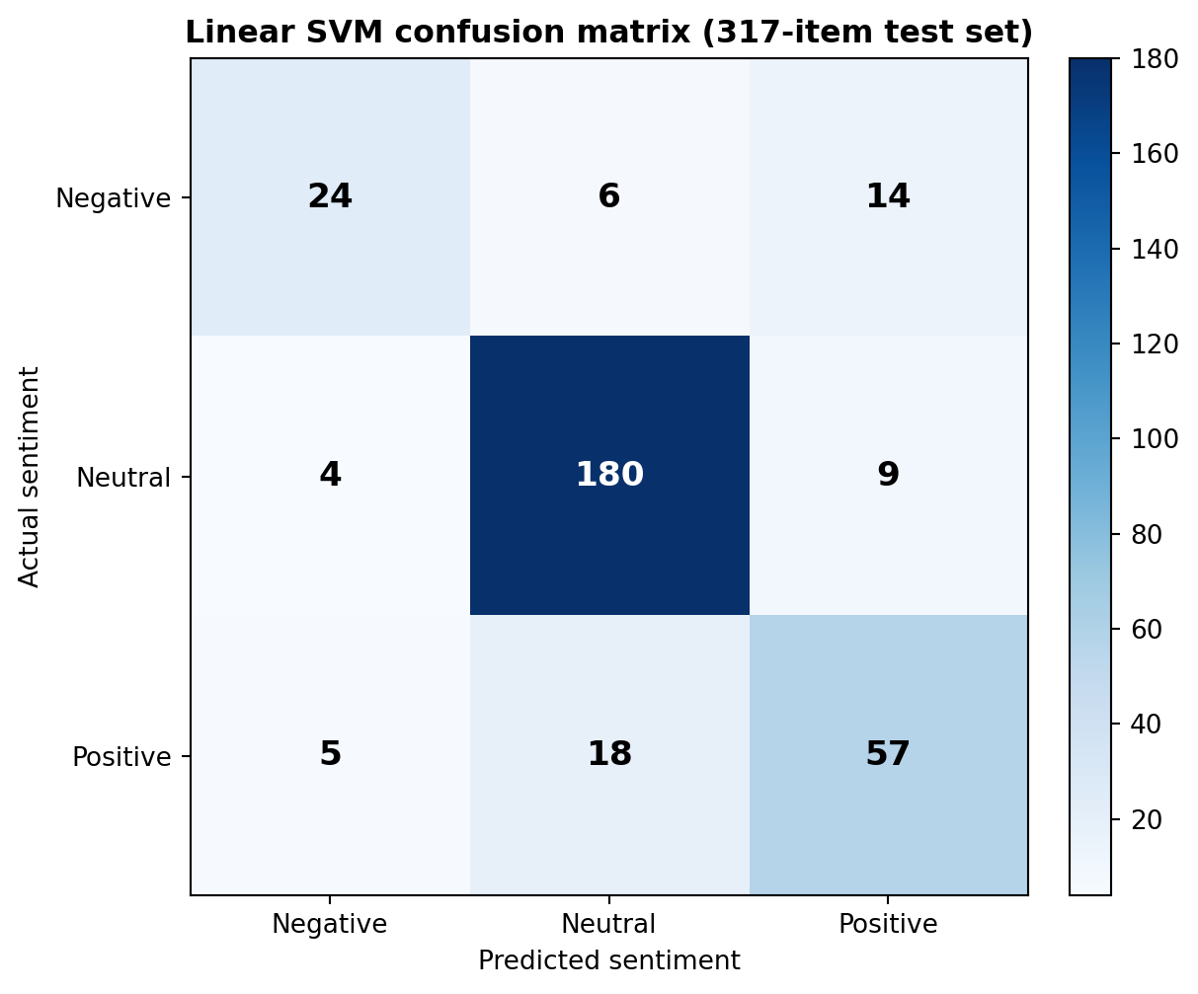
Linear SVM performed better, but negative recall remained weaker
Held-out test results (%)
Interpretation: neutral news was classified strongly; negative recall was 0.55, so important negative items still need human review.
17
Notes:
Linear SVM achieved 82.33 percent accuracy and 81.84 percent weighted F1, outperforming Logistic Regression. The confusion matrix shows 24 of 44 negative items, 180 of 193 neutral items and 57 of 80 positive items were correctly classified. The weaker negative recall is important because missed negative news may carry risk, so the model supports review rather than replacing judgement.
[Sources]
- 2435900_report.docx — Company Risk Intelligence Platform report, Shivam Sanjivkumar Patel (2026).
[/Sources]

Slide 18
The final run reconciled data from source to dashboard
The prototype completed as one controlled workflow rather than a collection of isolated notebooks.
20
197
12m 38s
COMPANIES
NEWS ITEMS
RUNTIME
20 matched / 20 selected
197 saved / 197 prepared
observed end-to-end run
100% prediction reconciliation • 100% company matching • Gold fact grain preserved
18
Notes:
The final prepared dataset contained 197 news items and the prediction table also contained 197 rows, so no predictions were lost. All 20 selected companies were matched, and the AI-enhanced risk output preserved all 20 source fact rows. The observed workflow duration was twelve minutes and thirty-eight seconds.
[Sources]
- 2435900_report.docx — Company Risk Intelligence Platform report, Shivam Sanjivkumar Patel (2026).
[/Sources]

Slide 19
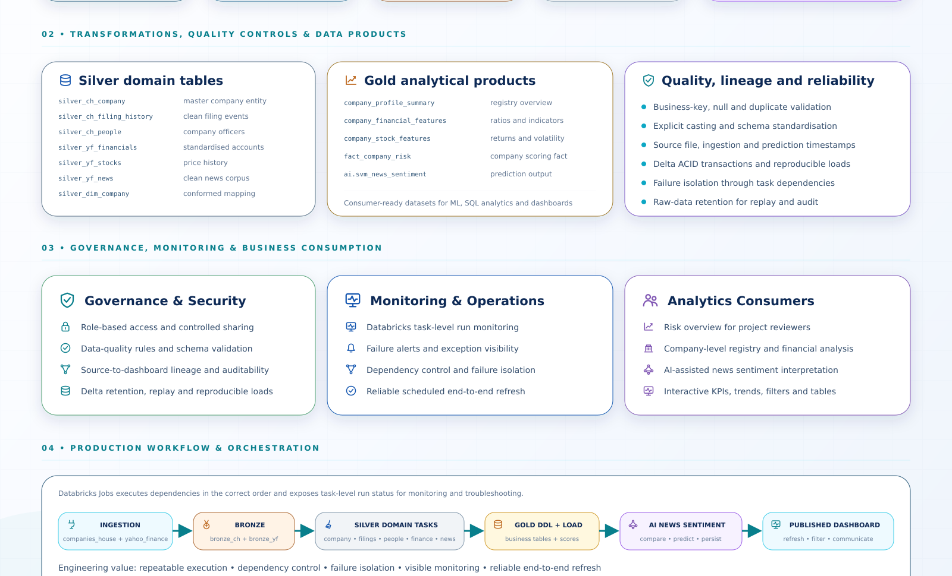
Governance and monitoring make the pipeline supportable
Operational controls
• Role-based access and controlled sharing
• Schema, key, null and duplicate validation
• Source-to-dashboard lineage and audit fields
• Task-level monitoring and failure visibility
• Dependency control and reproducible refresh
• Clear consumers: reviewers, analysts and dashboard users
Reliable delivery needs controls around the pipeline—not only transformation code.
19
Notes:
The lower section of the infographic focuses on the controls around the data flow. Governance covers access, data-quality rules, lineage and retention. Monitoring covers task status, alerts, dependencies and refresh reliability. The orchestration view shows ingestion, Bronze, Silver, Gold, AI and dashboard tasks in sequence. These controls are important because a technically correct transformation is not enough if failures cannot be traced or outputs cannot be reproduced.
[Sources]
- 2435900_report.docx — Company Risk Intelligence Platform report, Shivam Sanjivkumar Patel (2026).
- data bricks(2).png — project portfolio infographic supplied by Shivam Patel.
[/Sources]

Slide 20
Gold converts trusted entities into stable analytical products
01
Company summary
One reusable view of the selected company and its controlled identifiers.
02
Financial features
Comparable measures created from financial and market records.
03
Company-risk fact
One company-level grain that combines analytical measures.
04
Dashboard measures
Counts, averages and sentiment summaries prepared for reporting.
Gold shields reporting from raw API complexity.
20
Notes:
Gold is designed around analytical use rather than source structure. The company summary provides reusable identity and descriptive information. Financial and stock records are converted into comparable features. The company-risk fact uses one stable company-level grain. Dashboard measures are prepared in advance so the reporting layer does not need to repeat complicated joins or business logic.
[Sources]
- 2435900_report.docx — Company Risk Intelligence Platform report, Shivam Sanjivkumar Patel (2026).
[/Sources]

Slide 21
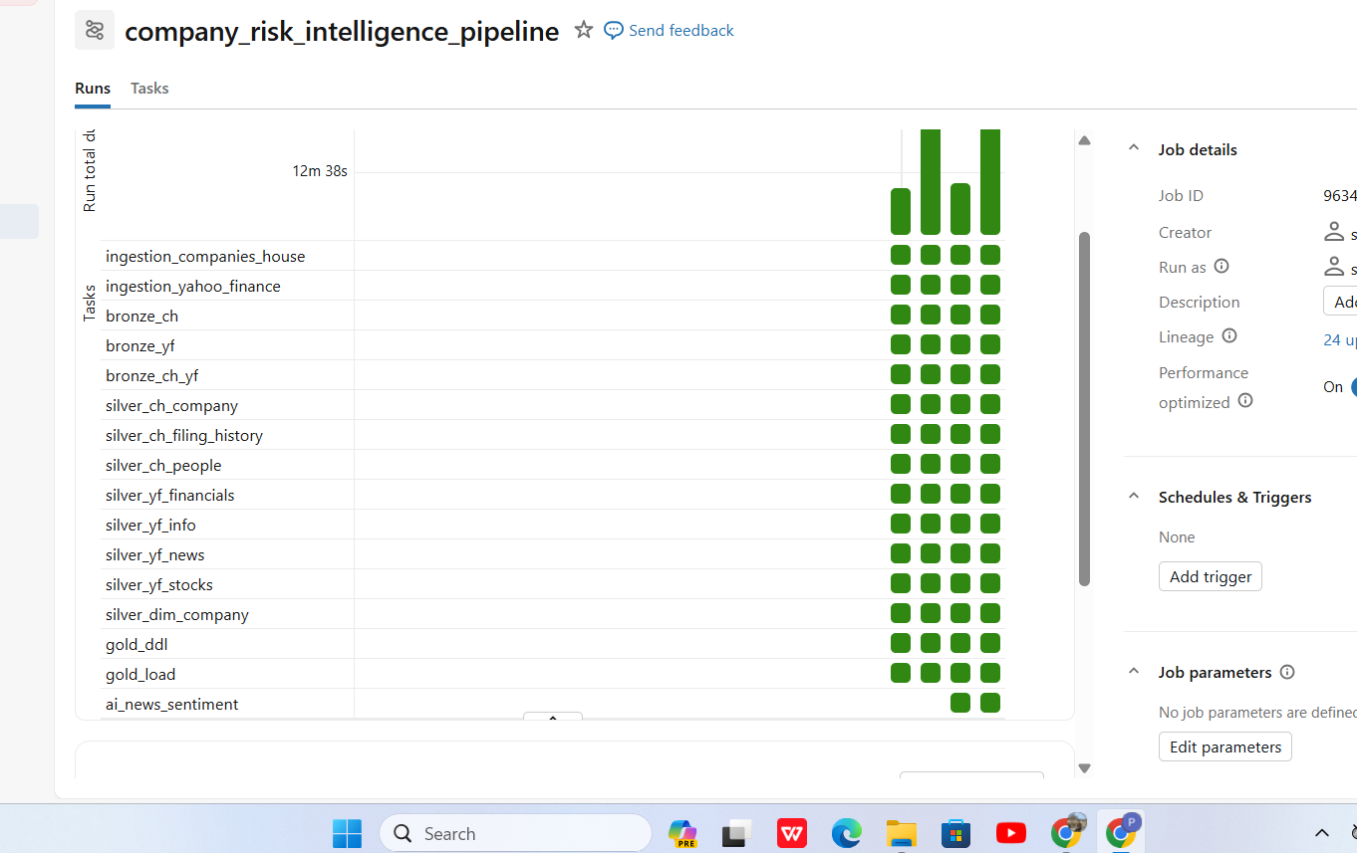
Databricks Jobs controlled dependencies and isolated failures
Why orchestration mattered
• Ingestion branches could run independently.
• Silver tasks ran only after the correct Bronze inputs.
• Gold waited for trusted domain tables.
• AI ran after prepared inputs were available.
• Task status made failures easier to diagnose.
21
Notes:
This screenshot shows successful task runs in the Databricks job. Dependencies prevented Gold and AI tasks from starting before their inputs were ready. A failed news task could be investigated without rerunning unrelated company or financial processing. This improved repeatability, monitoring and debugging.
[Sources]
- 2435900_report.docx — Company Risk Intelligence Platform report, Shivam Sanjivkumar Patel (2026).
[/Sources]

Slide 22
The dashboard communicates company-level insight
Published outputs
• Company count and average financial score
• Overall sentiment distribution
• Sentiment by company
• Time-based trend
• Company filter and detail table
Decision support—not investment advice
22
Notes:
The dashboard was designed for a non-technical reviewer. It shows company coverage, financial score, sentiment distribution, company comparison and trends. The company filter uses ticker_safe, so the same controlled identifier connects the data products. The dashboard supports investigation but does not make investment decisions.
[Sources]
- 2435900_report.docx — Company Risk Intelligence Platform report, Shivam Sanjivkumar Patel (2026).
[/Sources]

Slide 23
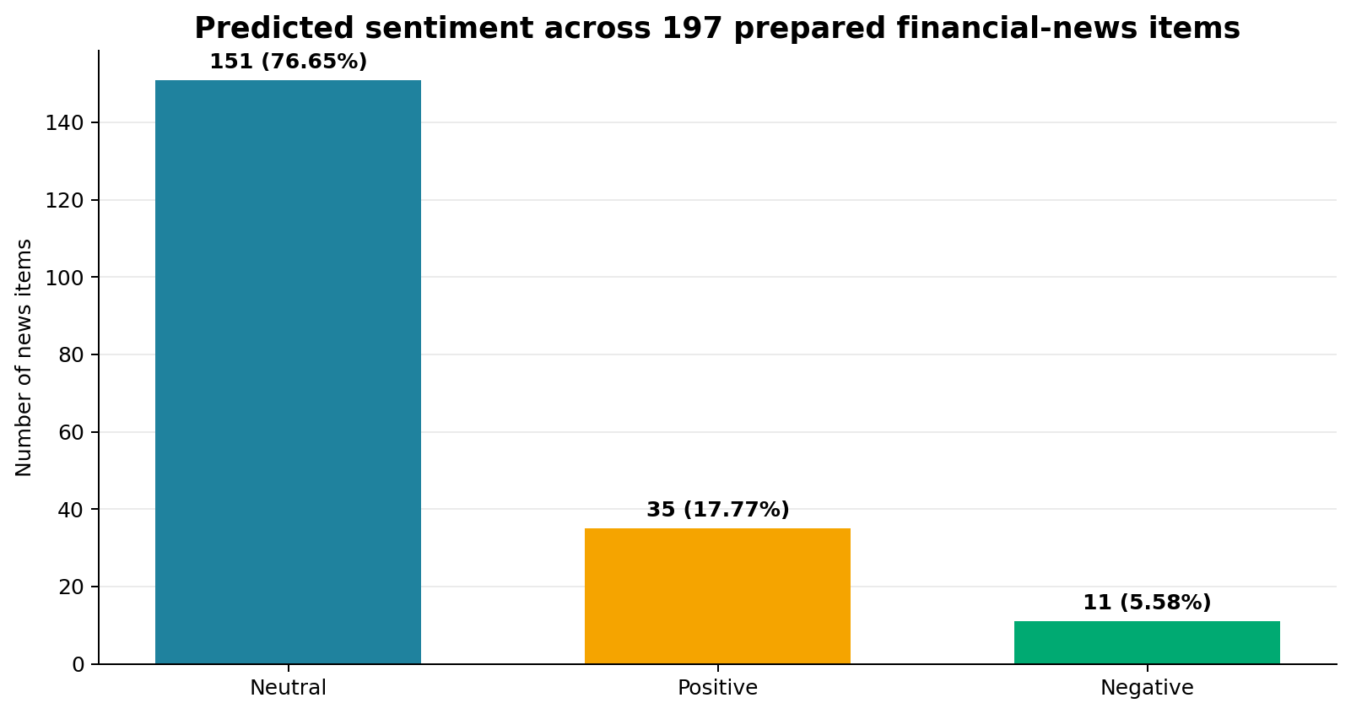
Most collected news was neutral, so class balance matters
What the distribution means
151 neutral
35 positive
11 negative
The result describes this collected period and model output. It does not prove that the companies are low risk.
23
Notes:
Of the 197 prepared news items, 151 were neutral, 35 positive and 11 negative. The dominance of neutral news may reflect routine company updates, the collection period, the providers and model behaviour. It should not be interpreted as evidence that the companies are safe or low risk.
[Sources]
- 2435900_report.docx — Company Risk Intelligence Platform report, Shivam Sanjivkumar Patel (2026).
[/Sources]

Slide 24
The main challenges improved the final design
Challenge
Why it mattered
Implemented response
Different identifiers
Names and tickers did not match reliably.
Created silver_dim_company with controlled keys.
Optional API fields
Nested or missing values could break rigid logic.
Preserved Bronze and used entity-specific Silver rules.
Duplicate records
Repeated requests could duplicate filings, prices and news.
Applied business keys at the correct grain.
Dashboard news count
Article-level rows did not provide the required chart measure.
Created news_count aggregation and company filtering.
Class imbalance
Neutral examples dominated the labelled data.
Used stratification, balanced weights and class-level metrics.
Learning: reliable data engineering depends on grain, identifiers, audit fields and clear downstream requirements.
24
Notes:
The most valuable learning came from solving real implementation problems. Company names were unsafe join keys, optional API fields required flexible transformations, repeated records needed grain-specific keys, and the dashboard needed aggregated measures that did not exist in the article table. These challenges improved the design and strengthened my debugging and data-modelling skills.
[Sources]
- 2435900_report.docx — Company Risk Intelligence Platform report, Shivam Sanjivkumar Patel (2026).
[/Sources]

Slide 25
The results are useful at prototype scale, but they have clear limits
Coverage
The final demonstration used 20 selected companies and a limited collection period.
Source dependency
API availability, rate limits and schema changes can affect refresh reliability.
Model scope
TF-IDF baselines do not understand context as deeply as finance-specific transformers.
Class imbalance
Negative examples were limited, and negative recall remained weaker.
Production maturity
Batch processing, persistent DQ history, alerts and CI/CD need further development.
These limits prevent overclaiming and directly define the next development priorities.
25
Notes:
The prototype gives measurable evidence, but I do not claim that it is already a production risk system. The demonstration covered 20 companies and one collected period. External APIs can change. The text models are explainable baselines but have limited contextual understanding, and negative recall needs improvement. Production deployment would also require persistent data-quality history, alerts, incremental processing and CI/CD.
[Sources]
- 2435900_report.docx — Company Risk Intelligence Platform report, Shivam Sanjivkumar Patel (2026).
[/Sources]

Slide 26
The live demonstration follows one record through the platform
1
Jobs
2
Bronze
3
Silver
Show the successful workflow and task dependencies.
Open a raw news or company record with its audit fields.
Show cleaned values, deduplication and ticker_safe mapping.
4
Gold
5
AI
6
Dashboard
Show the company-level fact and reconciled row count.
Open one prediction with label, margin, model and timestamp.
Filter one company and connect the chart back to its rows.
Demonstration message: every dashboard result can be traced back to prepared data and a controlled workflow.
26
Notes:
For the live demonstration, I will avoid opening every notebook. I will first show the successful job, then choose one example record and follow it through Bronze, Silver, Gold, AI prediction and the dashboard. This gives the examiner clear evidence that the components are connected and that the dashboard is based on traceable processed data.
[Sources]
- 2435900_report.docx — Company Risk Intelligence Platform report, Shivam Sanjivkumar Patel (2026).
[/Sources]

Slide 27
The prototype achieved its aim and revealed next priorities
What was achieved
Recommended next steps
• Integrated two external data sources in Databricks.
• Created traceable Bronze, trusted Silver and analytical Gold tables.
• Compared two sentiment models with measurable evidence.
• Automated task order and published an interactive dashboard.
• Expand company, history and trusted news coverage.
• Persist rule-level data-quality metrics for every run.
• Monitor confidence, drift and low-margin predictions.
• Compare the baseline with a finance-specific transformer.
• Add stronger production controls, alerts and CI/CD.
Questions and discussion
27
Notes:
In conclusion, the project achieved its main aim at prototype scale. It created a traceable route from source APIs to governed tables, evaluated AI predictions and a usable dashboard. The strongest contribution is the connected platform rather than one individual model. The next priorities are broader data coverage, persistent quality metrics, model monitoring and production controls. Thank you, and I welcome your questions.
[Sources]
- 2435900_report.docx — Company Risk Intelligence Platform report, Shivam Sanjivkumar Patel (2026).
[/Sources]

