Slide 1
The Zhou period

Slide 2
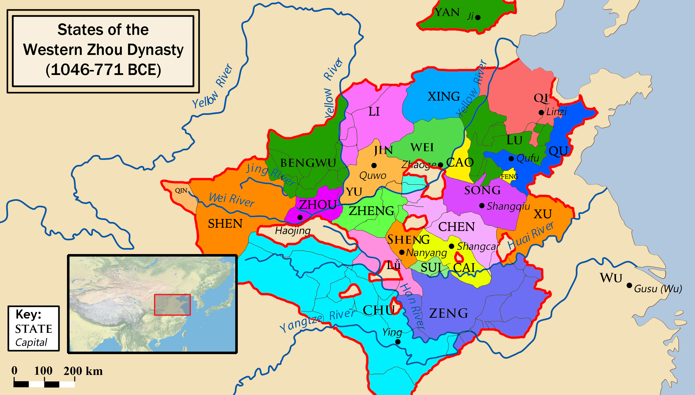
Western Zhou (Xi Zhou 西周)

Slide 3
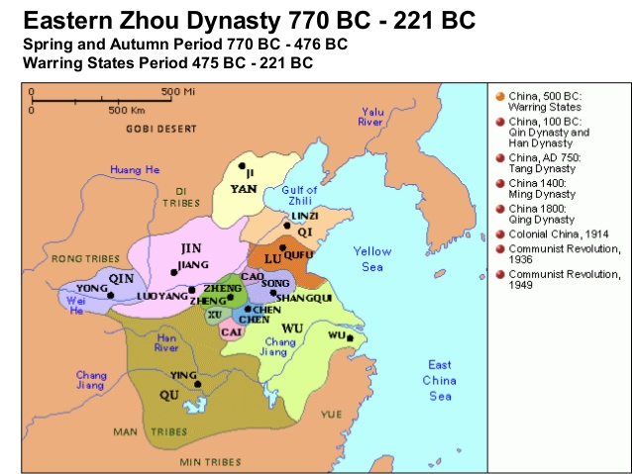
Eastern Zhou (Dong Zhou 東周)

Slide 4
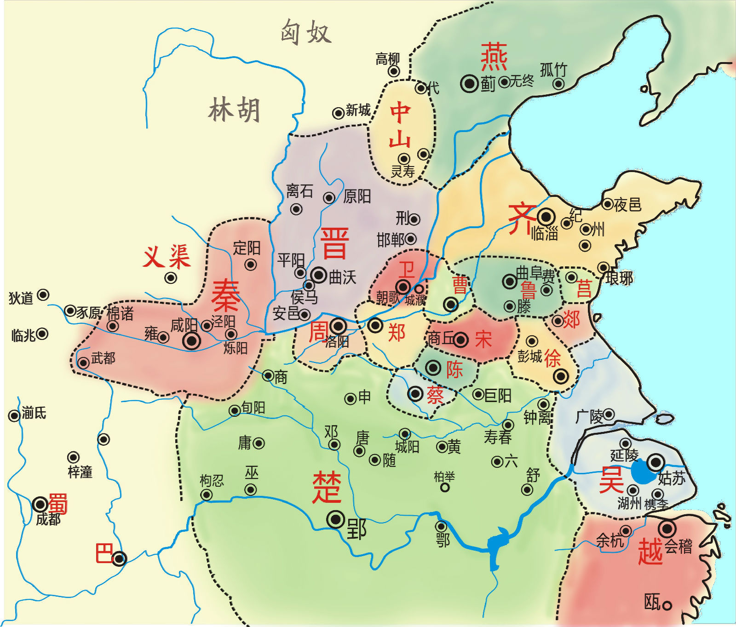
Spring and Autumn Period (Chunqiu 春秋)

Slide 5
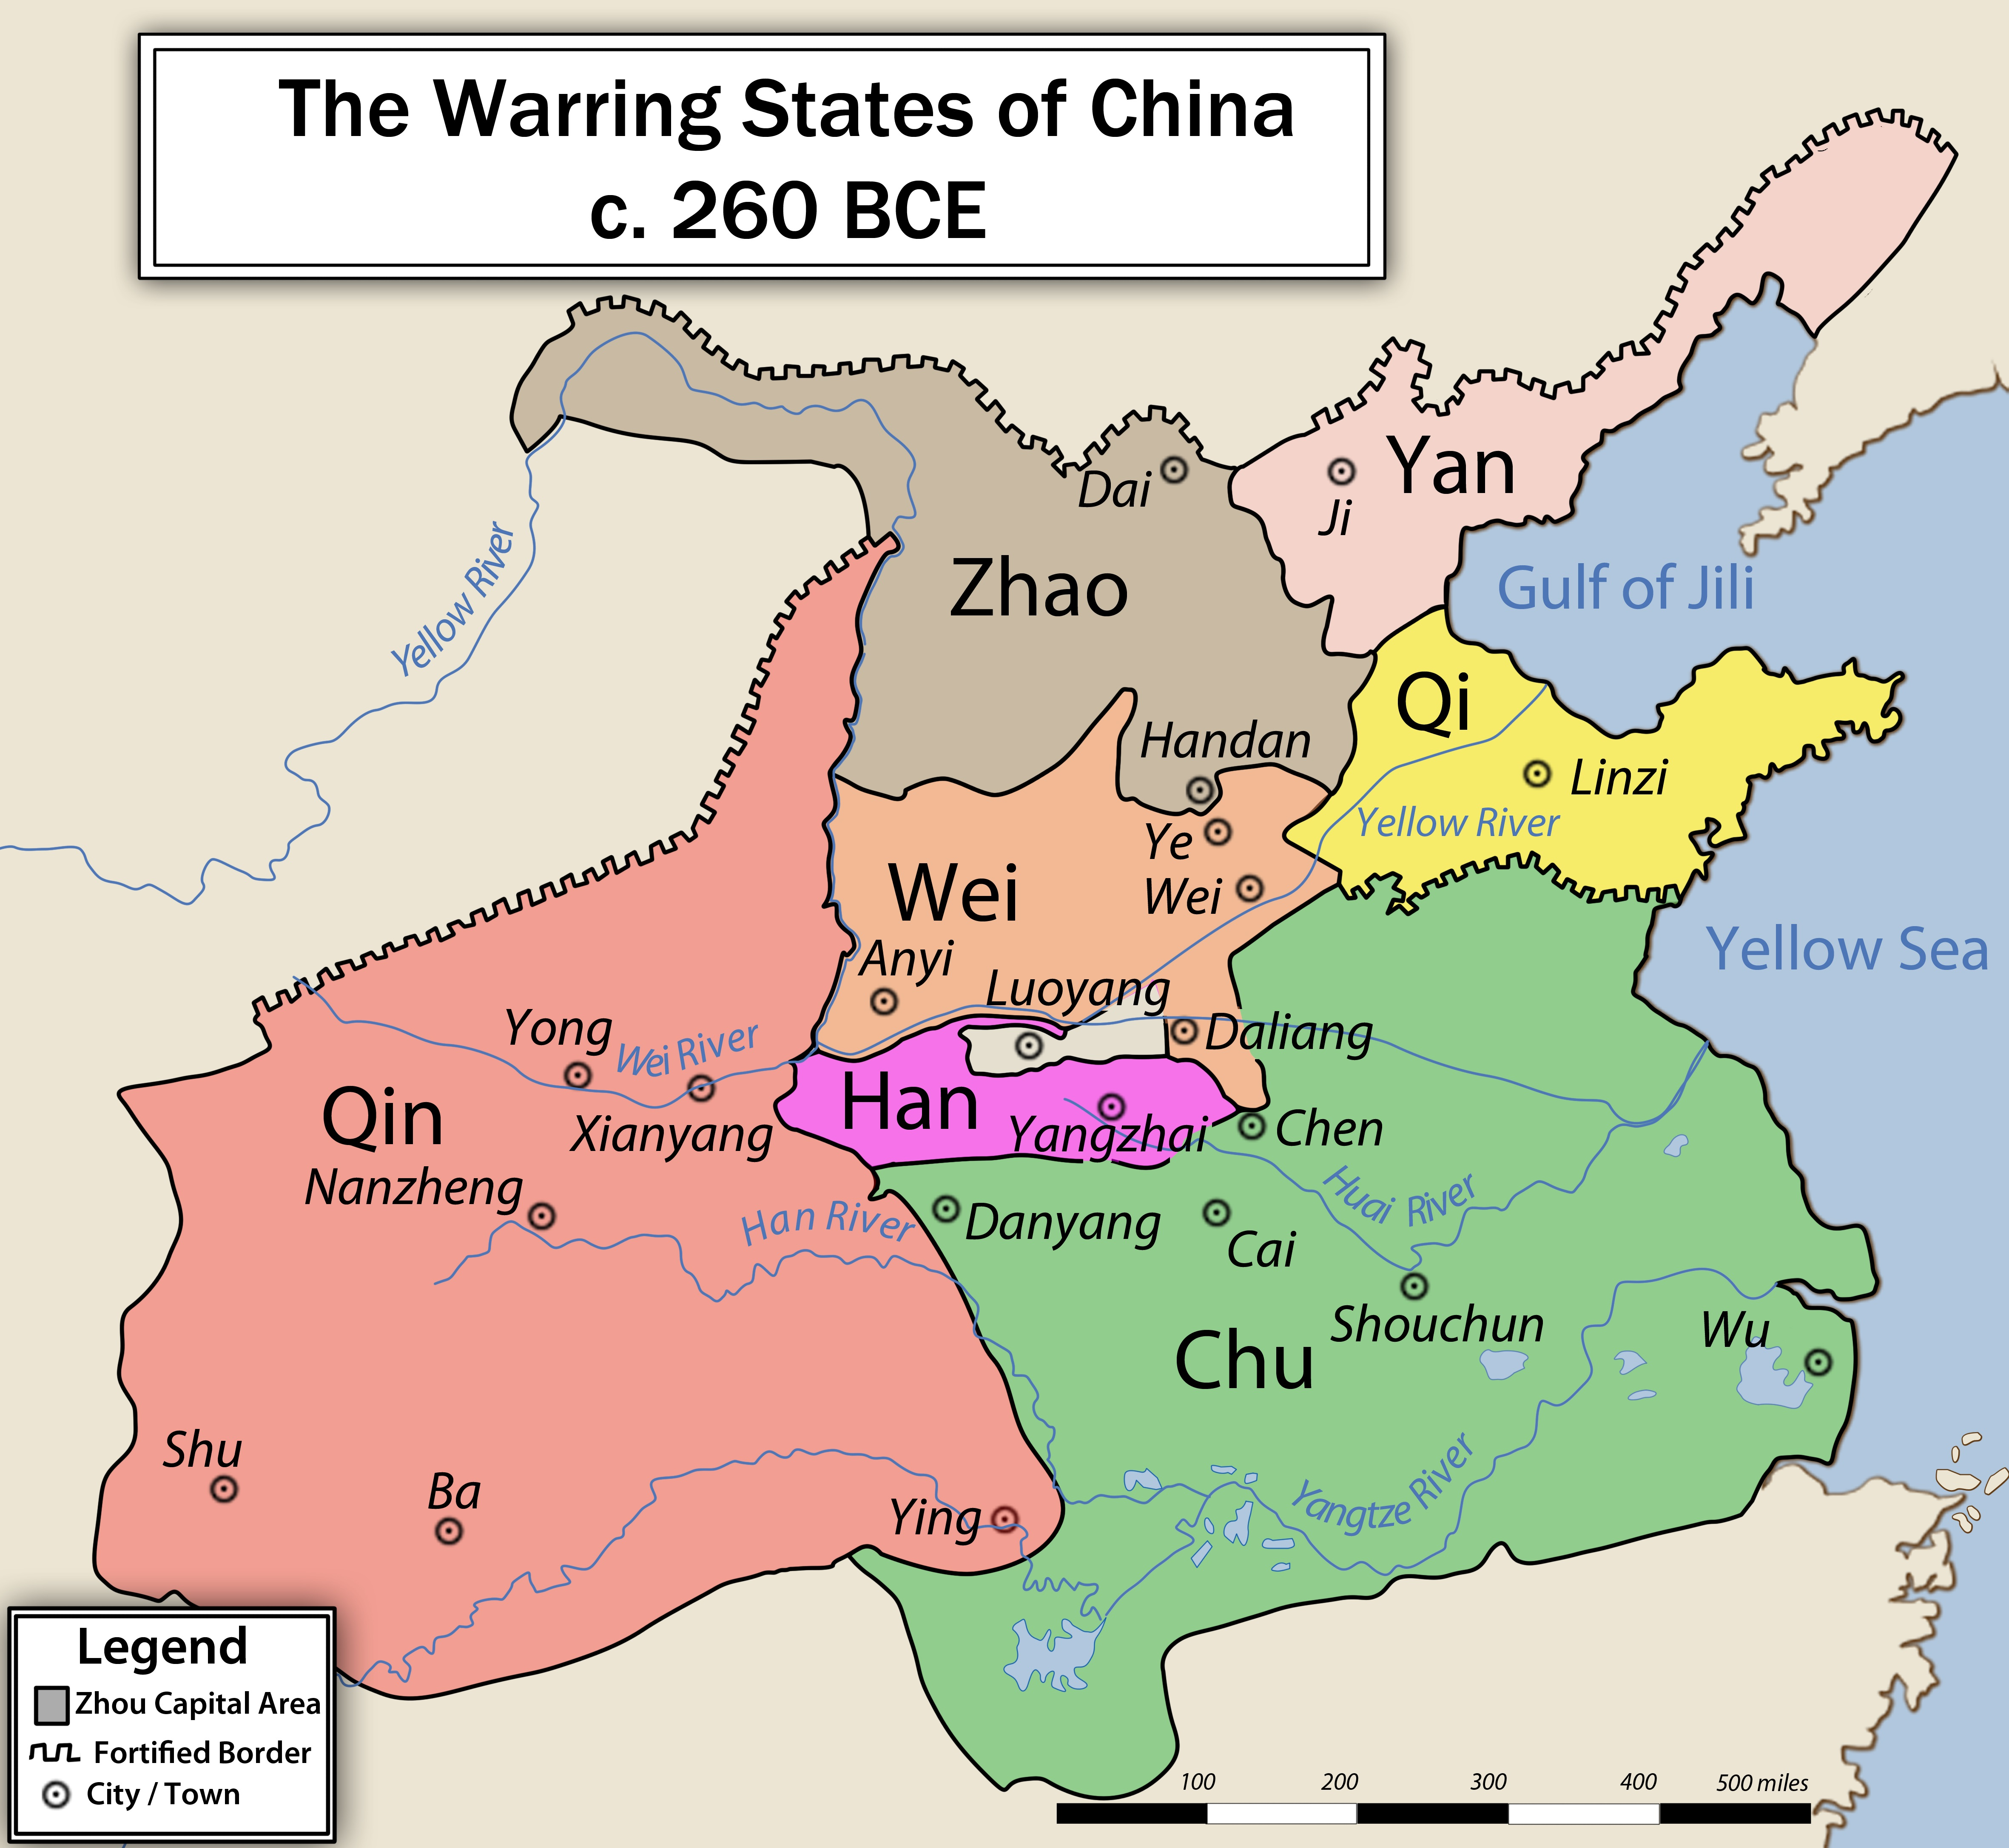
Warring States 戰國 (zhan guo)

Slide 6
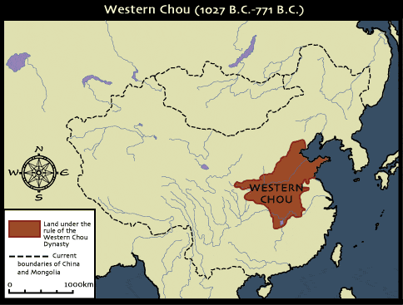
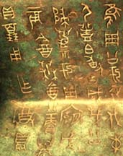
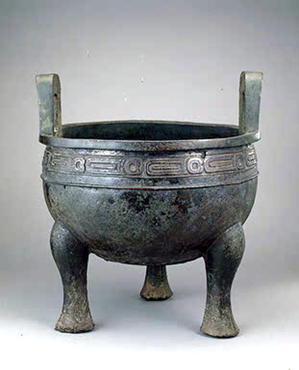
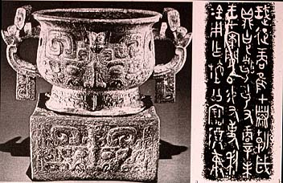

Slide 7
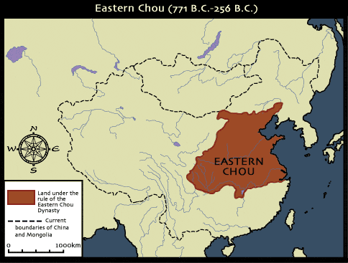

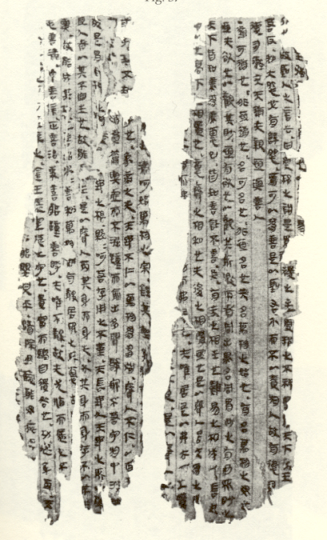
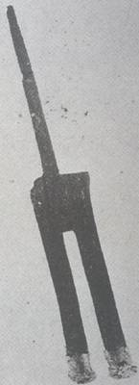

周

Slide 8
Guiding question
“To what extent was monarchic rule religiously or philosophically stipulated, or was it primarily conceived as an administrative necessity?”
(Pines, Envisioning the Empire, p. 14)

Slide 9
Religious Foundations of the ruler’s power
D. Keightley on the role of the Shang kings:
“It was the king who made fruitful harvests and victories possible by the sacrifices he offered, the rituals he performed, and the divinations he made. If, as seems likely, the divinations involved some degree of magic making or spell casting, the king’s ability to actually create a good harvest or a victory by divining about it rendered him still more powerful politically.”
→ Pontifical power of lineage heads; ancestral worship

Slide 10
Zhou overthrow of Shang
Significant political changes but religious continuity
‘Fiefs’ instead of loose alliances with other polities
Two-tier political system:
  Zhou monarch
  Regional feudal lords (zhuhou 諸侯)

Slide 11
Zhou religion
Power of lineage head remained intact
Intercourse with ancestors ritualized and formalized
Decline of divination (limited to resolving doubts)
Lineage had has exclusive access to ancestors
Mid-Western Zhou ritual reform

Slide 12
Zhou religion (cont.)
Kin-based religious community invariably headed by one person → conceptual foundations for monarchy; lineage and royal succession
BUT: not all feudal relations were based on kin, i.e. not all feudal lords were agnates of the royal Ji clan
→ non-ancestral system of religious legitimacy focusing on celestial and terrestrial deities (Heaven tian; “altars of soil and grain” sheji)
Cult of Heaven important source of authority for Zhou kings

Slide 13
Sources for Zhou religion
Early Western Zhou (1045-957); middle (956-858), late (857-771)
“Eulogies of Zhou” (Zhou song): performed during Western Zhou sacrifices
Royal speeches in the Book of Documents (Shangshu)
Bronze inscriptions (jinwen)
Ritual classics: Commentary on earlier sources:
  Rites and Ceremonies (Yili)
  Rites of Zhou (Zhouli)
  Book of Rites (Liji)

Slide 14
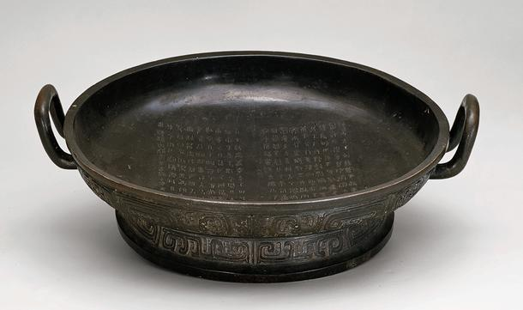
Shi Qiang bronze vessel (pan)
Middle Western Zhou Dynasty (end of tenth century B.C.)
Zhouyuan Administrative Office of Cultural Relics, Fufeng
©2015 National Gallery of Art, Washington D.C.

Slide 15
Bronze inscriptions (jinwen)
5,758 distinct inscriptions in Jinwen yinde (publ. 2001)
Bronze inscriptions complement and challenge transmitted sources
Example: ‘Heavenly mandate’ (tianming) and ‘Son of Heaven’ (tianzi) not well attested in bronze inscriptions → significant only in the late Western Zhou period (857-771 BCE)

Slide 16
Western Zhou sources
Commemorative function → “What do we wish to remember?”
Eulogistic; tendentious, even propagandistic diction
Audience: insiders who participated in the lineage ideology of the Zhou royal house
Focus on common origin and identity through common narrative of memory

Slide 17
Zhou Ancestral sacrifice
Space where ancestral spirits and living descendants could mingle
Sacrifice constituted and perpetuated identity of the living
Zhou king: sacrifice provides basis and legitimation to rule
Sacrifice embodied cultural practices of elite life; patterns of life that were handed down by the ancestors
Sacrifice was primary means to express, legitimize and enforce social hierarchy as well as solidarity
Sacrifice marked sacred space and time
Sacrifice to ensure continuation of past into the future (“may sons of sons, grandsons of grandsons, forever treasure and use [this sacrificial vessel]”
→ M. Kern: “the practice of writing as textual display evolved primarily within the setting of the ancestral sacrifice”

Slide 18
Part II: Ritual origins of the Warring States
Was the Shang religious mentality the origin of the bureaucratic state in China?
  Shang had no developed bureaucracy
Ritual basis of law
Rituals of control in the Court
Ritual invention of the sage king

Slide 19
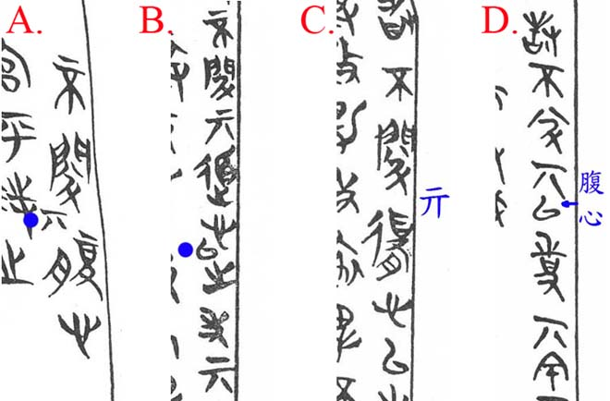
Houma Covenant Texts

Slide 20
Ritual basis of Chinese law
Covenants: ritual of covenant had dual function of binding independent groups and expelling unwanted elements from body politic → oath → reinforced by invocation of spirits and blood sacrifice
Excavated covenant texts represent “transitional stage” between inter-lineage covenants of Spring-and-Autumn period and law-based polities of Warring States
Casting of bronze vessels; medium for public proclamations, e.g. in the Zuozhuan
Legal texts as burial objects
Ritual significance of bestowing names → spell-binding power of naming → ritual based ‘rectification of names’ in Confucius thought

Slide 21
Rituals of control in the courts
Ceremonial and religious elements of techniques by which ruler controls his ministers
Source: Baoshan legal texts (ca. 316 BCE); state of Chu; individual cases to be adjudicated by central court
  Ceremony of appointment
  Application of ritual nomenclature to administration

Slide 22
Ritual invention of sage king
Royal power through ritual operations:
1. ability to respond to phenomena through trance and spirit possession
2. intellectual form of divination
3. ability to engage in spirit travel
Guanzi, ‘Inward training’ (‘Neiye’ 内業): Daoist “cosmo-psychological synthesis” (Lewis) → meditative procedures, spirit possession, and theory of sagely mind converge

Slide 23
Painted
image of a wu-shaman.
Detail of decorative images
on a zither excavated from
a Warring States–period
tomb in Chu (modern
Changtaiguan, Xinyang,
Henan) in 1957. Henan
Provincial Museum.

Slide 28
Detail from “Illustrations of Auspicious Anomalies” from Dunhuang, Gansu
(c. 8th–9th cent.), ink and colors on paper. The entry to the right on the Jiao-Dragon [no. 274] is missing an image that was not yet painted in. The text below cites the Guideways but is actually Guo Pu’s commentary to the relevant passage on this creature in chapter 5. The image to the left is identified as Yellow-Dragon (Huanglong). Bibliothèque Nationale de France (P.2683), Paris.

