Slide 1
WEEK THREE
Day Five
Session One
Presentations
Listening Skills & Presentation Feedback

Slide 2
Board Race
Brainstorm words and phrases that are useful to talk about places.
These could be adjectives – such as scenic
Nouns such as capital city
Verbs or phrases such as to go sightseeing.

Slide 3
City Presentations
Share your completed and up-to-date PPT on Teams. This will allow you to share your slides with us on the screen.
Choose a recording buddy. They will use your phone to record your presentation.
Each presenter will have up to three minutes to present the city they have selected. If you go over, I will stop you.
When you have completed your turn, upload your recording on Teams.
When you are not presenting, you are the audience. You should make notes about the presentation.

Slide 4
City Presentations
When you are the audience, you should make notes on:
Comprehensibility – Could you understand the presentation? If you had difficulty, why was that? Speed of delivery, unclear pronunciation, errors in language?
Interest – Did the presenter make the presentation interesting? How? Pace, humour, anecdotes or asides, choice of themes.
Clarity – Were the ideas clearly expressed? Note examples.
Visuals – How did the slides or any other visuals help you to follow the presentation?

Slide 5
Use the form below to make your notes
PSE Giving Feedback on a Classmate's Presentation.docx

Slide 6
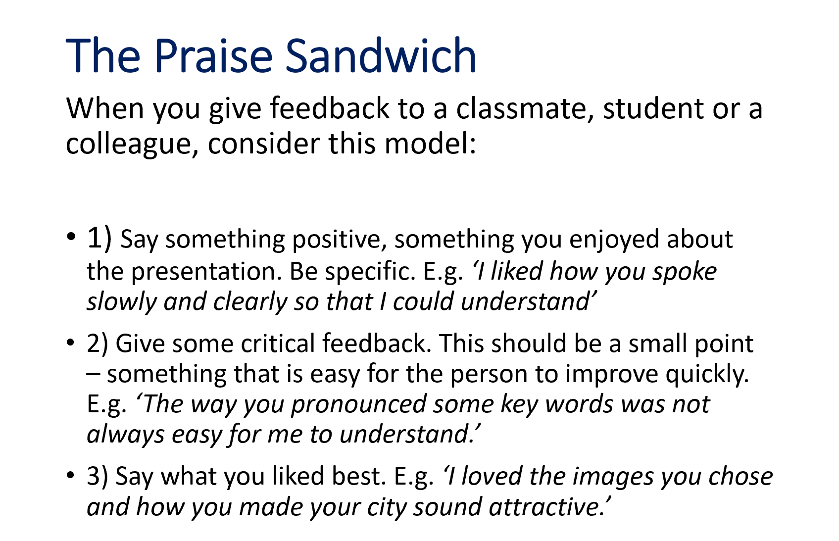
Giving Feedback
If you are asked to give feedback, use the Praise Sandwich.
If there is time, you might be able to ask a question.

Slide 7
Recording your Presentation buddy
Make sure the camera can see both the presenter and the slides.
Make sure the volume is turned up and we can hear the audio.
Set a 3-minute timer.
Signal when to start. Then start recording.
Signal when there is 1 minute left, then 30 seconds, then 15.
Signal when you are going to stop recording. Stop the recording.
Save the file [Chinese name of presenter – Presentation – week 3]

Slide 8
Presentations Timetable
Leon
Judy
Mamba
Joyce
Ross

Slide 9

Take a Break

Slide 10
WEEK THREE
Day FIVE
Session Two
Listening Practice
Discussion Practice
Review

Slide 11
Discussion Practice: Advances in Technology
What new technology do you use?
AI
Artificial Intelligence
VR
Virtual Reality
What are the advantages and disadvantages?
Immersive & Virtual Reality – UWTSD
Notes:
Make 2 lists (adv/disadv) in 2 groups. Share your lists on Teams

Slide 12
Listening Practice
S&L book pages 32-34
Note taking practice – listen to the presentation on VR & AR p. 33.

Slide 13
Listening Practice
Watch the band Boney M sing Painter Man
https://www.youtube.com/watch?v=xOVBMxnegwQ
Download the task sheet
Fill in the missing words.
What is the message of the song?
Do you agree with the lyrics? Why/why not?
Friday Song Painter Man Task.docx

Slide 14
Review Vocabulary
Play Kahoot!
www.Kahoot.it

Slide 15
Things you could do at the weekend
Parkland Views – A Two Mile Round Walk Around Waun Las NNR - National Botanic Garden of Wales
Good Journey – Getting to National Botanic Garden of Wales Car-free
Carmarthenshire County Museum | VisitWales
Parc yr Esgob – The Bishop's Park – Abergwili near Carmarthen
Castell Llansteffan | Cadw (gov.wales)
Go back to Tenby by train to enjoy the beach.

