Slide 1

Using Social Media to reach Customers.
Week 9 – LCLM4002 Digital Skills

Slide 2



During the session…
We will define and describe social media
Exploring how social media is used to reach customers
Examine and Evaluate company social media Content

Slide 3




What is Social Media?
Social media relates to networking sites and apps designed for people to swiftly and effectively post information in real-time. (NFI, 2021)
Social Media apps are diverse and numerous, but Meta dominates the sector with ownership of YouTube, Instagram and Facebook.
Notes:
Make it clear to students that a wide range of ever growing social media apps exist, other popular platforms are SnapChat and Telegram.
Whilst there are a range of personal uses for social media, the massive number of users generate income for the apps from the advertising and direct marketing that occurs via the apps.

Slide 4
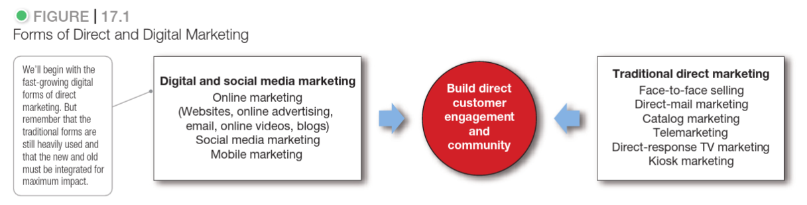
Reaching customers with social media
Source: Kotler, Armstrong and Opresnik (2018, Figure 17.1)
Marketing involves promoting products, brands and services to customers. During the past 15 years the way in which brands use marketing has changed dramatically. However, the aims of marketing remains the same: to build customer engagement.

Slide 5
Advantages
Using social media as a form of direct marketing, offers businesses and brands a range of advantages. (Kotler et al 2018)
User data
Flexibility
Social media apps allow brands to target their ads at their ideal customer.
Social media apps offer brands the ability to update and change ad content anytime.
Brands can check real-time data about unique user views of ads and products.
Social media ads can link the customer with the brand website with one click.

Slide 6
Challenges
Backlash
Embedding brand
Every type of customer engagement can have challenges. Social media is no different. Challenges will vary dependent on the platform, key challenges experienced on all apps are:
Social media is user lead, and reactions and responses to ads can be rapid and at times negative.
For a brand to avoid being viewed as an intruder they need to integrate with users.
Negative memes can be quickly made and virally shared, undermining the brand message.
Developing a brand presence with influencers and stories takes time to establish.

Slide 7

Moodle Poll
Go to the LCLM4002 Module Moodle Page - Week 9, complete the poll activity and see how your preferred social media compares with other students.
After a short break we will review our results.
Notes:
Time this activity with a short break to allow students to access Poll and complete – review the results with students – are they surprised or unsurprised by the responses. If we repeated the poll with younger or older people do you think the results would be different?

Slide 8
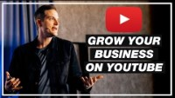
YouTube for Business
YouTube was established in 2005 by three former employees of PayPal.
The site was designed to be a platform for sharing video content. It is estimated that there are now 2 Billion users of YouTube.
How simple is it to be successful on YouTube?
Watch this video to learn more.
This offers a huge audience for brands and an opportunity to target their customers directly.
Notes:
Check the https://www.internetlivestats.com/ site to see how many current Youtube user are online now and how many videos are being uploaded today.
Emphasis how unchanged the format of youtube has been in the past 17years.
Watch the video as a class, highlight some of the real issues and successes that are shared by the business owners that the presenter speaks to.

Slide 9

Facebook for business
Established in 2004 by Mark Zuckerberg
Set up as a networking tool, allowing users to post short status updates and images.
Facebook has 3Billion regular users.
Notes:
https://www.youtube.com/watch?v=14amlEYDu_k – watch the first 9mins.

Slide 10
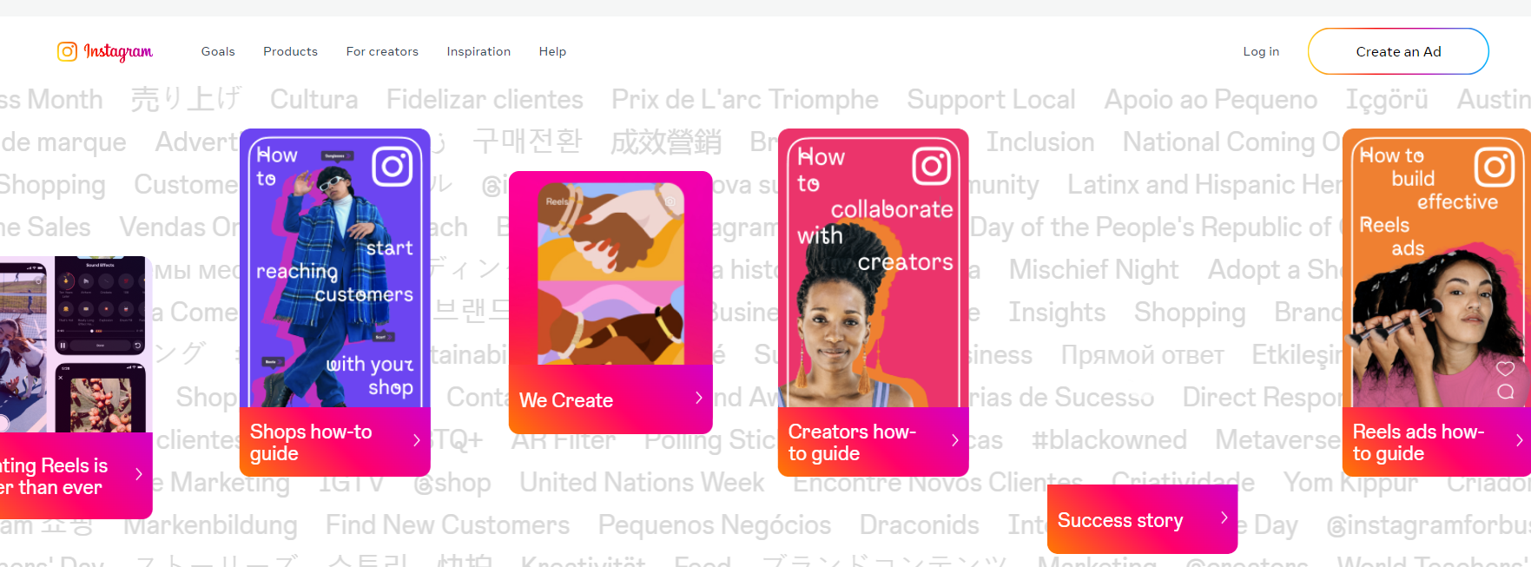
Instagram for Business
Instagram began in 2010 and focused on photo posting by users, allowing members to follow and interact with other users.
Notes:
Visit the Instagram for Business webpage to learn more about how to use the platform to grow a business brand presence - https://business.instagram.com/ - image has link embedded.
The ‘Get started’ page has a video of how to sign up - https://business.instagram.com/getting-started - show to students but avoid setting up an account or requesting that students set up an account in class in case of financial implications.

Slide 11

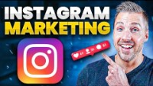


Instagram and Marketing
Instagram offers a major platform to millennial users who may not watch traditional television advertising or listen to radio ads. (Israfilzade &Babyev, 2020)
Instagram is a fast moving and constantly available app for user, so brands must be prepared to update content regularly and interact with users to build a following.
Watch the first few minutes of this Instagram guide to learn more.
Notes:
The video linked here included more information that the students need – watch a few mins to gain a sense of how strategic and planned a business needs to be if they are to maximise their impact on Instagram.

Slide 12
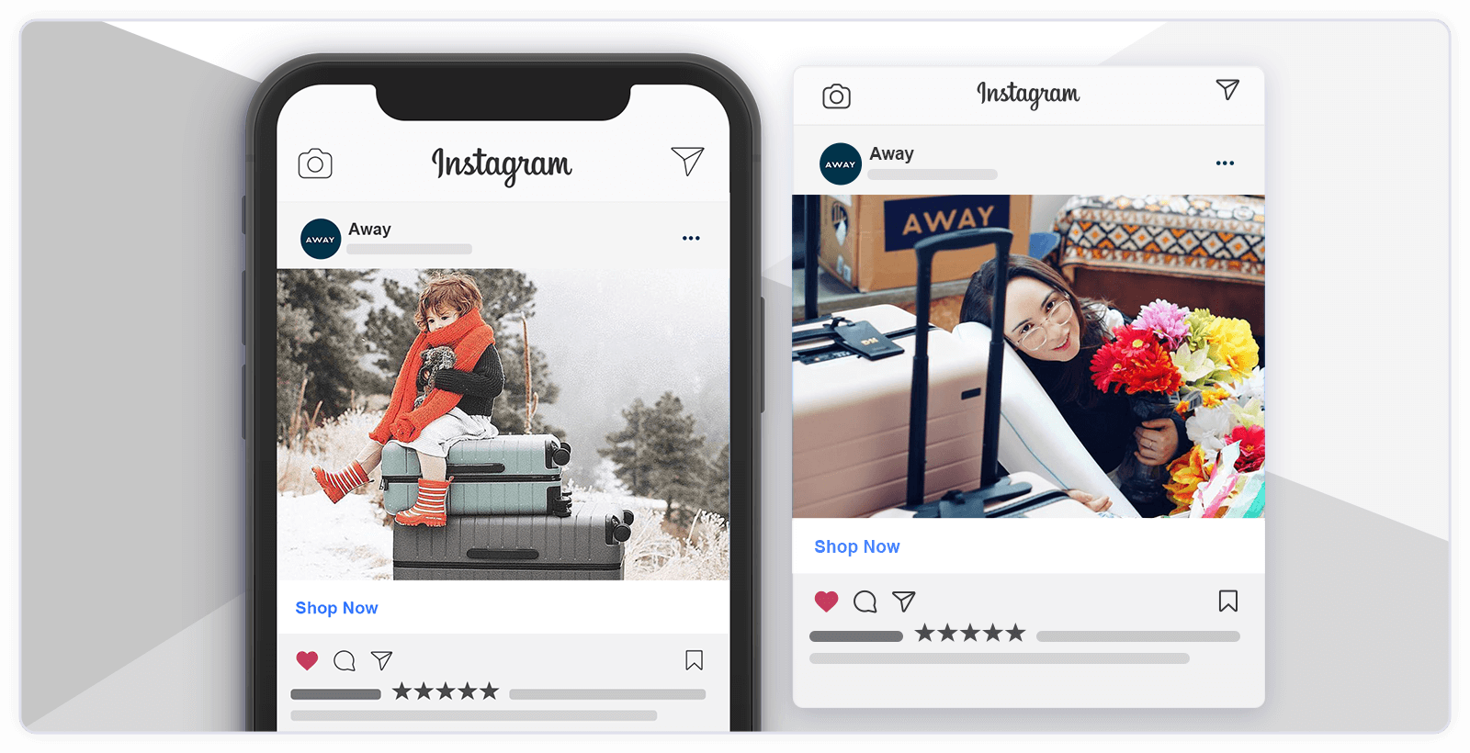
Case studies – Evaluate the ad
What Platform is this ad on?
Who is the ad aimed at?
How can user interact with the ad?
How could the ad be improved or developed?
How has the brand used colour?
Is the brand name made clear?
Do you notice the use of the brand name in the photo?
Notes:
https://business.instagram.com/success/ - Watch the Quantas success stories video.
Display the image and invite suggestion about who the target audience would be. Young or Old, Parents vs no children, poor vs affluent,
What are the strengths of the ad? – Bold image, opportunity to react to it and comment. Clearly stated brand name, Consistent use of colour, consistent use of nature.

Slide 13

Your turn – Evaluation Activity – 30mins
Complete the ‘Activity – Evaluate the Ads’ available in Week9 on the module Moodle Page.
Afterwards we will share some of the most inventive ideas for ad development.

Slide 14
Explore – Relevant literature
Task 3
Some students may have chosen to focus on Social Media for the Task 3 report.
Relevant journal articles and book chapters have been included in week 9.
Let’s signpost you to these now.

Slide 15
Next week..
Week 10 – Workshop
This is an opportunity to develop your ideas, plans and drafts for your task 3 activity.

Slide 16
References
Kotler, P., Armstrong, G. and Opresnik, M.O. (2018) Principles of marketing. 17th eds; global edition. Harlow: Pearson.
NFI (2021) What Is Social Media? – Everything You Need To Know, Available at: https://www.nfi.edu/what-is-social-media/ Accessed date: 09 Oct 2022

