Slide 1
BMSK4003
Digital Skills and Research Methods
Online Session 8
CertHE Skills for the Workplace

Slide 2
Module Aims
AIM(S)
To improve students’ digital skills within the workplace.
To develop awareness of the importance of effective analysis of information and its translation into knowledge.

Slide 3
Module Objectives
LEARNING OUTCOMES
Upon the successful completion of this module, the student should be able to demonstrate the ability to:
Evaluate the appropriate use of contemporary technologies to improve workplace efficiency and employability
Identify and effectively evaluate a range of information sources
Show competence in workplace data handling

Slide 4

Research Methods

Slide 5
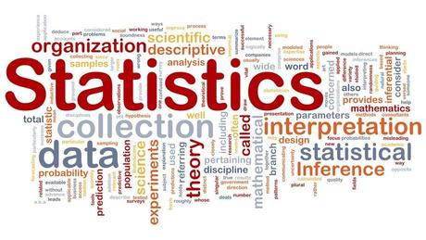
Statistics

Slide 6
Statistics
One of the reasons we are briefly looking at statistics in this module is that if you understand broadly what you are looking at, you will be able to:
Examine Raw Data, extract useful Information from it and turn it into Knowledge
Be discerning - which basically means you can ‘sort the wheat from the chaff’ or ‘see the wood for the trees’ and make judgements on the data or information before you.
These skills will enable you to Evaluate the information and make informed decisions on when and how to apply it.

Slide 7
Statistics
The purpose of descriptive statistics is to summarise or display data so we can quickly obtain an overview.
Descriptive statistics play an important role today because of the vast amount of data readily available at our fingertips.
Descriptive Statistics enable us to accurately summarise data to obtain the “big picture” - either graphically or numerically.
The most common descriptive statistic is the average.

Slide 8
Descriptive Statistics
Data are usually organised and presented in tables or graphs that summarise information, such as pie charts, bars or scatter-graphs.
Descriptive statistics are only descriptive and, therefore, do not involve generalising beyond the data that has been collected.

Slide 9
Inferential Statistics
Inferential statistics allow us to make claims (draw inferences) or form conclusions about a population, based on a sample of data from that population:
they cover a large variety of techniques that allow us to make actual claims about a population based on a sample of data.
can be used to make predictions about the population.

Slide 10
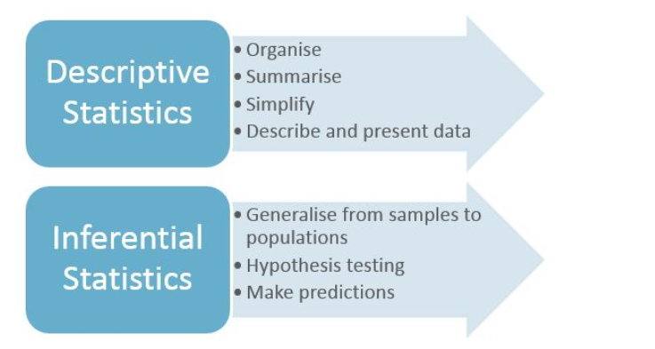
Descriptive vs Inferential

Slide 11
Population vs Sample
A population in statistics represents all possible measurements or outcomes.
A sample refers to a portion of the population that is representative of the population from which it was selected

Slide 12
Sampling
Virtually all statistical results are based on the measurements of a sample drawn from a population.
  E.g. Nielson ratings gather information on a small sample of homes for TV ratings
Measuring the entire population could be very expensive or even impossible
We can get very accurate information from samples

Slide 13
Interpretation – misleading stats
Take a look at this example:
'More than 80% of dentists recommend Colgate’.
Would you think that 80% of dentists recommended Colgate while 20% recommended other brands?

Slide 14
Interpretation
In fact, when dentists were surveyed, they could choose several brands instead of just one.
Therefore, other brands could be just as popular as Colgate.
The percentage of dentists who chose other brands was not presented in this example.
This completely misleading statistic was banned by the Advertising Standards Authority.

Slide 15
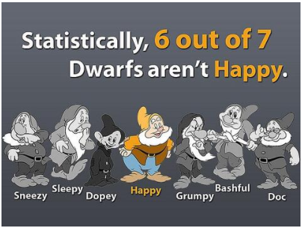
Therefore in the words popularised by Carl Sagan ( American astronomer, astrophysicist, author…)
consider yourself warned:
‘extraordinary claims require extraordinary evidence’.

Slide 16
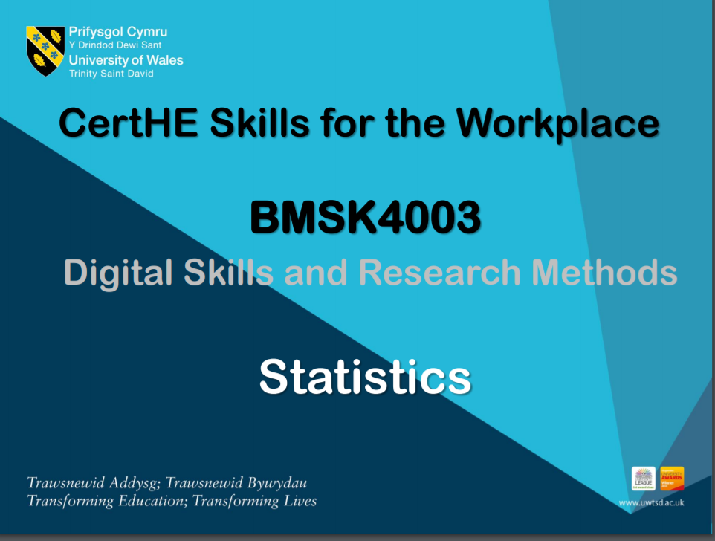
Statistics
There is a general overview of different types of statistics, what they measure and why in in the Resources Section of this module on Moodle.

Slide 17
References
ICO, (2018) ‘Guide to the Freedom of Information Act (FOI) [online] available at https://ico.org.uk/media/for-organisations/guide-to-freedom-of-information-4-9.pdf
ICO, (2018) ‘Guide to the General Data Protection Regulation (GDPR)’ [online] available at https://ico.org.uk/for-organisations/guide-to-the-general-data-protection-regulation-gdpr/
Maund, et al. (2017) Certificate in Higher Education: Skills for the Workplace Student Yearbook. London: Sage Publications Ltd.
Morgan, P. (2017) The Business Student’s Guide to Employability. London: Sage Publications Ltd.
Pierce, R. (2018) ‘Maths is Fun’ [online] available at http://www.mathsisfun.com/

