Slide 1

Name: Diana Anim
Student ID: 2240207
Module Title: Health, Wellbeing and Sustainable Development

Slide 2

Introduction
This presentation is titled as “The application of Health, Wellbeing and Sustainable Development and their integration into UK Health and Social Care Systems and Practise.
Purpose: The topic can be investigated thoroughly; theoretical, policy, and practice means to analyse research on the integration of health, wellbeing, and sustainability into the UK healthcare systems and NHS-programmes.
Scope: Discussion will cover SDG -3 alignment, Every Mind Matters campaign evaluation, governance structures, inequalities, barriers to access, and recommendations of balanced futuristic services.

Slide 3
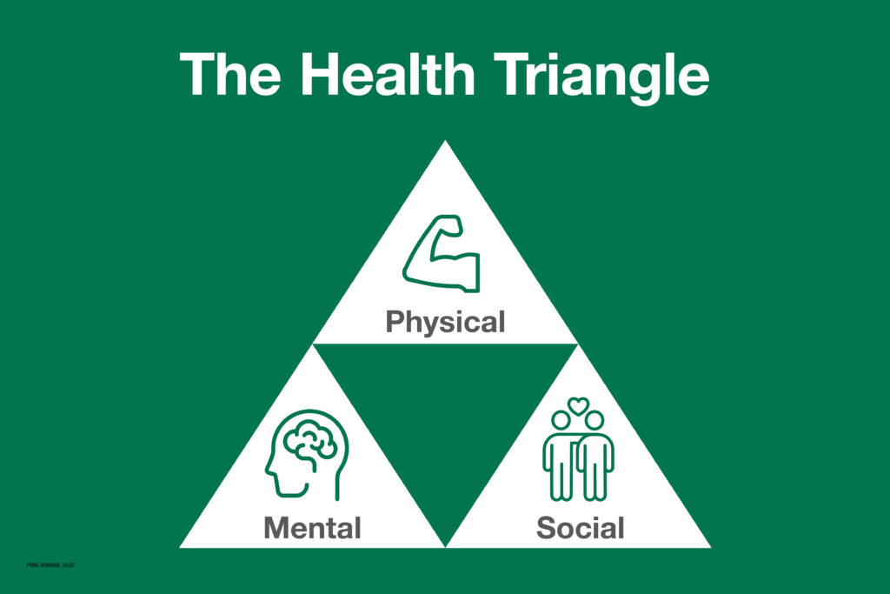
Definitions and Key Concepts [Health (physical, mental, social)]
Physical health: Best body functioning and lack of an illness that deteriorates everyday living.
  Definition: The State of efficient physiological functioning is called Physical (Taylor et al., 2022)
  Health and allows people to carry out daily activities with no considerable restriction.
Mental health: Cognitive-emotional condition which allows him to handle stress, productivity, and social contribution.
  Definition: Mental Health has been defined as the State of emotional, psychological, and cognitive wellbeing (Coronel-Santos and Rodríguez-Macías, 2022).
  This allows one to cope, make decisions, act resiliently, and be able to perform productively.
Social Health: Social Health Indicators are considered as confined to Social Relationships and Community Social Characteristics.
  Definition: Social health is the ability to form enabling relationships, belong to communities, and have positive and respectful social relationships (Doyle and Link, 2024)

Slide 4
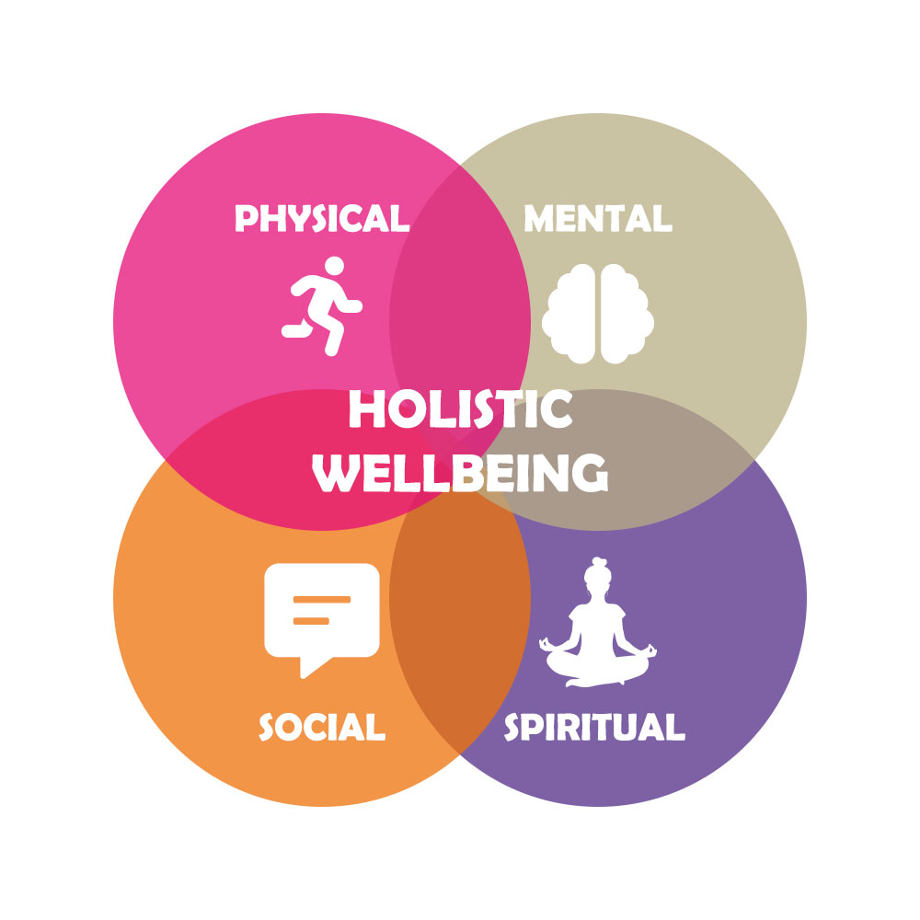
Definitions and Key Concepts [Wellbeing (holistic)]
Wellbeing is associated with physical, mental, social life satisfaction, purpose and positive emotion (Packheiser et al., 2024).
Anxiety and worthwhile, as well as subjective life satisfaction, are all UK measures of wellbeing.
England 2021 average wellbeing score was 26.0 which varied with age, health and loneliness (NHS, 2023).

Slide 5

Definitions and Key Concepts [Sustainable Development]
Sustainable development will make sure that the services are adequately designed to ensure that the health services do not impact on the well-being of the generations to come (Henderson and Loreau, 2023)
NHS England has aims to net zero emissions by the year 2040 (direct) and 2045 (supply chain).
The healthcare system in England has a carbon footprint of about 4-5 percent of the total greenhouse gas emissions in the country, and this has led to sustainability initiatives (NHS, 2022)

Slide 6
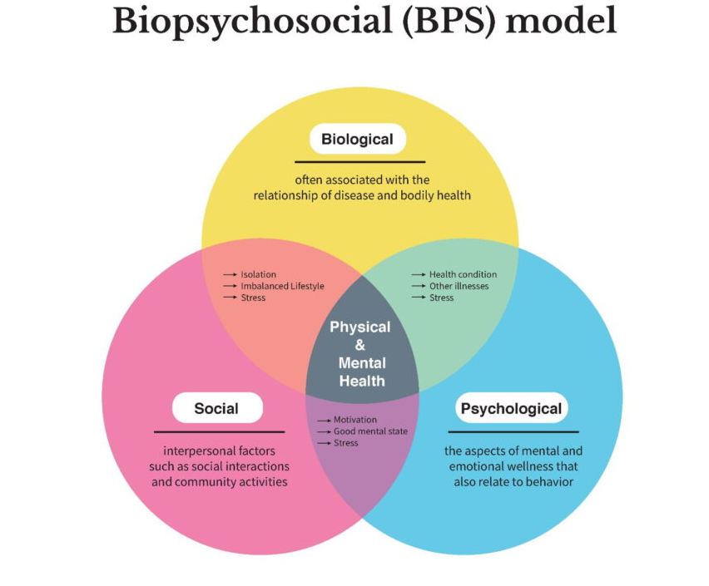
Theories and their application [Bio psychosocial Model]
Definition: Framework that combines biological, psychological, and social determinants in the explanation of health and illness in its entirety (Bolton, 2023)
Factors: biological (physiology), psychological (emotions, thinking), and social (support, socioeconomic situation) factors.
Relevance to topic: Enhances the holistic design of health services based on physical and mental health comorbidity (e.g. 40 of adults have long time conditions) (NHS, 2023)

Slide 7
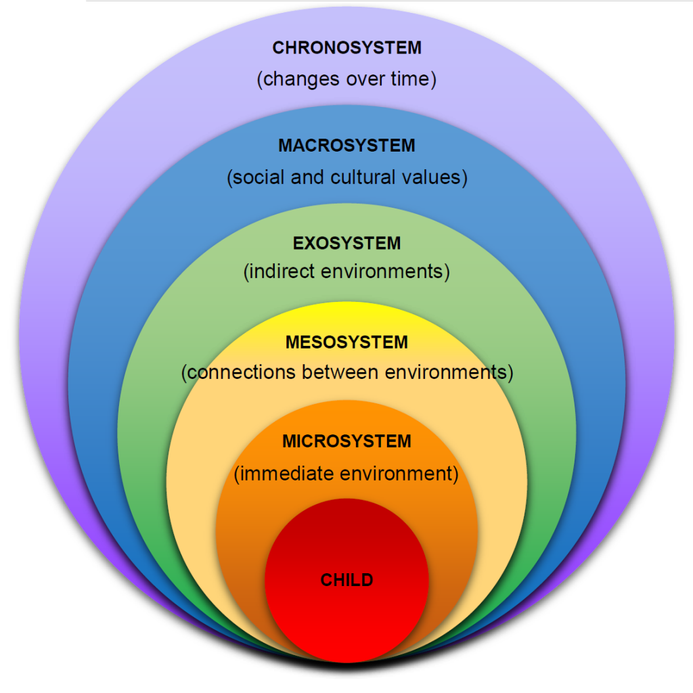
Theories and their application [Ecological Model]
Definition: Multilevel framework Health outcomes placed in the context of the individual, interpersonal, community, and society (Zhao et al., 2025)
Components: Nested levels Individual behaviour, social networks, community environments, public policy influences of health.
Connection to subject: Discourses on integrated care design in relation to social determinants and system-wide wellbeing outcomes in UK services.

Slide 8
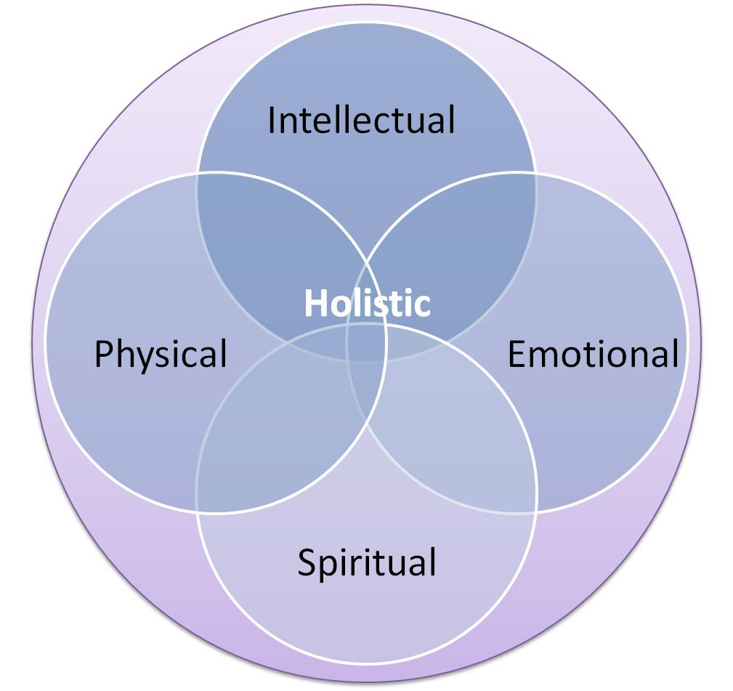
Theories and their application [Holistic Model]
Definition: Comprehensive care method that recognizes the physical, psychological, social, spiritual, and personal settings of people (Chintya, 2024).
Premises: Body, mind, environment, relationships, culture and community In assessing and Care planning.
Relevance to subject matter: In the UK integrated services, enables residents, all healthcare and the provision of sustainable health.

Slide 9

Sustainable Development Goals [Explanation]
SDGs refer to 17 global objectives embraced by the UK in order to enhance social, economic and environmental wellbeing (United Nations, 2025)
UK SDG reports on 81% of global indicators, improving the quantification of the progress to 2030 (UN, 2024)
The purpose of UK SDG monitoring is not to leave anyone behind by disaggregating the data to expose the inequalities.

Slide 10

SDG-3 integrated to concepts of health, wellbeing, and sustainability
SDG -3 is aimed at the promotion of health and wellbeing in all ages, killing or illness advances and mental wellbeing.
The UK records about 89% of indicators of SDG 3, which is the health equity and service quality progress monitoring (Sustainable Development Goals, 2023)
Integration is a way of ensuring sustainability of care through convergence of the priorities of prevention, reduction of chronic diseases and access to all.

Slide 11
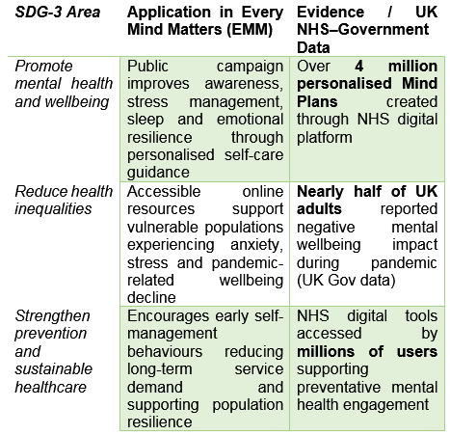
Relationship of the SDG 3 with the selected case
Every Mind Matters supports SDG 3 through raising mental health awareness and wellbeing behaviour in the population. Mind Plans, which are individualised, are over 4 million (NHS, 2023).
Mental health inequity in the UK is also addressed in the campaign through orienting the means of stress, anxiety, and sleep management. Almost half of the adults claimed to have been negatively affected by the pandemic on wellbeing.
Combination with SDG 3 sustainable goals is an incitement to preventive self-care and access to NHS support among adult populations.

Slide 12
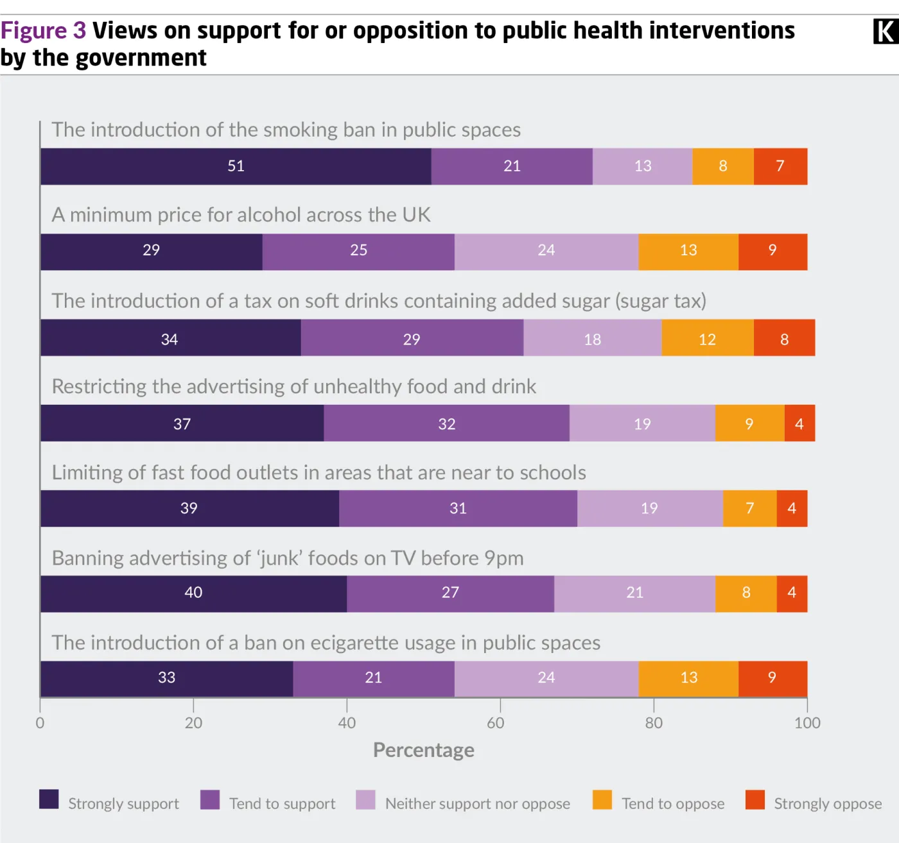
Key national and international frameworks
WHO Health in All Policies fosters cross-sector partnership to enhance the health outcomes of the population (Ham and Murray, 2026).
NHS Long Term Plan is a 10-year vision that focuses on the emphasis of prevention, community care and mental health integration (NHS England, 2026)
UK Policy Framework of Health and Social Care Research regulates the quality and ethical research practise in UK services.

Slide 13
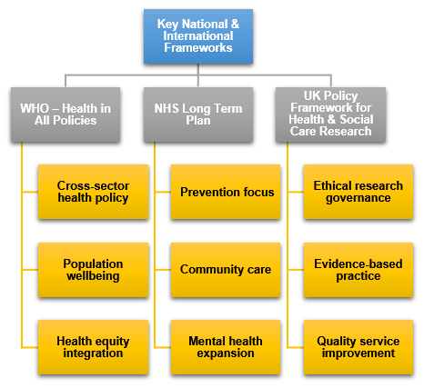
Influence of key national and international frameworks
Health in All Policies incorporates health factors in all decisions made by the government and eliminates systemic risks.
The Long Term Plan is a push towards greater community-based services and mental health services being included into NHS practise (Vusio et al., 2025)
Research policy framework enhances evidence-based practise, which guides a sustainable and fair provision of care.

Slide 14

Exploration of “Every Mind Matters”
Every Mind Matters provides adults with NHS-approved plans of the mind, which help overcome stress, anxiety, mood, and sleep issues with the self-direction of information. To date, the number of developed plans exceeds 4.7 million, which proves the wide coverage with preventative mental wellbeing resources (GOV.UK, 2026)
The campaign combines a social campaign with mental health promotion and sustainable wellbeing by empowering individuals to have evidence-based everyday coping skills supported by NHS and other partners. It focuses on individual behaviour and resilience of the population, which minimises the service burden in the long run.
When it comes to national mental health issues and the minimization of disparities, engagement with mental health charities, local governments and online platforms increases reach and equity of advice (Parenteau et al., 2022). Almost one-half of adults have reported adverse mental wellbeing effects of the pandemic that emphasises the need to be addressed easily.

Slide 15
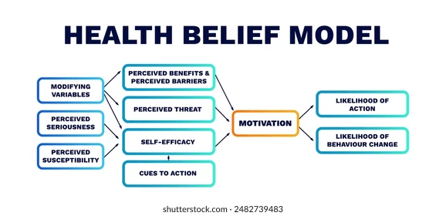
Use of HBM to explain the planning of Every Mind Matters
The perceived vulnerability and severity are countered using the NHS messaging that underlines prevalence of stress; approximately 1 in 6 adults report common mental disorders at least once per week (NHS, 2025)
The motivation to change behaviour is addressed through perceived advantages and obstacles using individualised Mind Plans that are complex behaviour change; generated plans show over 4 million plans have been created with practical participants of self-care behaviours (DHSC/NHS).
Digital reminders, quizzes and reminders in turn fortify cues to act and self-efficacy, 2.3 million adults have visited the NHS online mental health tools in campaign stages (GOV.UK, 2026)

Slide 16

Equity and Access
There are great ethnic imbalances such as emergency TB hospitalizations up to 29 times the White British populations (Davies et al., 2024)
Digital exclusion endangers equal access because lack of deprivation is associated with lower NHS app uptake.
Equality duty is incorporated in the NHS policy, wherein all design and reasonable adjustments should be made towards vulnerable groups.

Slide 17

Recommendations
Increasing the digital support by providing training, low-cost connections as well as non-digital parallels.
Improving the disaggregated data collection based on ethnicity, SES and disability to take appropriate actions in terms of resource allocation (Ponce et al.,2025)
Empowering place-based preventive measures of the deprived communities to curb inequities and inequities of diseases chronologically and infectiously.

Slide 18

Conclusion
Integrated analysis proves holistic models and SDG -3 forums enhance preventative, equitable, and sustainable UK health and social care provision.
The review of Every Mind Matters demonstrates that it is evaluated as effective in population engagement and preventative promotion of mental health in the long-term NHS sustainability goals.
Continuing inequalities, such as lack of access to resources, ethnicity and digital divide demand policy-based approaches where information is used to inform policy and deployment of inclusive growth approaches to achieve equitable future healthcare provisions and outcomes.

Slide 19
References
Bolton, D. (2023) ‘A Revitalized Biopsychosocial model: Core theory, Research paradigms, and Clinical Implications’, Psychological Medicine, 53(16), pp. 1–8. Available at: https://doi.org/10.1017/s0033291723002660.
Chintya, Y. (2024) ‘The Effectiveness of Holistic Nursing Care in Enhancing Psychosocial Well-Being and Quality of Life in Cardiovascular Patients’, The Journal of Academic Science, 1(8), pp. 964–978. Available at: https://doi.org/10.59613/6q0s5f92.
Coronel-Santos, M.A. and Rodríguez-Macías, J.C. (2022) ‘Integral definition and conceptual model of mental health: Proposal from a systematic review of different paradigms’, Frontiers in Sociology, 7. Available at: https://doi.org/10.3389/fsoc.2022.978804.
Davies, J.M., Leniz, J., Chua, K.-C., Williamson, L.E., Bajwah, S., Bolton, T., Bone, A.E., Hocaoglu, M., Verne, J., Fraser, L.K., Barclay, S., Murtagh, F.E.M., Higginson, I.J. and Sleeman, K.E. (2024) ‘Association between ethnicity and emergency department visits in the last three months of life in England: a retrospective population-based study using electronic health records’, BMJ Public Health, 2(2), pp. e001121–e001121. Available at: https://doi.org/10.1136/bmjph-2024-001121.
Doyle, D.M. and Link, B.G. (2024) ‘On social health: history, conceptualization, and population patterning’, Health Psychology Review, 18(3), pp. 1–30. Available at: https://doi.org/10.1080/17437199.2024.2314506.
GOV.UK (2026) Better Health Every Mind Matters, Campaign Resource Centre. Available at: https://campaignresources.dhsc.gov.uk/campaigns/better-health-every-mind-matters/?utm_source=chatgpt.com (Accessed: 6 February 2026).
Ham, C. and Murray, R. (2026) The NHS 10-year Plan, The King’s Fund. Available at: https://www.kingsfund.org.uk/insight-and-analysis/long-reads/nhs-10-year-plan (Accessed: 6 February 2026).
Henderson, K. and Loreau, M. (2023) ‘A model of sustainable development goals: Challenges and opportunities in promoting human well-being and environmental sustainability’, Ecological Modelling, 475(1), p. 110164.
NHS (2022) Climate and health: applying All Our Health, GOV.UK. Available at: https://www.gov.uk/government/publications/climate-change-applying-all-our-health/climate-and-health-applying-all-our-health?utm_source=chatgpt.com (Accessed: 6 February 2026).
NHS (2023a) Every Mind Matters, nhs.uk. Available at: https://www.nhs.uk/every-mind-matters/ (Accessed: 6 February 2026).
NHS (2023b) Health Survey for England, 2021 part 2, NHS. Available at: https://digital.nhs.uk/data-and-information/publications/statistical/health-survey-for-england/2021-part-2/loneliness-and-wellbeing?utm_source=chatgpt.com (Accessed: 6 February 2026).
NHS (2025) Adult Psychiatric Morbidity Survey: Survey of Mental Health and Wellbeing, England, 2023/4, NHS. Available at: https://digital.nhs.uk/data-and-information/publications/statistical/adult-psychiatric-morbidity-survey/survey-of-mental-health-and-wellbeing-england-2023-24/common-mental-health-conditions (Accessed: 6 February 2026).
NHS England (2026) NHS Long Term Plan, NHS England. Available at: https://www.longtermplan.nhs.uk/ (Accessed: 6 February 2026).
Packheiser, J., Hartmann, H., Fredriksen, K., Gazzola, V., Keysers, C. and Michon, F. (2024) ‘A systematic review and multivariate meta-analysis of the physical and mental health benefits of touch interventions’, Nature Human Behaviour, 8(6), pp. 1–20. Available at: https://doi.org/10.1038/s41562-024-01841-8.
Parenteau, A.M., Boyer, C.J., Campos, L.J., Carranza, A.F., Deer, L.K., Hartman, D.T., Bidwell, J.T. and Hostinar, C.E. (2022) ‘A review of mental health disparities during COVID-19: Evidence, mechanisms, and policy recommendations for promoting societal resilience’, Development and Psychopathology, 35(4), pp. 1–22. Available at: https://doi.org/10.1017/S0954579422000499.
Ponce, N.A., Becker, T. and Shimkhada, R. (2025) ‘Breaking Barriers with Data Equity: The Essential Role of Data Disaggregation in Achieving Health Equity’, Annual Review of Public Health, 46. Available at: https://doi.org/10.1146/annurev-publhealth-072523-093838.
Sustainable Development Goals (2023) Reporting Status - U.K. Indicators For The Sustainable Development Goals, Sdgdata.gov.uk. Available at: https://sdgdata.gov.uk/reporting-status/?utm_source=chatgpt.com (Accessed: 6 February 2026).
Taylor, J.A., Greenhaff, P.L., Bartlett, D.B., Jackson, T.A., Duggal, N.A. and Lord, J.M. (2022) ‘A Multisystem Physiological Perspective of Human Frailty and Its Modulation by Physical Activity’, Physiological Reviews, 103(2). Available at: https://doi.org/10.1152/physrev.00037.2021.
UN (2024) 17 goals to transform our world - U.K. Indicators For The Sustainable Development Goals, sdgdata.gov.uk. Available at: https://sdgdata.gov.uk/ (Accessed: 6 February 2026).
United Nations (2025) THE 17 GOALS | Department of Economic and Social Affairs, sdgs.un.org. Available at: http://sdgs.un.org/goals (Accessed: 6 February 2026).
Vusio, F., Odentz, K. and Plunkett, C. (2025) ‘Experience of compassionate care in mental health and community-based services for children and young people: facilitators of, and barriers to compassionate care– a systematic review’, European Child & Adolescent Psychiatry [Preprint]. Available at: https://doi.org/10.1007/s00787-025-02711-y.
Zhao, C., Yuan, J. and Huang, W.W. (2025) ‘Multilevel determinants of physical activity in children and adolescents: a meta-analysis guided by social ecological model’, BMC Sports Science Medicine and Rehabilitation, 17(1). Available at: https://doi.org/10.1186/s13102-025-01225-z.

Slide 20


