Slide 1

Rachel Jones
2308282
Youth In Action
Tackling Today’s Toughest Issues.
ECYW6009

Slide 2

Poverty!!!
Cost of living crisis

Slide 3
Definition of Poverty!!
“Poverty means not having enough resources to meet basic needs, live with dignity, and participate fully in society. It can harm health, education, and social and emotional wellbeing, limiting opportunities and reducing young people’s aspirations.” – Joseph Rowntree Foundation (JRF,2025).

Slide 4
Cost of living crisis !!!
Energy bills
Food and grocery prices
Housing costs (rent and mortgages)
Fuel and transport costs
Household goods and essentials
Interest rates and borrowing costs
Childcare and everyday living expenses
(ONS,2025), (JRF,2025)

Slide 5
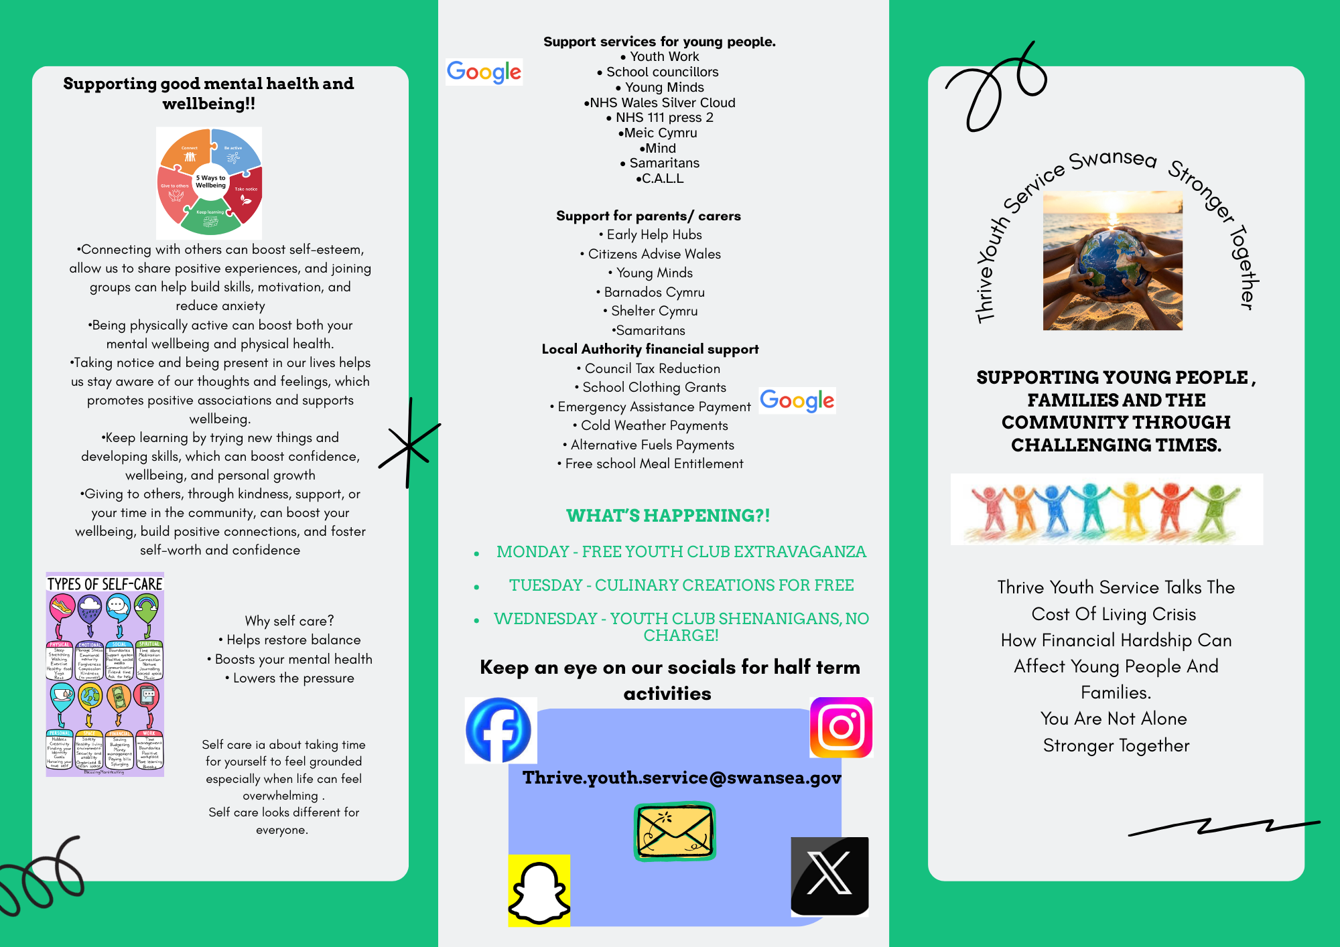
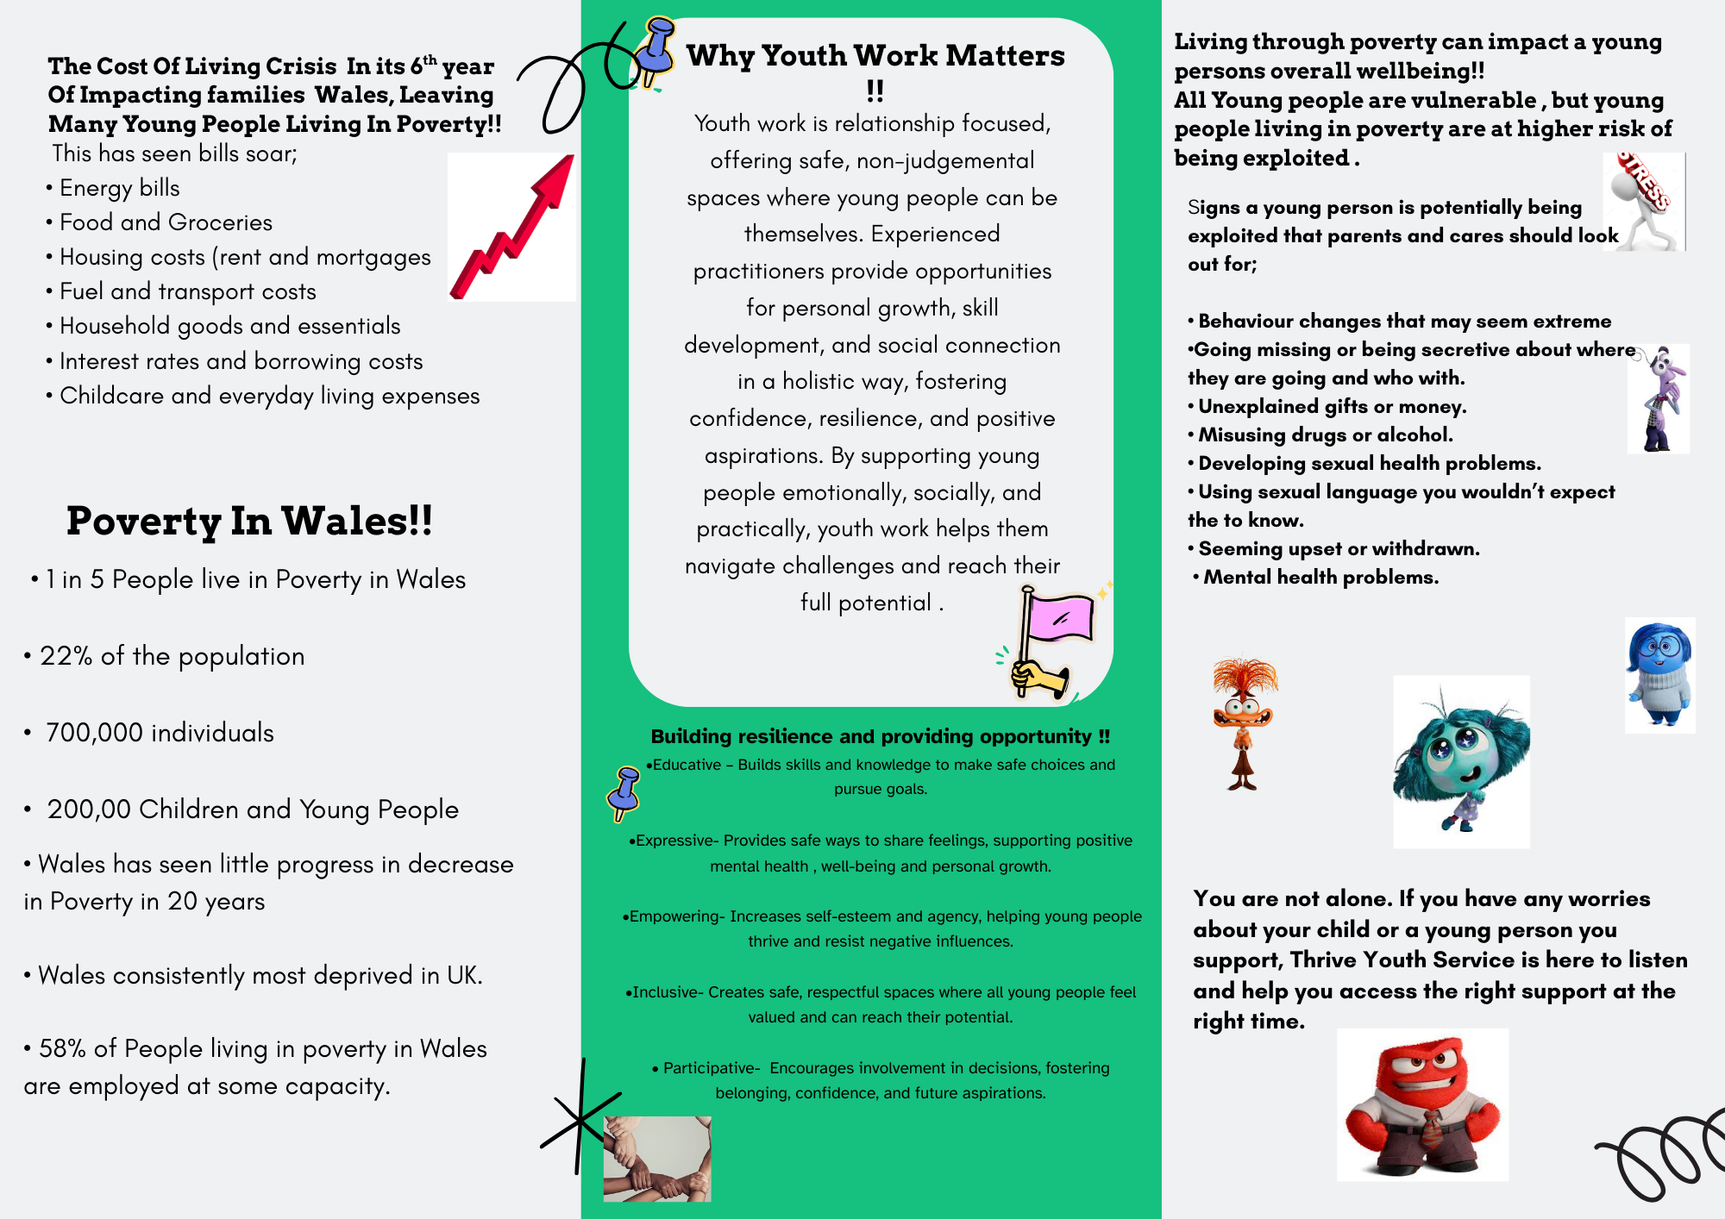
Advisory Leaflet

Slide 6
Poverty in Wales.
1 IN 5 People live in poverty in Wales .
22% of the population .
700,000 individuals .
200,000 children.
(JRF, 2025)

Slide 7


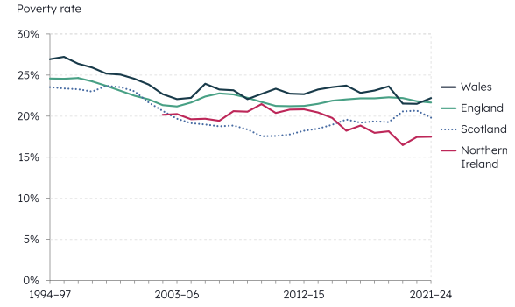
UK poverty statistics!!
(JRF, 2025)

Slide 8
Employment in Wales !!!
(JRF,2025)

Slide 9
(JRF,2025)

Slide 10

This shows that rising inflation is outpacing wages, leaving many working households still living in poverty (UK Parliament ,2025)

Slide 11
(JRF,2025)

Slide 12
Main factors affecting people living in poverty!!
Poorer overall health
Higher risk of illness at all ages
Shorter life expectancy
Fewer healthy years of life
Health problems starting young and lasting into adulthood
Big gaps between rich and deprived areas
Lower school achievement
Disadvantaged pupils falling behind early
Fewer job and income opportunities later
Ongoing cycle of poverty between generations
(JRF,2025)

Slide 13
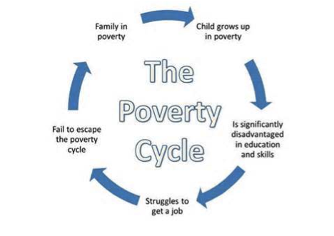
Persistent poverty in children and young people can be considered a form of toxic stress . A prolonged adverse childhood experience that can have a negative, lasting impact on their current and future life experiences, wellbeing, and aspirations.
(CFDCP,2024) (JRF,2025)

Slide 14
Poverty effects on a young persons subjective and objective wellbeing!!!
Emotional & Social Impacts
More stress and anxiety
Lower confidence and self-esteem
Higher risk of mental health problems
Feeling excluded or stigmatised
Weaker sense of belonging
Fewer opportunities for access to youth provision or activities
Increased risk of bullying and isolation
(JRF,2025)
(UNICEF,2021)

Slide 15
UNICEF ON SUBJECTIVE WELLBEING!!
UNICEF defines subjective wellbeing as a person’s experience of positive or negative emotions, their judgement of life experiences, and overall life satisfaction.
Negative factors associated with poverty like stress, social exclusion, and lack of opportunities can harm how young people perceive their overall wellbeing.
(UNICEF,2021)

Slide 16
Objective Outcomes!!!
Physical health - higher risk of illness, low birth weight, poor long-term health
Mental health - stress, anxiety, psychological distress
Education - poorer attendance, lower attainment, reduced engagement in learning
Participation - missing school trips, extracurriculars, holidays, and youth services
Social - isolation, stigma, fewer friendships, limited opportunities for activities
Long-term risk - greater chance of disadvantage in adulthood
( Children Poverty for Action Group, 2024)

Slide 17

“ No child should grow up hungry, cold or without hope for the future”
(WG,2025)

Slide 18

• Over 7 billion pounds invested to help reduce poverty in Wales since 2022.
• Free school meals / Breakfast club.
• Flying start.
• Increase of minimum wage .
• School Essentials Grants.
• Over 55,000 young people supported into education, training , employment ( Young persons guarantee scheme)
(WG,2025)

Slide 19
Wellbeing of future generations act (2015).
A more prosperous Wales – Where everyone has jobs and equal opportunity regardless of age , sex, ethnicity or background and there is no poverty.
A more equal Wales- Where everyone has an equal chance whatever their background .
(WG,2025)

Slide 20
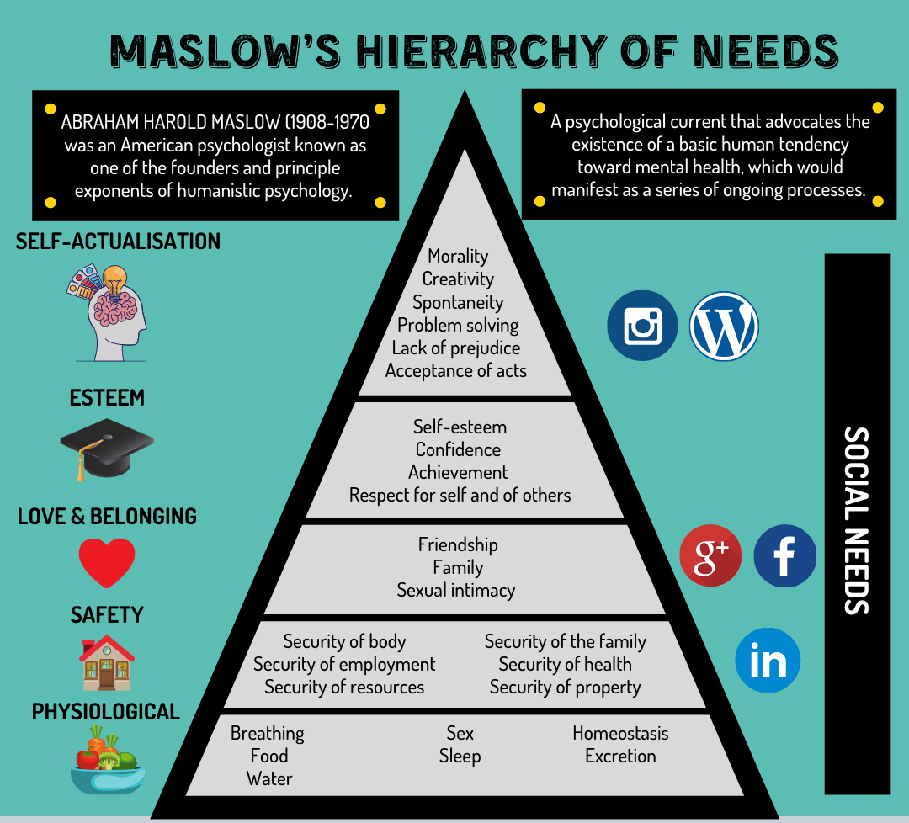
Maslow!!
Maslow’s hierarchy of needs shows that young people must have their basic needs food, shelter, safety, and security met before they can focus on higher-level needs like friendships, self-esteem, and personal growth. Without these foundations, poverty, stress, or unsafe conditions can prevent them from forming healthy relationships, building confidence, or developing a sense of purpose. This limits their life fulfilment, achievement of goals, and ability to reach their full potential, making it essential to ensure basic needs are secured for young people to thrive emotionally, socially, and academically.
(CAHMS, 2021)

Slide 21

“The Welsh Government is calling on Westminster to act so every child, young person and their family in Wales has the chance to prosper and thrive.”
(WG,2025)

Slide 22
“Barnardo’s warns that the cost-of-living crisis is having an unprecedented impact on children, young people, and families, leaving more children vulnerable to criminal and sexual exploitation.”
(Edwards , 2023)

Slide 23
ALL YOUNG PEOPLE ARE VULNERABLE, BUT LIVING THROUGH POVERTY CAN INCREASE RISK!!
All young people face risks during adolescence
Poverty can increase exposure to exploitation and harm
Financial hardship can make risky offers seem more attractive
Social exclusion can increase susceptibility to grooming
Poor mental health and feelings of isolation can increase vulnerability
Lack of trusted adult support can leave young people more exposed to exploitation
(JRF,2025)

Slide 24
Risks linked to increased vulnerability!!!
County lines exploitation
Child criminal exploitation (CCE)
Gang involvement
Online exploitation
Substance misuse
School exclusion and disengagement

Slide 25
Signs to look out for !!!
Sudden changes in behaviour, that seem extreme
Spending more time away or going missing from home or school
Being secretive about how they’re spending their time, including when using online devices
Having unexplained gifts, big or small
Misusing alcohol and/or drugs
Having a friendship or relationship with a much older person
Developing sexual health problems
Using sexual language, you wouldn’t expect them to know
Seeming upset or withdrawn
Mental health problems (NSPCC,2024)

Slide 26
PREVENTION AND EARLY SUPPORT MATTER!!!
Early support and protective relationships reduce risk
Tackling poverty is part of safeguarding young people
Prevention is more effective than late intervention
(JRF, 2025)

Slide 27
Why youth work matters !!!
Youth work is relationship focused, offering safe, non-judgemental spaces where young people can be themselves. Experienced practitioners provide opportunities for personal growth, skill development, and social connection in a holistic way, fostering confidence, resilience, and positive aspirations. By supporting young people emotionally, socially, and practically, youth work helps them navigate challenges and reach their full potential .
(CLD Standards Council Scotland, 2019)

Slide 28
Protective factor for young people!!
Educative – Builds skills and knowledge to make safe choices and pursue goals.
Expressive- Provides safe ways to share feelings, supporting positive mental health , well-being and personal growth.
Empowering- Increases self-esteem and agency, helping young people thrive and resist negative influences.
Inclusive- Creates safe, respectful spaces where all young people feel valued and can reach their potential.
Participative- Encourages involvement in decisions, fostering belonging, confidence, and future aspirations.
(Youth Work in Wales Review Group,2022)

Slide 29
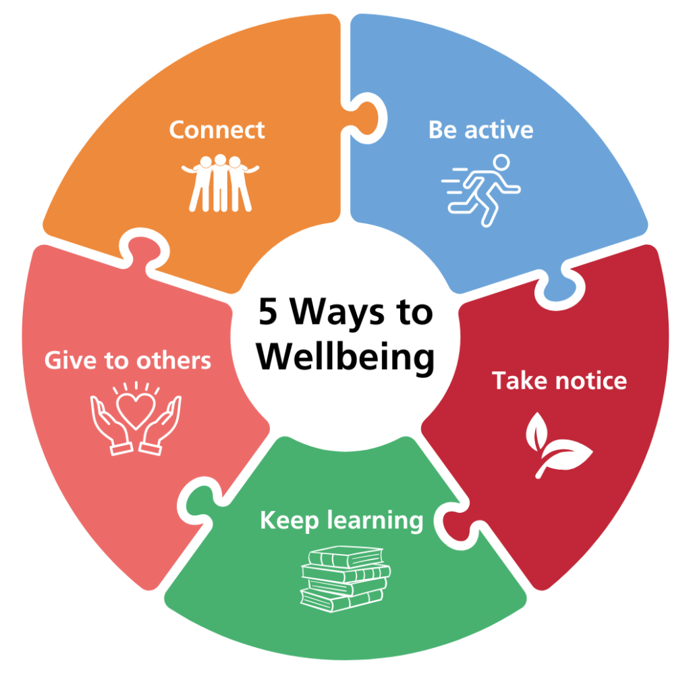
Connecting with others can boost self-esteem, allow us to share positive experiences, and joining groups can help build skills, motivation, and reduce anxiety.
Being physically active can boost both your mental wellbeing and physical health.
Taking notice and being present in our lives helps us stay aware of our thoughts and feelings, which promotes positive associations and supports wellbeing.
Keep learning by trying new things and developing skills, which can boost confidence, wellbeing, and personal growth.
Giving to others, through kindness, support, or your time in the community, can boost your wellbeing, build positive connections, and foster self-worth and confidence.
(NHS, 2024)

Slide 30

Why self-care???
Restore Balance
Boost your Mental Health
Lower the Pressure
(Young Minds, 2021)

Slide 31



“Self-care is about taking time for yourself to feel grounded, especially when life feels overwhelming. It means putting yourself first, looking after your mental health, and paying attention to how you’re feeling. It involves understanding what you need and doing little things to care for yourself every day. It’s also important to remember that self-care looks different for everyone, and what works for one person might not work for another.”- Young minds (2021).

Slide 32
Self-care!!
• Going for a walk
• A hot bubble bath
• A run
• Baking
• Out with Friends
• Reading a book
• Listening to music

Slide 33
Financial Support for Parents/Carers: Local Authority Services!!!
Free school meal entitlement
Council tax reduction
School grants
Emergency Assistance Payment (EAP)
Cold weather payments
Alternative Fuels Payment (AFP) £ 200

Slide 34
Parent Support: Free Advice & Resources!!
Early Help Hubs.
Citizens Advice Wales
Young minds- online / helpline
Barnardo’s Cymru
Shelter Cymru - Housing Advise.
Samaritans – Online / phone

Slide 35
Young people; support, free advice and resources.
Youth work
School Councillors
Young Minds
NHS Wales Silver Cloud
NHS 111 Press 2
Meic Cymru
Mind – online / phone
Samaritans – 24hour free phone service
C.A.L.L – 24hour helpline

Slide 36
Advisory Leaflet

Slide 37
References
Barnardo's Cymru (2026). Barnardo’s Wales (Cymru). [online] Barnardo’s. Available at: https://www.barnardos.org.uk/wales.
CAHMS Professionals (2021). MASLOW’S HIERARCHY OF NEEDS ? – CAMHS Professionals. [online] CAHMS Professionals. Available at: https://camhsprofessionals.co.uk/2021/04/01/maslows-hierarchy-of-needs-.
CALL Mental Health Helpline Wales (2025). C.A.L.L. Mental Health Helpline - Community Advice and Listening Line. [online] Call Helpline. Available at: https://callhelpline.org.uk [Accessed 18 Feb. 2026].
Centers for Disease Control and Prevention (2024). About adverse childhood experiences. [online] U.S. Centers for Disease Control and Prevention. Available at: https://www.cdc.gov/aces/about/index.html.
Child Poverty Action group (2024). The Effects of Poverty. [online] Child Poverty Action Group. Available at: https://cpag.org.uk/child-poverty/effects-poverty.
Citizens Advice (2025). Wales. [online] Citizens Advice. Available at: https://www.citizensadvice.org.uk/policy/wales/.

Slide 38
CLD Standards Council Scotland ,2019. The National Occupational Standards.
Edwards, J. (2023). Understanding the risk of the cost-of- living crisis and school holidays on child sexual and criminal exploitation. [online] Available at: https://www.barnardos.org.uk/sites/default/files/2023-06/summer23-report-invisible-children-cost-living-criminal-sexual-exploitation.pdf.
End Future Poverty (2025). Help for individuals and families - End Furniture Poverty. [online] End Furniture Poverty. Available at: https://endfurniturepoverty.org/help-for-individuals-and-families/ [Accessed 18 Feb. 2026].
Francis-Devine, B. (2024). High cost of living: Impact on households. [online] House of Commons Library. Available at: https://commonslibrary.parliament.uk/research-briefings/CBP-10100/.
Joseph Rowntree foundation (2025). Poverty in Wales 2025. [online] Joseph Rowntree Foundation. Available at: https://www.jrf.org.uk/poverty-in-wales-2025#downloads [Accessed 17 Feb. 2026].
Kennedy, A. (2024). Cycle of poverty | EBSCO. [online] EBSCO Information Services, Inc. | www.ebsco.com. Available at: https://www.ebsco.com/research-starters/politics-and-government/cycle-poverty.
Meic Cymru (2026). Getting Help - Meic. [online] Meic. Available at: https://meic.cymru/getting-help/ [Accessed 18 Feb. 2026

Slide 39
NHS (2023). BLOG: Psychological Wellbeing Practitioner, Sam, provides advice on how to prevent low mood and anxiety - NHS Shropshire, Telford and Wrekin. [online] www.shropshiretelfordandwrekin.nhs.uk. Available at: https://www.shropshiretelfordandwrekin.nhs.uk/mental-health-support-psychological-wellbeing-practitioner/.
NSPCC (2024). Grooming: recognising the signs. [online] NSPCC Learning. Available at: https://learning.nspcc.org.uk/safeguarding-child-protection/grooming.
NHS WALES (n.d.). SilverCloud. Making Space For Healthy Minds. [online] nhswales.silvercloudhealth.com. Available at: https://nhswales.silvercloudhealth.com/signup/.
Office for National Statistics (2025). CPIH ANNUAL RATE. [online] Ons.gov.uk. Available at: https://www.ons.gov.uk/economy/inflationandpriceindices/timeseries/l55o/mm23
Review Group in Wales (2022) Youth Work In Wales; Principles and Purposes.
Samaritans (2022). Homepage. [online] Samaritans. Available at: https://www.samaritans.org/?nation=wales.
Swansea Council (2023). Early Help Hubs. [online] Swansea. Available at: https://www.swansea.gov.uk/article/5815/Early-Help-Hubs.

Slide 40
UNICEF,2021. Understanding Child Subjective Wellbeing; A call for more data, research and policy making targeting children. UNICEF.ORG.
Welsh Government (n.d.). Discretionary Assistance Fund (DAF). [online] GOV.WALES. Available at: https://www.gov.wales/discretionary-assistance-fund-daf.
Welsh Government (2022). Get help with your utility bills. [online] GOV.WALES. Available at: https://www.gov.wales/get-help-your-utility-bills.
Welsh Government (2025). Child Poverty Strategy for Wales: progress report 2025 [HTML] | GOV.WALES. [online] GOV.WALES. Available at: https://www.gov.wales/child-poverty-strategy-wales-progress-report-2025-html.
Welsh Assembly Government (2026). Children and Families (Wales) Measure 2010 - Explanatory Notes. [online] Legislation.gov.uk. Available at: https://www.legislation.gov.uk/mwa/2010/1/notes/contents [Accessed 17 Feb. 2026].
Young Minds (2021). What Is Self-Care? | Self-Care And Mental Health. [online] YoungMinds. Available at: https://www.youngminds.org.uk/young-person/coping-with-life/self-care/#Whatisselfcare.
Young Minds (2024). Parents Mental Health Support | Advice for Your Child. [online] YoungMinds. Available at: https://www.youngminds.org.uk/parent/.
YoungMinds (2022). YoungMinds - children and young people’s mental health charity. [online] YoungMinds. Available at: https://www.youngminds.org.uk.

