Slide 1

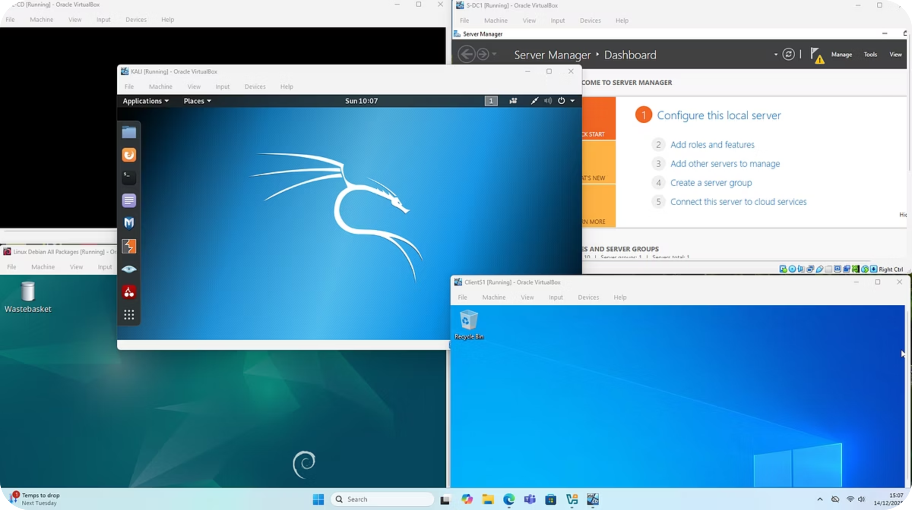
Advanced Cybersecurity Assessment
Student ID: 2313748
Student Name: Mariana Lupu
Subject Code: ACCB6000
Lecturer Name: Dr. Mohamed Ghanem

Slide 2
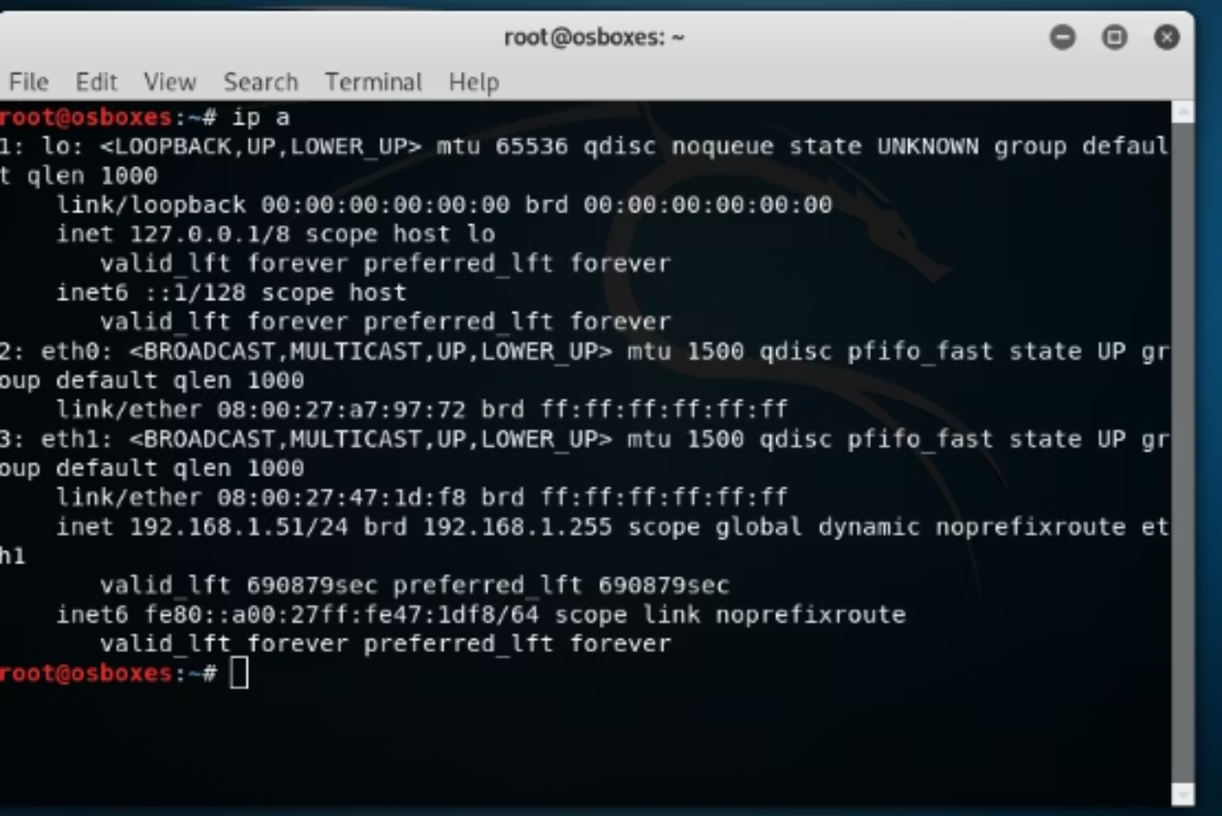


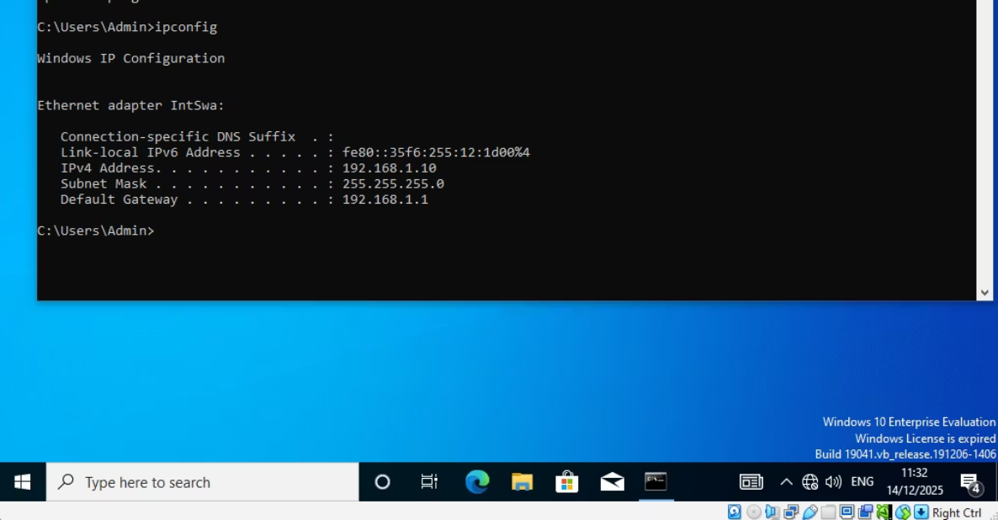
Task 1: Initial Network Configuration & Connectivity
Our initial phase involved setting up and verifying the network to ensure a stable environment for testing. This critical step laid the groundwork for all subsequent tasks.
IP Configuration Verified
Precise IP addressing was confirmed on ClientS1 and Kali Linux, aligning with the established network topology.
Connectivity Confirmed
Successful communication between all critical systems was established and verified using standard ICMP ping commands, ensuring network readiness.

Slide 3
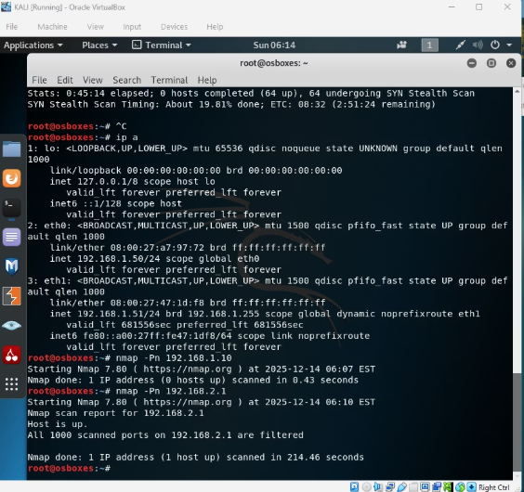
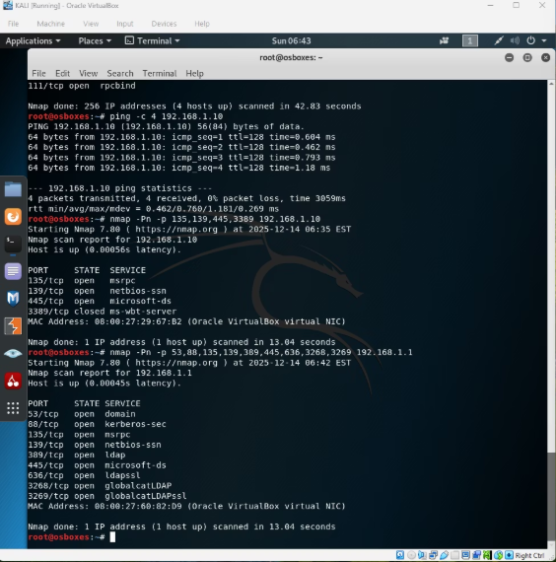


Task 2: In-Depth Information Gathering
Utilising Nmap, we conducted a comprehensive network discovery to map the digital landscape of the SWANSEA network and identify key active components.
Network Discovery
Domain Controller Identified
Key Services Discovered
Nmap was deployed to identify all active hosts within the SWANSEA network, providing a clear overview of the operational environment.
A critical Domain Controller, hosting Active Directory services, was successfully located, highlighting a central point of control.
Vital network services, including DNS, Kerberos, LDAP/LDAPS, SMB, and Global Catalog, were identified, revealing potential interaction points.

Slide 4
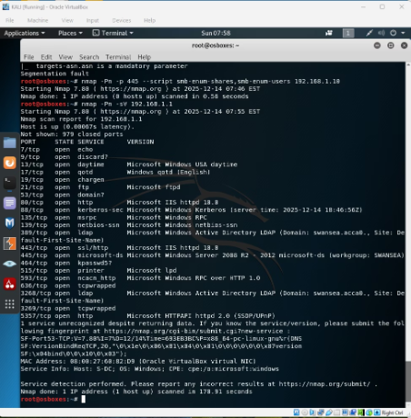
Task 2: Identified Vulnerabilities Overview
Our thorough analysis revealed several vulnerabilities, categorised by their potential impact on the SWANSEA network's security posture.
High Severity
1
SMB service exposure (Port 445): This represents a significant risk for remote code execution or credential harvesting.
LDAP and Global Catalog exposure: Potential for information disclosure and authentication bypasses.
Medium Severity
2
Kerberos authentication service exposure: Could be exploited for brute-force attacks or Golden Ticket scenarios.
IIS and FTP services: These increase the attack surface, potentially introducing vulnerabilities from outdated software or misconfigurations.
Low Severity
3
RPC services exposed: While generally less critical, they can be targeted for reconnaissance or specific exploits.
Printer and auxiliary services enabled: These services often have unpatched vulnerabilities or weak default configurations.

Slide 5





Task 3: Ethical Hacking & Exploitation Attempts
From Kali Linux, we initiated controlled exploitation attempts, focusing on critical services identified during the information gathering phase.
Kali Linux Origination
Targeted Services
All exploitation efforts were launched from a controlled Kali Linux environment, simulating real-world attack vectors.
Our primary targets included SMB, LDAP, and Kerberos, selected due to their identified vulnerabilities and critical roles.
Advanced Reconnaissance
No Unauthorised Access
Enumeration and reconnaissance techniques were applied rigorously to gather intelligence before attempting exploitation.
Despite concerted efforts, no unauthorised access was achieved, indicating robust security measures.

Slide 6
Task 3: Post-Exploitation Analysis & Barriers
Our post-exploitation activities were significantly constrained, highlighting the effectiveness of the deployed security controls in preventing deeper penetration.
Limited Scope
Access Control
Filtered Ports
Post-exploitation actions were severely restricted, confirming the difficulty in escalating privileges or moving laterally within the network.
Rigid access control restrictions proved to be a formidable barrier against further compromise.
Strategic filtering of ports effectively limited our ability to establish new connections or exploit additional services.
Hardened Services
Defence-in-Depth
Services were found to be well-configured and hardened, significantly reducing their susceptibility to common exploits.
This outcome strongly demonstrates the efficacy of a defence-in-depth strategy, successfully mitigating risks at multiple layers.

Slide 7




Challenges Encountered & Key Learning Outcomes
The practical application of cybersecurity tasks presented several challenges, which ultimately enriched our learning experience and underscored key principles.
Time Allocation
Practical tasks demanded significant time, emphasising the iterative and intricate nature of cybersecurity investigations.
Hardware Limitations
Virtual machine performance was impacted by hardware constraints, highlighting the need for robust computational resources in cybersecurity.
Multi-System Work
The necessity of leveraging multiple systems for practical work demonstrated the interconnectedness of modern network environments.
Fundamental Importance
The exercise reinforced that strong cybersecurity fundamentals are indispensable for effective analysis and accurate interpretation of results.

Slide 8










Conclusion: Strengthening Cybersecurity Skills
This assessment provided an invaluable opportunity to apply theoretical knowledge in a practical setting, significantly enhancing our understanding and skill set in cybersecurity.
Vulnerability Insight
Practical Application
Key services and potential vulnerabilities were successfully identified.
Hands-on experience with network security assessment techniques was gained.
Realistic Scenarios
Ethical hacking attempts offered insights into real-world attack vectors.
Future Foundation
A solid foundation for advanced cybersecurity studies and career development has been established.
Skill Enhancement
Practical skills and overall security awareness were significantly strengthened.

Slide 9
References
Kali Linux Documentation. (n.d.). Retrieved from https://www.kali.org/docs/
Nmap (Network Mapper) Official Website. (n.d.). Retrieved from https://nmap.org/
Microsoft Learn. (n.d.). Active Directory Domain Services. Retrieved from https://learn.microsoft.com/en-us/windows-server/identity/ad-ds/active-directory-domain-services
CVE Details. (n.d.). Common Vulnerabilities and Exposures. Retrieved from https://www.cvedetails.com/
SANS Institute. (n.d.). Information Security Resources. Retrieved from https://www.sans.org/

Slide 10
Thank You
For your attention and engagement in this exploration of advanced cybersecurity principles and practices.

