Slide 1

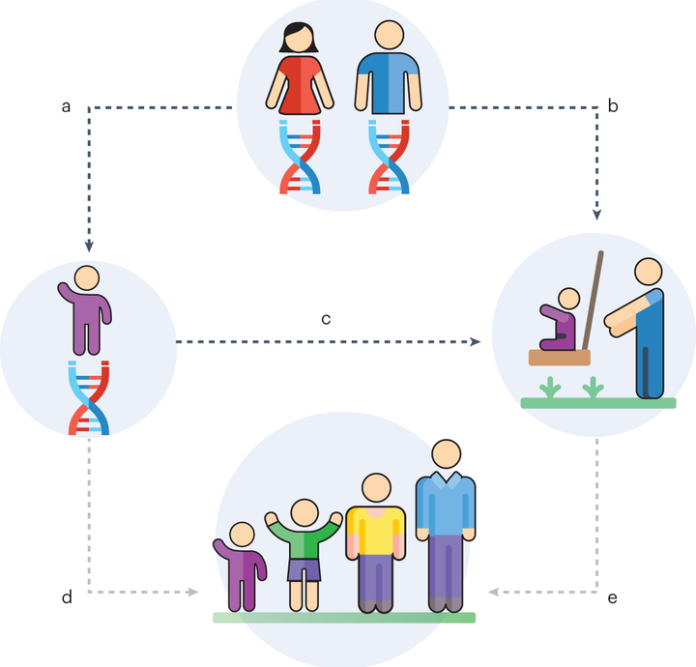
Living Well:
A Life Course Approach to Health and Wellbeing
BMNS4014 Individual Presentation
Student Name: Ebrima Njie
Student Number : 2514125

Slide 2
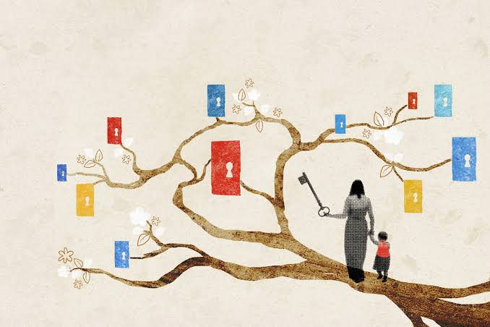
2
Introduction
The presentation critically analyses the life course approach to health and wellbeing, where health is considered a lifetime process that is influenced by transitions and exposures (WHO, 2025).
It considers the positive and negative impacts over the lifespan, with inclusion of broader determinants, early life experiences, lifestyle behaviour, and accumulating risks (Sadana et al., 2025).
The discussion incorporates evidence-based interventions and recommendations, including policy, practice, and education strategies of enhancing resilience and reducing inequalities (Public Health Wales, 2025)
2

Slide 3
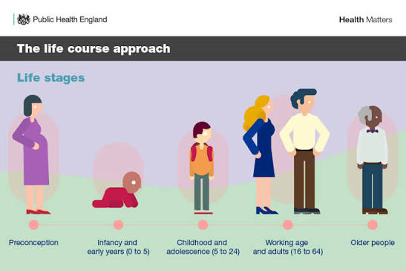
3
What Is the Life Course Approach?
Life course approach conceptualizes health as a lifelong journey that is influenced by timing, transitions and connected lives, starting at preconception through later adulthood (Elder et al., 2003).
It demonstrates how the intervention in the early years may change long-term results, enhancing the health course in later life and by the next generations (Kuh et al., 2014).
This view upholds holistic approaches, acknowledging that the factors that affect health are interrelated biological, social and environmental (Fang, Zhao and Wu, 2025).
3

Slide 4
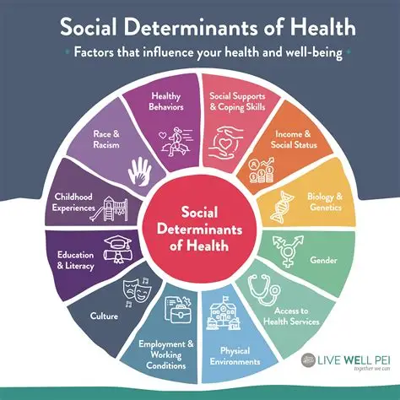
4
Wider Determinants of Health
The determinants of health (income, housing, education, and employment) are social, economic and environmental factors (Dahlgren and Whitehead, 2006).
The disparities in these determinants remain across generations, perpetuating disadvantage and poor health (Marmot, 2013).
It is important to tackle them through cross-sector collaboration since multifactorial effects like diet, activity, and sleep interact with psychological and ecological effects (Ammar et al., 2026).

Slide 5
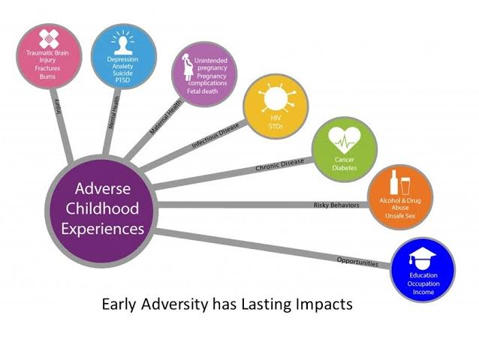
5
Early Life and ACEs
Poor mental health and chronic disease in adulthood are closely associated with adverse childhood experiences (ACEs), such as abuse and neglect (Hughes et al., 2017).
According to national data, ACEs are highly prevalent and a primary public health concern that needs to be addressed in its early stages (Annor et al., 2026).
Long-term harm and lessening inequalities can be alleviated by protective factors like family support and resilience-enhancing interventions (Abate et al., 2024).
5

Slide 6
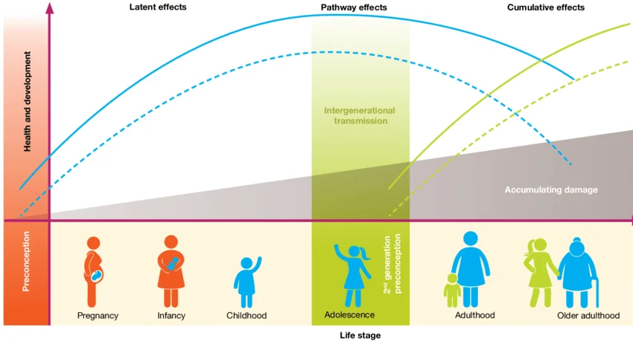
6
Life Stages and Health Transitions
During pregnancy and infancy, nurturing care, nutrition and safe environments establish robust developmental platforms (Godfrey et al., 2025).
In childhood and adolescence, lifelong behaviours and resilience are formed with the help of education, immunisation and mental health support (WHO, 2024).
The independence, chronic disease, and quality of life in adulthood and older age depend on lifestyle, work and social connection (Sukenova et al., 2026).
6

Slide 7
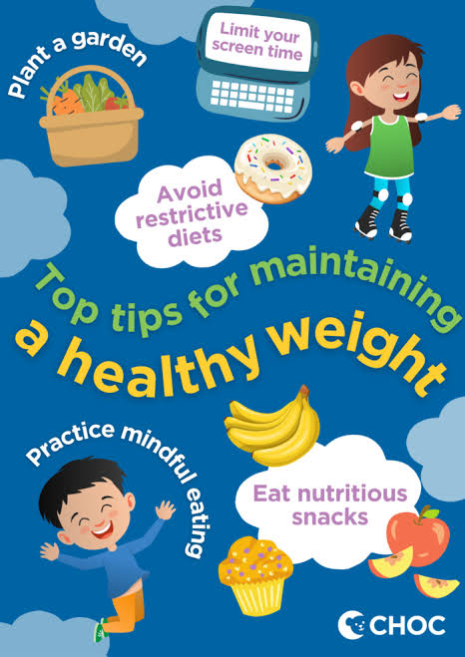
7
Cumulative Risks and Protective Factors
Dietary, smoking, alcohol abuse, and inactivity are risk factors that build up over decades and contribute to the burden of non-communicable diseases (Mikkelsen et al., 2019).
It has been demonstrated that young uptake of healthy behaviours greatly reduce the risks of obesity, cardiovascular disease, and mental health issues (Men et al., 2026).
Education and community connection are examples of protective factors that minimise the influence of the disadvantage and enhance resilience (Kozioł-Kozakowska and Wójcik, 2026)

Slide 8
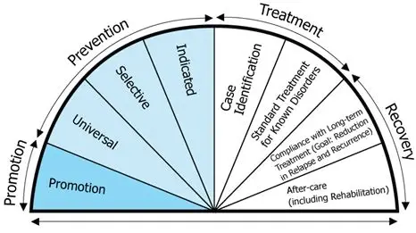
8
Life Course Interventions
Interventions should be person-centred, equity based and lifelong interventions that combine health, education, and social care (Witham et al., 2026).
Examples of individual-level interventions are smoking in pregnancy, nutrition education and behaviour-change interventions (Chamberlain et al., 2017).
Population-level approaches involve early years programmes, social prescribing, healthy housing, and policies tackling inequalities (Valiente-Gómez et al., 2026).
8

Slide 9

9
Recommendations
Early years investment, trauma-informed services, and equitable housing should be prioritised by policy to decrease inequalities in the long-term (WHO, 2025).
Life course thinking should be incorporated into practice, training professionals to be preventive and trauma-informed care providers (Bassey et al., 2026).
Life course theory should be incorporated into the curriculum and be funded to conduct longitudinal research to assess interventions (Britto et al., 2017).
9

Slide 10

10
Conclusion
The lifespan approach to health is an integrated process that needs cross-sectoral efforts to create resilience and lessen inequalities (Kuh et al., 2014).
Experiences early on, broader determinants, and repetitive behaviours have a cumulative effect, which supports the necessity of prevention and equity (Marmot, 2013).
An enhanced life course response requires early intervention, equitable policy, knowledgeable practice, and comprehensive services in the health, educational, residential, and community realms (Sadana et al., 2025).
10

