Slide 1
Module Name : Electronics I
Module Code : ACDB5002
Lecture : 4
Topic : Capacitors as Filters
Lecture By,
Mrs. Jenifer Prince Devaraj,
Lecturer - Embedded Electronics,
Faculty of Applied Computing,
UWTSD
Email:j.prince-devaraj@uwtsd.ac.uk

Slide 2
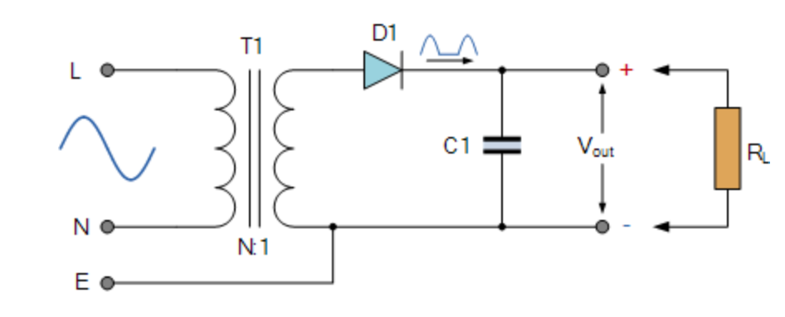
Capacitors as Filter
Filter
A capacitor can store an electrical charge on its plates which can be used to smooth out some of the pulsating waveform.
During the positive half cycle, when the diode is forward biased, C1 is charged
During the negative half cycle, when the diode is reverse biased, C1 discharges at a rate determined by the loads time constant.

Slide 3
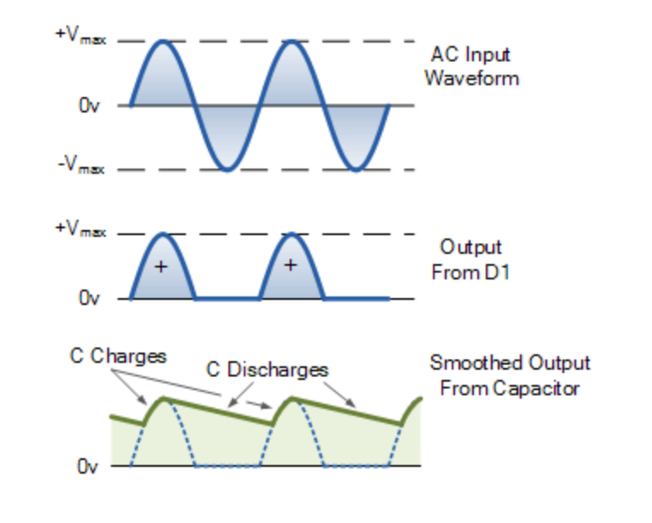
Capacitors as Filter
Filter
During the negative half cycle, capacitor C1 supply's all the current to the load and thus discharges.
The process is repeated at every half cycle resulting in smoothened output from the capacitor.

Slide 4

Capacitors as Filter
Passive Filters
  Passive filters are based on combinations of resistors (R), inductors (L) and capacitors (C).
  Passive filters do not depend upon on external power supply, and they do not contain any active components such as transistors.

Slide 5
Capacitors as Filter
Filters
Types Of Filters
Low Pass Filter (LPF)
High Pass Filter (HPF)
Band Pass Filter (BPF)

Slide 6
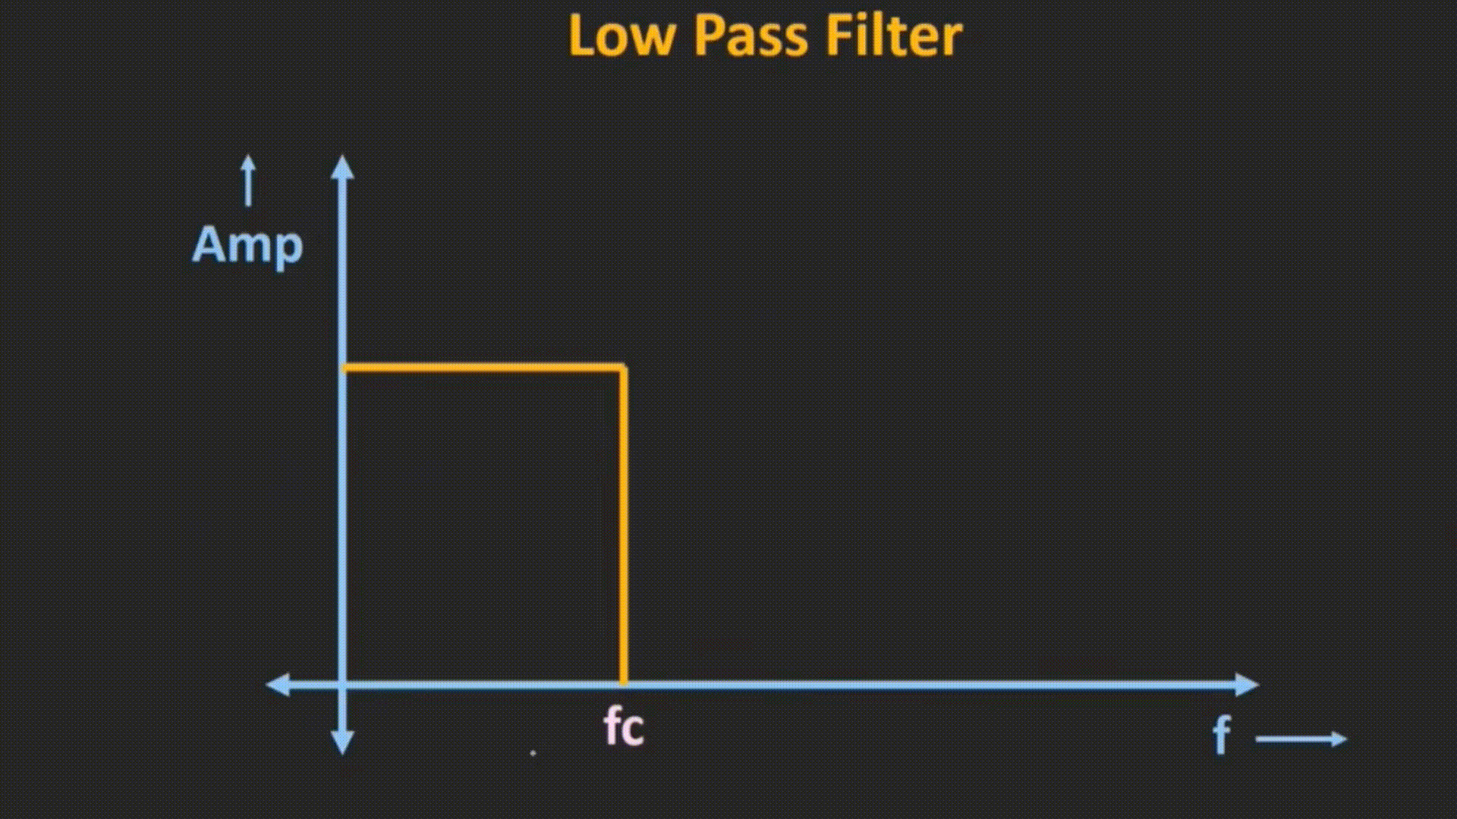
Capacitors as Filter

Slide 7
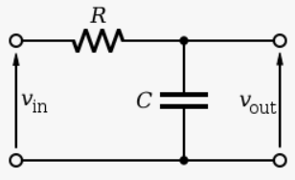
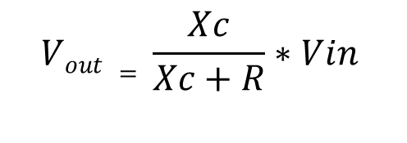

Capacitors as Filter
Low Pass Filter
The low pass filter only allows low-frequency signals from 0Hz to its cut-off frequency, ƒc point to pass while blocking those any higher frequency.
$$Vout = \frac{Xc}{Xc+R}∗Vin$$
$$Xc is the Reactance Of the Capacitor$$
We Know that $Xc= \frac{1}{ωc}$
When f_{c} increases, the value of the reactance reduces, hence output will also reduce.

Slide 8
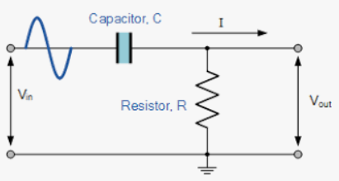
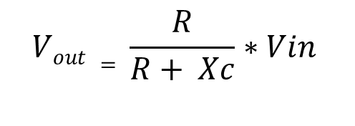
Capacitors as Filter
High Pass Filter
The high pass filter only allows high-frequency signals from its cut-off frequency, ƒc point, and higher to infinity to pass through while blocking those any lower.
$$Vout = \frac{R}{R+ Xc}∗Vin$$
$$Xc is the Reactance Of the Capacitor$$
We Know that $Xc= \frac{1}{ωc}$
When f_{c} increases, the value of the output will increase.

Slide 9

Capacitors as Filter
Band Pass Filter
The bandpass filter allows signals falling within a certain frequency band set up between two points to pass through while blocking both the lower and higher frequencies on either side of this frequency band.

Slide 10
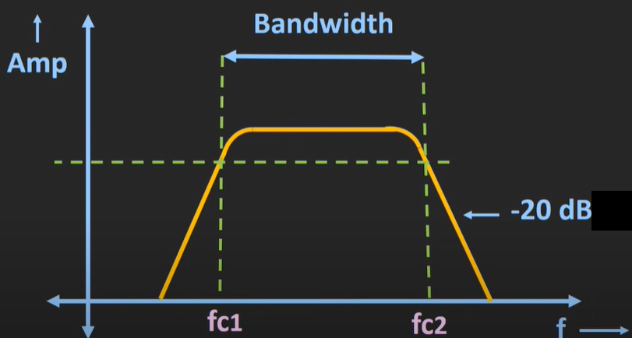
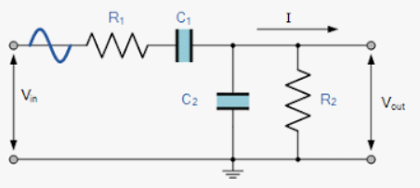


Capacitors as Filter
Band Pass Filter
The bandpass filter allows signals falling within a certain frequency band set up between two points to pass through while blocking both the lower and higher frequencies on either side of this frequency band.
$$f_{c2 }=\frac{1}{2π{R_{2}C}_{2}}$$
$$f_{c1 }=\frac{1}{2π{R_{1}C}_{1}}$$

Slide 11
Thank You

