Slide 1


Campus Brew UK – Market Research and Digital Marketing Project
Student Name: Tudor-Florin Vass
Student Number: 2436754

Slide 2

Project Overview
The present project has created a business idea named Campus Brew UK, a university-based mobile coffee kiosk.
Market research was based on a questionnaire on Google Forms, in order to get an idea of what students liked.
Survey data were also analysed through use of Microsoft Excel in order to capture trends and insights.
The findings were analysed to develop a video ad and marketing materials and a site.
Notes:
The current project was aimed at developing a business idea, which is a mobile coffee stand that targets university students and is named Campus Brew UK. This was to be done to find out the student coffee consumption patterns and what prospects an affordable coffee service on campus had. In order to do that, primary market research was conducted through Google Forms questionnaire. The data collected through the survey was analysed in Microsoft Excel in order to establish patterns and insights. According to these results, a Web site, advertising materials and a video advertisement have been developed as means of spreading the idea of Campus Brew UK and conveying the brand message.

Slide 3
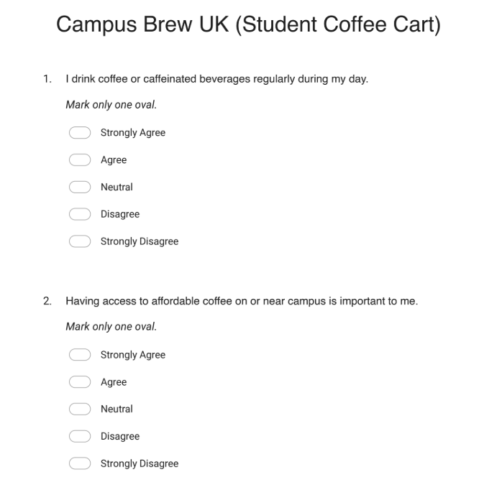
Market Research Design
To gather primary data, a questionnaire containing 10 questions in Google Forms was developed.
The survey was conducted with a five-point Likert scale with strongly agree to strongly disagree (Bhandari and Nikolopoulou, 2020).
The sample population was students in the university that consume coffee and drinks on a regular basis.
The aim of the survey was to know about coffee drinking habits, price sensitivity, and campus coffee services interest.
Notes:
The questionnaire that was developed via Google Forms was used to carry out the market research in this project. The questionnaire contained ten formatted questions that were aimed at knowing the coffee consumption habits and preferences of the students. The Likert scale was five points, whereby the respondents were allowed to respond on a scale of strongly agree to strongly disagree. The respondents of interest were the university students as they are the major customers of Campus Brew UK. This survey was to be carried out in order to obtain information concerning the demand of coffee by students, their sensitivity to price and the interest of having convenient coffee services that are within the campus.

Slide 4

Data Analysis Process
Survey data was transferred to Microsoft Excel to be analysed and visualised (Regmi et al., 2016).
Excel charts were used to establish patterns and trends in the responses of the students.
Questions with the most insightful answers were identified to be analysed further.
The data that was analysed assisted in informing the business idea, price policy and the marketing.
Notes:
The survey results were obtained and then the data was exported to Microsoft Excel to be analysed. The responses were organised and percentages calculated using Excel and visual charts were created which aided in determining the trends in the data. With the help of these charts, it became convenient to comprehend the attitude of students to coffee use, affordability, and offers. The analysis was done with an aim of coming up with the most crucial questions that made pertinent contributions to the business concept. Through Excel, the data was interpretable making the findings to be used as a guide to make significant decisions regarding pricing, marketing strategies and the general structure of the Campus Brew UK site.

Slide 5
Key Findings from Market Research
70% of the respondents stated that they drink coffee regularly or strongly agreed that they do, which means high demand amongst students.
70% respondents indicated that it is imperative to have affordable coffee on campus.
70% of the respondents expressed interest in purchasing coffee at a mobile coffee cart within the campus.
70% of the respondents said they would buy coffee because it had a discount and was promoted.
Notes:
The survey analysis brought about interesting results concerning the behaviour of students. To begin with, approximately seventy percent of the respondents either approved or highly approved that they consume coffee or caffeinated drinks on a regular daytime basis. This validates the claim that coffee is an aspect of the daily lives of students. Secondly, seventy percent of the respondents revealed that it is important to them that affordable coffee is available on campus. Also, a majority of the respondents had indicated that they were interested in buying coffee in a mobile coffee cart that could be found in campus. Lastly, offers and student discounts were also determined to have a great impact on buying behaviour and marketing effort ought to be concentrated on promotions and incentives.

Slide 6
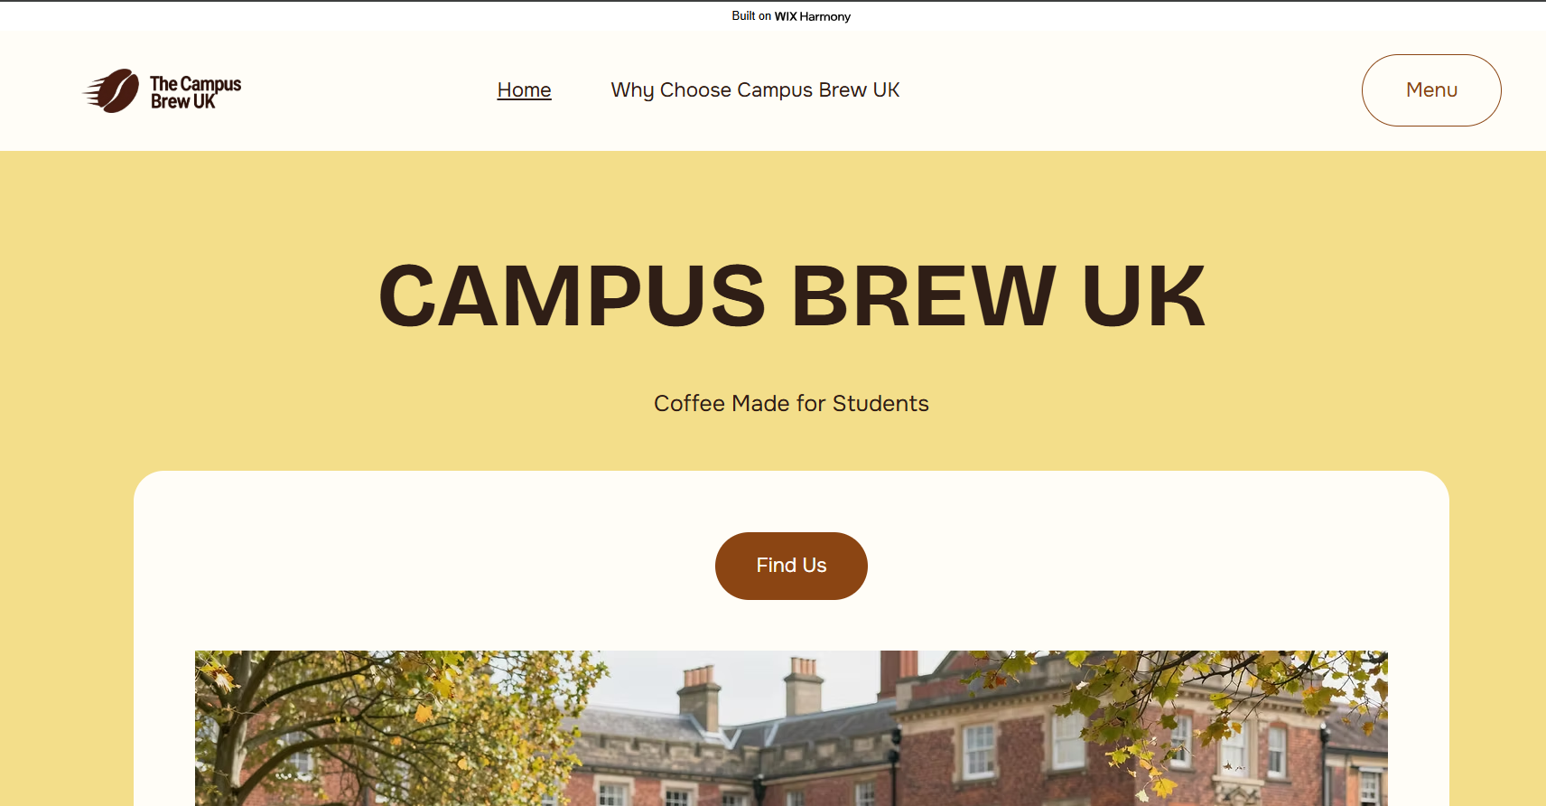
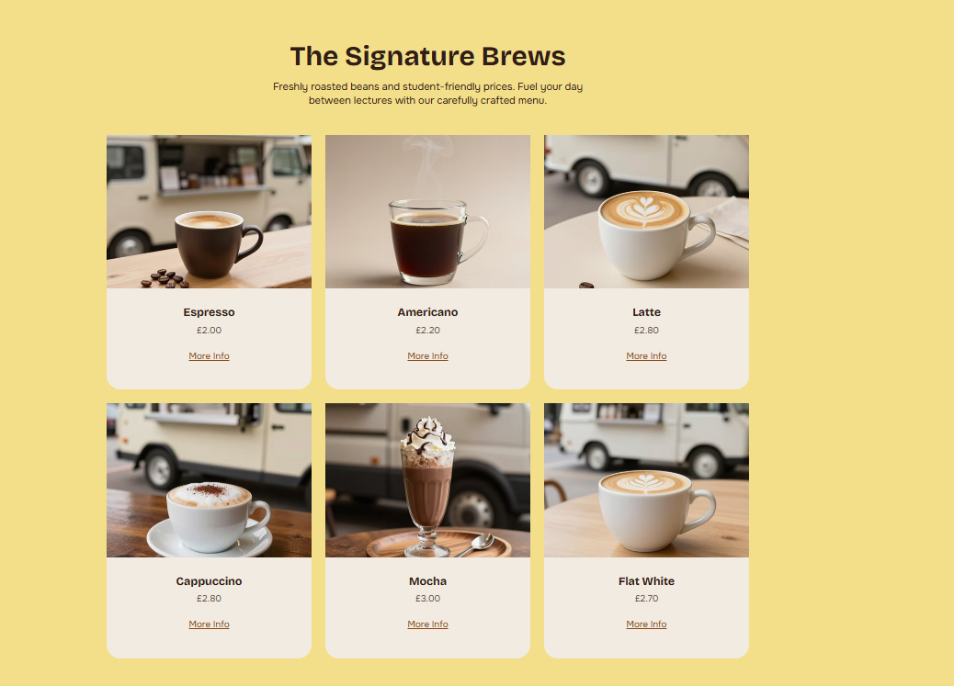
Website Development
The Campus Brew UK web site has been created in the Wix platform to design a simple and attractive business web site (Prepp, 2025).
The site layout puts emphasis on low price of coffee and the on-campus convenience service, guided by the survey findings.
Important areas like menu, student-oriented messages and brand story were also added to appeal to the target audience.
Their images of coffee, campus scenes, and well-written headings were created to make it interesting and easy to navigate.
Notes:
The Campus Brew UK web-site is created on the basis of the Wix platform to introduce the business idea in a clear and interesting manner. The web site was developed based on the findings of the survey. The site has focused on affordability and speed since students pointed out that these are key factors that they would use to decide on the choice of coffee at the campus. The menu, brand story and convenience message sections were added to appeal to the target audience. The use of images of coffee, and campus themes was also a visual feature that enhanced a pleasant and recognisable experience to students.

Slide 7
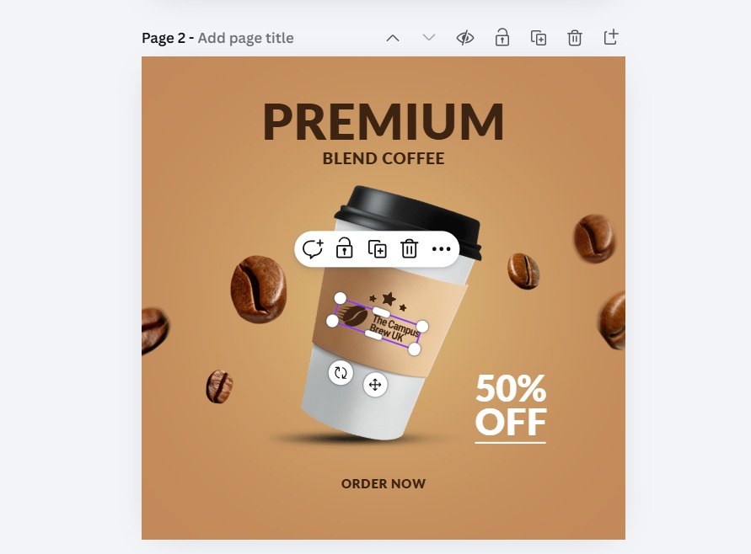
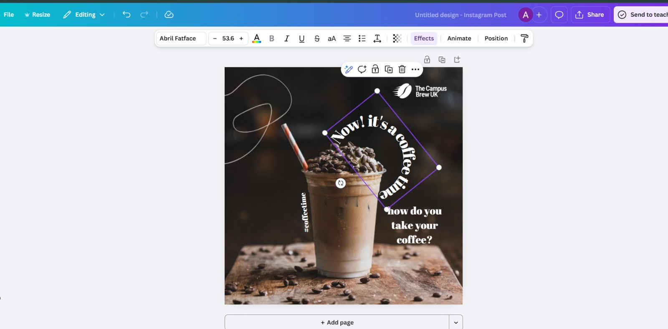
Marketing Materials Design
Marketing materials for Campus Brew UK were designed using Canva to create visually engaging promotional content (Roger Coles, 2024).
Promotional graphics were developed to highlight affordable coffee and student discounts.
The design focused on attracting university students through appealing visuals and clear messages.
These materials help promote the brand and increase awareness of Campus Brew UK on campus.
Notes:
The marketing assets of Campus Brew UK were designed on the Canva design platform. Canva led to the creation of appealing promotional posters and graphics that brings to the fore the message of the brand. These were materials based on advertising cheap coffee, student discount and conveniently having access to coffee within the campus. The designs were bold in text, attractive colours and images related with coffee to attract the attention of the students. The marketing materials contribute to raising the brand awareness and motivate students to use the Campus Brew UK coffee service by designing promotional visuals that are appropriate on social media and digital platforms.

Slide 8
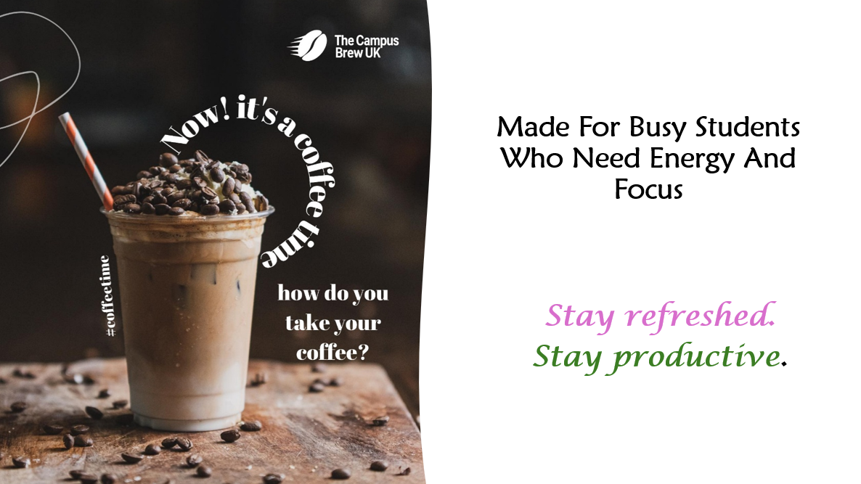
Video Advertisement Campaign
Canva was used to produce a short video advertisement about Campus Brew UK and target students.
The video is an integration of visual marketing contents, promotion, and coffee images.
The advertisement conveys the brand message of being able to have cheap and convenient coffee to students.
The video will be used to attract the audience and motivate the students to stop by Campus Brew UK coffee cart.
Notes:
Canva was used to create a short video commercial to market the Campus Brew UK brand. The video is an amalgamation of visuals in the marketing materials, and plain promotional messages relaying the value proposition of the brand. The advert emphasises the ease of having a mobile coffee cart at college and the cost-effectiveness of the coffee sold to the students. Through the attractive images and concise communication, the video will capture the interest of the student audience, and the video will motivate them to seek out the coffee cart. Digital marketing using social media that is promoted in the video as well.

Slide 9
Reflections and Learning
This project taught me how vital market research is in coming up with business ideas and marketing strategies.
I acquired some new knowledge about survey design, analysis of data with the help of Excel, and creating websites with Wix.
I also enhanced my skills in designing digital marketing and video advertisement in Canva.
I want to improve on digital marketing, search engine optimization techniques, and deep data analytics in the future.
Notes:
This project was a good learning experience in research and digital marketing. I was taught how market research can assist business to comprehend the customer needs and make strategic decisions. The skills that I acquired through this project were the ability to design questionnaires, data analysis with the help of excel, designing websites with the assistance of Wix, and marketing material design with Canva. Another area that I acquired experience in was to make a short video promotion. Additionally, I would like to enhance my knowledge in digital marketing, search engine optimisation, and advanced data analysis in the future to enhance business decision-making.

Slide 10
References
Bhandari, P. and Nikolopoulou, K. (2020). What is a likert scale? | guide & examples. [online] Scribbr. Available at: https://www.scribbr.com/methodology/likert-scale/ [Accessed 8 Mar. 2026].
Prepp (2025). From Vision to Website: How Wix Empowers Anyone to Build a Professional Online Presence. [online] Prepp. Available at: https://prepp.in/news/e-1521-from-vision-to-website-how-wix-empowers-anyone-to-build-a-professional-online-presence [Accessed 10 Mar. 2026].
Regmi, P.R., Waithaka, E., Paudyal, A., Simkhada, P. and Van Teijlingen, E. (2016). Guide to the Design and Application of Online Questionnaire Surveys. Nepal Journal of Epidemiology, 6(4), pp.640–644.
Roger Coles (2024). Make Animated Product Ads with Video Mockups from Canva. [online] YouTube. Available at: https://www.youtube.com/watch?v=RwDFgMPixi0 [Accessed 10 Mar. 2026].

