Slide 1
BA Dip Cert HE International Gastronomy Management.
Assignment 1: 10 Minute Presentation
Module: Placement: Restaurant Management –BMGM4004.
Student: Paulina Anna Skoczek.
ID : 2219392
Lecturer: Ffion Cubmerpatch.

Slide 2
The purpose of the presentation
To identify an operational issue in a current placement provider.
Analyse the issue and its root cause.
Impact on the business and customers.
Questions?
References.
Solutions.
Benefits.

Slide 3
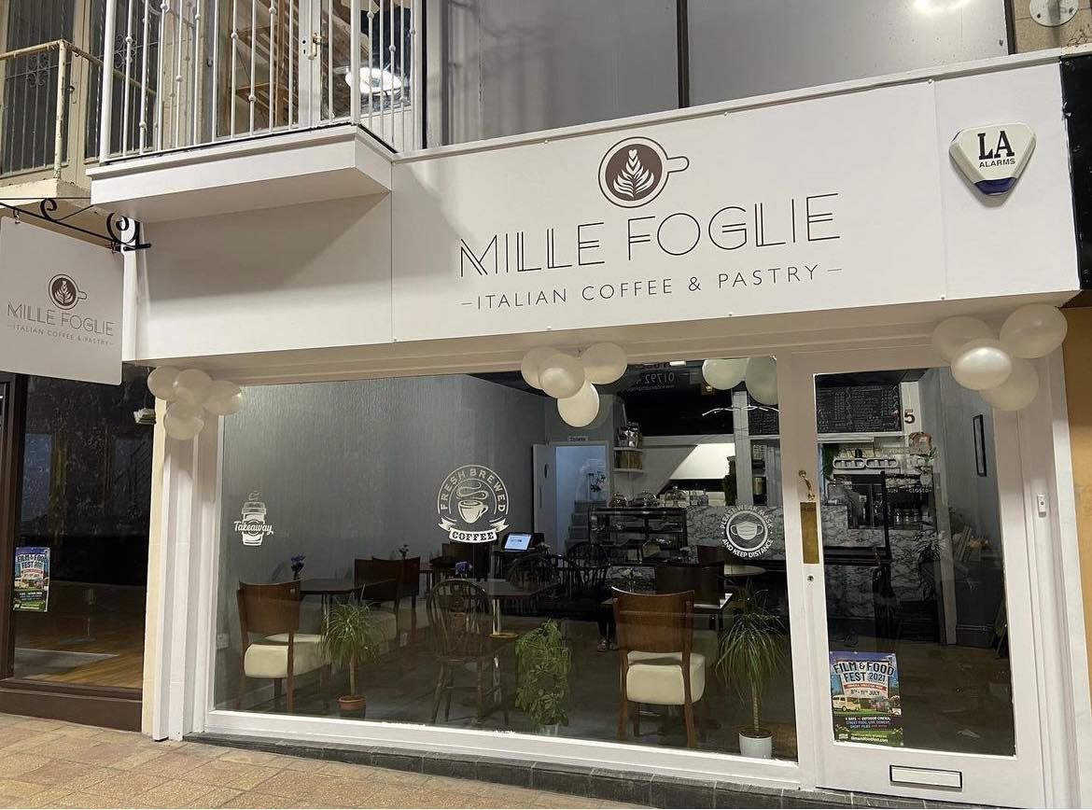
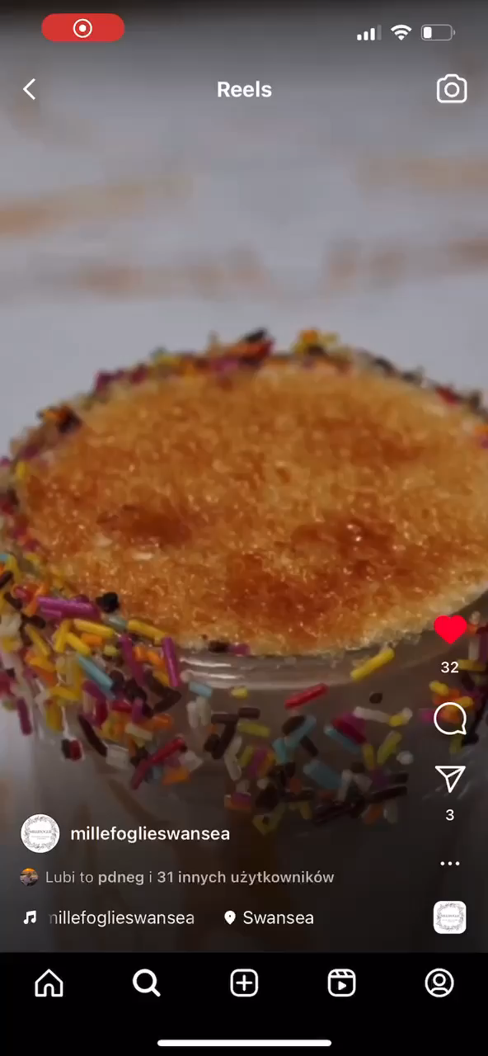
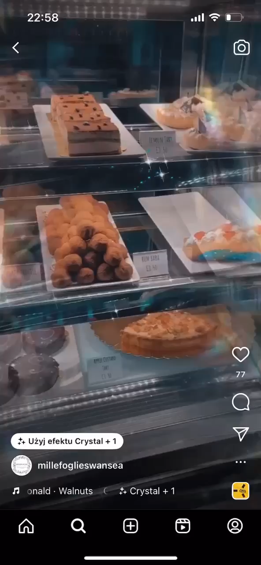
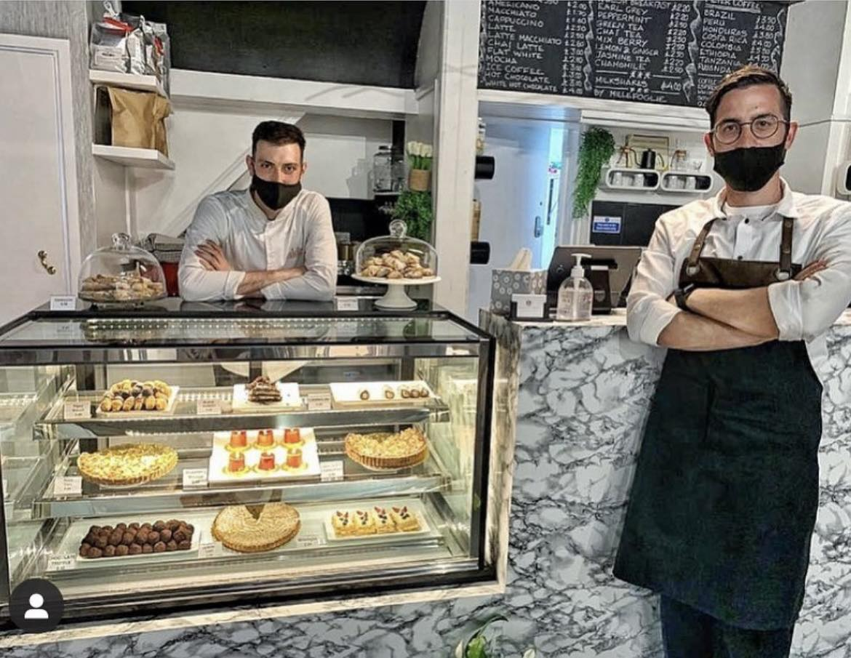

Slide 4

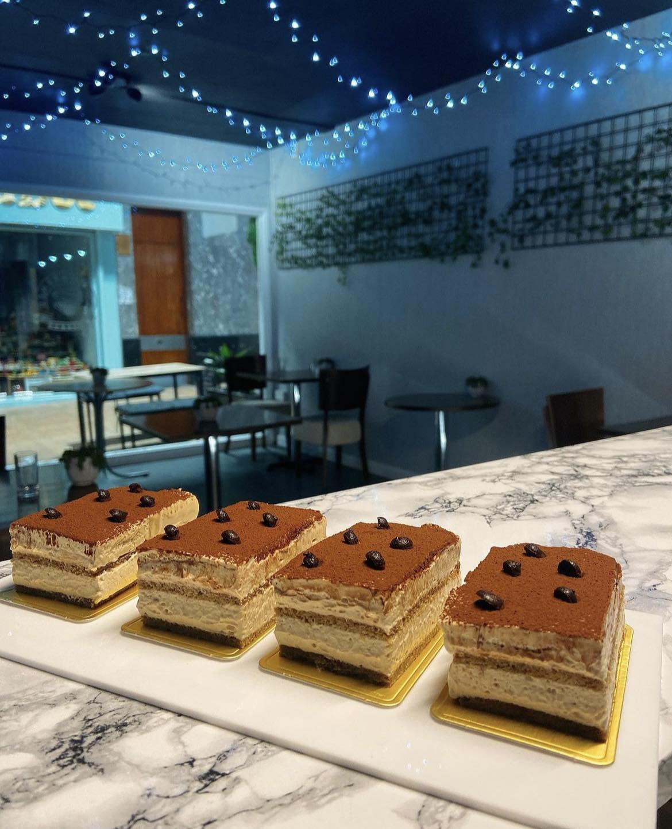
The restaurant and its operational issue

Slide 5
Absence Of Management Team Structure.
The starting point of any organization is a realistic management team structure that is based on well-thought strategy and needs of the business (Tiller. S.R, 2012)
Issue analyzation:
Figure1. - Theoretical Team structure
Milliefogile is a café which, is successively taking steps forward on market. The increased demand and popularity among customers makes the management -solely under the care of the owners- simply unachievable and difficult. Stress and work overload are not good companion. World and Health Organization (2021), has found that people working 55h a week face an estimated 42% risk of heart disease and a 19% risk of stroke. Consequently, solving the understaffing in MillieFogile will not only improve the business operations but also potentially improve the overall psychical and mental health of the owners.
Manager/Owner
Assistant manager
Shiftleader
Barista
Root Cause of the issue in MillieFogile:
Independent, small and newly opened business on the market.
Uncertainty of the business success, grow and demand.
Operating on thin margins
Limited business budget for staff internal training. MillieFogile has less ability to absorb unexpected financial blows, therefore, making the business more cautious when it comes to hiring.
Lack of experience in management sector.
Poor employee interest due to lack of available staff benefits.

Slide 6
The Consequences and Negative Impacts of being understaffed.
Business | Customers
Loss of Sales. Brand damage and poor reputation. A decrease in work quality. A decrease in service quality. Missed chance for marketing. Complaints . Limits for the company to expand Increased risk of accidents Safety and operating procedures are exchanged for service expectations. Less repeat business Word of mouth effect. | Unfulfilled marketing promises therefore, customer disappointment. Frustration due to long waiting times. Poor service experience and lack of creating positive memories. (Edays,2020)
According to research conducted by Work Service (2017), over 50% of entrepreneurs reported lack of staff, which translates into problems with their functioning. Taking that into consideration, this part of the presentation is dedicated to demonstrate those problems and confront, how being understaffed can influence the business as well as customers on a long-term effect.

Slide 7

Solutions

Slide 8

How to solve a restaurant operation issue in MillieFogile?
The research has proven that 72% of managers practicing a careful conduction of staffing needs and creating a human resource plan improves the business profitability. (Viter. I ,2022) This finding demonstrates that without this practice, it will be impossible to move from point A to point B and for example start a hiring process that helps find the right candidates.
Internships
Staffing Agency
Benefits?

Slide 9

Working with staffing agency
-Gives the business the flexibility and successfully source individuals with diverse talents that match or exceed business requirements and expectations in a time efficient manner.
-It is a time saving process as there is no need for the business to go through recruitment process and prohibitional periods.
-It creates savings in labor cost and training. With the help of staffing agency, the business will be able to benefit from a lower labor budget as in comparison to hiring employees with a traditional payroll approach.

Slide 10

University, College collaborations and internships.
-Positive publicity and additional marketing to potential jobseekers.
-By offering internships the business can grow connections, therefore, increase its visibility on the market, promote community and have a positive impact in developing students or future employees. As a result, increasing staff retention.
- It is a valuable and budget safe support.

Slide 11

The benefits of applied solutions
-Teamwork! Innovations and new ideas.
-Work-life balance.
-Increased performance
-Better communication
-Increased efficiency
-Larger sense of work community within the organization.
-Better trust and stronger bonds.
(Indeed. E.T, 2023)

Slide 12

Any Questions?

Slide 13

References:

Slide 14
1.Apifonica (2023) Braki Kadrowe- Przyczyny, Skutki, Przeciwdziałanie
Available at: Prowadź komunikację dowolnym kanałem i na całym świecie | Apifonica
(Accessed: 01.06.2023)
2.Edays (2020) - What is understaffing and how it can damage the organisation?
Available at: What is Understaffing | edays (e-days.com)
(Accessed:31.05.2023)
3.Indeed Editiorial Team (2023) - 8 Advantages of Using a Team-Based Structure in Business.
Available at: 8 Advantages of Using a Team-Based Structure in Business | Indeed.com
(Accessed: 01.06.2023)
4.Irina Viter (2022)- Human Resource Planning Done Right: A Step-by-Step Guide.
Available at:Human Resource Planning Done Right: A Step-by-Step Guide | Runn
(Accessed:31.05.2023)
5.Pictures used in the presentation are sourced from the Cafe Website:
Available at: Pastry Shop | Millefoglie Italian Coffee & Pastry | Wales
(Accessed: 29.05.2023)

Slide 15
6.Stephen R.Tiller, (2012) Organizational Structure and Management Systems.
Available at: Organizational Structure and Management Systems | Leadership and Management in Engineering | Vol 12, No 1 (ascelibrary.org)
(Accessed: 30.05.2023)
7.Steve Jobs & Bill Gates interview (2007)
Available at: (6) Steve Jobs & Bill Gates interview 2007 - YouTube
(Accessed:31.05.2023)
8.Workservice (2017) -Jak brak pracownikow wpływa na hamowanie rozwoju firmy?
Available at: Jak brak pracowników wpływa na hamowanie rozwoju firmy - Pro4work karta pobytu Wrocław, Legnica, Wałbrzych, Opole
(Accessed:31.05.2023)
9.World and Health Organization (2021) -Long working hours increasing deaths from heart disease and stroke
Available at: Long working hours increasing deaths from heart disease and stroke: WHO, ILO
(Accessed:31.05.2023)
10. Videos used in the presentation are sourced from the Milliefogile Instagram
Available at: https://www.instagram.com/millefoglieswansea
(Accessed:29.05.2023)

