Slide 1
LCMB7034
International Business Concept
Week 08
Value Chain, International Marketing and Global Operations

Slide 2
Learning Objectives
  Understand the concept of Value Chain of a company and understand the benefits of internationalising key aspects of the Value Chain
  Understand, appreciate and contrast between key marketing policy choices available to MNCs in an International Marketing context
  To describe the different dimensions of a global manufacturing strategy
  To examine the elements of global supply chain management
  To show how global sourcing is an important aspect of global supply-chain and operations management
UWTSD - Copyright 2023

Slide 3
The Firm as Value Chain
Value Chain: set of linked value-creating activities that company perform to design, produce, market, deliver, and support a product
  Helps the managers integrate the knowledge and skills of employees around the world in the way that allows the best global reach
Value Chain Analysis helps the manager understand the behavior of cots and the existing and potential sources of differentiation
  Primary Activities: inbound logistics, operations, outbound logistics, sales and marketing, service
  Support Activities: procurement, technology and system development, human resource management, firm infrastructure, Shipping, Customer Services
UWTSD - Copyright 2023
Notes:
The value chain is the set of linked value-creating activities the company performs to design, produce, market, distribute, and support a product. Value-chain analysis helps managers understand the behavior of costs and existing and potential sources of differentiation.
A value chain disaggregates a firm into:
• Primary activities that create and deliver the product
• Support activities that aid the individuals and groups engaged in primary activities
Value chains identify the format and interactions between different activities of the company.
Configuration is the way in which managers arrange the activities of the value chain.
Manufacturing costs vary from country to country because of wage rates, worker productivity, resource
availability, and fiscal and monetary policies.
An industry cluster is a system of businesses and institutions engaged with one another at various levels.
Logistics entails how companies obtain, produce, and exchange material and services in the proper place and in proper quantities for the proper value activity.
The process of digitization involves converting an analog product into a string of zeros and ones. Increasingly, products like software, music, and books, as well as services like call centers, application processing, and financial consolidation, can be digitized and, hence, located virtually anywhere. Equipped with networked computers, workers can move goods and services anywhere in the world at negligible cost and complication. Consequently, the potential for digitization of goods or services influences how a company configures its value chain.
The concept of economies of scale refers to a situation wherein a firm doubles its cumulative output yet total cost less than doubles due to efficiency gains. Effectively, reductions in the unit cost of a product result from the increasing efficiency that comes with larger operations.

Slide 4
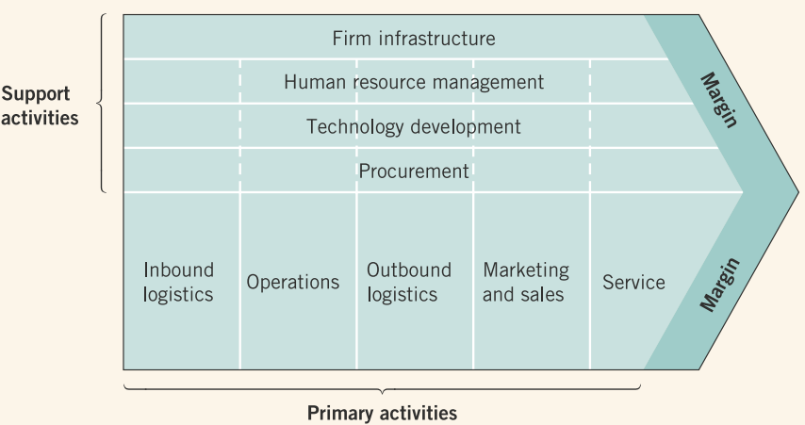
Company Value Chain
1
Porter’s Value Chain Model
Primary activities are directly concerned with the creation or delivery of a product or service.
Support activities help to improve the effectiveness or efficiency of primary activities.
UWTSD - Copyright 2023

Slide 5
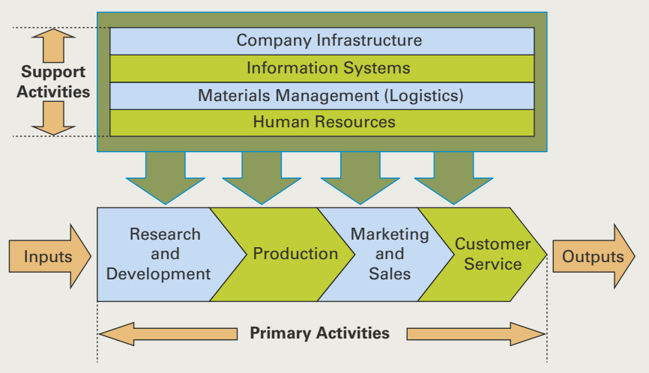
Company Value Chain
2
All functions of a company - production, marketing, product development, service, information systems, materials management, and human resources - have a role in lowering the cost structure and increasing the perceived value of products through differentiation.
Global value chains
UWTSD - Copyright 2023

Slide 6
Factors That Influence The Value Chain
Configuration: the way that mangers arrange the activities of the value chain to exploit location economies (economies from performing a value activity in the optimal location given prevailing economic, political, legal, and cultural conditions)
Cost Factors: differences in wage rates, worker productivity, inflation rates, and government regulations (creating significant variations in production costs)
Cluster Effects: particular industry gradually clusters more and more related value creation effects
Logistics: how companies obtain, procure, and exchange material and services in the proper place and proper quantities for the proper value activity
UWTSD - Copyright 2023

Slide 7
Coordination
Coordination: the way that managers connect the activities of the value chain, whether they are performed in one or many countries
Core Competencies: a special outlook, skill, capability, or technology that creates unique value for the firm
Sources of Core competency:
  Product development
  Employee productivity
  Manufacturing expertise
  Marketing imagination
  Executive leadership
UWTSD - Copyright 2023
Notes:
Coordination is the way that managers connect the activities of the value chain. As companies globally configure value activities, they must develop coordination tools. Coordinated well, MNEs can leverage their core competencies, using them to serve customers, boost sales, and improve profits.
A company’s core competency is:
• The unique skills and/or knowledge that it does better than its competitors
• Essential to its competitiveness and profitability
A core competency can emerge from various sources, including:
• Product development
• Employee productivity
• Manufacturing expertise
• Marketing imagination
• Executive leadership
Several factors influence value chain coordination:
• Operational obstacles
• National cultures
• Learning effects
• Subsidiary networks
The globalization of a company’s value chain, such as design done in Finland, inputs sourced from Brazil, production done in China, distribution organized in the United States, and service done in Mexico, presses managers to understand how foreign cultures influence coordination.
National cultures also impose hurdles in coordinating a transaction from one stage of the value chain to another. Units anchored in individual versus collectivist cultures may disagree over information sharing or collaboration responsibilities; conflicts complicate coordination. Hence, features of national culture require managers to understand their implications to the collaborative relationship that shape the coordination of value activities.
A learning curve is the commonsense principle that the more one does something, the better one gets at it.
Companies configure value chain activities to exploit the learning curve.
The matter of learning shapes how manufacturing and service MNEs coordinate value chains. In the case of the former, MNEs often adapt production activities for different attitudes and approaches to manufacturing. For example, an MNE may have factories in different countries, such as Japan and Mexico, which manufacture the same product but apply different production philosophies. The Mexican factory may use a traditional assembly-line operation given the local conditions of inexpensive labor, patchy transportation infrastructure, and marginal cost of high technology. The Japanese factory, in contrast, may use a lean production system given local labor competency, manufacturing expertise, and efficient logistics. The different manufacturing approaches complicate how managers coordinate activities between factories. Planning to learn how to coordinate these links in the value-chain positions the MNE to gain production efficiencies that lead to lower costs, higher quality, satisfied customers, and new sales. MNEs run into problems getting the various links of their global value chain to engage.
Operating internationally inevitably runs into communication challenges because of time zones, differing languages, and ambiguous meanings. Increasingly, companies rely on browser-based communications methods to coordinate the handoffs from link to link. The thinking goes that electronically linked producers and retailers can lower coordination costs throughout the value chain. In addition, standardizing the format for data input helps standardize the format for interpretation. Electronic transactions boost efficiency by reducing intermediary transactions and the associated unneeded coordination (streamlining the distributor link in the value chain by eliminating an intermediary).
The growing prevalence of social networks provides perspectives for managers to better understand the dynamics of their subsidiary networks.

Slide 8
Coordination Concerns
Operational Obstacles: problems when trying to get the various links of their global value chain to deal with each other
National Cultures: disagreement over how much information to share or who should take lead responsibility, and so on
Learning effects: costs saving that comes from learning by doing
Experience Curve: gain new insights into managing the value chain and cut costs by 20-30% each time their cumulative output doubles
Subsidiary Networks: subsidiaries exchange information freely, whether systematically within an Enterprise Resource Planning (ERP) context or via emails
UWTSD - Copyright 2023

Slide 9
International Marketing
Overview: First steps in building your marketing strategy for a global brand
Segmentation Targeting Positioning Perceptual Mapping

Slide 10
Segmentation
The identification of individuals or organisations with similar characteristics that have significant implications for the definition of marketing strategy
Jobber, 1998
The process of splitting customers, or potential customers, in a market into different groups, or segments with which customers share a similar level of interest in the same, or comparable, set of needs satisfied by a distinct marketing proposition.
McDonald, 2004

Slide 11
Segment characteristics – Kotler et al (2013)
Substantial and profitable
Measurable and definable
Differentiable
Accessible
Actionable
Notes:
New Criteria for Market Segmentation - Harvard Business Review
https://hbr.org/1964/03/new-criteria-for-market-segmentation

Slide 12







Basis for segmentation
Profile based
  Geographic
  Demographic
  Socio-economic
Psychological
  Lifestyle
  Personality
  Attitudes
Behavioural
Notes:
Geographic - Where people live can also affect purchase behaviour. Think of climate and location differences – very cold areas and hot areas; city vs country, house vs apartment, mountainous vs flat, seashore vs inner country.
Demographic -
Age
Gender
Family life cycle
Family size
Type of residence (flat/ house/ terrace/ detached/ owned/ rented/ council)
Income
Occupation
Education
Social class
Psychographic - Analyses consumers lifestyles and attitudes
AIO
VALS
Behavioral – Considers factors such as
Occasion
Benefits sought
Usage
Loyalty

Slide 13
Geodemographic - ACORN
Provides categorisation of all postcodes by analysing significant social factors and population behaviour
Groups into 6 categories, 18 groups, 62 types
Categories: Affluent achievers, Rising prosperity, Comfortable communities, Financially stretched, Urban adversity, Not private households
http://acorn.caci.co.uk/try-acorn
Notes:
Acorn is a powerful consumer classification that segments the UK population. By analysing demographic data, social factors, population and consumer behaviour, it provides precise information and an understanding of different types of people. Acorn provides valuable consumer insight helping you target, acquire and develop profitable customer relationships and improve service delivery. CACI Ltd of London
Understanding your customers using Acorn - YouTube
https://www.youtube.com/watch?v=K8Hte8KXuf4

Slide 14
MOSAIC
Classifies consumers into 67 types, aggregated into 15 groups:
  Alpha territory, professional awards, rural solitudes, small town diversity, active retirement, suburban mindsets, careers and kids, new homemakers, ex-council community, claimant cultures, upper floor living, elderly needs, industrial heritage, terraced melting pot, liberal opinions
E.g. Alpha territory “Alpha Territory people are likely to purchase bespoke luxury items such as expensive brands of jewellery, cars, kitchens and furniture...”
Suburban mindsets “Suburban Mindset people have unpretentious tastes and are among the most likely to purchase mainstream brands and to shop at nationally known retail chains”
Notes:
Mosaic Consumer Classification | Experian Marketing Services
www.experian.co.uk/marketing-services/products/mosaic-uk.html

Slide 15
Segmentation criteria - summary
Difficult and high
Behaviour
Psychological
Ease and cost of measurement
Geodemographics
Demographics
Easy and low
Low
Predictability of consumer choice behaviour
High
Baines et al 2008

Slide 16
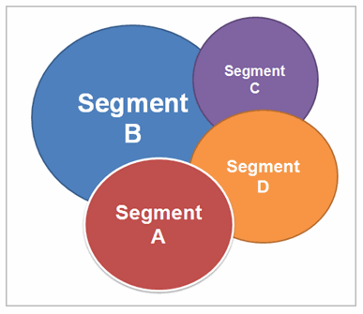
Targeting
Targeting refers to the selection of the market segments towards which the marketing efforts will be directed
Target marketing refers to the process of matching a specialised marketing mix to the needs of a specific market segment

Slide 17

Targeting
Criteria
  Segment size
  Segment growth rate
  Segment competitiveness
  Segment compatibility with the firm’s competences
  Segment compatibility with the firm’s mission and objectives

Slide 18
Positioning
Positioning
  The identification of a particular appeal that the firm can make to customers in each target segment, designed to convince customers to choose that firm over rivals

Slide 19

Positioning dimensions
Attribute positioning
  Uniqueness of design
  Exclusivity
Benefits
User positioning
Competitor positioning
Quality or price positioning

Slide 20


Matching the benefits with what consumers are looking for
Brand name
Reliability
Safety
Price
Cost of operating and fuel efficiency
Speed
Design
Status/prestige
Reputation

Slide 21
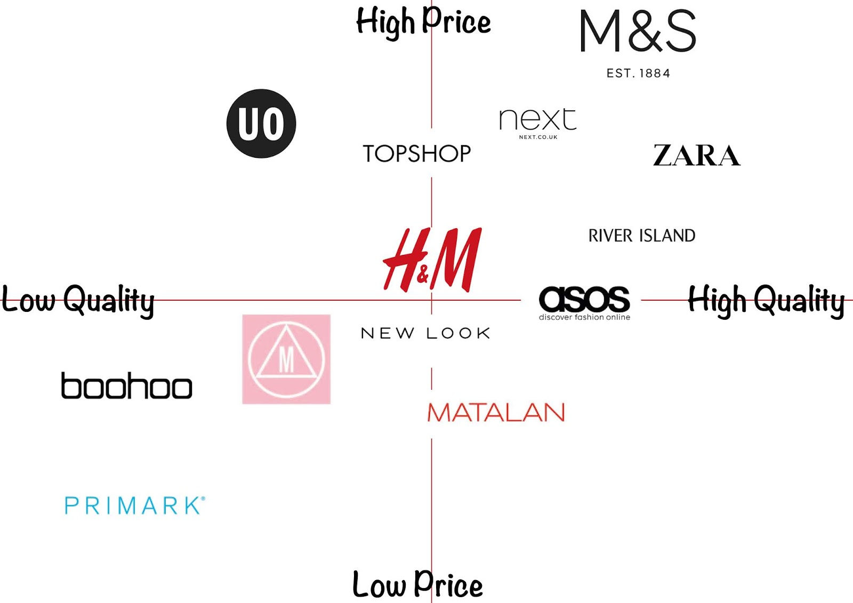
Positioning map example

Slide 22
IM - Segmenting and Targeting Markets
  By Global Segment - Identify and target some segments globally
  By Country - Segment its market by selecting a single country to enter
  Mixing the Marketing Mix - Hold one or more elements of its marketing functions—prices, promotion, branding, and distribution— constant while altering the others.
  Mass Markets versus Niche Markets - Must decide when to enter international markets with a mass market or niche market strategy.
    As the percentage of people that fall into any segment may vary substantially among countries, a niche market in one country may be a mass market in another.

Slide 23
Product Policies - Country Adaptation Versus Global Standardization
Why Firms Adapt Products
  Legal Considerations
    Labeling Requirements
    Environmental-Protection Regulations
    Indirect Legal Considerations
    Issues of Standardization
  Cultural Considerations
  Economic Considerations
Notes:
The primary reasons behind the tendency of firms to alter their products to meet local conditions are legal, cultural, and/or economic in nature.
Legal Considerations. Explicit product-related legal requirements vary widely by country but are usually meant to protect customers, the environment, or both.
Labeling Requirements. One of the more cumbersome product alterations for companies is adjusting to different laws on labeling.
Environmental-Protection Regulations. Some countries prohibit certain types of containers, others restrict the volume of packaging materials, and there are sometimes mandates on container reusability.
Indirect Legal Considerations. Marketing managers must also watch for indirect legal requirements such as higher taxes on heavy automobiles that may shift demand to lighter ones.
Issues of Standardization. A recurring issue is the need to arrive at international product standards and eliminate some of the wasteful product requirements for alterations among countries.
Cultural Considerations. Cultural factors affecting product demand may or may not be easily discerned. While religious beliefs may offer clear guidelines regarding product acceptability, other factors such as color, design, and artistic preferences may be much more subtle.
Economic Considerations. Levels of income, differences in income distribution, and the extent and condition of available infrastructure can all affect demand for a particular product. Often, price-reducing alterations are required if a firm wishes to participate in a particular country market. Poor infrastructure may also require alterations, as companies must deal with rough terrain, etc.

Slide 24
Product Policies - Country Adaptation Versus Global Standardization
Usually, firms will choose to standardize basic components while altering critical end-use characteristics. Certain alterations (such as packaging and color options) may be inexpensive to make, yet they can have an important effect on demand
Although most companies produce multiple products, it is doubtful that all of these products could generate sufficient sales in a given foreign market to justify the cost of penetrating that market
  Consider the cost and effect on sales of offering one/few products internationally as opposed to an entire family of products
Notes:
Whereas narrowing a product line allows for the concentration of effort and resources, the broadening of a product line may lead to distribution economies.

Slide 25
International Pricing Policies
The complexities of pricing are exacerbated in the international arena. Consider factors like
  Government Intervention and Legal requirements
  Market Diversity
  Export Price Escalation
  Fluctuations in Currency Value
  Fixed vs Variable pricing
Notes:
The complexities of pricing are exacerbated in the international arena.
Government Intervention. Every country has laws that either directly or indirectly affect prices at the consumer level. Price controls may set either maximum or minimum prices for designated products. The WTO permits a government to establish restrictions against any imports that enter the country at a price below the price charged to customers in the exporting country (dumping). However, a firm may charge different prices in different countries because of competitive and demand factors (e.g., a firm may choose to exclude fixed costs in the price calculation of products exported to developing countries in order to be price competitive in those markets.)
Market Diversity. Country variations lead to many ways of segmenting the market for a particular product. Consumers in some countries simply like certain products more and are willing to pay more for them.
Export Price Escalation. If standard markups occur within distribution channels, lengthening the channels or adding expenses somewhere in the system will further raise the price to the consumer by more than incremental transport and duty costs—a situation known as export price escalation. Common reasons for price escalation in export sales are tariffs and the often-greater distance to the market. To compete in export markets, a firm may have to sell its products to intermediaries at a reduced price in order to lessen the amount of price escalation [see Fig 17.2].
Fluctuations in Currency Value. Pricing in the case of highly volatile currencies can be extremely difficult, especially under conditions of high inflation. Pricing decisions must assure the company of sufficient funds to replenish inventory. This may result in the need for frequent price adjustments. Further, currency fluctuations also affect pricing decisions for any product that faces foreign competition; when a currency is strong, producers may have to accept a lower profit margin if they wish to be price competitive.
The Gray Market. The gray market, or product diversion, is the selling and handling of goods through unofficial distributors, thus enabling the unofficial ones to import cheaper supplies from abroad to compete against official ones.
Fixed versus Variable Pricing. MNEs often negotiate export prices, while small companies frequently give price concessions too quickly. This limits small companies’ ability to negotiate on a range of marketing factors that affect their costs such as:
Discounts for quantity or repeat orders
Deadlines that increase production or transportation costs
Credit and payment terms
Service
Supply of promotional materials
Training of sales personnel or customers
Supplier Relations. Dominant retailers with substantial clout may get suppliers to offer them lower prices, which in turn will enable them to compete as the lowest-cost retailer. However, such clout may not exist in new foreign markets. In addition, many industrial buyers are claiming large price reductions through Internet purchases.

Slide 26
International Promotion
Standardization vs Customization - Advertising represents any paid form of media (nonpersonal) presentation.
  Standardization reduces costs, improves the quality of advertising at local level, prevents confusion associated with different national messages and images and speeds up the entry of products into new country markets
  Issues
    Translation
    Legality
    Message Needs
Notes:
Because of diverse national environments, promotional problems are varied. In many countries regulations pose an even greater barrier. In emerging economies, MNEs usually have to use more push strategies for mass consumer products.
Advertising Standardization: Pro and Con. Advertising represents any paid form of media (nonpersonal) presentation. Although savings from the standardization of advertising are not as great as those from product standardization, they can nonetheless be substantial. However, in addition to reducing costs, standardized advertising may also improve the quality of advertising at the local level, prevent the confusion associated with different national messages and images and speed the entry of products into new country markets. Standardization usually implies using the same agency globally. The issue of standardization in advertising raises problems in a few other areas—namely, translation, legality, and message needs.
Translation. When a media transmission spans multiple countries, there is no opportunity to translate a message into other local languages. When messages are translated, numerous difficulties can be encountered with both language (content and meaning) and images.
Legality. What is deemed to be legal advertising in one country may, in fact, be illegal elsewhere. Differences result mainly from varying national views on consumer protection, competitive protection, standards of morality, and nationalism.
Message Needs. An advertising theme may not be appropriate everywhere because of national differences in how well consumers know a product, how they perceive it, who makes the purchasing decision, and what features are most important.

Slide 27
International Branding
Advantage and Disadvantages of Global Brand vs Local
  Global Brands assists in the marketing to international travelers and creates an international identity as a global player
  However, offers concerns such as
    Language
    Brand Acquisition
    Country-of-Origin Image
    Locational Origin of Names
    Generic and Near-Generic Names
Notes:
A number of problems are inherent in using global brands
Language. Both the translation and pronunciation of brand names pose potential problems in many markets. Often the problems are obvious, but other times they are quite subtle, yet critical. In addition, brand symbols (shapes and colors) are culturally sensitive in many societies.
Brand Acquisition. When an MNE acquires a (foreign) firm, it automatically acquires its brands. In some instances those brands will be maintained; in others they will be folded into a larger brand in order to capture economies of scale and to promote regional/global brand recognition.
Country-of-Origin Image. Firms must determine whether to promote a local or foreign image for their products. The products of some countries may be perceived as being particularly desirable and of higher quality than products from other countries. A firm may be able to enhance its competitive advantage by effectively exploiting this perception.
Locational Origin of Names. One ongoing international legal debate concerns product names associated with location. The EU protects the names of many European products based on location names, such as Roquefort and Feta cheeses, Parma ham, and Chianti wine. It has also pushed for protection against the foreign use of regulated names associated with wines, such as clos, chateau, tawny, noble, ruby, and vintage.
Generic and Near-Generic Names. While firms want their brand names to become household words, they do not want those names to become so common they are considered to be generic (e.g., Kleenex and Xerox). Generic names may either stimulate or frustrate the sales of the firm from whom the name was expropriated.

Slide 28
Global Operations and Supply Chain Management

Slide 29

Production Strategies
Production operations are important to achieving a company’s strategy
  Four strategic issues that managers should plan for:
    Production capacity
    Facility location
    Production processes
    Facility layout
UWTSD - Copyright 2023
Notes:
Production operations are important to achieving a company’s strategy. Careful planning of all aspects of production helps companies cut costs (to become low-cost leaders) or design new products and product features necessary for a differentiation strategy.
Among the important strategic issues that managers must consider are planning for production capacity, the location of facilities, production processes to be used, and the layout of facilities.

Slide 30

Global Manufacturing Strategies
Four Key Factors:
    Compatibility
    Configuration
    Coordination
    Control
UWTSD - Copyright 2023

Slide 31
Compatibility
Company managers must consider the following strategies:
    Efficiency/Cost
    Dependability
    Quality & Innovation
    Flexibility
UWTSD - Copyright 2023

Slide 32
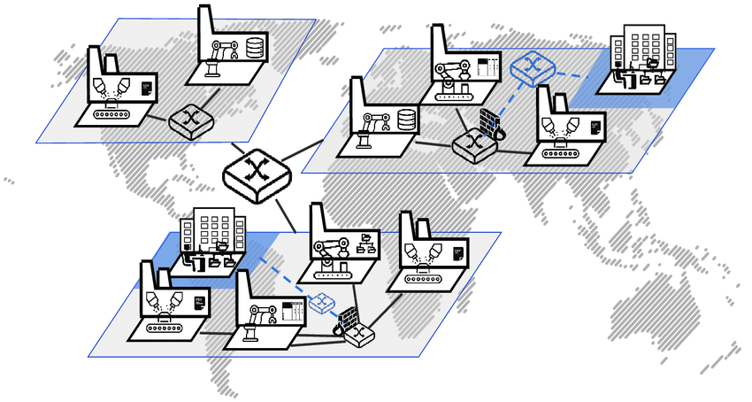
Manufacturing Configuration
Centralized manufacturing in one country
Manufacturing facilities in specific regions to service those regions
Multidomestic facilities in each country
UWTSD - Copyright 2023

Slide 33
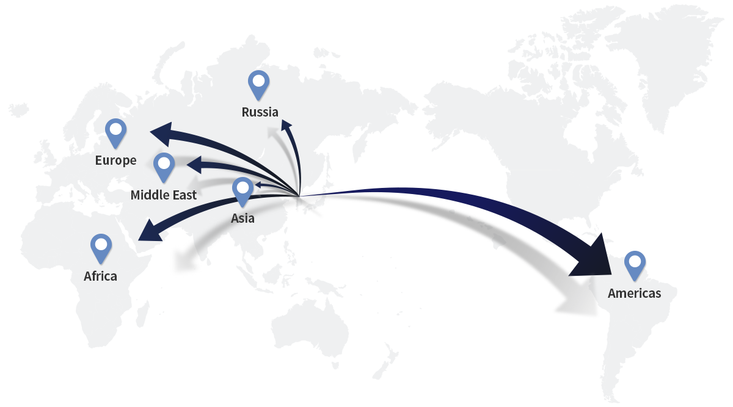
Coordination Control
Control systems, such as organizational structure and performance measurement systems, ensure that managers implement company strategies.
UWTSD - Copyright 2023

Slide 34
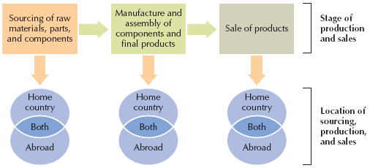
Global Sourcing
Global sourcing - The use of suppliers anywhere in the world, chosen on the basis of their efficiency.
UWTSD - Copyright 2023

Slide 35

Global Supply Chain Management
https://www.youtube.com/watch?v=mEIqLcGxZRM
UWTSD - Copyright 2023

Slide 36
Manufacturing of Goods
MNEs face a variety of concerns in manufacturing goods and services. Primary among these are cost, quality and efficiency in production systems.
Decisions about the selection and acquisition of raw materials are important to many different types of manufacturers. The quality of raw material has a huge influence on the quality of a company’s end product.
Levels of quality standards:
  General level - ISO 9000, Malcolm Baldrige National Quality Award
  Industry-specific level
  Company level
UWTSD - Copyright 2023

Slide 37
Make or Buy Decision
Make or buy - outsource or supply parts from internal production
If MNEs outsource parts instead of sourcing them from internal production, they need to determine the degree of involvement with suppliers.
Supplier relationships are very important but sometimes complicated, especially for MNEs trying to manage supplier relationships around the world
UWTSD - Copyright 2023

Slide 38
Major Sourcing Strategies
Assign domestic buyers for foreign purchasing.
Use foreign subsidiaries or business agents.
Establish international purchasing offices.
Assign the responsibility for global sourcing to a specific business unit or units.
Integrate and coordinate worldwide sourcing.
UWTSD - Copyright 2023

Slide 39
International Logistics
International logistics is the designing and managing of a system to control the flow of materials and products throughout the firm.
This includes the inflow of materials, movement through the production process and outflow to the wholesale/retail firm or final consumer.
Transportation, packaging and storage are three key aspects of international logistics.
UWTSD - Copyright 2023

Slide 40
International Finance
Foreign Exchange Management
International Investment
International Financing and Capital
Risk Management
Compliance and Accounting
UWTSD - Copyright 2023

Slide 41

Any Questions?
Thank You ☺
UWTSD - Copyright 2023

Slide 42
Sources:
Collinson, S., Narula, R., & Rugman, A. M., 2020. International Business. 8 ed. Essex: Pearson Education Limited.
Daniels, J. D., Radebaugh, L. H., Sullivan, D. P., & Click, R. W., 2022. International Business: Environments and Operations. 17 ed. Essex: Pearson Education Limited.
Hill, C. W. L., 2023. International Business: Competing in the global marketplace. 14 ed. New York: McGraw-Hill.
Wild, J. J. & Wild, K. L., 2023. International Business: The Challenges of Globalization. 10 ed. Essex: Pearson Education Limited.
UWTSD - Copyright 2023

