Slide 1
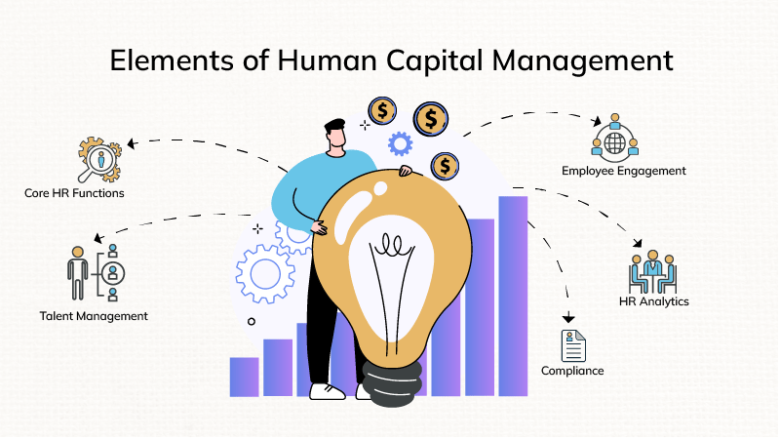


Program: Master in Business Administration
Module: Human Capital Management
Module Code: LCMB7023

Slide 2
GROUP PRESENTATION
Group Members
Student 1- Krinal Gandhi (ID: 2504763)
Student 2 - Bansi Vastarpara (ID: 2508499)
Student 3 - Pratikkumar Kevadiya (ID: 2435897)
Student 4 – Meet Malani (ID: 2504764)

Slide 3
Topic: Recruitment and selection
Krinal Gandhi (ID: 2504763)

Slide 4

Overview of Recruitment at Amazon
Amazon is a worldwide company that constantly needs to develop skills for its various businesses, including technology, logistics, and customer service.
In relation company gets hold of people who are innovative, flexible, and focus on customer satisfaction.
It hires both internally and externally through Amazon Jobs, LinkedIn, and in association with universities.
Technology helps Amazon tap into the best candidates in the most efficient manner possible.

Slide 5
Current HR Policies and Practices
1. Identify job vacancy and define key responsibilities.
2. Write and post job descriptions on various platforms.
3. Use automated systems to review applications.
4. Shortlist suitable candidates based on qualifications and experience (Amazon, 2024)
This process helps save time and ensures fairness in selection.

Slide 6
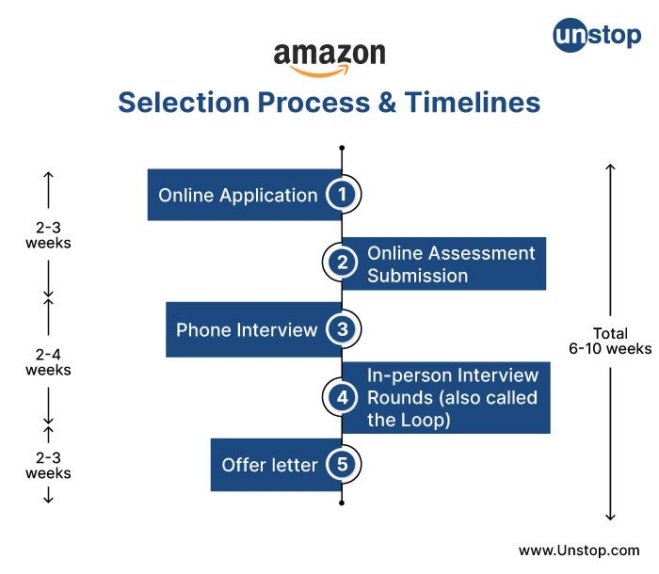
Role of Line Managers in Recruitment
• Determine staffing requirements and identify job responsibilities clearly (Forbes, 2024)
• Conduct interviews and ensure a fit to team culture (Amazon, 2024a)
• Provide onboarding support and track early performance progress.
• Liaise with HR to align recruitment with department objectives.
• Ensure fairness, compliance, and productivity in the hiring process (SHRM, 2023)

Slide 7
Strategic Alignment with Amazon’s Goals
Amazon’s HR supports its vision to be the most customer-centric company (Amazon, 2024b)
Recruitment targets innovative, high-performing, and customer-focused talent.
Leadership principles like ‘Hire and Develop the Best’ guide decisions.
HR helps achieve business growth through skilled, future-ready teams.
Training builds leadership pipelines to meet long-term goals.

Slide 8
Key HR Challenges at Amazon
• High employee turnover and burnout in fast-paced roles (BBC News, 2023).
• Balancing efficiency with work-life balance in warehouses.
• Managing a diverse global workforce across regions.
• Retaining top talent in a competitive tech market.
• Integrating automation and AI while maintaining human connection.

Slide 9
Practical Recommendations
• Introduce more flexible working options and mental well-being support (CIPD, 2023)
• Develop mentorship programs for employee growth and retention.
• Promote inclusive leadership and continuous diversity training.
• Use predictive data to improve workforce planning and talent retention.
• Enhance engagement through transparent communication and rewards (Forbes, 2024; SHRM, 2023).

Slide 10
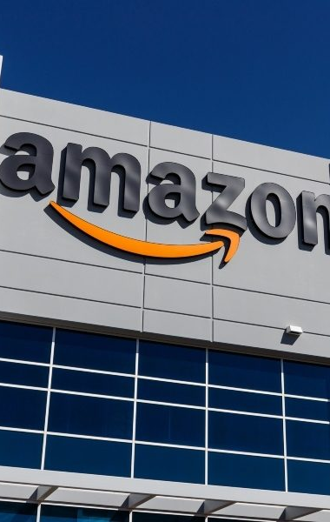
Conclusion
At the center of Amazon's success are its strategies for recruitment and selection. Amazon continues to attract and retain some of the best talents by aligning HR initiatives with strategic organizational goals. Innovation in addressing existing HR challenges through employee-focused approaches ensures long-term sustainability and competitive advantage..

Slide 11
Reference List
Amazon. (2024) Careers at Amazon. Available at: https://www.amazon.jobs (Accessed: 29 october 2025).
Amazon. (2024) Leadership Principles. Available at: https://www.aboutamazon.com (Accessed: 29 October 2025).
CIPD. (2023) Recruitment: An Overview. Chartered Institute of Personnel and Development. Available at: https://www.cipd.co.uk (Accessed: 29 October 2025).
SHRM. (2023) Innovations in Talent Management at Amazon. Society for Human Resource Management. Available at: https://www.shrm.org (Accessed: 29 October 2025).
Financial Times. (2024) Amazon’s HR Strategy and Global Workforce Trends. Financial Times. Available at: https://www.ft.com (Accessed: 29 octoberr 2025).
BBC News. (2023) Inside Amazon: Working Culture and Employee Challenges. Available at: https://www.bbc.co.uk/news(Accessed: 29 October 2025).
Forbes. (2024) How Amazon Attracts and Retains Top Talent. Available at: https://www.forbes.com(Accessed: 29 October 2025).
Harvard Business Review. (2023) Building a High-Performance Culture: Lessons from Amazon. Available at: https://hbr.org (Accessed: 29 October 2025).

Slide 12
Topic: Training and development
Bansi Vastarpara (ID: 2508499)

Slide 13

Training and Development Practices at Amazon
Brief introduction:
This presentation evaluates Amazon’s global learning culture and training strategy, exploring how continuous employee upskilling supports innovation, productivity, and long-term organizational growth (Amazon, 2023).

Slide 14
Current HR Policies and Practices
Key Training and Development Practices at Amazon
Career Choice Programme - Tuition-funded courses for hourly employees; supports career mobility across UK, EU, and global sites (Team, 2025).
Upskilling 2025 Initiative - Commitment to train 300,000 employees globally through AWS Skill Builder and Machine Learning University (Amazon, 2024).
Training Models - Combination of blended learning, leadership academies, on-the-job training, and mentorship.
Strategic Focus - Innovation, scalability, and tech-enabled workforce development.
Theory Link - Human Capital Theory (Caire & Becker, 1967): investing in employee skills improves productivity and organisational performance.

Slide 15
Role of Line Managers
Key Points:
Visual Idea
Identify employee training needs during performance reviews.
Provide coaching and feedback guided by Amazon’s Leadership Principles.
Support learning transfer by linking training to real job tasks.
Motivate teams and create opportunities for continuous learning.
Apply the AMO Framework enhancing:
1. Ability (skills development)
2. Motivation (encouragement & recognition)
3. Opportunity (space to apply learning)
Identify Needs
Train & Coach
Monitor Progress
Evaluate
Motivate & Support

Slide 16
Strategic Alignment with Company Goals
Amazon’s Mission Alignment
Amazon’s Training–Strategy Alignment
Customer Obsession - Training builds service excellence mindset.
Innovation - Upskilling in AI & automation drives digital transformation.
Operational Excellence - Training improves efficiency & quality control.
Leadership Pipeline - Develops future managers for sustainable growth.
Employee Engagement - Continuous learning reduces turnover.
Theory Link
Resource Based View (Barney, 1991): skills & knowledge = key competitive advantage.
Strategic Goal
Impact
Training Focus
AI & Automation
Leadership Programs
Employee Learning
Digital Transformation
Sustainable Growth
Engagement & Retention
Innovation & Efficiency
Strong Pipeline
Improved Employee Retention

Slide 17
Key HR Challenges
Main HR Challenges at Amazon
High staff turnover especially in warehouse & logistics roles (Team, 2025).
Hard to standardise global training due to diverse cultures & locations.
Employee fatigue and few promotion paths at lower levels.
High cost & scalability of global digital training.
Evaluation difficulties measuring learning outcomes (Kirkpatrick & Kirkpatrick, 2006).
Fairness issues access to training varies across roles (Adams, 1965).
Turnover
Standardisation
Fatigue
Cost
Evaluation

Slide 18
Practical Recommendations
Key Actions
Proposed Solutions to Amazon’s Training and HR Challenges
AI-based learning dashboards - personalise content & track progress (Popenici & Kerr, 2017).
Expand Career Choice - add non-technical & inclusive pathways (Amazon, 2024).
Strengthen leadership coaching - build frontline management capability.
Link training KPIs - connect learning results with performance appraisals.
Develop DEI-focused programmes - promote fairness & inclusive growth.
Challenge | Recommendation | Expected Impact
Limited personalisation | AI-based dashboards | Improved learning outcomes
Narrow career scope | Broaden Career Choice | Inclusive growth
Weak leadership transfer | Coaching programmes | Stronger performance
Low KPI linkage | Add training KPIs | Measurable results
DEI gaps | DEI development tracks | Engaged, diverse teams

Slide 19
References
amazon (2023). Our Upskilling Commitments. [online] UK About Amazon. Available at: https://www.aboutamazon.co.uk/workplace/upskilling.
Team, A.A. (2025). How Amazon’s latest update to Career Choice aims to remove barriers to upskilling and growth for European employees. [online] EU About Amazon. Available at: https://www.aboutamazon.eu/news/job-creation-and-investment/how-amazons-latest-update-to-career-choice-aims-to-remove-barriers-to-upskilling-and-growth-for-european-employees.
Amazon (2024). Our Upskilling Commitments. [online] US About Amazon. Available at: https://www.aboutamazon.com/workplace/upskilling-commitments.
Caire, G., & Becker, G. S. (1967). Human Capital, A Theoretical and Empirical Analysis with Special Reference to Education. Revue Économique, 18(1), 132. https://doi.org/10.2307/3499575
Appelbaum, E., 2000. Manufacturing advantage: Why high-performance work systems pay off. Cornell University Press.

Slide 20
Marin-Garcia, J.A. and Tomas, J.M. (2016). Deconstructing AMO framework: a systematic review. Intangible Capital, 12(4), p.1040. https://www.researchgate.net/publication/308577915_Deconstructing_AMO_framework_A_systematic_review
Barney, J. (1991). Firm Resources and Sustained Competitive Advantage. Journal of Management, 17(1), 99–120. https://doi.org/10.1177/014920639101700108
Amazon About Us. https://www.aboutamazon.com/about-us
Adams, J.S. (1965). Inequity in Social Exchange. Advances in Experimental Social Psychology, 2(1), pp.267–299. https://web.mit.edu/curhan/www/docs/Articles/15341_Readings/Justice/InequityInSocialExchange_Adams.pdf
Kirkpatrick, D. and Kirkpatrick, J., 2006. Evaluating training programs: The four levels. Berrett-Koehler Publishers.
Amazon (2024). Our Upskilling Commitments. [online] US About Amazon. Available at: https://www.aboutamazon.com/workplace/upskilling-commitments.
Kolb, D.A., 2014. Experiential learning: Experience as the source of learning and development. FT press.
Popenici, S.A. and Kerr, S., 2017. Exploring the impact of artificial intelligence on teaching and learning in higher education. Research and practice in technology enhanced learning, 12(1), p.22.

Slide 21
Topic: Performance management
Pratikkumar Kevadiya (ID: 2435897)

Slide 22

Introduction
Amazon has been funded by Jeff Bazos in 1994, which is a global company dealing in e-commerce and technology leader with employees over 1.5 million in global market.
Performance management at Amazon has focus on continuous improvements along with data-driven evaluation and innovation.
This ensures employees align with customer obsessions, long-term growth goals and operational excellence.
Notes:
This presents Amazon as the selected company and identifies its global leadership in e-commerce and technology. It states the relevance of performance management in ensuring efficiency, innovation, and congruence with company goals. It is important to pay attention to the way data-driven systems and cultural norms affect worker performance and behaviour.

Slide 23
Current HR Policies
Employees experience annual reviews supported by connections and anytime feedback surveys.
HR policies highlight merit-based rewards along with high-performance culture and continuous learning via Amazon’s career choice program with investigating over $1.2 billion in employee development skills in global market (Charles and Uford, 2023).
Amazon uses a performance review system with adding the leadership principles and quantitative metrics (Nabovvati, 2025).
Notes:
This describes Amazon's performance management system including annual evaluation, immediate feedback, and connection survey system. It showcases the way HR promotes a high-performance culture with measurable goals and learning initiatives. It refers to the career choice program, which highlights Amazon's commitment to employee development, upskilling, and coordinating talent development with operational effectiveness.

Slide 24
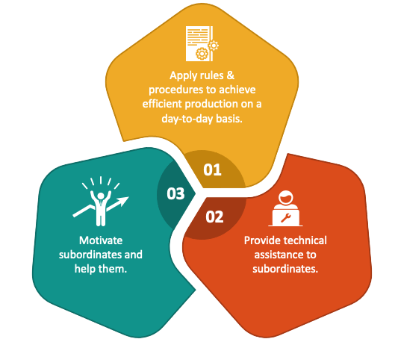
Role of Line Managers in Implementation of Performance Management
Line manager has a key role by setting SMART goals along with conducting performance reviews and providing real-time feedback (Obi, 2024).
They utilise pivot coaching programs to support low performance in this context.
Managers at Amazon ensure team KPIs has alignment with business outcomes, encouraging accountability, motivation and innovation within work environment (Oyewole, 2021).
(Source: ACTE.com, 2024)
Notes:
This highlights the necessary role of line managers in implementing HR policies into action. However, managers define SMART objectives, track progress, and offer feedback with tools such as pivot. This explains the way efficient management communication and coaching enhance employee motivation, productivity, and alignment to Amazon's performance standards and leadership principles.

Slide 25
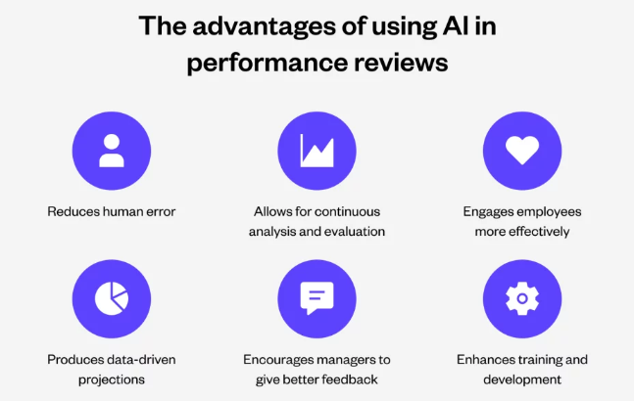
Strategic Alignment of HR Practices with Company Goals Performance Management
HR practices of Amazon have alignment with corporate goals of customer obsession, innovation and scalability approach (Harney, 2023).
HR tracks productivity, engagement and retention through AI tools and advanced analytics.
The initiatives like working backwards and leadership principles integrate employee performance with business strategy, which indicates sustainable competitive advantages in the global market (Qin and Liu, 2022).
(Source: yellow.ai, 2023)
Notes:
It said that HR strategies at Amazon are designed to enhance corporate goals such as innovation and customer satisfaction. However, the application of AI-based analytics in tracking performance trends is included in this. It highlights the working backwards principle and leadership principles as guidelines to ensure that HR initiatives have a direct impact on Amazon's competitive advantages and operational scalability.

Slide 26
Key HR Challenges Performance Management
Key challenges
Balancing efficiency with employee wellbeing remains difficult in this case.
The AI integration and rapid automation create reskilling challenges, while managing inclusion and diversity across global operations constant to be a strategic concern.
Amazon faces high turnover average 150% in warehouses, burnout complaints and criticism over strict productivity monitoring (Quyet and Phung, 2023).
Notes:
Amazon has significant HR issues including excessive employee turnover, burnout, and criticism of productivity expectations. However, it has the impact of automation on job security and skill deficits. Additionally, it highlights diversity and inclusion issues in international operations along with the necessity to balance performance conflict with wellbeing and workforce stability.

Slide 27
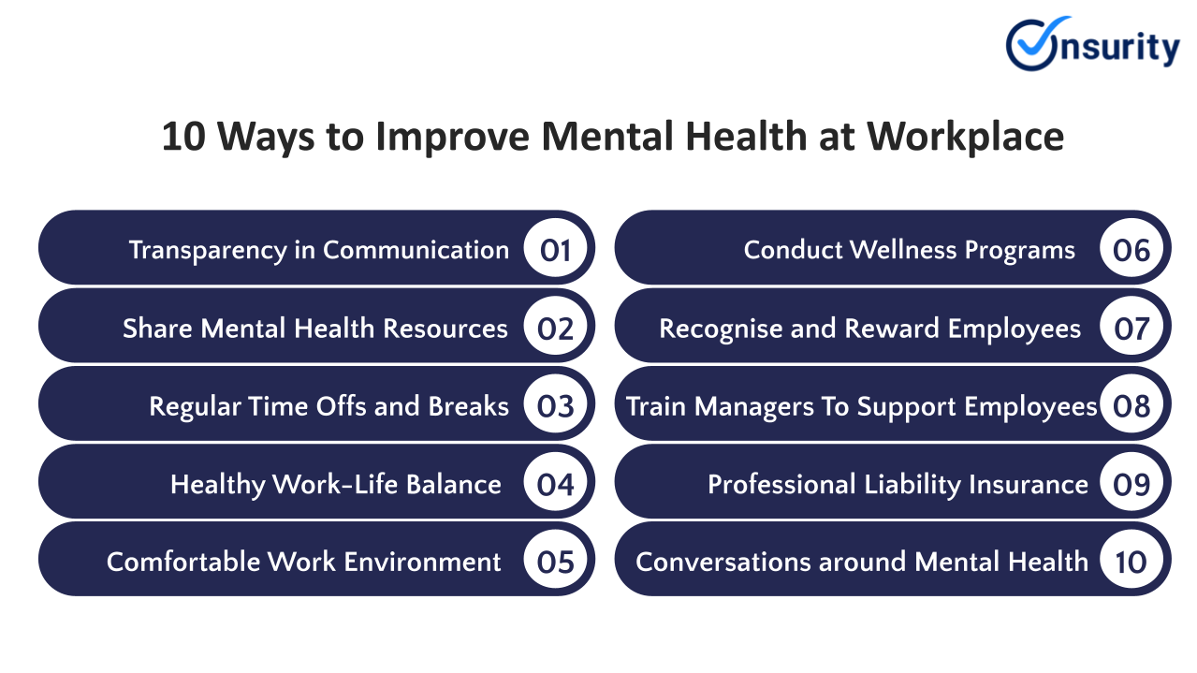
Practical Recommendation
Amazon should enhance employee wellbeing through mental health programs along with workload flexibility approach.
The introduction of hybrid performance metric with the quantitative and behavioural indicators can reduce pressure in the business.
Expanding leadership training and upskilling initiatives for mangers will improve engagement along with ensure sustainable performance and reduce turnover in digital environment (Aloqaily, 2022).
(Source: onsurity.com, 2021)
Notes:
It showcased that implementing flexible work schedules, expanding wellbeing programs, and updating measures to reward cooperation and innovation. However, the highlight on the significance of ongoing training, leadership building, and diverse culture is important. These actions will decrease contrition, enhance morale, and align Amazon's workforce with its sustainability and innovation-oriented strategy.

Slide 28
Conclusion
Effective performance management is important for continual success of Amazon. Balancing innovation with human-centric policies will influence the long-term sustainability. Amazon can strengthen its employer brand along with enhance retention and maintain its position as a global performance-integrated leader by encouraging supporting leadership, continuous development and fair evaluations.

Slide 29
Reference List
Aloqaily, A. N. (2022). The Role of the Human Resources Information Systems in Enhancing the Organizational Creativity Process (A case study in the International Amazon company–Jordan). Res Militaris, 12(2), 5441-5458. https://www.researchgate.net/profile/Ahmad-Aloqaily-2/publication/367168952_The_Role_of_the_Human_Resources_Information_Systems_in_Enhancing_the_Organizational_Creativity_Process_A_case_study_in_the_International_Amazon_company_-Jordan/links/63c5408fd9fb5967c2e00020/The-Role-of-the-Human-Resources-Information-Systems-in-Enhancing-the-Organizational-Creativity-Process-A-case-study-in-the-International-Amazon-company-Jordan.pdf
Charles, I. I., and Uford, I. C. (2023). Comparative analysis and evaluation of business and financial performance of Amazon. Com: A three-year period critical review of exceptional success. European Journal of Business, Economics and Accountancy, 11(2), 69-92. https://www.idpublications.org/wp-content/uploads/2023/07/Full-Paper-COMPARATIVE-ANALYSIS-AND-EVALUATION-OF-BUSINESS-AND-FINANCIAL-PERFORMANCE-OF-AMAZON.com_.pdf
Harney, B. (2023). The limits of HRM in a new era of work: Bezonomics and the Amazon Effect. Protecting the future of work: New institutional arrangements for safeguarding labour standards, 67-84. https://www.emerald.com/insight/content/doi/10.1108/978-1-80071-248-520221010
Nabovvati, H. (2025). Human Resource Management in Amazon Projects: The Role of Organizational Culture in Optimizing Time and Cost to Increase Earned Value. Journal of Future Digital Optimization, 1(2), 23-29. https://iscihub.com/index.php/JFDO/article/download/48/106
Obi, R. I. (2024, July). Leveraging Technology and data Analytics in Performance Management-An Exploratory Study on its Evolution: the when, now, and hereafter. In ARPHA Conference Abstracts (Vol. 7, p. e129581). Pensoft Publishers. https://aca.pensoft.net/article/129581/download/pdf/
Oyewole, O. (2021). Analysis of Amazon’s Current Organisational Performance Management System. https://www.academia.edu/download/87808933/Analysis_of_Amazon_s_Current_Organisational_Performance_Management_System.pdf
Qin, Y., and Liu, H. (2022). Application of value stream mapping in E-commerce: a case study on an Amazon retailer. Sustainability, 14(2), 713. https://www.mdpi.com/2071-1050/14/2/713
Quyet, N. X., and Phung, T. K. (2023). Comparative analysis of information security policies at Big 4 logistics companies in the world.“. International Journal Of Multidisciplinary Reseach And Growth Evaluation, 4(6), 675-682. https://www.academia.edu/download/108555811/F_23_133.1.pdf

Slide 30
LCMB7023: Human Capital Management
Topic: MANAGING INTERNATIONAL OPERATIONS AND THE COMPANY IS AMAZON
Student Name: Meet Malani
Student ID: 2504764

Slide 31
Introduction
Over 1.6 million employees globally (operations, corporate, delivery) (s2.q4cdn, 2022).
Leverages Leadership Principles; appended Strive to be the Best Employer on Earth.
Notes:
The Amazon company was launched in 1994 and provides fulfilment services, retail services and cloud services globally with a workforce exceeding by a significant margin more than a million employees worldwide. The company culture is designed based on its Leadership Principles, with the latest inclusion being Strive to be Earths Best Employer in 2021, which publicly vows the areas of HR and operations to safety, development and inclusivity as Amazon expands to global locations.

Slide 32
HR practices and policies
Promotion and Hiring, Daily decisions are based on Leadership Principles.
Learning: Amazon Career Choice and upskilling (Amazon, 2023).
Keeping track of performance by data; wide-ranged surveillance.
Notes:
The HR at Amazon relies on its Leadership Principles to influence their selection decisions, promotions and daily decision-making. It spends much on internal training (e.g. Career Choice) to fill technical and operations jobs. At the same time, granular, data-driven performance metrics and monitoring in fulfilment operations is employed by Amazon - enhancing productivity and raising eyebrows regarding surveillance and ergonomics.

Slide 33
Part played by line managers in implementation
Get corporate HR policy to day-to-day team action.
Coach employees, performance reviews and development (amazon, 2024).
Impose security, time and place conformity
Notes:
The operational bridge is the line managers themselves: they receive HR strategy and make it practical at sites and shifts. They do performance appraisals, career counseling and in charge of the safety procedures, schedules and local legal compliance. Good line managers are thus important in employee involvement, retention and success of any local HR interventions.

Slide 34
HR challenges and practices
Hazards/ ergonomics; various OSHA/ agency violations.
Increasing unionism and labour conflicts in geographic areas.
Shortage of hiring, high retention pressure and frontline turnover.
Notes:
Amazon has been experiencing repeated HR issues since 2020: government safety checks and fines on ergonomic and reported violations; rising unionizations and legal battles in various countries; and the frontline hiring/retention discrepancies in season times. These have impact on continuity of operations, brand awareness and necessitate coordinated HR operations feedbacks across domestic jurisdictions.

Slide 35
Practical recommendations
Focus on ergonomics and safety: organizational controls and reporting.
Empower managerial training + staff relations and open communication lines (U.S. Department of Labor, 2023).
Broaden reskilling, flexible working and front line careers.osha.gov
Notes:
To begin with, make a bet in engineering controls, rotation and ergonomic equipment, and publicize the transparency of injury reporting to mitigate risk and regulatory pressure. Second, prepare line managers with superior people-skills (conflict resolution, engagement) and develop formal schemes of employee voice to limit the adverse labour relations. Third, scale Career Choice-style reskilling, provide flexible working conditions and transparency of career ladders inside the organisation to enhance retention and inner mobility.

Slide 36
References
Amazon (2023). Leadership Principles. [online] Amazon. Available at: https://www.amazon.jobs/content/en/our-workplace/leadership-principles.
amazon (2024). Amazon Operations Human Resources. [online] amazon.jobs. Available at: https://www.amazon.jobs/content/en/teams/fulfillment-and-operations/human-resources.
s2.q4cdn (2022). [online] Google.com. Available at: https://s2.q4cdn.com/299287126/files/doc_financials/2022/ar/Amazon-2021-Annual-Report.pdf [Accessed 3 Nov. 2025].
U.S. Department of Labor (2023). US Department of Labor Finds Amazon Exposed Workers to Unsafe conditions, Ergonomic Hazards at Three More Warehouses in Colorado, Idaho, New York | Occupational Safety and Health Administration. [online] www.osha.gov. Available at: https://www.osha.gov/news/newsreleases/national/02012023.

Slide 37

Thank You

